Slide 1

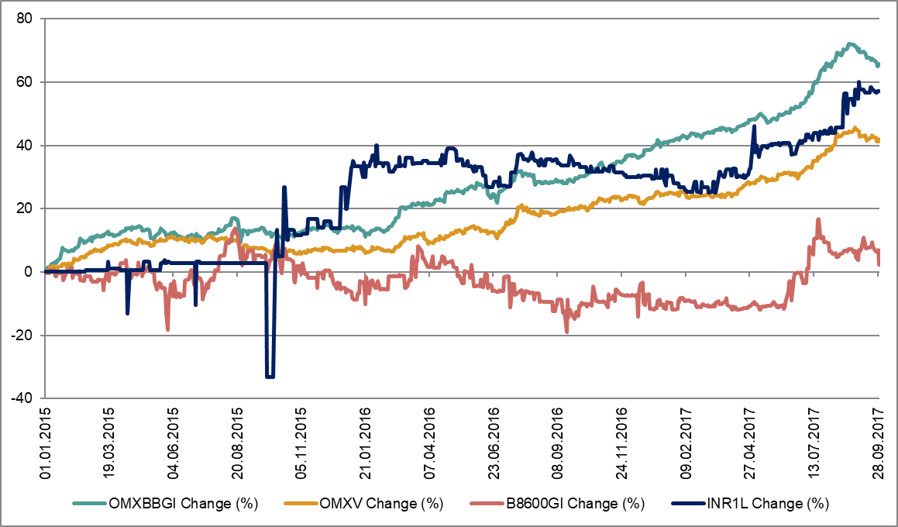
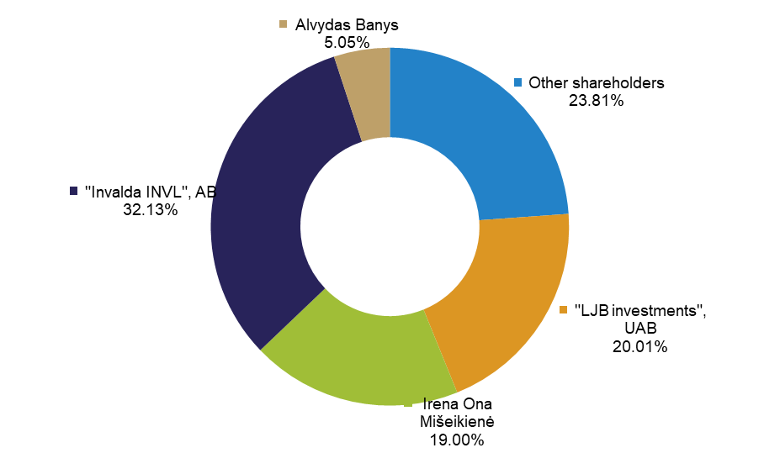

Key information for 9 months of 2017
Activity: operating since 1997, real estate investment company “INVL Baltic Real Estate” seeks to ensure the growth of leasing income and to profit on investments in commercial real estate.
Shares: listed on the Baltic Secondary List of Nasdaq Vilnius, AB stock exchange since 2014.
Assets under management: about 55,000 sq. m. of real estate in Vilnius and Riga – mostly business centres, manufacturing, warehouse properties and other commercial premises. These properties generate stable cash flows and most of them have high occupancy rates. In addition, some of them have further development potential.
Management of the Company: On 22 December 2016 the bank of Lithuania for INVL Baltic Real Estate issued the closed-ended type investment company operating license enabling to engage in the closed-ended type investment company's activities under the Republic of Lithuania Collective investment undertakings act. The special closed-ended type real estate investment company will work 30 years from receiving the special closed-ended real estate investment company license, the term of company's activity may be further extended for a period of no longer than 20 years. Upon receipt of the license, the company's management was transferred to the management company INVL Asset Management.
Main information
ISIN code | LT0000127151
Share price 30.09.2017, EUR | 0.471
Equity per share, EUR | 0.49
Last paid out dividends (EUR per share) | 0.012
Number of Shares | 65,750,000
Consolidated equity, thousand EUR | 32,375
Net asset value per share, EUR | 0.4924
INVL Baltic Real Estate change of share price and indexes
Votes as of 30 September, 2017
Comment made by INVL Asset Management real estate fund manager Vytautas Bakšinskas
INVL Baltic Real Estate’s consolidated revenue for three quarters of this year was EUR 4.8 million and, compared with the same period of 2016, grew 4.3 per cent. Of that, EUR 2.9 million was consolidated leasing income from owned properties, which increased 7.4 per cent.
We’re pleased with the results that have been achieved – they encourage us to continue working actively to increase the value of property holdings and so create gains for investors. After completion in the third quarter of the main reconstruction works at the Vilnius Gates business centre, the real occupancy of the centre’s premises reached 82 per cent, which will result in significant growth of leasing income in the last quarter of this year. Vilnius Gates leasing income rose 38.7 per cent in the first nine months of this year compared with the same period last year to EUR 0.39 million.
At the end of July we signed a new lease agreement with TransferGo, one of biggest Lithuanian start-ups, providing international money transfer services in 46 countries, for the lease of nearly a thousand square metres of space in the centre of Vilnius, on Palangos
Street. This agreement will not only make it possible to boost leasing income from that property, but also, once the premises are reconstructed, will increase the property’s leasable area.
The leasing income for the largest property the company owns – the 23,000 sq. m. IBC Business Centre on Šeimyniškių Street in the Lithuanian capital – for the first three quarters of this year grew 1.6 per cent from the same period last year to EUR 1.42 million.
The value of the transaction for the sale of 3,000 square metres of office and warehouse premises on Kirtimų Street in Vilnius, which was completed in September this year, was EUR 1 million. This property was valued at EUR 0.8 million at the end of 2016, so the transaction had a positive impact of EUR 0.2 million on 2017 results.
  More information: www.invlbalticrealestate.com

Slide 2
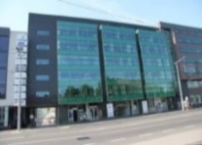
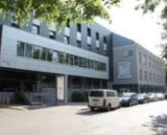
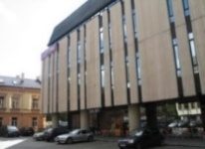
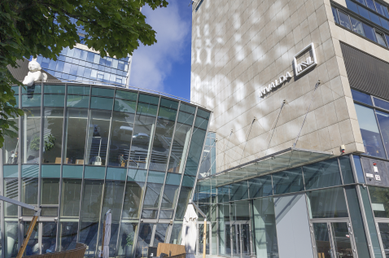
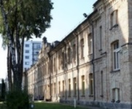
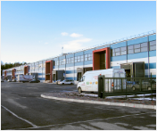
Key information for 9 months of 2017
Portfolio, thousand EUR | 30.09.2015 | 30.09.2016 | 30.09.2017
Operational Property investments | 36,228 | 46,785 | 50,114
Property Investment redevelopment | 2,533 | 1,720 | 350
Other investment properties | 3,174 | 3,735 | 4,042
TOTAL PROPERTY VALUE | 41,935 | 52,240 | 54,506
Rent Income from own properties during 9 months | 2,142 | 2,690 | 2,889
NOI (Net Operating Income) from own properties during 9 months* | 1,426 | 1,788 | 1,880
NLA (Net Leasable Area), m² | 42,076 | 48,476 | 45,676
Balance sheet, million EUR | 30.09.2015 | 30.09.2016 | 30.09.2017
Investment properties | 41.9 | 52.2 | 54.5
Cash | 0.8 | 0.4 | 0.7
Other assets | 2.2 | 2.3 | 1.5
TOTAL ASSETS | 44.9 | 54.9 | 56.7
Borrowings from credit institutions | 18.0 | 21.8 | 21.1
Borrowings from Invalda INVL | 5.4 | - | -
Other liabilities | 5.1 | 5.6 | 3.2
TOTAL LIABILITIES | 28.5 | 27.4 | 24.3
EQUITY | 16.4 | 27.5 | 32.4
Equity per share | EUR 0.38 | EUR 0.42 | EUR 0.49
Profit (loss) statement, million EUR | 01.01.2015- 30.09.2015 | 01.01.2016- 30.09.2016 | 01.01.2017- 30.09.2017
Revenue | 4.2 | 4.6 | 4.8
from own properties | 2.1 | 2.7 | 2.9
from subleased properties | 1.3 | 1.2 | 1.1
other revenue | 0.8 | 0.7 | 0.8
Net profit | 1.9 | 0.9 | 2.1
Earnings per share | EUR 0.04 | EUR 0.02 | EUR 0.03
Borrowings | 30.09.2015 | 30.09.2016 | 30.09.2017
Borrowings, thousand EUR | 23,361 | 21,771 | 21,097
Borrowings to value of investment properties* | 55.7 | 41.7 | 38.7
Gearing ratio* | 0.58 | 0.44 | 0.39
Interest coverage ratio* | 2.32 | 3.59 | 4.10
Bank‘s Debt Service Coverage Ratio* | 1.83 | 1.81 | 1.67
IBC Class A Business centre
Šeimyniškių str. 1, Šeimyniškių str. 3 Vilnius
Acquired – 2003
NLA 7,100 m²
Property value – 11.9 million EUR
Occupancy – 99%
IBC Class B Business centre
A. Juozapavičiaus str. 6, Vilnius
Acquired – 2003
NLA 10,300 m²
Property value – 10.4 million EUR
Occupancy – 90%
Office building
Palangos str. 4/ Vilniaus str. 33
Vilnius
Acquired – 2006
NLA 6,200 m²
Property value – 7.7 million EUR
Occupancy – 96%
Business centre Vilnius Gates
Gynėjų str. 14
Vilnius
Acquired 2015
NLA 6,400 m²
Property value – 13.4 million EUR
Occupancy – 82%
Žygis Business centre
Žygio str. 97
Vilnius
Acquired – 2006
NLA 2,600 m²
Property value – 2.6 million EUR
Occupancy – 100%
„Dommo
business park“
Riga
Latvia
Acquired – 2015
NLA 12,800 m²
Property value – 8.1 million EUR
Occupancy– 88%
NLA – Net Leasable Area
*https://bre.invl.com/lit/en/for-investors/reports/formulas-of-performance-indicators
More information: www.invlbalticrealestate.com

