Slide 1

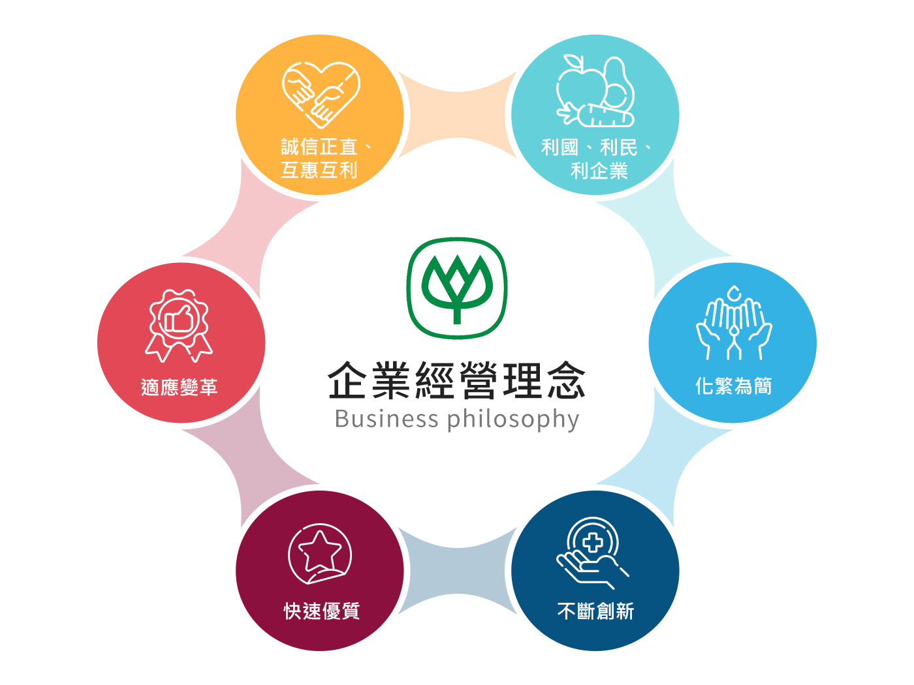
Charoen Pokphand Enterprise
Taiwan CO.LTD
Investor Conference

Slide 2
Industrial & Operational Overview -Feeds

Slide 3
Industrial & Operational Overview –Meat Processing
2017-2026 Import Volume of Chicken
2017-2026 Slaughter Volume of White-meat Chicken
Unit：Ton
Unit：Piece
2020-2026 Yearly Origin Price of Live Chicken
Unit：NTD/KG

Slide 4
Industrial & Operational Overview - Pig Husbandry
2017-2026 (Jan.) Slaughter Volume of Pork
2017-2026 (Jan.) Import Volume of Pork
Unit：Ton
Unit：Piece
2020-202 (Jan.) Yearly Price of Live Pig
Unit：NTD/KG

Slide 5
Consolidated IS（Twelve months ended Dec.31 2025 & 2024）
Amount：Million TWD
Notes:
Data-FS.xlsx \ PL (YTD)

Slide 6
Consolidated BS（As for Dec. 31 2025 & 2024）
Amount：Million TWD
Notes:
Data-FS.xlsx \

Slide 7
Quarterly Operating Performance（FY.2023- FY.2025）
Amount：Million TWD
Sales Revenue
Operating Margin
營業收入
營業毛利
營收入
營業利
% Sales Growth
% Margin
Notes:
Data-FS.xlsx \

Slide 8
Key data -Operating Performance（FY.2013–FY.2025）
Amount：Million TWD
Notes:
Data-FS.xlsx \

Slide 9
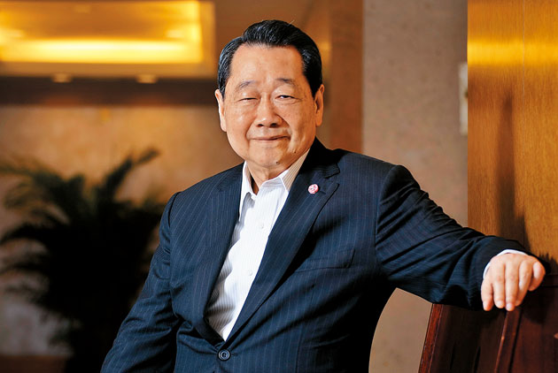
企業社會責任 (CSR)
Chairman Dhanin of CP Group
By following the business philosophy of 『Benefit Country, Benefit People, Benefit Company』, we always require all of our employees not only to take account of our economics, corporate social responsibility, environmental protection while executing our policies, but also to do their full efforts to ensure consumer food safety and health

