Slide 1
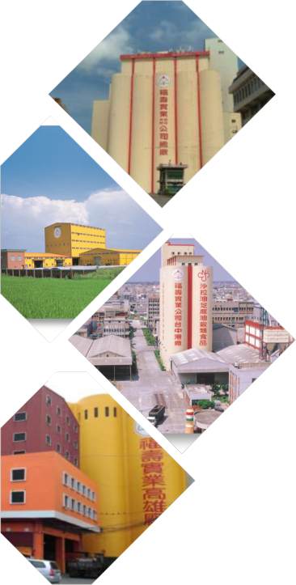

Stock Code：1219
2018
Investor Conference
September 5th , 2018

Slide 2
Agenda
01
Company Profile
02
Financial Performance
03
Future Outlook
04
Q & A

Slide 3
01
Company Profile
Company Name：Fwusow Industry Co., LTD.
Established Year ：1920
Date of Listing：December 1st , 1990
Paid-in Capital：NTD$ 3,220,138,879
Employees：672
Main Products：Edible Oils, Cereal Products, Pet Foods, Animal Feeds, Agricultural Bio-Products, Organic Fertilizers

Slide 4
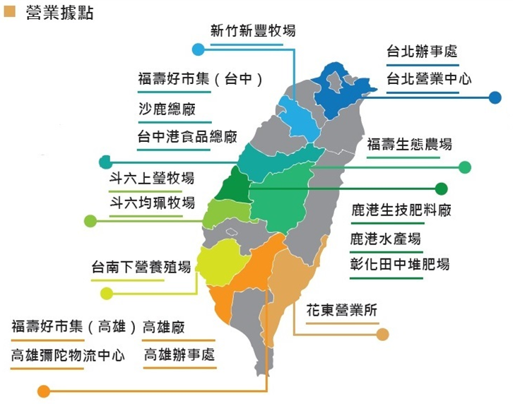
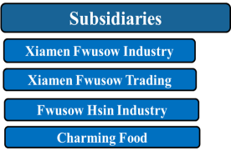
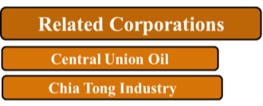
Offices and Operating Locations
Hsinchu Xinfeng Ranch
Taipei Office
Fwusow market (Taichung)
Taipei Business Center
Shalu Headquarters
Taichung Harbor Food Plant
Nanto Eco Farm
Douliu Shang-Ying Ranch
Douliu Jiun-Pei Ranch
Lukang Bio-Fertilizer Plant
Lukang Aquatic Farm
Tainan Xiaying Ranch
Changhua Tianzhong Ranch
Fwusow market (Kaohsiung)
Hualien and Taitung Operating office
Kaohsiung Plant
Kaohsiung Mituo Logistics Center
Kaohsiung Office

Slide 5









Operating Business Divisions
Grains &
Oils Business Division
Livestock
Business
Division
Retail & Distribution Business Division
Aquatic
Business
Division
Agricultural Materials Business Division
Notes:
「提供全民健康安全的食糧」為公司使命。
跨足食糧、畜糧、水產、農業資材與寵物食品領域，多角化經營模式。

Slide 6
Manufacturing Plant
Lukang Bio-Fertilizer Plant
  Organic Fertilizers
  Microbial pesticides
Taichung Harbor Food Plant
  Cereal Foods
  Edible Oils, Barley
  Bonito Products
Kaohsiung Animal Feed Plant
  Livestock and Aquatic Feeds
  Barley products
Shalu Headquarters
  Livestock and Aquatic Feeds
  Barley products
  Pet foods
Fwusow Industry
Nantou Eco Farm
  Chickens, eggs and pigs from Eco Farm

Slide 7
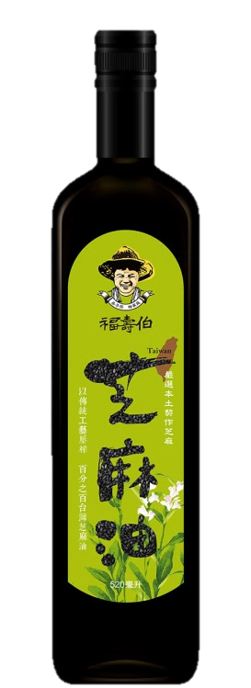
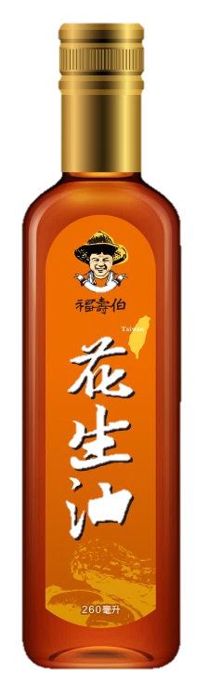
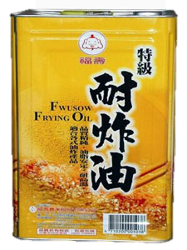
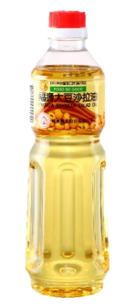

Business
Diverse, safe and healthy edible oil products
Edible Oil
Varieties of refined soybean oil, and
palm oil etc
Fwusow-Bo edible oil series used raw materials grown domestically
Soybean oil
Palm oil
Sesame oil
Domestic sesame oil, peanut oil
6

Slide 8
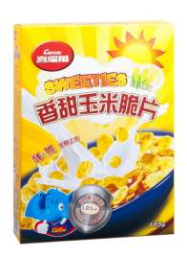
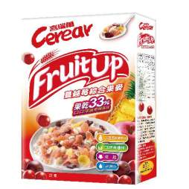
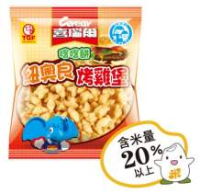
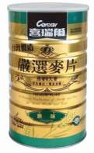
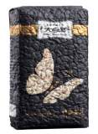
Non-GMO corn utilized,
enjoy every bite!
Cereal Food
Breakfast Cereal
Mixed Muesli
Campus Food
Edible Barley
Breakfast Cereal
Mixed Muesli
Campus Food
Edible Barley
7

Slide 9
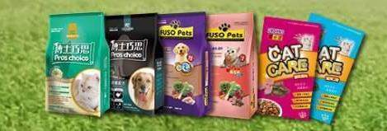
The only to use domestic, fresh “non-GMO corns” as raw materials in Taiwan.
Pet Foods
Out of the ordinary 1%
Caring for land
Choice of ingredients on materials
Fresh and healthy
Dry and canned foods for dogs and cats
Koi, aquarium fish, spectacular bird and small animals
8

Slide 10
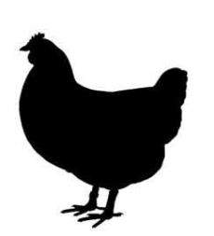
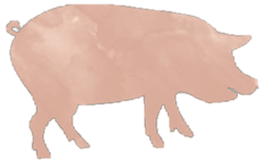
Providing diverse livestock feeds and aquatic
feeds made by pellet and extrusion processing
Animal feeds
Livestock feed
Feeds for layers, broilers, pigs, and ducks etc
Aquatic feed
Feeds for tilapia, milkfish, trout and other aquarium fish
9

Slide 11



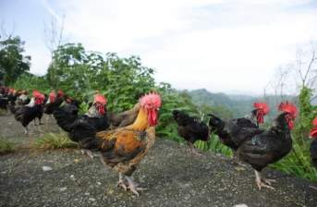
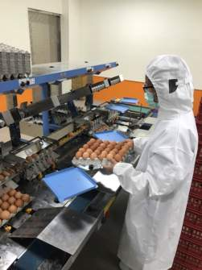
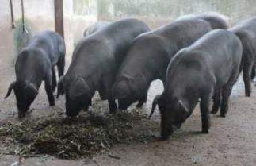
Certificated of traceable, human farming and TSAS. Comply with EU animals welfare standard.
Livestock product
Eco eggs
Eco chickens
Eco pigs
10

Slide 12
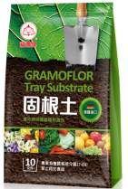
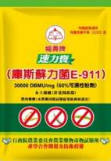
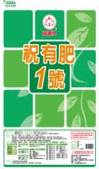

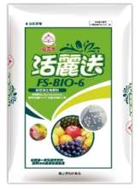
Launch Organic Agricultural Material and environmental friendly products
Agricultural
Material
16 organic fertilizers, 2 bio-fertilizers listing on the Organic Agricultural Material Recommendation Catalogue by Council of Agriculture
9 products received organic material certifications
Organic Fertilizer
Bio-fertilizer
Bio-pesticide
11

Slide 13
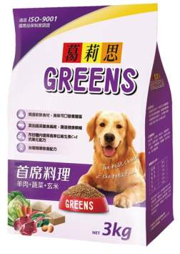
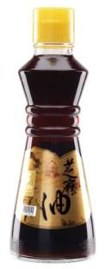
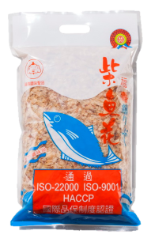
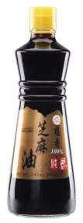
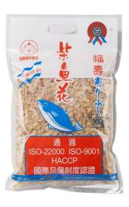

Carbon footprint products
Sesame oil, bonito flakes, Greens pet foods received certifications for carbon footprint
All edible oils and cereal products received FSSC 22000、 ISO 22000 、HACCP、TQF quality assurance certification
Carbon Labeling
12

Slide 14
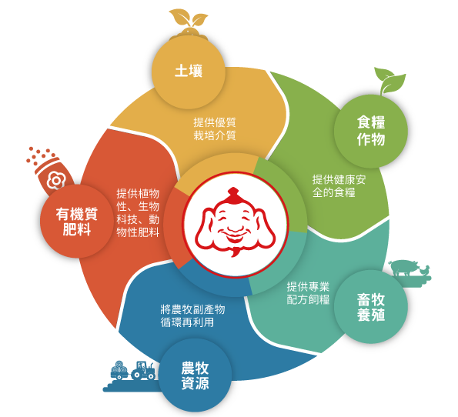
Sustainable agriculture and circular economy
Organic fertilizers enhance soil fertility and improve soil quality
Contract production and procurement of corns, sesames,
and peanuts
Production of organic fertilizers and composts using microbial biotechnology
Production of edible oil, feeds
Recycle broiler manures, mushroom and agricultural residues
13

Slide 15

The first Taiwan food manufacturer to receive BS 8001: 2017 circular economy verification
We continue to promote friendly farming, to achieve the goal of recycling of food and agriculture grains for a sustainable agriculture, to implement circular economy and actively develop applications to move towards to becoming a green enterprises.
14

Slide 16
02
Financial Performance
Y2018 Q2 Consolidated P & L
+

Slide 17
Y2018 H1 Consolidated P&L
金額: 仟元
金額: 仟元
+
Notes:
。
整體近五年公司營業毛利均穩定成長，但淨利卻未隨毛利提升而相較前年提升，原因：營業費用逐年攀升。
每年營業費用如下：
2014年 642,723(千元)
2015年 757,915
2016年 905,419

Slide 18
Y2018 Q2 Operating Segment Consolidated Revenue
Segment | Main Products
Grains and Oils Division | Grains and Oil Food
Animal Feeds Division | Livestock and Aquatic Feed, Pet Food
Processed Meat Division | Raw Broiler (Charming Food) and Processed Meat
Other Division | Agricultural Materials, Eggs, Agricultural Commodity
Y2018 Q2 Operating Revenue
NTD 2.97 Billion
Y2017 Q2 Operating Revenue
NTD 2.51 Billion

Slide 19
Y2018 Q2 Operating Division Consolidated P&L
Unit: NTD in thousand
Processed Meat Division
Animals Feeds Division
Y2017 Q2 P&L

Slide 20
Y2018 H1 Operating Segment Consolidated Revenue
Y2018 H1 Operating Revenue
NTD 5.85 Billion
Y2017 H1 Operating Revenue
NTD 5.34 Billion

Slide 21
Y2018 H1 Operating Division P&L
Unit: NTD in thousand
Animals Feeds Division
Grains and Oils Division
Processed Meat Division
Other Division
Y2018 H1 P&L
Y2017 H1 P&L

Slide 22
2018 H1 Consolidated Balance Sheet

Slide 23
03
Future Outlook
Continuing to implement the circular economy of agriculture and expand the scope of application
Continuing to develop functional pet foods and create an image of high-quality Made-in-Taiwan pet food
Continuing to develop Cerear cereals using local ingredients and create differentiation
Developing agricultural applications and bio-products using microbial biotechnology, and to facilitate the development of organic material usages
Introducing AI smart manufacturing to achieve precise and efficient productions

Slide 24
Q & A
Thank you

