Slide 1
FORMOSA OILSEED PROCESSING CO., LTD.
2020 Third Quarter
Results Report
Stock Code：1225

Slide 2
Company Profile
Date of Establishment：April 18th, 1986
Listed in Taiwan Stock Exchange on Sep., 1993
Stock Code：1225
The company has obtained the relevant certification as follows :
ISO 9001
ISO 22000
HACCP (Hazard Analysis Critical Control Points)
HALAL (Taiwan Halal Integrity Development Association)
FACS (Food Safety Accreditation & Certification System)

Slide 3
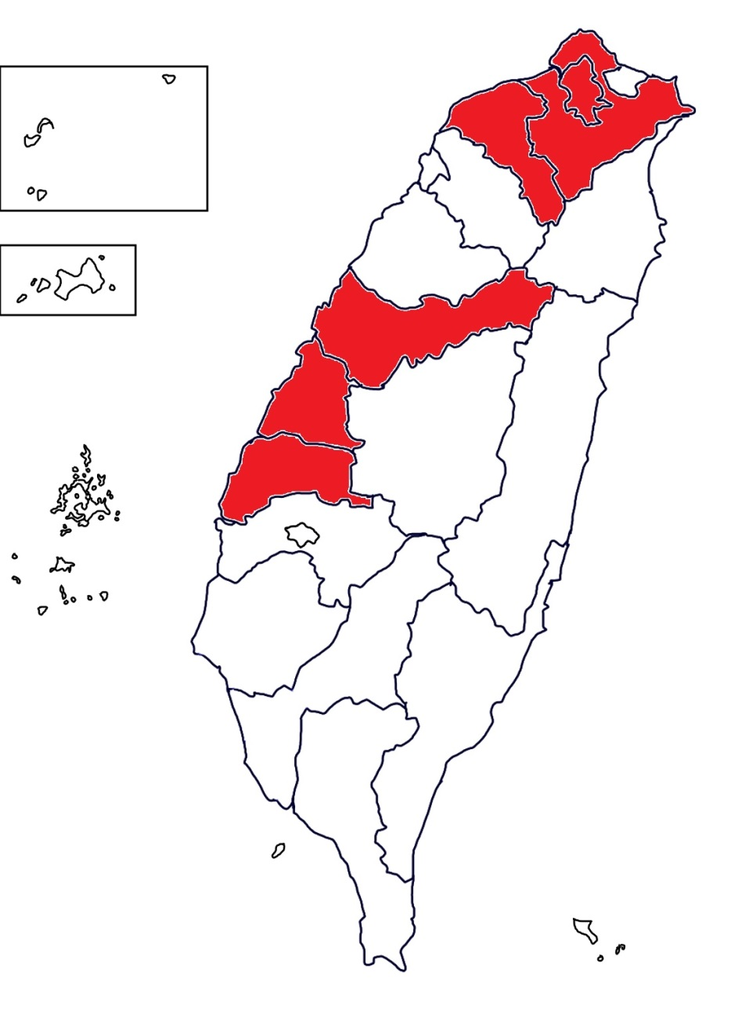
Location
TAIPEI BRANCH OFFICE
The plant is in a centralized location wedged between interchange 189 and interstate 1 ; two of the most convenient transport routes in Taiwan. This allows us to rapidly attend to the needs of our customers within just 4 hours of any direction. As such, the attentiveness of our service has garnered the recognition and praise of our customers over the years.
HEAD OFFICE

Slide 4
Major Business
DEPT | Production and sale
OIL DEPT | soybean oil, soybean meal, full fat soybean meal, palm oil.
ANIMAL FEED DEPT | Manufacturing and sales business of feed, barley, corn and by-products, full fat soybean meal and by-products. General import and export trading business. Import and sale of corn, soybean, wheat, barley, other grains etc.
FLOUR DEPT | flour, wheat bran, wheat pollard, wheat germ etc.

Slide 5
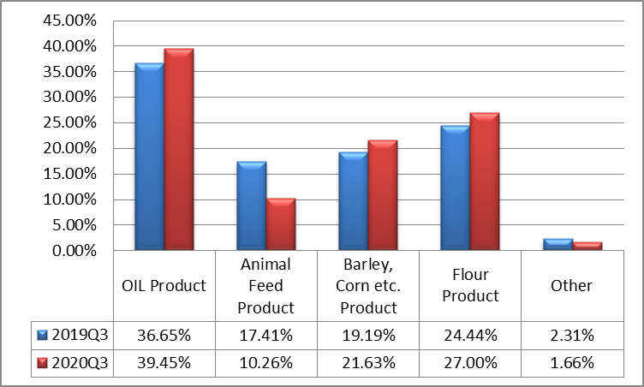
Major Business Proportion

Slide 6
Production Profile
Unit：MT；NTD in Thousands
2020/1/1~9/30
Production value | Capacity | Quantity | Output value
OIL DEPT | 243,000 | 161,903 | 2,328,801
ANIMAL FEED DEPT | 148,500 | 93,237 | 1,078,270
FLOUR DEPT | 180,000 | 185,325 | 1,976,580
Total | 571,500 | 440,465 | 5,383,651

Slide 7
Sale Profile
Unit：MT；NTD in Thousands
2020/1/1~9/30
Sales value | Domestic value |  | Export value
 | Quantity | Sales value | Quantity | Sales value
OIL DEPT | 168,030 | 2,909,423 | 1,727 | 45,248
ANIMAL FEED DEPT | 218,230 | 2,186,898 | 36,032 | 201,466
FLOUR DEPT | 145,612 | 1,924,440 | 9,225 | 97,725
OTHER EDPT | 2,008 | 124,328 | - | -
Total | 533,880 | 7,145,089 | 46,984 | 344,439

Slide 8

Annual Segment Information (Consolidated)
Unit：NTD in Thousands
Item | 2020/1/1~9/30 |  | 2019/1/1~9/30 |  | YOY
 | Amount | % | Amount | %
Revenue | 7,489,528 | 100 | 7,838,370 | 100 | (4%)
Gross Profit | 756,539 | 10 | 732,918 | 9 | 3%
Selling Expenses | 279,536 | 4 | 270,187 | 3 | 3%
Administrative Expenses | 126,018 | 2 | 125,759 | 2 | 0%
Research and Development Expenses | 25,764 | - | 24,641 | - | 5%
Operation Profit | 327,429 | 4 | 318,189 | 4 | 3%
Profit Before Tax | 358,636 | 5 | 349,509 | 4 | 3%
Profit After Tax | 254,648 | 3 | 279,965 | 3 | (9%)
Profit After Tax (attribute to owners of the parent) | 227,752 | 3 | 242,607 | 3 | (6%)
EPS (NTD dollar) | 1.04 |  | 1.11

Slide 9
Key Balance Sheet Items & Indices (Consolidated)
Unit：NTD in Thousands
Item | 2020 Q3 |  | 2019 Q3
 | Amount | % | Amount | %
Property, Plant & Equipment | 2,952,271 | 40 | 2,057,463 | 25
Total Assets | 7,443,695 | 100 | 8,164,988 | 100
Interest-bearing Debt (short / long-term borrowings、short-term notes and bills payable、corporate bonds) | 3,170,982 | 43 | 3,696,868 | 45
Total Liabilities | 3,876,876 | 52 | 4,602,327 | 56
Total Equity | 3,566,819 | 48 | 3,562,661 | 44
Key Indices
Current Ratio | 130% |  | 169%
Acid Test Ratio | 86% |  | 114%
Total Liabilities to Equity Ratio | 109% |  | 129%

Slide 10
Key Cash Flow Items(Consolidated)
Unit：NTD in Thousands
Items | 2020/1/1~9/30 | 2019/1/1~9/30
Beginning Balance | 819,700 | 482,737
Net Cash provided by operating activities | 157,917 | 32,165
Net Cash (used in) provided by investing activities | 380,062 | (653,938)
Net Cash (used in) provided by financing activities | (406,238) | 1,266,475
Net increase (decrease) in short-term loans and short-term notes / bills payable | (29,027) | 1,170,998
Net increase (decrease) in long-term loans | (35,484) | 405,000
Ending Balance | 950,606 | 1,103,912

Slide 11
Taichung Port Area
New Factory Construction Project
Location：Taichung Port
Estimated completion date：2021 Q2
Estimated investment amount：NTD1,350,000,000
Production capacity ：200 MT/Day

Slide 12
Thank you for your attention.

