Slide 1
FORMOSA OILSEED PROCESSING CO., LTD.
2022 Third Quarter
Results Report
Stock Code：1225

Slide 2
Company Profile
Date of Establishment：April 18th, 1986
Listed in Taiwan Stock Exchange on Sep., 1993
Stock Code：1225
The company has obtained the relevant certification as follows :
ISO 9001
ISO 22000
HACCP (Hazard Analysis Critical Control Points)
HALAL (Taiwan Halal Integrity Development Association)
RSPO (Roundtable on Sustainable Palm Oil)

Slide 3
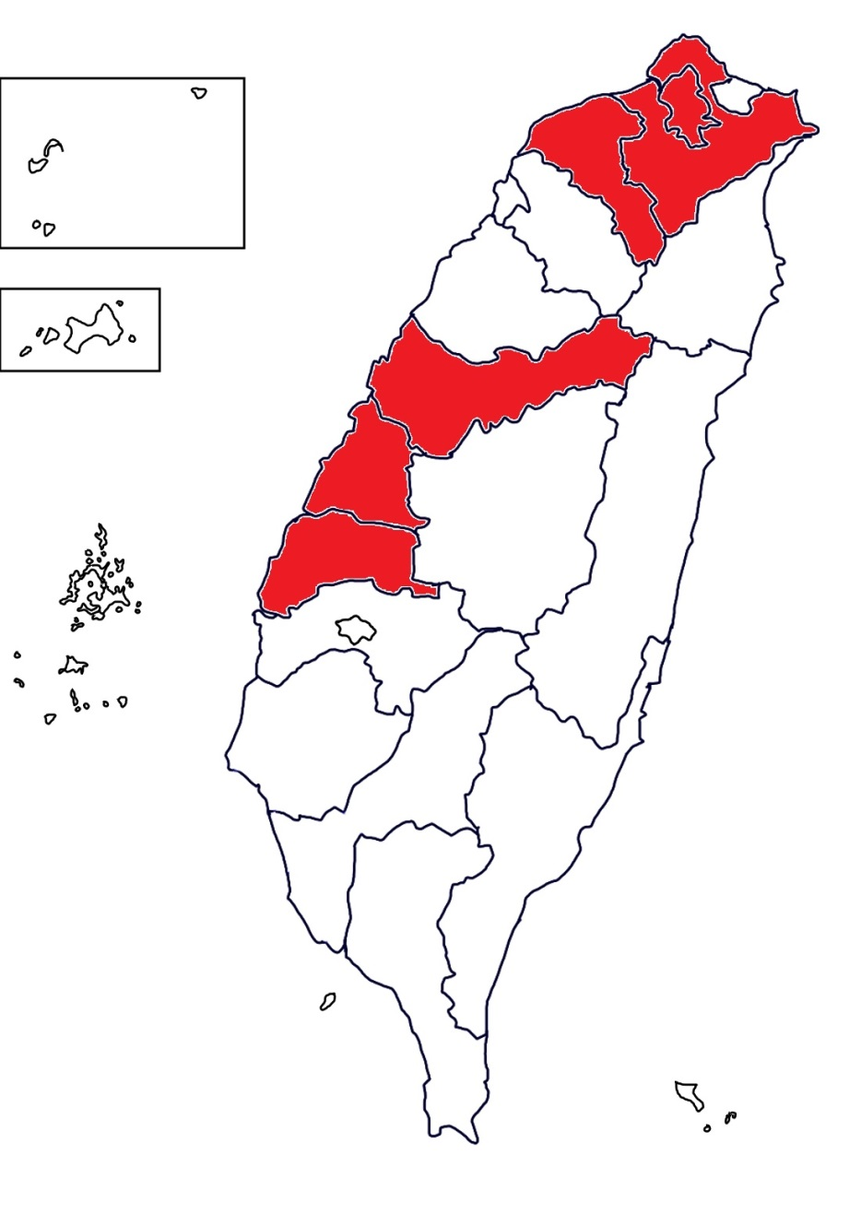
Location
TAIPEI BRANCH OFFICE
The plant is in a centralized location wedged between interchange 189 and interstate 1 ; two of the most convenient transport routes in Taiwan. This allows us to rapidly attend to the needs of our customers within just 4 hours of any direction. As such, the attentiveness of our service has garnered the recognition and praise of our customers over the years.
HEAD OFFICE

Slide 4
Major Business
DEPT | Production and sale
OIL DEPT | soybean oil, soybean meal, full fat soybean meal, palm oil.
ANIMAL FEED DEPT | Manufacturing and sales business of feed, barley, corn and by-products, full fat soybean meal and by-products. General import and export trading business. Import and sale of corn, soybean, wheat, barley, other grains etc.
FLOUR DEPT | flour, wheat bran, wheat pollard, wheat germ etc.

Slide 5
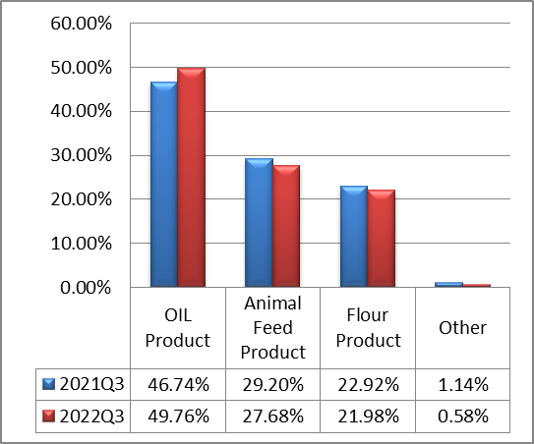
Major Business Proportion

Slide 6
Production Profile
Unit：MT；NTD in Thousands
2022/1/1~9/30
Production value | Capacity | Quantity | Output value
OIL DEPT | 243,000 | 166,267 | 4,118,569
ANIMAL FEED DEPT | 148,500 | 88,036 | 1,364,646
FLOUR DEPT | 180,000 | 189,318 | 2,564,475
Total | 571,500 | 443,621 | 8,047,690

Slide 7
Sale Profile
Unit：MT；NTD in Thousands
2022/1/1~9/30
Sales value | Domestic value |  | Export value
 | Quantity | Sales value | Quantity | Sales value
OIL DEPT | 174,415 | 5,134,242 | 9,603 | 461,579
ANIMAL FEED DEPT | 204,527 | 2,959,670 | 17,402 | 152,371
FLOUR DEPT | 172,481 | 2,354,588 | 8,142 | 116,588
OTHER EDPT | 808 | 65,571 | - | -
Total | 552,231 | 10,514,071 | 35,147 | 730,538

Slide 8

Annual Segment Information (Consolidated)
Unit：NTD in Thousands
Item | 2022/1/1~9/30 |  | 2021/1/1~9/30 |  | YOY
 | Amount | % | Amount | %
Revenue | 11,244,609 | 100 | 9,447,797 | 100 | 19%
Gross Profit | 833,030 | 7 | 860,254 | 9 | -3%
Selling Expenses | 319,358 | 3 | 297,044 | 3 | 8%
Administrative Expenses | 137,868 | 1 | 141,451 | 2 | -3%
Research and Development Expenses | 28,222 | - | 27,438 | - | 3%
Operation Profit | 347,437 | 3 | 396,236 | 4 | -12%
Profit Before Tax | 407,317 | 4 | 444,311 | 5 | -8%
Profit After Tax | 334,694 | 3 | 362,904 | 4 | -8%
Profit After Tax (attribute to owners of the parent) | 340,989 | 3 | 330,365 | 4 | 3%
EPS (NTD dollar) | 1.56 |  | 1.51

Slide 9
Key Balance Sheet Items & Indices (Consolidated)
Unit：NTD in Thousands
Item | 2022 Q3 |  | 2021 Q3
 | Amount | % | Amount | %
Property, Plant & Equipment | 3,272,395 | 35 | 3,189,938 | 39
Total Assets | 9,226,218 | 100 | 8,202,060 | 100
Interest-bearing Debt (short / long-term borrowings、short-term notes and bills payable、corporate bonds) | 4,626,312 | 50 | 3,664,114 | 46
Total Liabilities | 5,394,090 | 58 | 4,453,810 | 54
Total Equity | 3,832,128 | 42 | 3,748,250 | 46
Key Indices
Current Ratio | 132% |  | 132%
Acid Test Ratio | 72% |  | 85%
Total Liabilities to Equity Ratio | 141% |  | 119%

Slide 10
Key Cash Flow Items(Consolidated)
Unit：NTD in Thousands
Items | 2022/1/1~9/30 | 2021/1/1~9/30
Beginning Balance | 1,108,318 | 1,225,893
Net Cash provided by operating activities | (175,466) | (195,214)
Net Cash (used in) provided by investing activities | (69,858) | (124,191)
Net Cash (used in) provided by financing activities | 3,892 | 130,160
Net increase (decrease) in short-term loans and short-term notes / bills payable | 330,358 | 789,580
Net increase (decrease) in long-term loans | 62,091 | (310,000)
Ending Balance | 871,694 | 1,035,044

Slide 11
Taichung Port Area
New Factory Construction Project
Location：Taichung Port
Mass produce ：2022 November
Investment amount：NTD1,347,000,000
Production capacity ：200 MT/Day

Slide 12
Thank you for your attention.

