Slide 1
大統益股份有限公司
TTET UNION CORPORATION
2020 H1 Financial Results
Code：1232 TT
Aug. 18, 2020

Slide 2
Disclaimer
This presentation contains certain forward-looking statements that are based on current expectations and are subject to known and unknown risks and uncertain ties that could cause actual results to differ materially from those expressed in the statements.
Except as required by law, we undertake no obligation to publicly update any forward-looking statements, whether as a result of new information, future events or others.

Slide 3
Location
Taipei City
Yellow Part：
Area of local animal industry.
TTET Union stands at the center.
Taichung Port
TTET
Union
Kaohsiung Port

Slide 4
Shareholder Structure
updated: July 31, 2020

Slide 5
About Us
Largest Soybean Crusher in Taiwan
  Crush 1 million tons of soybean per year
  (nearly 50% of local crushing volume)
Largest Soy Protein Provider in Taiwan
  Main product：Soybean Meal
  Application：Feed Ingredients (plant protein)
Largest Veg. Oil Producer & Seller in Taiwan
  Brand name：美食家

Slide 6
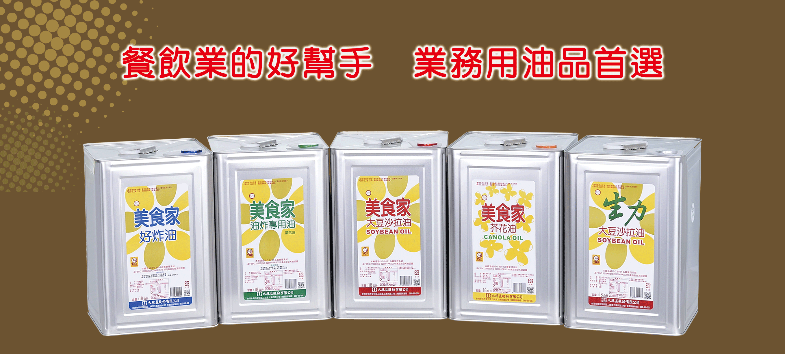

Slide 7
Key Income Statement Items ( Consolidated )
In NT$ millions
Items | 2020 1st Half |  | 2019 1st Half
 | Amount | % | Amount | %
Revenue | 8,025 | 100.0 | 8,231 | 100.0
Gross Profit | 1,037 | 12.9 | 1,012 | 12.3
Operating Expenses | (383) | 4.8 | (388) | 4.7
Operating Profit | 654 | -- | 624 | --
Profit Before Tax | 670 |  | 653
Profit After Tax (attribute to owners of the parent) | 519 | 6.5 | 509 | 6.2
EPS (NT dollar) | 3.24 | -- | 3.18 | --

Slide 8
Key Balance Sheet Items ( Consolidated )
In NT$ millions
Items | June 30, 2020 |  | June 30, 2019
 | Amount | % | Amount | %
Total Assets | 6,602 | 100 | 5,865 | 100
Total Liabilities | 2,752 | 42 | 2,216 | 38
Total Equity | 3,850 | 58 | 3,649 | 62
Current Ratio | 223 % |  | 252 %

Slide 9
Key Cash Flow Items ( Consolidated )
In NT$ millions
Items | 2020 1st Half | 2019 1st Half
Beginning Balance | 1,952 | 1,791
Net Cash flows from operating activities | 232 | 138
Net Cash flows used in investing activities | (137) | (55)
Net Cash flows from (used in) financing activities | 74 | (12)
Ending Balance | 2,121 | 1,862

Slide 10
Stable Profits ( EBIT: Individual )
In NT$ billions
↑7.4 %

Slide 11
Stable Dividends
NT$5 per share
Cash Dividend
since 2014.
Payout Ratio>80%

Slide 12
Return on Equity>20%

Slide 13
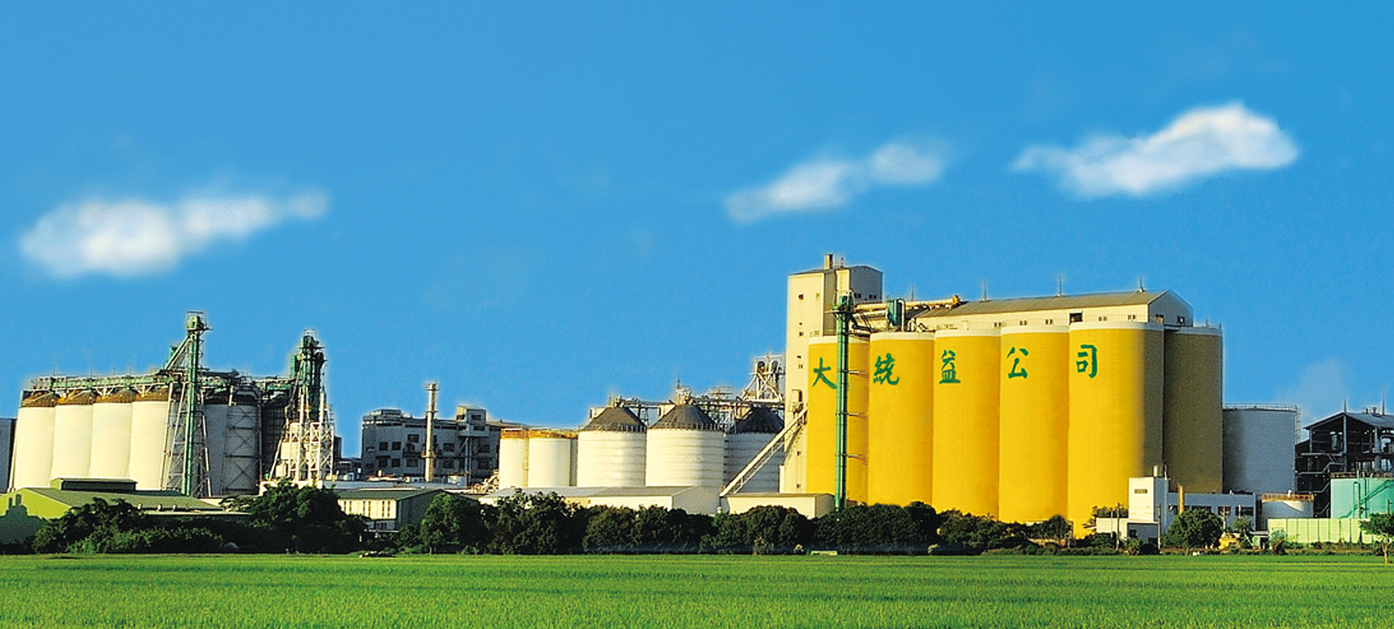
Thank You

