Slide 1
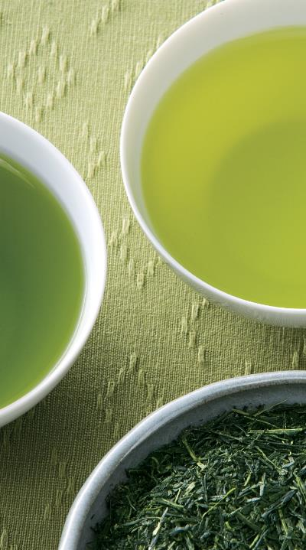


TenRen Tea Co., Ltd.
Investor Conference
Listed Ticker 1233
Chen, Chung-Chih
Vice President, Finance and Administration Group
December 12, 2024
Natural, healthy, humanity

Slide 2

Topic Outline
Group and Brand Development
About TenRen
Sustainable performance in tea business in 2024
2024 Marketing Events
Promotion of tea culture
Financial status over the last five years
Current profit and loss for the most recent year
Happiness in tea imparts peace
Business Development Plan

Slide 3
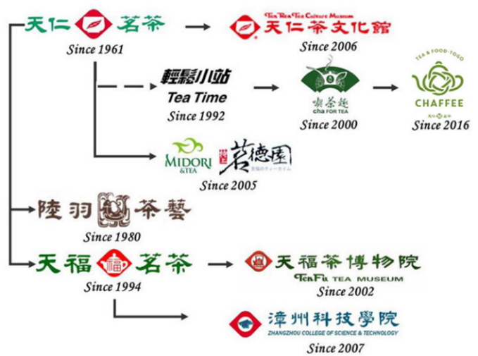
Group and Brand Development

Slide 4
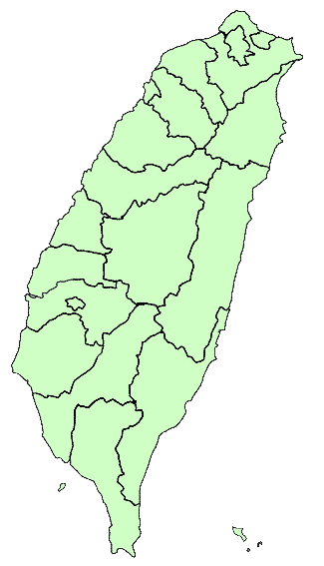
About TenRen
TenRen Tea stores: 46
CHAFFEE: 8
Domestic directly operated bases: 99
Department store booths: 35
TenRen CHA FOR TEA: 10

Slide 5
Analysis of domestic and foreign sales

Slide 6
Product mix

Slide 7

Actively expand chain systems internationally
The current state of franchise stores overseas
101 direct/franchise stores overseas
Business locations have been established in many countries, including the United States, Canada, Hong Kong, Macau, Singapore, Japan and Australia.
There are 1,300 Tenfu Tea stores in China.
Note: Tenfu Tea serves as the general distribution agent for TenRen’s Tea series products in China.

Slide 8
Sustainable performance in tea business in 2024
Sustainable performance 2024
TenRen continues to live up to the business philosophy of “natural and healthy with a human touch.” On TenRen’s 71st anniversary, we continue to enhance the quality of tea leaves and digital retailing to provide more accurate and high-quality services, while continuing to move toward sustainability so as to incorporate key sustainability issues into TenRen’s corporate culture.
1. Corporate governance:
(1) Outsourced identification of domestic tea production areas for regular procurement.
(2) The laboratory continues to pass TAF certification, with “zero” major food safety incidents.
(3) ESG sustainable performance is linked to managers’ remuneration, upholding the spirit of sustainable governance.
(4) A dedicated information security team is established to enhance system security protection and response capabilities.

Slide 9
Sustainable performance in tea business in 2024 (Continued)
2. Environmental protection:
(1) Encourage consumers to bring their own shopping bags and eco-friendly cups.
(2) Gradually reduce the use of packaging materials and disposable utensils.
(3) Introduce scenario simulation tools to analyze the financial impact of extreme weather events.
(4) Conduct domestic and international GHG inventory for organizational sites based on the ISO 14064-1 standard.
(5) Reduce the thickness of shopping paper bags to decrease the use of paper and plastic film.
(6) Set the goal for 2025 to use eco-friendly recycled polyester (recycled PET bottles) for store uniforms and member birthday gift bags, promoting sustainable circular reuse.

Slide 10
Sustainable performance in tea business in 2024 (Continued)
3. Social responsibility:
(1) Colleagues proactively form teams to participate in marathons, promoting physical and mental well-being.
(2) Regularly assist underprivileged, sustainable, and cultural organizations to fulfill social responsibility.
(3) Strengthen workplace grievance channels and gender equality advocacy, representing the uniqueness of employees.
(4) Established an Occupational Safety Committee to improve communication channels between labor and management.

Slide 11
2024 Marketing Events
Introduction of Diversified Digital Tools
The APP was introduced in late July 2022, and as of now, nearly 400,000 members have become members.
Currently, the APP is used successfully to carry out demassification and general marketing activities. The official LINE@ for TenRen Tea is expected to launch in November, followed by the introduction of the CHA FOR TEA and CHAFFEE online pre-order functions in December, enhancing the convenience of ordering for consumers. In the future, different types of activities will be planned for various digital tools to expand the depth and breadth of engagement with consumers.
Digital tools make it easier for customers to buy and use products, while also strengthening the brand’s grip on consumers and effectively increasing consumer loyalty and brand recognition.

Slide 12
2024 Marketing Events (Continued)
Diversified Product Development
The Tie Guan Yin Chocolate Flavor Handmade Granola were launched in April 2023 and have been highly favored by consumers. The Oolong Tea Flavor Handmade Granola were launched in June 2024 to meet the needs of different consumer groups. The 913 Peanut & Sesame Handmade Granola is planned for release by the end of the year, enriching the granola product line.
In September, we also reintroduced the tea candies that were previously popular with tourists, launching Oolong Tea Candy and Jasmine Tea Candy.
The development of a diverse range of products can broaden the brand’s reach and consumer breadth, which contributes significantly to brand continuity and development.

Slide 13
2024 Marketing Events (Continued)
Sustainable and fun tea savoring
1. Continued to implement the concept of sustainable development, printed all DMs with eco-friendly paper and vegetable-based inks, carried out a plan to reduce DMs with digital DMs, thereby reducing the quantity of DMs mailed.
2. Replaced fructose with sucrose for all beverages and sourced locally.
3. Adopted HPP Taiwan’s freshly squeezed orange juice and lemon juice regardless of the cost, to improve product safety and quality stability and ensure local procurement. Reduced the food waste that would be produced from juice squeezing by workers at stores; suppliers used the food waste as fertilizer and compost to achieve the effect of recycling and reuse.
TenRen aims to ensure sustainable and fun tea savoring, promote sustainable development with consumers, and do our share to protect the environment.

Slide 14
2024 Marketing Events (Continued)
TenRen CHA FOR TEA
We launched a new package meals based on the concepts of “refined, simple, and profound,” featuring seasonal ingredients, simplified preparation, and high-quality materials. The set includes Assam Pork Tender Bone (CHOHO Pork Tender Bone), Green Tea Plum Sauce Yam (Sustainable “Old Plum” Economic Circle), Beauty Mountain Delicacy Mixed Rice (Momordica Cochinchinensis Vegetarian Meat Floss), Oolong Rose Cold Drink (Pesticide-Free Rose Brew), Green Tea Grapefruit Honey Vinegar (Grapefruit from Environmentally Friendly Cultivation in Kochi, Japan), Pi Lo Chun Black-Feathered Farm Chicken (Free-Range Black-Feathered native Chicken), and Ten Lu Apple Fragrant Strawberries (Strawberries that have passed inspection by relevant authorities), aiming to enhance customer satisfaction.

Slide 15
2024 Marketing Events (Continued)
TenRen CHA FOR TEA
2. Stopped using paper placemats completely to reduce the use of paper pulp and the amount of waste in line with the ESG concept.
3. Launched the “913 Peeled Chili Pepper Egg” to contribute efforts toward sustainable procurement and addressing the egg surplus.
4. Introduced limited-time seasonal add-on products in collaboration with local specialties at tea stores, including Old Plum Pastry, Dual Tea Mille Crepe Cake, and Rose Brew, offering customers a diverse range of dining options.
5. Operated a LINE@ official account to communicate with consumers with zero distance.
6. Gradually adopted food delivery robots, making manpower planning more flexible.

Slide 16
Promotion of Tea Culture
TenRen Tea Culture Museum
Tea Ren Tea Culture Museum opened in 2006. It is a concrete manifestation of promoting sustainable development, adhering to the spirit of “take from tea and use for tea.” The general public can rest, learn, and gain experience through free visits, guided tours, and tea service.
To encourage the general public to visit for exchange and learning, the museum continues to launch new activities such as tea art, flower art, ceramic art, and forums. Exhibitions are also held to provide an excellent platform for Taiwanese ceramic artists to promote Taiwanese pottery and create business opportunities.
The company is actively involved in public welfare and care for the disadvantaged, provides necessary teaching and experiential services to remote schools, indigenous and new resident families, deviated students, disability associations, elderly and young groups, community universities, schools of all levels, and so on.
After the pandemic, the number of visitors and various tea art classes and on-site services have resumed and even become more vibrant. We will start from the basics, focusing on tea, and actively and passionately promote tea culture to the general public.

Slide 17
Financial structure in the last five years – debt ratio

Slide 18
Liquidity in the last five years – current ratio

Slide 19
Liquidity in the last five years – quick ratio

Slide 20
Profitability in the last five years – net operating income
Unit: NTD thousand

Slide 21
Profitability in the last five years – net profit for the current period (after tax)

Slide 22
Profitability in the last five years – earnings per share
Unit: NTD

Slide 23
Dividend distribution in the last five years
Unit: NTD

Slide 24
Current profit and loss for the most recent year
New Taiwan Dollars-thousand dollars
Item | 2024/January – September Results | 2023/January – September Results | Growth rate %
Operating income | 1,634,309 | 1,559,270 | 4.81
Gross profit | 961,108 | 901,751 | 6.58
Operating expenses | 899,235 | 815,861 | 10.22
Operating profit (loss) | 61,873 | 85,890 | (27.96)
Non-operating income and expenses | 17,602 | 14,322 | 22.90
Profit before tax | 79,475 | 100,212 | (20.69)
Profit after tax | 65,515 | 81,042 | (19.16)
Earnings per share (EPS) (NTD) | 0.72 | 0.89 | (19.10)

Slide 25
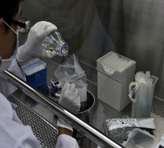
Happiness in tea imparts peace
In April 2015, our company established a food safety laboratory.
In 2017, TAF certification was obtained.
ISO 17025 was approved in 2020.
In 2021, addition and transfer certification applications were
approved once more.
In 2022, the 3-year certificate extension certification was obtained.
In 2024, the laboratory relocation adjustment application passed audits and supervisory evaluations
Meal ingredients, product self-inspection, and outsourced SGS inspection have been completed since the establishment of the food safety laboratory since its establishment. The SGS safe information platform-TenRen tea area was established to fully protect the company’s food safety.
In 2024, completed audits for the updates of FSSC22000 V6, ISO22000, and HACCP.
Since January 1, 2023,a “Traceable Agricultural and Food Products” sticker has been put on each domestic tea product.

Slide 26

Happiness in tea imparts peace
Year | Laboratory self-inspection | Outsourced inspection |  |  | Total number of cases
 | Meal raw materials, products | Raw material by batch | Random inspection of products | Meal raw materials, products
2019 | 1,553 | 777 | 10 | 201 | 2,541
2020 | 1,547 | 590 | 10 | 221 | 2,368
2021 | 1,560 | 696 | 9 | 218 | 2,483
2022 | 1,583 | 737 | 12 | 291 | 2,623
2023 | 1,278 | 789 | 19 | 299 | 2,385
As of Q3 2024 | 979 | 522 | 14 | 232 | 1,747
Total (beginning 2015) | 14,459 | 8,106 | 133 | 2,178 | 24,876
As of Q3 of 2024, a total of 384 certificates of origin have been obtained and are under continuous supervision and management.
As of Q3 of 2024, a total of 70 pieces of raw materials were inspected for the place of origin (all in Taiwan).

Slide 27
Business Development Plan
Inflation, geopolitical conflicts, and the outcome of the U.S. election are expected to impact the gains of the current economic recovery. The Company will strive for operational rationalization and assess the sensitivity of various resources to factors such as interest rates, exchange rates, and tariffs, aiming to build more resilient operational strength.
Continue to strengthen the concepts of “green marketing” and “sustainability,” dedicated to creating an energy-efficient and environmentally friendly green enterprise, and taking more proactive actions to contribute to a greener environment and the protection of the Earth.
Actively participate in various public welfare activities and continue to care for underprivileged children in rural areas by rallying members to participate in charitable activities. Internally, we encourage employees to contribute through donations, aiming to strengthen the spirit of corporate social responsibility.

Slide 28
Business Development Plan (Continued)
In response to the ongoing labor shortage, the Company will increase investment in automation capital expenditures for production equipment on the manufacturing side and service equipment on the sales and service side, aiming to mitigate the impact of labor shortages through automated capital expenditures.
Accelerate talent development across various fields, continuously strengthen the depth of brand management and innovative capabilities, to enhance the competitive advantage in domestic and international channel development and lay the foundation for TenRen’s international expansion.
Strengthen the digitalization of retail by introducing a pre-order system coupled with a delivery mechanism, expanding the reach of TOGO tea drink sales. Accelerate investment in digitalization and intelligence to support the diverse development needs of operations.

Slide 29
Business Development Plan (Continued)
Continue to deepen local and sustainable procurement, ensuring that consumers can access locally produced products they can trust, while also reducing carbon emissions during procurement and transportation. TenRen currently maintains 80% of its procurement value from local suppliers. In terms of sustainable procurement, this includes sourcing Rainforest Alliance certified black tea, locally produced fresh milk from humane farming practices, and meat from animals raised and slaughtered humanely. We will fulfill our social responsibility for sustainable procurement by adhering to standards and regulations.
The Company will continue to adopt “natural, healthy, and additive-free” principles for raw material selection and new product development, offering high-quality, nutritious products. Combined with “humanity” service, we aim to deliver the warmth of tea to consumers and develop healthy, affordable food for them.

Slide 30




Thank you for your time
Vice President Chen, Chung-Chih
ericchen@tenren.com.tw
SGS Safe Information Platform-TenRen Tea Area

