Slide 1
Hunya Food co., Ltd
2017 Investors conference
2017.12.5

Slide 2
Disclaimer
The consolidated financial information included in this presentation were prepared based on IFRS and audited/reviewed by CPA.
Except as required by law, we undertake no obligation to update any forward-looking statements, whether as a result of new information, future events or otherwise.

Slide 3
Company profile
Establishment : 1976.6.14
Listed in TWSE: 2001Y
Capital : NT$10 bn
No of employees: 850
2016 Consolidated sales: NT$21.2 bn
Main Product: Chocolate, Cookies, Cakes/
Moon cake baking,
Chocolate Museum

Slide 4
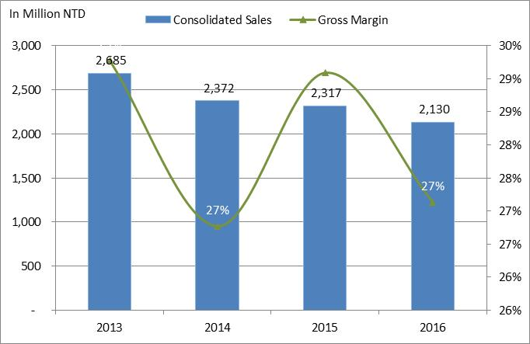
Financial results—Sales & Margin

Slide 5
Dividend Policy

Slide 6
Quarterly Sales and Margin Trend

Slide 7
Consolidated Income Statement- Q o Q

Slide 8
Consolidated Income Statement -Y o Y

Slide 9
Consolidated Balance Sheet & Financial Ratios

Slide 10
Cash Flow

Slide 11
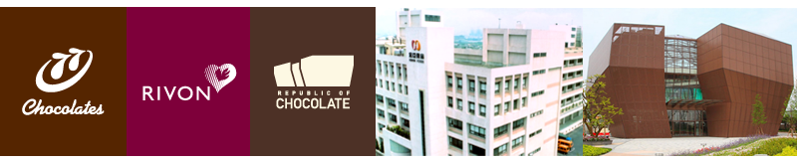
Hunya~40 years chocolate / cake expert
Hongya Food Co., Ltd. was founded in the Republic of China in 65 years (1976), and the establishment of "77", “Rivon " the two major brands, since then continue to seek innovation from tradition..
In 2012 led to establishment of the first Chocolate Museum in Southeast Asia.
Since its launch in 2015 “We Made”has introduced a series of biscuits that are "non-additive" and "tasty".

Slide 12
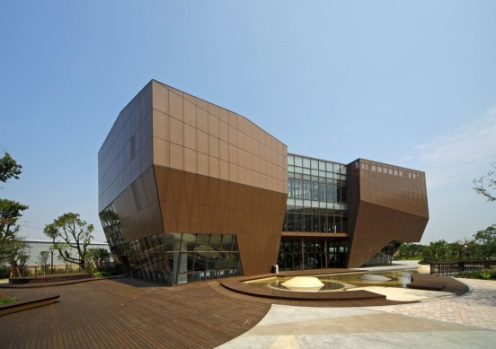
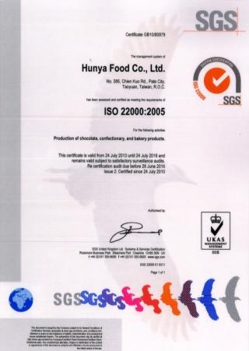
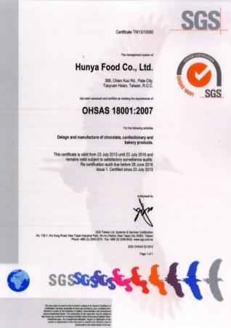
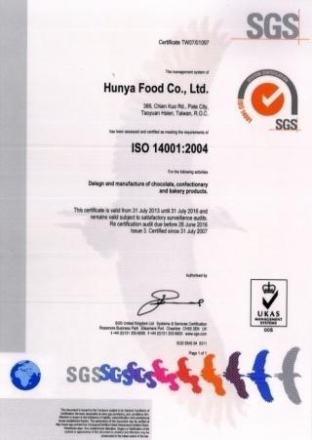
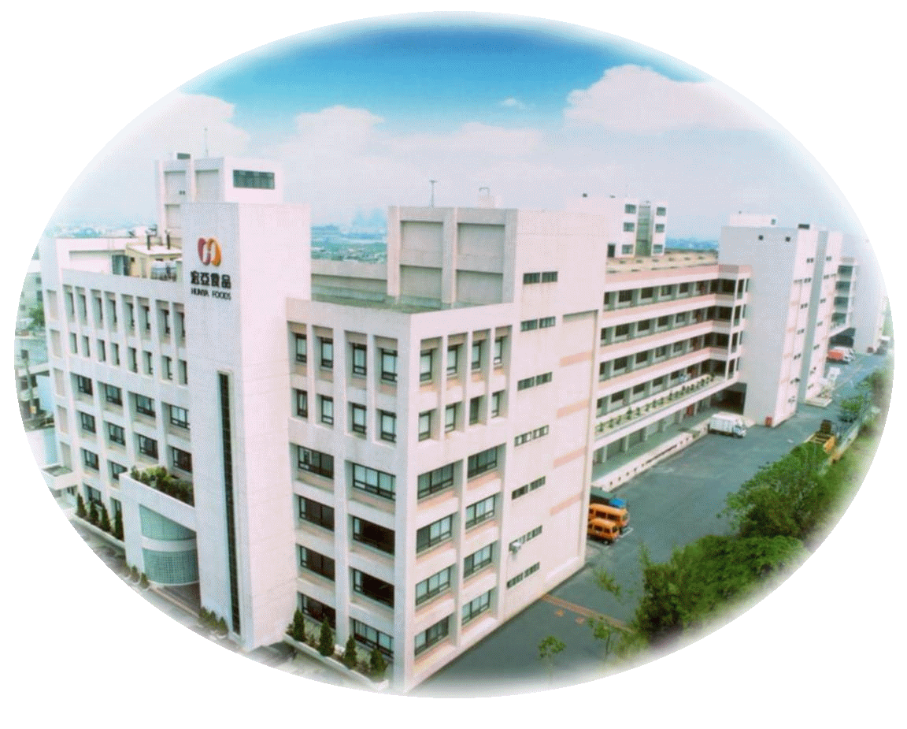
Milestone
2015
Taoyuan Ba Dao Plant expansion
Chocolate Museum
Openning
2012
2010
OHSAS 18001 verification
2007
ISO 22000 verification
2005
HACCP verification
2001
Stock listed on TWSE
1998
Stock listed on OTC，ISO 14001 verification
1997
ISO 9001 verification
1993
Taoyuan Ba Dao new Plant is completed. Land area 30,000㎡, invest amount NT$10bn
1990
HQ moved to Xindian
1981
Distributor system build up
1976
Establishment in New Taipei City, and Manufactured base on Taoyuan Ba Dao.

Slide 13








77 Brand
Main Product：Nougat Chocolate, New Wafer Pies, Milano, Always Chocolate, Tappl milk Chocolated, Chofers….and so on.

Slide 14




Rivon Brand
Adhere to the use of raw materials, to provide safe, healthy and high-quality gifts. The creative and ingenious fashion gift box design, not only stunning the consumer mass, forming a new wave

Slide 15

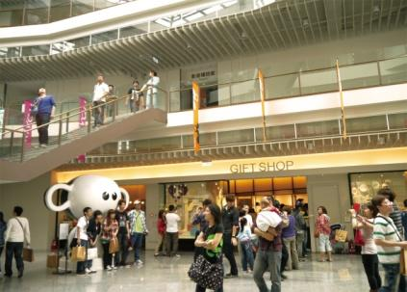
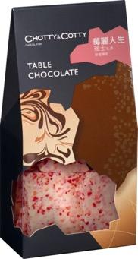
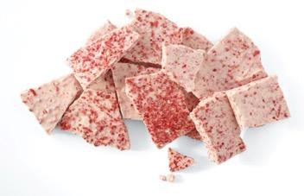
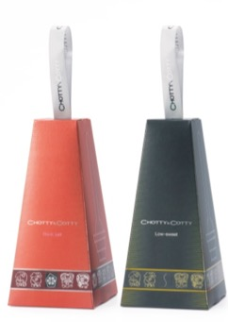
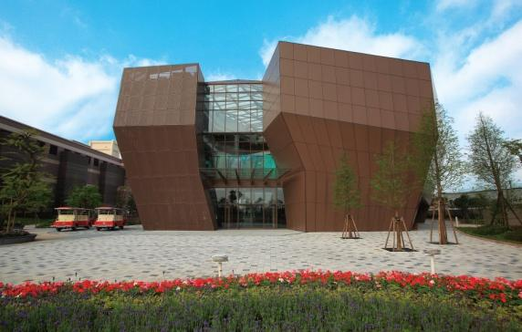
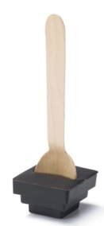
Chocolate Museum
-We are Southeast Asia's first chocolate museum and won the Ministry of Economic Affairs fine tourism factory selection, and was awarded twice the International Highlights Tourism Factory.
-There are about 200,000 visitors, 95% of whom are domestic tourists,70% whom are family.
-Chocolate DIY course, guide the knowledge of Chocolate and handmade chocolate sales.

Slide 16






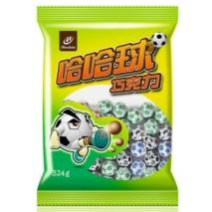

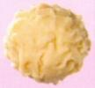


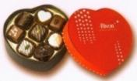




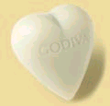
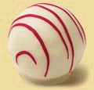
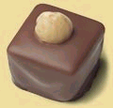
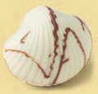
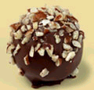
Product
(1) Nougat Chocolate
(2) Sugar coated Chocolate
(3)Handmade Chocolate

Slide 17
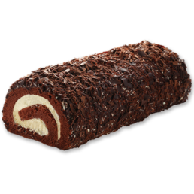
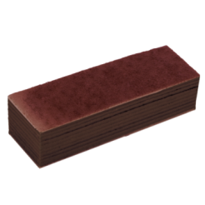
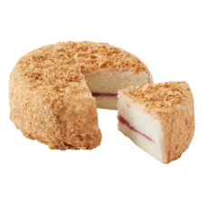
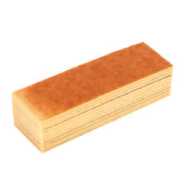
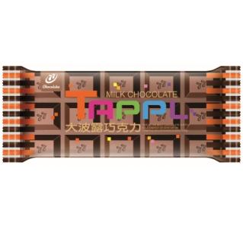




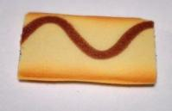




Product
(4)Cake
(5)Flaky Chocolate
(6)Flake cookies

Slide 18
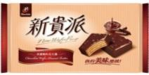
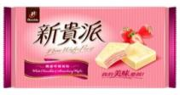
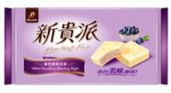
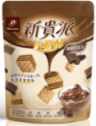
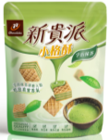
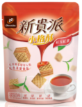
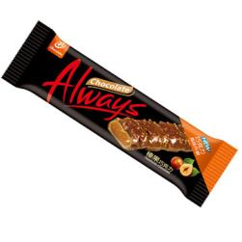
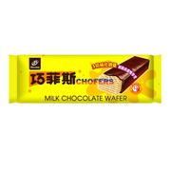
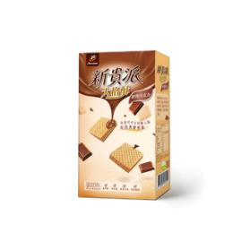
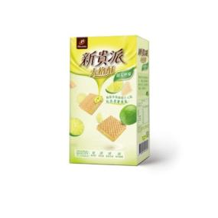
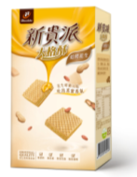
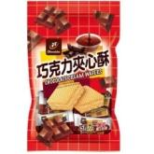
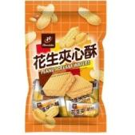
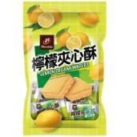
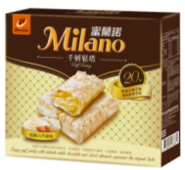
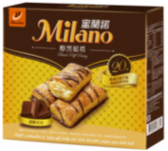
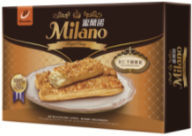
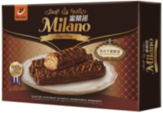
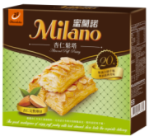
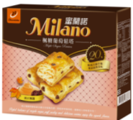

Product
(7)Wafer
(8)Pies

Slide 19






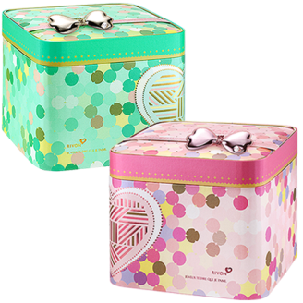
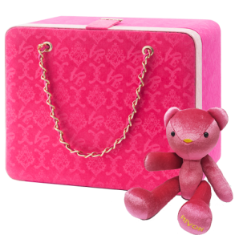
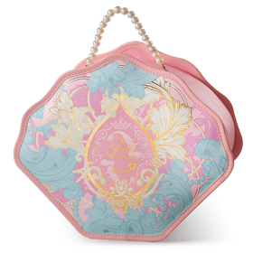



Product
(9)Cookies

Slide 20








Product
(10)Chinese cake
(11)Moon cake

Slide 21










Product
(12)Ice Cream
(13)Cookies
(14)Cluster
(15)Infusion

Slide 22

Challenge
Changes in population structure? (Aging, newcomers, children less ...)
No longer like to give gifts to others
Hi new tired old.
The new product is difficult to succeed.

Slide 23

Operating model
Product premium
Product extension
Brand value and
experience
Relevant innovation
EC channel
Channel portfolio
Regional intensive
Marketing
Chanel
Manufacture
Food resume
Quality assurance
Data management and
process improved
Industry 4.0

Slide 24


Trend:
Relief, health, small Fortunately, not cheap like
Small fortunately
Packaging / taste rich / brand value, experience
Health
Sugar-free / sweetened, natural ingredients / true
ingredients
Safety
Raw material、Origin、Clean Label)

Slide 25









New premium Nougat
Classic-12元
Premium-20元

Slide 26






Wafer
No added aroma
小口品嚐的獨享格子酥
大口滿足的同樂格子酥

Slide 27





Milano~Royal
100% Nature butter

Slide 28


We Made
The best quality materials
The best method of cooking

Slide 29





「Real」
Visual, Taste
Moon cake
奶黃松露酥
頂級黑松露醬配上法國頂級鮮奶油
醇沙乳香酥
純粹無添加，白豆沙、綠豆沙、荷蘭菲仕蘭奶油
私房巧克力月餅
巧克力風味豆沙＋台灣在地釀酒食材入餡
老行家廣式
添加老行家優質燕窩，包覆整顆蜜栗子，食感豐盛

Slide 30
Base in Taiwan, Intensive China、Looking to the worldwide
Strategy | Action plan | To do
China market | CVS, supermarket, Discount store, EC Channels | Build up Sales and marketing team
Nougat launch | Global market launch | China, Korea, HK, Philippine, USA Launch on the main channel
Product portfolio | China Market | Dealer build up EC set up
Global market |  | New product, new channel, new market

Slide 31
Innovation
1. Human-intensive → Mechanization → Automation → Industry 4.0
2. Traditional factory → sightseeing factory → chocolate dreamer

Slide 32

Business Outlook
除夕 2/15
清明 4/5
中元 8/25
New market
channel
除夕 2/4
季節挪移
New product
New product
季節挪移
New product
SALES
BASE
SALES
BASE
SALES
BASE
SALES
BASE
Q1
Q2
Q3
Q4

Slide 33


