Slide 1


Taita Chemical Co., Ltd
Tianjin FAC
2018 Investor Conference
Head Office
Glass-wool FAC
Cubic FAC
Chien Chen FAC
Zhong Shan FAC
Lin Yuan FAC
2018 05 21

Slide 2
Taita Chemical Co., Ltd
2018 Investor Conference
Agenda | Reported by
Product Briefing | T M Yen
2017 Market Review | T M Yen
2018 Market Outlook | T M Yen
Finance Information | Tony Lin
Q & A | Paul Wu

Slide 3


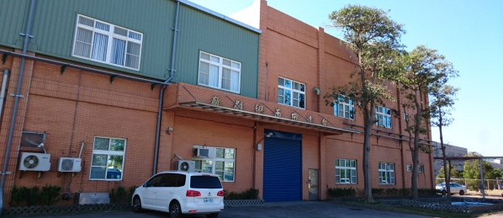
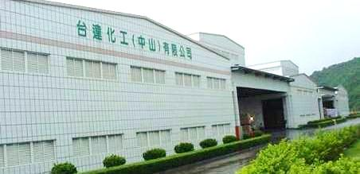

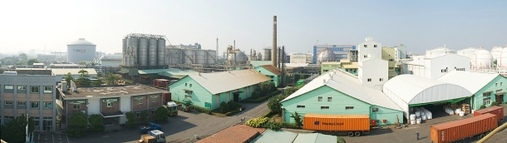
production Capacities
Head Office
Taipei
Tianjin Factory (Est. 2005 09 )
EPS Cap: 140,000 MTA
Tianjin FAC
Cubic FAC (Est. 1987 06) Glasswool FAC (Est. 1991 03)
Cubic Printing Cap: 200,000 JIG/Y Glass-wool Cap: 10,000 MTA
Glass-wool
Zhong Shan Factory (Est. 2000 05)
EPS Cap: 180,000 MTA
Cubic
Chien Chen
Zhong Shan
Lin Yuan
Lin Yuan FAC ( Est. 1979 08)
ABS/SAN Cap: 125,000 MTA
Chien Chen FAC (Est. 1960 04)
EPS Cap: 60,000 MTA GPS/IPS Cap: 100,000 MTA
Taita Chemical has a combined Cap of 600,000 MTA for all diversified products

Slide 4
Taita Chemical Co., Ltd
2018 Investor Conference
2017 Market Review
Economy
Feedstocks
Industry
Sales
Performance

Slide 5
2017 Market Review- Economy
Global US Europe China
Source : IMF
Notes:
KC\法說GDP 2016 2017 2018.xlsx

Slide 6
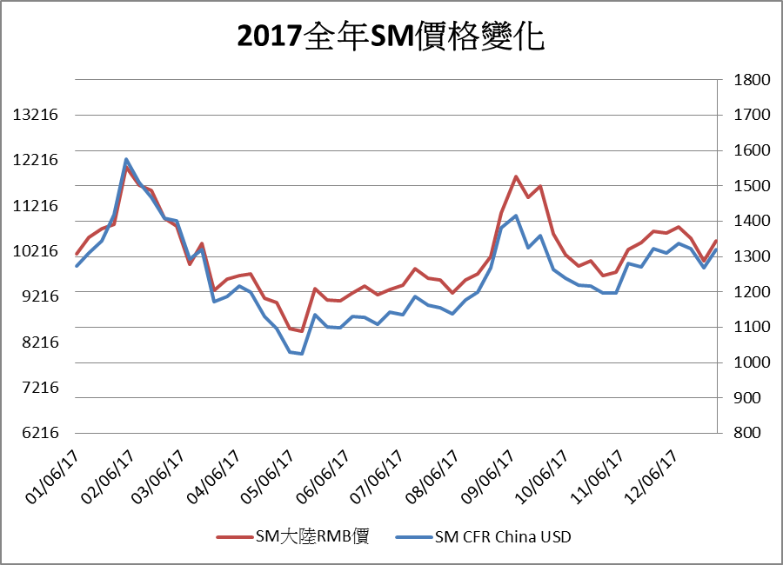
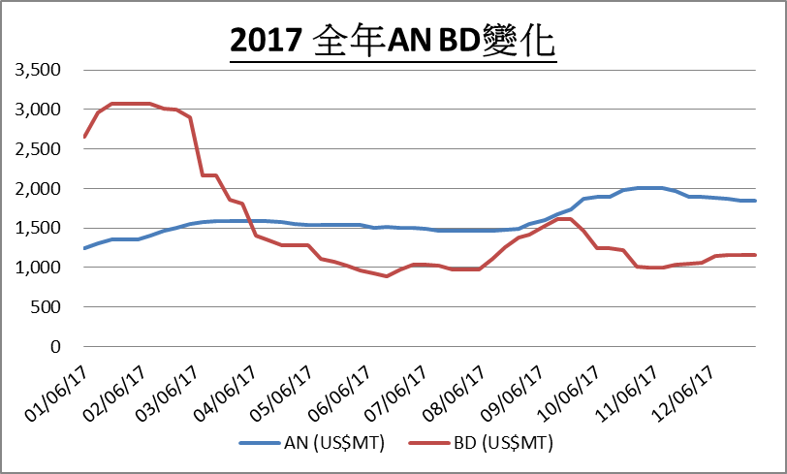
2017 Market Review- Feedstocks
2017 SM price change
2017 AN & BD price change
SM in RMB

Slide 7
2017 Market Review- Industry(China)
unit:x10,000 MT
 | ABS * | GPS | EPS
Capacity | 380 | 328 | 590
Production | 360 | 215 | 335
Operation rate (%) | 94.7 | 77.7 | 56.9
In 2017, Trinseo new ABS capacity of 80,000 MTA
2014 – 2017, only a few new capacity in China.

Slide 8
2017 Market Review- Sales
ABS / SAN
  In2017, sales of ABS/SAN increased by 32.7%
    ABS/SAN sales reached a record high.
    World economy expanded.
    China house appliance market continue to grow. White goods by 26% and refrigerator by13%
    China’s policy to prohibit the import of plastic scrap help the demand.
GPS
  In 2017, sales of GPS increased by 4.8%
    World economy expanded.
    Consumption of one-time-use utensils and food vessels increased.
    Demand for Diffuser of TFT-LCD increased.

Slide 9
2017 Market Review- Sales
Chien
Chen
In 2017 , EPS sales increased by 5.0%
➢World economy expanded.
➢Sales to S. America and S E Asia increased.
EPS
Zhong
Shan
In 2017 , sales slightly decreased by 1.6%
➢ Sales decreased mainly in East Guangdong .
➢Credit review on customers for better collection.
➢Appliances packaging/vegetable box market stably
increased. Core market (West Guangdong and
Yunnan) sales continue to increase.
Tian
Jin
In 2017, sales decreased by 35%
➢ Construction slowed due to staggering real estate market
➢ Customers cut operation rate to meet EPA requirement
➢ Export decreased by 48%
➢ Supply outpaced demand.

Slide 10

2017 Market Review- Sales
Glasswool
In 2017, glasswool sales decreased by 5%.
➢Lost 700 MT of production due to furnace rebuild. Less
quantity available for export.
➢Local demand slightly increased. Domestic sales
increased by 7%.
➢ Stable margin maintained.
Cubic printing
In 2017, cubic printing sales increased by 13%,
New orders in spray printing increased, which compensated the loss in cubic printing market share due to the decrease of car sales.

Slide 11
2017 Market Review- Performance
Sales vs Product Inventory (Taiwan + China)
Unit: MT
Integrated Supply Chain Management
sales
Product inventory

Slide 12
2017 Market Review- Performance
SM Usage vs SM Inventory (Taiwan +China)
Unit: MT
Integrated Supply Chain Management
SM usage
SM inventory

Slide 13
Taita Chemical Co., Ltd
2018 Investor Conference
2018 Market outlook
Economy
Feedstocks
Industry
Sales
Performance

Slide 14
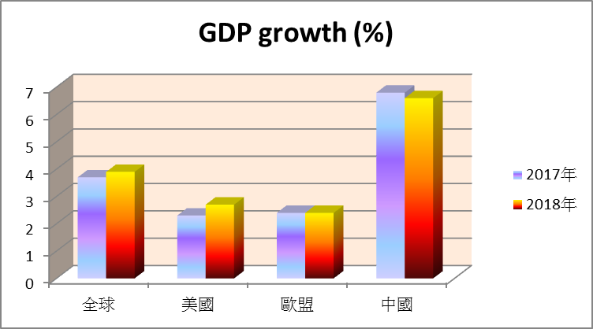
2018 Market outlook- Economy
Factors
Sino-US trade war
Korean Peninsula
issues
Regional stability
Crude oil
Global US Europe China
Source: IMF

Slide 15
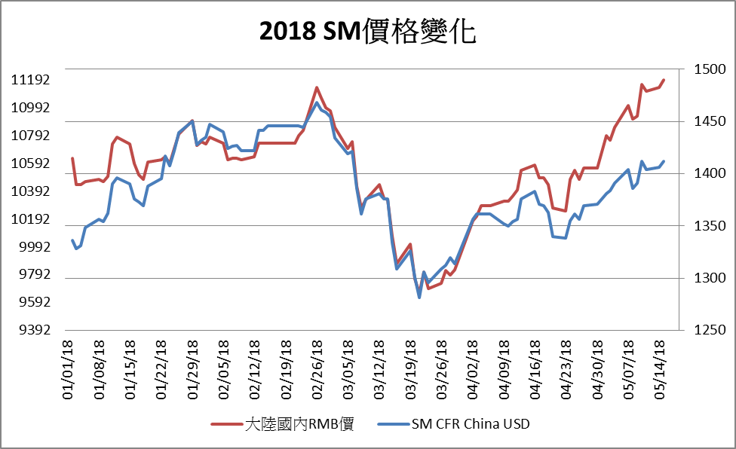
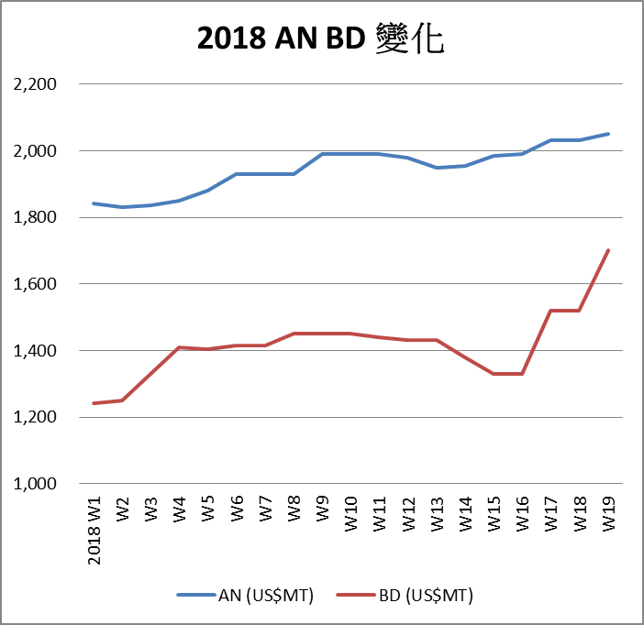
2018 Market outlook- Feedstocks
2018 SM price change
2018 AN & BD price change
11,190
2,050
1,468
1,830
1,700
1,281
9,690
1,240
SM in RMB
Notes:
KC\SM AN BD 2017 and 2018 變化.xlsx

Slide 16
2018 Market outlook- Industry(China)
Unit:x10,000 MT
 | ABS * | GPS | EPS
Current Capacity | 380 | 328 | 590
Estimate increase | 60 | --- | ---
Events:
Anti-Dumping Duty
on SM
Prohibition on Plastic
Scrap Import
* Haili 200,000 MTA；Keyuan 400,000 MTA

Slide 17
2018 Market outlook- Sales
ABS / SAN
Maximizing
Production/sales
  Sales expect further growth in 2018
  ➢Global economy go on expanding
  ➢China appliances demand strong
  ➢ China continue to prohibit the import
  of plastic scrap
  China’s Anti-Dumping-Duty on
  imported SM
  ➢ Developing new application
  2018 Q1 Sales already increased by
  11%
GPS
Sales forecast moderate increase in 2018
➢Global economy go on expanding
➢ Optimization of product mix
➢ Sales grow in target market (Central /
South America and Africa)
➢ Disposable food vessel/ Diffuser demand up
2018 Q1 sales already increased by 21%

Slide 18
2018 Market outlook- Sales
Maximizing
Production/sales
Chien
Chen
Sales expect further growth in 2018
➢ Global economy continue to expand.
➢ Developing the packaging market of TFT-LCD panel.
➢ Shortening cycle time to increase market share.
2018 Q1 sales increase by10%
EPS
Zhong
Shan
Sales expect further growth in 2018
➢ Appliances packaging/Vegetable box demand grow continuously.
➢ Combining facility resources in Zhong Shan and Tian Jin to optimize
production efficiency (streamline the production grade).
➢ Shortening cycle time to increase market share in packaging market.
2018 Q1 sales flat than last year
Tian
Jin
Sales expect to grow in 2018
➢ Join force with Zhong Shan sales team to maximize the sales.
➢ Grow in export sales.
➢ Develop new packaging markets.
➢ Product Differentiation.

Slide 19
2018 Market outlook- Sales
Glasswool
For 2018, sales expected to grow by 5% in local market, 15% in export.
  Local demand for glasswool expected to grow.
  Furnace rebuild completed. Output up by 7-8%.
  Developing endcapped & sealed glasswool.
  Apply for pattern for insulation Port Board.
2018 Q1 sales flat than last year
Cubic Printing
For 2018, sales expected to grow by 8.6%
  Secure more orders in spray painting and subcontracting.
2018 Q1 sales increased by 2.1%

Slide 20
2018 Market outlook- Performance
Sales vs Product Inventory (Taiwan+ China)
單位:噸
Unit: MT
Integrated Supply Chain Management
sales
Product inventory

Slide 21
2018 Market outlook- Performance
SM Usage vs SM Inventory (Taiwan +China)
單位:噸
Integrated Supply Chain Management
SM usage
SM inventory

Slide 22
Taita Chemical Co., Ltd
2018 Investor Conference
Finance Information
＊Consolidated I/S
＊Sales by product
＊Financial ratio analysis

Slide 23
Consolidated Statements of Income
(In millions of NTD, except per share data)

Slide 24
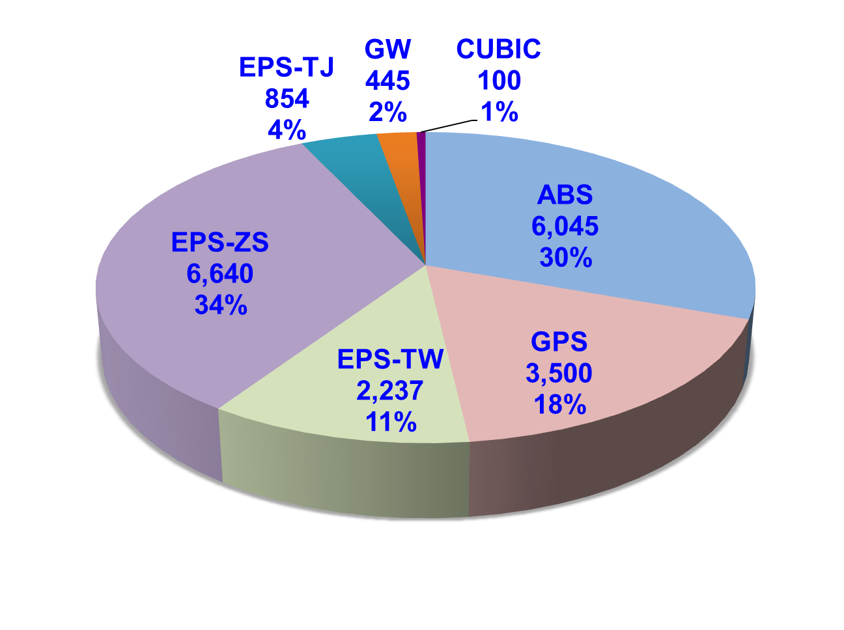
Sales by product - 2017
In millions of NTD

Slide 25
Financial ratio analysis
(Consolidated Statement)

Slide 26
Consolidated Statements of Income
In millions of NTD, except per share data

Slide 27
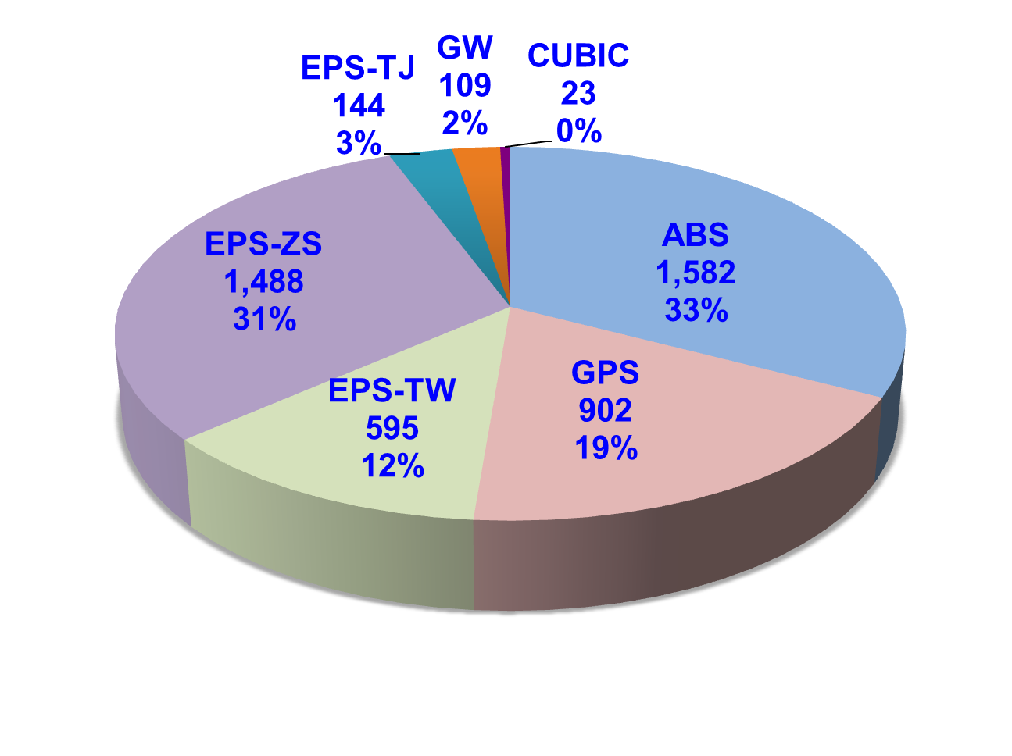
Sales by product - 2018 Q1
In millions of NTD

Slide 28
Taita Chemical Co., Ltd
2018 Investor Conference
Disclaimer
This presentation includes the Company’s current information and any development or adjustments thereof will be published according to laws, regulations or rulings. The Company is not obligated to update or revise this presentation.
The information in this presentation is not for investment advices.

Slide 29
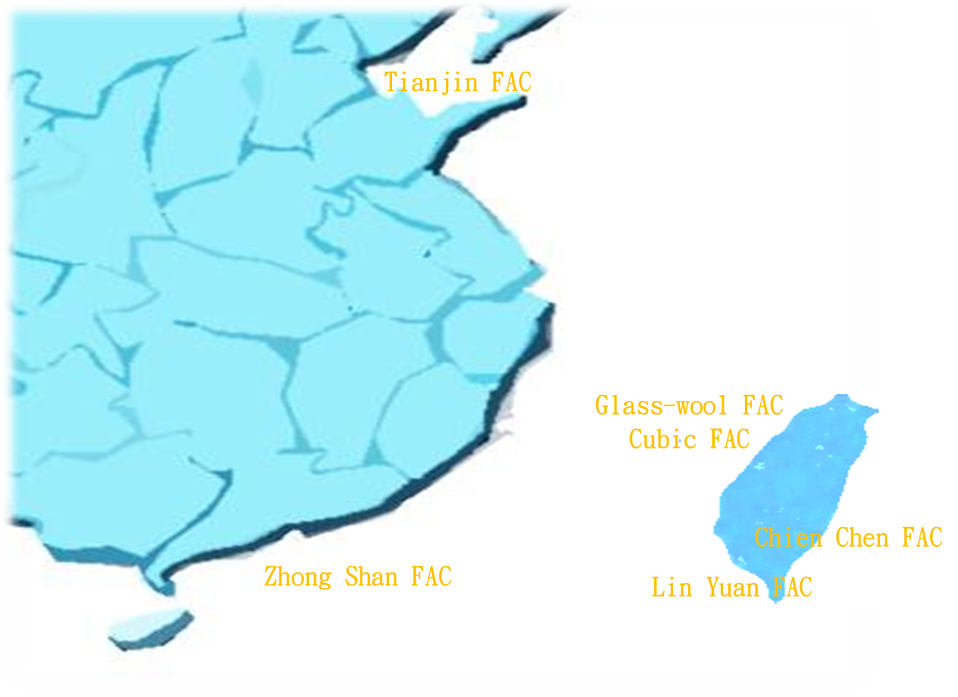
Taita Chemical Co., Ltd
2018 Investor Conference
Q & A
Q & A
Taipei HQ

Slide 30
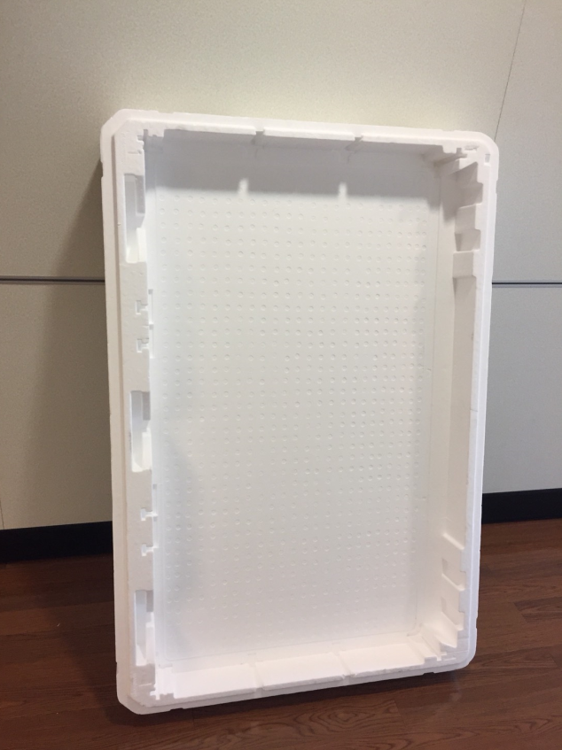
Protection package for TFT-LCD panel
– Anti-static grade EPS

Slide 31
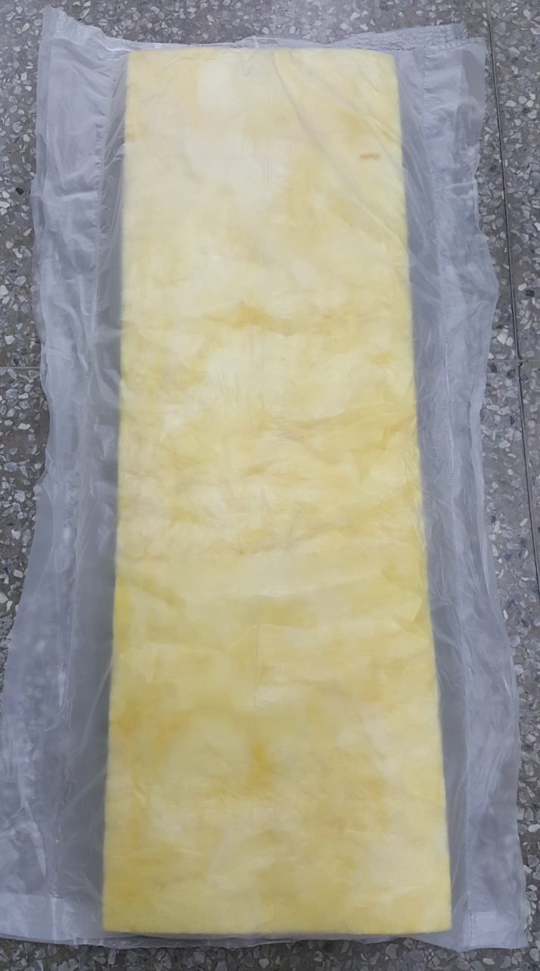
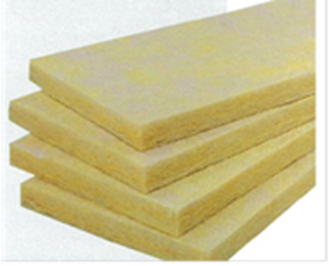

GW new product development- Endcapped sealed glasswool
Naked glasswool endcapped & sealed by PE film。Advantage:
1. Reduce dust.
2. Reduce the pruritus on construction
workers when expose to naked glasswool.

Slide 32
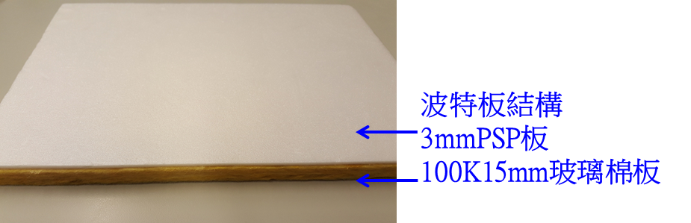
GW new development– Port board floor insulation
Port Board structure
3mm PSP board
100K 15mm glasswool board
1. New revision in Construction Guideline. Insulation for floor impact shall be≧17dB (△Lw≧17dB)，implemented starting 2019/7/1 .
2. Port Board had been tested by Performance Experiment Center, Architecture and Building Research Institute, Ministry of the Interior. Test result shows Impact floor Sound Transmission loss 26 dB (△Lw26dB)

