Slide 1
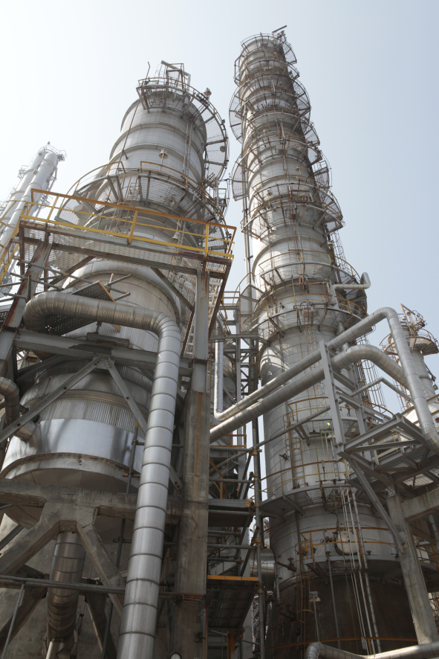
established | 1973
capital | NT 9.27 billion
revenue | NT 11.5 billion (2020Q1-Q3)
employee | 378 (2020Q3)

Slide 2
Disclaimer
The forward-looking statements contained in this presentation are subject to risks and uncertainties and actual results may differ materially from those expressed or implied in these forward-looking statements.
Grand Pacific Petrochemical Corporation makes no representation or warranty as to the accuracy or completeness of these forward-looking statements and nor does Grand Pacific Petrochemical Corporation undertake any obligation to update any forward-looking statements, whether as a result of new information or future events.

Slide 3
Outline
Upstream and downstream products
Market review and prospect
Financial results

Slide 4
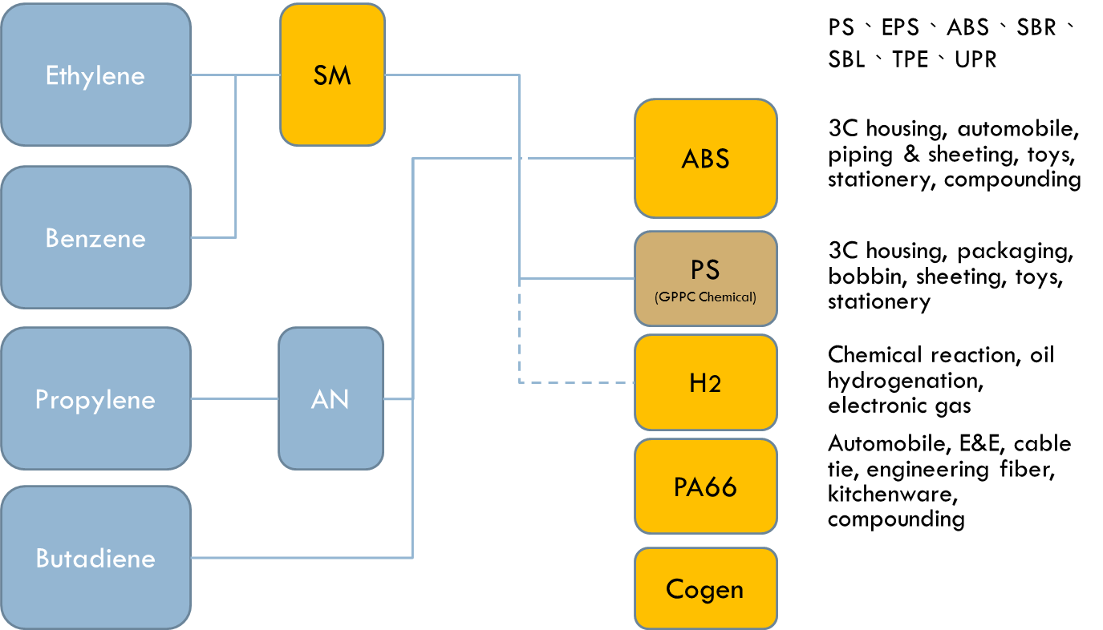
Upstream and downstream

Slide 5
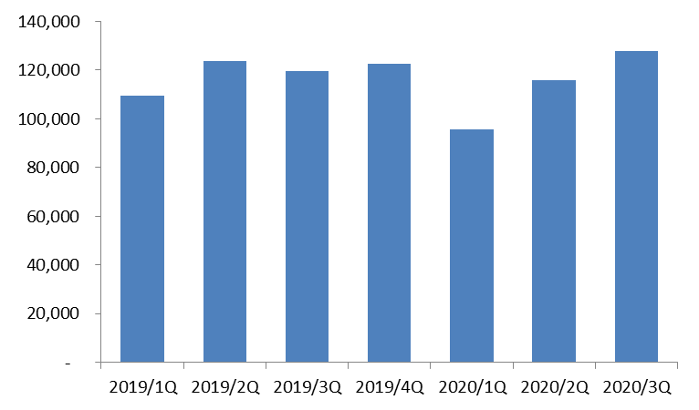
Sales volume(MT)
Cogen products and hydrogen excluded

Slide 6
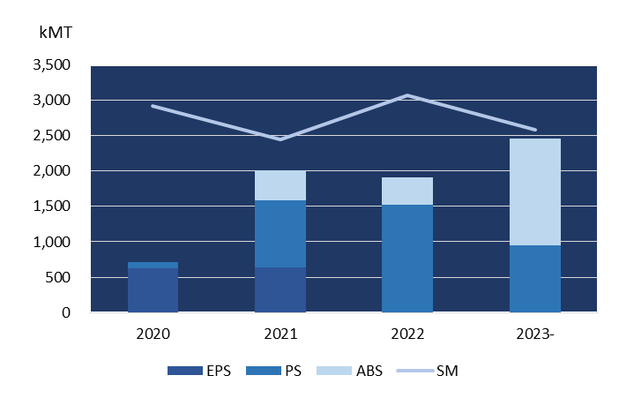
New capacity of SM and major derivatives in China
Capacities in styrene equivalent
Notes:
八月中國出口5000mt sm 到韓國

Slide 7
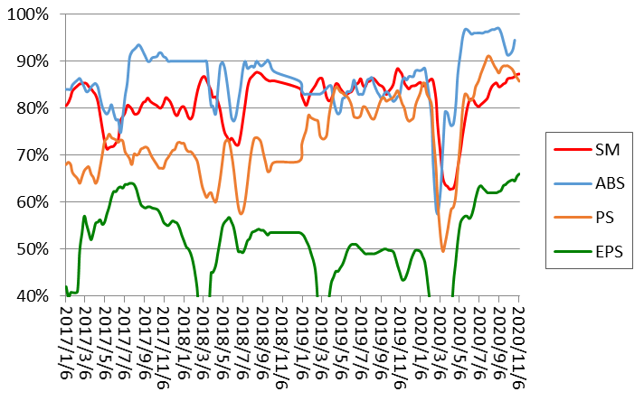
Operation rate of SM and major derivatives in China
4 weeks moving average

Slide 8
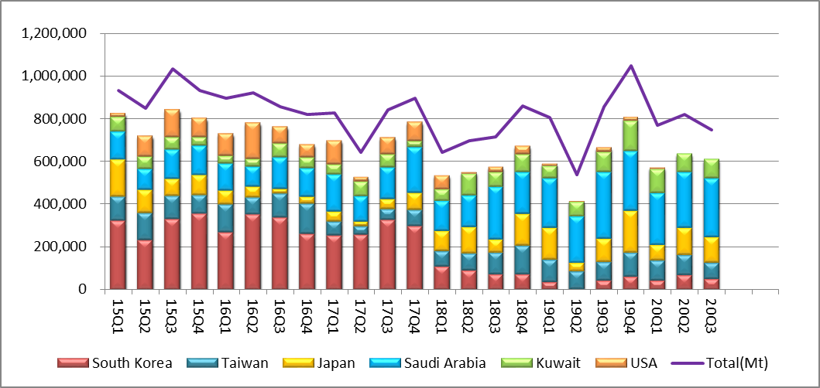
China SM imports, quarterly
China made its first shipment of 5,000MT styrene to South Korea in August.

Slide 9
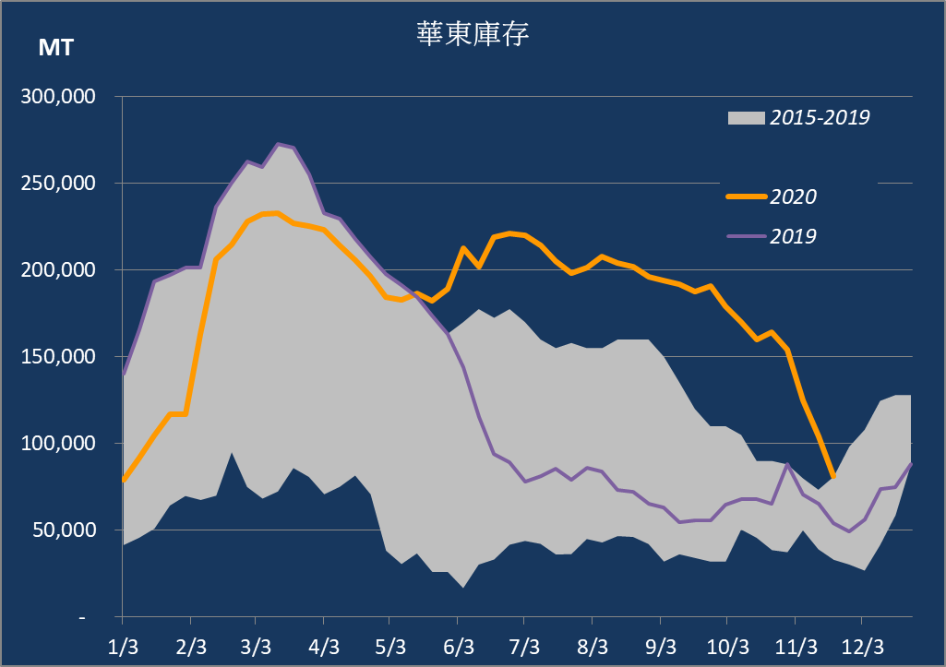
SM trader’s inventory in east China

Slide 10
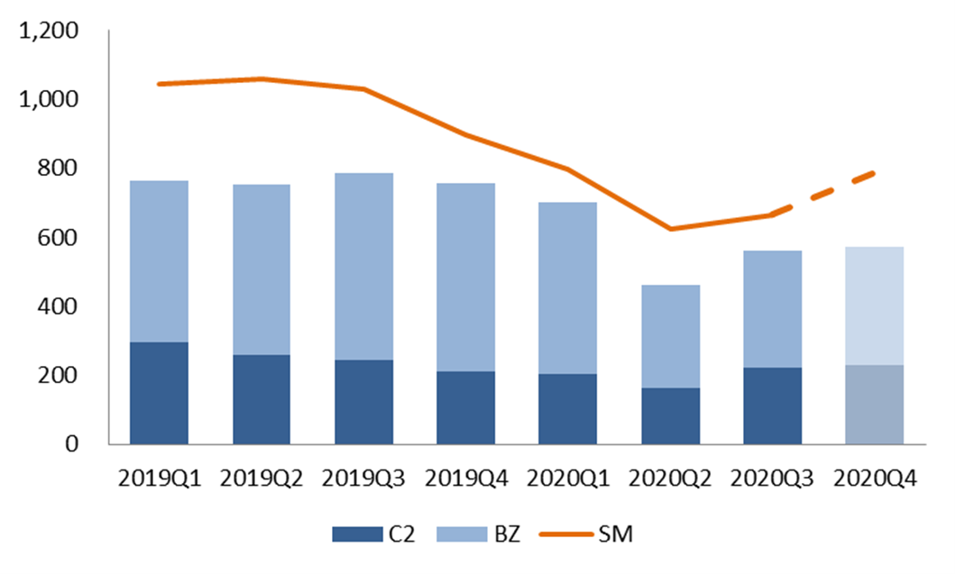
Asian price trend - styrene

Slide 11
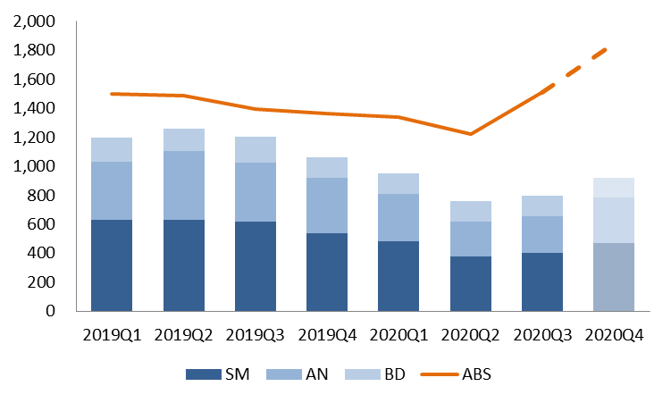
Asian price trend - ABS

Slide 12
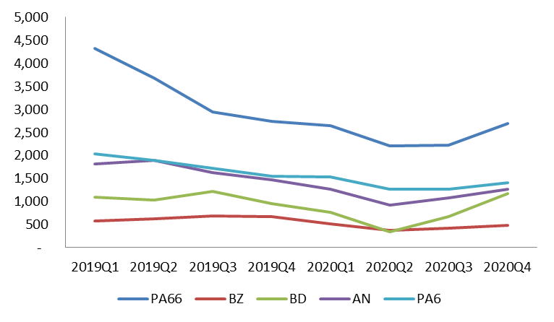
Asian price trend – PA66

Slide 13
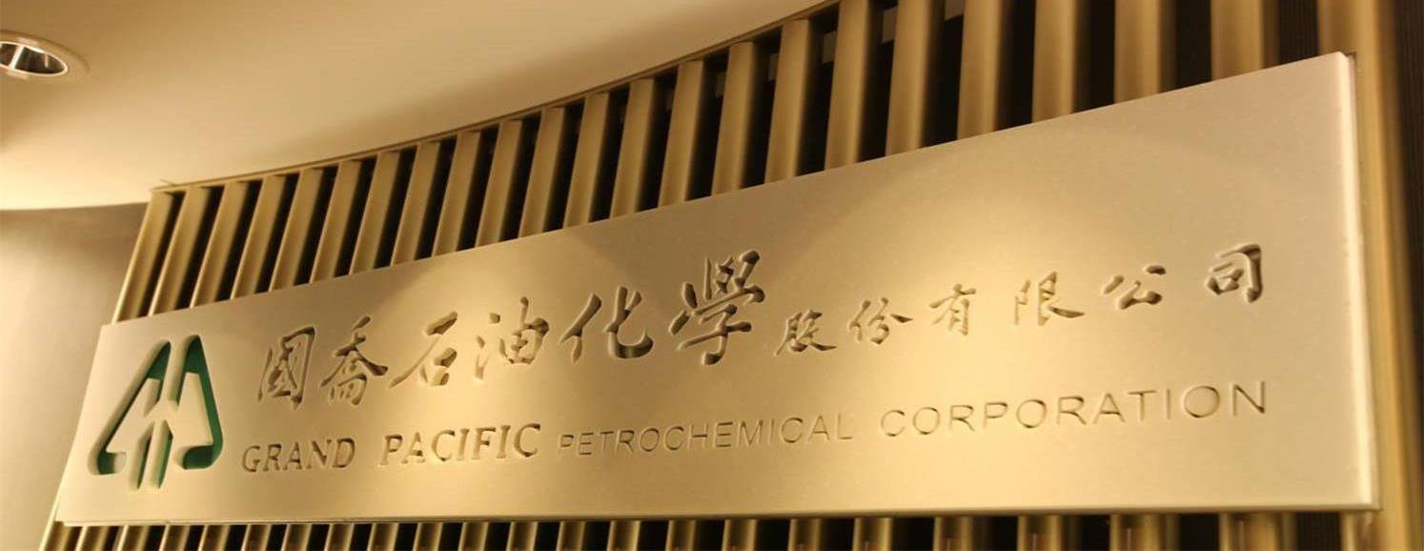
Financial results

Slide 14
Consolidated Statements of Income
(NT$ BN)

Slide 15
Revenue structure
9M20

Slide 16
Financial Analysis

