Slide 1


OCEAN PLASTICS CO., LTD.
2021 Institutional Investor Conference
Reporter: Spokesman Wang Yi-Ho
August 23, 2021

Slide 2
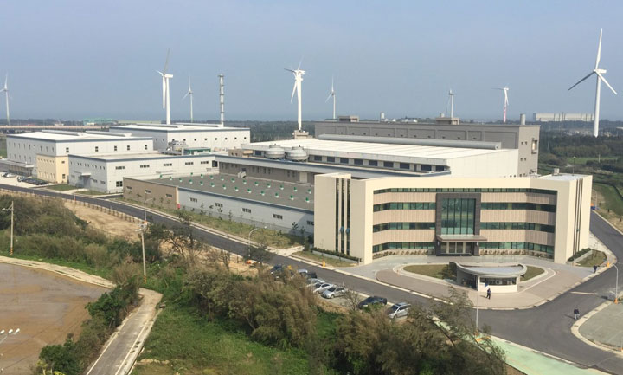
Briefing Outline
Company Profile
2021 Business Unit Operations
Investment benefit
Business performance

Slide 3
Company Organization
Plastic
processing
Unit
Sales
Division-1
Building
materials
Unit
Building
Material
Sales
Hui
Zhou
Factory
Tao-
Yuan
Factory
PU Unit
Dong
Guan
Factory
PVC raw
materials
Unit
Xinwu
Factory
Chung-
Li
Factory
PU
Leather
Sales
Raw
material
Sales
OPC
Tao-
Yuan
Factory-3

Slide 4
Main Products
 | Plastic processing Unit | Building materials Unit | PU Unit | PVC raw materials Unit
Product Category | Transparent film general film rigid sheet and film printing film cellwood | PVC plastic pipe High impact resistant tube, CD flexible tube Impact resistant plate, Foam pellets, Plastic wood composite materials PVC anglewood | Water-based PU synthetic leather, Solvent-free PPU synthetic leather Water-based PU resin, Solvent-free PPU resin, | PVC Resin, PVC Compound, Modified Clear PS Compound, Medical Compound,
Important use | Folders, advertising and label, curtain cloth, Medical treatment and tent, Quarantine station curtain, For ships, restaurants awnings bathroom floor, landscape table | electrical water supply piping Tap water, health sewer works Plastic products injection Indoor and outdoor landscape use | High-foaming, trademark, sports equipment, balls, apparel, furniture and electronic related products (headphone covers, audios, tablet cases) | PVC sheet, PVC pipe, profile extrusion, painting agent, and ink materials. IC package tube Thick transparent PVC pipe

Slide 5
2021 Plastic Processing
Unit Operations
Operation review for the first half of the year | Operation outlook for the second half of the year
 In the first half of 2021, due to the gradual relief of the Covid-19 pneumonia epidemic, demand in Europe and the United States increased, and overall sales significantly better than the same period last year by approximately17%. Subsequent development was affected by the uncertain factors of export cargo space and freight rates, which makes it difficult for customers to respond to the cost and therefore they are conservative, mostly responding with a small number of rush orders.It is estimated that there will be a chance to rebound in the fourth quarter after the settlement of shipping containers and the reduction in freight rates Overall, the second half of the year will be similar to the first half, with no significant peak season effect. Product development and shipment coordination will be enhanced to meet customer demand. |  The second half of the year focused on building material decoration, advertising and super transparent tape for ships, tents, restaurant awnings and personal studios. Customer development has been strengthened. Various uses of medical and super transparent tape have been successively certified and received orders steadily. Shipping space has been obtained at reasonable prices and shipped smoothly, so that the sales performance in the second half of the year can remain stable.

Slide 6
2021 Building Materials
Unit Operations
Operation review for the first half of the year | Operation outlook for the second half of the year
 The number of COVID-19 cases and deaths globally has declined, and international economic transactions have rebounded. Due to the proper prevention of epidemics, the government actively promoted private construction and continuous investment by Taiwanese companies, coupled with high prices of raw materials, resulting in a strong domestic demand, as a result, the building materials market maintained its growth trend in the first half of the year. |  The recovery of the economy in some countries has been affected by the outbreak of mutated viruses and the resurgence of international epidemics.The housing market is slowing down due to the outbreak of the local epidemic and the implementation of a nationwide Level 3 alert, in addition to the interference of policy factors, the market demand is postponed. Therefore, the growth of the economy is expected to slow down in the second half of the year.

Slide 7
2021 PU Unit Operations
Operation review for the first half of the year | Operation outlook for the second half of the year
 The shipment before the Lunar New Year was not smooth, and the epidemic in Europe and the United States improved after the Year, orders for high-foam, trademark, furniture leather, baseball, gloves and resins began to be placed in large quantities.  Development of audio, headphone leather, etc. and towards the additional function of anti-mold, anti-bacterial and biomass materials |  Due to the outbreak of the Asian epidemic, although the demand for environmentally PU leather is currently growing, the development project in the first half of the year is continued, and it is hoped that orders will start in the second half of the year, but the epidemic factor has made the market full of uncertainty.

Slide 8
2021 PVC Raw Material
Unit Operations
Operation review for the first half of the year | Operation outlook for the second half of the year
In the PVC powder market, due to the reduced production of competing manufacturers, the increase in export orders for PVC pellets, and the increase in product unit prices, the revenue and profitability increased. However, the outbreak of variants of COVID-19 in late May resulted in the closure of international cities, affecting the trading market; therefore, orders began to decrease in June. | The COVID-19 epidemic is still subject to many variables in the third quarter, while the unit price of PVC powder and pellets is trending lower as it is at a high point. In addition, orders in the main export markets have shrunk, which is expected to be reversed in the fourth quarter, and the overall forecast for the second half of the year will be remain stable. The demand for the development of customized products of plastic pellets is increasing and the orders of old products are slightly reduced. We will actively develop medical plastic pellets to obtain the quality confirmation from customers, which will help to increase the order capacity in the market.

Slide 9
Business Performance
The last two years’ revenue by product category
Unit: NTD10,000

Slide 10
Business Performance
Consolidated revenue for the last five years
Unit: NTD1,000,000

Slide 11
Business Performance
Consolidated income statement
Unit: NTD1,000
 | 2021(1~6) | 2020(1~6) | Increased (reduced) amount | Change %
Net Operating Revenue | 3,185,808 | 2,168,027 | 1,017,781 | 46.95
Cost of Goods Sold or Manufacturing Costs | 2,961,172 | 1,970,943 | 990,229 | 50.24
Gross Profit | 224,636 | 197,084 | 27,552 | 13.98
Operating Expenses | 234,523 | 157,110 | 77,413 | 49.27
Operating Income (loss) | (9,887) | 39,974 | (49,861) | (124.73)
Non-operating Expense or Loss | 203,303 | 46,968 | 156,335 | 332.85
Profit (loss) from continuing operations before tax | 193,416 | 86,942 | 106,474 | 122.47
Income Tax Expense | 1,088 | (1) | 1,089 | (108,900.00)
Profit (loss) from continuing operations | 192,328 | 86,943 | 105,385 | 121.21
Profit (loss) from discontinued operations, net of tax | - | 341,055 | (341,055) | (100.00)
Net Income(net loss) | 192,328 | 427,998 | (235,670) | (55.06)

Slide 12
Reinvestment benefits
Name of the company | E'DALE TECHNOLOGY CO., LTD.
Service items | 1-Epoxy resin materials for electronic product package 2-Epoxy resin material for IC package
Investment benefit | Profits are stable and an annual dividend will fund the company's working capital

Slide 13
Reinvestment benefits
Name of the company | Chun Pin Enterprise Co., Ltd.
Main business | Warehousing logistics
Service items | 1-Ship loading and unloading service of chemical/oil products 2-Chemical/oil products storage management 3-Chemical/oil products filling tanker operation 4-Pipeline oil transportation 5-Oil products trading and export services
Investment benefit | 1-Rent storage tanks to save raw material shipping costs. 2-It is an equity method investment that recognizes non-operating investment income on a quarterly basis. 3-The profit is stable, and the annual interest rate is paid to the working capital of the company.

Slide 14
Reinvestment benefits
Name of the company | Fuzetec Technology Co., Ltd.
main products | Resettable Fuse (PPTC) Category: plug-in type, cells, chips and customization.
Market application | 1-car electronics 2-Intelligence application 3-Industry 4.0 4-Energy industry
Investment benefit | 1- Has been listed on the OTC, the company has potential benefits. 2- Belonging to a growth enterprise and the profit is stable, and the annual dividend payments are used to the company's non- operating revenues.

Slide 15
Activating Assets–
Zhonghe Land Development Case
Construction position
Sec. 2, Zhongshan Rd., Zhonghe Dist., New Taipei City
Base area
The original land area of 15,730 Pings, after deducting 37% donated land, the actual development area is 9,912 Pings
Construction progress
City planning
Land development
The rezoning of the public works is already completed.
Has signed the co-construction contract with Kingdom Construction Corp.; the development project is currently in urban design review stage carried out in the city government. Construction is expected to start in the next first quarter.

Slide 16

End of this report
Thanks

Slide 17


