Slide 1
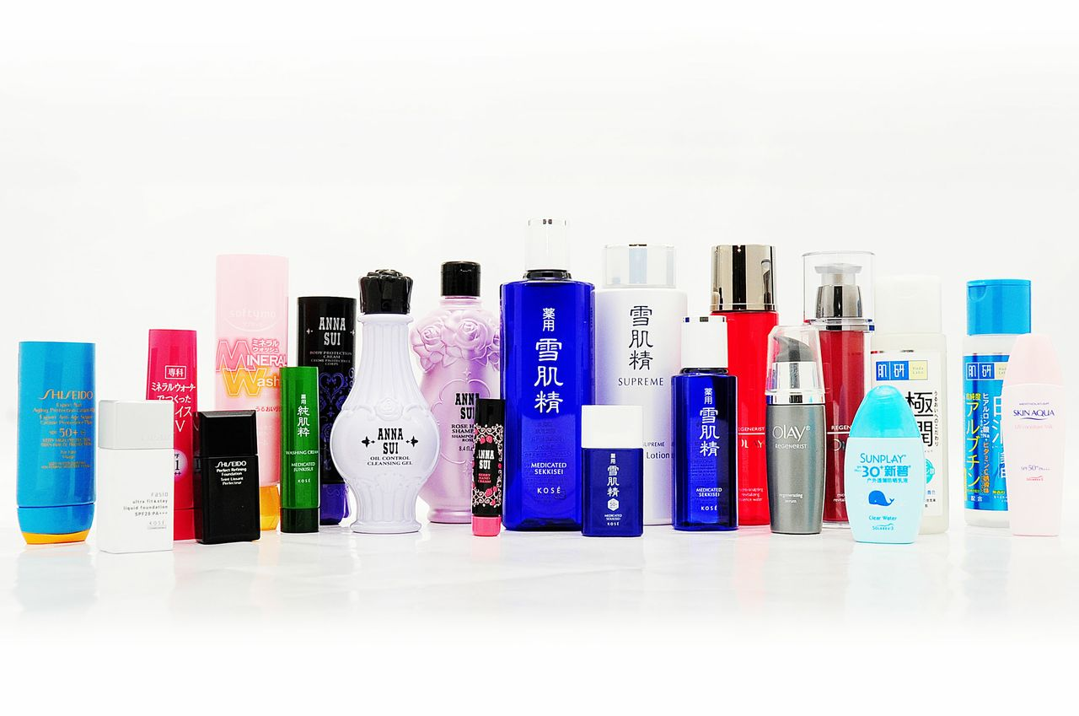
永裕塑膠工業股份有限公司
YONYU PLASTICS CO.,LTD.
股票代號：1323
Investor Conference
Time | Agenda
14:15~14:30 | Online Register
14:30~14:50 | Operation Summary
14:50~15:30 | Q&A (Participants are allowed to ask questions through internet)
2022 November 14th
Creative Innovation、Pursue Excellence、Improving Life

Slide 2
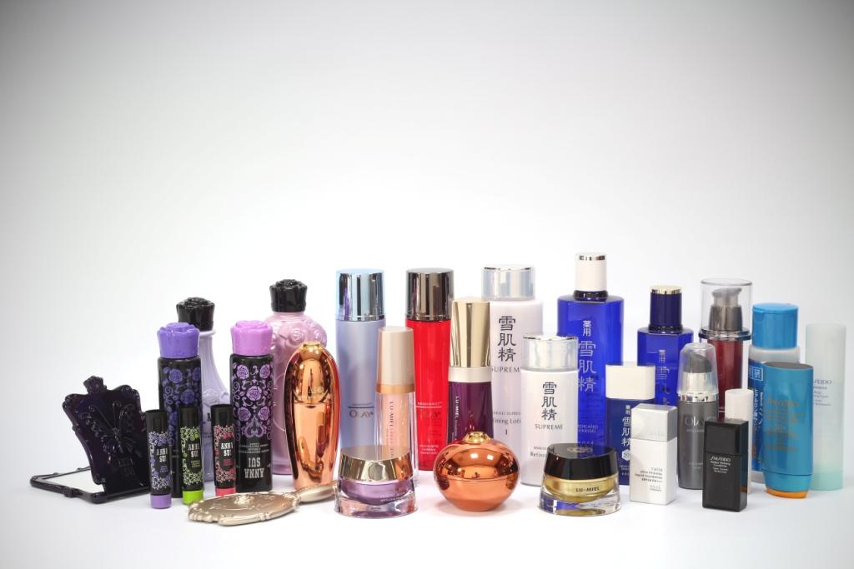
Company Presentation
Company Introduction
Operation and Finance Review
Future Glance
Q&A

Slide 3
Company Overview

Slide 4
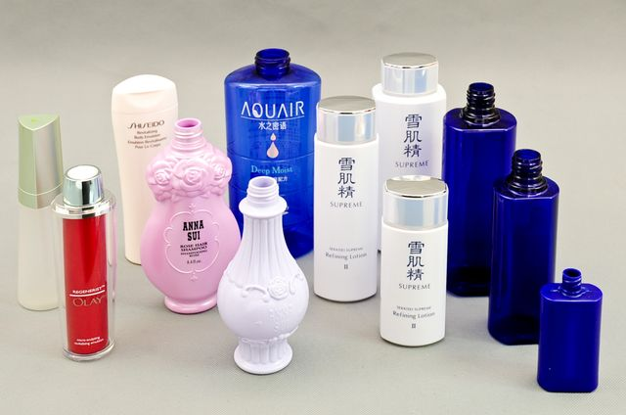
Company Information
Company Established | 1964.05
Capital | NTD$ 913 Million
President | Mr. William Wang
Date of IPO / Stock Code | 1996.07.17 / 1323
Factory Locations | - Rende District, Tainan (24,900 square feet) - Minhang District, Shanghai (33,210 square feet) - Jiashan Xian, Zhejiang (40,030 square feet)(Estimate to go into official operation in the 2023 Q1)
Main products / Revenue percentage / Product application | 1. Plastic Bottle: Taiwan 29% / Shanghai 67%
 | 2. Plastic Cap: Taiwan 36% / Shanghai 25%
 | 3. Plastic Tube : Taiwan 22% / Shanghai 4%
 | Cosmetics, Household goods, Medicines and other Container Packaging.
Total Employees | Taiwan 868; Shanghai 499

Slide 5
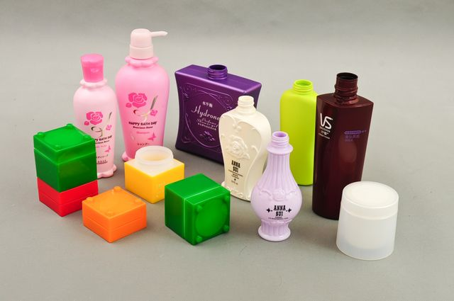
Corporate Organizational Chart
1.31%
YONYU PLASTICS CO., LTD.
32.59%
100.00%
100.00%
100.00%
YONYU CABLE ACCESSORRIES
YONYU APPLIED TECHNOLOGY MATERIAL
YONYU CO.,
LTD (BVI)
WELLMAX BEAUTY LABS
100.00%
100.00%
100.00%
YONYU PLASTICS SHANGHAI
YONYU PLASTICS HUADONG
WECHANGE INTERNATIONAL CO., LTD

Slide 6
Operational Overview

Slide 7
Operations Overview Report ~
Consolidated Sales
Consolidated Overall Sales
 |  |  |  | Unit: Thousand NTD$
 | 2021 |  |  | 2020
 | Sales Amount | Percentage |  | Sales Amount | Percentage
Yonyu Plastics Taiwan | 1,659,345 | 43.69% |  | 1,507,403 | 44.25%
Yonyu Plastics Shanghai | 1,255,209 | 33.05% |  | 1,200,790 | 35.25%
Yonyu Cable Accessories | 863,515 | 22.74% |  | 697,449 | 20.47%
Others | 19,521 | 0.51% |  | 890 | 0.03%
Total Amount | 3,797,590 | 100.00% |  | 3,406,532 | 100.00%

Slide 8
Operations Overview Report ~
Product Distribution
Consolidated Overall Products
Unit: Thousand NTD$
 | 2021 |  | 2020
 | Sales Amount | Percentage | Sales Amount | Percentage
Plastic Bottles | 1,395,068 | 36.74% | 1,256,361 | 36.88%
Injection Parts | 1,602,194 | 42.19% | 1,368,470 | 40.17%
Plastic Tubes | 457,697 | 12.05% | 427,390 | 12.55%
Others | 342,631 | 9.02% | 354,311 | 10.40%
Total Amount | 3,797,590 | 100.00% | 3,406,532 | 100.00%

Slide 9
Operations Overview Report ~
Region Distribution
Consolidated Overall Regions
 |  |  | Unit: Thousand NTD$
 | 2021 |  | 2020
 | Sales Amount | Percentage | Sales Amount | Percentage
Taiwan | 725,513 | 19.10% | 728,532 | 21.39%
China | 1,173,674 | 30.91% | 1,025,477 | 30.10%
US / Europe | 796,584 | 20.98% | 651,056 | 19.11%
Japan | 759,248 | 19.99% | 663,259 | 19.47%
Others | 342,571 | 9.02% | 338,209 | 9.93%
Total Amount | 3,797,590 | 100.00% | 3,406,532 | 100.00%

Slide 10
Financial Summaries

Slide 11
Statement of Comprehensive Income
(Quarterly)
Unit: NT$ thousand
ITEM | 2022Q3 | 2022Q2 | 2022Q1 | 2021Q4 | 2021Q3 | 2021Q2 | 2021Q1
Net sales revenue | 964,512 | 896,161 | 992,715 | 1,035,024 | 992,392 | 940,270 | 829,904
Gross profit (loss) from operations | 224,864 | 189,071 | 218,596 | 235,200 | 241,734 | 236,185 | 201,051
Gross profit margin | 23.31% | 21.10% | 22.02% | 22.72% | 24.36% | 25.12% | 24.23%
Operating expenses | 137,033 | 117,848 | 120,230 | 132,249 | 120,946 | 115,661 | 104,604
Net operating income (loss) | 87,831 | 71,223 | 98,366 | 102,951 | 120,788 | 120,524 | 96,447
Non-operating income and expenses | 15,418 | (5,676) | 11,334 | 5,529 | 1,510 | (4,110) | (6,315)
Profit (loss) from continuing operations before tax | 103,249 | 65,547 | 109,700 | 108,480 | 122,298 | 116,414 | 90,132
Profit (loss) | 77,399 | 48,161 | 85,664 | 88,776 | 91,592 | 96,817 | 67,086
Profit (loss), attributable to:
Owners of parent | 49,650 | 19,090 | 58,109 | 70,540 | 66,802 | 83,024 | 55,929
Earnings per share | 0.55 | 0.21 | 0.64 | 0.78 | 0.74 | 0.91 | 0.62

Slide 12
Statement of Comprehensive Income
(Yearly)
Unit: NT$ thousand
ITEM | 2022Q1-3 | Year 2021 | 2021Q1-3 | Year 2020 | Year 2019
Net sales revenue | 2,853,388 | 3,797,590 | 2,762,566 | 3,406,532 | 3,639,735
Gross profit (loss) from operations | 632,531 | 914,170 | 678,970 | 860,781 | 869,399
Gross profit margin | 22.17% | 24.07% | 24.58% | 25.27% | 23.89%
Operating expenses | 375,111 | 473,460 | 341,211 | 398,898 | 418,385
Net operating income (loss) | 257,420 | 440,710 | 337,759 | 461,883 | 451,014
Non-operating income and expenses | 21,076 | (3,386) | (8,915) | 11,645 | 8,654
Profit (loss) from continuing operations before tax | 278,496 | 437,324 | 328,844 | 473,528 | 459,668
Profit (loss) | 211,224 | 344,271 | 255,495 | 353,094 | 353,283
Profit (loss), attributable to:
Owners of parent | 126,849 | 276,295 | 205,755 | 290,567 | 289,074
Earnings per share | 1.40 | 3.04 | 2.26 | 3.20 | 3.18

Slide 13
Financial Review
(Consolidated Basis)
Unit: NT$ thousand
Item | 2022/9/30 | 2021/12/31 | 2020/12/31 | 2019/12/31
Total liabilities | 2,827,822 | 3,001,749 | 2,892,010 | 2,757,468
Total assets | 5,665,147 | 5,728,613 | 5,473,347 | 5,126,573
Liabilities/assets ratio | 49.92% | 52.40% | 52.84% | 53.79%
Total equity attributable to owners of parent | 2,382,792 | 2,319,999 | 2,207,100 | 2,022,047
Number of shares | 91,274,554 | 91,274,554 | 91,274,554 | 91,274,554
Book value per share | 26.11 | 25.42 | 24.18 | 22.15

Slide 14
Dividend Payout
Unit: NT$ per share
Earning payout ratio | 53% | 50% | 50% | 54% | 47% | 58% | 61%
Cash dividend payout ratio | 53% | 50% | 50% | 54% | 47% | 58% | 61%

Slide 15
A look into the Future

Slide 16
Production and Marketing
Production Policy：
Production and detection automation to lower rising labor costs.
Reinforce the effective management of reducing carbon emissions and water resource management. Regularly hold the water-saving meeting.
Keep promoting TPM. Focus on energy management to reduce carbon emissions and avoid dust attachment to reduce the manufacturing cost overall.
Plan to expand the lights-out factory of the fully automatic manufacturing process to increase the output and enlarge Yonyu in the plastic packaging market in China.

Slide 17
Production and Marketing
Production Policy：
Development of packages with organic and degradable material, and meeting global environmental protection regulation. Following the new 2025 environmental protection regulations, A new product line has been developed and being mass-produced in 2021.
With the eco-friendly packaging materials being mass produced, introduce the peripheral equipment and machines to increase the production efficiency.

Slide 18
Production and Marketing
  Marketing Policy：
      Invest in the packaging market of high-end medicine and apply for the related certifications.
      Expanding the packaging market of high-end cosmetic.
      Promote sales in e-channel with the development of skin analyzing device
      Reinforce the promotion of the nano carbon fiber’s application.
      Strengthen the sales of high-end masterbatch.
      Manage the marketing services for Arimino Japan in Taiwan.

Slide 19
Future Plans
Multilayer product development, secondary process innovation and patent filing.
GMP grade pharmaceutical and skin care packaging product research and development.
Standardize the production procedure for naturally extract products and continuous development on herbal based cosmetics.
Develop oversea customers, increase sales, promote product popularity
Training programs for high level managers.

Slide 20
Future Plans
Combination of self-developed skin test device and skin care products researched by wellmax.
Expand the business opportunities of medicine and entertainment industry’s packaging.
Development of high value-added product.
Development of packagings for Biochemical testing.

Slide 21
6 Key Corporate Practices
Innovation Development：Yonyu provides expertise in plastic resin development and new material research.
  Develop high quality cosmetics, household goods, medicines and other container packaging. That will increase and strengthen customer’s business opportunities and create future benefits.
  Strengthen the technical capability of secondary process and strong partnership bonding with customers.
  Innovations that will boost company growth and visibility, and improve the ratio of high value products.

Slide 22
6 Key Corporate Practices
One-Step Service：Integrate all the production techniques in one-step, such as masterbatch sales, mold design, molding, secondary process, cosmetic filling.
  Innovate manufacturing process to improve the quality of packaging, special color, and make the product easy to use.
  Based on the advantage of one-step production, Yonyu could provide customers comprehensive and instant service.
  The new Huadong Yonyu(華東永裕) plant in Jiashan, Zhejiang(浙江嘉善) is estimated to go into operation in first half of 2023. Hope it also could mark a milestone in the Yonyu’s history.

Slide 23
6 Key Corporate Practices
Lean Management：Improve quality and efficiency and create benefits through effective managing.
  Accelerate the automation of key process, JIT one stop service production mode, improve inventory turnover efficiency to meet urgent delivery demands oversea.
  Reshape the corporate structure and improve overall business performance through target/cost management and TPM.
  Application of the PLM (product lifecycle management) system and data management will help increase the efficiency of customer service and reduce production costs.
  Improving the efficiency of cost, quality, service, response, intelligent production with the newly implemented corporate ERP system.

Slide 24
6 Key Corporate Practices
Carbon Reduction：Uphold environmental and social responsibility, green business management.
  Consistently improve the performance of carbon emission and carbon footprint reduction, with the water resource management implemented together, increase the efficiency of the consumption of each energy resource .
  Replace the old, energy intensive machine with new, low power consumption ones for better energy management.
  Installing the system of solar energy generating in the factory; introducing the green energy gradually.

Slide 25
6 Key Corporate Practices
Ecological Sustainbility：Display Yonyu’s core competency to combine the company’s sustainable growth with environmental responsibility to meet the global trend of ESG.
  Green Marketing – Keep sharing Yonyu’s innovation results with customers, such as the development of Bio-based materials, PCR composite materials, carbon-reduction composite materials, weight-reducing bottle, and alternative materials. Some of such products have been mass produced and delivered to the customers.
  ESG Added-Value – By developing the product differentiation in the environmental-protection area, fight for the recognition of the clients with close ideas. With ESG as the premise ahead, improve the management on environmental responsibility, corporate benefits, and social responsibility.
  Green Material – Keep developing the quality of Nano carbon fiber and expand the application of various lithium battery to re-create a eco-friendly living surrounding.

Slide 26
6 Key Corporate Practices
Healthy Life：Integrate the group resources. Focus on medical and high-end health care marketing opportunities.
  Connect to the market in Beauty Industry –
    Establish skincare e-commerce system and building up self-own brand. Focus on costumer interaction with development of skin test devices. And manage marketing service for the salon brand.
  Bio-Tech Business Opportunity –
    Improve productivity and production efficiency for GMP packaging plant and try to open up the market of animal vaccine and biochemical testing packaging. Work with customers on development of pharmaceutical packaging for daily use.

Slide 27
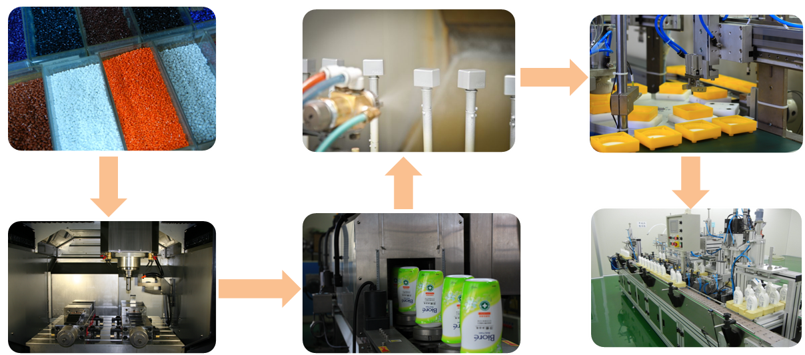
One Stop Service
Masterbatch Develop and Sales
Decorative Applications
Automated Assembling
Mold Design / development
Plastic Molding process
Cosmetic Formulation Development and Filling

Slide 28
General Disclaimer
The company does not provide financial forecasting. All of the financial, business and Q&A statements provided in the presentation are expectations solely based on the current operational status and may differ from actual results in the future. The company, stakeholders, and representatives are not responsible for any loss that is caused relevant to the above presentation information.
With the exception of court order, the company is not obligated to update any new information or remind anyone of any corrected statements that may or may not be generated from future unknown events.
The presentation provides a vision for future operations and should be a reference only. Please also refer to official public reports and other authorized statements.

Slide 29
永裕塑膠工業股份有限公司
YONYU PLASTICS CO.,LTD.
Stock Code：1323
Thank You
Q&A
Creative Innovation、Pursue Excellence、Improving Life

