Slide 1

Shinkong Synthetic Fibers Corporation
2022 Investors’Conference
Date：2022/08/30

Slide 2
Disclaimer
Shinkong Synthetic Fibers Corporation does not release any financial forecast. However, the statement of the company’s business, finance condition and Q&A in this presentation may differ from future actual results. This causes from market demand, prices fluctuations, competitions behavior, global economic situations, exchange rate fluctuations, supply chain and other factors or risks beyond the company’s control.
Future prospects in this presentation reflects the company perspective based on the condition until now. If any change or adjustment of views later in the future, the company undertakes no obligation to update.

Slide 3
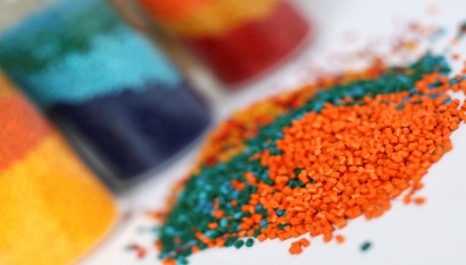
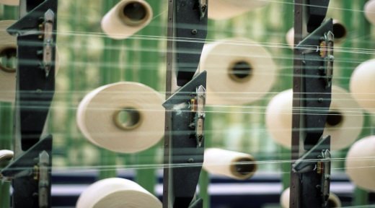

SSFC Major Business
Plastics
Fibers
Optronics
Main Enterprises：
1.SSFC
2.Pan Asian plastics
3.TSIC
4.Xinguang applied materials
Main Enterprises：
1.SSFC
2.Shinpont Industry
Main Enterprises：1.Shinkong Materials Technology
2.Ubright Optronics Corp.
3.Tacbright Optronics Corp
Main Products：
PET Resin、Advanced Materials-Engineering Plastics/
Thermoplastic elastomer、
PET Sheets、PET Bottle /Preform
Main Products：
PET Resin、 POY、DTY、Industrial Yarn、PSF、Spandex
Main Products：
Pet Films 、 Optical Films、Brightness Enhancement Film、Release Film、TAC Film
2021 Revenues ratio
58 %
23 %
19 %

Slide 4
PET Resin
PET Bottle
(preform)
Carbonated drink
Drinking water
Heat-resistant
Eco-PET Resin
None Heavy Metal
Energy Saving
Bio PET
PCR rPET
PET Sheet
Food Electronics
Medical
Printing
  Food grade
CPET
P E T
PET Resin
Aseptic
Hot-filling
Low AA
Modified PET Resin
Low Melting Point
High Heat-Resistant
High Transparency
Film Grade PET Resin
High Transparency
Dimensional Stability

Slide 5
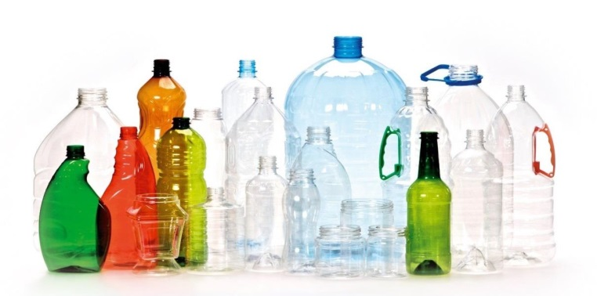
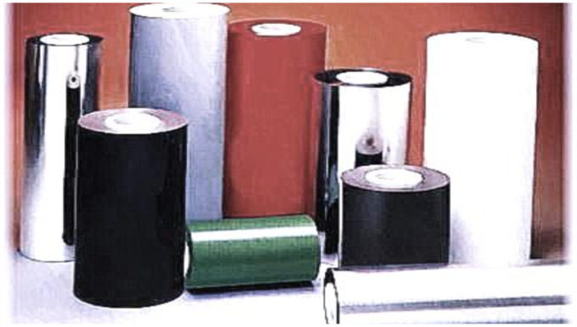



PET bottle(preform)、PET Sheet
PET preform and sheet production
Upstream & downstream integrated
and value added
PET bottle
Supply drink makers
PET preform
Supply drink makers
PET Sheet
Electronics and Medical applications

Slide 6




Engineering Plastic-Key Products
High-Value Modified Plastics
Foam Applied Materials
Advanced Materials-
Key Products
Thermoplastic Elastomer
Materials
Sustainable Materials,
Biodegradable Plastics

Slide 7
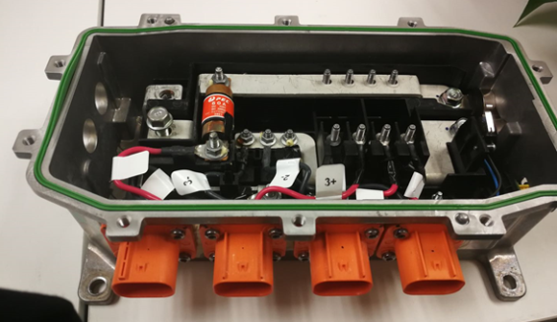
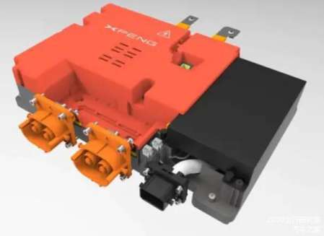
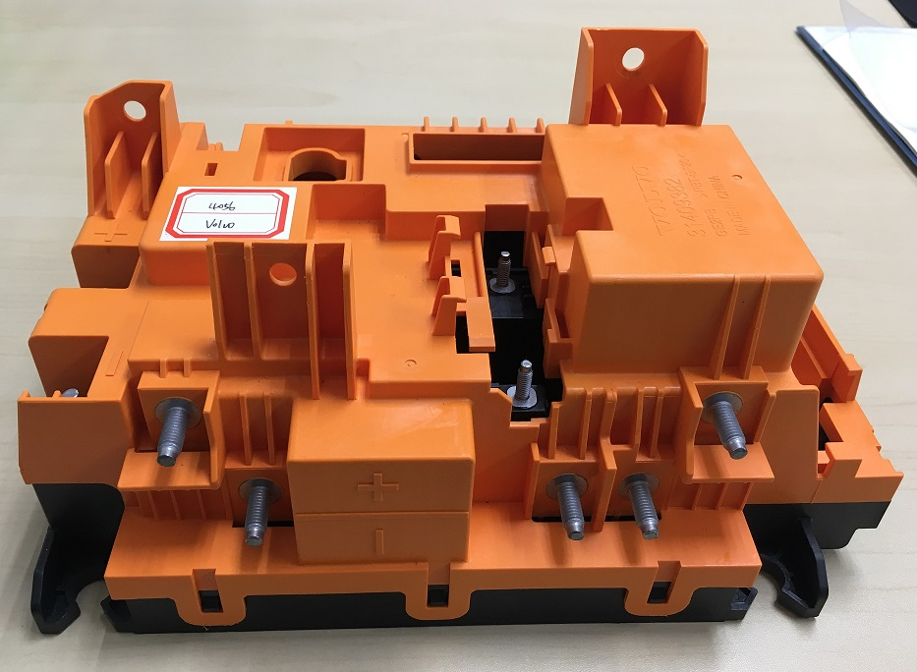
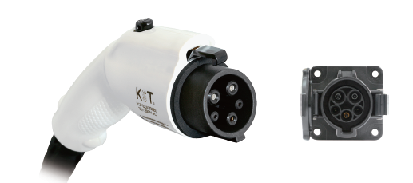
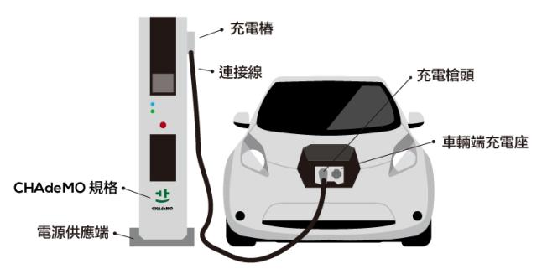
High-Value Materials –
New Energy Vehicles System and plications
OBC Connector
BDU SHELL

Slide 8

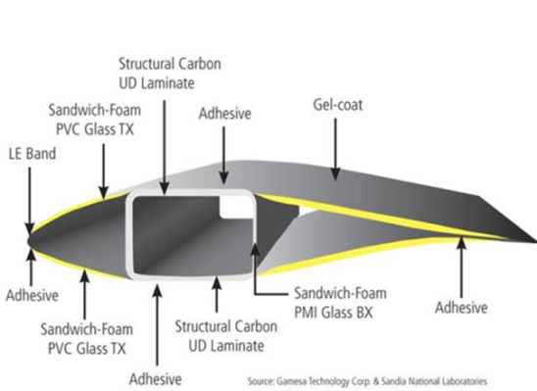
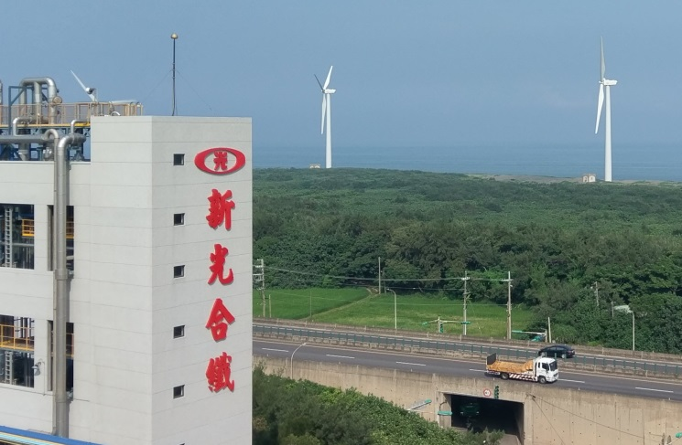
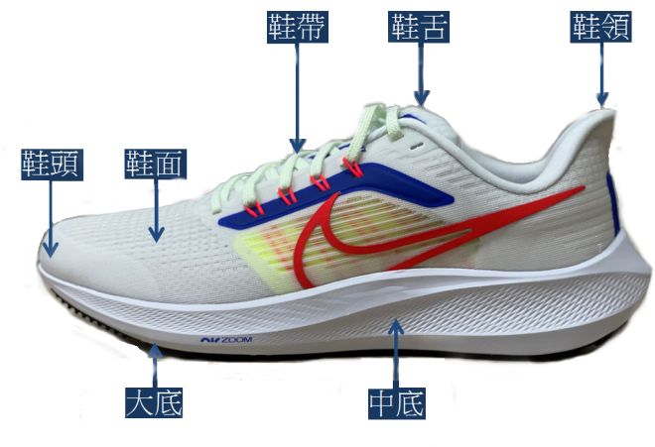
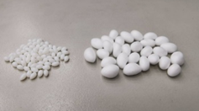
Foam Applied Materials
1
Wind turbine-blade
material
2
Light weight
structural materials
Reduce CO₂ Emission
3
Sneakers insole use

Slide 9
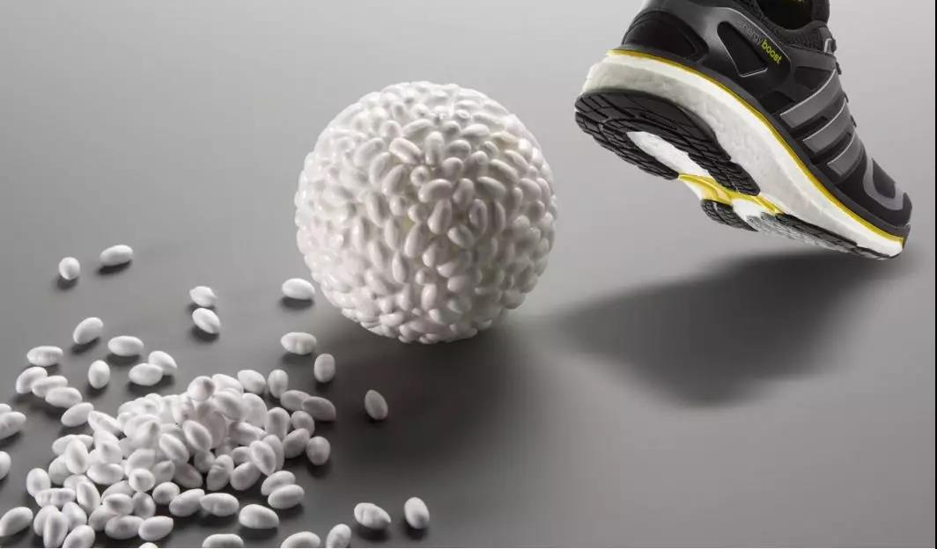
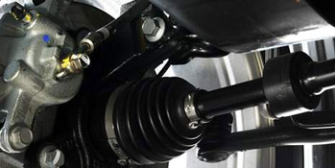
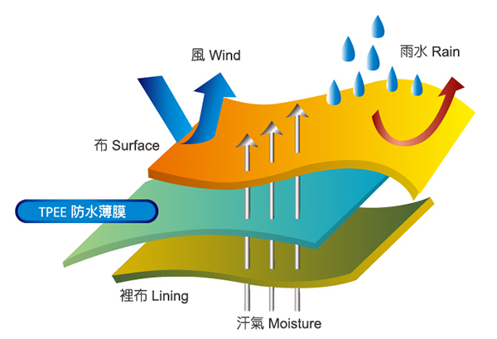
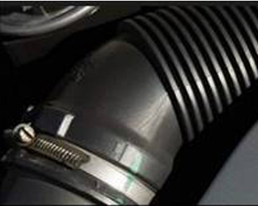
Thermoplastic Elastomer : TPEE
Polymeric Foam、
Breathable & Water Proof Membrane、CV Joint Boot

Slide 10
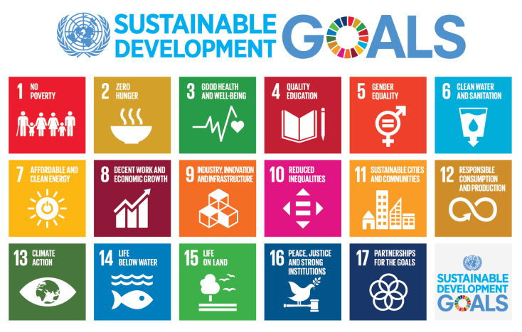
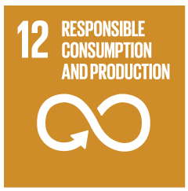
Sustainable Materials
Recycled - PET, PBT, PP, TPEE
Bio - PET, PBT, TPEE
Bio Degradable - PBAT, PBS
Raw Material from
Carbon Capture
The 12th SDGs target is "Responsible Consumption and Production“
Through prevention, reduction, recycling and reuse, reduce waste generation to achieve sustainable development.

Slide 11
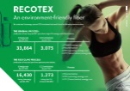

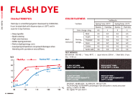
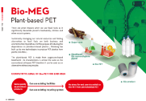
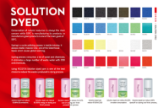

Filament Yarn
Recycled polyester
Solution dyed polyester
Bio base polyester
Bio degradable polyester
Low temperature dyeable CD
Spinning and Texturizing in Vietnam
Recycled chips for fiber grade in Taiwan
Garment recycling polyester
Cutting waste recycling project
MEG from C02 emissions capturing
TPEE
Vietnam expansion
Aligned supply chains (chips , spinning ,knitting )

Slide 12
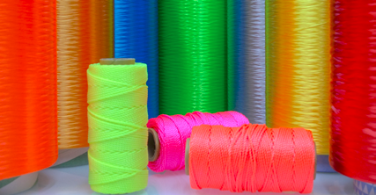
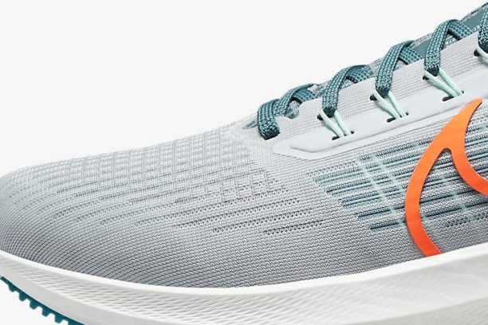
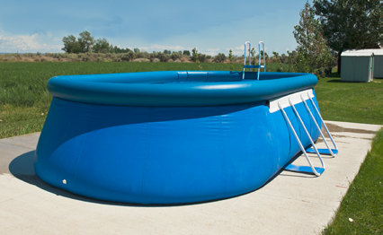
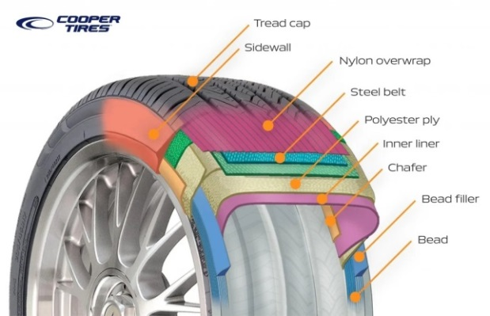
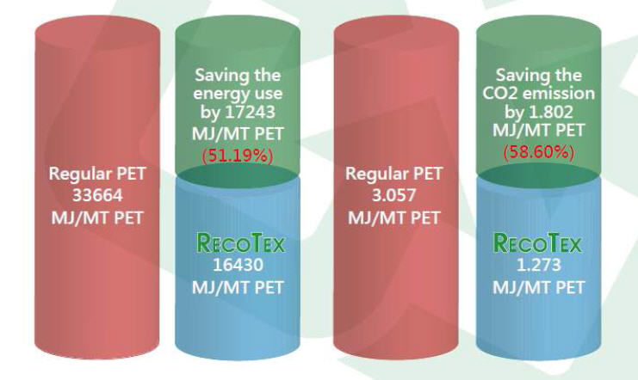
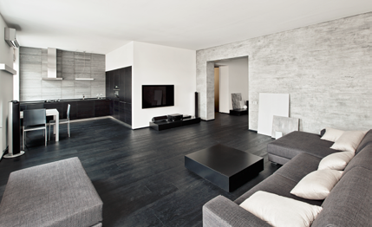
HTY
High Tenacity Dope Dyed Yarn
Engineered Mesh Yarns
High Tenacity
Anti-wick Yarn
HMLS tire cord yarn
Eco-friendly
High Tenacity Yarn
(RecoTex)
Flame Retardant
Industrial Yarn

Slide 13



SSFC Business Policies
Sustainable Development
Green Guarantee
Sincere Care

Slide 14


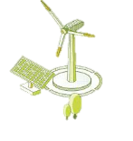

How to Reach Net-Zero Emissions Goal
By 2050 the Net-Zero Emissions is Not a Single Solution
Fuel
Low-carbon energy transition ---
Replace coal-fired with natural gas, promote biomass fuels.
Process energy conservation and carbon reduction---
Improve energy efficiency, save energy, and reduce carbon emissions by changing process and raw materials.
Process
Increase the proportion of renewable energy use --- Develop green electricity(Construction of solar and wind power plants)
Green Electricity
New Technology
Other new carbon reduction technologies---
Develop hydrogen energy, Carbon Capture and Utilization & Carbon Capture and Storage technology.

Slide 15
SSFC Pathways to Reduce
Carbon Emissions
The Carbon Reduction Trend of SSFC Group
SSFC Group's Carbon Reduction Target
Base Year : 2021
Target :2025 minus 7%
2030 minus 22%
2050 carbon neutral
Base year 2021
2025
-7%
2030
-22%
Using low-carbon energy, replace coal-fired with natural gas.
Total carbon reduction
(Tons/yr)
Develop green electricity and reduce gray electricity consumption.
Develop hydrogen energy,
Carbon Capture and Utilization & Carbon
Capture and Storage technology.

Slide 16
SSFC Net Zero Carbon Emissions Countermeasures
Planning schedule
Carbon reduction target | 2% off every year | 3% off every year | 3.9% off every year
Key method | Converting coal-fired boilers to gas to reduce carbon emissions. Purchasing green electricity Process improvement and equipment replacement Promote intelligent production process Drive product carbon footprint. | Invest in wind and solar power. Introduce new carbon reduction technologies. Develop green products with low energy consumption. Purchasing green electricity | Equipment electrification, development Hydrogen energy to replace fossil fuels. Invest in CCUS (carbon capture utilization and storage) technology.
2022~2025
2026~2030
2031~2050

Slide 17
Business Strategy for 2022
1. ESG sustainability
2. Intelligent Manufacturing
& Digital Transformation
3. R&D reinforcement
4. Capacity Expansion
5. Net Zero &
Circular Economy
6. Multiple Employment Training

Slide 18
2021、2022 Revenue
Announcement Comparison

Slide 19
Five-Year Financial Statement
（In Millions of New Taiwan Dollars）
 | 2017 | 2018 | 2019 | 2020 | 2021
Total Revenues | 36,537 | 42,494 | 34,791 | 32,129 | 44,155
Net Profit | 1,130 | 2,862 | 2,251 | 3,640 | 4,805
Profit Margin | 3.09% | 6.74% | 6.47% | 11.3% | 10.9%

Slide 20
2021 H1、2022 H1 Comparison
（In Millions of New Taiwan Dollars）
 | 2021 H1 | 2022 H1 | +/- %
Total Assets | 186,683 | 187,275 | 0.3%
Total Liabilities | 143,861 | 142,673 | -0.8%
Total Equity | 42,822 | 44,602 | 4.2%
Revenues | 21,027 | 24,651 | 17%
Net Profit after tax | 2,218 | 2,187 | -1.4%
Attributed to :
Owners of the Company | 1,799 | 1,695 | -5.8%
Non-controlling interests | 419 | 492 | 17%
EPS（In NT$） | 1.11 | 1.05 | -5.4%

Slide 21
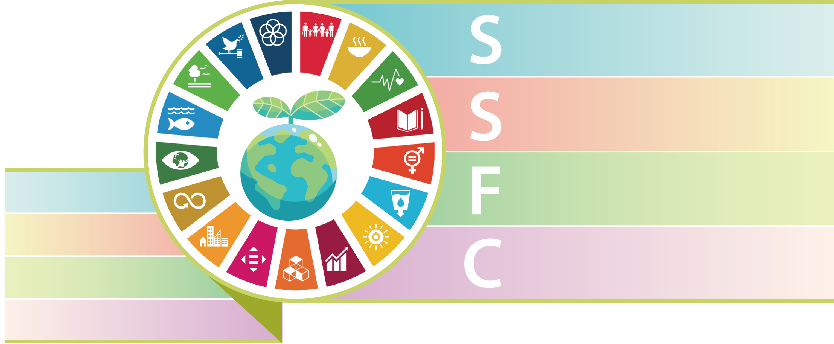
Prospect
Innovation, Intelligence, Sustainability, and Caring
Sustainable growth
永續成長
Smart factory
智能工廠
Friendly green product
綠色產品
Caring society
關懷社會

Slide 22
Q & A

