Slide 1
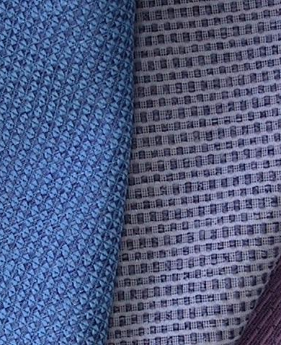

2024
Investor Conference
Nov. 19 , 2024
UNIVERSAL TEXTILE CO., LTD. Code：1445

Slide 2
Disclaimer
The information contained in this presentation includes materials of the company overview, financial figures, future plan and etc.
The Company has not issued a financial forecast, the information contained in this document regarding the Company's financial, Business, Q & A description involved in the future business and industry development . The views of the exhibition may differ from the actual results of the future. This difference reasons may include changes in market demand, price fluctuations, competitive behavior, the international economy status, exchange rate fluctuations, upstream and downstream supply chain and other various risk can not grasp by the company.
The future of this document reflects the company's view of the future. If any of these changes or adjustments in the future, the company is not responsible for remind or update.

Slide 3
Agenda
Company Profile
Business Operations
Financial Summary
The Outlook
Q&A

Slide 4
Company Profile
Inception 1969/9/12
Capital NTD1.306 billion
Chair man Mr. Chen,Yao-Ming
President Mr. Yang,Ren-Kai
Date of Listing 1991/2/5
Headquarters 7/F 62-5 SINING N. ROAD, TAIPEI
TAIWAN R.O.C.
Factory Weaving：300 looms
(Capacity:1,800,000 yards/month)
Spinning：16 textured machines
(Capacity:1,300 ton/month)
Employees 300
Main Products Polyester filament woven fabrics
Polyester draw textured yarn (P-DTY)
Market Fabrics: 90% for export sales
Textured yarns: 99% for domestic sales

Slide 5

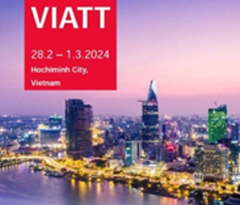
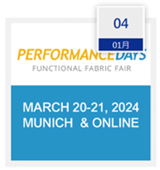


Business Operations
SOURCING at MAGIC LV
2/13-2/15
Texworle Vietnam Feb
2/28-3/1
PERFORMANCE DAYS
3/20-3/21
Techtextil texprocess
4/23-26
PanTextiles Tokyo
5/22-23

Slide 6
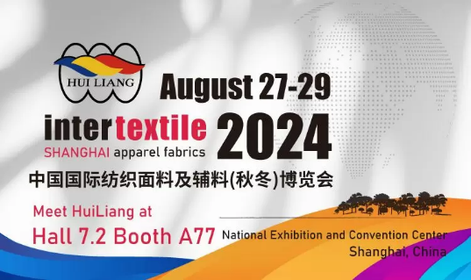
Business Operations
Inter textile SHANGHAI
8/27-8/29
automechanika Frankfurt
PanTextiles Osaka
SOURCING at MAGIC AUGUST
8/19-8/21
9/10-9/14
10/30-10/31

Slide 7
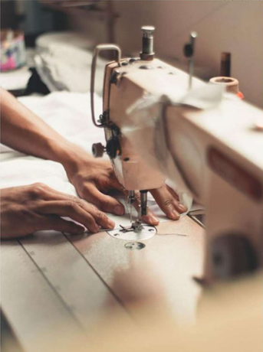
UNIVRESAL TEXTILE X NANAO TOWNSHIP OFFICE
Strengthen community ties, cultivate local sentiment
Preserving cultural heritage.
Mutual benefit and weaved into common good.

Slide 8
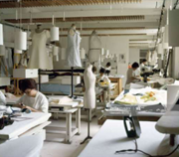
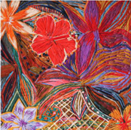
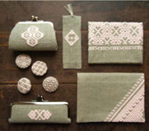


Project Phrase Planning
1. Establish Community Sewing Studio
2. Cultural Heritage Preservation and Promotion Workshop
3.Blending traditional culture with contemporary design for local products

Slide 9
Project Phase Planning
2024. September
1.9/6 First Visit
Nan-ao Township Office.
2. Proposal for Collaboration between UNIVRESAL TEXTILE and Nan-ao.
3. Proposal Revision.
4.Project Confirmation and Signing of the Cooperation Agreement.
2024. October
1. Project budget and related collaboration discussions.
2.Official project launch.
3. Event planning.
4. Localized product development and planning.
2024. December
1. UNIVRESAL TEXTILE and Nan-ao product first wave testing.
2. UNIVRESAL TEXTILE and Nan-ao product development and sample making.
3. Market testing
4. Sales channels
2024. November
1.Product design execution.
2. UNIVRESAL TEXTILE and Nan-ao sewing classroom trial operation.
3. UNIVRESAL TEXTILE and Nan-ao
textile art workshop.
4. Textile Art Workshop.
5. Annual textile art exhibition planning.

Slide 10
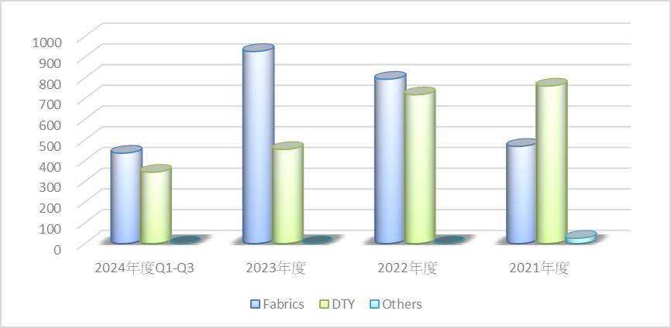
Revenue
Unit：NTD millions

Slide 11
Market Distribution 2024
Market Distribution

Slide 12
Simplified Income statement
 | 2024Q1~Q3 | 2023 | 2022 | 2021
Net Revenue | 780 | 1,381 | 1,511 | 1,254
Cost Of Revenue | -706 | -1,195 | -1,392 | -1,259
Gross Profit | 74 | 186 | 119 | -5
Gross Profit Rate | 9.5% | 13.5% | 7.9% | -0.4%
Operating Expenses | (127) | (262) | (153) | (43)
Income From Operation | (53) | (76) | (34) | (48)
Non-operating Income And Expenses | 39 | 1,132 | 28 | 26
Income Tax Expense | (1) | (48) | 17 | (3)
Net Income | (15) | 1,008 | 11 | (25)
Net Income Rate | -1.9% | 73.0% | 0.7% | -2.0%
EPS | (0.12) | 7.72 | 0.08 | (0.19)

Slide 13
Balance Sheets
Unit：NTD millions | 2024Q3 |  |  | 2023 |  |  | 2022 |  |  | 2021
Assets | Amount | % |  | Amount | % |  | Amount | % |  | Amount | %
Cash & Marketable Securities | 1,264 | 46% |  | 1,786 | 58% |  | 609 | 29% |  | 448 | 22%
Accounts Receivable | 165 | 6% |  | 186 | 6% |  | 195 | 9% |  | 233 | 12%
Inventories | 376 | 14% |  | 345 | 11% |  | 403 | 19% |  | 384 | 19%
PP&E | 656 | 24% |  | 670 | 22% |  | 804 | 38% |  | 836 | 42%
Other | 264 | 11% |  | 117 | 3% |  | 120 | 6% |  | 109 | 6%
Total Assets | 2,725 | 101% |  | 3,104 | 100% |  | 2,131 | 101% |  | 2,010 | 101%
Liabilities
Current Liabilities | 277 | 10% |  | 317 | 10% |  | 347 | 16% |  | 202 | 10%
Noncurrent Liabilities | 88 | 3% |  | 93 | 3% |  | 151 | 7% |  | 162 | 8%
Total Liabilities | 365 | 13% |  | 410 | 13% |  | 498 | 23% |  | 364 | 18%
Total equity | 2,360 | 87% |  | 2,694 | 87% |  | 1,633 | 77% |  | 1,646 | 82%
Key Indices
A/R Turnover Days* | 64 |  |  | 50 |  |  | 52 |  |  | 48
Inventory Turnover Days* | 140 |  |  | 114 |  |  | 103 |  |  | 117
Current Ratio (x) | 4 |  |  | 6 |  |  | 3 |  |  | 4
Asset Productivity (x)* | 0.38 |  |  | 0.45 |  |  | 0.73 |  |  | 0.62
*Annualized net revenue and cost

Slide 14
Cash Flows
Unit：NTD millions | 2024Q3 | 2023 | 2022 | 2021
Beginning Balance | 1,243 | 302 | 164 | 400
Cash from operating activities | (207) | 122 | 122 | (157)
Marketable Securities Investment | (426) | 20 | 24 | 8
Capital expenditures | (651) | 18 | 18 | 1
Short-term loans | 214 | (3) | (3) | 0
Dividends | 11 | 5 | 9 | 7
Capital Expenditure | (43) | (91) | (95) | (12)
Short-term debt | 120 | 1,059 | 80 | (50)
Distribute dividends | (327) | 13 | 0 | (26)
Other & Treasury Stock | (2) | (182) | 7 | 1
Ending Balance | 358 | 1,243 | 302 | 164

Slide 15
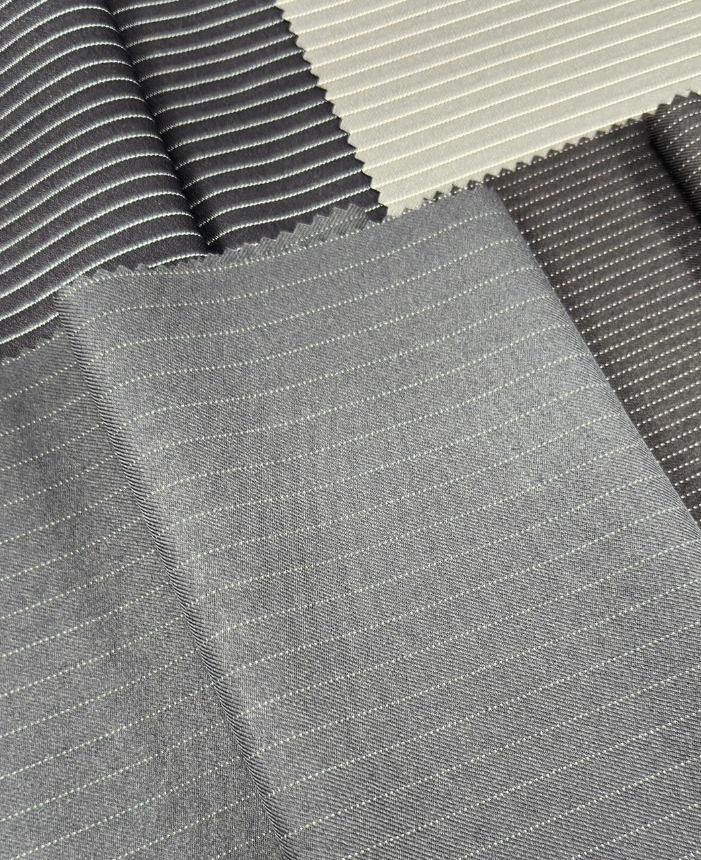
The Outlook
Diversification
Product Development
Innovation

Slide 16

Thank You
Q&A
UNIVERSAL TEXTILE CO., LTD.
7F 62-5 Sining N. Road Taipei Taiwan
Tel：886-2-25523701

