Slide 1
INVESTOR CONFERENCE
2024.03.25

Slide 2
DISCLAIMER
The content and related information in this briefing report and the synchronous announcement are sourced from TTF’s inner and outer material, including the operation result, financial situation and the business development, et cetera.
■ No financial forecasting is released by TTF. Discrepancy may be existed between the actual result in the future and the estimated opinion to the company operation and business developing subjects indicated in this briefing report with respect to the financial, business and Q&A part. The causes of the discrepancy may include the variation of market needs, price fluctuation, competition activities, international economic situation, exchange rate fluctuation, upper and downer stream supply chain, and any other risk factors that beyond TTF’s control. 
The prospects to the future in this briefing report reflect TTF’s vision of future. TTF is not responsible for any notification or update with regard to any change or adjustment to these prospects in the future.

Slide 3
Company Profile

Slide 4
Company Profile
Head office | 8/F, 70-1, HSI-NING N. Road, Taipei, Taiwan
Weaving Factory | No.50, Ln. 660, Guangfu Rd., Bade Dist., Taoyuan
Yarn Factory | No.18, Fufeng S. Rd., Yangmei Dist., Taoyuan
Established Time | June 1, 1973
Paid-in Capital | NTD 1,298,338,480
Date of Listing | May 5, 1993
Main Product | Woven Fabrics / Texturized Yarn
Employees | 403
Website | www.ttfco.com

Slide 5
Company History

Slide 6
Company History
1973 | Founded by Mr. Chang Ze Shen in 1973, TTF located its first factory at No. 60 Fuchou St., Kwang-Xing Vil., Bade Township, Tao Yuan County, Taiwan. TTF started its business with 1 sizing machine and 100 weaving looms, and its main product were nylon taffeta fabrics, 100% polyester suiting fabrics and shirting fabrics
1987 | 64 Tsudakoma water jet looms ware added into the production facility. The factory area was expanded by 4,000 square meters.
1988 | The weaving looms were increased to be 260 water jet looms, and 64 rapier looms，and the total factory area were expanded to be 32,000 square meters.
1995 | With the installation of 50 Picanol jacquard looms, TTF started to supply jacquard fabrics.
1998 | The yarn texturizing plant was set up in Yang Mei District, Taoyuan, TTF thus integrated the supply chain vertically.
2023 | Announance ElasLana, a highly elastic wool-feel functional fabric. It is the most classic fabric brand among functional fabrics and dominates the market. It is highly recognized by international brands. This fabric is 100% independently developed by TTF. It is positioned as an urban casual functional fabric, symbolizing fullness. Vitality and fashion innovation.

Slide 7
Operation Overview

Slide 8
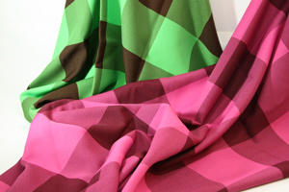
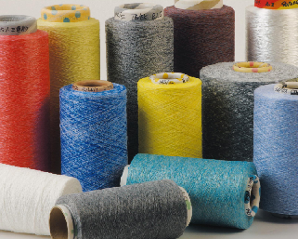
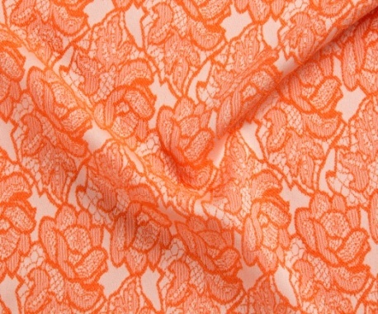


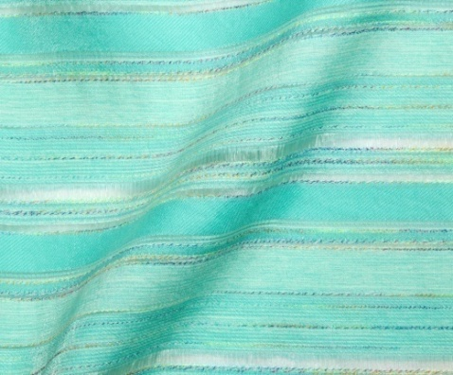
Operation Overview
Product: Woven Fabrics / Texturized Yarn
Website: www.ttfco.com
Comfortable Wool Touch Fabrics
Texturized Yarn
Jacquard Fabrics
Glittering Fashion Fabrics
Casual Shirting Fabrics
Casual Shirting Fabrics
Notes:
8

Slide 9

Next Generation of Functional Fabrics

Slide 10

Operation Overview
Business Partner
Notes:
10

Slide 11
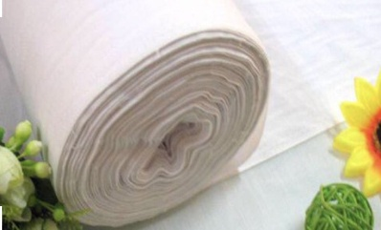
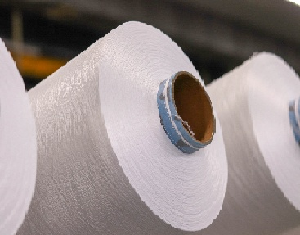
Operation Overview
Product & Capacity
 |  | 2021 | 2022 | 2023 | 2024
greige fabrics |  | 14,288 | 16,971 | 21,140 | 21,138 | (仟碼)
yarn |  | 12,366 | 19,257 | 18,800 | 13,487 | (公噸)
Notes:
11

Slide 12
Comparison of Quarterly Sales Revenue
Operation Overview
單位:仟元
109Q4 | 110Q1 | 110Q2 | 110Q3 | 110Q4 | 111Q1 | 111Q2 | 111Q3 | 111Q4 | 112Q1 | 112Q2 | 112Q3 | 112Q4
327,401 | 367,005 | 419,004 | 394,123 | 394,687 | 450,137 | 501,333 | 454,227 | 390,583 | 363,878 | 395,249 | 410,085 | 317,626

Slide 13
Operation Overview
Gross Margin
年度 | 106 | 107 | 108 | 109 | 110 | 111 | 112
毛利率 | 8.49% | 7.47% | 10.31% | 2.64% | 8.15% | 10.53% | 9.19%
(%)

Slide 14
Outlook

Slide 15
Outlook
Fabrics business remains flat, while processed yarn is expected to grow
Establishment of special fabrics such as work clothes and industrial use
Develop multi channels for work clothes fabrics
Develop and establish quality control laboratory and R&D center
Promote the fabric brand "ElasLana“
Develop European and American markets

Slide 16
Q & A
～THANK YOU～

