Slide 1


Investor Update
Jun 29, 2020

Slide 2
Disclaimer
The information contained in this presentation, including all forward-looking information, is subject to change without notice, whether as a result of new information, future events or otherwise, and De Licacy Co., Ltd. (the “Company”) undertakes no obligation to update or revise the information contained in this presentation. No representation or warranty, either expressed or implied, is provided in relation to the accuracy, completeness or reliability of the information contained herein, nor is the information intended to be a complete statement of the Company, markets or developments referred to in this presentation.

Slide 3
Outline
Capacity
Financial Performance
Adjust the organizational structure

Slide 4
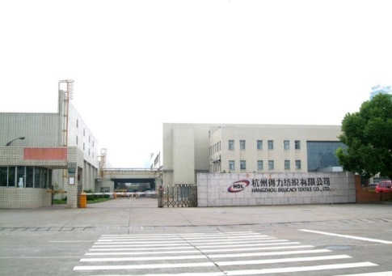
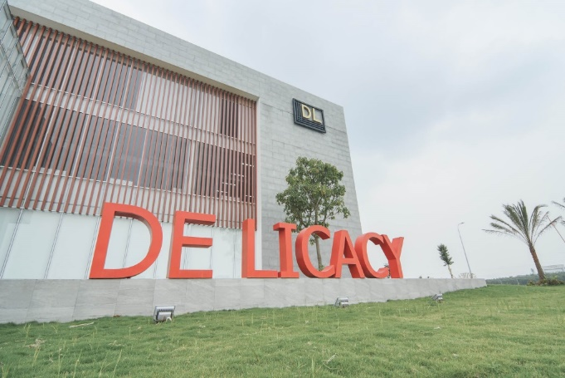
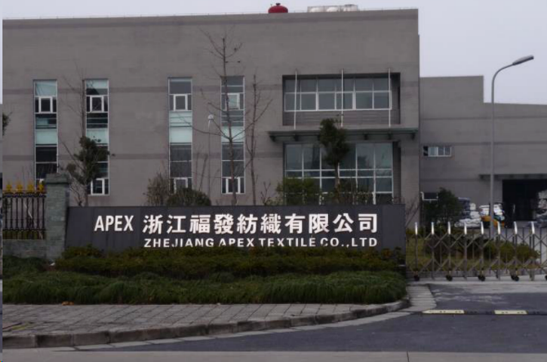
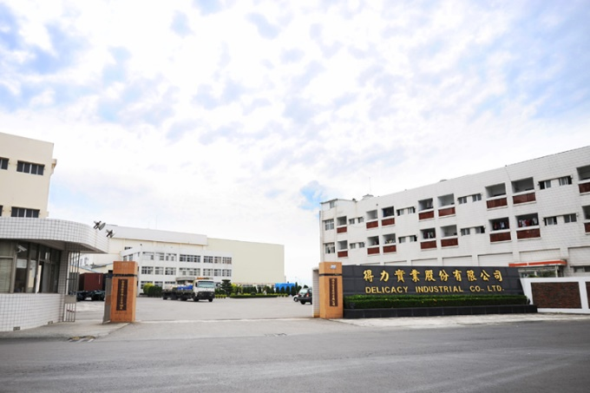
Capacity Overview
DL, Hangzhou
DL, Vietnam
P/D: 4.5M/month
Y/D: 1.2M/month
P/D: 3.0M/month
Y/D: 0.9M/month
DL, Zhejiang & Anhui
P/D: 3.0M/month
Y/D: 0.9M/month
DL, Tainan
P/D: 2.5M/month

Slide 5
Capacity
Financial Performance
Adjust the organizational structure

Slide 6
Profitability
Total Revenue (NT$B)
Operating Margin (%)

Slide 7
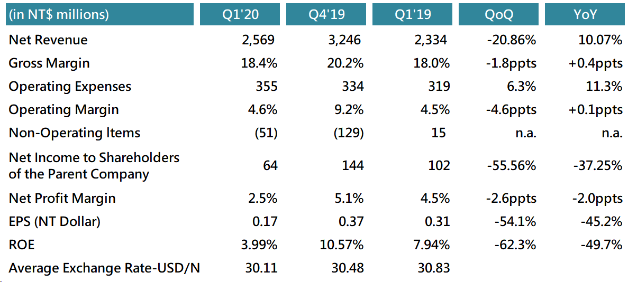
Consolidated P&L

Slide 8
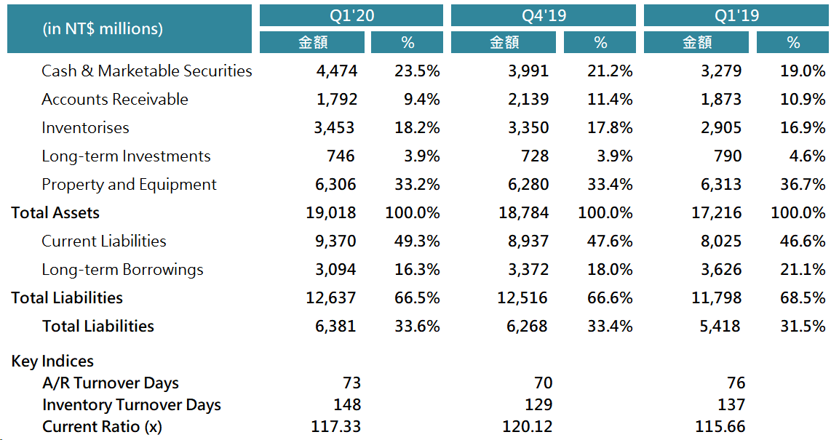
Balance Sheets & Key Indices

Slide 9
Capacity
Financial Performance
Adjust the organizational structure

Slide 10
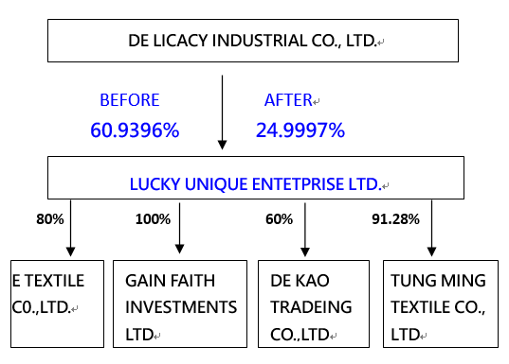
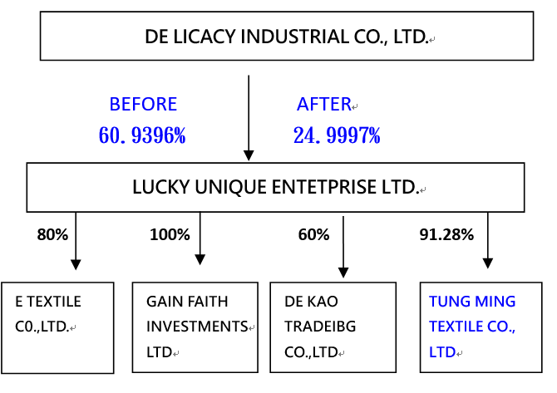
Adjust the organizational structure

Slide 11
Q & A
http://www.delicacy.com.tw

