Slide 1


2017 Taiwan Investors Conference
TSE Code : 1468
Chang-ho fibre Corporation
2017.12.19

Slide 2


● Company Networking
● On-Going Transformation
● Core Competence
● Green Power and Carbon
Offset
● Customer Relationship MGT
● Business Focus
● Moves Ahead

Slide 3


.
Company Networking

Slide 4

Chang-ho Group Networking
Garment Design
California ,USA
Weaving & Dying
Shaoxing, China
Garment making
Vietnam
Sales & marketing
Shanghai, China
Sales & marketing
Kansas, USA
GoLite Brand Company
Washington, USA
Headquarters‘
Taipei, Taiwan
Weaving & Dying
Taoyuan, Taiwan

Slide 5

.
On-Going Transformation

Slide 6
On-Going Transformation
Leads in making
and marteking funtionalFabrics in industry
Adopts humanistic approach to business management
Phase I
1981-1990
Phase II
1991-2000
Phase III
2001-2016
Phase IV
2017-
Emerges as the world’s No.1 supplier of artificial flower
Focuses on high C/P product mix via blue sea strategy

Slide 7
Business Nucleus
Humanistic
High-tech in conventional craftsmanship
Giving back to the earth what we take from it by
Comittment to protect environment and save energy
Elevating global competence
Business visionary
Business soul
&
Backbone
positioning
Businesses
across the borders
Revolutionary
innovation
Staying ahead of competitiors

Slide 8

.
Core Competence

Slide 9
Competitive Advantages
All-round mfg. facilities
for full range of textile products
Aspiring to be bench-mark in
energy saving and carbon reduction
Certified as green factory
through strict criteria
Every employee concious
of humanism within
work scope
Worldwide fully integrated making
and selling presences

Slide 10

.
Green Power and Carbon Offset

Slide 11
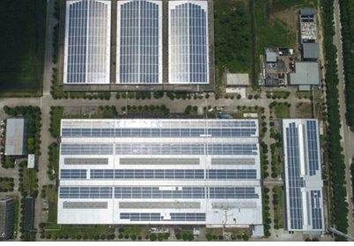
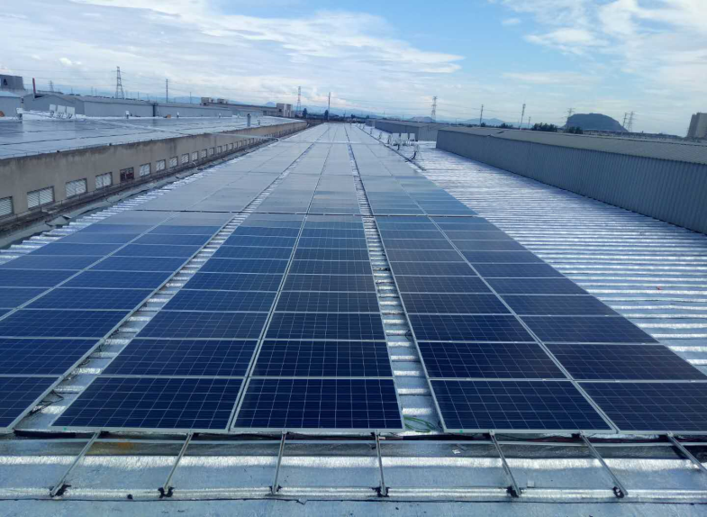
Green Energy (Solar Power)
● Solar roof on premises generating
1.01MM KWH per year
● Accounting for 20% of total plant
power consumption
● Reducing 650,000kg in carbon
dioxide emission per year
● Accommodation of expansive solar roof as
indicator for clean-production business

Slide 12
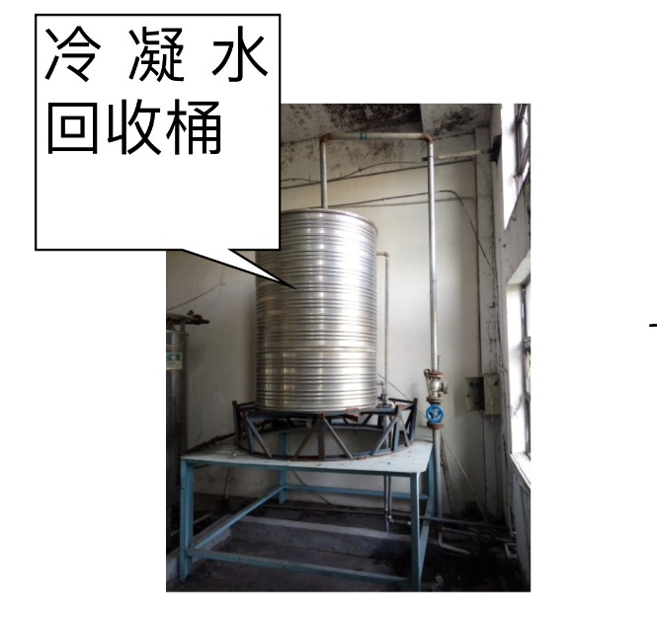
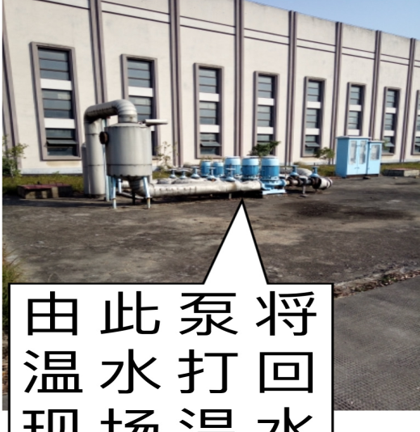
Effectiveness of Carbon Reduction
High water intake rate per 100m , ow water linkage rate , railfall recycling rate(98%) 、in-house industrial water recycling rate , steam cooling water recycling rate …etc, all makes the company stay ahead of competitors in plant recycling and cleaning.
Cooling water recycling system
In-house water recycling
將水打回廠
內染整使用

Slide 13
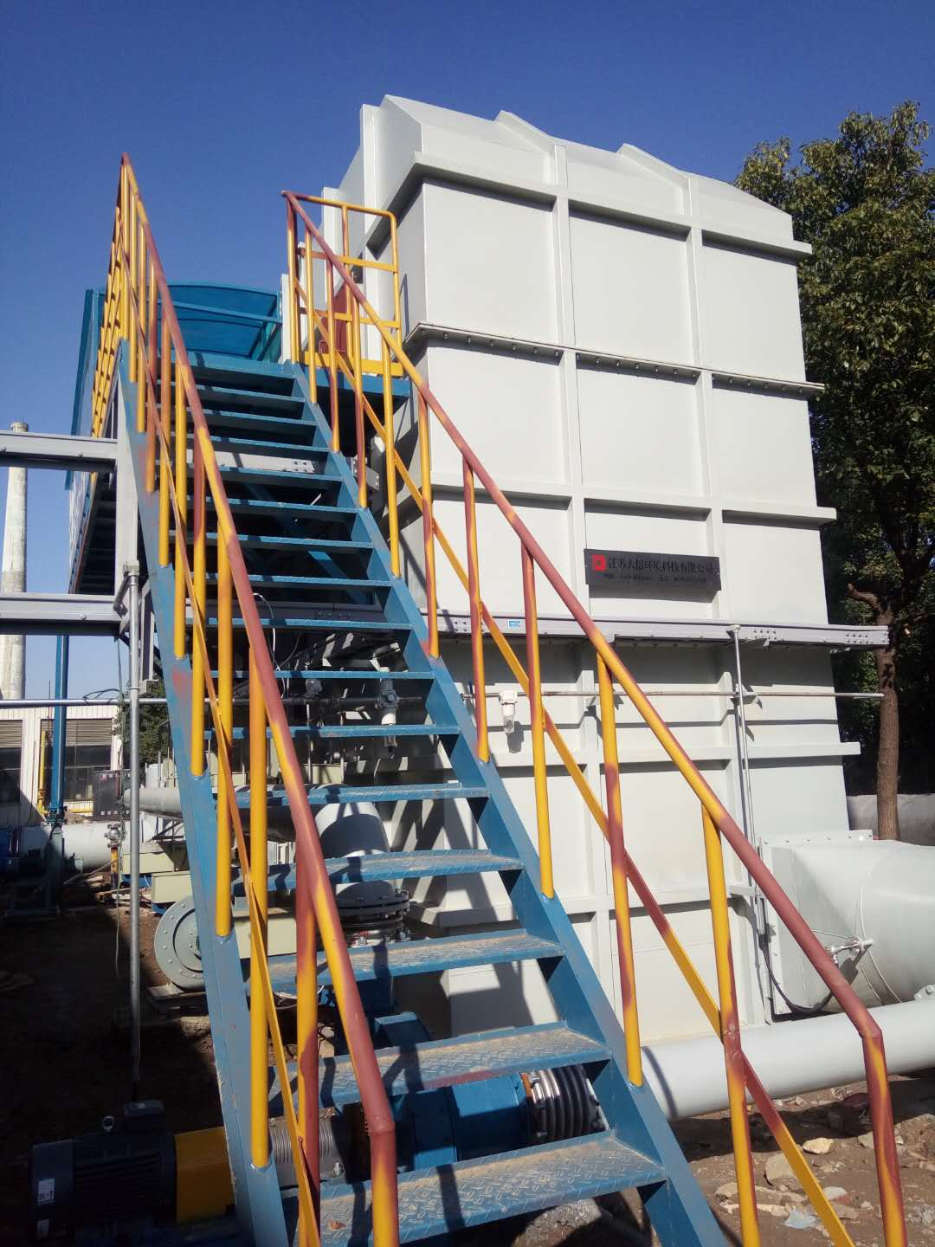
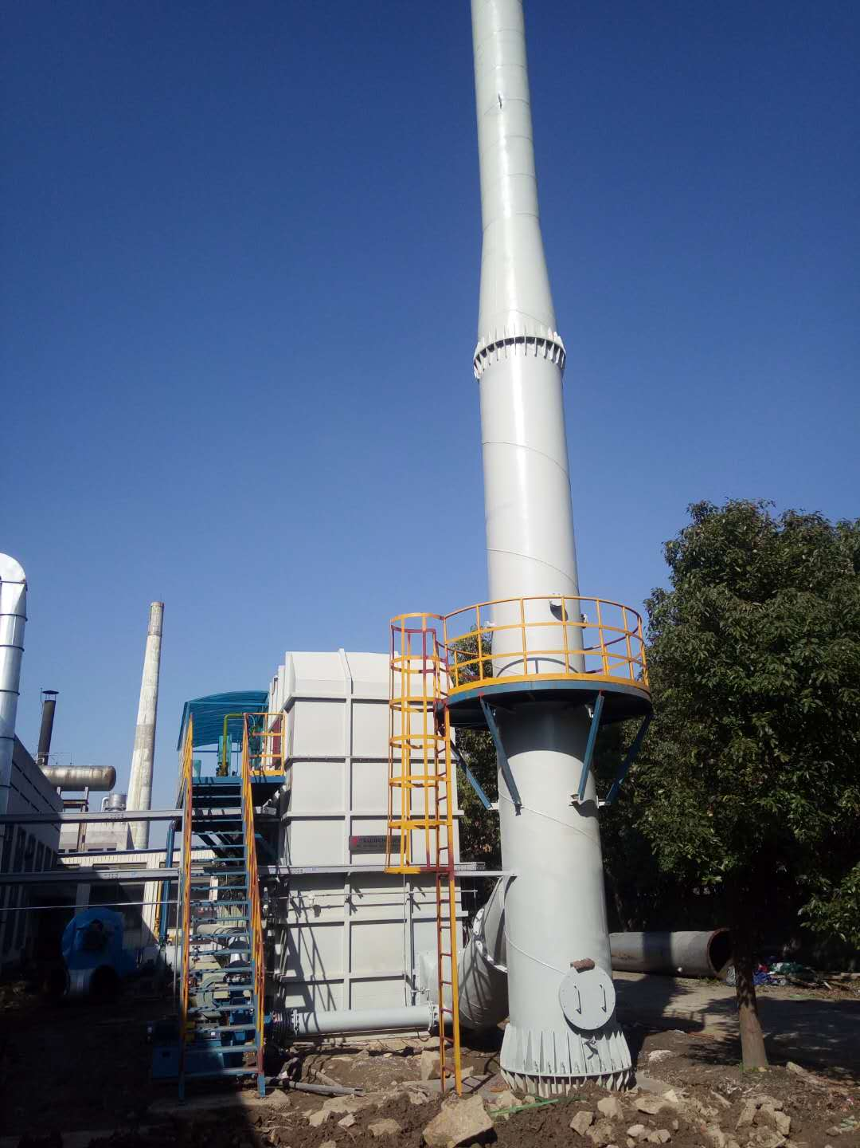
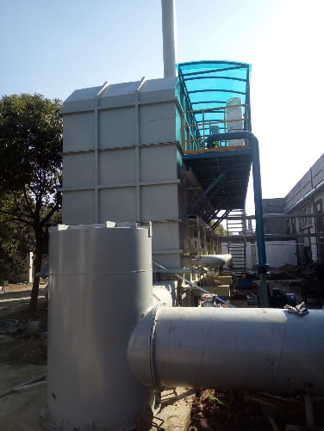
Benefits Of Reducing Waste
RTO waste air treatment system with 0% emission of hazardous gas .Use natural gas in replacement of coal to win back blue sky.

Slide 14
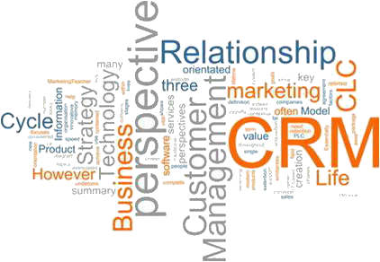
.
Customer Relationship MGT

Slide 15

Manufacturing as Service Industry
The value of business lays in providing services
Must be customer and market oriented
Truly understand Thy customers by offering B2C service
Stick to 4 basics :
quality 、delivery 、price
and eco-friendly as a qualified and reliable vendor

Slide 16

.
Business Focus

Slide 17
Business Edge and Niche
A great variety of product mix to choose from
(Knitting /weaving 、 10~2000 deniers 、 N6 、N66…)
Good quality, competative price to touch customers heart
Fully industrial integration from fibre down to
ready-to-wear
Remarkable international presences in sales
and marketing network
Green – power and waste – reducing driven policy

Slide 18
.
Moves Ahead

Slide 19

Moves And Strategies Ahead
Recruit high-caliber talents to expand R & D team
Use green power to become a green business
Enter internet sales market and launch own brand promotion program
Make international market more accessible and company’s product more available
To better serve customers by strategic alliance with business partners
Business grows along with more humanistic care

