Slide 1


2019 Taiwan Investors Conference
TSE Code : 1468
Chang-Ho Fibre Corporation
2019.11.29

Slide 2

Disclaimer
The information contained in this presentation, including all forward-looking information, is subject to change without notice, whether as a result of new information, future events or otherwise, and Chang-Ho Fibre Corporation undertakes no obligation to update or revise the information contained in this presentation.
No representation or warranty, either expressed or implied, is provided in relation to the accuracy, completeness or reliability of the information contained herein, nor is the information intended to be a complete statement of the Company, markets or developments referred to in this presentation.

Slide 3
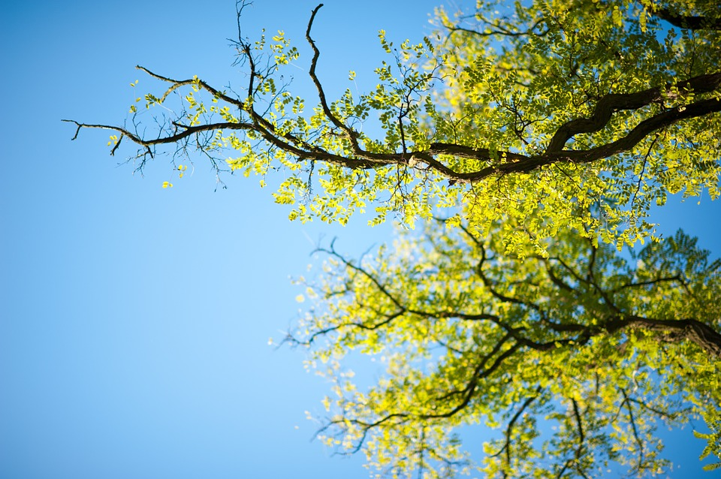
● Company Networking
● Developing Course Of Company
● Core Competency Of Enterprise
● Achievement Of Circular Economy
● Customer Relationship MGT
● Business Focus
● Moves Ahead
● Operating Performance

Slide 4

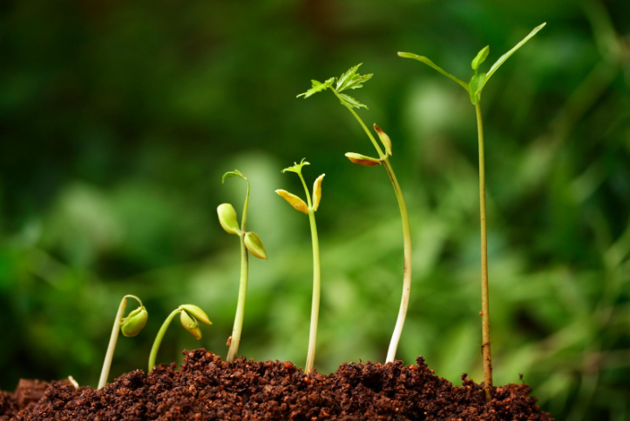
.
Company Networking

Slide 5
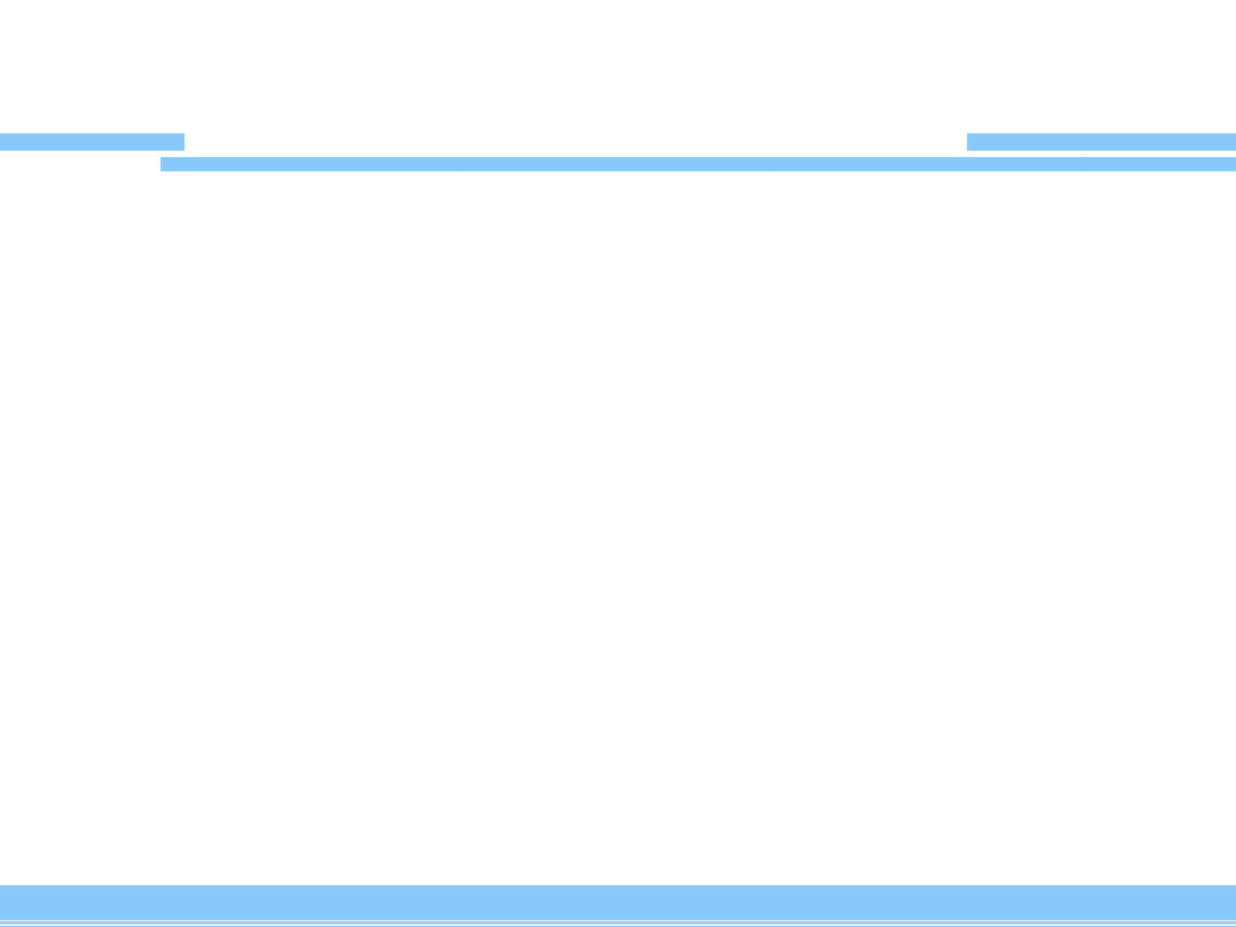
Chang-Ho Group Networking
Chang-Ho Fibre (Shaoxing) CORP.
NOA Group CORP.
Vietnam Factory
Chang-Ho Fibre CORP.
Taoyuan Factory

Slide 6
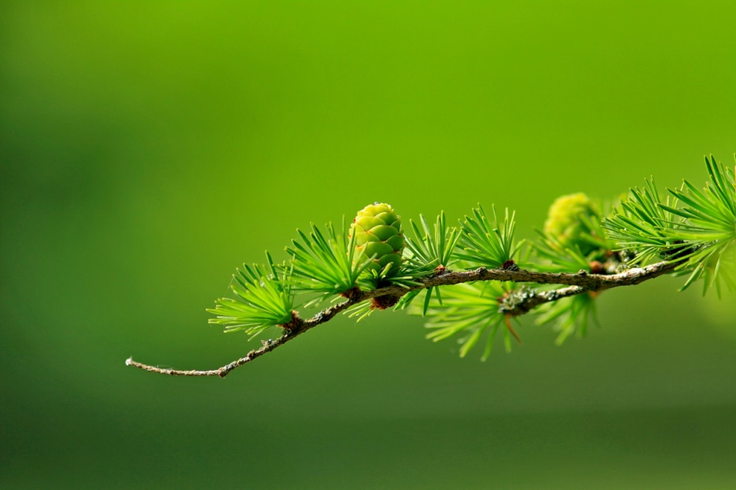
.
Developing Course Of Company

Slide 7
On-Going Transformation
Leads in making
and marketing funtional Fabrics in industry
Adopts humanistic approach to business management
Phase I
1981-1990
Phase II
1991-2000
Phase III
2001-2016
Phase IV
2017-
Emerges as the world’s No.1 supplier of artificial cloth flower
Focuses on high C/P product mix via blue sea strategy

Slide 8
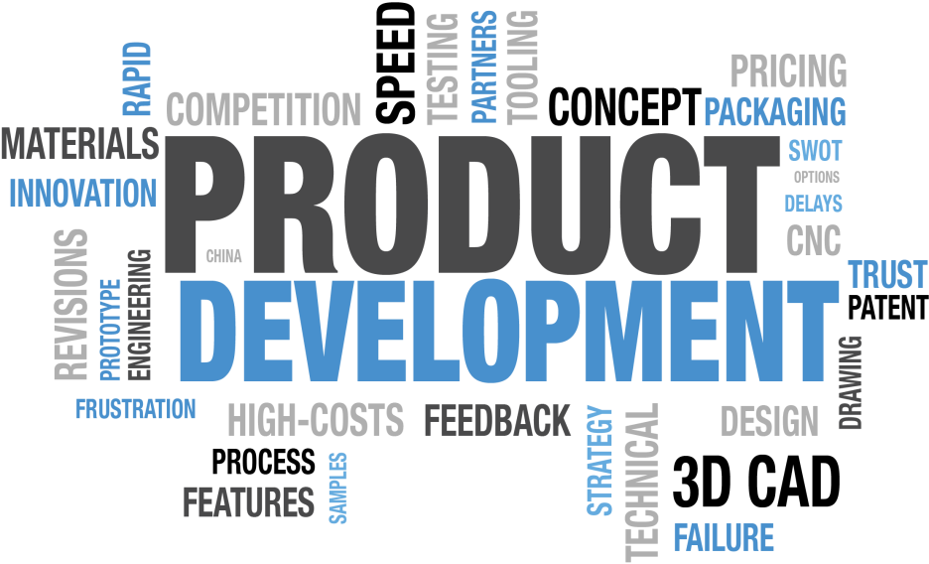
.
Core Competency of Enterprise

Slide 9
Business Nucleus
Humanistic
Giving back to the earth what we take from it by
Comittment to protect environment and save energy
Creating International Competence
High-tech in conventional craftsmanship
Business Soul
&
Backbone
Businesses
across the borders
Businesses
across the borders
Revolutionary
innovation
Revolutionary
innovation
The Vision Of
Enterprise Position
Play The Leading Role
Of Brotherhood

Slide 10
Competitive Advantages
All-round mfg. facilities
for full range of textile products
Energy saving and carbon reduction
Be benchmarking enterprise
Certified as green factory
through strict criteria
Every employee concious
of humanism within
work scope
Creating the thinking of product value

Slide 11

.
Achievement Of Circular Economy

Slide 12
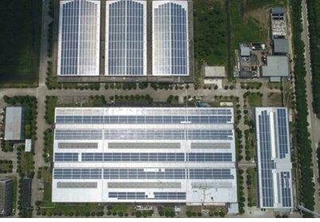
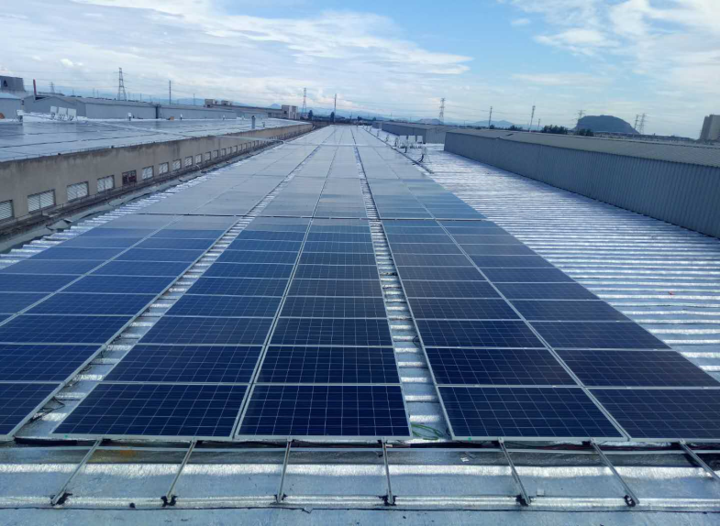
Green Energy (Solar Power)
● Solar roof on premises generating
1.20MM KWH in 2018
● Accounting for 24% of total plant
power consumption
● Reducing 720,000kg in carbon
dioxide emission per year
● Accommodation of expansive solar roof as
indicator for clean-production business
100% eco-friendly roof

Slide 13
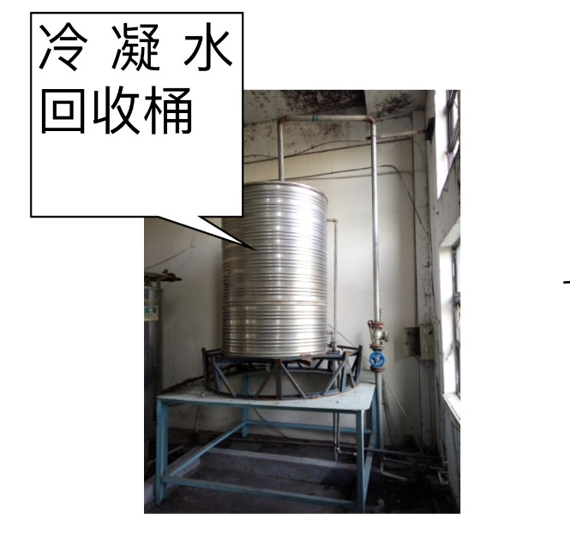
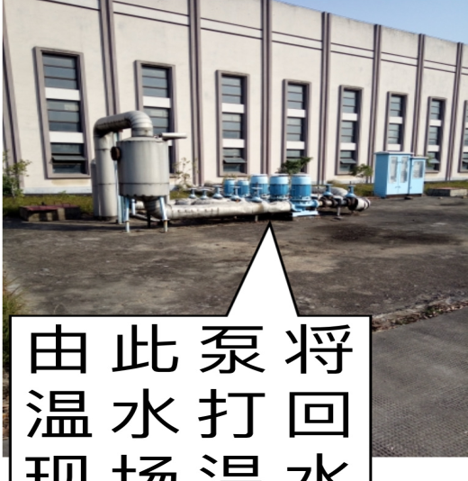
Effectiveness Of Carbon Reduction
Low water consumption rate per 100 meter cloth in 2018, water leakage rate , railfall recycling rate(99%) 、in-house industrial water recycling rate , steam cooling water recycling rate etc, all makes the company stay ahead of competitors in plant recycling and cleaning.
Cooling water recycling system
In-house water recycling
將水打回廠
內染整使用

Slide 14
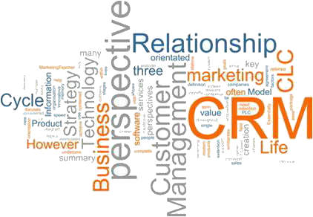
.
Customer Relationship MGT

Slide 15

Manufacturing As Service Industry
Excellent services to
win the trust of customers
The concept of consuming trend oriented
The concept of 100% provide customers with services timely based on customer needs
Stick to 4 essences of top-quality vendor:
quality 、delivery 、price
and eco-friendly

Slide 16

.
Business Focus

Slide 17
Business Edge And Niche
A great variety of product mix to choose from
(Knitting /weaving 、 10~2000 deniers 、 N6 、N66…)
The value of product replace the price of product
The advantage of one package service from fibre 、 ready-to-wear down to private brand
To innovate the mindset of marketing and sales
Benchmarking enterprise-
the advantage of eco-friendly textile products

Slide 18


Performance materials.
Inspired by nature.
©2014 OrganoClick AB
Notes:
18

Slide 19
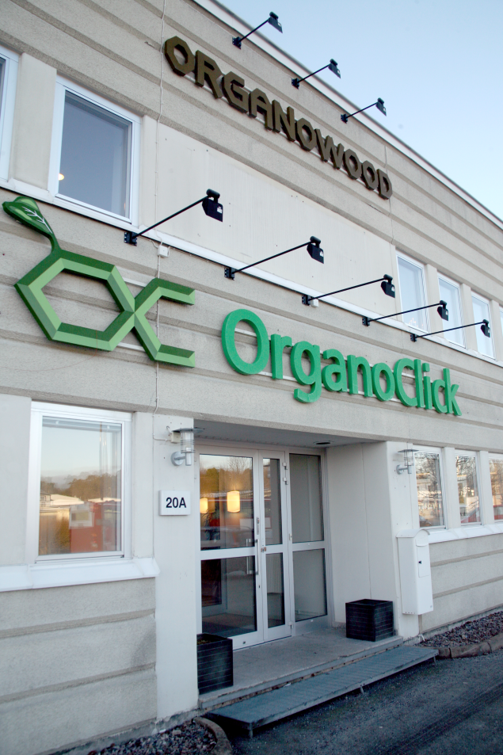

Company Overview
Swedish spin-off from Stockholm University and SLU in Uppsala
Founded in 2006
Headquarter, production and R&D facility in Stockholm, Sweden.
Experts in fiber-functionalization and biobased materials.

Slide 20
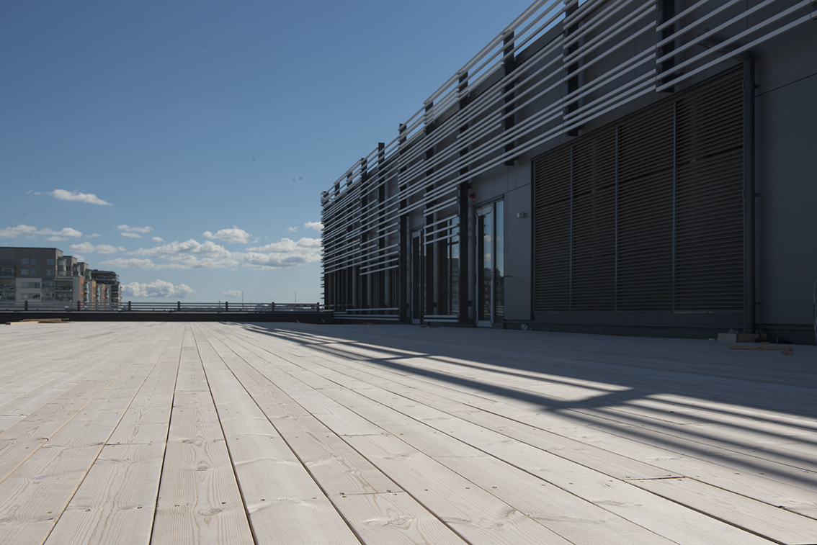
Skanska’s head office with Organowood®
©2014 OrganoClick AB

Slide 21

Sustainability
Fully fluorocarbon free
Readily biodegradable
(OECD 301)
Non-harmful (REACH)

Slide 22
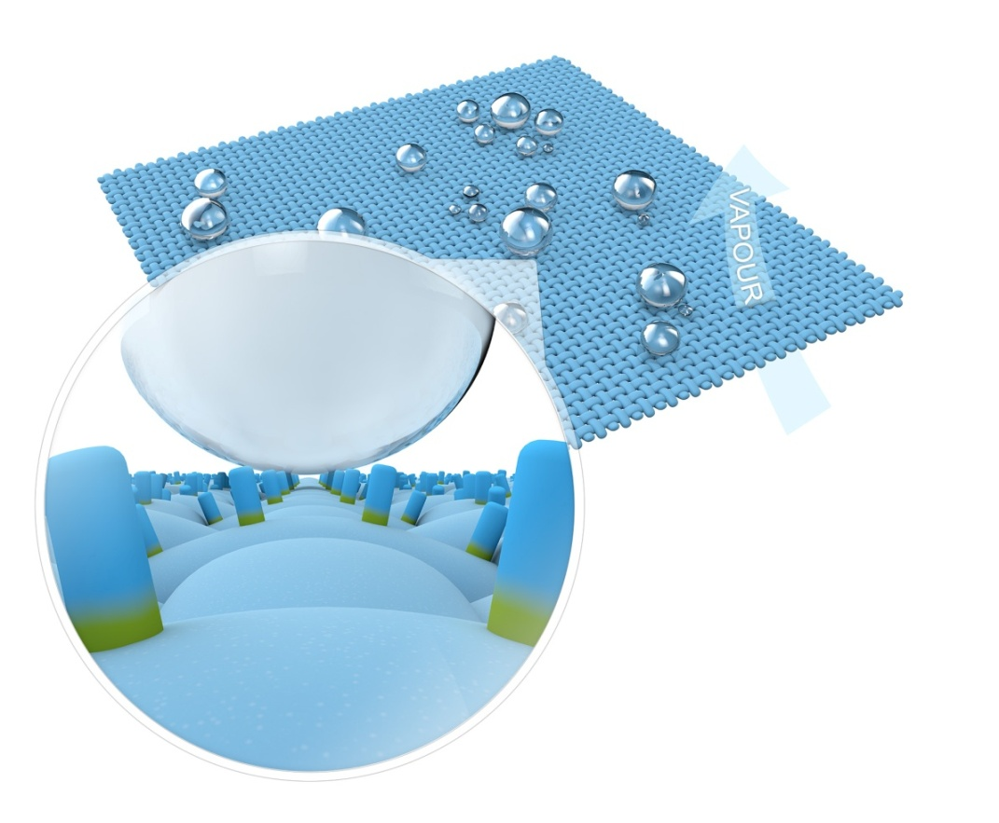
Technology
A 3D pattern of organic polymers.
They have two different ends:
- one hydrophobic and
- one biodegradable/reactive
The reactive end is durably bound
via the Organo Click-technology
using plant-based catalysts.
The hydrophobic end phases
outwards and creates the water
repellent effect

Slide 23
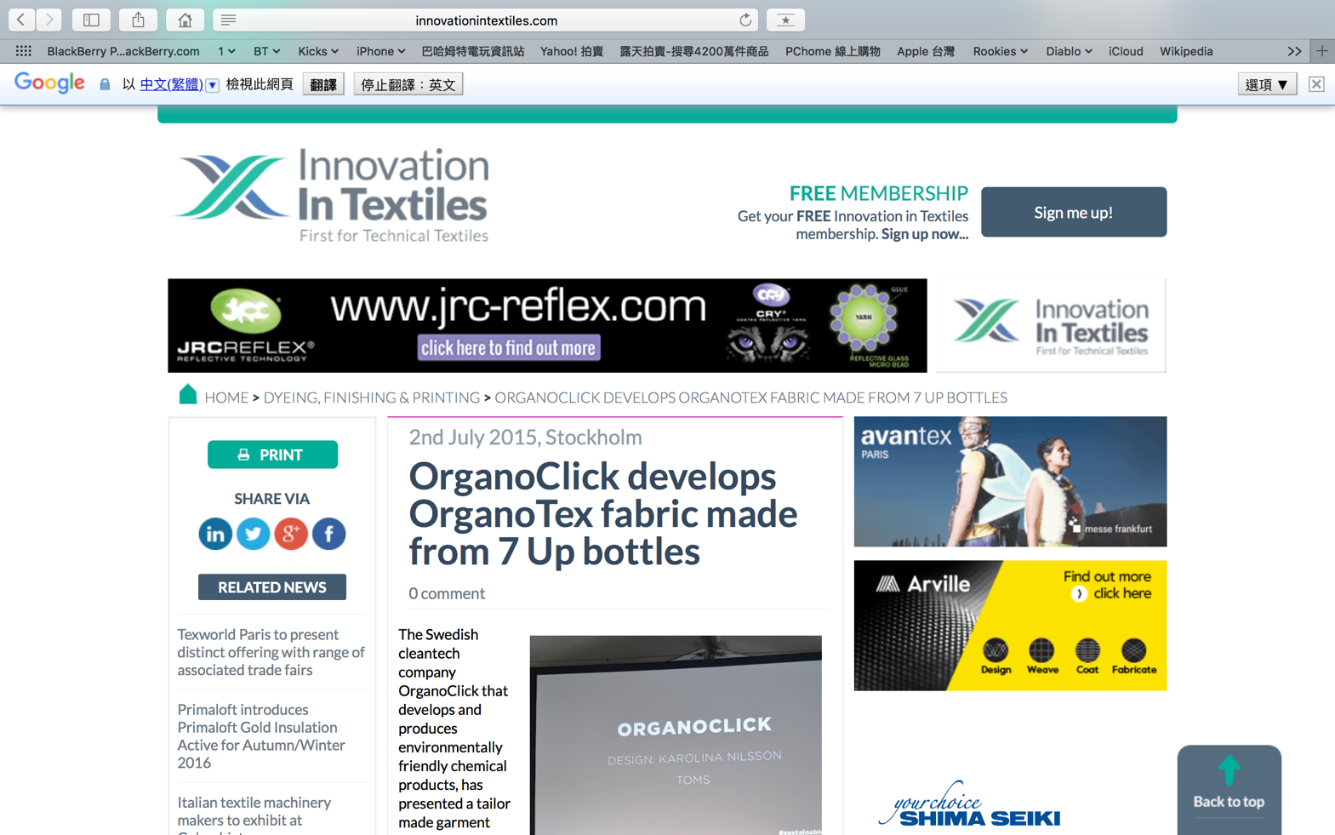
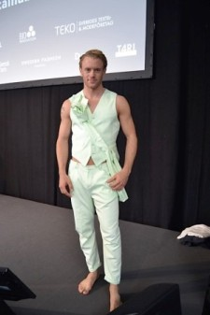

Innovation in textiles
“ The fabric is undyed and thereby the original green colour of the bottle has been preserved, which is said to save great amount of chemicals, water and energy during the manufacturing process. The garment has been developed in collaboration between Organo Click, Chang-Ho Fibers, the Textile University of Borås ” –
Ecotextile

Slide 24
More Products…..

Slide 25


Slide 26
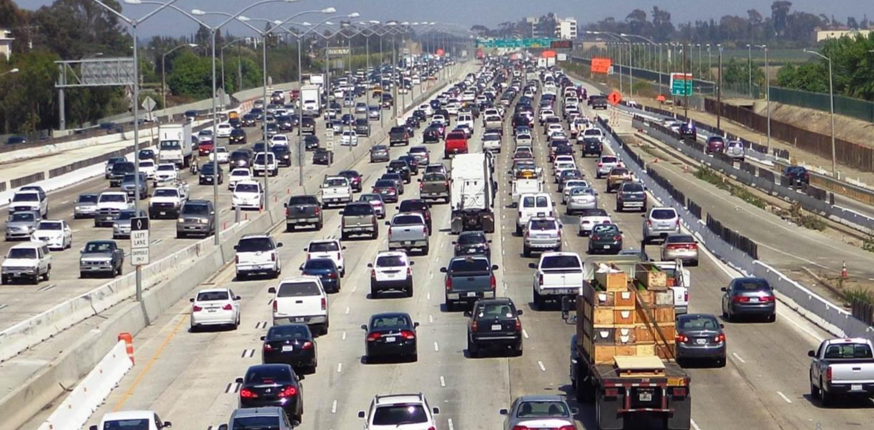

Slide 27
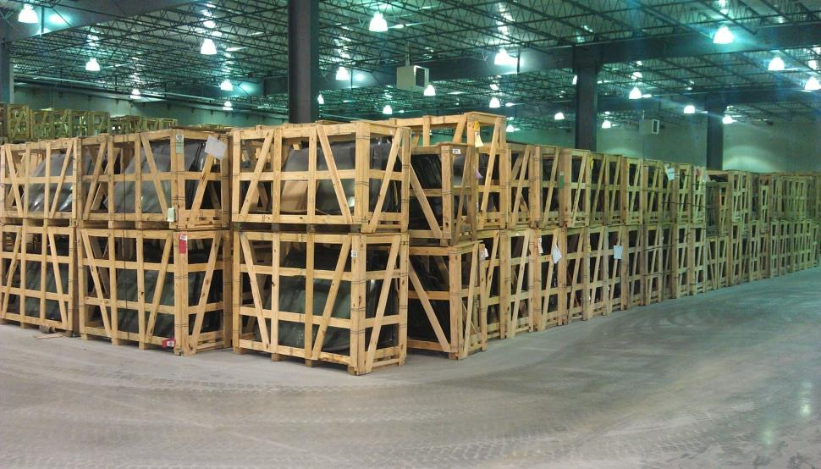
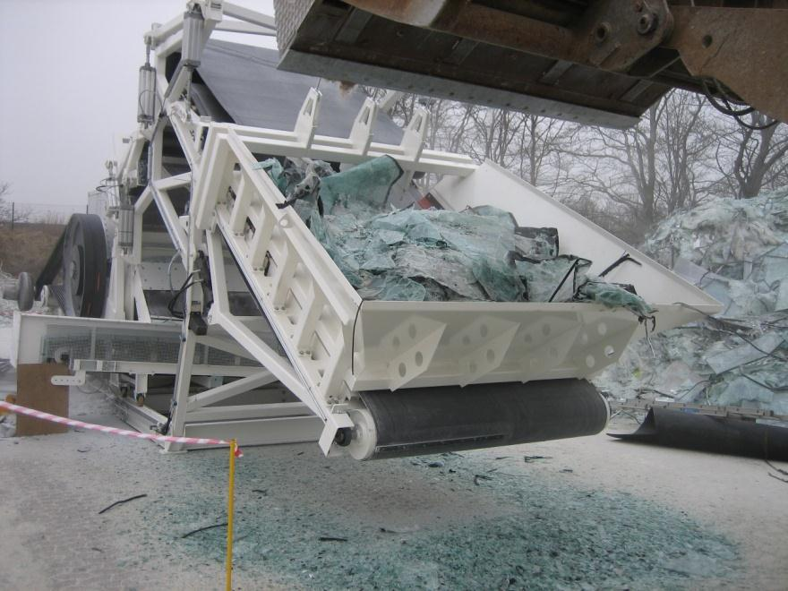
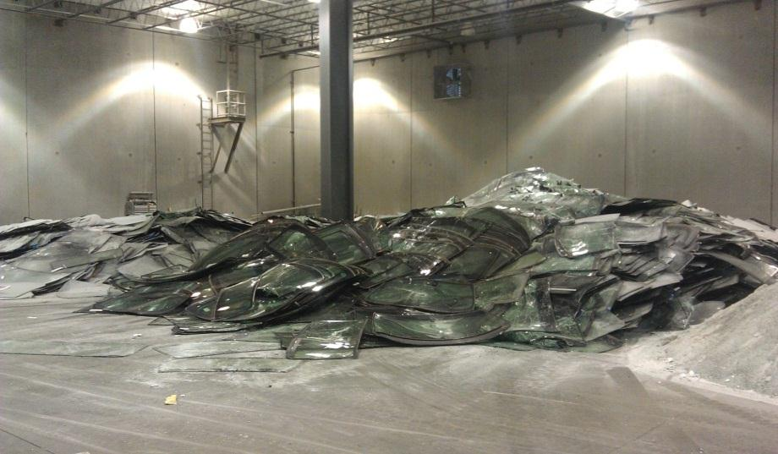
Unwanted Wastes from the road……

Slide 28
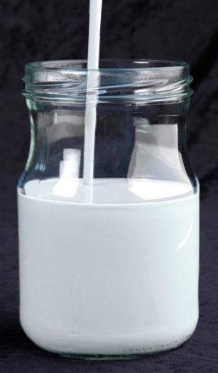
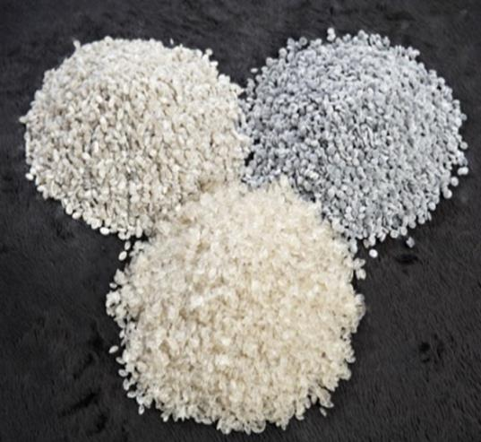
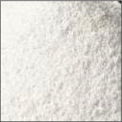
New PVB Raw materials
Water Based PVB
Dispersion
PVB Pellets for compound (Extruded and filtered )
PVB powder grined to around 400 micron

Slide 29

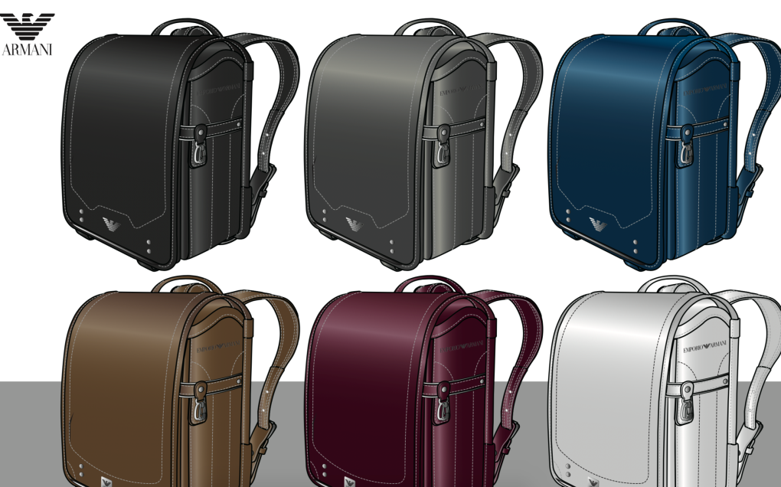
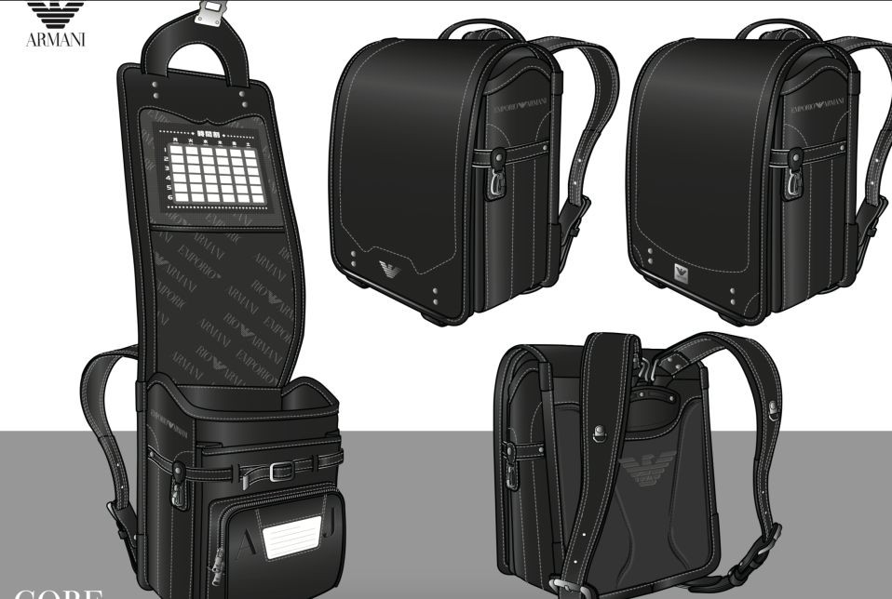

Slide 30
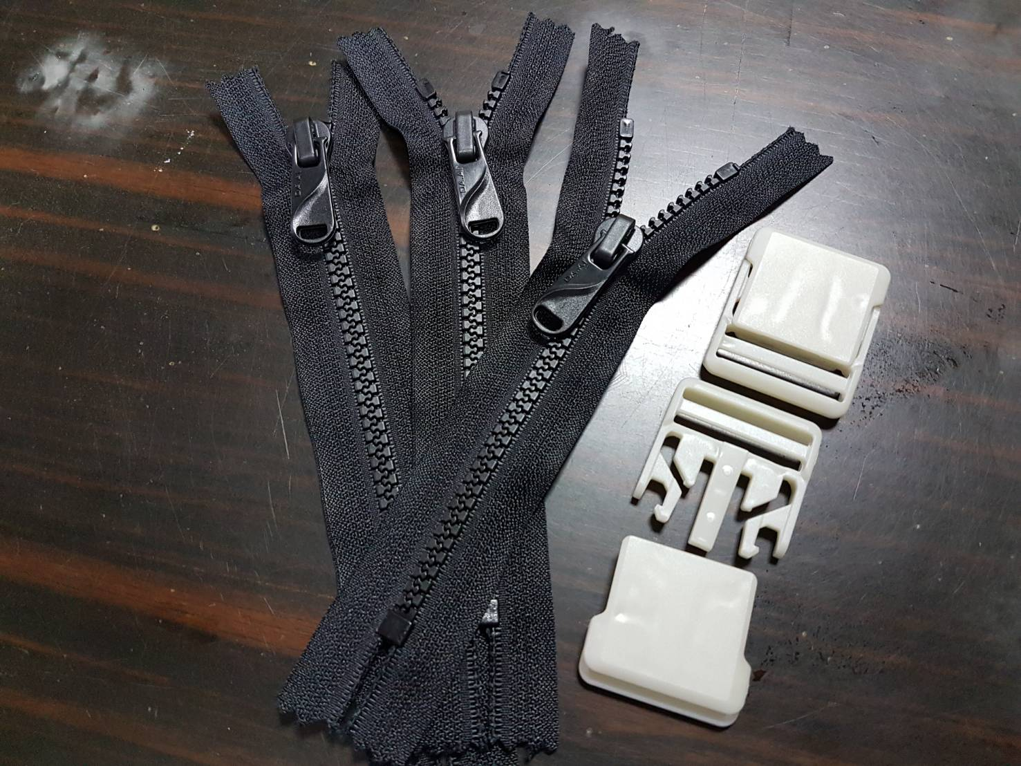
Recycled trims.

Slide 31
.
Moves Ahead

Slide 32

Moves And Strategies Ahead
Increasng the value of products.
Enhancing the quality of service.
The bellwether of build green supply chain.
In response to U.S.-China trade war, increaseing the ratio of domestic sales .
Adjustment the international production distribution.
To increase research in E-commerce.
To raise E-commerce cooperation.
Humanistic-oriented outstanding enterprise

Slide 33
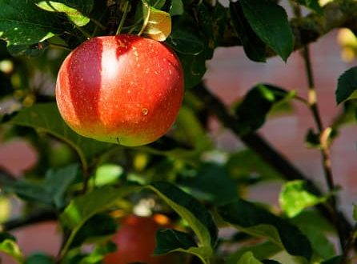
.
Operating Performance

Slide 34
Consolidated Statements Of Income
In Million of New Taiwan Dollars
Item | 3Q 19 | 3Q 18 | Difference | 1Q-3Q 19 | 1Q-3Q 18 | Difference
Operating Revenue | 254 | 233 | +9.15% | 772 | 692 | +11.46%
Operating Costs | 218 | 208 | +4.85% | 634 | 577 | +9.95%
Gross Profit | 35 | 24 | +46.14% | 137 | 115 | +19%
Gross Margin Ratio | 13.9% | 10.4% | +3.5% | 17.8% | 16.7% | +1.1%
Operating Profit (Loss) | 10 | (19) | +29 | 38 | (16) | 54
Operating Profit Ratio | 3.8% | -8.3% | +12.1% | 4.9% | -2.3% | +7.2%
Pretax Profit (Loss) | 7 | 22 | -15 | 50 | 42 | +8
Earnings Per Share | 0.04 | 0.14 | -71.43% | 0.28 | 0.25 | +12%

Slide 35
Consolidated Balance Sheet
2019/9/30

