Slide 1

              2022年法人說明會
              2022.12.01

Slide 2
免責聲明
本簡報及同時發佈之相關訊息內容，取自於公司內部與外部資料，其中包含營運 成果、財務狀況與業務發展等內容。
本公司並未發佈財務預測，但本簡報所作有關本公司財務上、業務上、Q&A之說 明，若涉及本公司對未來公司經營與產業發展上之見解，可能與未來實際結果存 有差異。此差異其造成之原因可能包括市場需求變化、價格波動、競爭行為、國 際經濟狀況、匯率波動、上下游供應鏈等其他各種本公司所不能掌握之風險因 素。
本簡報中對未來的展望，反應本公司迄今對未來的看法。對於這些看法未來若有 任何改變或調整時，本公司並不負責隨時提醒或更新。

Slide 3


2022
Company Profile
WORLD CLASS APPAREL MANUFACTURER SINCE 1961
TAINAN ENTERPRISES CO., LTD

Slide 4

BRIEF ABOUT
TAINAN

Slide 5
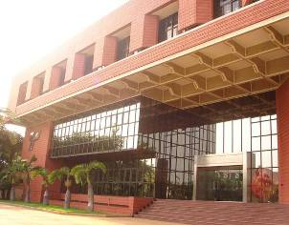
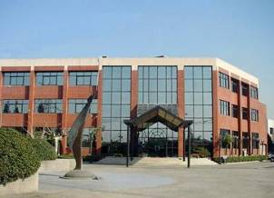
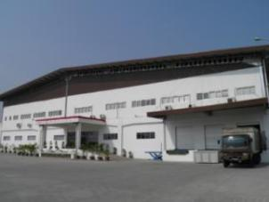
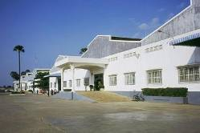
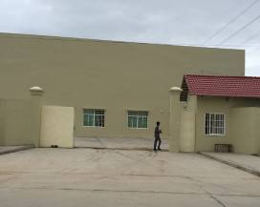
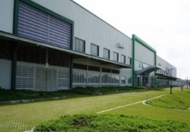
ONE CUSTOMER
MULTIPLE SITES FOR UTILIZATION
Facility
Location | Taiwan | China | Indonesia |  | Cambodia |  | Vietnam
 |  |  |  |  | (TC1+TC3) | (GIN SOVANN)
Production | 2 LINES | 10 LINES | JAKARTA 28 LINES | SOLO 1 24 + SOLO2 22 LINES | 50 LINES | 15 LINES | 20 LINES
Line
Monthly Capacity | 20,000 pcs | 200,000 pcs | 300,000 pcs | 400,000pcs | 800,000 pcs | 300,000 pcs | 300,000 pcs
Strength | R&D Sample Room, Active wear, Small Size Order | Novelty items, Complicated Craftsmanship, Embellishment Sourcing, Fast Turn Around, Sample room | Outerwear, Jacket, Blouse, Refined and Tailored Garments, Denim, Affiliate Laundry Facility |  | In-house Laundry Facility, Woven bottom, Woven Top, light Outerwear & Athleisure Apparel | Performance active wear & Athleisure Apparel, Cut-And-Sew Knits, Sleepwear, Loungewear | Woven bottom, Woven Top, light Outerwear & Athleisure Apparel
Total | WOVEN: 24,000,000 pcs/ year KNIT: 1,400,000 pcs / year
OUR CUSTOMERS USUALLY ULIZE 2-3 OF OUR FACILITIES SIMUTANEOUSLY
FOR CATOGORY SPECIALTY AND COUNTRY RISK HEDGE

Slide 6
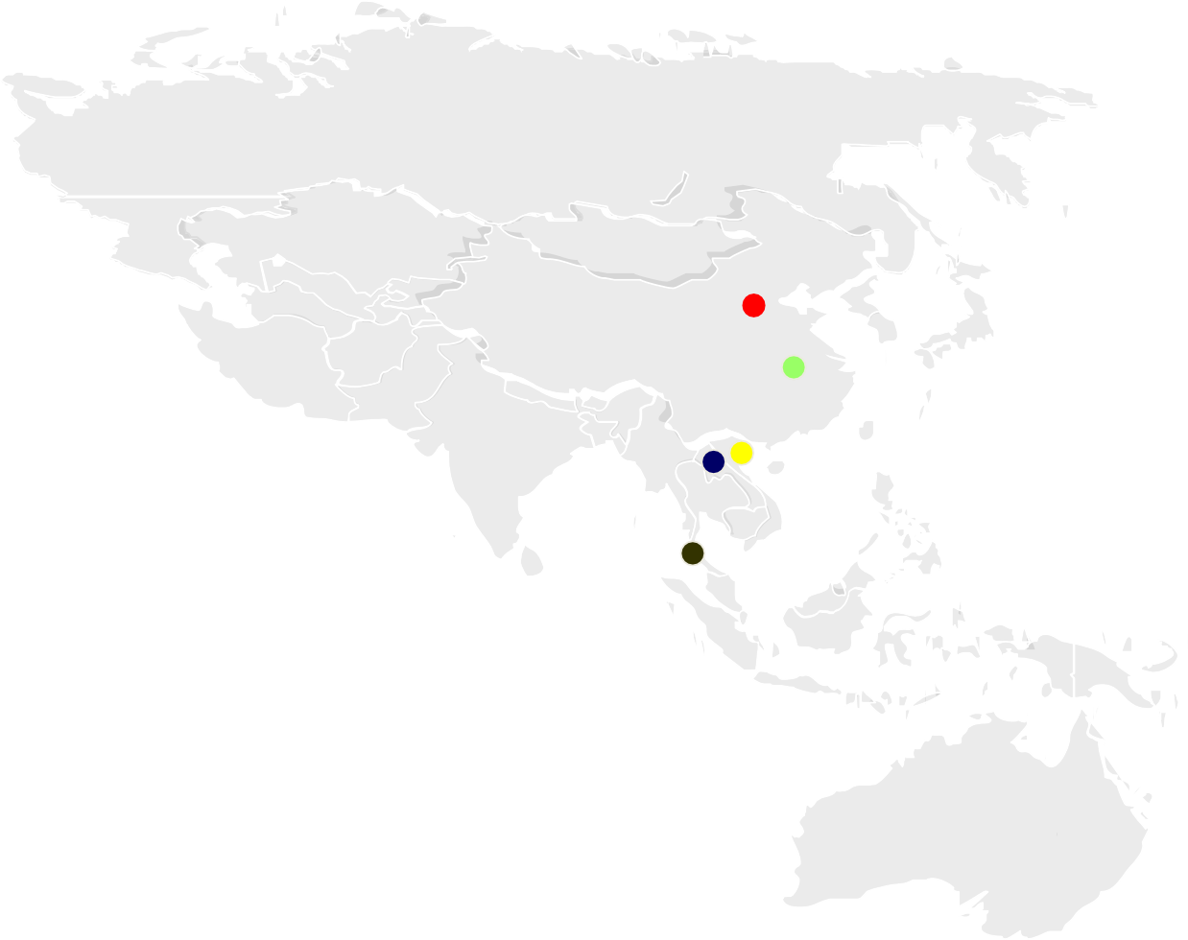
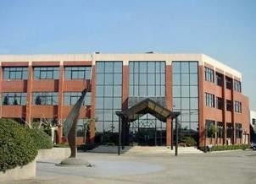
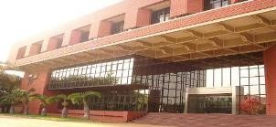
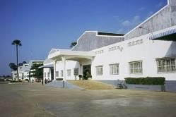
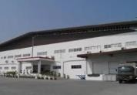

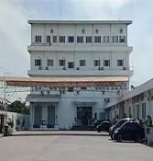

PRODUCTION SPECIALTY BY LOCATION
QUICK REACTION / SMALL ORDERS / SAMPLE ROOM / FABRIC SOURCING HUB
China
Taiwan
TAIPEI CONTINUE TO BE HQ OF TAINAN TAINAN BEING R&D Centre ALSO LUXURY PRODUCTION
MID-PRICED ORDERS WITH VOLUME
BOTTOM/ SOFT TOPS
Cambodia
OUTERWEAR INCL. JACKETS /
PARKA/ TOPS
Vietnam
BOTTOM/ SOFT TOPS
Indonesia JAKARTA
SOLO
BOTTOM
UPSCALE MARKET ORDERS
ietnam

Slide 7































OUR CLIENTS

Slide 8
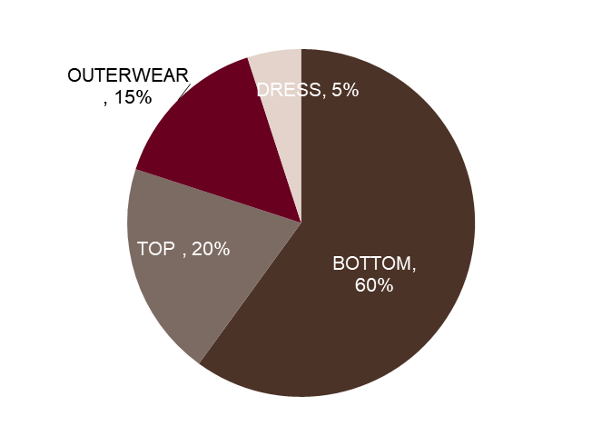
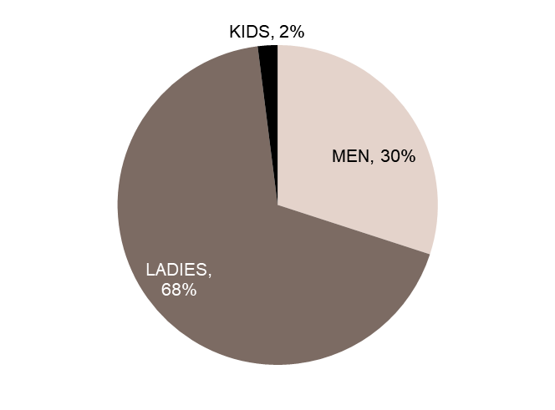
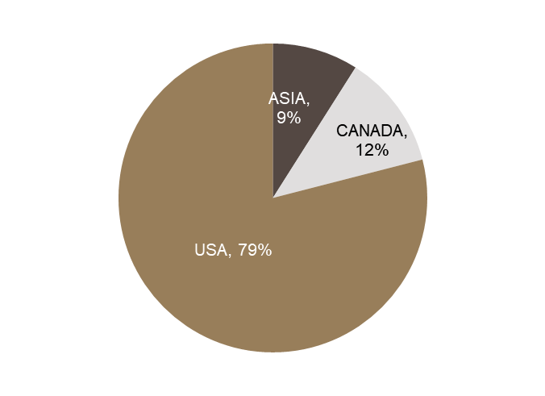
WHAT’S NEW AT TAINAN
By Product Category
By Gender
Customers Share
Global Market Share

Slide 9
合併財務報告 (I)
年度
營收
毛利
營業利益
稅前淨利
稅後淨利
每股盈餘
金額
(NT$mn)
成長率 (%)
(NT$mn)
(NT$mn)
(NT$mn)
(NT$mn)
(NT$)
2017
8,329
(10.76)
1,047
15
90
94
0.64
2018
8,326
(0.03)
1,068
5
110
80
0.54
2019
7,660
(8.00)
1,065
74
66
80
0.55
2020
5,970
(22.00)
670
(327)
(380)
(355)
(2.45)
2021
5,761
(3.5)
776
(156)
(126)
(135)
(0.92)
2022Q3
5,892
37
936
175
301
261
1.79

Slide 10


TAINAN FACILITY
Vietnam factory receives the LEED GOLD certification since 2017

Slide 11
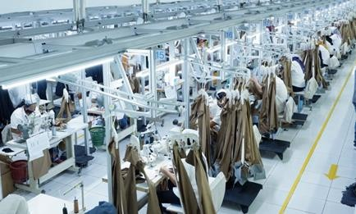
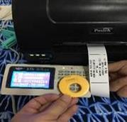
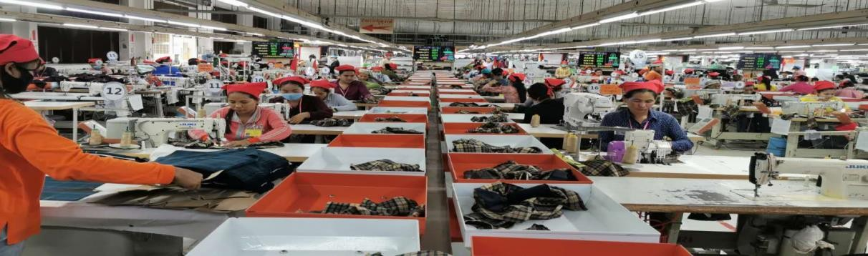
MODERNIZED PROCESS FLOW
HANGER SYSTEM - INDONESIA SOLO
U SHAPE CONVEYER
CAMBODIA
RFID SYSTEM
ALL FACTORIES

Slide 12
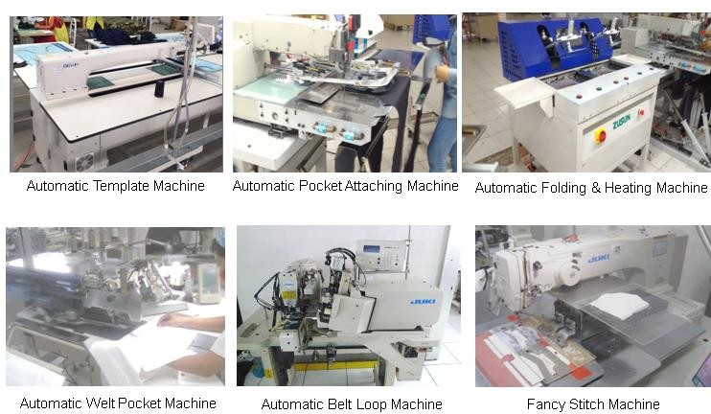
BOTTOM PRODUCT AUTOMATION
OTHER AUTOMATION MACHINES AND MANY MORE…

Slide 13
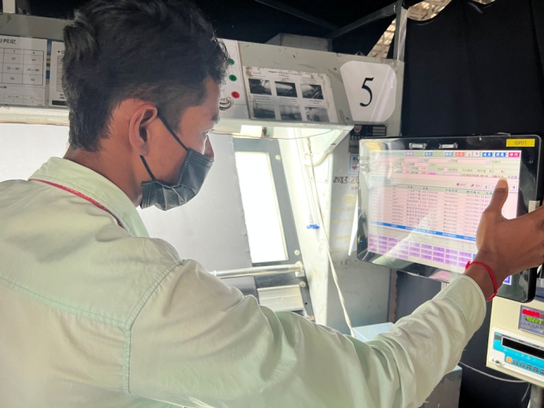
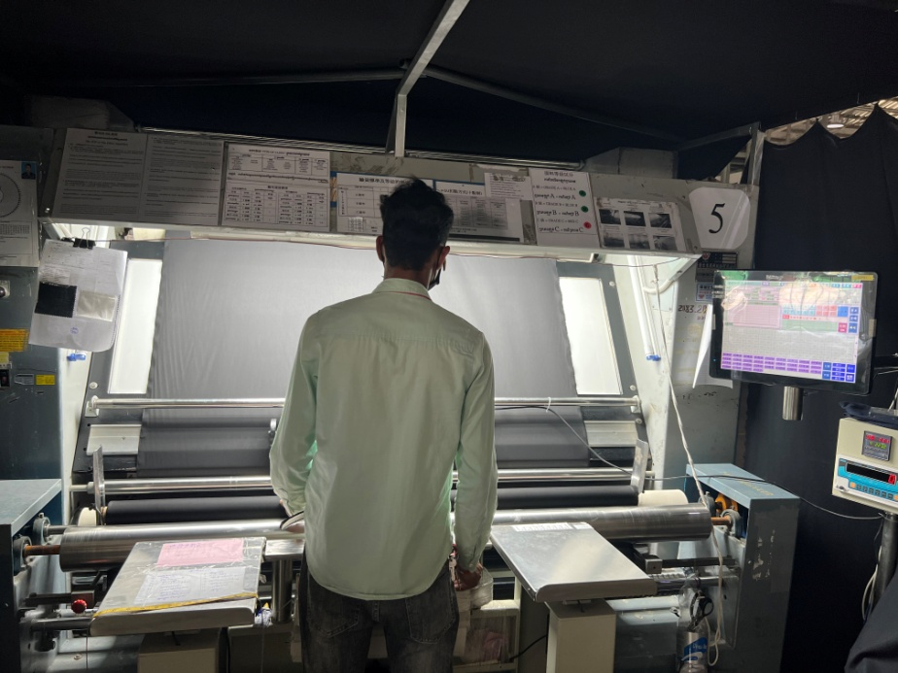
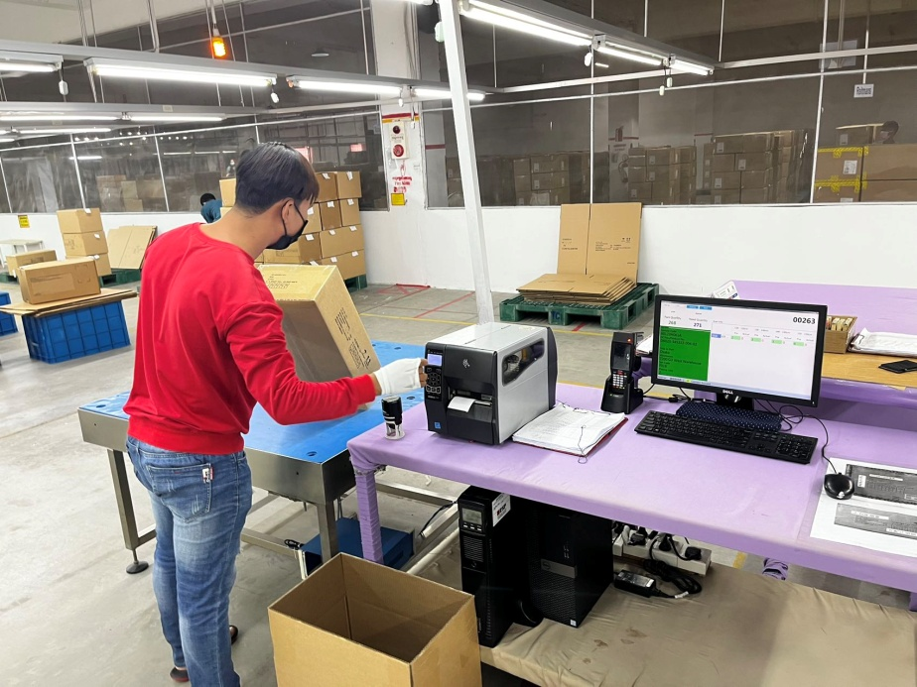
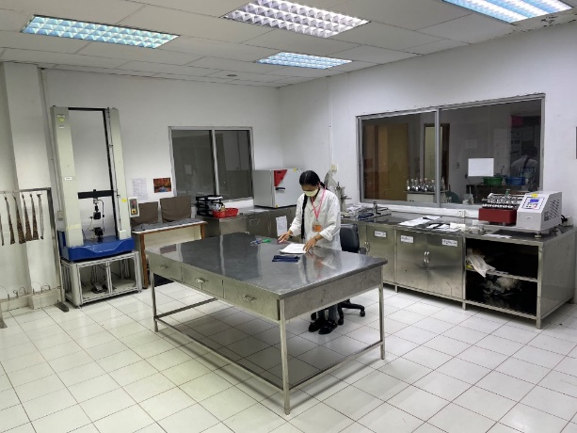

FABRIC DEFECT RECORD
SYSTEM PILLOT IN
CAMBODIA
SCAN & PACK SYSTEM
IN-HOUSE LAB TEST

Slide 14
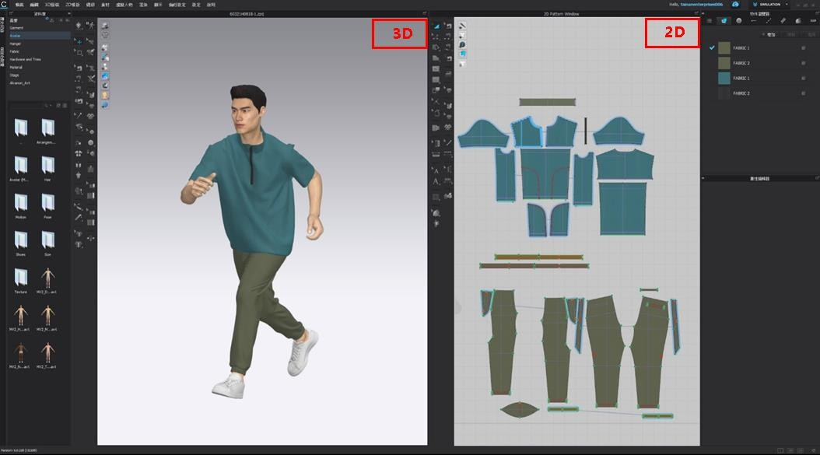
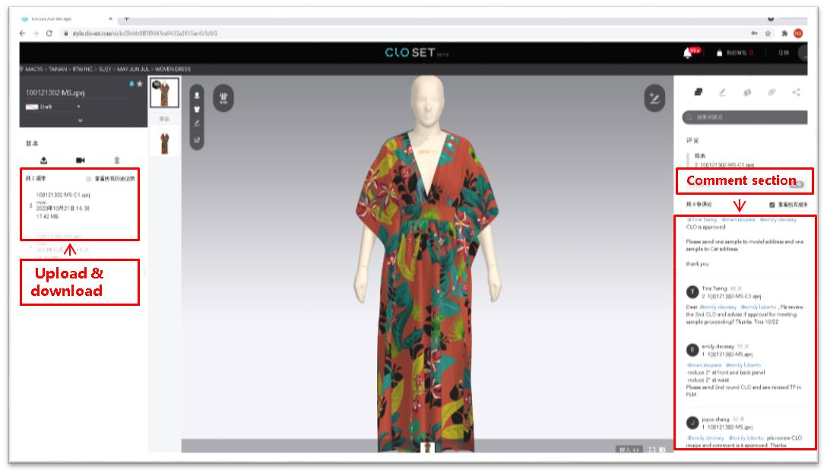
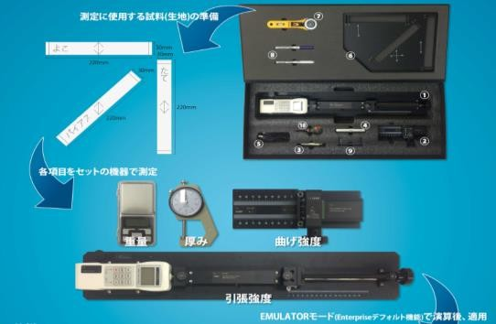
3D TECHNOLOGY
CLO- SET
Instantly review changes as any modifications to 2D patterns, colors, textures and finishing details are immediately simulated
AUTOMATIC FABRIC ANALYSIS
accurately emulate drape-sensitive fabrics such as lightweight woven and jerseys with various material properties

Slide 15
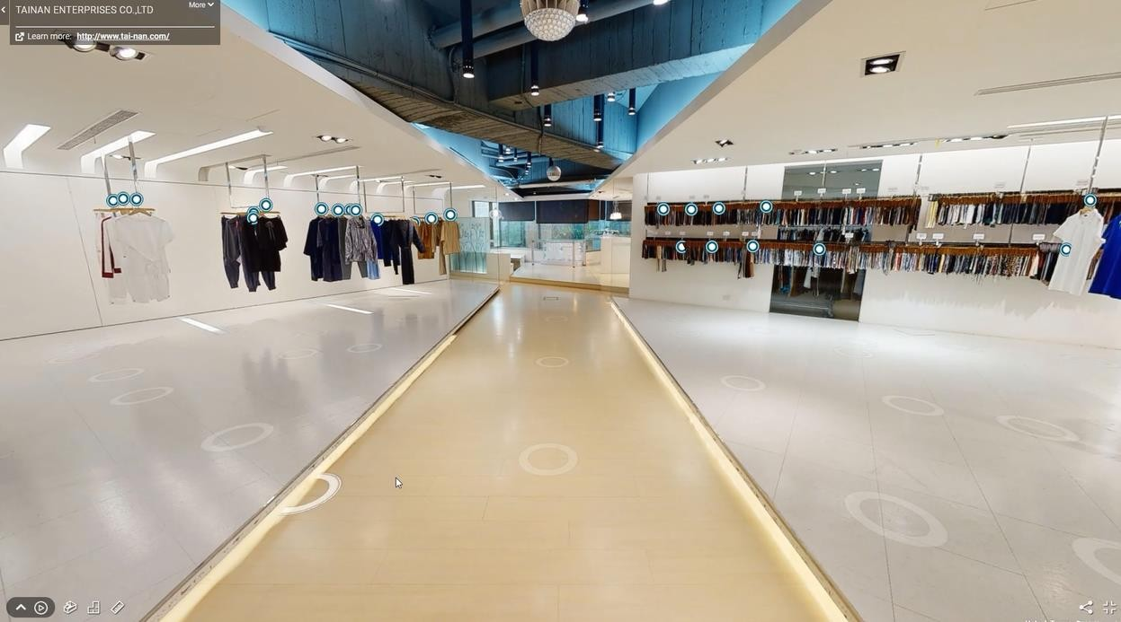

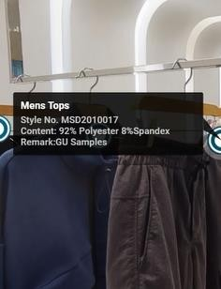
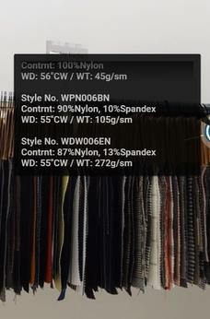
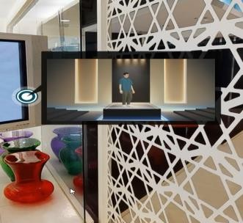
VIRTUAL SHOWROOM
Tainan 3D Show Room
a virtual space where customers can interact with all the production without the constraints of the physical environment
Samples Fabrics Catwalk

Slide 16

Target: 30% CO2e reduction
per garment by 2030
Baseline year 2018

Slide 17
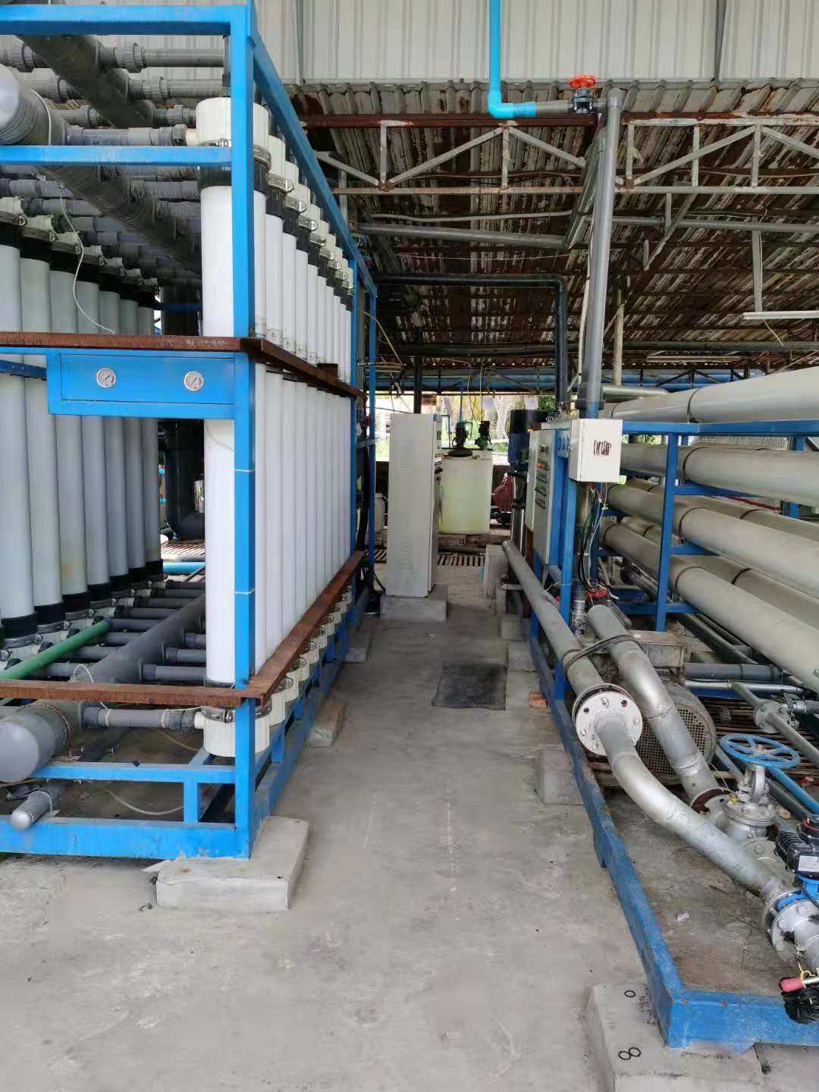
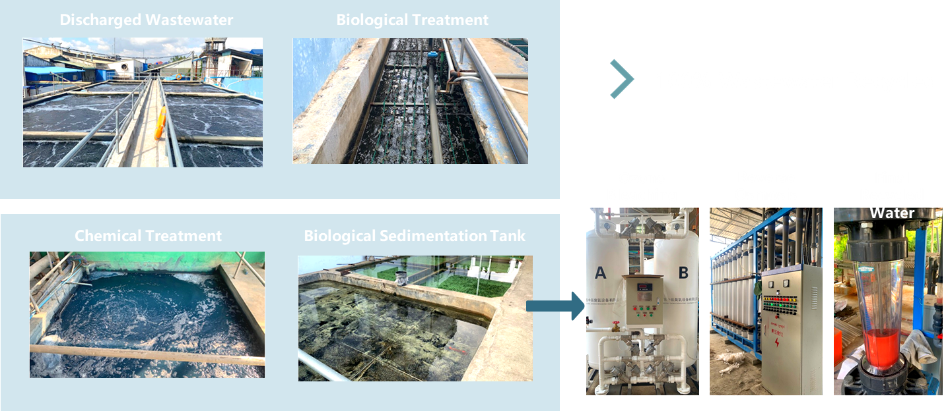
100% Wastewater Recycled
Effluent Treatment
CAMBODIA IN-HOUSE LAUNDRY

Slide 18





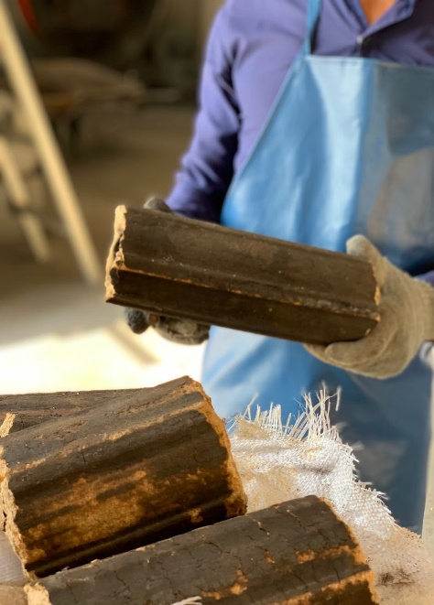
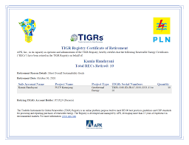
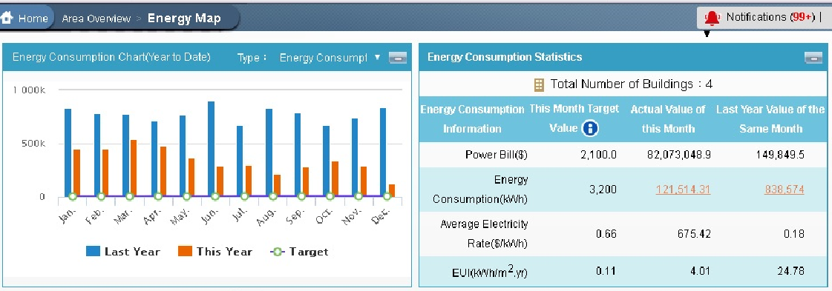
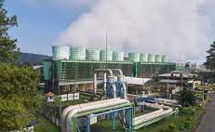

TAINAN ENTERPRISES TARGET :
30% CO2e REDUCTION PER GARMENT BY 2030
Rooftop Solar
Biomass Energy
Renewable Energy Certificates
Energy Management System
Geothermal Electric Power Station

Slide 19

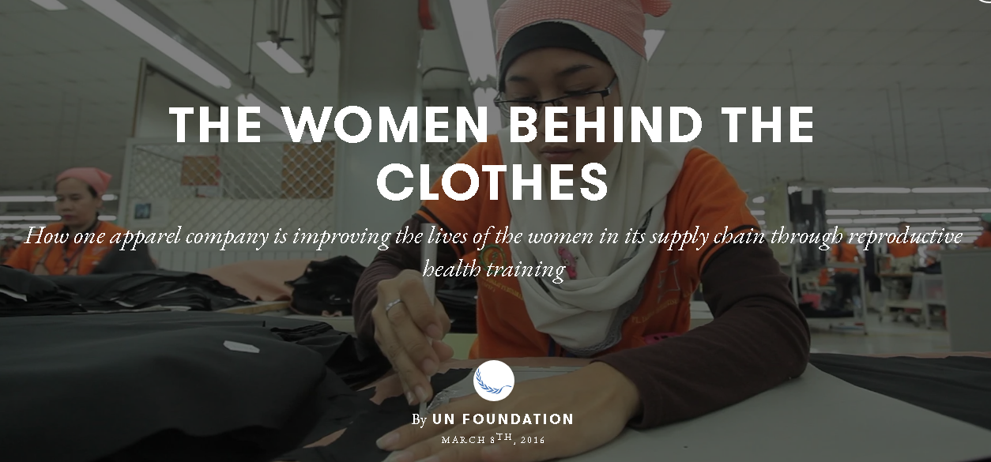
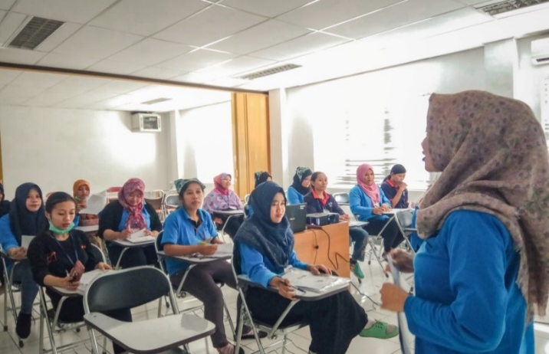
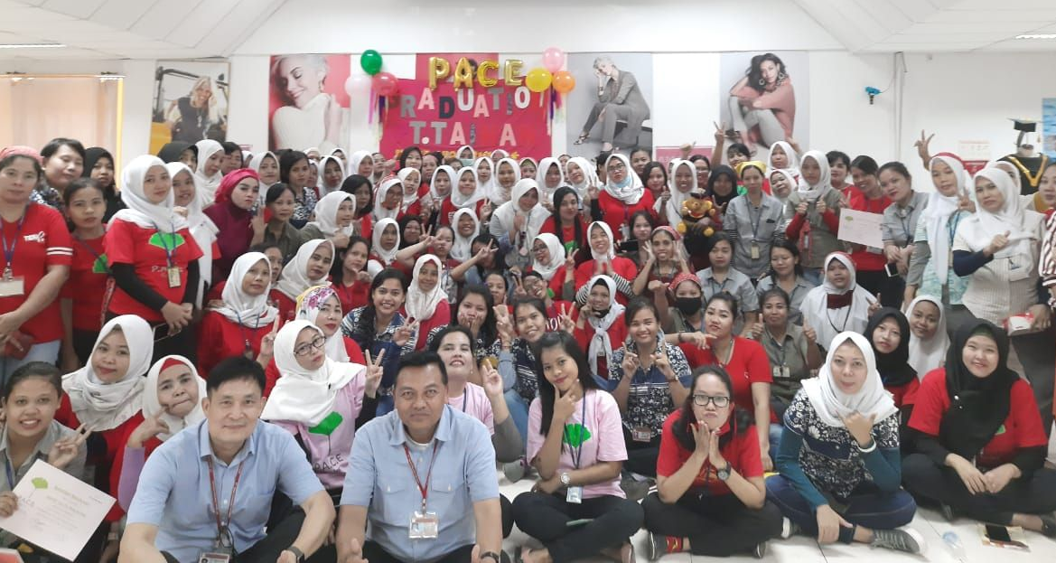
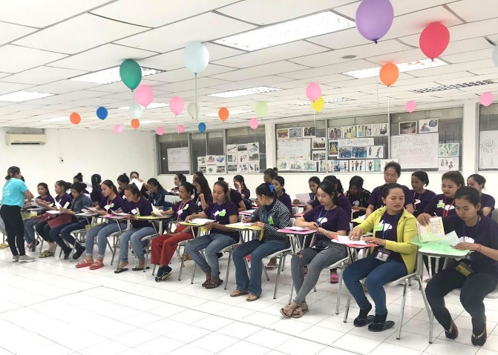

WOMEN EMPOWERMENT PROJECTS
Health education, Financial planning guidance, Communication & problem solving trainings
Introduced to Indonesia, Vietnam factory
Project success published by UN Foundation’s Universal Access Project
Introduced to Cambodia, Indonesia, Vietnam factory
Indonesia factory P.A.C.E opening
Cambodia P.A.C.E course

Slide 20
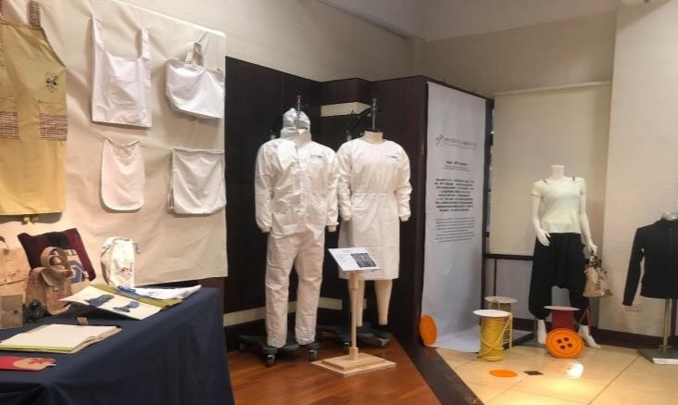
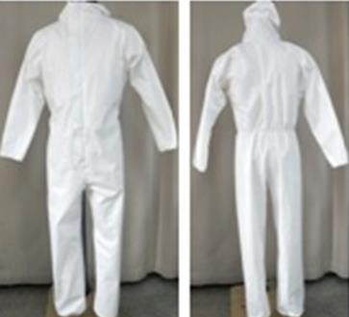
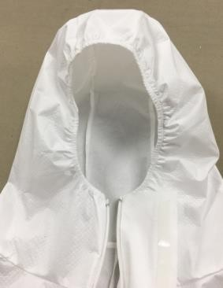
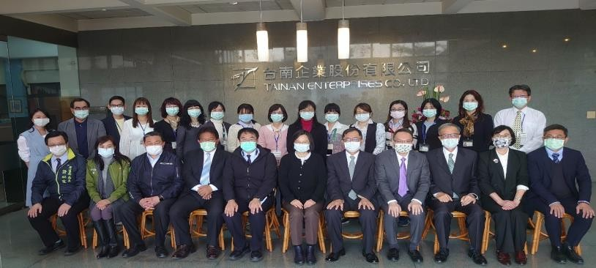
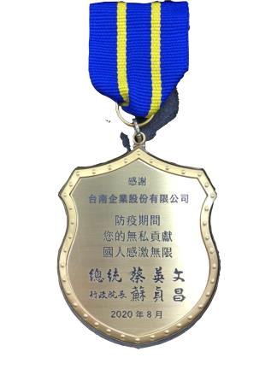

PPE FOR THE HEALTH WORKFORCE DURING COVID-19
TAIWAN / CAMBODIA
Passed P2 Level
Moisture Permeability ≧ 1500 g/㎡ . 24h
Hydrostatic Pressure ≧ 50cmH₂O
Sub-micron Particle Filtration Efficiency ≧ 70%
President Tsai visited Tainan Enterprises to thank the contribution of COVID- 19 prevention of production of "one million PPEs".

Slide 21
Thank you
https://www.eng.tai-nan.com/

