Slide 1
1503TW 士林電機
SHIHLIN ELECTRIC & ENGINEERING CORP.
BUSINESS REVIEW

Slide 2
Safe Harbor Statement
This Presentation contains certain forward-looking statements that are based on current expectations and are subject to known and unknown risks and uncertainties that could cause actual results to differ materially from those expressed or implied by such statements.
Except as required by law, we undertake no obligation to update any forward –looking statements, whether as a result of new information, future events or otherwise.

Slide 3

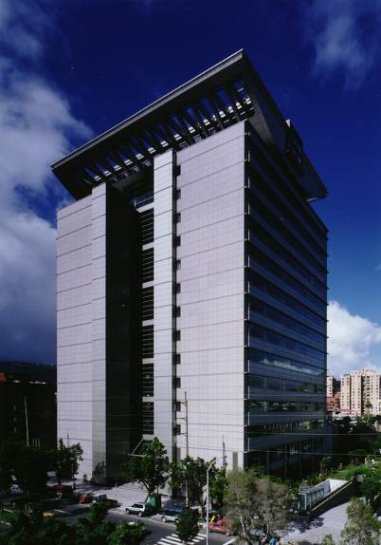
Corporate Overview
Established in 1955
Manufacturing leader of electrical products for the industrial, automotive and transportation industries
Mitsubishi Electric Japan is Shihlin‘s largest shareholder (21%)
Original Technology from Mitsubishi
Reputation in Taiwan, China and Asia for Integrity, Quality-made Products, Application Support and Service
Headquarters Address:16 F, No.88, Chung Shan N. Rd., Sec. 6, Taipei, Taiwan

Slide 4
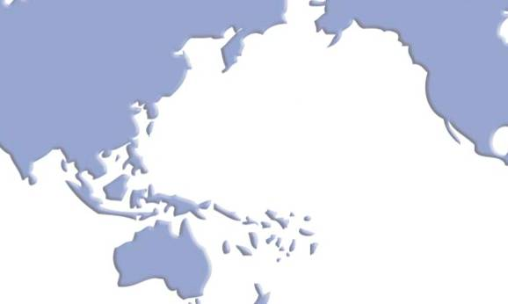
Global Factories, Branch and Sales
3 Factories in Vietnam
12 Factories in China
5 Branch offices in China
18 Sales offices in China
Headquarters in Taipei
3 Factories in Taiwan
5 Branch(Sales) offices in Taiwan
California USA Subsidiary
Philippines Branch
Australia Subsidiary

Slide 5
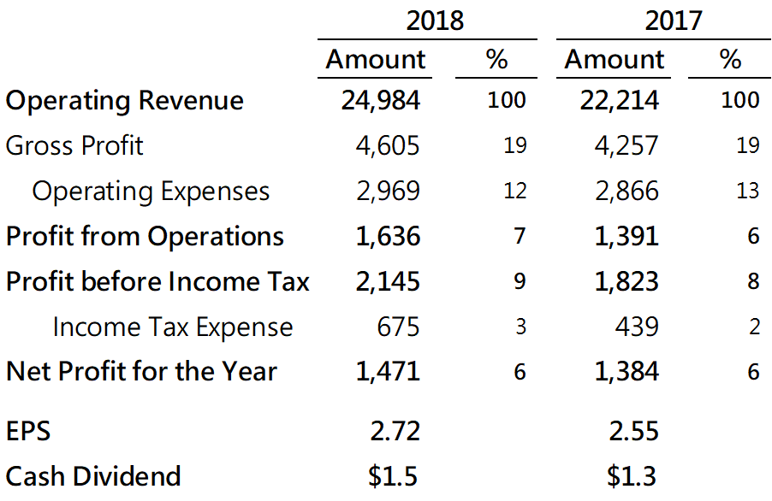
Financial Highlights – Income Statement (Consolidated)
(In Millions of NTD, Except EPS and Dividend)

Slide 6
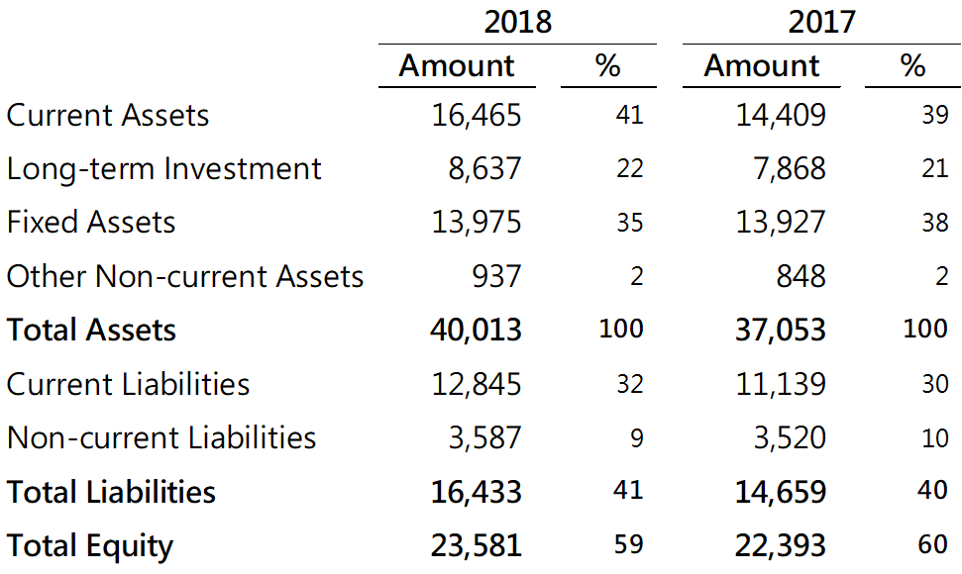
Financial Highlights – Balance Sheet
(Consolidated)
(In Millions of NTD)

Slide 7
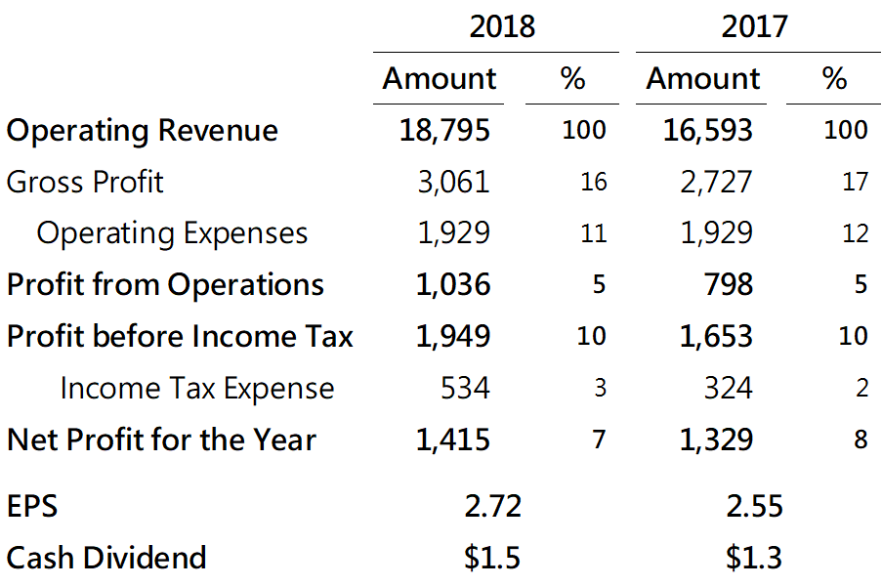
Financial Highlights – Income Statement (Standalone)
(In Millions of NTD, Except EPS and Dividend)

Slide 8
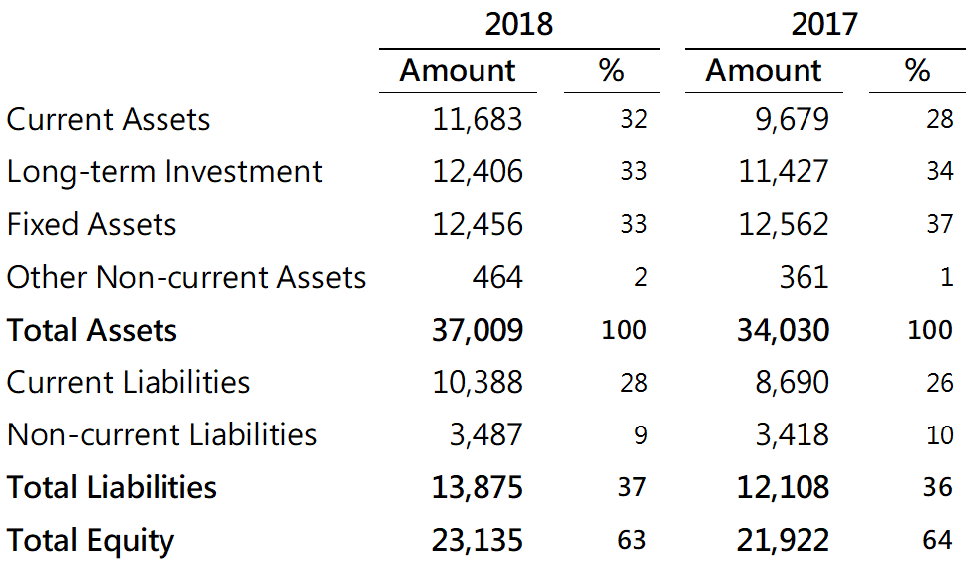
Financial Highlights – Balance Sheet
(Standalone)
(In Millions of NTD)

Slide 9
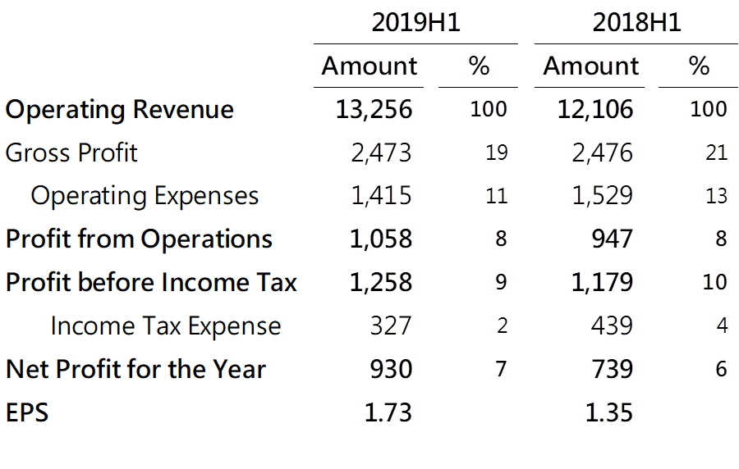
Financial Highlights – Income Statement (Consolidated)
(In Millions of NTD, Except EPS)

Slide 10
Thank you for your listening !

