Slide 1
Right Way Group
Introduction
ISO/TS 16949
ISO14001
Version: 2018

Slide 2
Disclaimer
The information contained in this confidential document ("Presentation") has been prepared by Right Way (the "Company"). It has not been fully verified and is subject to material updating, revision and further amendment.
While the information contained herein has been prepared in good faith, neither the Company nor any of its shareholders, directors, officers, agents,employees or advisers gives, has given or has authority to give, any representations or warranties (express or implied) as to, or in relation to, the accuracy,reliability or completeness of the information in this Presentation, or any revision or supplement thereof, or of any other written or oral information made or to be made available to any interested party or its advisers (all such information being referred to as "Information") and liability therefore is expressly disclaimed. Accordingly, neither the Company nor any of its shareholders, directors, officers, agents, employees or advisers takes any responsibility for, or will accept any liability whether direct or indirect, express or implied, contractual, tortious, statutory or otherwise, in respect of, the accuracy or completeness or injury of the Information or for any of the opinions contained herein or for any errors, omissions or misstatements or for any loss, howsoever arising, from the use of this Presentation or the information.
Neither the issue of this Presentation nor any part of its contents is to be taken as any form of commitment on the part of the Company to proceed with any transaction and the right is reserved by the Company to terminate any discussions or negotiations with any prospective investors. In no circumstances will the Company be responsible for any costs, losses or expenses incurred in connection with any appraisal or investigation of the Company. In furnishing this Presentation, the Company does not undertake or agree to any obligation to provide the recipient with access to any additional information or to update this Presentation or to correct any inaccuracies in, or omissions from, this Presentation which may become apparent.
This Presentation should not be considered as the giving of investment advice by the Company or any of its shareholders, directors, officers, agents,employees or advisers. Each party to whom this Presentation is made available must make its own independent assessment of the Company after making such investigations and taking such advice as may be deemed necessary. In particular, any estimates or projections or opinions contained herein necessarily involve significant elements of subjective judgment, analysis and assumptions and each recipient should satisfy itself in relation to such matters.
This Presentation includes certain statements that may be deemed “forward-looking statements”. All statements in this discussion, other than statements of historical facts, that address future activities and events or developments that the Company expects, are forward-looking statements. Although the Company believes the expectations expressed in such forward-looking statements are based on reasonable assumptions, such statements are not guarantees of future performance and actual results or developments may differ materially from those in the forward-looking statements. Factors that could cause actual results to differ materially from those in forward-looking statements include market prices, continued availability of capital and financing, general economic, market or business conditions and other unforeseen events. Prospective Investors are cautioned that any such statements are not guarantees of future performance and that actual results or developments may differ materially from those projected in forward-looking statements.

Slide 3
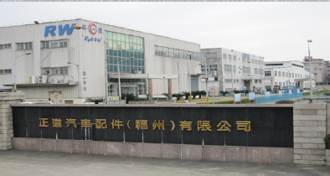
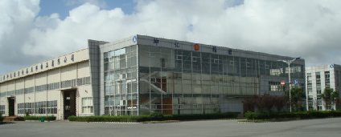
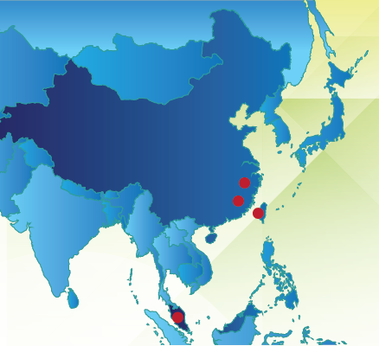
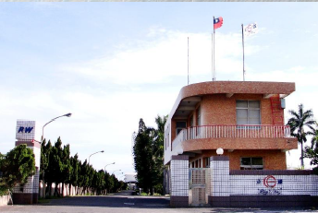
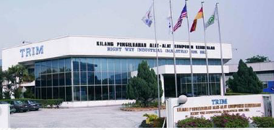
Right Way Group
Mfg abilities :
Tube hydroforming
Products:
-- Chassis
-- Frame
RW Fuzhou, China
Unimax Shanghai, China
Mfg abilities:
Steel forging, machining
Products :
-- Pistons
-- Conrods
-- Steering components
RW Tainan, Taiwan
Mfg abilities :
Gravity casting/forging, machining
Products:
-- Pistons
-- Conrods
-- Steering components
-- Al castings
-- Al forgings
-- Balance shafts
RW Kuala Lumpur, Malaysia
Mfg abilities :
Gravity casting, machining
Products:
-- Pistons
-- Al castings

Slide 4
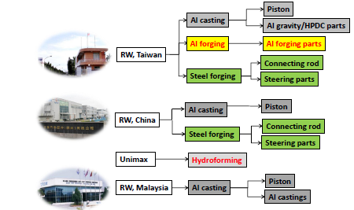
Product Manufacturing Capabilities

Slide 5
Milestones
Founded in Tainan, Taiwan
Technical Cooperation with Japan ART metal Ltd. for Pistons Technology
Technical Cooperation with Japan Yayoi Forging Co. for Steering & Suspension Parts
Publicly traded on the Taiwan Stock Exchange
Establishment of Right Way Industrial (Kuala Lumpur), Malaysia
Establishment of Right Way Auto Parts (Fu Zhou), China
ISO 9001 and ISO 14001 Certified
ISO TS16949 Certified
Licensed by NASA (USA) to use
high performance materials
Celebrated our
50th Anniversary!
Acquisition of Unimax
(Hydroforming)
IATF 16949
Certified
1964
1967
1973
1980
1989
1996
2002
2004
2005
2014
2015
2018

Slide 6
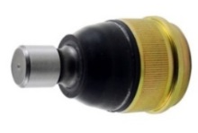
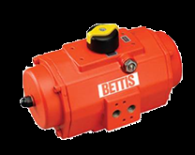
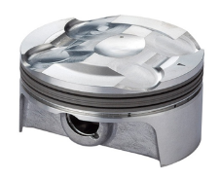
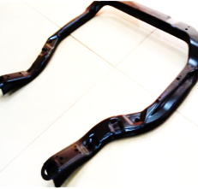
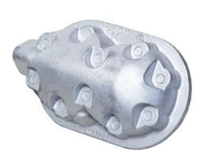
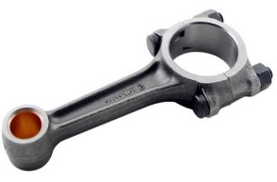
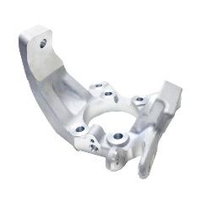
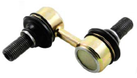
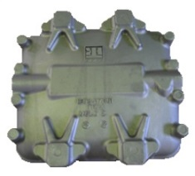
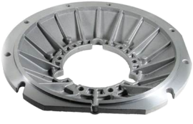
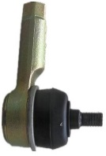
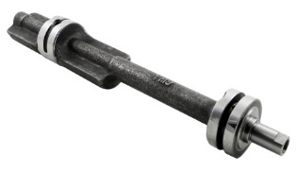
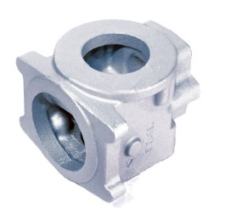
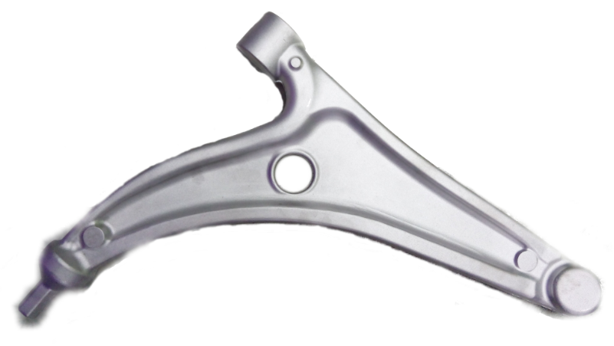
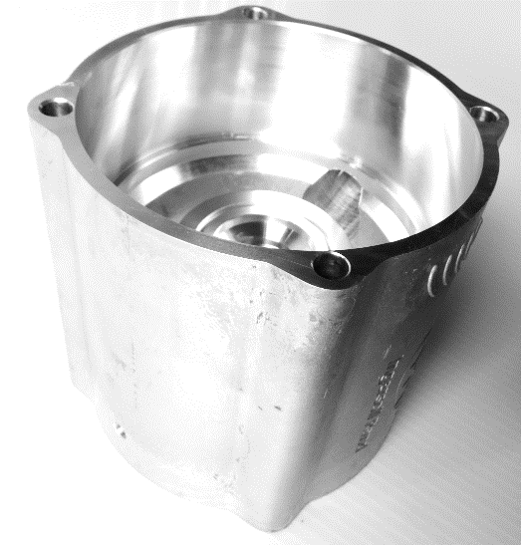

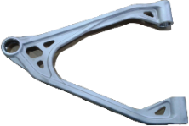
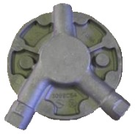
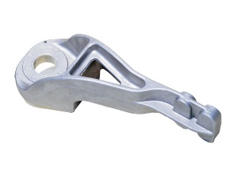

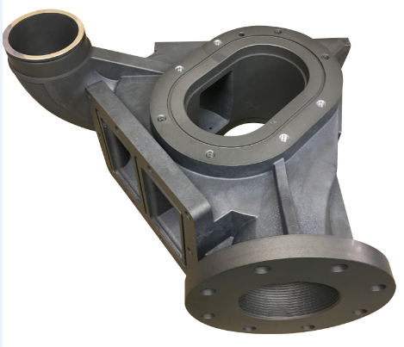
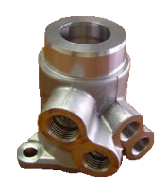
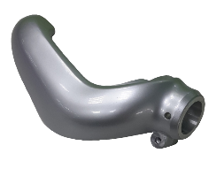
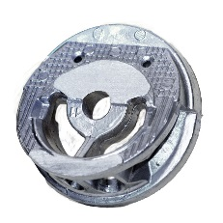
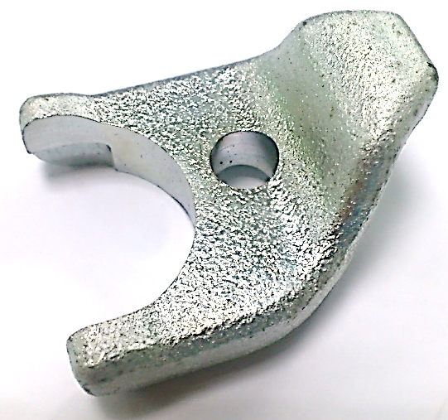
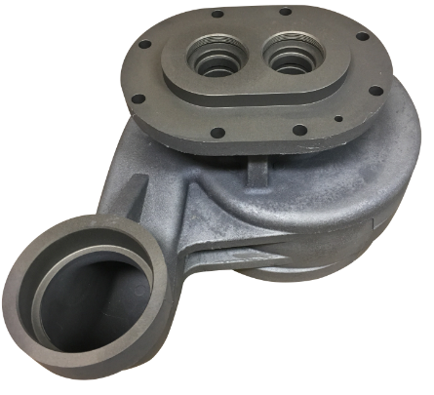
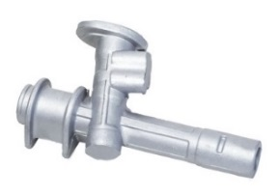
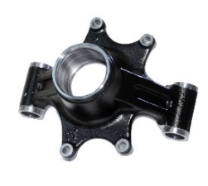
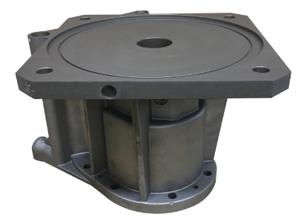
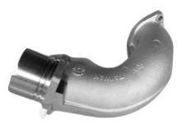
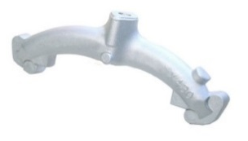
一、Product Applications
Applications | Engines | Steering components | Chassis/suspension | Refrigeration compressors | Industrial
Material | Aluminum/Steel | Aluminum/Steel | Aluminum/Steel | Aluminum/cast iron | Aluminum
Process | Castings/forgings | Castings/forgings | Castings/forgings | Castings | Castings/forgings
Products
piston
C/R
ball joint
subframe
cylinder head
actuator
housing
link
knuckle
oil pump
flange
balance shaft
tie rod
control
arm
throttle valve
tie rod
housing
engine mount
link
pump cover
valve housing
suspension
arm
nozzle bracket
cam rotor
pump housing
pinion
housing
knuckle
manifold
manifold

Slide 7



















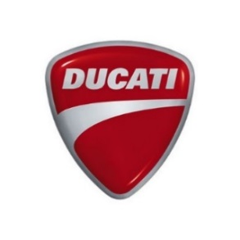














Our Customers
Automotive OE
China
Taiwan | Malaysia
Tier 1
(Nissan)
(Mitsubishi)
North America
Motorcycle

Slide 8
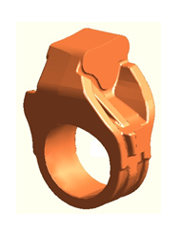
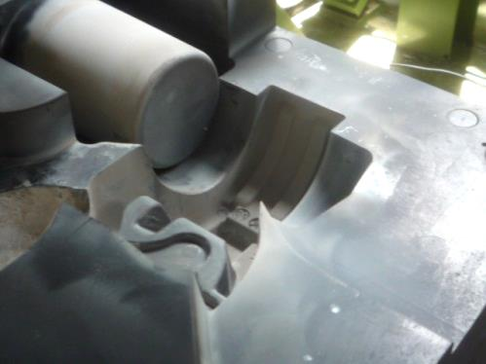
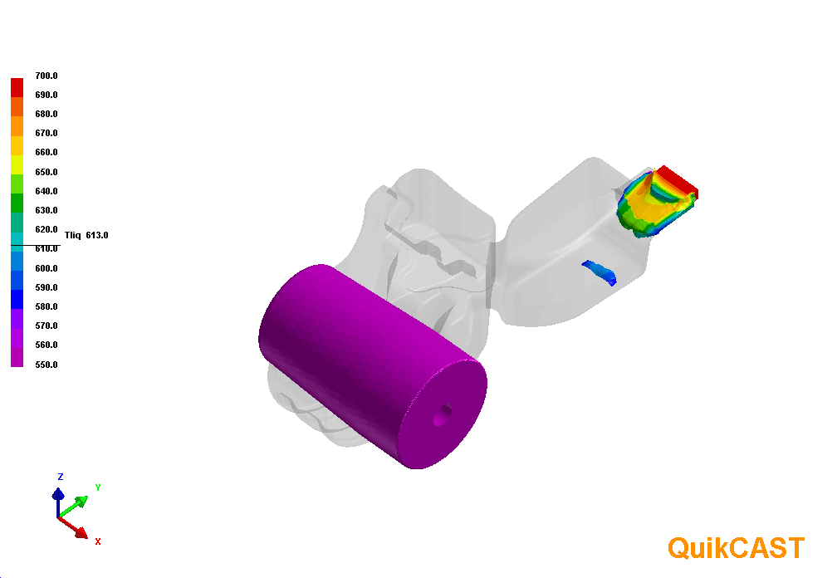
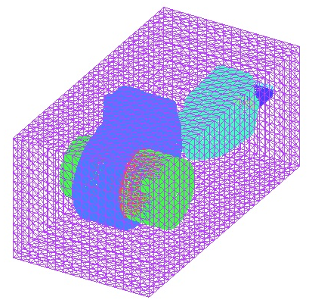
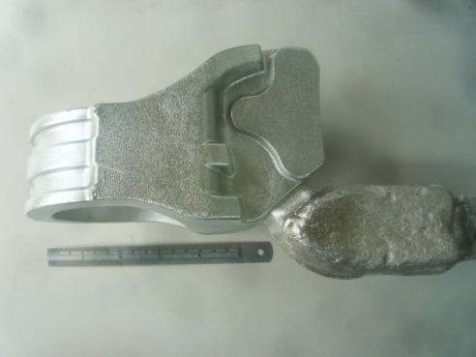
Product Development Process-Aluminum Casting
To achieve effective mold creation and excellent blank quality
1.CAD model
4. Mold fabrication
3.
Casting simulations (QuikCAST)
is used to evaluate the feasibility of mold design
2. Initial mold design
is created for analysis
5. Casting trial

Slide 9
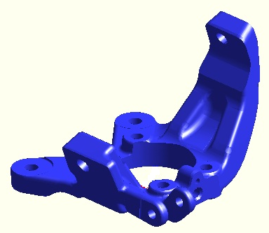
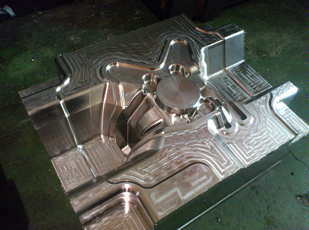
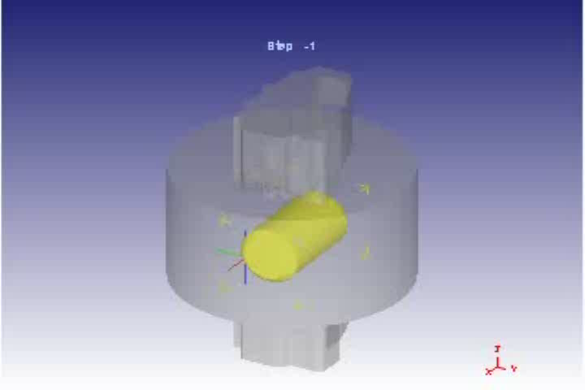
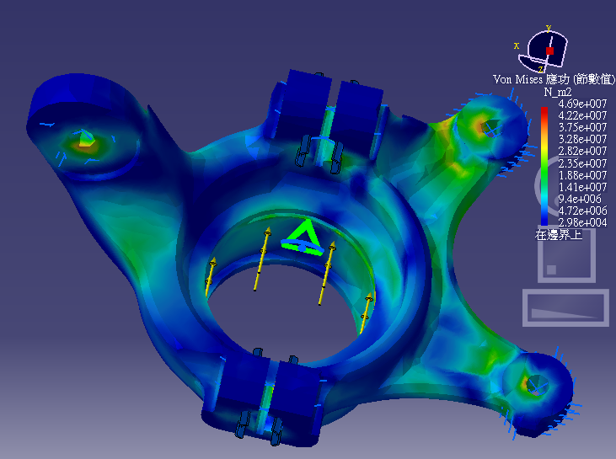
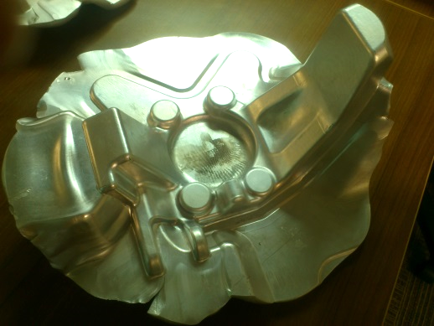
Product Development Process-Aluminum Forging
To achieve effective mold creation and excellent blank quality
1. CAD model
4. Mold fabrication
3. Forging process CAE analysis
2.
FEA & Grain Flow simulations
Analysis will be done if needed to
evaluate the stress distribution
5. Blank production trial

Slide 10
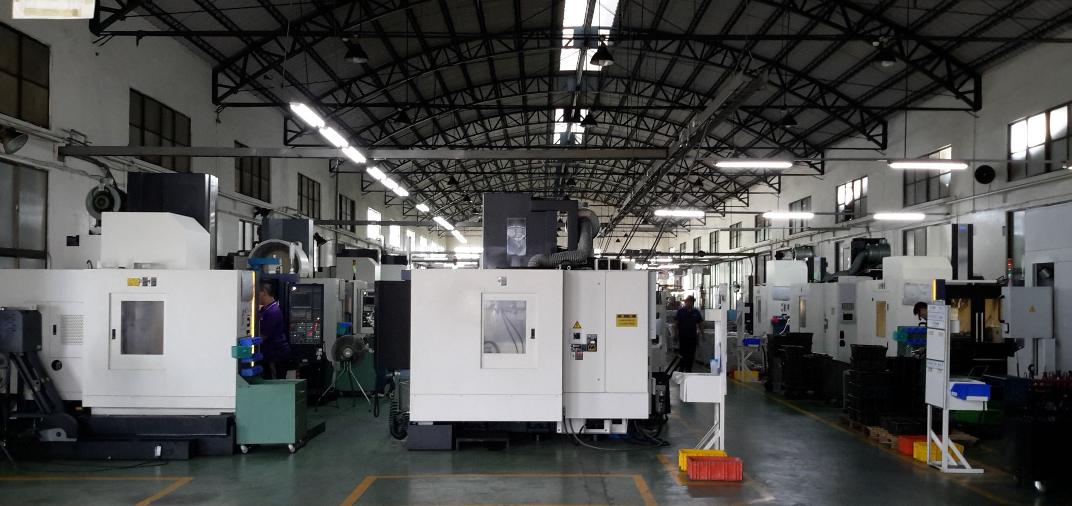
Precision Machining
State of the art CNC Lathes & CNC Machine Centers
High capacity; operated by highly trained technicians

Slide 11
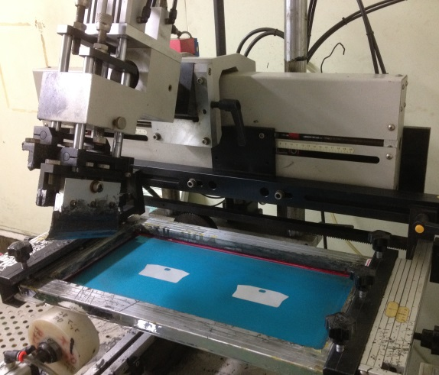
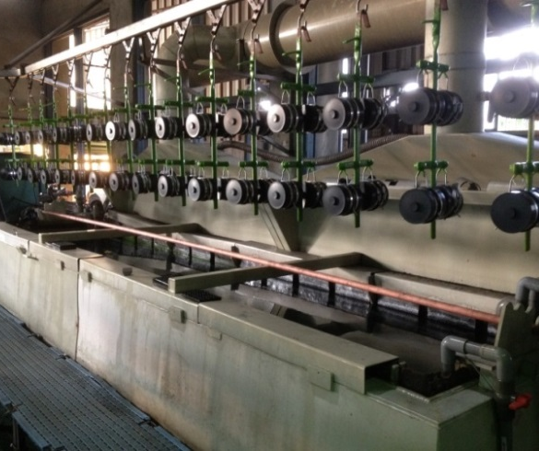
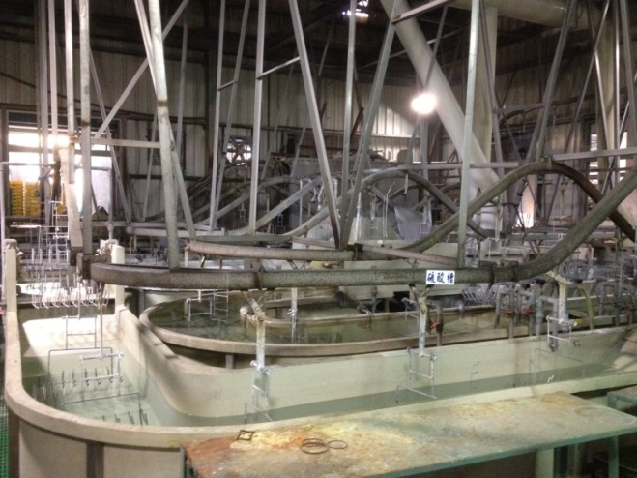



Surface Treatments
Available treatments include: ED coating, Hard chrome plating, Black anodizing, Powder coat and gloss.
Piston surface treatments include:
Skirt Coating
Anodizing
Tin Plating

Slide 12

12

Slide 13

13

Slide 14

14

Slide 15

三、QC-IATF 16949
15

Slide 16


Slide 17


Slide 18


Slide 19


Slide 20


Slide 21


What Are We Good at?
Light Weight Oriented Solution Expert
  Aluminum Casting/Forging Suspension/Chassis Parts
    Lighter, stronger, and more durable
    Excellent mechanical properties
    Fuel Economy
Engine Parts Solution Expert
  NASA High Performance Pistons
    Lighter and stronger under high temperature operating environment
    RaiSuitable for lightweight design without compromising horse power
    sing compression ratio
    Reduce emissions & CO2 (green house gas)
  Fracture Splitting Connecting Rods
    Better Reproducibility

Slide 22
Your Best Choice
Capability & Quality：Having over 50 years experience in automotive industry with well-managed quality systems, we are able to meet customers’ requirements.
Deliver (Just-in-Time)：With different facilities and integrated processes in different regions, we have the ability to serve our customers on a JIT basis.
One Stop Solution : With our product development capability, supply chain management and quality systems, we are able to find every solution for you to develop any metal products you desire.
Unique Services：Our full range services are unique, comprised of passion, pro-activity, reliability, innovation and efficiency.

