Slide 1



Chiu Ting Machinery Co., Ltd
Year 2023 Q3 Earnings Call
Stock Code : 1539
2023/12/20
www.geetech.com.tw

Slide 2
Company Profile
Business Scope
Core Business: Professional Woodworking Machinery ODM for brand customers.
Main export market: North America & Europe.
Established in August 1981.
Listed in over-the-counter market in February 2001
Public listed in Taipei Stock Exchange in October 2002
www.geetech.com.tw

Slide 3
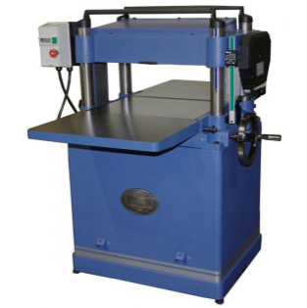
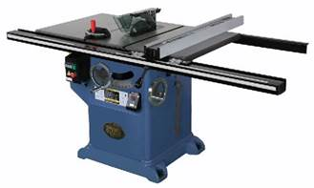
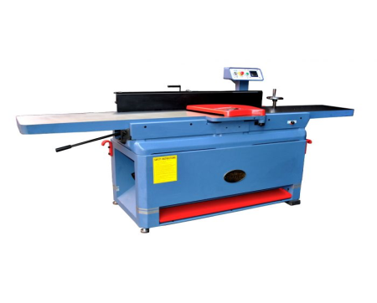
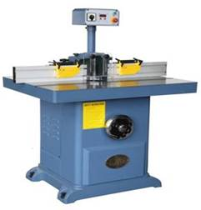
Main Products Categories
Planer, Bench Top & Stationary
Table Saw, Bench Top & Stationary
Jointer, Bench Top & Stationary
Single Spindle Shaper
www.geetech.com.tw

Slide 4
Market Segments
Construction
Home Enhancement
Furniture
Remodeling
Cultural and Creative Crafts
Hobbyist
www.geetech.com.tw

Slide 5

Long Term Strategic Customers
www.geetech.com.tw

Slide 6
2021 ~ 2023 Q3 Revenue by Product Category
Product \ Year | 2021 | 2022 | 2023 Q1~Q3
TABLE SAW | 25% | 30% | 26%
PLANER | 50% | 42% | 45%
JOINTER | 11% | 11% | 12%
OTHER | 14% | 17% | 17%
www.geetech.com.tw

Slide 7
2021 ~ 2023 Q3 Revenue by Regions
Region \ Year | 2021 | 2022 | 2023 Q1~Q3
USA | 82.48% | 89.32% | 89.87%
EUROPE | 7.27% | 3.65% | 2.39%
OTHER | 10.25% | 7.02% | 7.73%
Total | 100.00% | 100.00% | 100.00%
www.geetech.com.tw

Slide 8
Year 2023 P&L and Comparison with Previous Year
In Thousands of NT Dollars; EPS as in Dollar
 | Year 2023 |  |  |  | Year 2022 | Growth Against 2022
Subject | Q1 | Q2 | Q3 | Q1~Q3 | Q1~Q3 | Amount | %
Revenue | 253,971 | 450,920 | 396,355 | 1,101,246 | 2,207,729 | (1,106,483) | (50.12%)
Gross Profit | 20,931 | 46,195 | 48,009 | 115,135 | 270,343 | (155,208) | (57.41%)
Gross Margin | 8.24% | 10.24% | 12.11% | 10.45% | 12.25%
Operating Expense | 20,626 | 23,416 | 23,489 | 67,531 | 87,929 | (20,398) | (23.20%)
Expense Ratio | 8.12% | 5.19% | 5.93% | 6.13% | 3.98%
Net Operating Profit | 305 | 22,779 | 24,520 | 47,604 | 182,414 | (134,810) | (73.90%)
Operating Margin | 0.12% | 5.05% | 6.19% | 4.32% | 8.26%
Net Profit | - 3,473 | 26,777 | 37,945 | 61,249 | 411,036 | (349,787) | (85.10%)
EPS | - 0.05 | 0.41 | 0.58 | 0.94 | 6.28
www.geetech.com.tw

Slide 9
Year 2023 Q1 ~ Q3 Revenue by Product
Category and Comparison with Previous Year
In Thousands of NT Dollars
Product Category | Revenue
 | 2023 Q1 ~ Q3 | 2022 Q1 ~ Q3 | Difference
Planer | 495,316 | 984,471 | (489,155)
Table Saw | 285,743 | 649,290 | (363,547)
Jointer | 127,542 | 243,687 | (116,145)
Other | 192,645 | 330,281 | (137,636)
Total | 1,101,246 | 2,207,729 | (1,106,483)
In comparison with year 2022 first 3 quarters, year 2023 product category Planer, its revenue decreased 489 million NT dollars. Product category Table Saw decreased 363 million dollars. And product category Jointer decreased 116 million dollars.
www.geetech.com.tw

Slide 10
Year 2023 Quarterly Revenue
In Thousands of NT Dollars
Product Category | Revenue
 | Q1 | Q2 | Q3 | Sum
Planer | 90,511 | 215,013 | 189,792 | 495,316
Table Saw | 76,068 | 107,515 | 102,160 | 285,743
Jointer | 36,446 | 57,559 | 33,537 | 127,542
Other | 50,946 | 70,833 | 70,866 | 192,645
Total | 253,971 | 450,920 | 396,355 | 1,101,246
◆ Year 2023 Q2 revenue 450 million NT dollars, compare to Q1 253 million dollars, 2nd quarter revenue increased 196 million dollars. Main increase comes from Product Category Planer, Table Saw and Jointer, increased 124 million dollars, 31 million dollars and 21 million dollars respectively.
◆ 2023 Q3 revenue 396 million dollars, compare to Q2 450 million dollars, 3rd quarter decreased 54 million dollars. Main decrease comes from Planer and Jointer product categories, decreased 25 million dollars and 24 million dollars respectively.
www.geetech.com.tw

Slide 11
Year 2023 Non-operating Income in
Comparison with Previous Year
In Thousands of NT Dollars
Item | Q1 ~ Q3 2023 | Q1 ~ Q3 2022 | Difference
Interest Income | 9,718 | 1,888 | 7,830
Foreign Exchange Gain(Loss) | 32,626 | 204,180 | (171,554)
Gain-Disposal Subsidiary | 0 | 115,750 | (115,750)
Finance Cost | (7,065) | (10,850) | 3,785
Other Expense and Receivable | 2,457 | 7,180 | (4,723)
Total | 37,736 | 318,148 | (280,412)
USD : NTD | Average Asset in USD持有美金平均淨資產 | Exchange Rate difference匯率增減 | Exchange Rate Variation匯率變動
Q1 ~ Q3 2023 | 20,596 | 1.56 | 30.71→32.27
Q1 ~ Q3 2022 | 47,969 | 4.07 | 27.68→31.75
www.geetech.com.tw

Slide 12
Operational Risks
Exchange Rate Risk
Raw Material Price Risk
Market Uncertainty Risk
www.geetech.com.tw

Slide 13
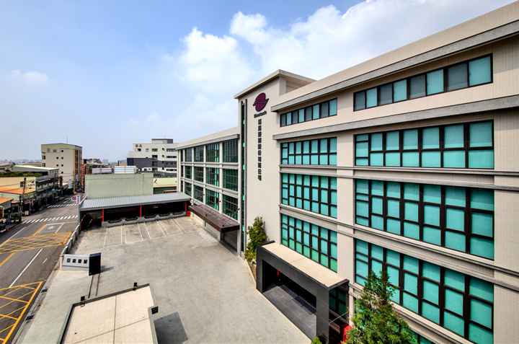
New Facility in Operation
www.geetech.com.tw

Slide 14
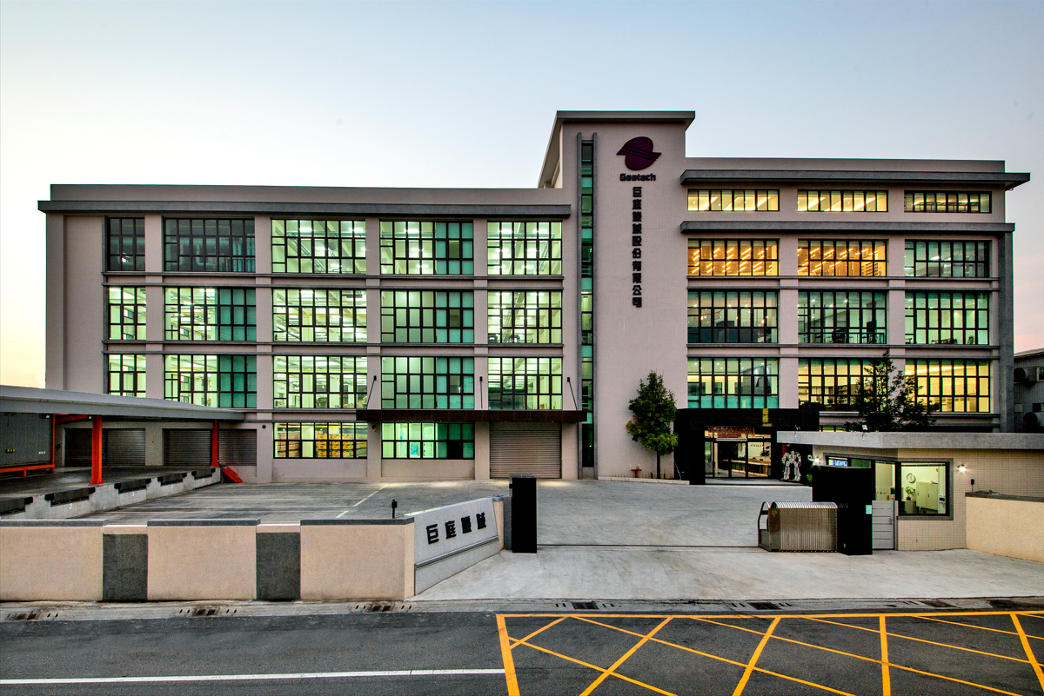
New Facility in Operation
www.geetech.com.tw

Slide 15


Chiu Ting Machinery Co., Ltd
Q&A
Innovation Is an Ongoing Project
www.geetech.com.tw

