Slide 1



Chiu Ting Machinery Co., Ltd
Year 2024 Earnings Call
Stock Code : 1539
2024/5/9
www.geetech.com.tw

Slide 2
Company Profile
Business Scope
Core Business: Professional Woodworking Machinery ODM for brand customers.
Main export market: North America & Europe.
Established in August 1981.
Listed in over-the-counter market in February 2001
Public listed in Taipei Stock Exchange in October 2002
www.geetech.com.tw

Slide 3
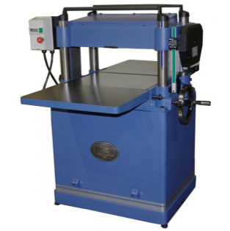
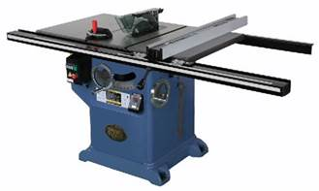
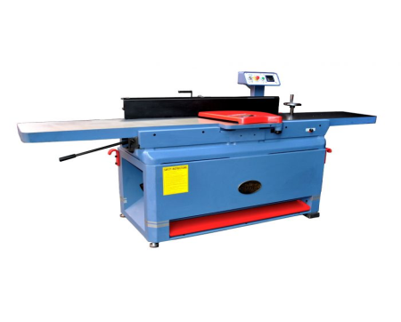
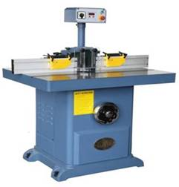
Main Products Categories
Planer, Bench Top & Stationary
Table Saw, Bench Top & Stationary
Jointer, Bench Top & Stationary
Single Spindle Shaper
www.geetech.com.tw

Slide 4
Market Segments
Construction
Home Enhancement
Furniture
Remodeling
Cultural and Creative Crafts
Hobbyist
www.geetech.com.tw

Slide 5

Long Term Strategic Customers
www.geetech.com.tw

Slide 6
2021 ~ 2023 Revenue by Product Category
Product \ Year | 2021 | 2022 | 2023
TABLE SAW | 25% | 30% | 25%
PLANER | 50% | 42% | 48%
JOINTER | 11% | 11% | 11%
OTHER | 14% | 17% | 16%
www.geetech.com.tw

Slide 7
2021 ~ 2023 Revenue by Regions
Product \ Year | 2021 | 2022 | 2023
USA | 82.48% | 89.32% | 90.88%
EUROPE | 7.27% | 3.65% | 2.26%
OTHER | 10.25% | 7.02% | 6.86%
TOTAL | 100% | 100% | 100%
www.geetech.com.tw

Slide 8
Year 2023 P&L and Comparison with Previous Year
In Thousands of NT Dollars; EPS as in Dollar
 | Year 2023 |  |  |  |  | Year 2022 | Growth Against 2022
Subject | Q1 | Q2 | Q3 | Q4 | Amount | Amount | Amount | %
Revenue | 253,971 | 450,920 | 396,355 | 432,238 | 1,533,484 | 2,500,729 | (966,595) | (38.66%)
Gross Profit | 20,931 | 46,195 | 48,009 | 57,616 | 172,751 | 296,511 | (123,760) | (41.74%)
Gross Margin | 8.24% | 10.24% | 12.11% | 13.33% | 11.27% | 11.86%
Operating Expense | 20,626 | 23,416 | 23,489 | 25,212 | 92,743 | 110,787 | (18,044) | (16.29%)
Expense Ratio | 8.12% | 5.19% | 5.93% | 5.83% | 6.05% | 4.43%
Net Operating Profit | 305 | 22,779 | 24,520 | 32,404 | 80,008 | 185,724 | (105,716) | (56.92%)
Operating Margin | 0.12% | 5.05% | 6.19% | 7.50% | 5.22% | 7.43%
Net Profit | - 3,473 | 26,777 | 37,945 | 1,749 | 62,988 | 392,240 | (329,242) | (83.94%)
EPS | - 0.05 | 0.41 | 0.58 | 0.03 | 0.96 | 6.00
www.geetech.com.tw

Slide 9
Year 2023 Revenue by Product
Category and Comparison with Previous Year
In Thousands of NT Dollars
Product Category | Revenue
 | Year 2023 | Year 2022 | Difference
Planer | 734.411 | 1,053,216 | (318,805)
Table Saw | 383,497 | 756,261 | (372,764)
Jointer | 169,625 | 272,863 | (103,238)
Other | 245,951 | 417,739 | (171,788)
Total | 1,533,484 | 2,500,079 | (966,595)
In comparison with year 2022, year 2023 product category Planer, its revenue decreased 318 million NT dollars. Product category Table Saw decreased 372 million dollars. And product category Jointer decreased 103 million dollars.
www.geetech.com.tw

Slide 10
Year 2023 Non-operating Income in
Comparison with Previous Year
In Thousands of NT Dollars
Item | Year 2023 | Year 2022 | Difference
Interest Income | 12,862 | 5,297 | 7,565
Foreign Exchange Gain(Loss) | (2,458) | 173,688 | (176,146)
Gain-Disposal Subsidiary | 0 | 115,750 | (115,750)
Finance Cost | (9,047) | (13,302) | 4,255
Other Expense and Receivable | 5,686 | 8,109 | (2,423)
Total | 7,043 | 289,542 | (280,499)
USD : NTD | Average Asset in USD | Exchange Rate difference | Exchange Rate Variation
Year 2023 | 25,359 | -0.005 | 30.71→30.705
Year2022 | 25,201 | 3.03 | 27.68→30.71
www.geetech.com.tw

Slide 11
Operational Risks
Exchange Rate Risk
Raw Material Price Risk
Market Uncertainty Risk
www.geetech.com.tw

Slide 12
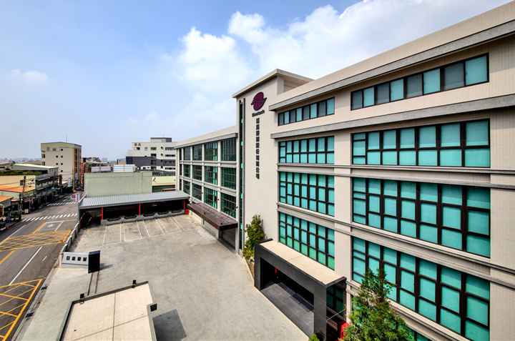
New Facility in Operation
www.geetech.com.tw

Slide 13
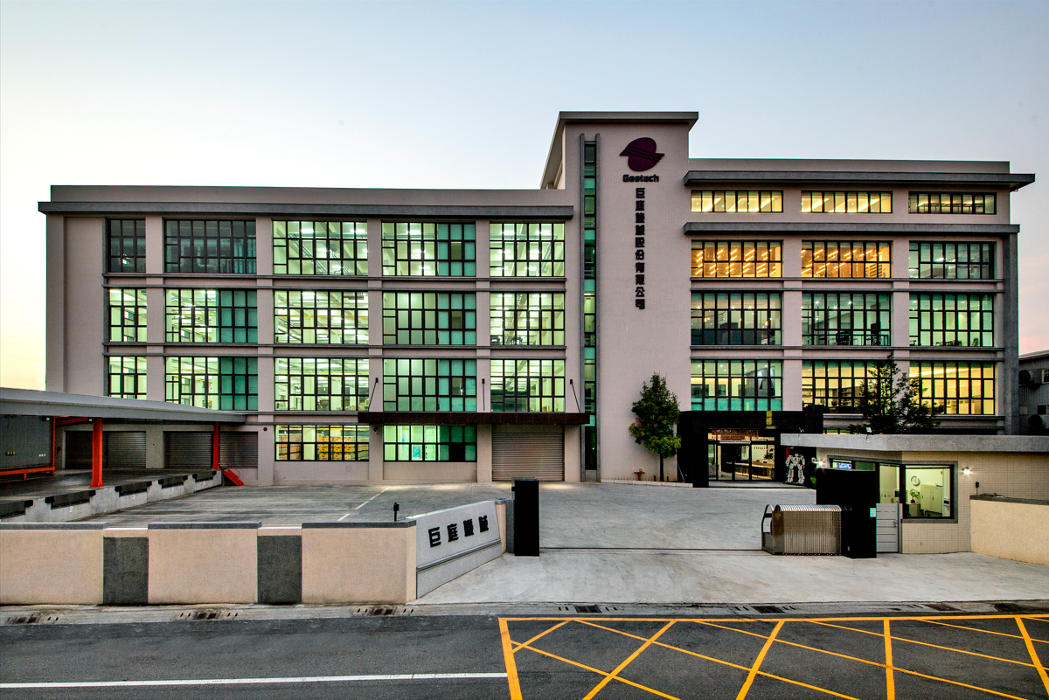
New Facility in Operation
www.geetech.com.tw

Slide 14


Chiu Ting Machinery Co., Ltd
Q&A
Innovation Is an Ongoing Project
www.geetech.com.tw

