Slide 1



Chiu Ting Machinery Co., Ltd
Year 2024 Q3 Earnings Call
Stock Code: 1539
2024/12/18
www.geetech.com.tw

Slide 2
Company Profile
Business Scope
Core Business: Professional Woodworking Machinery ODM for brand customers.
Main export market: North America & Europe.
Established in August 1981.
Listed in over-the-counter market in February 2001
Public listed in Taipei Stock Exchange in October 2002
www.geetech.com.tw

Slide 3
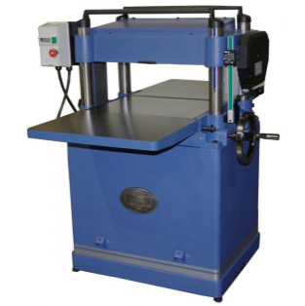
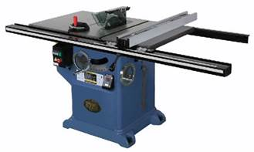
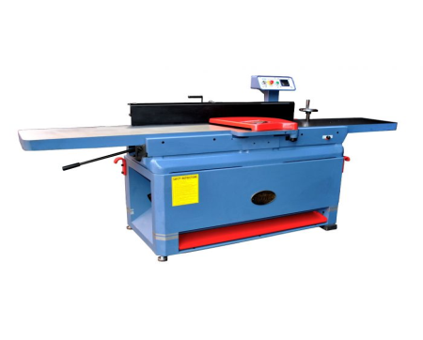
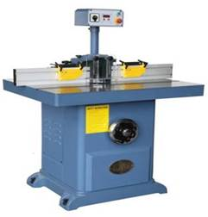
Main Products Categories
Planer, Bench Top & Stationary
Table Saw, Bench Top & Stationary
Jointer, Bench Top & Stationary
Single Spindle Shaper
www.geetech.com.tw

Slide 4
Market Segments
Construction
Home Enhancement
Furniture
Remodeling
Cultural and Creative Crafts
Hobbyist
www.geetech.com.tw

Slide 5

Long Term Strategic Customers
www.geetech.com.tw

Slide 6
2022 ~ 2024 Q3 Revenue by Product Category
Product \ Year | 2022 | 2023 | 2024 Q1~Q3
TABLE SAW | 30% | 25% | 27%
PLANER | 42% | 48% | 44%
JOINTER | 11% | 11% | 11%
OTHER | 17% | 16% | 19%
www.geetech.com.tw

Slide 7
2022 ~ 2024 Q3 Revenue by Regions
Region \ Year | 2022 | 2023 | 2024 Q1~Q3
USA | 89.32% | 90.88% | 89.36%
EUROPE | 3.65% | 2.26% | 4.46%
OTHER | 7.02% | 6.86% | 6.18%
Total | 100.00% | 100.00% | 100.00%
www.geetech.com.tw

Slide 8
Year 2024 P&L and Comparison with Previous Year
In Thousands of NT Dollars; EPS as in Dollar
 | Year 2024 |  |  |  | Year 2023 | Growth Against 2023
Subject | Q1 | Q2 | Q3 | Q1~Q3 | Q1~Q3 | Amount | %
Revenue | 384,104 | 321,024 | 340,387 | 1,045,515 | 1,101,246 | (55,731) | (5.06%)
Gross Profit | 42,791 | 45,427 | 36,911 | 125,129 | 115,135 | 9,994 | 8.68%
Gross Margin | 11.14% | 14.15% | 10.84% | 11.97% | 10.45%
Operating Expense | 25,114 | 23,873 | 24,506 | 73,493 | 67,531 | 5,962 | 8.83%
Expense Ratio | 6.54% | 7.44% | 7.20% | 7.03% | 6.13%
Net Operating Profit | 17,677 | 21,554 | 12,405 | 51,636 | 47,604 | 4,032 | 8.47%
Operating Margin | 4.60% | 6.71% | 3.64% | 4.94% | 4.32%
Net Profit | 41,856 | 26,675 | 1,801 | 70,332 | 61,249 | 9,083 | 14.83%
EPS | 0.64 | 0.41 | 0.03 | 1.08 | 0.94
www.geetech.com.tw

Slide 9
Year 2024 Q1 ~ Q3 Revenue by Product
Category and Comparison with Previous Year
In Thousands of NT Dollars
Product Category | Revenue
 | 2024 Q1~Q3 | 2023 Q1~Q3 | Differences
Planer | 455,070 | 495,317 | (40,247)
Table Saw | 279,652 | 285,744 | (6,092)
Jointer | 115,196 | 127,542 | (12,346)
Other | 195,597 | 192,643 | 2,954
Total | 1,045,515 | 1,101,246 | (55,731)
In comparison with year 2023 first 3 quarters, year 2024 product category,:
Planer revenue decreased 40 million NT dollars.
Table Saw revenue decreased 6 million NT dollars.
Jointer revenue decreased 12 million NT dollars.
Other Category revenue increased approx. 3 million dollars.
Overall Revenue decreased 55 million dollars.
www.geetech.com.tw

Slide 10
Year 2024 Non-operating Income in
Comparison with Previous Year
In Thousands of NT Dollars
Item | 2024 Q1~Q3 | 2023 Q1~Q3 | Differences
Interest Income | 8,161 | 9,718 | (1,557)
Other Expense and Receivable | 5,669 | 1,450 | 4,219
Non-operating Income/Loss | 28,338 | 33,633 | (5,295)
Finance Cost | (5,369) | (7,065) | 1,696
Total | 36,799 | 37,736 | (937)
USD : NTD | Average Asset in USD | Exchange Rate Diff. | Exchange Rate Variation
2024 Q1 ~ Q3 | 15,898 | 0.945 | 30.705→31.65
2023 Q1 ~ Q3 | 15,580 | 1.56 | 30.71→32.27
www.geetech.com.tw

Slide 11
Operational Risks
Exchange Rate Risk
Raw Material Price Risk
Market Uncertainty Risk
www.geetech.com.tw

Slide 12
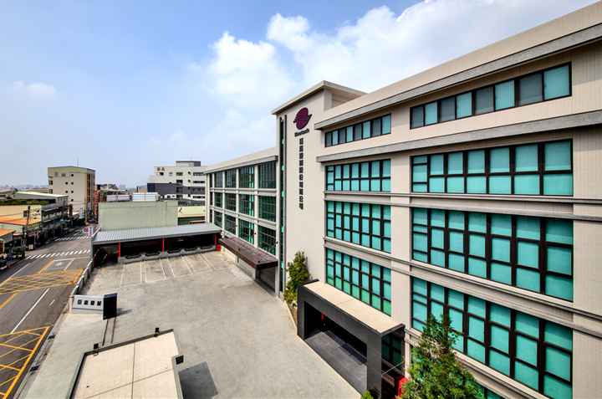
Headquarter
www.geetech.com.tw

Slide 13
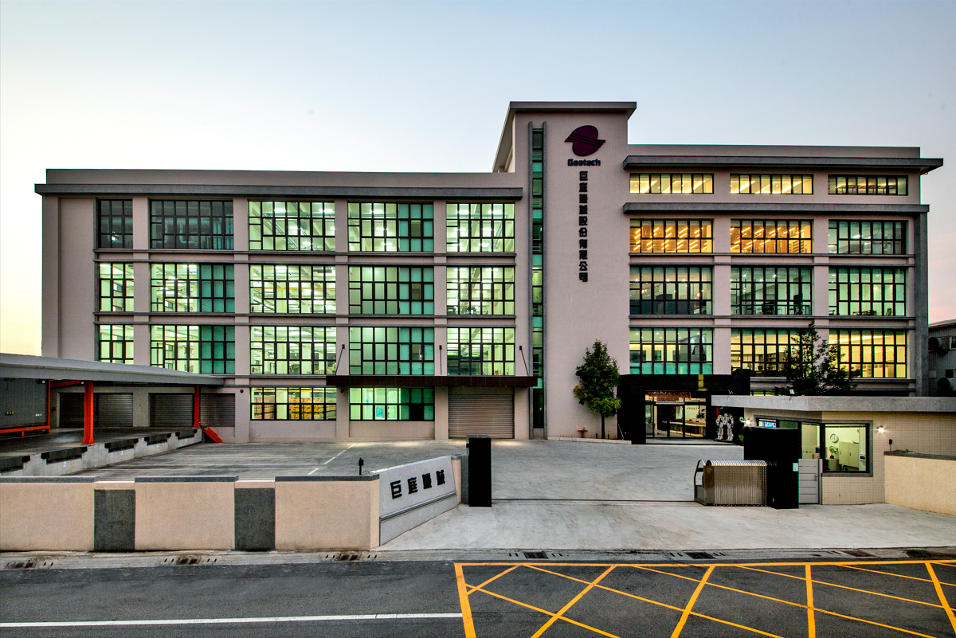
Headquarter
www.geetech.com.tw

Slide 14


Chiu Ting Machinery Co., Ltd
Q&A
Innovation Is an Ongoing Project
www.geetech.com.tw

