Slide 1

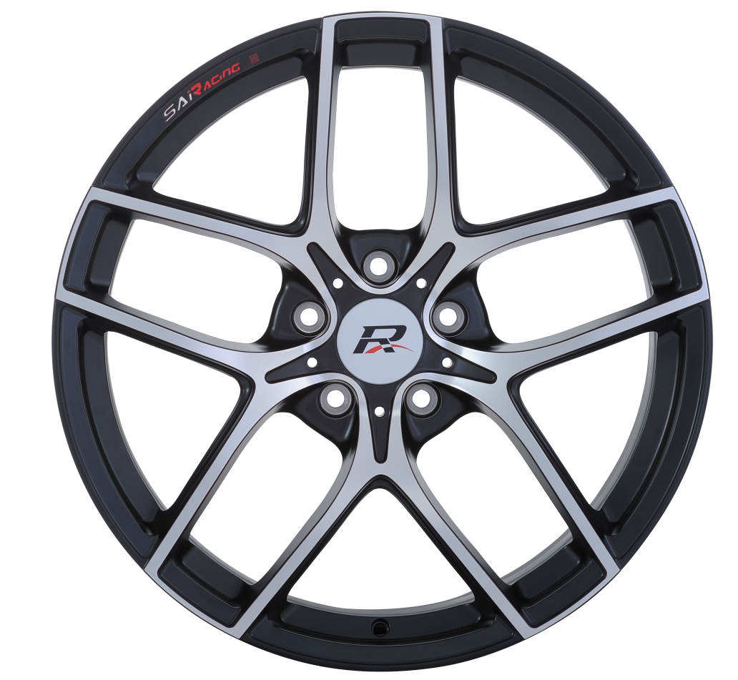
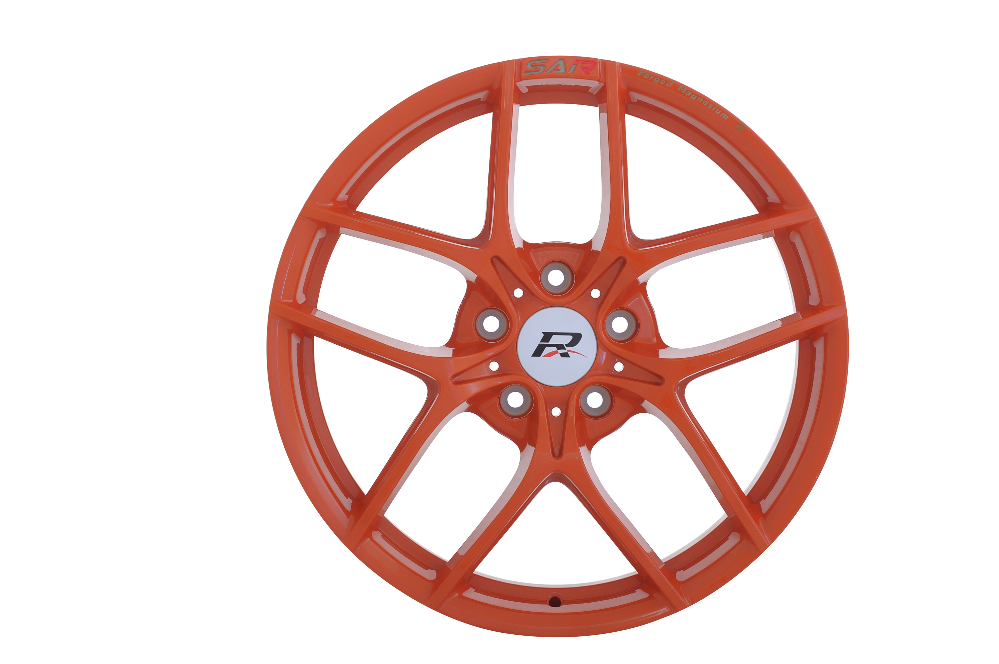
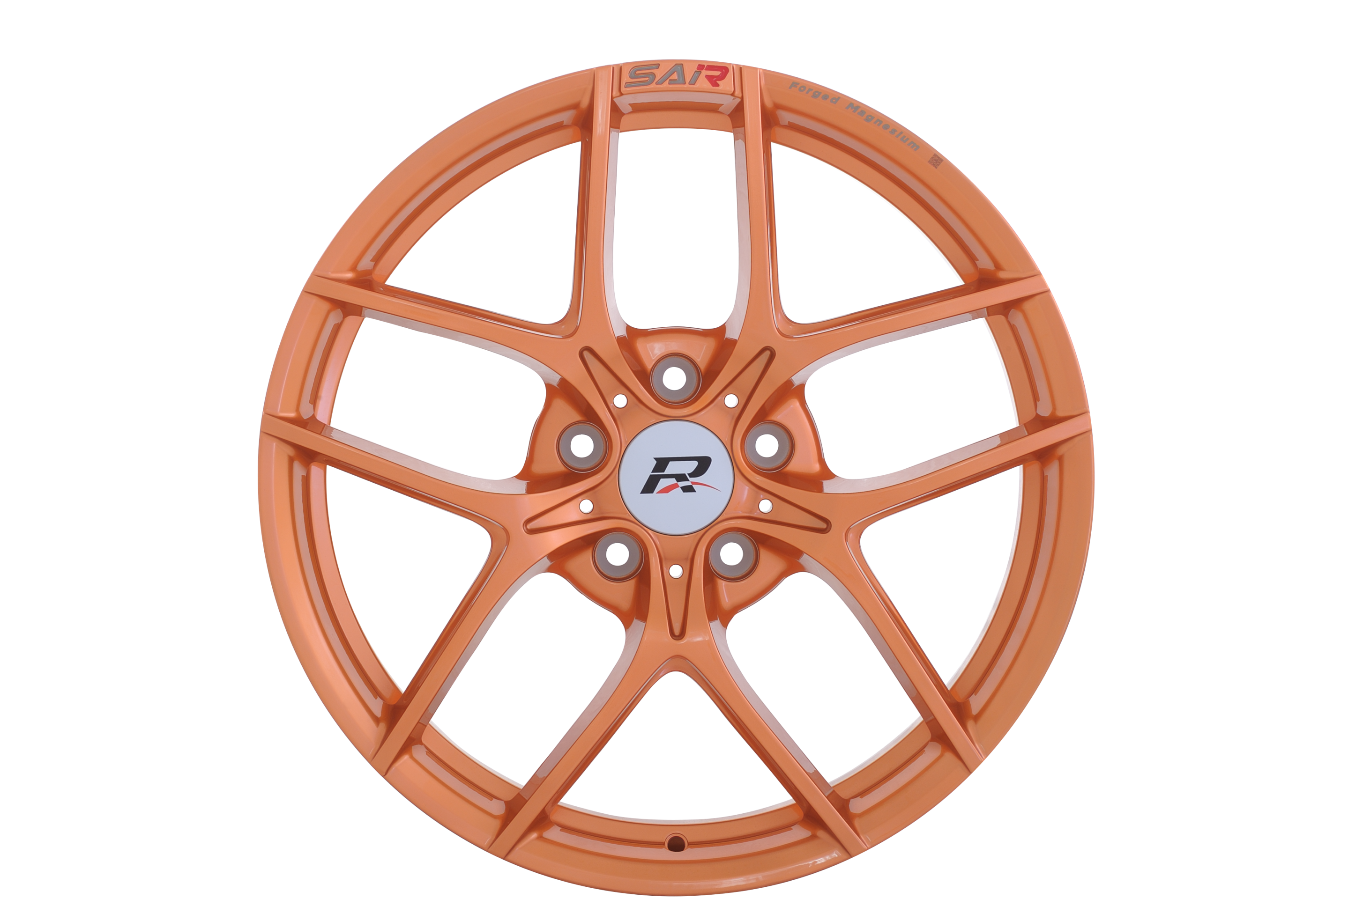
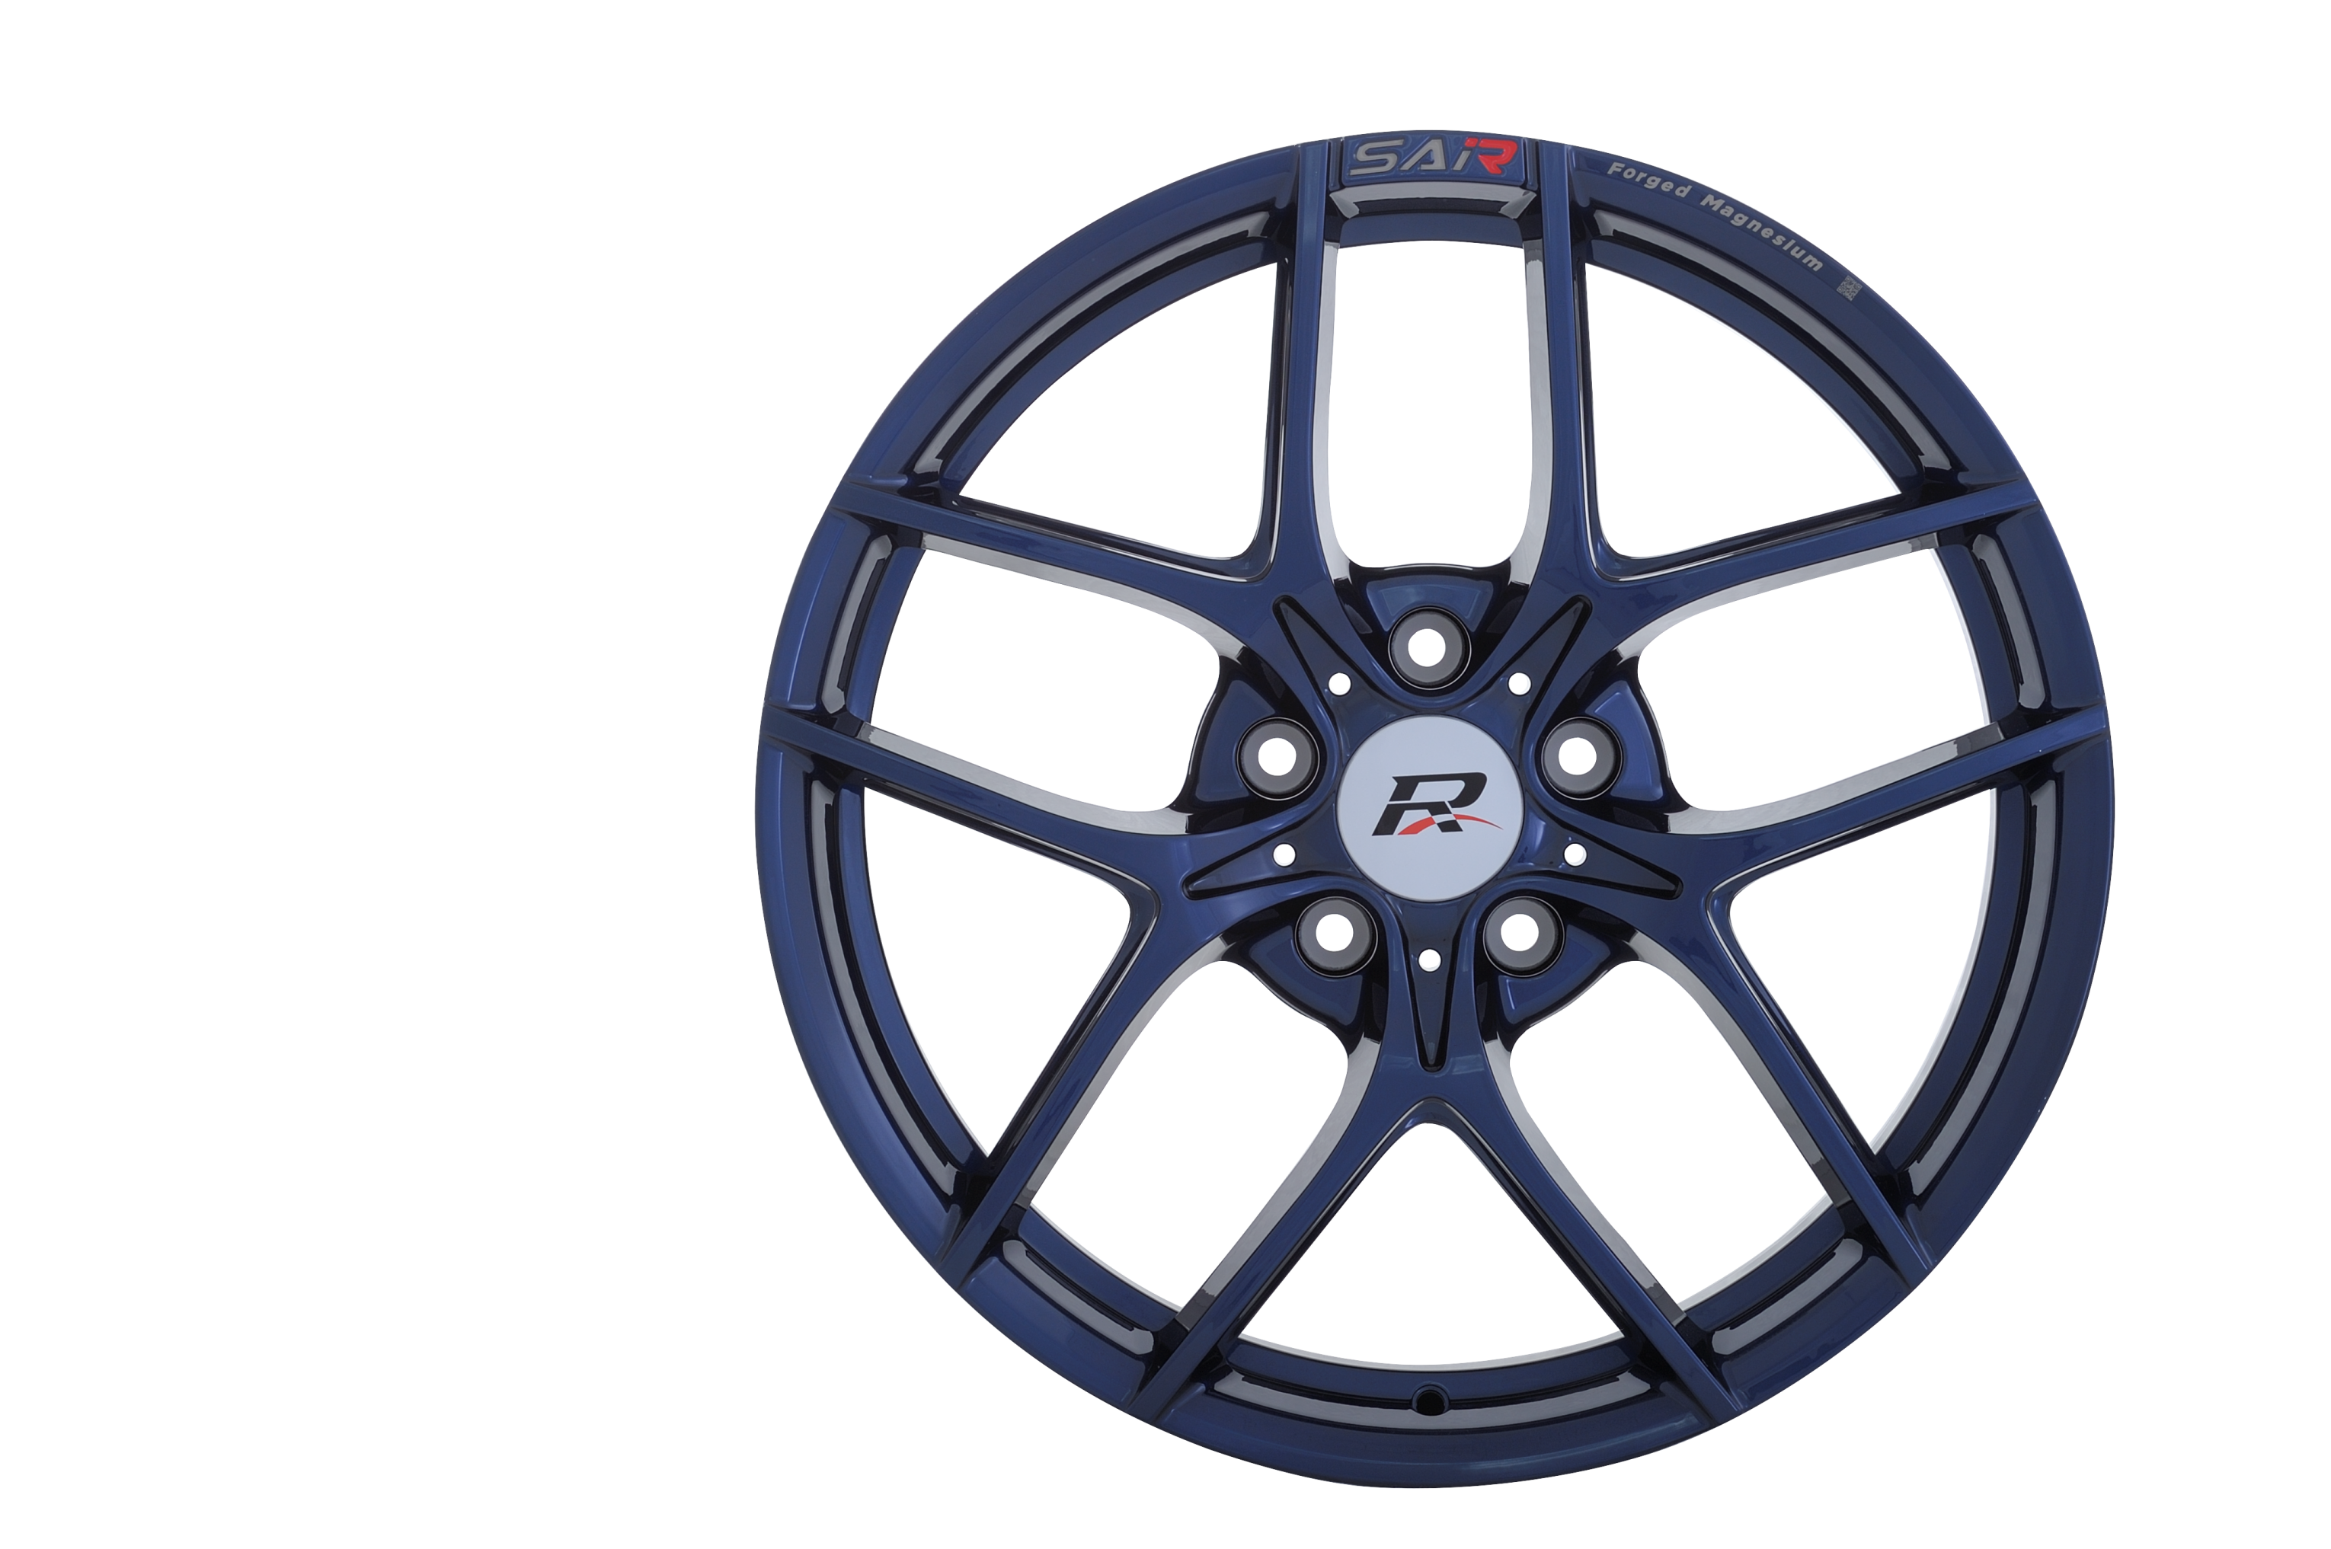
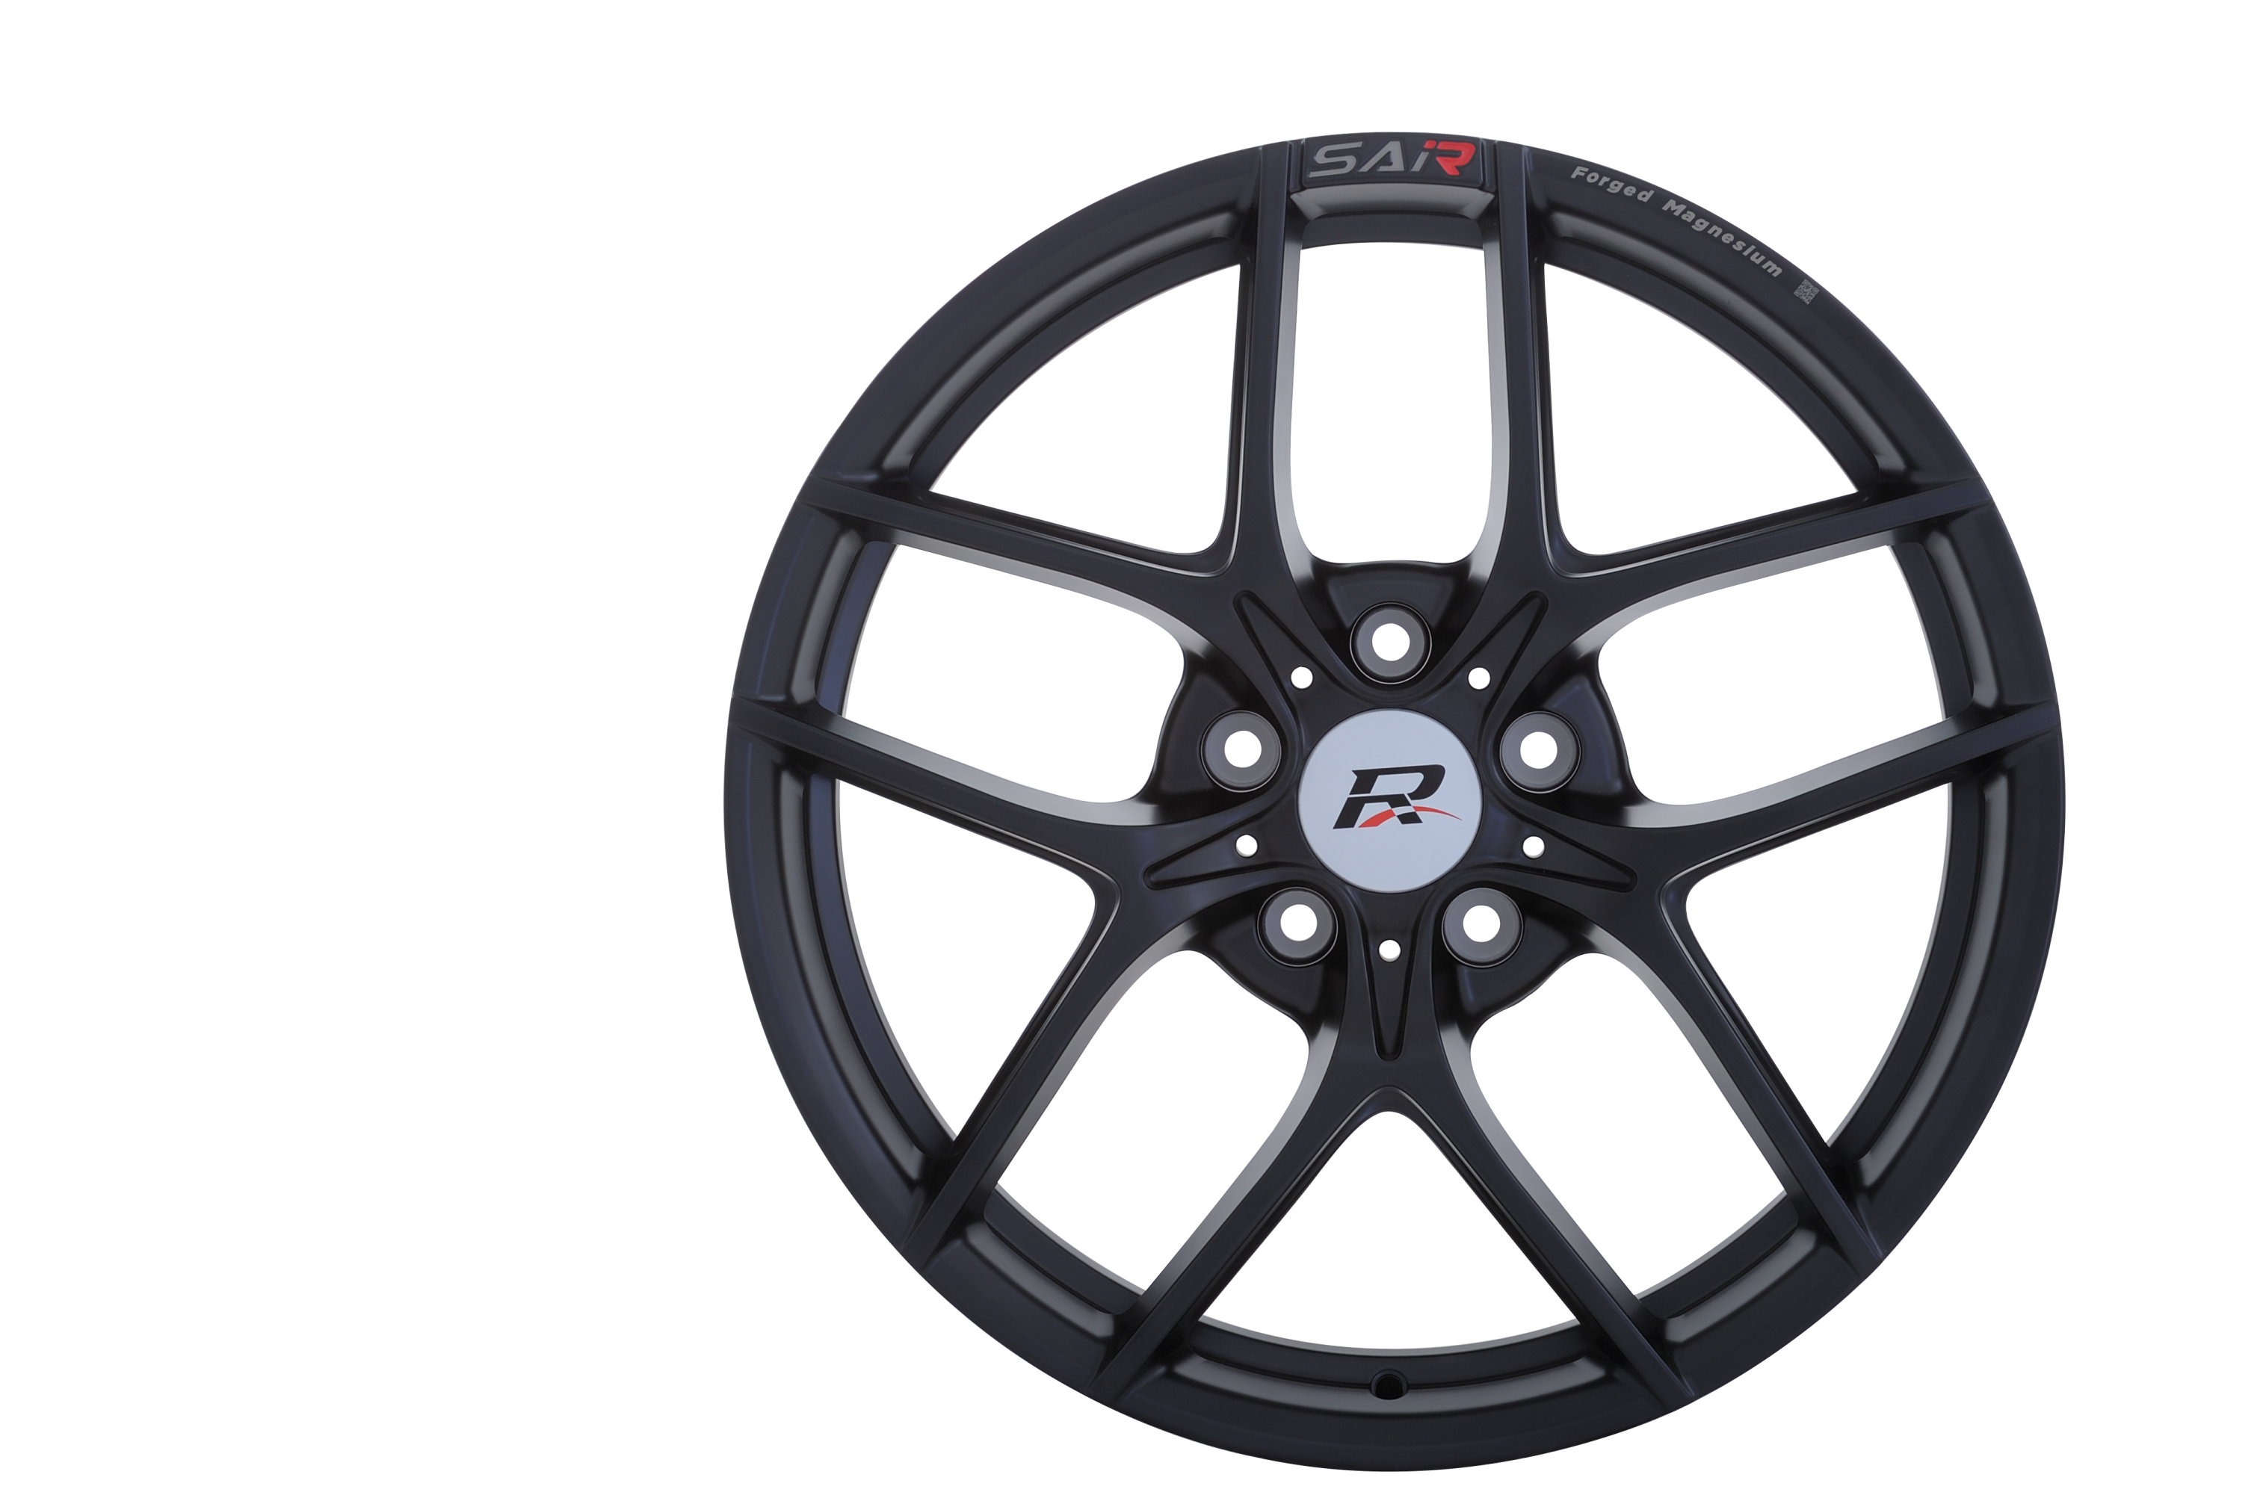
SuperAlloy Industrial Co. Ltd.
Investing a Brighter Future

Slide 2
Executive Summary
We are a world leading aluminum automotive wheel supplier for luxury and premium automobiles. We have the high-end design capability to manufacture forged wheels and suspension parts with benchmark equipment.
We sell to Tier 1 luxury and premium car brands, who are growing faster than the overall market. The global trend towards lightweight vehicles is an additional tailwind for our business.
To enrich our offering, we have invested in new state-of-the-art plants in Germany and Taiwan.
We are committed to achieve 15% ROE after new capacity ramp up and aim to maintain a 40% dividend payout ratio.

Slide 3
Content
1
World Leading Aluminum Forged Wheel Supplier for Luxury and Premium Automobiles
2
Industry Trends Favor Growth in SAI’s Business
3
The SAI Vision for Future Growth
4
Financial Summary
5
Appendix

Slide 4
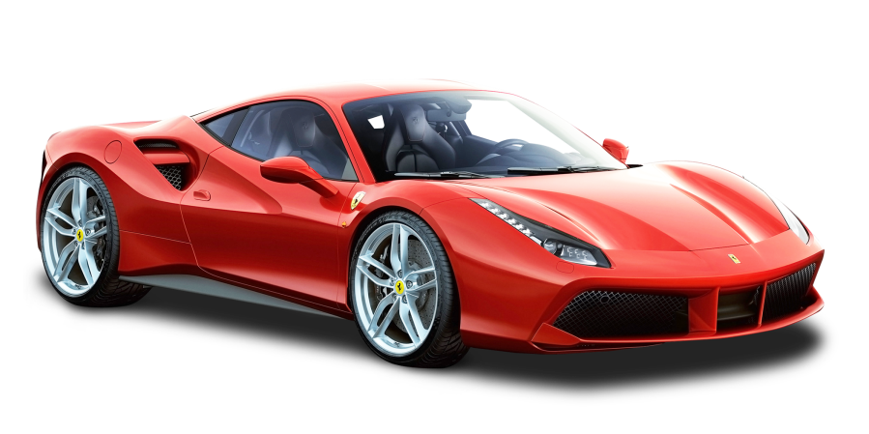
World Leading Aluminum Forged Wheel Supplier for Luxury and Premium Automobiles

Slide 5
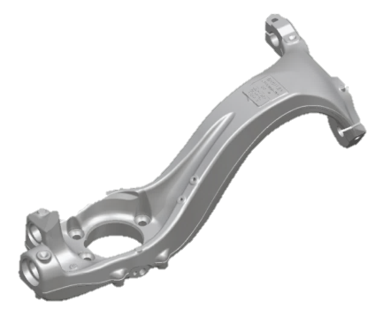
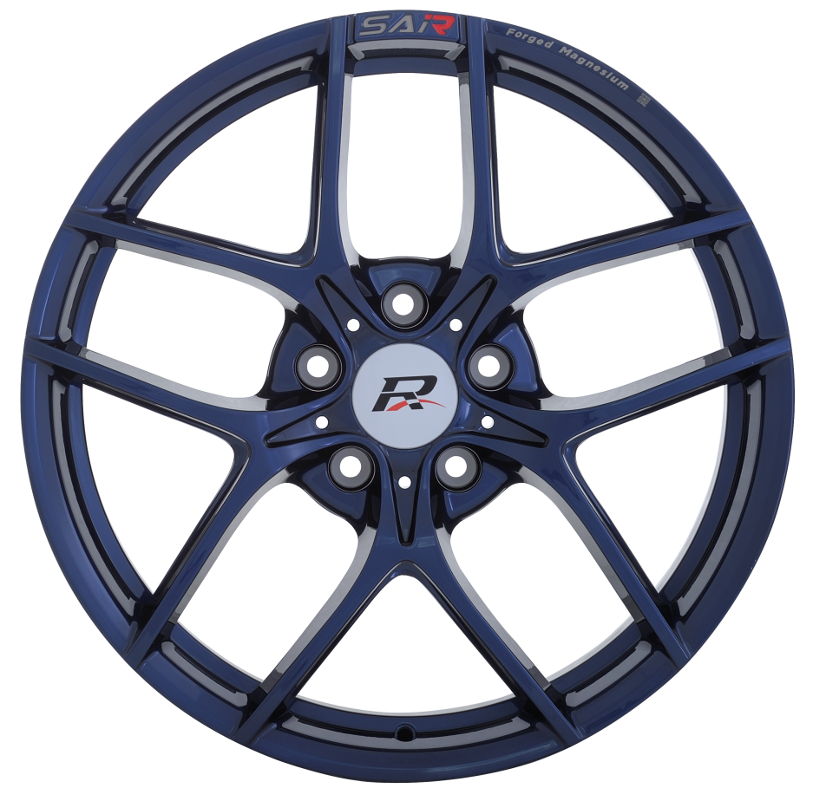
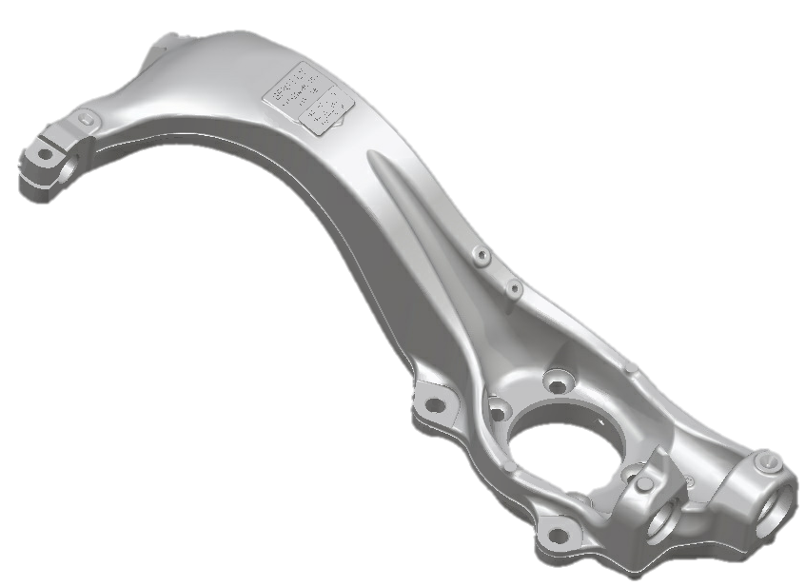
SAI – A Lightweight Metal Engineering Expert
We specialize in manufacturing of lightweight alloy products for the automotive industry
Forged wheels have historically been our key sales and profit driver
NT$mn
Forged wheels
76.2% sales
Suspension parts/ Others
18.3%/ 5.5% sales
*
*
*Product portfolio consolidation to increase profitability, plus reduction of alloy prices.
Source: SAI

Slide 6


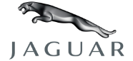





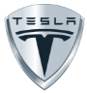

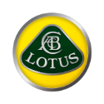















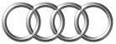





Tier-One Supplier to Top Global Brands
2 decades of design and manufacturing experience
Top Clients are Jaguar Land Rover (JLR), BMW, Porsche, Daimler and FCA
2001
2006
2008
2010
2012
2015
2017
2019
2004
2007
2009
2011
2013
2016
2018

Slide 7
Improved Development in Scope and Scale
1994
2000
2001
2006
2011
2012
2013
2017
2019
Established
Aluminium
forged wheels
GM Supply
Contract
Listed on TW
Emerging Board
Suspension
Parts Business
JLR Supply
Contract
Aircraft
Component
Business
New Plant in
Lossburg, DE
New Plant in
Pingtung, TW
*Current no. of employees: 1,460.
Source: SAI and TEJ

Slide 8
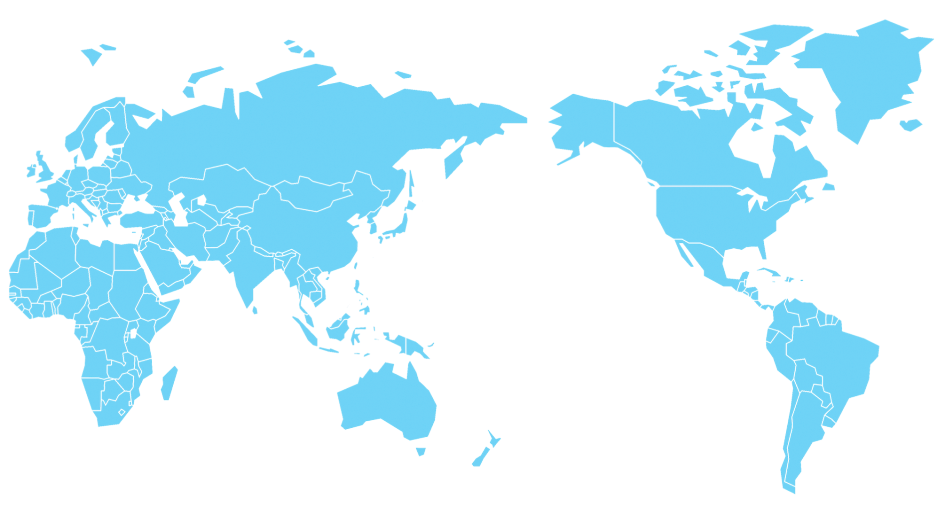


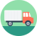







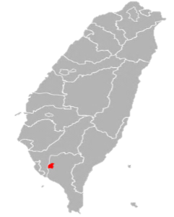








Global Sales Offices and Warehouses
To support our brand customers, SAI has set up global sales, painting lines and warehouses, providing a consistently high level of service quality, supply reliability and flexibility.
SAE
NIPPON
SAEU
CTC SANA
AMS
Rotterdam, NL
CTCD, ATCO
Birmingham, UK
Düsseldorfer, DE
Loßburg, DE
Headquarters
Michigan, US
SAMF
South Carolina, US
SUNLAND
Alabama, US
T&W
Engineering
Logistics
Douliu, TW
Quality
Sales
Pingtung, TW
Manufacture
Marketing
Melbourne, AU
GIBSON
Technology
Warehouse

Slide 9
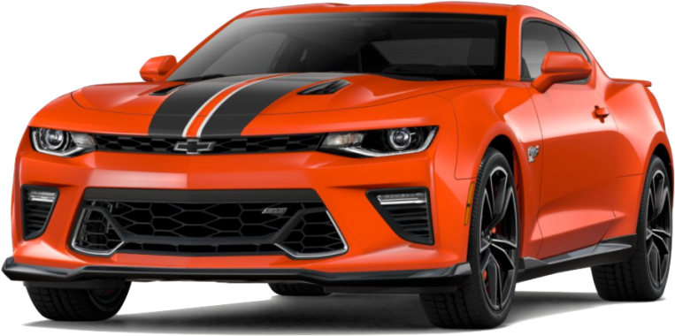
Industry Trends Favor Growth in SAI’s Business

Slide 10
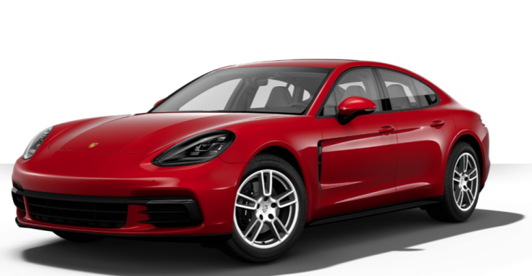
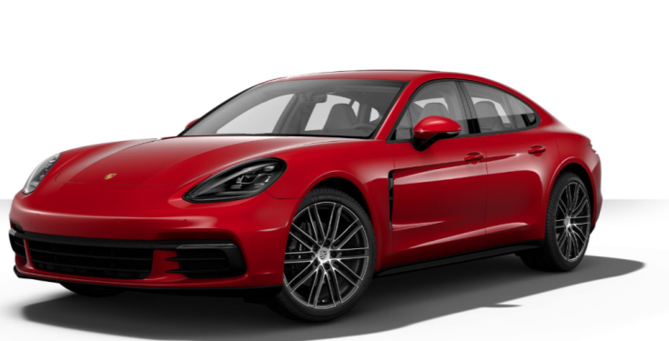
Premium Segment is Outgrowing Overall Market
SAI focuses on high-end forged wheels of super car, luxury and premium brands.
Premium, luxury and super car shipment growth to outgrow global automotive market.
Top 10 Premium Car Brands Global Vehicle Deliveries | Car Brand | 2018 | 2019 | Y-Y
 | Mercedes | 2,253,000 | 2,278,000 | 1.1%
 | BMW | 2,125,026 | 2,185,793 | 2.9%
 | Audi | 1,812,485 | 1,845,573 | 1.8%
 | Lexus | 698,330 | 765,330 | 9.6%
 | Volvo | 642,253 | 705,452 | 9.8%
 | JLR | 592,708 | 557,706 | -5.9%
 | Cadillac | 381,859 | 390,458 | 2.3%
 | Porsche | 256,255 | 280,800 | 9.6%
 | Infiniti | 184,600 | 180,700 | -2.1%
 | Acura | 158,934 | 157,385 | -1.0%
 | Subtotal | 9,105,450 | 9,347,197 | 2.7%
Super/ Luxury Car Brands Global Vehicle Deliveries | Car Brand | 2018 | 2019 | Y-Y
 | Bently | 10,494 | 11,006 | 4.9%
 | Ferrari | 9,251 | 10,131 | 9.5%
 | McLaren | 4,829 | 4,765 | -1.3%
 | Rolls- Royce | 4,107 | 5,100 | 24.2%
 | Subtotal | 28,681 | 31,002 | 8.1%
Total Vehicle Deliveries |  | 9,134,131 | 9,378,199 | 2.7%
US$9k to upgrade
from 19” standard wheels
to 21” high-end optional wheels
Porsche Panamera
*Yellow highlights are SAI customers. Source: SAI
Notes:
Compared to die casted, forged wheels are 30% lighter and 6-8% fuel saving with US$250 ASP for complicated design and manufacturing vs. die casted wheel’s US$30-80 ASP.

Slide 11
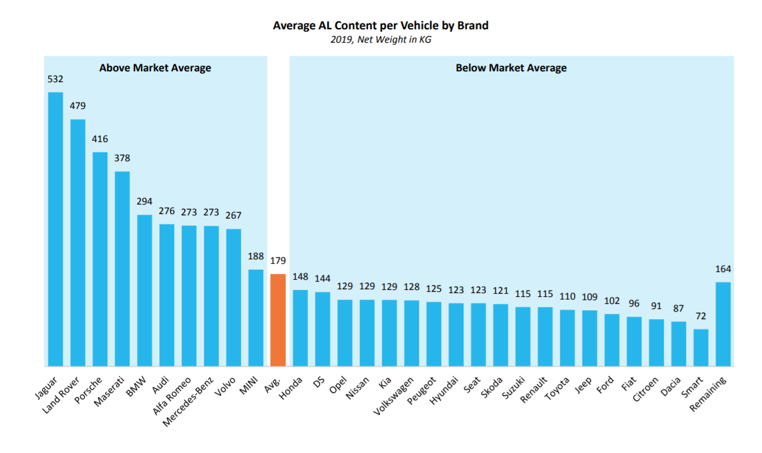
Premium & Luxury Cars Use Aluminum to Reduce Weight
Premium and luxury sedans, full & mid-size luxury SUVs and sport cars use more aluminum components than automobiles targeted at the mass market.
Source: Ducker Frontier

Slide 12
Industry Trends Create Multiple Growth Opportunities
Government policies mandate lighter cars for energy conservation and CO₂ emissions reduction.
  2025 U.S Corporate Average Fuel Economy (CAFE) target is 23km/l vs. current 12km/l.
The rise of aluminum parts: Average aluminum content per car is projected to grow +3% y-y till 2025.
  1kg reduction in wheels/suspension parts equals 5~8kg reduction in other parts, so even mainstream market cars will increase their use of Aluminum parts to meet CAFE.
EV* and sharing vehicles target the use of aluminum parts for weight reduction and energy efficiency.
9y CAGR +3%
Source: European Aluminum forecast
*EV: Electric Vehicle

Slide 13
SAI Competitive Edge
High Entry Barriers
Customer
Portfolio
Operation
Efficiency
RD and Design Capabilities
Technology and capex intensity
Available capacity
Long qualification period: at least 2~3 years
Europe, U.S and Asia luxury and premium car brands
Co-design with distinguished global car brand studios
Before painting process yield is high-ninety %
New plants to shorten cash conversion cycle
From aluminum, magnesium to composite material wheels
Manufacturing process development
Specialized in short production run orders with a high level of customization.

Slide 14
Experienced Management Team
Name | Position | Function | Years in Industry | Education/Experience
Tsung-Jung Huang | Chairman/CEO | Creating and implementing the organization's vision and overall direction | 40+ | ￭ Feng Chia University, TW
Dr. Ralph-R. Ohlsen | Executive VP | Strategy, Processes, European sales and marketing | 34 | Ph.D., Economics Cologne Magna Steyr President, BMW Thailand Board BMW South Africa Roland Berger Consultants
Stephen Liu | Chief Operating Officer | Management of global sales, technology development, manufacturing, and overall operation | 1+ | ￭ Kaohsiung Institute of Technology, TW ￭ Sales Director, Hon Hai Precision
Ben Huang | VP, Administration | General management of German production and sales | 18 | ￭ Chung Hsing University, TW
Y.C. Kao | Senior Director, Production | Management of global manufacturing | 30+ | ￭ Formosa University, TW
Steven Kuo | Senior Manager, Quality | Quality control and product assurance | 20+ | ￭ Taiwan University, TW
Stephen Tseng | Manager, Sales | Sales management and strategy creation | 10 | ￭ Yun-Lin Technology University, TW

Slide 15
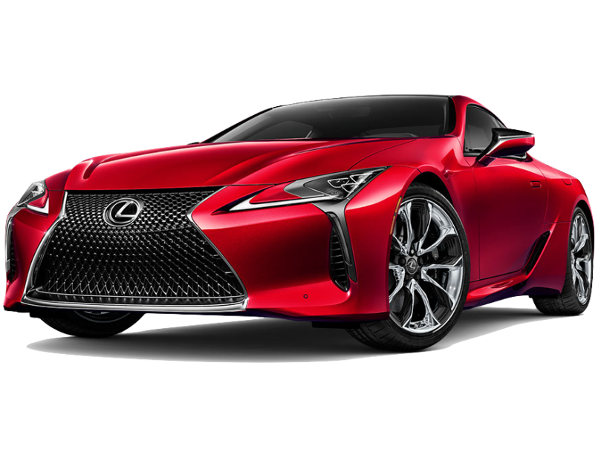
The SAI Vision for Future Growth

Slide 16
The SAI Vision
1
Expand Market Presence in
Suspension Systems
Investments to reaching the
Position as the Industry Leader
2
Improving Long-Term ROE
3
16

Slide 17
Comprehensive Strategy Planning in Six Aspects
Talents
Lightweight
Products with
Safety & High
Quality
CSR
Provider of
Forged-Products
in Mobility
Industry
Advanced
Material &
Process
Technologies
Globalization
Smart
Manufacturing
17

Slide 18
Increased Product Reach, Expanded TAM*
Aluminum Suspension Wheel Units
Net Shape Forged Wheels
Fully-Machined Forged Wheels
Aluminum Suspension Wheel Units
Strategically target EV application products
The Automotive chassis market is projected to grow at 5% pa through 2025
Net Shape Forged Wheels
This product targets the large volume premium car market.
In 2019, SAI shipment accounted for 1.5% of BMW 2.1mn cars.
Fully-Machined Forged Wheels
Continue to make market share gains in the growing super car and luxury car markets
In 2019, SAI shipment accounted for 35% of global fully-machined forged wheels market.
*TAM: Total Addressable Market
Source: Research and Markets and SAI
Notes:
2016 premium car brand shipments grew 7% y-y to 8.7mn units with a US$150-250 ASP per wheel
2016 super and luxury car brand shipments rose 14% y-y to 26,000 units with a US$250+ ASP per wheel

Slide 19
Net Shape Solutions – Extending our Competitive Edge
Our net shape forged wheels utilize precision forging to shorten post-forging processes
  Simplifies the production process, leading to lower production costs
They are optimal for large volume orders from premium brands
  We expect the higher order volumes to increase plant output/utilization, leading to higher asset turns
 | Traditional Forging | Net Shape Forging
Rim type | Super high end | Luxury and Premium
Forging process | Shorter, cheaper and less exact mold | More exact mold with higher tooling costs
CNC machining time | Longest and requires the most plant floor area for CNC machines | Reduced need for machining
Material costs | High | Less
Advantages | Enhanced design options Best Appearance and precision Small volume orders | Lower production costs Stable quality with high automation Large volume orders
Source: SAI
Notes:
Near-Net-Shape Forging
Near-Net-Shape Forging is a forging process that requires little or no extra machining to complete the component. This innovated development results in stronger components and the improvement of the performance of the engine. The process normally refers to two types of forging, cold and warm. Cold forging which generates an improved precision in the components requires stronger tools than warm forging.
What Type of Parts are Good Candidates for Near-Net-Shape Forging?
The new advancements in Near-Net-Shape Forging work has made it possible for a wide variety of shapes and sizes of parts to be manufactured using various methods of forging. Sizes may vary from a few grams up to products that can weigh tons. A steering arm was replaced from a three piece welded unit to a one piece hot forged impression. A 450,000 pound generator shaft was created using an open die forging. Cold forging should be considered for parts that require geometric configurations as they are expensive and difficult to machine.
Designing Parts for Near-Net-Shape Forging
Near-Net-Shaped-Forging was designed to lower the cost associated with post machining operations. There is little waste connected with Near-Net-Shape-Forging work which results in a lower cost for materials. This type of forging was designed to overcome the necessity of machining away large percentages of a finished product resulting in unnecessary waste. There are several different types of metals used for forging depending on the part to be produced. Carbon and alloy steel are used for a wide range of products. Stainless steel is used when heat and corrosion resistance is needed, and aluminum is used when weight is an issue. Copper, brass and bronze are used when corrosion, high thermal and electrical conduction resistance is necessary.
https://www.forging.org/forging/design/5223-net-and-shape-forging.html
http://journals.sagepub.com/doi/abs/10.1177/0954405417708220

Slide 20
Expanded Presence in Suspension Components Will Reinforce Core Business Momentum
Synergies with
Wheel Business
Suspension Business
Including knuckles, control arms, ball joints, brake systems and corner module assembly
Longer production runs, high volume and longer order visibility
Gain more share in luxury and premium car brands
Access to car brands core suspension design spec, enhancing wheel R&D and design capabilities
Improve factory utilization and shorten cash conversion cycle
Sharing of production processes.

Slide 21
Investments to Raise Efficiency and Enhance Customer Service
Economies of Scale
Provides the ability to support both small and large volume orders
Allows for more flexible capacity allocation among wheels and suspension parts
Aluminum Recycling Facility
40,000 tonnes per year capacity will reduce raw material costs
INDUSTRY
LEADER
Further Investment in Automation
To improve efficiency and profitability at original Douliu facility and new Pingtung plant
Loßburg Painting Facility
For flexibility and
proximity to European auto plants

Slide 22


Our Strong Moats
Global Client Base
Geographically diversified client portfolio
Reduces single market risk, lends to sustainability in cash flows
Full Spectrum of Forging Skills
Allows expansion into a higher volume niche of the wheel market
Innovative manufacturing R&D
Accumulated MFG Process Experiences
Our library of wheel designs is based on 2 decades of accumulated materials science, industrial design and testing experience
Process guidelines lead to higher yield
Availability of Certified Capacity
The right capacity at the right time
Competitors need a minimum of 2 years to add new capacity and another
1-2 years to achieve certification
22
Notes:
在媒體策略上，主要規劃重點包括運用 新媒體創造話題
(按)並且進行波段規劃，加強預防成效
(按)透過廣泛宣傳深入社區及家庭
(按)以階段式溝通，建立正確認知

Slide 23
Our Manufacturing Processes Refinement
New aluminum recycling facility to strengthen alloy design and material science R&D
Alloy
Design
Grain refining to decrease grinding/ polishing process and enhance quality
Grain
Refinement
Improve
Efficiency
Improve material usage efficiency
by 20%
23

Slide 24
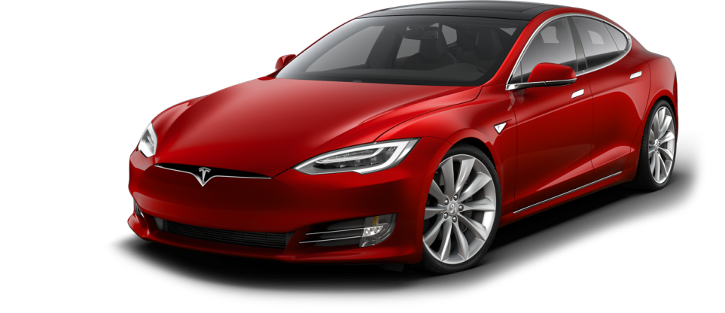
Financial Summary

Slide 25
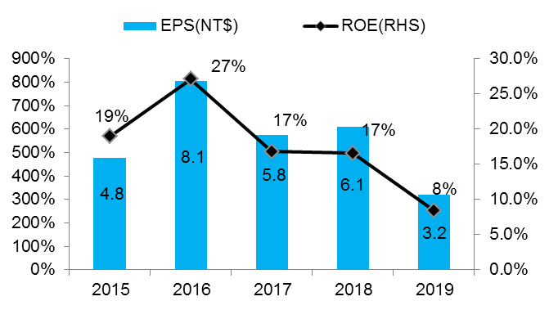
Key Financial Performance
NT$mn
*
*
*Product portfolio consolidation to increase profitability, plus reduction of alloy prices.
Source: Capital IQ and Bloomberg
25

Slide 26
2015-2019 Income Statement
NT$ million | 2015 | 2016 | 2017 | 2018 | 2019
Sales Revenue | 6,823 | 7,704 | 7,391 | 6,587 | 5,892
Gross Profit | 2,060 | 2,769 | 2,460 | 2,028 | 1,343
Operating Profit | 1,386 | 1,993 | 1,722 | 1,122 | 756
Income before tax | 1,224 | 1,996 | 1,476 | 1,568 | 753
Net Income | 950 | 1,603 | 1,148 | 1,201 | 619
EPS (NT$) | 4.8 | 8.1 | 5.8 | 6.1 | 3.2
Y-Y (%)
2016 | 2017 | 2018 | 2019
12.9 | -4.1 | -10.9 | -10.5
34.4 | -11.2 | -17.6 | -33.8
43.8 | -13.6 | -34.8 | -32.7
63.1 | -26.1 | 6.2 | -52.0
68.7 | -28.4 | 4.6 | -48.5
68.7 | -28.4 | 5 | -47.5
Gross Margin | 30.2% | 36.0% | 33.3% | 31% | 23%
Operating Margin | 20.3% | 25.9% | 23.3% | 17% | 13%
Net Margin | 13.9% | 20.8% | 15.5% | 18% | 11%
ROE | 19.0% | 27.11% | 16.8% | 16.6% | 8.43%
Source: Capital IQ and Bloomberg
26

Slide 27
2015-2019 Balance Sheet
NT$ million | 2015 | 2016 | 2017 | 2018 | 2019
TOTAL ASSETS | 10,370 | 14,127 | 16,485 | 17,036 | 16,982
Cash | 946 | 1,973 | 2,637 | 1,809 | 1,143
NR & AR | 1,057 | 1,093 | 949 | 932 | 697
Inventory | 2,379 | 3,047 | 3,707 | 4,487 | 4,986
PP&E | 5,227 | 7,020 | 8,629 | 9,335 | 9,631
TOTAL LIABILITIES | 5,079 | 7,600 | 9,411 | 9,665 | 9,576
Bank Loans | 3,862 | 6,322 | 8,076 | 8,117 | 8,232
AP | 83 | 103 | 78 | 83 | 74
TOTAL EQUITY | 5,291 | 6,527 | 7,074 | 7,371 | 7,406
Y-Y (%)
2016 | 2017 | 2018 | 2019
36.2 | 16.7 | 3.3 | -0.3
108.5 | 33.7 | -31.4 | -36.8
3.3 | -13.2 | -1.8 | -25.2
28.1 | 21.6 | 21.0 | 11.1
34.3 | 22.9 | 8.2 | 3.2
49.6 | 23.8 | 2.7 | -0.9
63.7 | 27.5 | 0.5 | 1.4
24.3 | -24.7 | 6.4 | -10.8
23.4 | 8.4 | 4.2 | 0.6
A/R turnover days | 53 | 51 | 50 | 53 | 52
Inventory turnover days | 165 | 201 | 250 | 354 | 424
A/P turnover days | 68 | 74 | 84 | 89 | 79
Cash conversion cycle | 150 | 178 | 216 | 318 | 397
Source: Bloomberg and SAI
27

Slide 28
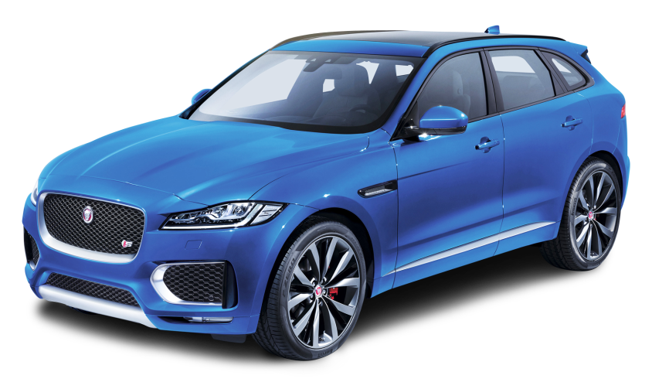
Appendix
28

Slide 29
Diversified Board Members Enhancing Corporate Governance
Name | Independency | Expertise/Experience | Years in Industry | Education
Tsung-Jung Huang | Non-independent director | Chairman, CFO, investments | 40+ | ￭ International Business, Feng Chia University, TW
Long-Cheng Wei | Non-independent director | Senior executive and operations | 30+ | ￭ Chemical Engineering, National United University, TW
Te-Hsing, Chen | Non-independent director | Investment | 30+ | ￭ National Dajia Industrial High School, TW
Chien-Chung, Chu | Non-independent director | Engineering and Semiconductor industry | 15+ | ￭ Ph.D., Electrical Engineering, National Taiwan University, TW
Chih-Hsiang, Chang | Non-independent director | IT industrial | 15+ | ￭ Computer Science and Information Engineering, Da Yeh University, TW
Ting Wang Cheng | Independent director | Financial and accounting | 30+ | ￭MS, Accounting, University of Missouri, USA
Mao Lin Shih | Independent director | Legal, government and public Policy | 30+ | ￭ College of Law, National Taiwan University, TW

Slide 30

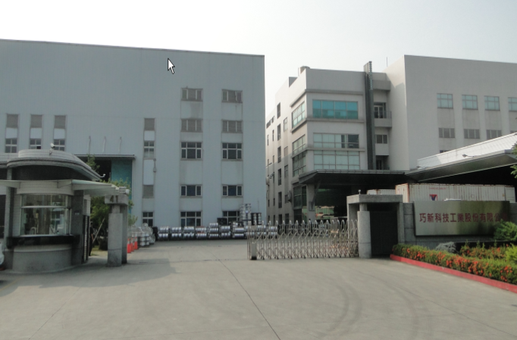
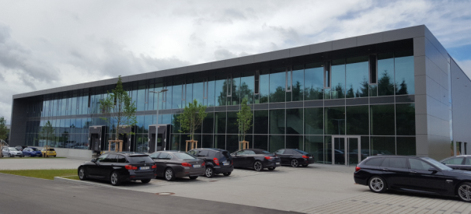



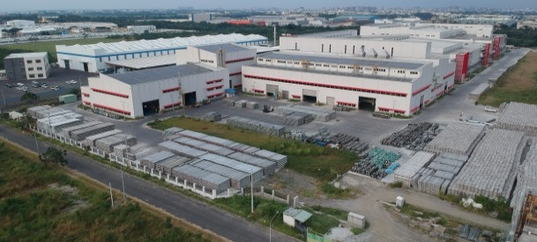
Global Manufacturing Plants
SAI has two Taiwan manufacturing sites and one Germany painting site.
Below are our 2019E capacity:
Germany
Freudenstadt
15000 m²
Douliu
94735 m²
Taiwan
Douliu
Pingtung
Freudenstadt
Forging
Machining
Polishing
Painting
Testing
Pingtung
98660 m²
Melting
Capacity(pcs)
700,000
300,000
400,000

Slide 31
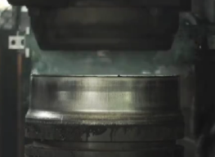
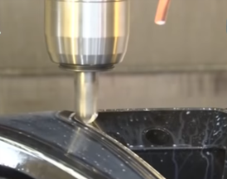
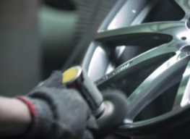
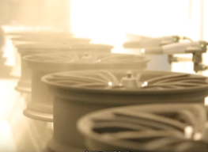
World-class Manufacturing Efficiency
We provide the best forged wheels manufacture and services by:
Design, customized spec and pre-production support
Before painting process yield is high-ninety %
Strict material, functional and environmental testing ensuring safety and quality
Forging
Machining
Polishing
Painting
8,000 Ton Forging
7,000 Ton Forging
Horizontal Flow Forming
Vertical Flow Forming
T4 Heat-Treatment
T6 Heat-Treatment
Turning
Milling
Lathing
Hole Punching
Diamond-Cutting
Dot Marking
Laser Etching
Manual Grinding
Robotic Grinding
Dynamic (Vibration)- Polishing
Physical (Mechanical)- Polishing
Manual Painting
Automated Painting
Masking
Powder Painting
Liquid Painting
Up to 6 Coats- 6 Bakes
Up to 50 Colors

Slide 32
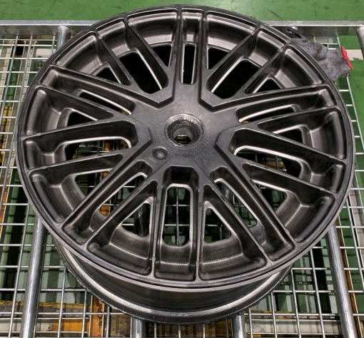
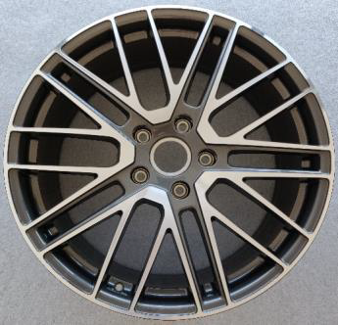
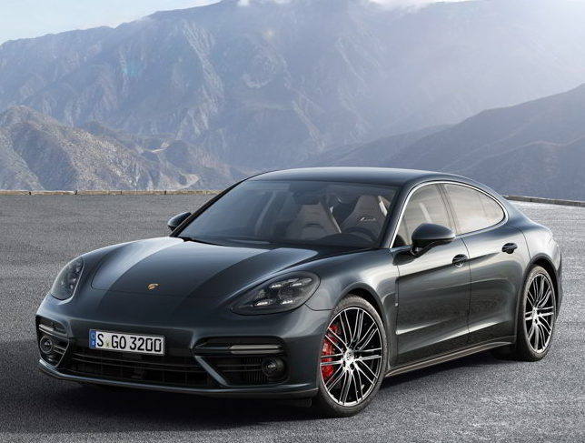
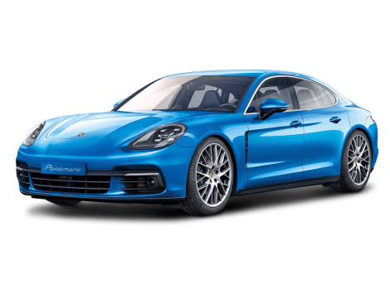
A Recent Example of Order Won with
Net Shape Forging Capability
SAI Net Shaped Forging solutions have been qualified for Porsche’s flagship models.
Our Germany painting site provides localized service and quick response to customer requests, enhancing their inventory management.
Net Shape Forged
Semi-finished rim
Minimal machining, polishing and local painting
Porsche Panamera
Source: SAI and Porsche

Slide 33



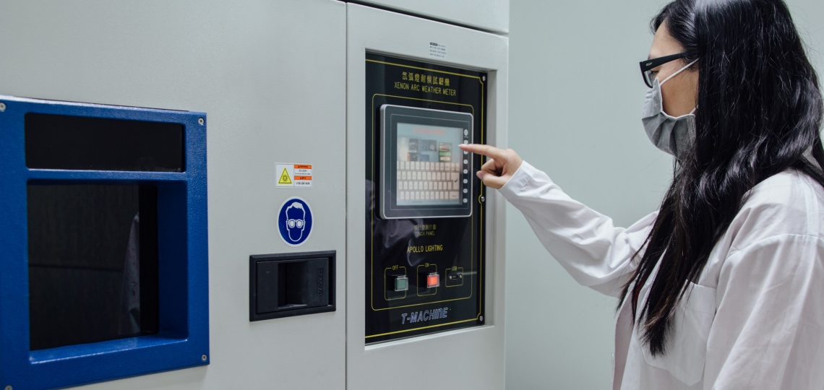
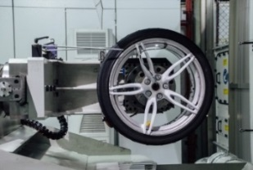
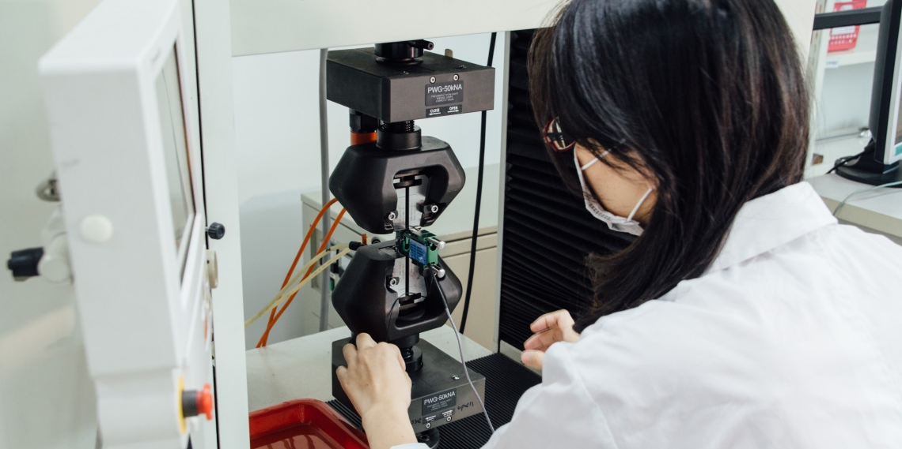
Extensive Testing Ensuring Safety and Quality
Complete quality system and professional safety laboratory testing.
Develop QA technology, testing processes and accumulate related big data.
Continuous improvement to achieve higher quality standards and better services.
SAI wheels adhere to international standards, including
Bending Fatigue
Radial Fatigue
13 Degree Impact
30 Degree Impact
Bi-axial Test
Functional
Tests
Salt Spray
CASS
Filiform Corrosion
Thermal Shock
Water Resistance
Xenon (Weathering Resistance Test)
Chip Resistance
Gasoline Resistance
Cycle Crack
Solvent Rub
Color
Metrology Measurement
CMM
Brinell hardness
Vicker hardness
Metallography microscope
Tensile
Fatigue Material Test
ARL spark O.E.S.
Rockwell hardness
Physical-
Mechanical
Tests
Environ-
mental
Tests
33

Slide 34
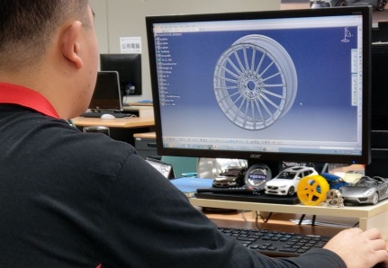
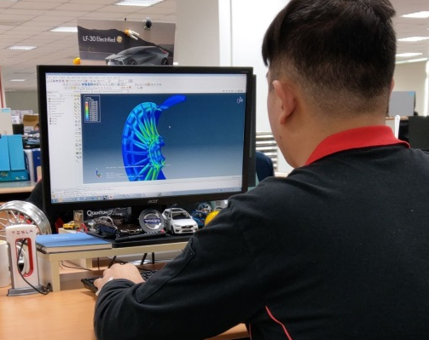
SAI Design & FEA Capability
ABAQUS 2017
HYPER Works 12
LS Dyna 7.1
Fe-safe V6.5
CAE
UniGraphic NX (CAD/CAM) NX11
I-DEAS (CAD) 12
CATIA (CAD) V5-6 R2015
Pro/E (CAD/CAE) 4.0
AutoCAD 2017
Master Cam (CAM) 2017
Power Mill (CAM) 2017
DEFORM
Simufact Forming
Radial & Rotary Analysis
Impact Analysis
Stiffness Analysis
Natural Frequency
CAD
CAM
Simulation
Ability
34

Slide 35
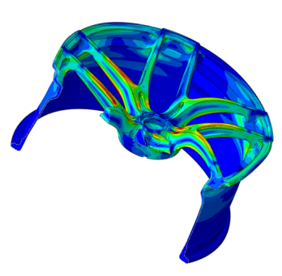
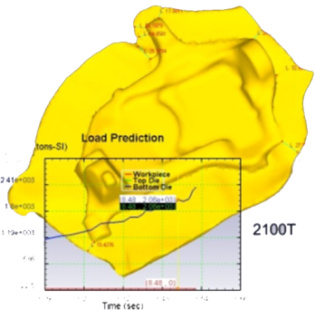
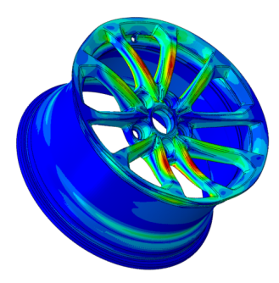
Research & Development Capability
Fields of Research
01
Microstructure-Processes-Properties Evaluation
05
Lightweight Magnesium Alloys
02
Optimization on Forging Processes
06
CAE/CAD Design on
Chassis Products
03
Near Net Shape Forging
07
Modularization of Automotive
Structural Parts
04
Composite Materials
08
Automation Equipment Development

Slide 36
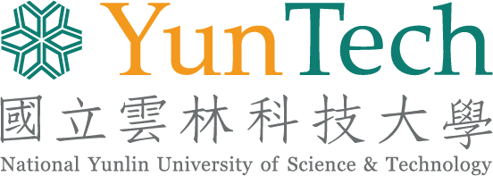



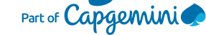


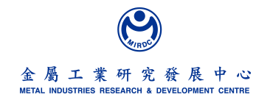

Our Industry and Research Partners
A Win-Win strategy through industrial and research institution collaboration in material science, manufacturing processes and product development.
Material Engineering
Surface Treatment
3D Printing Application
Automation Engineering
Forging Process
36

Slide 37
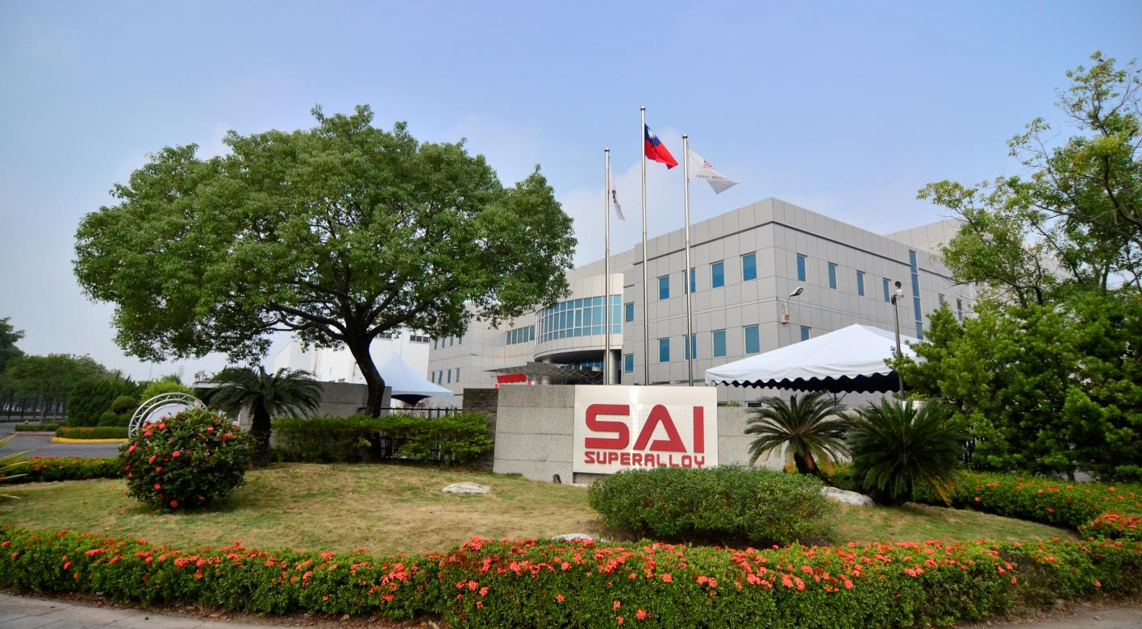
Thank You
37

Slide 38
Disclaimer
The information contained in this confidential document ("Presentation") has been prepared by SuperAlloy Industrial Company Ltd. (the "Company"). It has not been fully verified and is subject to material updating, revision and further amendment.
While the information contained herein has been prepared in good faith, neither the Company nor any of its shareholders, directors, officers, agents, employees or advisers gives, has given or has authority to give, any representations or warranties (express or implied) as to, or in relation to, the accuracy, reliability or completeness of the information in this Presentation, or any revision or supplement thereof, or of any other written or oral information made or to be made available to any interested party or its advisers (all such information being referred to as "Information") and liability therefore is expressly disclaimed. Accordingly, neither the Company nor any of its shareholders, directors, officers, agents, employees or advisers takes any responsibility for, or will accept any liability whether direct or indirect, express or implied, contractual, tortious, statutory or otherwise, in respect of, the accuracy or completeness or injury of the Information or for any of the opinions contained herein or for any errors, omissions or misstatements or for any loss, howsoever arising, from the use of this Presentation or the information.
Neither the issue of this Presentation nor any part of its contents is to be taken as any form of commitment on the part of the Company to proceed with any transaction and the right is reserved by the Company to terminate any discussions or negotiations with any prospective investors. In no circumstances will the Company be responsible for any costs, losses or expenses incurred in connection with any appraisal or investigation of the Company. In furnishing this Presentation, the Company does not undertake or agree to any obligation to provide the recipient with access to any additional information or to update this Presentation or to correct any inaccuracies in, or omissions from, this Presentation which may become apparent.
This Presentation should not be considered as the giving of investment advice by the Company or any of its shareholders, directors, officers, agents, employees or advisers. Each party to whom this Presentation is made available must make its own independent assessment of the Company after making such investigations and taking such advice as may be deemed necessary. In particular, any estimates or projections or opinions contained herein necessarily involve significant elements of subjective judgment, analysis and assumptions and each recipient should satisfy itself in relation to such matters.
This Presentation includes certain statements that may be deemed “forward-looking statements”. All statements in this discussion, other than statements of historical facts, that address future activities and events or developments that the Company expects, are forward-looking statements. Although the Company believes the expectations expressed in such forward-looking statements are based on reasonable assumptions, such statements are not guarantees of future performance and actual results or developments may differ materially from those in the forward-looking statements. Factors that could cause actual results to differ materially from those in forward-looking statements include market prices, continued availability of capital and financing, general economic, market or business conditions and other unforeseen events. Prospective Investors are cautioned that any such statements are not guarantees of future performance and that actual results or developments may differ materially from those projected in forward-looking statements.
38

