Slide 1
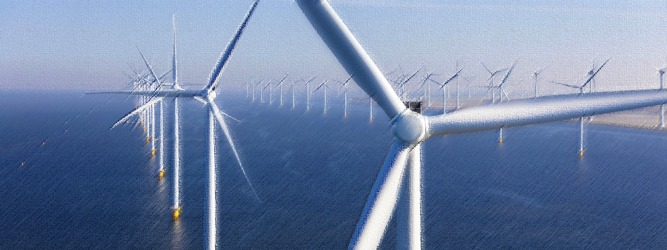

Yeong Guan Group (1589 TT)
2023/04

Slide 2
Disclaimer
The information contained in this document was verified by an independent third party. YG does is not responsible for the accuracy, fairness, and completeness of any information contained in this document. You should not assume any information in this document to be accurate, fair, nor complete. The information or opinions contained in this document is provided on a specified date, which YG reserves all right to update. YG has no obligation to notify you of any updates after a specific date or any development of information in the documents. YG will not accept any liability for any loss resulting from the use of this document or its contents or for other reasons related to this document.
This document does not constitute an offer or solicitation of an offer of purchase or acquisition to sell or issue shares of YG or any of its subsidiaries or related parties in any jurisdictions, does not serve as a part an offer or incentive, nor should be interpreted as such. Any part thereof or distribute the facts does not constitute the basis of any contract or commitment, and should not be relied upon in respect of any contract or commitment.
Your acceptance of this document constitutes your agreement that the information contained in the document is kept strictly confidential, securities researchers should have eligibility of the securities research and follow any relevant securities laws and regulations and restrictions of the appropriate jurisdiction before publishing research results on YG.
This document is provided for the securities researchers for use as their research reference only. Any part of the document cannot be photocopied, copied, forwarded, or in any manner, directly or indirectly transferred to any other person or for public announcement and for any other purpose.

Slide 3
Outline
Section One: 公司策略
1. Yeong Guan Overview & Development plan
Section Two: 營運目標
2. Market Trends
Section Three: 永冠簡介
3. Development Strategy
4. Detailed Financial Figures
Section Four: 財務表現

Slide 4

Yeong Guan Overview & Development plan

Slide 5

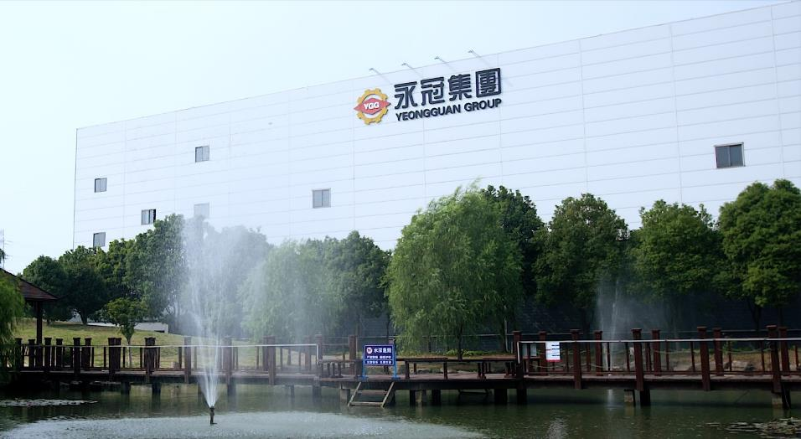


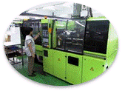

Yeong Guan Overview
Vertical and horizontal integration
Design
Casting
  From mold design, casting, welding, painting, processing to assembly, Yongguan can meet the needs of customers for one-stop procurement.。
Total
Solution
Assembly
Machining
Scale advantage
Welding
Painting
  With an annual designed casting capacity of nearly 220,000 tons, customers can use a single window to simplify supplier management.
Renewables
Regional advantage
  Serve customers nearby and shorten the process.
Plastic
Injection
Industrial
Machinery

Slide 6
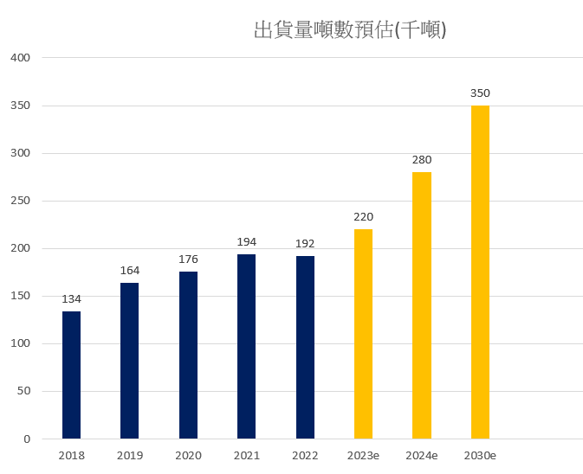
Development plan
  Near Term
  In 2021, the turnover will reach NT$8.95 billion, and the shipment will reach 194,000
  In 2022, the turnover will reach NT$9.38 billion, and the shipment will reach 192,000
  Growth period of 15~20% in 2023
  2024 Shipments Estimates Promise 50% Growth Over 22
Mid Term
  Taichung factory: 2023 Q3 certification
  Thailand factory: 2025 Q1 put into operation
  Cooperation case of Jiuquan First Heavy Industry Wind Power Group: central enterprise/Goldwind cooperation (including wind farm development)
  Capacity optimization of existing production bases
長期目標(5-10年)
  永續經營與傳承
  深化環境、社會及公司治理 (ESG)、善盡企業社會責任 (CSR)
  年產能預期超越35萬噸
Estimated Shipments (thousand tons)

Slide 7
Development plan
Long Term
  Sustainable Management and Inheritance
  Deepening Environmental, Social and Corporate Governance (ESG) and Fulfilling Corporate Social Responsibility (CSR)
  The annual production capacity is expected to exceed 350,000 tons
Estimated Shipments (thousand tons)

Slide 8

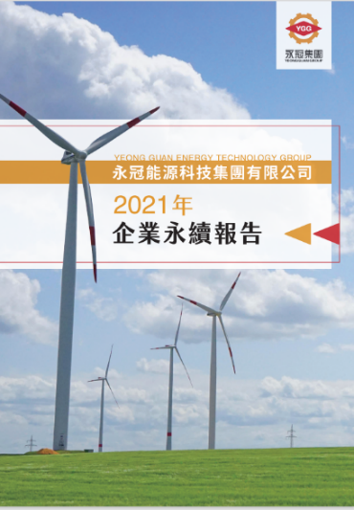



Sustainability and Sustainable Management
Environmental
  Invest in wind farms
  Reserve green energy resources
  Calculating carbon emissions; managing carbon footprint
Social
  Technology bring home
  Industry-academia collaboration
  Talent cultivation
Governance
  Increase the number of outside directors
  Increase female board members
  Chairman no longer serve CEO at the same time
來源:TCSA台灣企業永續獎::TCSA台灣企業永續獎 (tcsaward.org.tw)

Slide 9




Core Competitiveness: Strengthening of Professional and Technical Capabilities
技術能力
Good quality
Accumulation of decades of work experience by the professional team
Excellent product quality, high reliability and long service life
Advanced Material Formula Control Capabilities
  Simultaneous processing of more than 30 chemical elements and metallographic analysis
  Professional processing capabilities of high standards, high specifications, and special materials
  Ability to support advanced equipment
  Production equipment selection and design planning
  Adaptive integration capability of automation and intelligent equipment
  High-end, precision, large-scale, continuous investment in automation equipment
  Excellent production management ability and product line change planning
  Quick response to mold on-line and line change
  A small amount of various production arrangements to respond to rapid changes in customer demand
  Modularization of process design, intensive production
Focus on quality improvement, lean production, personnel training, etc., and promote Industry 4.0, introduce Manufacturing Execution System (MES), and strengthen technical capabilities and production efficiency.

Slide 10
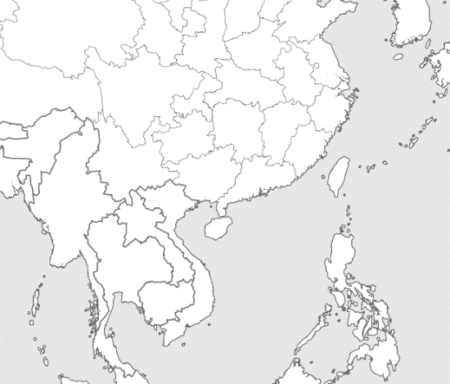
Our Production Sites
YGB Liyang
YGW Jiangsu
  Product/Service: Casting
  Employee: 242
  Plant Area: 36,401 m²
  Since 2016
  Product/Service: Casting, Machining
  Employee: 806
  Plant Area: 120,239 m²
  Since 2008
YGA Taipei
YGS Ningbo
  Product/Service: Casting
  Employee: 103
  Plant Area: 1,829 m²
  Since 1971
  Product/Service: Casting, Machining
  Employee: 701
  Plant Area: 93,072 m²
  Since 2000
Taichung Port, Taiwan
YGL Ningbo
  Product/Service: Casting, Machining
  Employee: 800
  Plant Area: 205,000 m2
  Since 2022
  Product/Service: Casting
  Employee: 326
  Plant Area: 27,288 m²
  Since 2006
Chonburi Province, Thailand
YGD Dongguan
  Product/Service: Casting
  Employee: 158
  Plant Area: 15,015 m²
  Since 1995
  Product/Service: Casting
  Employee: 300
  Plant Area: 968,000 m2
  Since 2024

Slide 11





















renewable energy
The top ten high-quality customers in the industry
Renewable energy
Injection molding machine
Industrial machinery
The goal is to win more global high-end equipment and international first-line manufacturers, and work closely together to develop new products.

Slide 12
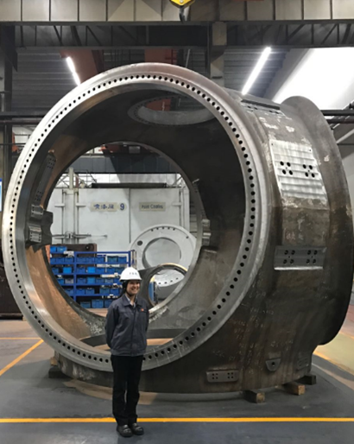
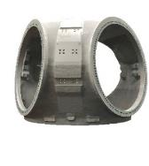
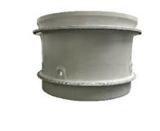
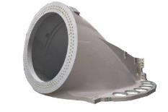
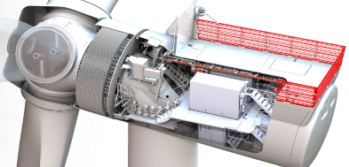
Direct Drive Wind Turbine
Fixed axis
Hub
Base

Slide 13
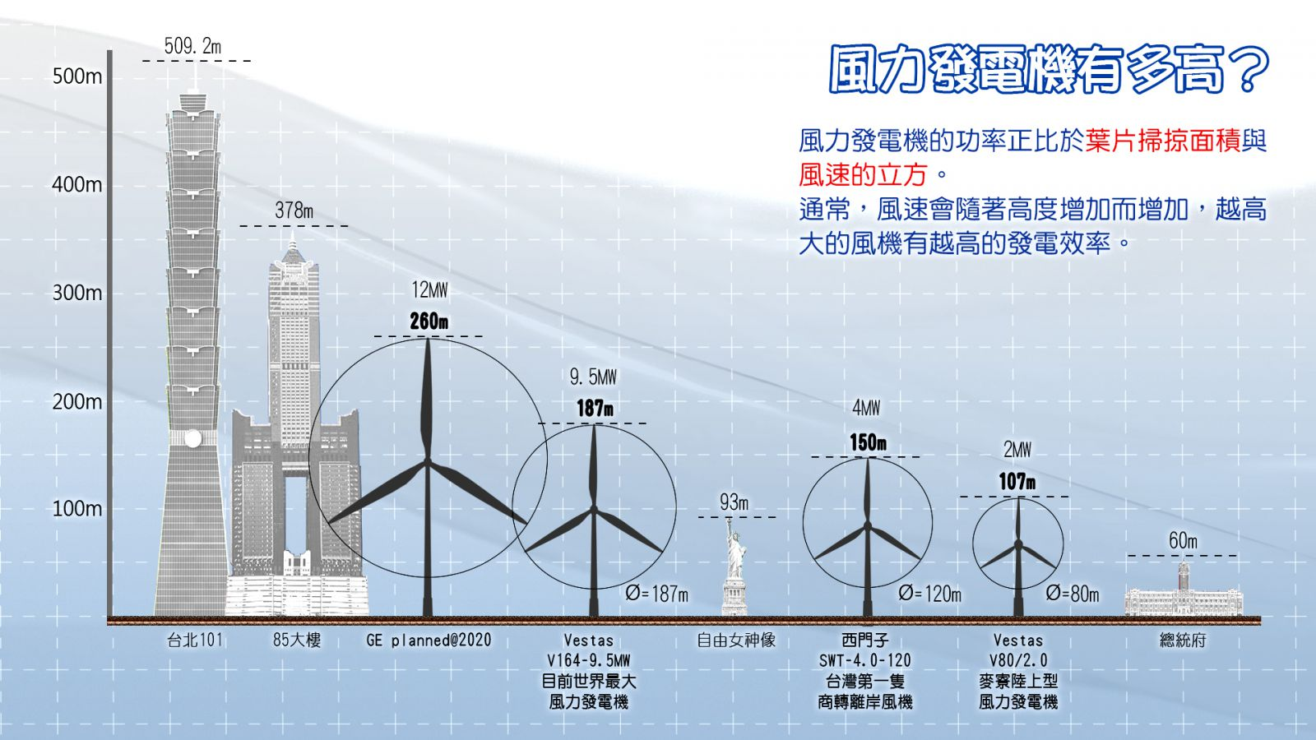
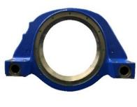

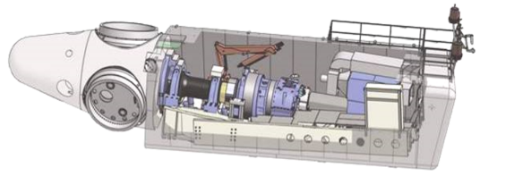
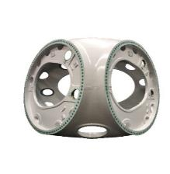
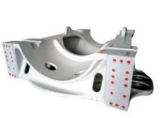
Doubly-fed wind turbine
Front bearing seat
Rear bearing seat
來源:
https://learnenergy.tw/index.php?inter=knowledge&caid=5&id=341&page=9
Hub
Base

Slide 14
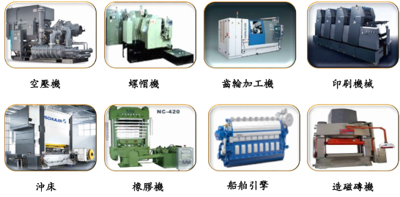
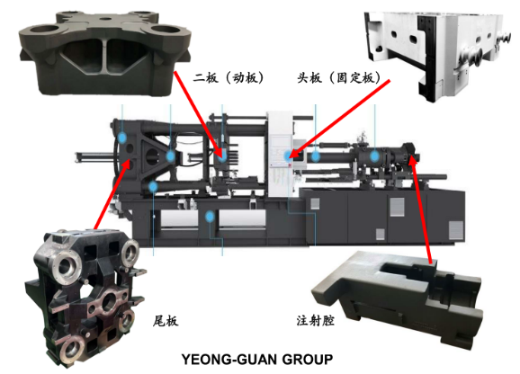
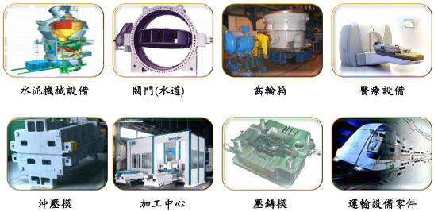
產品應用廣泛
Injection molding machine
Industrial machinery

Slide 15

Market Trends

Slide 16
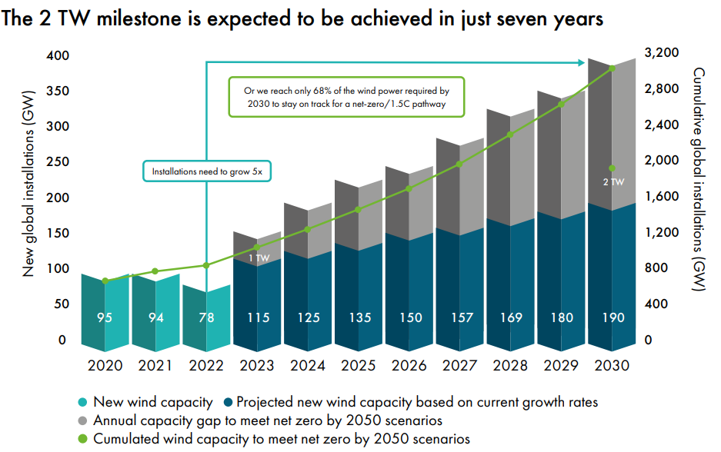
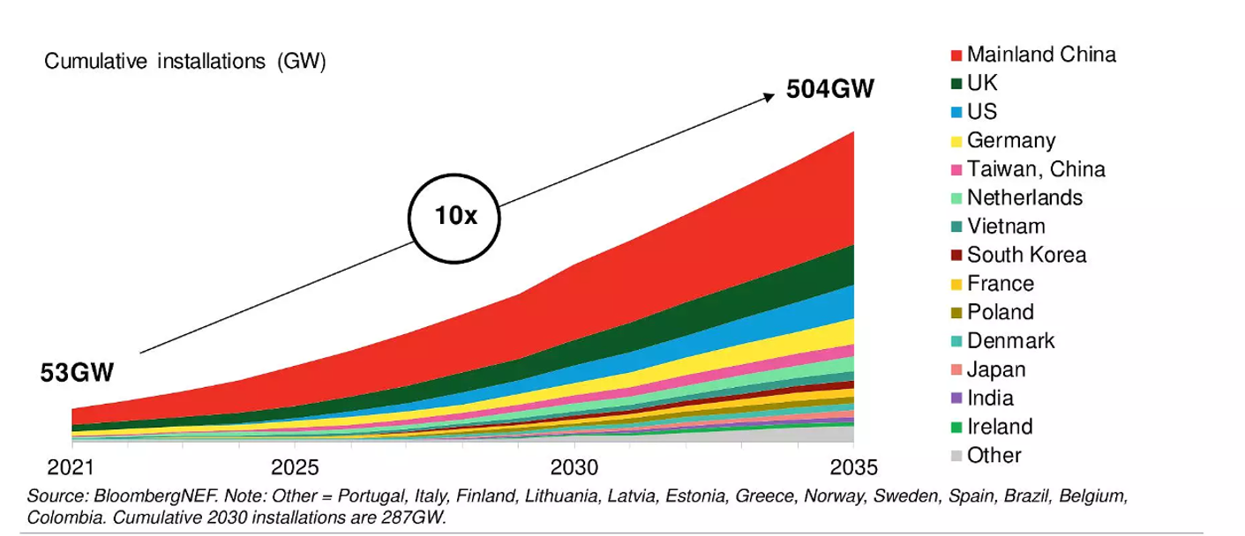
Global Market Trends
The demand of the global wind energy market has greatly exceeded expectations and the growth rate has been astonishing

Slide 17
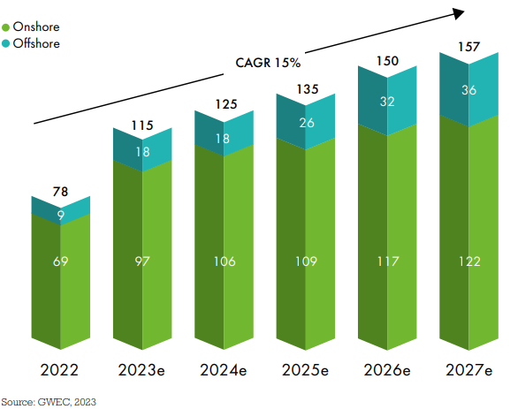
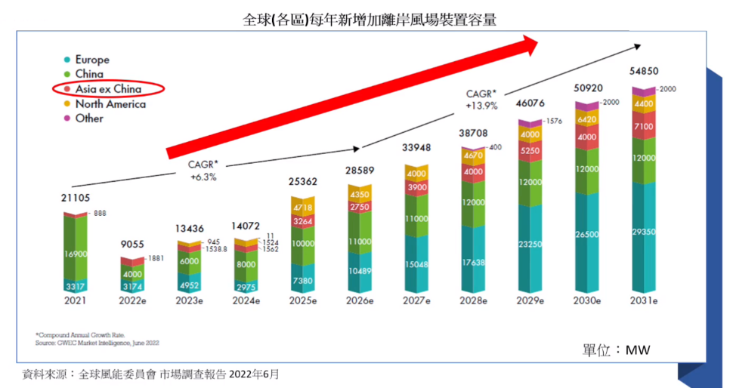
Global Market Trends

Slide 18
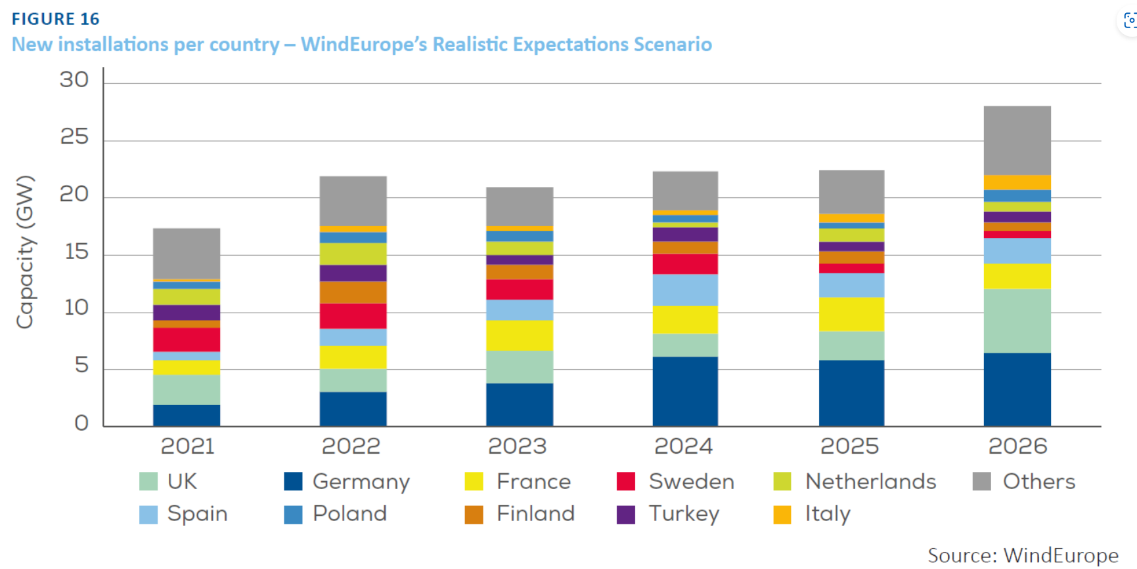
European Market Trend
The demand for wind power in the EU will remain above 20GW annually from 2022, especially in Germany and the UK.
The Russia-Ukraine war catalyzed the EU to get rid of its energy dependence on Russia and accelerate the development of new energy sources. In addition to the spillover of Europe's supply chain demand for large castings for offshore models to Asia, the demand for large castings in Asia must be digested by itself.

Slide 19
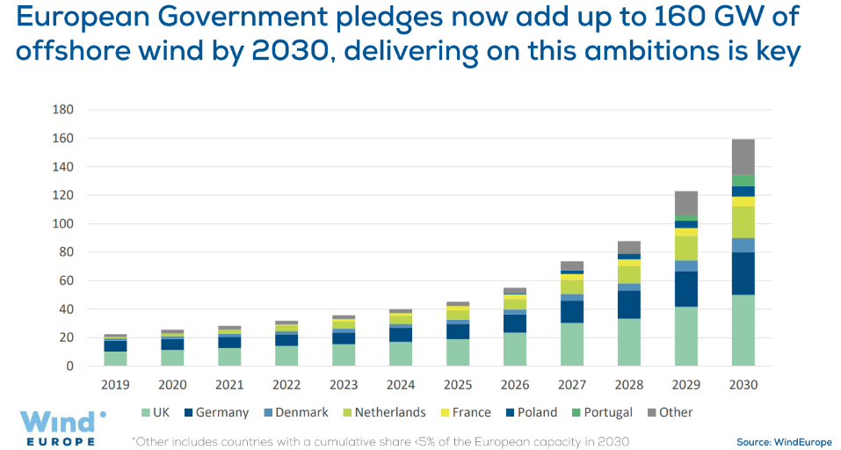
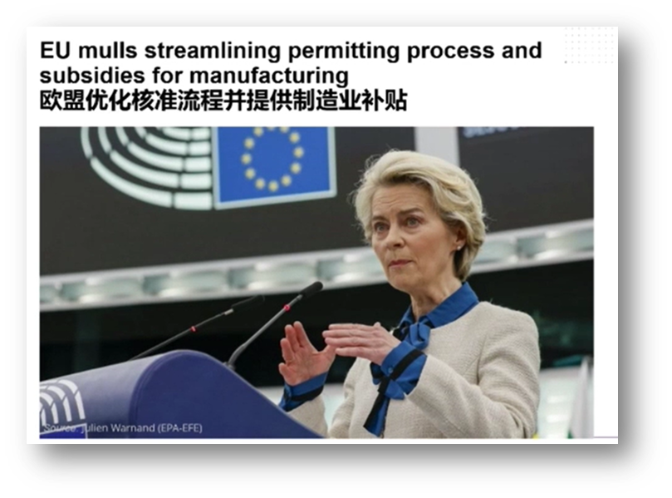
歐盟市場潛力
Medium and long-term growth of the European market doubles

Slide 20
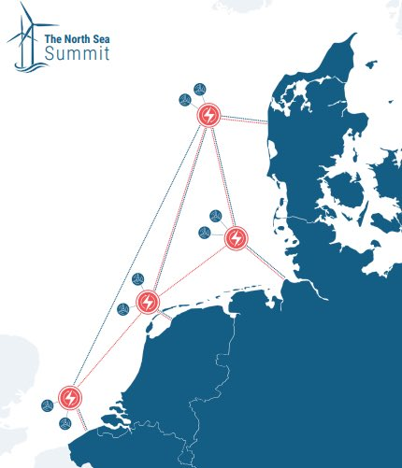
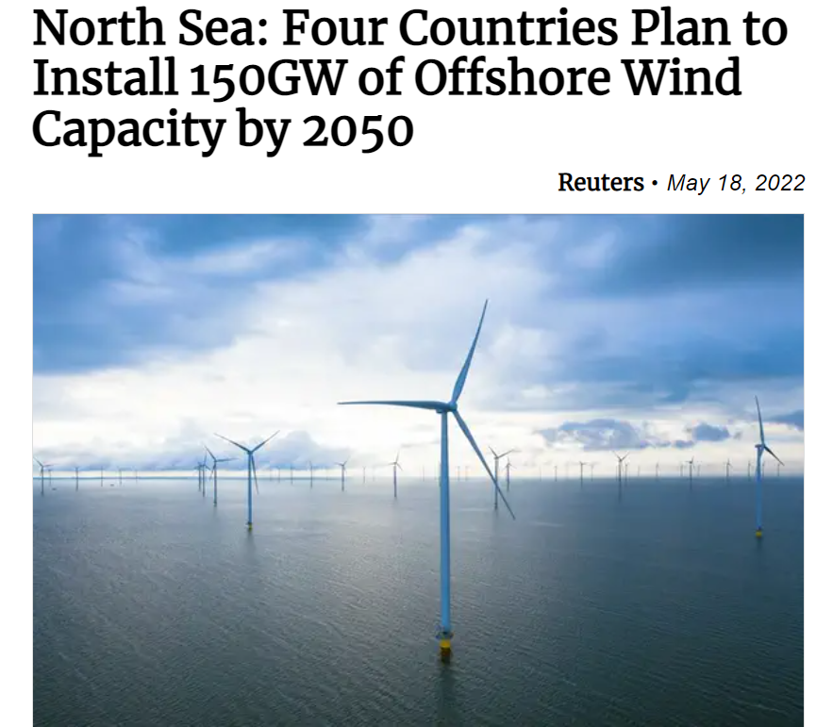


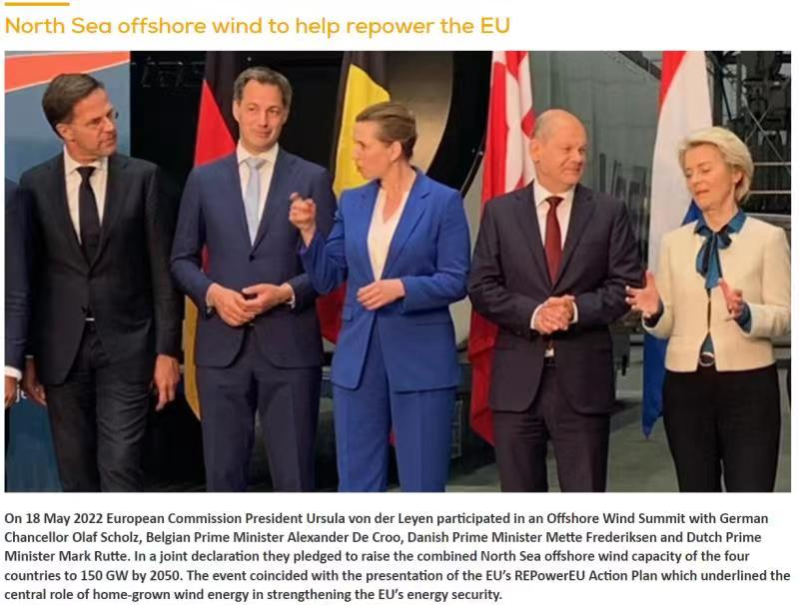


EU market trends
The North Sea offshore wind farm investment plan is 150GW; and the European casting supply chain is bound to be unable to meet the demand
來源:https://twitter.com/#NorthSeaSummit

Slide 21
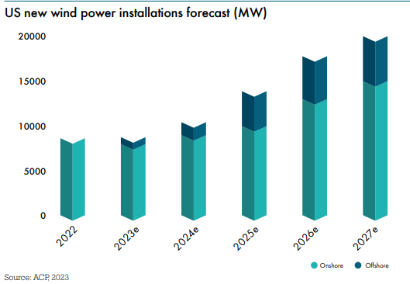
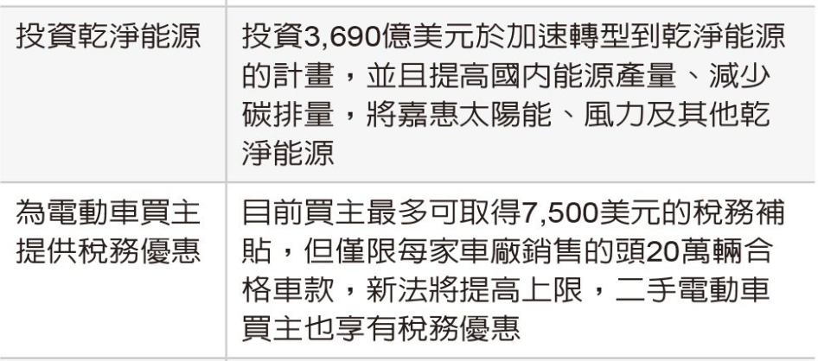
American market trends
78%
來源:Biden announces new climate change actions but holds an emergency declaration in reserve (theconversation.com

Slide 22
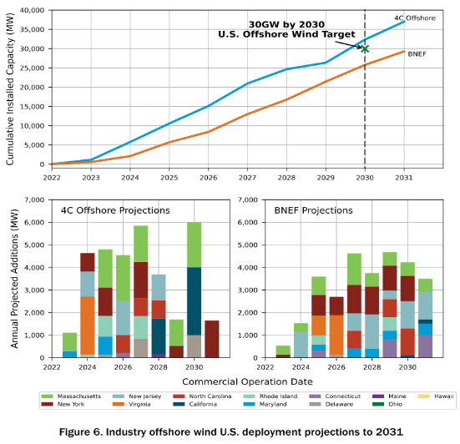
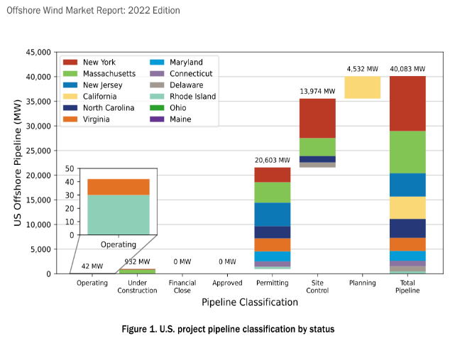
American market trends
In the forecasts of different agencies, the American market is expected to achieve substantial

Slide 23
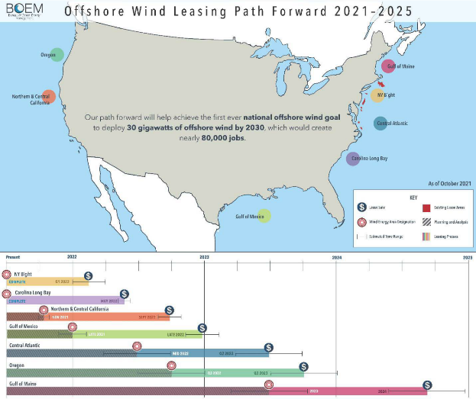
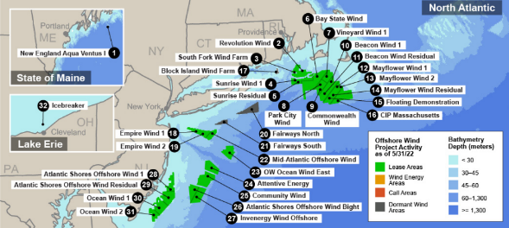
American market trends
There are abundant offshore wind energy resources in the United States, and 56 wind farms have been planned in the east and west coasts, the Great Lakes region, the Gulf of Mexico and the Hawaiian waters;
At the same time, it is expected to bring 80,000 job opportunities before 2030.

Slide 24
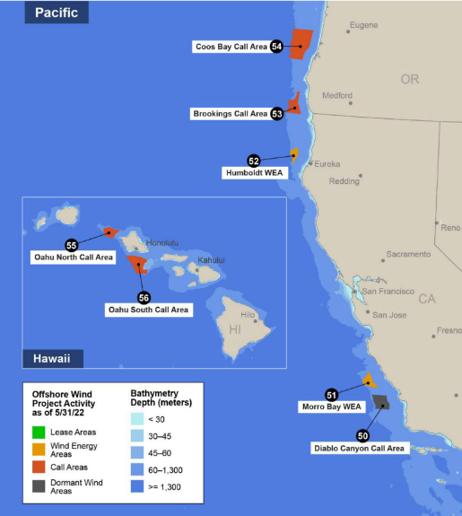
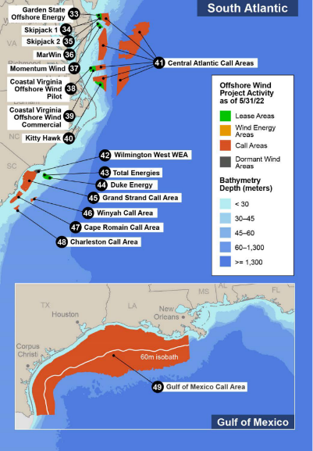
American market trends

Slide 25
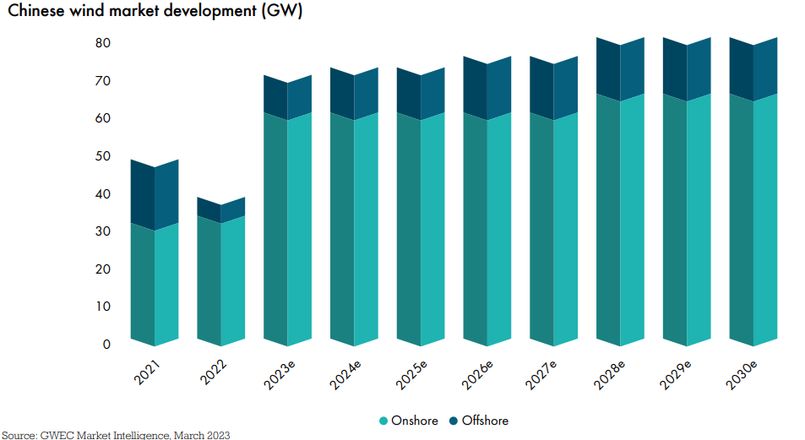
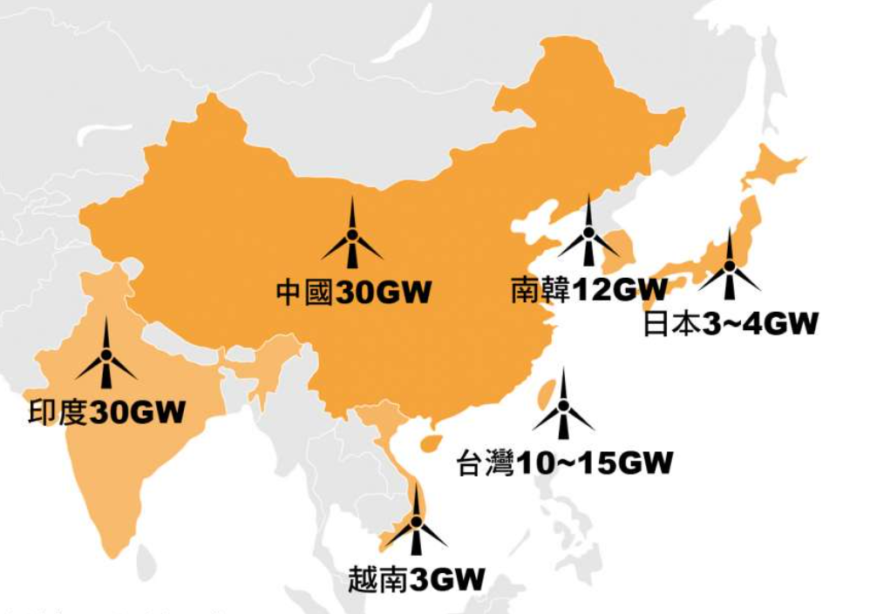

Asian Market Highlights
2035 Offshore wind power installation plans in Asian countries
The scale and rapid development of offshore wind power in Asia
Technology and Supply Chain Integrity
According to the 14th Five-Year Plan, by 2030, China's annual new installed capacity will not be less than 60GW

Slide 26
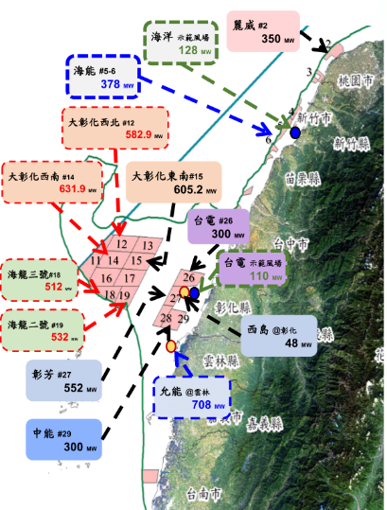
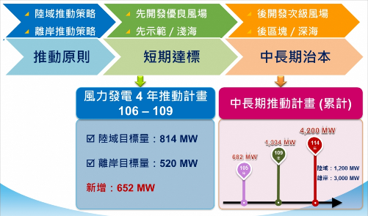
Taiwan Offshore Wind Power Market
Block development from 2026 to 2035: It is planned to release 15GW of installed capacity, which is nearly three times that of the previous two stages. The cumulative installation capacity is 20.7GW.
Target 2025, the total installed capacity of offshore wind power will reach 5.7GW

Slide 27
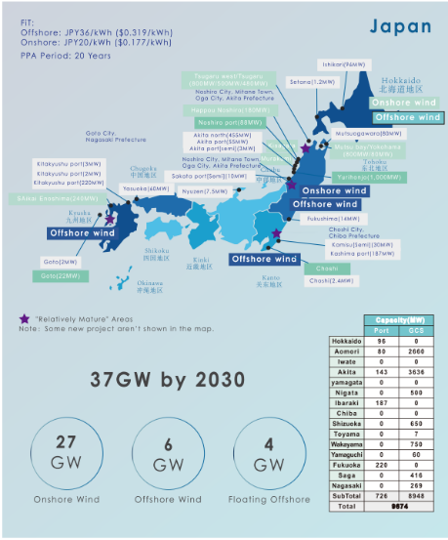
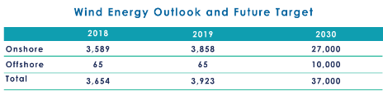
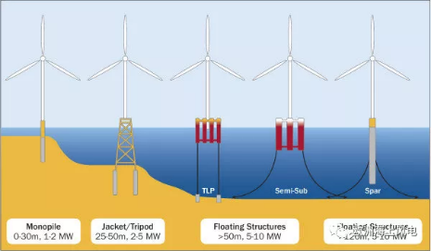
Japan Wind Power Market Planning
Installed wind power generation and future targets
陸上
離岸
總共
The 2030 offshore wind power target is 10GW, of which 4GW are floating projects.

Slide 28
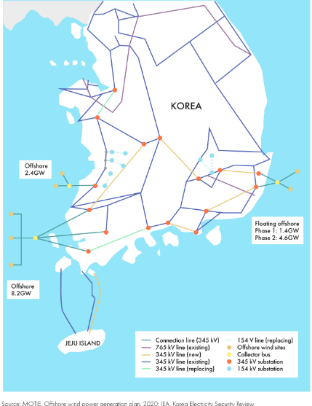
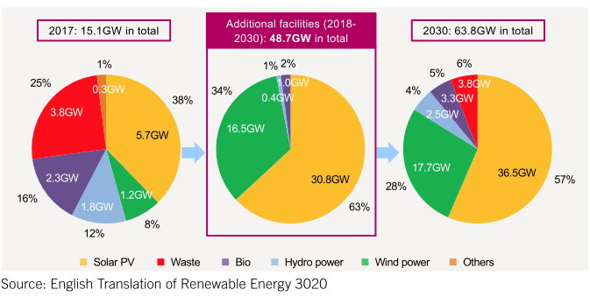
South Korea's Wind Power Market Vision
According to the South Korean government’s announcement in 2021, 16.5 GW of new wind power generation capacity will be built in 2030 (of which offshore wind power will account for 12 GW)
As of 2021, South Korea currently has 87 offshore wind farm projects under construction or approved, of which five have already generated electricity.
Aim to become a top 5 offshore wind power country by 2030

Slide 29
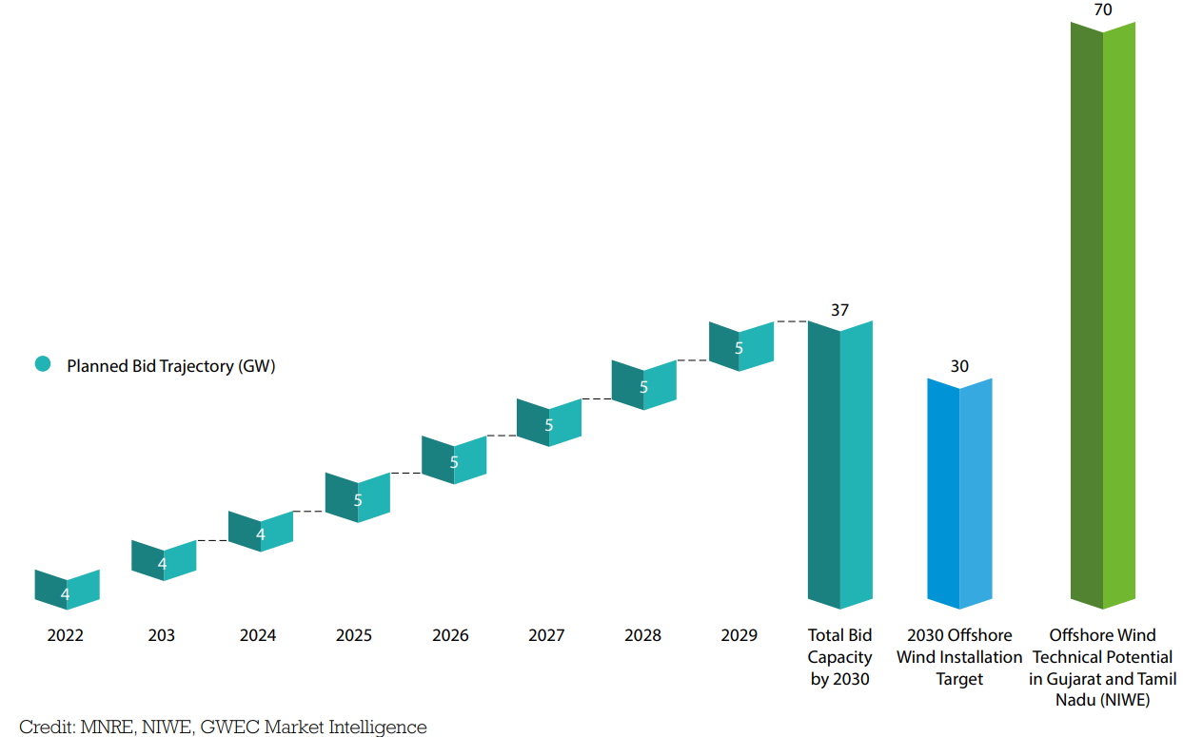
Indian Wind Power Market Vision
The Indian government announced that from 2022, the wind farms for bidding will be 4GW per year; from 2025, 5GW per year
Accumulated to 37 GW by 2030, of which 30GW is offshore wind power.

Slide 30
Anticipated market demand conversion orders
Large-scale foundries around the world's ports and offshore wind power – rare
About 1.5GW = 20,000 tons of orders
The United States has a 25% tariff condition for China
The only manufacturer of domestically produced castings for wind power in Taiwan
Price & gross profit are higher than onshore wind power

Slide 31
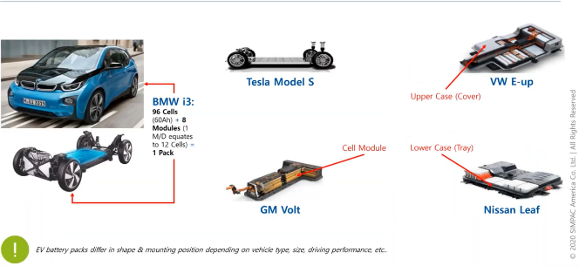
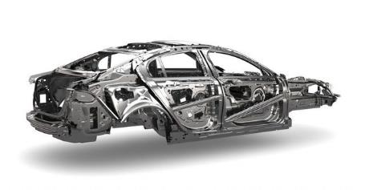
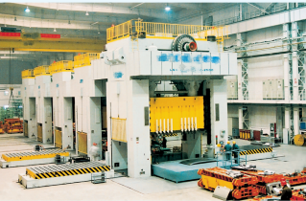


新能源汽車市場願景

Slide 32
新產能投資 & 發展願景

Slide 33

Taichung Foundry State
2023 2Q
Go into operation
2023
Commissioning 7k – 10K tons
2024
Capacity reach to 50k tons
  Schedule： 2020 ground breaking，2023 2Q go into operation
  Max capacity：100k tons/year
  renewable energy industry 60%，
  plastic injection and industrial
  machinery 40%
  Advantage：
  Next to Siemens Gamesa & Vestas
  Localization policy
  Located in port reduce logistic cost
  Government support
  Avoid trade frictions
Already signed a contract with Siemens, Taichung foundry will provide 30K tons/year for Taiwan market & 50K tons/year for global market.

Slide 34


With the No. 1 market share, Siemens Gamesa settled in Taichung Po

Slide 35

Market share No. 1 Siemens Gamesa looks to the world
Siemens is in the leading position in fan technology (traditional/medium-speed/direct/floating) that has reached the stage of commercial transformation

Slide 36


泰國厰投資案
距離曼谷國際機場91 km
距離林查班港口40 km
距離芭堤雅60 km
總佔地面積
968,000平方米

Slide 37

Thailand Foundry
2022 August
groundbreaking
2024 4Q
Go into operation
2025
Commissioning 20k tons
  Schedule：2022 August ground breaking，2024 go into operation
Capacity：80k tons/ year，Renewable industry（onshore wind power）， Injection molding machine & industrial machinery
Advantage
  968,000 square meters
  8 years tax-free;5 years 50% off for tax
  ASEAN huge market
  (major appliance 、 automotive industry)
  Abundant human resources & low cost

Slide 38


Cooperation case of Jiuquan First Heavy Industry Wind Power Group
Central enterprise/Goldwind/Yongguan joint development (equipment base/wind field)
At present, 600MW franchise has been obtained
Northwest wind farm development (Jiuquan wind farm estimated total generating capacity is about 80GW)
In line with China's One Belt One Road policy, radiating Central Asia/Middle East
來源:維基百科

Slide 39
Detailed Financial Figures

Slide 40
Historical Income Statement
NT$ Million | 2019 | 2020 | 2021 | 2022 | YoY(%)
 |  |  |  |  | 2019 | 2020 | 2021 | 2022
Sales Revenue | 7,900 | 8,184 | 8,948 | 9,384 | 27.5 | 3.6 | 9.3 | 4.9
Gross Profit | 1,371 | 1,790 | 1,770 | 1,344 | 65 | 30.6 | -1.1 | -24
Operating Profit | 212 | 545 | 316 | 98 | -186.5 | -157.1 | -42 | -69
Income before Tax | 221 | 624 | 321 | -314 | -195.3 | -182.4 | -48.6 | -198
Net Income | 164 | 517 | 214 | -444 | -159.9 | -215.2 | -58.6 | -307
EPS (NT$) | 1.54 | 4.81 | 1.95 | -3.96 | -162.1 | -212.3 | -59.5 | -303
Key financial ratio (%)
Gross Margin | 18 | 22 | 20 | 14
Operating Margin | 3 | 6 | 3 | 1
Net Margin | 2 | 6 | 2 | -5
OPEX ratio | 15 | 16 | 17 | 13

Slide 41
Historical Balance Sheet
NT$ Million | 2019 | 2020 | 2021 | 2022 | YoY(%)
 |  |  |  |  | 2019 | 2020 | 2021 | 2022
TOTAL ASSETS | 13,521 | 16,394 | 18,470 | 21,891 | -7 | 21.2 | 12.7 | 18.5
Cash | 1,451 | 2,682 | 1,994 | 2,114 | -54 | 84.8 | -25.7 | 5.7
NR & AR | 2,947 | 3,517 | 3,242 | 3,742 | 40.1 | 19.3 | -7.8 | 15.4
Inventory | 1,226 | 1,324 | 1,660 | 1,858 | -10.4 | 8 | 25.4 | 11.9
Fixed Asset | 5,735 | 5,756 | 7,239 | 9,651 | -3.1 | 0.4 | 25.8 | 33.2
TOTAL LIABILITIES | 5,699 | 7,630 | 9,635 | 13,399 | -8.8 | 33.9 | 26.3 | 39
Bank Loans | 3,858 | 3,498 | 4,344 | 8,482 | -15.8 | -9.3 | 24.2 | 95
NP & AP | 990 | 1,646 | 2,422 | 2,296 | -5.7 | 66.3 | 47.1 | -5.2
TOTAL EQUITY | 7,822 | 8,764 | 8,835 | 8,492 | -5.5 | 12 | 0.8 | -3.9
Common Stock | 1,056 | 1,106 | 1,106 | 1,106 | -5.4 | 4.7 | 0 | 0
Book value per share | 72.5 | 79.2 | 79.9 | 76.8
A/R turnover days | 117 | 145 | 139 | 137
Inventory turnover days | 78 | 76 | 77 | 82
A/P turnover days | 57 | 75 | 103 | 107
ROE (%)* | 2.1 | 6.3 | 2.5 | -5.1
*股東權益報酬率：母公司淨利/ 平均普通股股東權益

Slide 42
Quarterly Income Statement
NT$ Million | 3Q20 | 4Q20 | 1Q21 | 2Q21 | 3Q21 | 4Q21 | 1Q22 | 2Q22 | 3Q22 | 4Q22
Sales Revenue | 2,431 | 2,488 | 2,146 | 2,235 | 2,270 | 2,296 | 1,813 | 2330 | 2,481 | 2,760
Gross Profit | 582 | 616 | 551 | 450 | 400 | 369 | 196 | 307 | 349 | 493
Operating Profit | 290 | 212 | 200 | 83 | 36 | (2) | (118) | (17) | 59 | 174
Income before Tax | 267 | 262 | 157 | 123 | 36 | 5 | (217) | (87) | (75) | 65
Net Income | 207 | 230 | 126 | 141 | 29 | (82) | (196) | (91) | (135) | (21)
EPS (NT$) | 1.94 | 2.12 | 1.13 | 1.27 | 0.27 | (0.72) | (1.75) | (0.81) | (1.21) | (0.19)
Revenue by Application (%) | 3Q20 | 4Q20 | 1Q21 | 2Q21 | 3Q21 | 4Q21 | 1Q22 | 2Q22 | 3Q22 | 4Q22
Renewable Energy | 72.8 | 67.4 | 60.3 | 46.2 | 43.2 | 41.1 | 33.8 | 42.3 | 45.7 | 56.4
Injection Molding Machine | 11.7 | 14.4 | 18.4 | 24.5 | 26.5 | 30.7 | 32.4 | 27.6 | 30.2 | 21.5
Industrial Machinery | 15.5 | 18.2 | 21.3 | 29.3 | 30.3 | 28.2 | 33.8 | 30.1 | 24.1 | 22.1

Slide 43
2022 Q3 Revenue by Application and Exchange Rate

Slide 44

感謝您的關注!
www.ygget.com

