Slide 1

中華電線電纜股份有限公司
CHINA WIRE & CABLE CO., LTD.
Stock code：1603
Corporate briefing

Slide 2
Disclaimer
The content of this briefing report is prepared in accordance with the financial report of the accountant's visa. The financial report is prepared in accordance with IFRS. The complete content and data shall be based on the financial report.
This information may contain statements about future prospects. Such statements are based on expectations of current conditions, but are also subject to known or unknown risks or uncertainties. Therefore, actual results may be significantly different from those expressed.
Except as required by law, the company is not obligated to actively update its expression of future prospects in response to the generation of new information or the occurrence of future events.
The copyright of this newsletter belongs to the company. Without the company's formal written consent, it may not be used for unauthorized purposes.

Slide 3
Investment safety reminder
In addition to the historical information provided in this document, if part of the content involves the expression of future prospects, etc., due to the influence of risks and uncertain factors, the actual results and the content of the expression may be significantly different. Investors should judge and control risks by themselves.

Slide 4
Briefing points
Business Overview
Financial Information
Business philosophy and outlook

Slide 5
Business Overview
中華電線電纜股份有限公司
2018年法人說明會

Slide 6
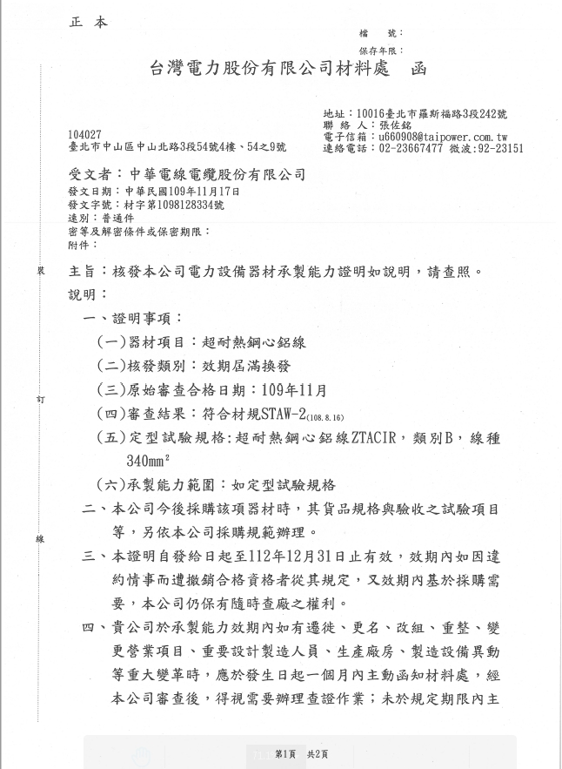
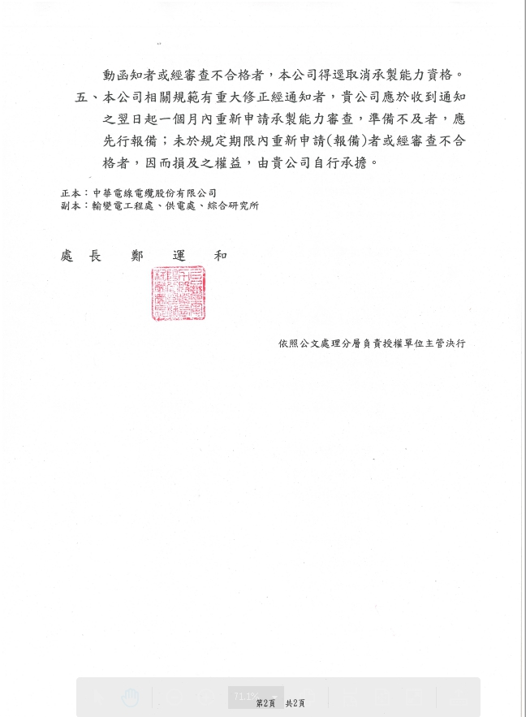
1、Cable department

Slide 7
Wire and Cable
    超耐熱鋼心鋁線 ZTACIR (與日本SEI技術合作)
高容量低弛度導線
弛度：指導線至連接該導線兩支撐點間直線之鉛垂距離。
全國第一家取得認證及投標資格

Slide 8
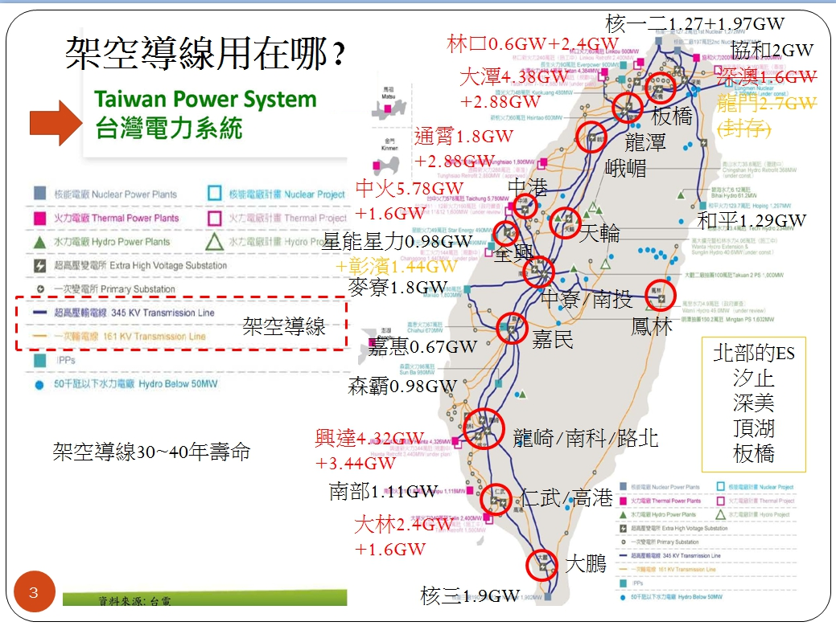

Slide 9
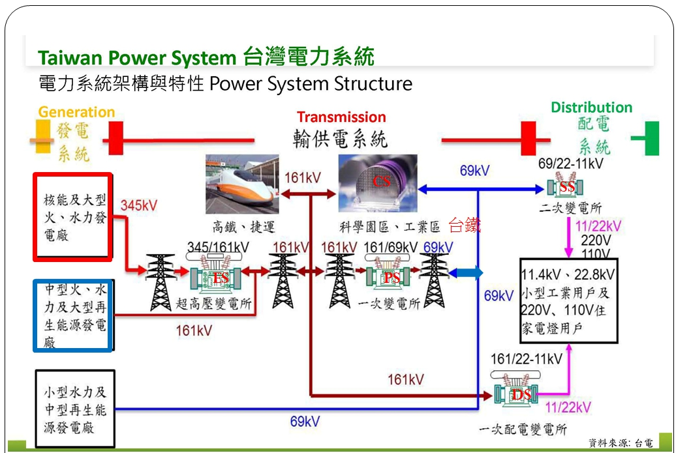

Slide 10
2、Window/door department
Contract Nature | Party | Case Name
Engineering Contract | 品興營造 | 華固建設「華固創富中心」辦公大樓新建工程
Engineering Contract | 世康開發 | 台北南港生技產業大樓(BOT)新建工程
Engineering Contract | 科定企業 | 科定企業總部大樓新建工程
Engineering Contract | 大成工程 | 南紡置地廣場開發案(二期)
Engineering Contract | 助群營造 | 宏盛建設汐止區智興段889-1地號等9筆新建工程
Engineering Contract | 宏林營造 | 中原段(商業區)集合住宅新建工程
Engineering Contract | 聚力建設 | 聯悅臻(台中梧棲鎮南段)
Engineering Contract | 大砌營造 | 新業築願景
Engineering Contract | 瑞助營造 | 瑞恩悅琚新建工程

Slide 11
Financial Information
中華電線電纜股份有限公司
2020年法人說明會

Slide 12
PRODUCTI0N VALUE TABLE
Unit：NTD1000；MT
年度 Year | 109年度前三季 (2020 First three quarters) |  |  | 108年度 (2019)
Production Value Major Products (or Department) | Capacity | Productivity | Output value | Capacity | Productivity | Output value
Wire and Cable | 15,000 | 5,041 | 515,022 | 20,000 | 8,155 | 1,042,302
Aluminum Window Curtain Wall | 3,000 | 1,153 | 742,629 | 4,000 | 2,194 | 1,236,020
Total | 18,000 | 6,194 | 1,257,651 | 24,000 | 10,349 | 2,278,322

Slide 13
Last two years sales volume value table
Unit：NTD1000；MT
年度 Year | 109年度前三季 (2020 First three quarters) |  | 108 年度 (2019)
Sales Value Major Products (or Department) | Domestic sales |  | Domestic sales
 | Volume | Value | Volume | Value
Wire and cable | 5,317 | 840,829 | 8,995 | 1,288,151
Aluminum Window Curtain Wall | 1,185 | 838,195 | 2,218 | 1,426,113
Construction Department | - | - | - | -
Total | 6,502 | 1,679,024 | 11,213 | 2,714,264

Slide 14
Business proportion
Unit：NTD1000
Product Category | Domestic sales |  | Export |  | Total
 | Amount | Ratio | Amount | Ratio | Amount | Ratio
Wire and Cable | 840,829 | 50.10% | - | 0.00% | 840,829 | 50.10%
Aluminum Window Curtain Wall | 838,195 | 49.90% | - | 0.00% | 838,195 | 49.90%
Construction Department | - | - | - | 0.00% | - | -
Total | 1,679,024 | 100.00% | - | 0.00% | 1,679,024 | 100.00%

Slide 16
Financial analysis(ifrs merge)
營業收入單位:新臺幣仟元
每股盈餘單位:新臺幣元
項目 Items | 109年度前三季 (2020 First three quarters) | 108年 (2019) | 107年 (2018) | 106年 (2017)
流動比率(%) Current Ratio | 158.27 | 165.91 | 154.69 | 167.44
資產報酬率(%) ROA | 4.41 | 3.08 | 1.82 | 3.81
純益率(%) Net Profit Ratio | 16.06 | 8.58 | 5.21 | 10.45
每股盈餘(元) EPS | 1.96 | 1.46 | 0.82 | 1.77
股東權益報酬率 ROE | 6.86 | 4.64 | 2.61 | 5.71
現金股利(元/股) Cash dividends | 0.5 | 0.5 | 1.0 | 0.5

Slide 17
Business philosophy and outlook

Slide 18
Business philosophy and outlook
In the third quarter of 2020, Coronavirus (Covid-19) spread throughout the world, resulting in the implementation of quarantine and travel restrictions on subsidiaries, customers and suppliers in some parts of the country. The combined company evaluated the overall business and financial aspects and It has not been significantly affected, and there is no doubt about the ability to continue operations, asset impairment and financing risks.

Slide 19
Presentation finished

Slide 21
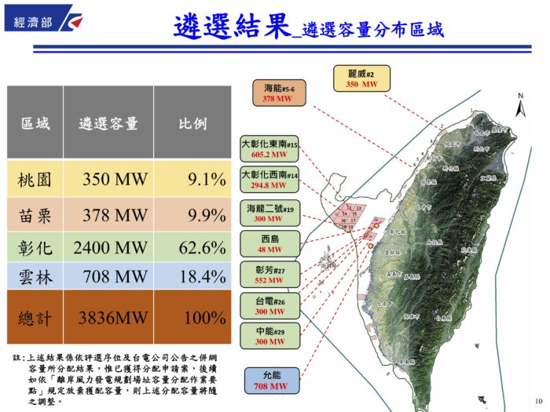

Slide 22
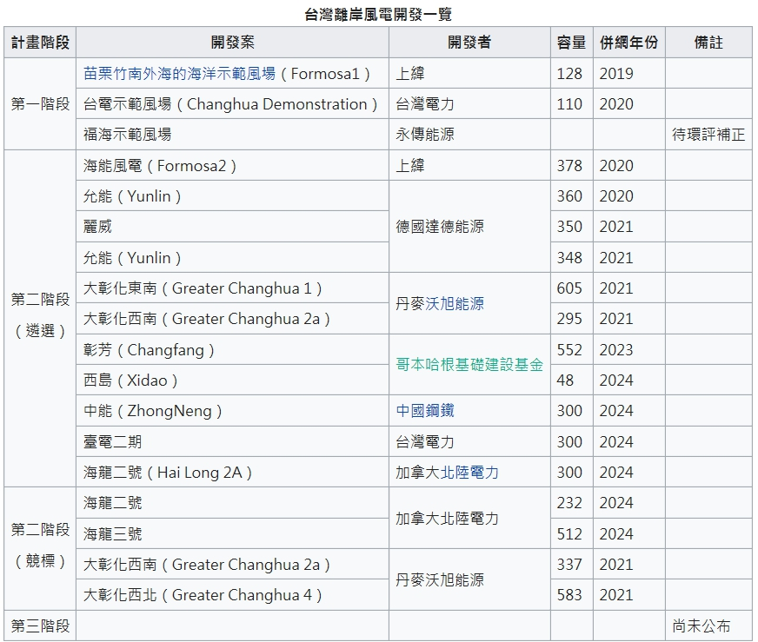

Slide 23
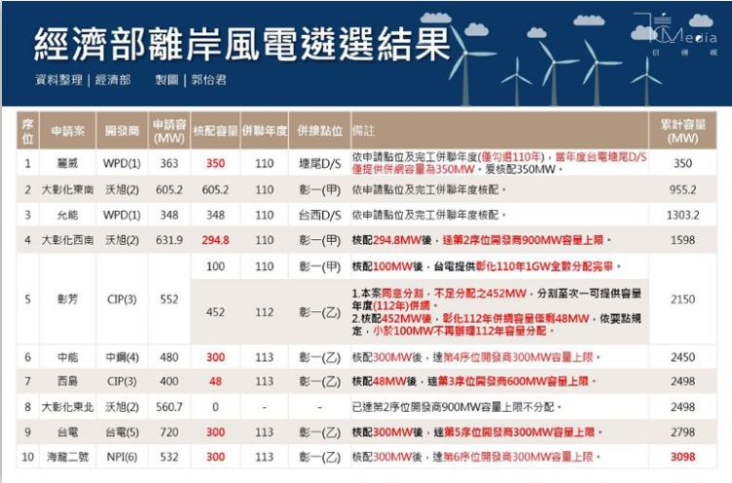

Slide 24
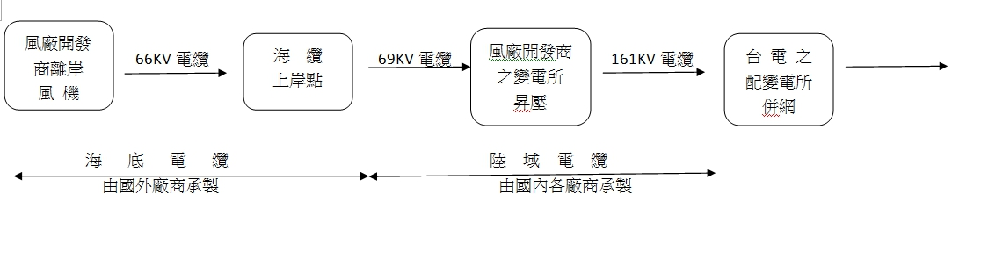

Slide 25
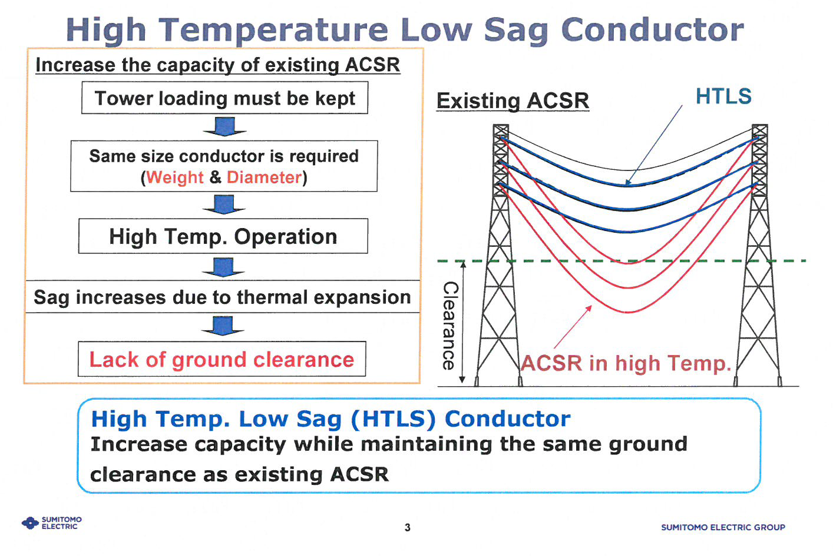

Slide 26
