Slide 1
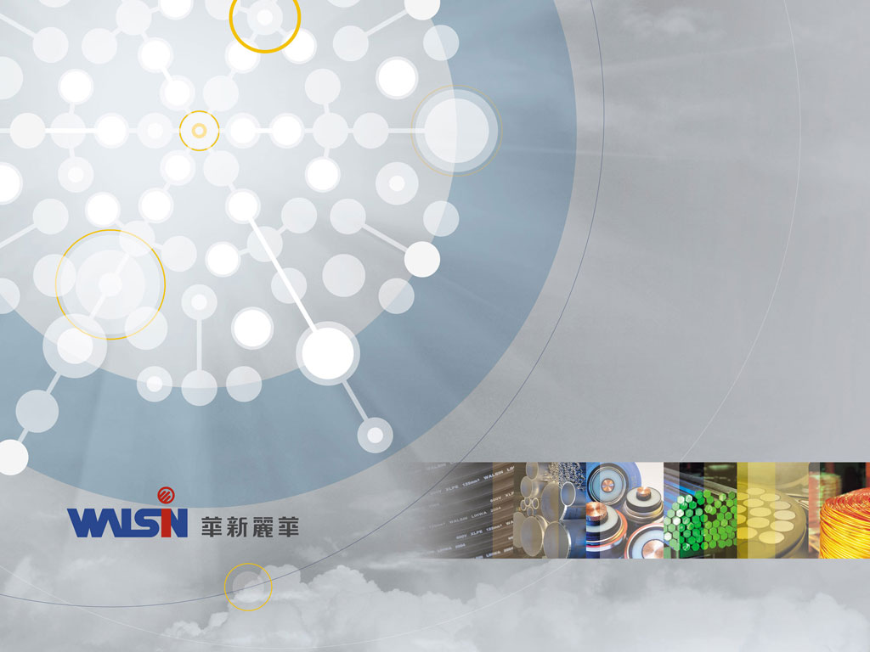
Walsin Lihwa Corporation
2018/Q4 Investor Conference
1

Slide 2
Disclaimer
Walsin’s statements of its current expectations are forward looking statements subject to significant risks and uncertainties and actual results may differ materially from these forward-looking statements.
Except as required by law, Walsin undertakes no obligation to update any forward-looking statement, whether as a result of new information, future events, or otherwise.

Slide 3
Agenda
2018 Profit | P4
Wire and Cable Segment | P5
Stainless Steel Segment | P6 ~ P7
Commercial Real Estate Segment | P8
Appendix Segment Definitions | P9 ~ P10

Slide 4
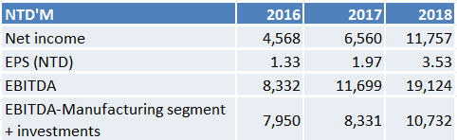
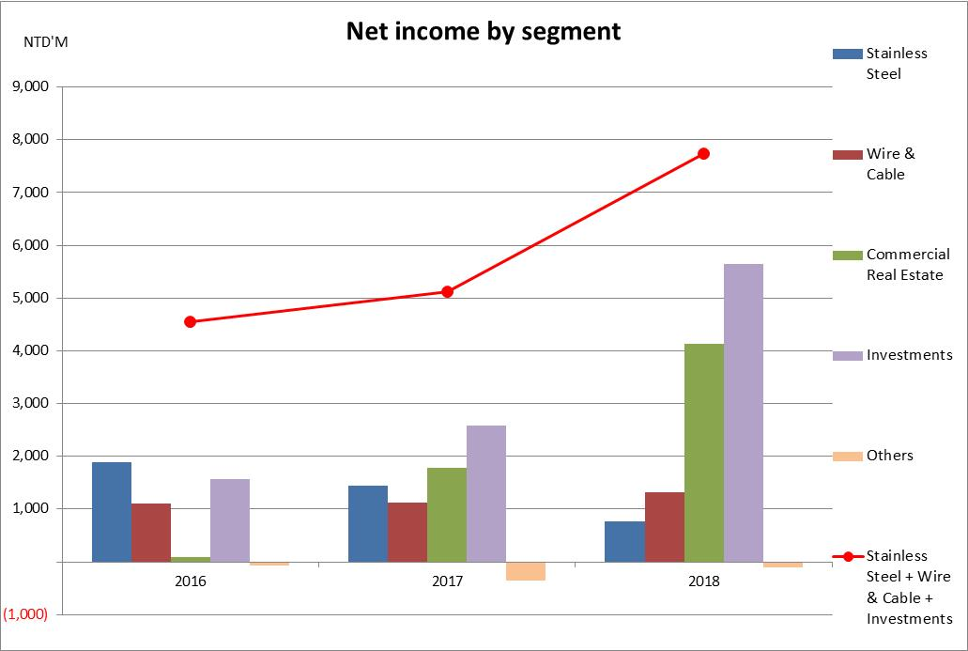
2018 Profit
The company’s profits hit record high. However, supply and demand imbalance in the stainless steel market intensified in the second half of the year, impacting the stainless steel segment’s profits
The commercial real estate segment recognized profits from the closing of the Phase I office units on Lot AB and Phase II residential units on Lot D
Investments profits increased mainly due to recognition of increased profits from the investment in Walsin Technology Corporation
2018 EPS was NTD3.53 and the company declared a dividend of NTD1.2 per share
Please refer to the Appendix for each segment’s definition
Notes:
大陸不鏽鋼產品提高退稅率及競爭者產能開出，影響不鏽鋼部門獲利
大陸條類出口退稅率提高差10% (4->13%), 所以大陸條類出口產品對我們有成本優勢
ＲＭＢ１０％貶值影響ｍｉｎｏｒ，原料
鄭總4Q18季績效: 特鋼看不出來不景氣 因為當產品走到nitch eg GDI 就不受到景氣影響
鹽水還是commodity 仍要focus cost, etc

Slide 5
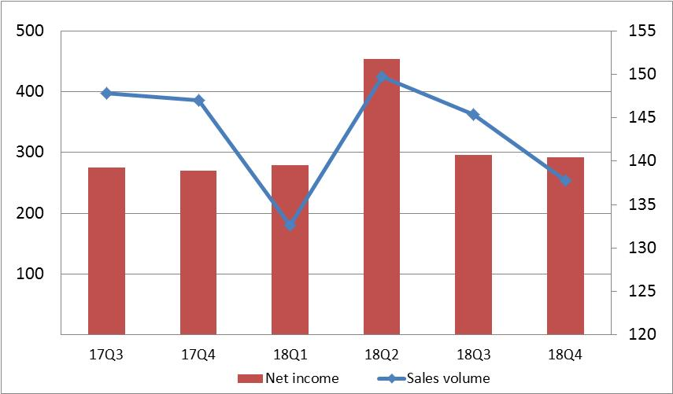
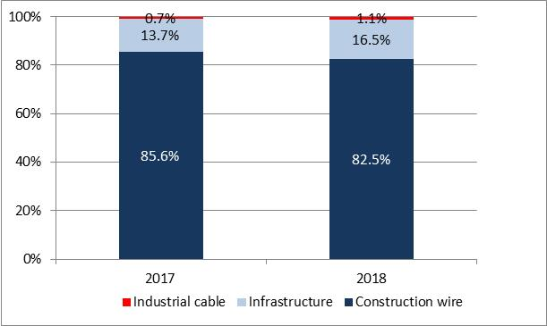
Wire and Cable Segment
Wire and Cable Segment –
Net Income & Sales Volume
Net income
(NTD M)
Sales volume
(KMT)
Stable sales volume and profits for the Wire and Cable Segment
Copper Wire
  Nearing full capacity, with stable profits
Power Cable
  Higher profits in Q2 due to concentration of infrastructure profit recognition
  Continuously increasing the sales proportion of industrial cable products (green energy and port machinery) and looking for opportunity to expand the export market
Power Cables Product Mix

Slide 6
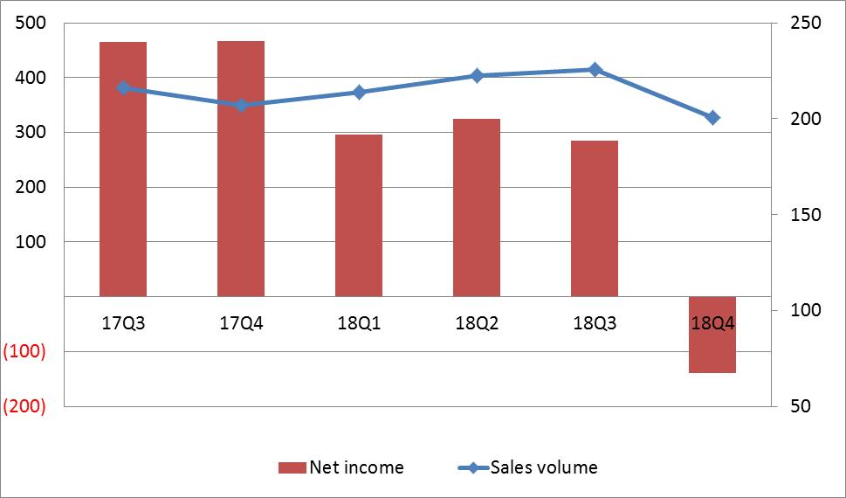
Stainless Steel Segment
  Profits of the Stainless Steel Segment declined
    Mainland China raised the export rebate rate in Q4 for wire rod products, competition in the export market intensified, affecting profits
    Competitors in Indonesia and Mainland China continued expanding their capacity, intensifying the long-term supply and demand imbalance in the stainless steel market
Stainless Steel Segment –
Net Income & Sales Volume
Net Income
(NTD M)
Sales Volume
(KMT)
Notes:
圖表定義：不鏽鋼部門-台灣+大陸 : 銷量不含鋼纜，但淨利含鋼纜
4Q18 :
存貨跌價損失&時間差: 2.5億元 (鹽水NTD 1.9億元+特鋼 NTD 0.6億元)
量差1.4億元
共計3.9億元
**********************************************************************
17Q2量減少: 鉻價影響
17Q4量減少: 一半因為對寶鋼銷售量降(寶鋼政策), 與常熟因環保因素停工(酸排放問題)

Slide 7
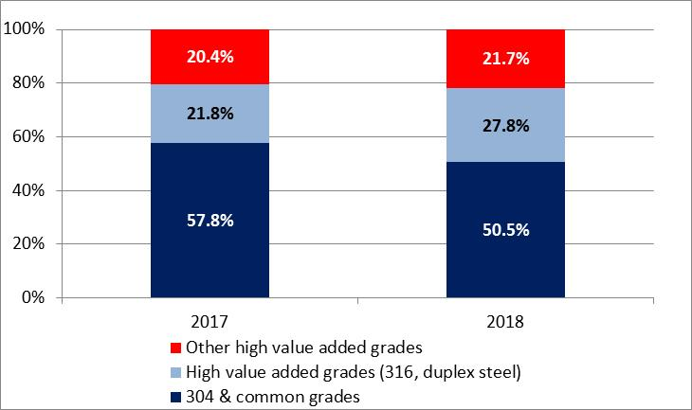
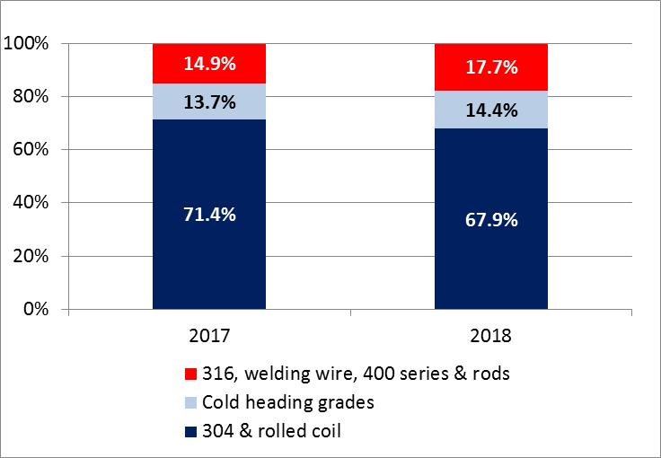
Stainless Steel Segment
Rods in Mainland China- Product Mix
Accelerating the development of new steel grades and expanding variety of product sizes, increasing sales proportion of high-value products, adjusting product structure and increasing industrial applications
Increasing production and sales volumes of straight bars
Stainless Steel in Taiwan – Product Mix

Slide 8
Commercial Real Estate Segment
Rental occupancy of Taipei Xinyi Headquarter is close to 100%, bringing steady rental income annually
Construction of the “Jingyuan” residential project on Lot D of Nanjing Walsin Centro was completed in 2017:
Status | Area (K m²) | Sale Price (RMB billion) | Remarks
Closed | 52.3 | 2.27 | Recognized RMB 328 million net income in 2018
For sale | 30.3 | NA | Excluding 700 parking spaces
Office buildings on Lot AB of Nanjing Walsin Centro are being developed in various phases:
Status | Area (K m²) | Sale Price (RMB billion) | Remarks
Closed | 106.8 | 2.1 | Recognized RMB 560 million net income in January 2018; the sale price and net income includes sales of 286 parking spaces
Under Construction | 120.6 | NA | Office building attached to the mall, excluding 650 parking spaces; expected to be completed by the end of 2020
In Planning | 183.8 | NA | Excluding 1100 parking spaces
OneMall, located on plot AB of Nanjing Walsin Centro, has a total gross floor area of approximately 170,000 m². We adopted “Healthy Life”, “Fun for Parents and Children” and “Aesthetics Experiences” as the three core elements in designing and building living aesthetics areas and planning art-sharing and cultural spaces. OneMall is expected to be open in May 2019.

Slide 9
Appendix
- Segment Definitions

Slide 10
Segment Definition
  Stainless Steel Segment: Yansheui Factory, Taichung Factory, Yantai Walsin, Jiangyin Walsin Specialty Alloy, Jiangyin Walsin Steel Cable, Shanghai Baihe Walsin and Changshu Walsin.
  Wire and Cable Segment: Xinzhuang Factory, Yangmei Factory, Nanjing Walsin Metal, Dongguan Walsin and Shanghai Walsin Power Wire & Cable.
  Investments: Winbond, Walsin Technology Corporation, Walton Advanced Engineering, HannStar Display Corporation , HannStar Board Corporation, Borrego, Lippo, WPT, Hangzhou Walsin Power Cable & Wire Co., Ltd., Jinxin Investment Co., Ltd and Powertec Energy Corp.
  Others: impairment loss, tax for undistributed surplus earnings, etc.

