Slide 1
2021 Q1 Results Presentation
TA YA ELECTRIC WIRE & CABLE CO., LTD.
Stock Code: 1609
TA YA Group Overview & Financial Highlights
Company Spokesman：Chen,Chung-Kuang
2021/05/27

Slide 2
DISCLAIMER
The purpose of the briefing is to provide information, therefore will not be updated under any circumstances.
TA YA Group does not have any responsibility to update or correct any information in this presentation.
The information within the presentation does not hint future decisions or promise any solid validity.

Slide 3
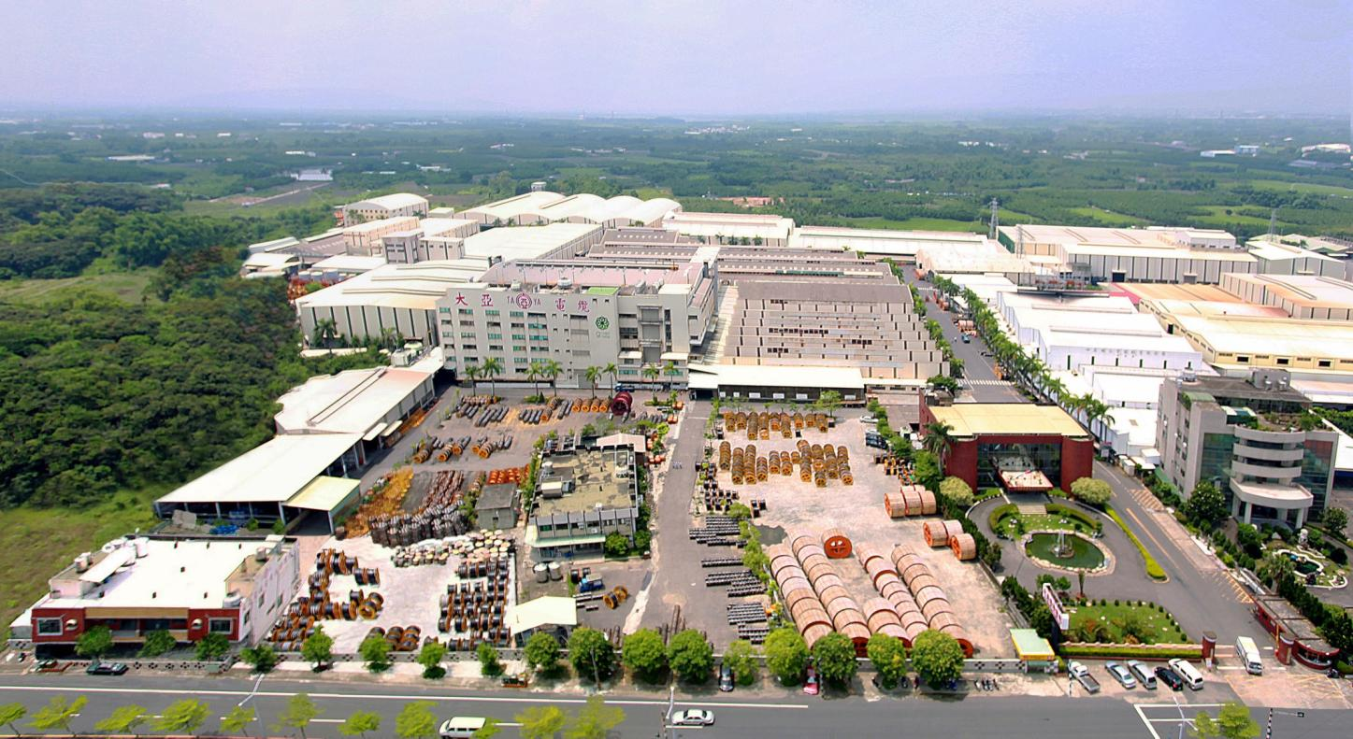
TA YA Headquarter
Found：1955
Capital：NTD 5.951 billion
Revenue：NTD 18.15 billion ( 2019 Consolidated Results)
Area：138,038 ㎡
Employee : 625
Product : Power Cable / Magnet Wire / Telecom Cable /
Optical Fiber Cable / Bonding Wire /
Residential Properties and Office Buildings

Slide 4




About TAYA Group
A leading brand in energy connection
Vision
A business trusted by employees, customers, shareholders, and society
A creator of harmonious environment and pristine homeland

Slide 5




TAYA’s 4 Courses to Connect Energy Industries
Transmission
Transform
Production
Storage

Slide 6

About TA YA Group
Combined with 5 Business Groups
Energy and Telecom Communication Cable Business Group
Magnet Wires Business Group
New Business Development, Investment and Copper Management Business Group
Construction Business Group
Business
Administration Group
Operates the production, development, and sales of electricity and communication cables and monitors affiliated enterprises, including Ta Ho, AD, and UEI.
Operates the production, development, and sales of enamel wires and monitors affiliated enterprises, including Heng Ya Electric Ltd. (Hong Kong), Heng Ya Electric (Kunshan) Co., Ltd., Ta An Precision Co., Ltd., and Ta Yi Plastic Co., Ltd.。
Coordinates all groups, responds demands of stakeholders rationality, fulfills comprehensive effectiveness of groups, keeps learning and growing
Operates building construction and sales management.
Operates the production, development, and sales of encapsulation solder wires, copper procurement, management of the Taipei Branch, and the evaluation of overseas investments.

Slide 7


TAYA Solar Power
Installation with 2.89MW for solar power plant on rooftop in the Headquarter of Kuan Miao.
Cooperation with Taiwan Sugar for 6.94MW on rooftop by thousands of square meters.
Completed the change in land project for 71 hectares in Syuejia District, installed with 76MW which is the 1st successful land change on a private large-scale land over more than 30 hectares in Taiwan.
The plant of Kuan Miao, Tainan individually installed with “TAYA Energy Storage Microgrid” System of 600kWh 200kWp, combining with storage, electric facilities, environment control and grid information as one, providing a full-service for power control.
In future, TAYA proactively develops large-scale rooftops on enterprises and ground-mounted solar power plants, and our target in 2022 will be achieving 240MW.
Notes:
ps.
1.台糖畜殖事業部2284.91kw+ 台糖南區2,653.695kw+ 東海豐1,997.75kw = 6,936.355KW
2.學甲 75,696.60kw

Slide 8
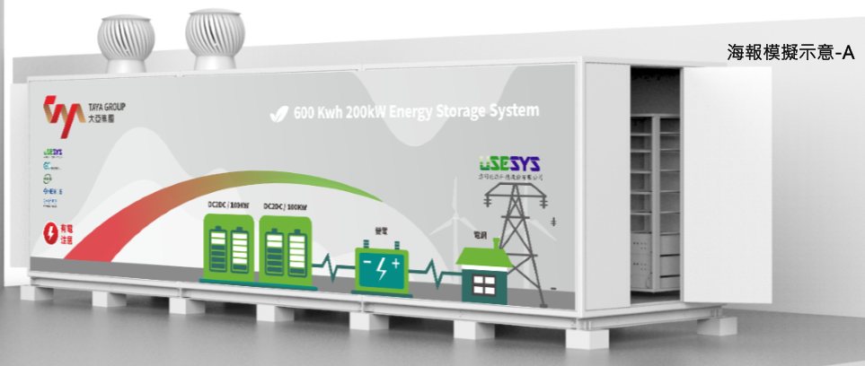
The Market of Energy Storage in Taiwan
Electric Vehicle Charging Station :
Dispatching in Peak and Off-Peak Hour
The Balance of Electrical Grid
Keeping the Charging Quality
Renewable Power Plant :
Smoothing of the Renewable Power Production Curve
Energy Transmission Over Time
High Energy User Clause :
The users whose contract capacity is over 5,000kWh a month are required to buy 10% of that from green source, or build energy storage in 5 years.
Demands of Electric Companies :
Dispatching
The Stable of Electric Grid
The Balance of User’s Load
Notes:
This is our group chart, we have 5 grope in TAYA. our group is Energy & telecom business group.
there have many Subsidiaries company in our group . We will introduce the Subsidiaries in the next page.

Slide 9

  Financial Highlights
Sales Volume Of Various Products:
Sales Volume : Ton

Slide 10
  Financial Highlights
Sales Volume Of Various Products:

Slide 11
  Financial Highlights
2021 Q1 The ratio of Product sales volume

Slide 12
  Financial Highlights
2021 Q1 The ratio of Product sales figures

Slide 13
  Financial Highlights
Consolidated Statements of Income : 2021Q1
Unit: Thousand of NTD, except for EPS in NTD
Item | 2021Q1 | % | 2020Q1 | % | Annual Growth Rate
Net Sales | 6,011,651 | 100.0 | 3,957,011 | 100.0 | 51.9
Operating Costs | 5,391,487 | 89.7 | 3,695,318 | 93.4 | 45.9
Gross Profit | 620,164 | 10.3 | 261,693 | 6.6 | 137.0
Operating Expenses | 257,643 | 4.3 | 224,561 | 5.7 | 14.7
Net Profit | 362,521 | 6.0 | 37,132 | 0.9 | 876.3
Non-Operational Income(Expenditure) | 184,321 | 3.1 | 202,794 | 5.1 | (9.1)
Net Profit After Tax | 435,433 | 7.2 | 139,807 | 3.5 | 211.5
(Attributable to Shareholders of the Parent)
EPS | 0.74 |  | 0.24 |  | -

Slide 14
  Financial Highlights
Operating Performance Per Share
Item / Year | 2016 | 2017 | 2018 | 2019 | 2020 | 2021Q1
Earnings Per Share | 0.05 | 0.83 | 0.83 | 0.86 | 1.45 | 0.74
Cash Dividend Per Share | 0 | 0.35 | 0.3 | 0.3 | 0.35(註) | -
Stock Dividend Per Share | 0 | 0 | 0.4 | 0 | 0.35(註) | -
Return on Equity | 0.44% | 7.15% | 7.15% | 7.09% | 11.44% | 4.94%
Net Value Per Share | 11.17 | 11.27 | 11.11 | 11.92 | 13.05 | 13.81
Operating Cash Flow Per Share | 0.19 | (0.33) | 0.75 | 1.02 | 0.99 | (1.69)

Slide 15
  Financial Highlights
Green Power Industry Performance
Note: Sin Jhong Syuejia project installed total with 75,969.60kWp (Meter on & generating in 2020/12/8); as of 2021 Q1, the project generates 25,911.41kWh.

Slide 16
  Financial Highlights
Green Power Industry Performance
Unit: Thousand of NTD
Note: 1. Sin Jhong Syuejia project installed totally with 75,969.60kwp, as of 2021 Q1, the project generates 25,911.41kWh; after acquiring the Electricity Business License, it begins to receive the income from Taipower.
2. The Electricity Business License of Sin Jhong is estimated to acquire in 2021 Q2.

Slide 17

Q & A
TA YA ELECTRIC WIRE & CABLE CO., LTD.
Stock Code: 1609

