Slide 1
Panion &BF Biotech Inc
2020.04.20

Slide 2
Disclaimer
Panion & BF Biotech Inc. (The Company)
Disclaimer • The presentation and the relevant information mentioned in this material, including operating performance, financial performance and the business outlook, have been compiled from both internal and external resources. • These forward looking statements involve known and unknown risks, uncertainties and other factors, including price variation, competition, global economy, exchange rate movement and market demand, which may cause actual results to differ materially from those implied by such forward-looking statements. • This Presentation should not be considered as the giving of investment advice by the Company or any of its shareholders, directors, officers, agents, employees or advisers. Each party to whom this Presentation is made available must make its own independent assessment of the Company after making such investigations and taking such advice as may be deemed necessary. In particular, any estimates or projections or opinions contained herein necessarily involve significant elements of subjective judgment, analysis and assumptions and each recipient should satisfy itself in relation to such matters. • The forward looking statements expressed in this material reflect the Company’s current view about the future as of today. The Company is not responsible for any updates if there are any changes in the future.

Slide 3

1. Corporate Overview
2. Financial Analysis
Table of Contents
3. Five Business Unit Analysis & Prospect
PBF Taiwan
PBF China
Innovative Aesthetics
Innovative Diagnostics
Innovative Medication
4. Conclusion
(Risk vs. Growth Momentum )
PBF寶齡富錦生技 www.pbf.com.tw

Slide 4

Corporate Overview
PBF寶齡富錦生技 www.pbf.com.tw

Slide 5
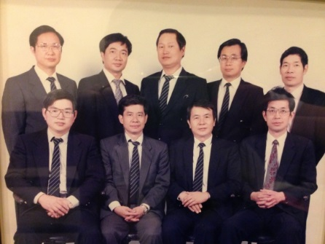
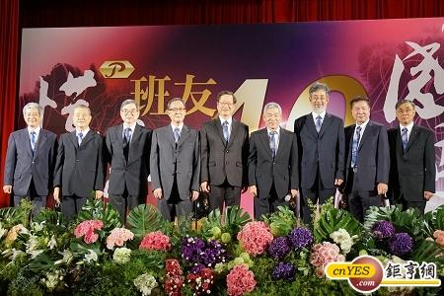
Company History –
Panion Group
Established in 1974 by 9 pharmacy school classmates
Dedicated to provide solution to human healthcare & lifestyle
40 years of growth and is now a holding company
Panion Holdings
Panion & BF Biotech
Sun Ten Pharmaceutical
J-O Technology
Pharmaceuticals
Cosmeceuticals
Nutraceuticals
Veterinary
Botanical Drug
Natural Product
Medical Device (orthopedics)

Slide 6

PBF Details
Founded：January 7th, 1976
IPO: January 23rd, 2018 Listed as Pharmaceutical (Ticker : 1760)
Vertical Integration Converting R&D，Manufacturing、Brand & Channel Marketing，Diversification。
Business Unit: New Drug、Medicine、Cosmeceutical、Nutriceutics、Antiseptics、Diagnostics and IVD
Capital : NTD 767 Millions
Dual National Certified Pharmaceutical Company
  Taiwan: Medicine PIC/S GMP + Cosmeceutical GMP
  China: Cosmeceutical Factory & Antiseptic FactoryEmployees: Taiwan (300+)、China (70+)
總公司 : 台北市南港區園區街3號16樓 (F棟)
平鎮廠 : 桃園市平鎮區興隆路266號
汐止辦公室 : 新北市汐止區大同路一段306號6樓之3

Slide 7

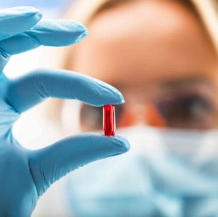










Milestones
1976
Bowling Pharma Founded
2001
1984
2004
1990
Acquired Fujin Pharma, Upgraded to GMP Standard
Medicine Manufacturing Site certified cGMP
Drug Delivery Tech.
Business Diversifications
1988 Dermatology to Cosmetical
1990 Developed Controlled Releasing Platform，Acquired TW 1st New Drug Certificate
2012
Global New Drug Development
2005
Global Collaboration
Licensed in New Drug Compound；
Corporate name changed to PBF Biotech
2003 Established New Drug Patent Profile
Licensed out to Keryx for EU, USA, Japan、Global PII Clinical Trial Completed
Pic/s GMP Certified
Global PIII Clinical Trial Completed
Nephoxil
2012
Obtained Japan、US NDA Approval
Allied with Wego China
2015 Obtained Taiwan NDA Approval
Obtained EU NDA Approval
2007 Sub-Licensed JT-Torii for Japanese Market
2009 Cosmetics GMP Certified
Founded Wholly-Own China Subsidiary
Taiwan PIII Clinical Trial Completed、NDA Submission
2014

Slide 8
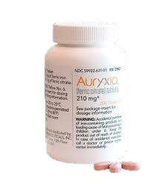


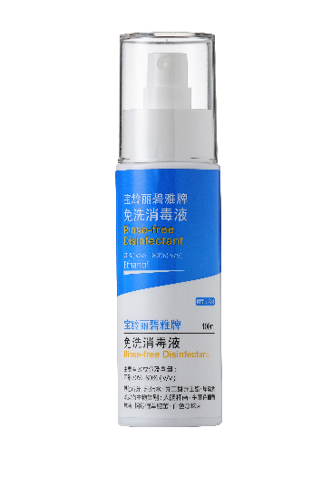

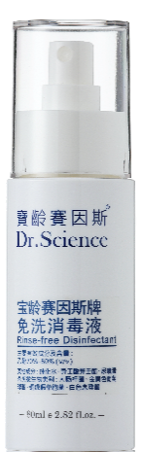
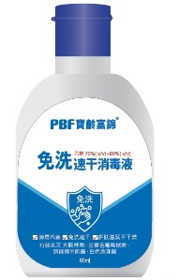
2017
Successful IPO in TW Index
Approved by CFDA to proceed Nephoxil Clinical Trial
Auryxia Included in US Federal Medicare Part- D
KKKR (Korea) Applied NDA
Auryxia Obtained USFDA sNDA Approval
2019
2020
Received USFDA 510K for H-Pylori IVD
TFDA Approved Nephoxil to proceed Clinical Trial for CKD-IDA
China Nephoxil Clinical Trial Kicked Off
Thailand Nephoxil Exclusive Distributional Agreement with DKSH Limited
Obtained China Certified Approval to Manufacture Antiseptics

Slide 9


Financial Analysis
Stable Growth
Elite in New Drug

Slide 10
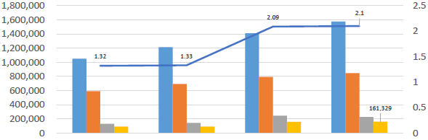
2016-2019 Consolidate Income statement
UNIT : NTD Thousand
 | 2016 | 2017 | 2018 | 2019
Gross Revenue | 1,049,246 | 1,212,478 | 1,408,741 | 1,573,944
Gross Profit | 591,656 | 694,379 | 793,175 | 844,776
Profit before Tax | 129,424 | 143,139 | 244,378 | 226,294
Profit after Tax | 89,720 | 90,539 | 159,171 | 161,329
Earnings Per Share | 1.32 | 1.33 | 2.09 | 2.1

Slide 11
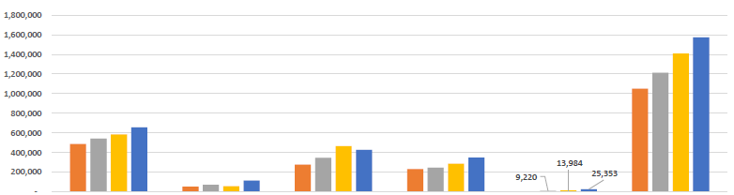
2019-2019 H1 Gross Revenue By product Groups
2016 2017 2018 2019
UNIT : NTD Thousand
Product | Medical |  | Health Food |  | Cosmeceutical |  | New Drug |  | Diagnostics |  | Combine
2016 | 487,208 | 46.43% | 50,924 | 4.85% | 275,688 | 26.27% | 231,453 | 22.06% | 3,973 | 0.38% | 1,049,246 | 100.00%
2017 | 541,387 | 44.65% | 72,340 | 5.97% | 344,363 | 28.40% | 245,168 | 20.22% | 9,220 | 0.76% | 1,212,478 | 100.00%
2018 | 584,979 | 41.52% | 57,884 | 4.11% | 465,665 | 33.06% | 286,229 | 20.32% | 13,984 | 0.99% | 1,408,741 | 100.00%
2019 | 656,220 | 41.69% | 115,283 | 7.32% | 427,729 | 27.18% | 349,359 | 22.20% | 25,353 | 1.61% | 1,573,944 | 100.00%

Slide 12

Five Business Unit Analysis and Prospects

Slide 13
PBF Product Development Platform
Innovative Development Platform From Successful Nephoxil (New Drug) Development Process，
Incubated Skilled R&D Professionals and Development Platform
Potential technology/ product
Screening
In-house core development team
Consultants
Global outsourcing partners
PBF value-add platform
CMC
Clinical
Patent
Regulation
Commercial
Synthesis & Analysis team
Formulation team
API mfg team
DP mfg team
Investigators
Safety & Medical Team
Statistical Team
Data Mgnt Team
Clinical Mgnt Team
Patent Lawyer
Patent Agent
Regulatory Agent
Finance Advisor
Legal Advisor
13

Slide 14
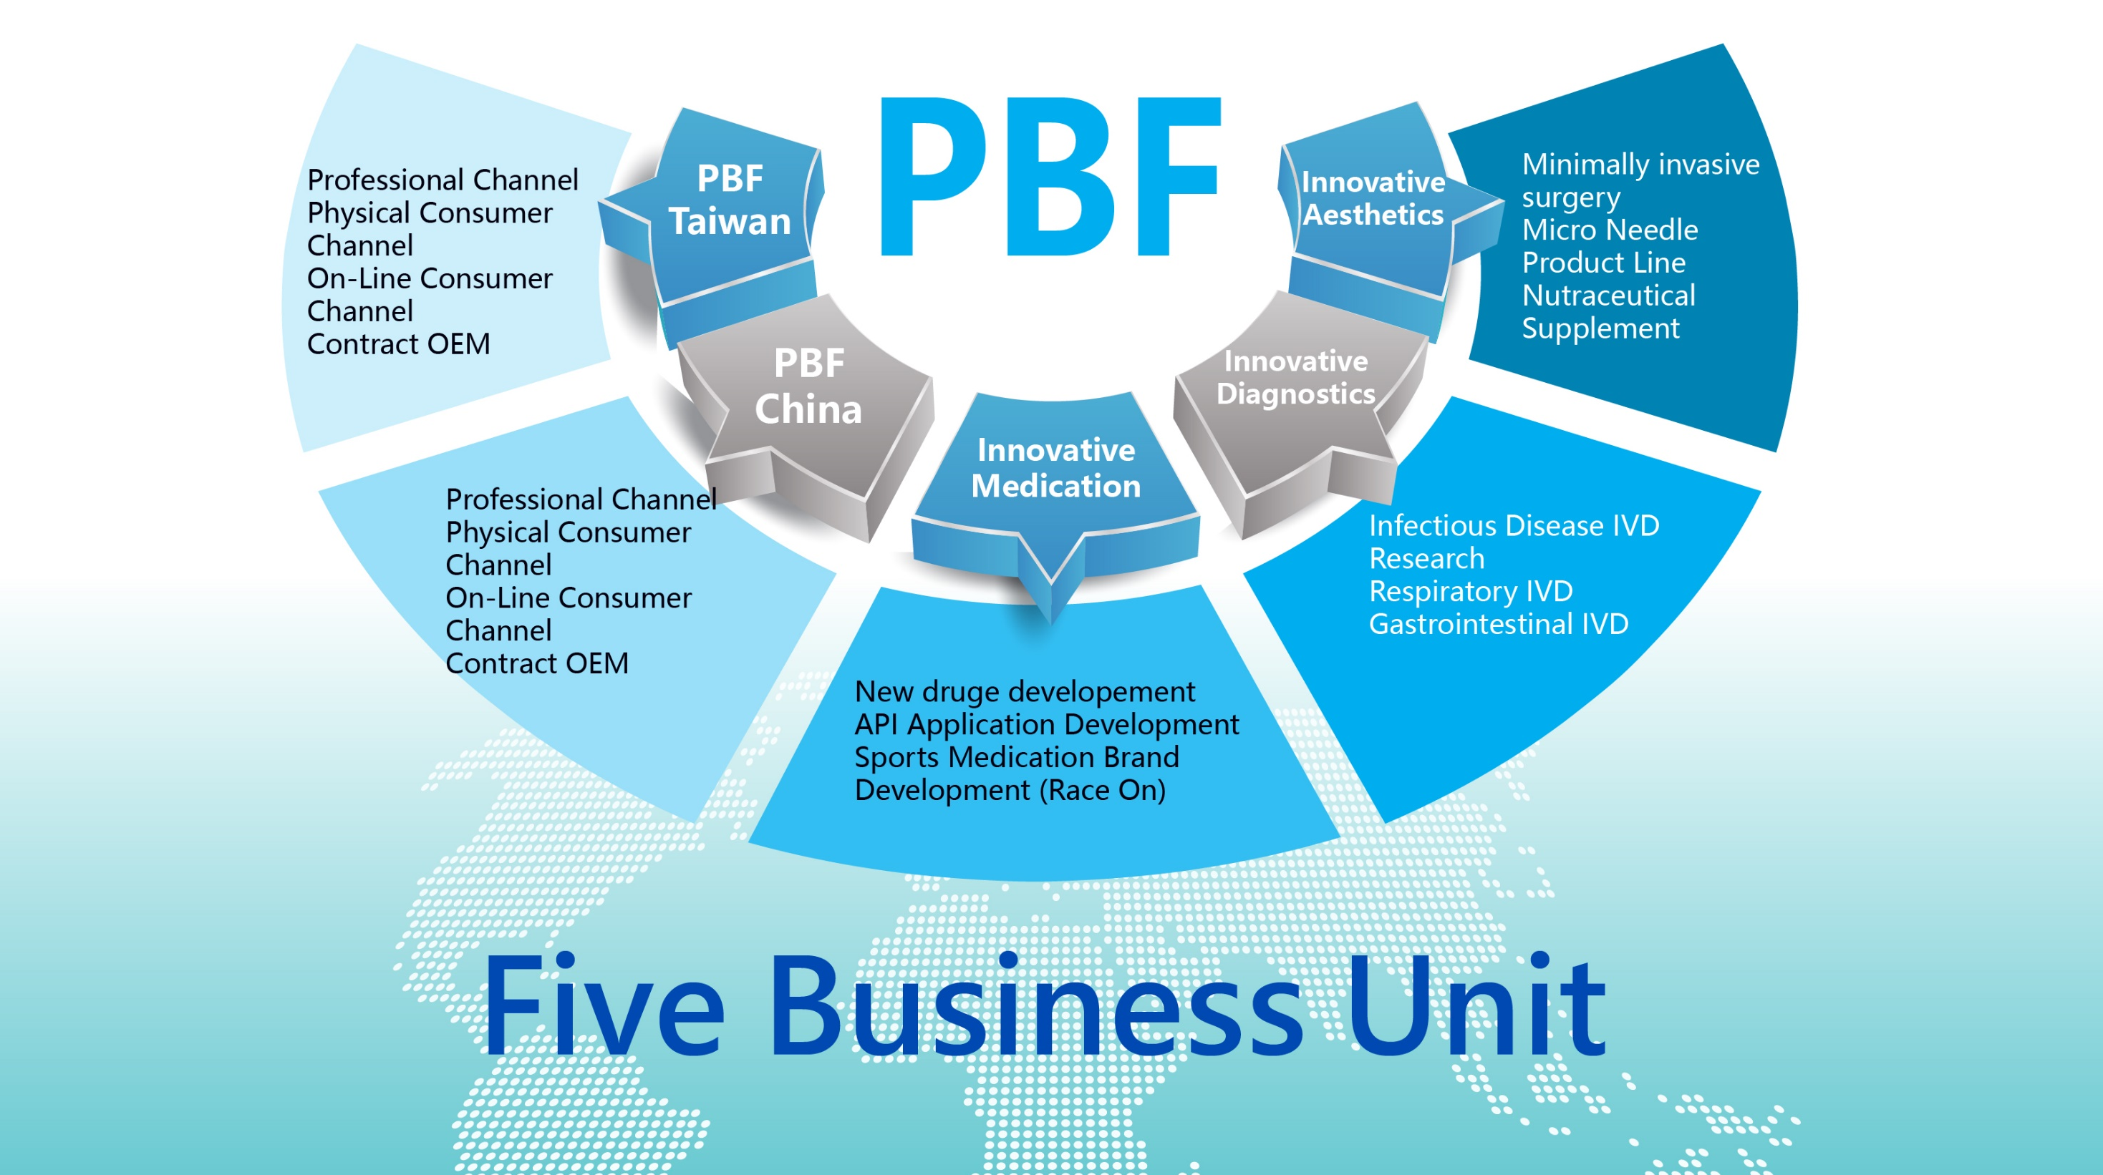

Slide 15
PBF Taiwan Business Unit
(A) Channel Development Strategy
Professional Channel
Aesthetic Clinic
Hospital<Specialized +
Infectious Control>
Clinics
Chain & Individual Drug Store
Physical Consumer Channel
Skin Salon
Hair Salon
Chain and Individual Commercial Store
Professional Channel
Physical Consumer Channel
Applying chlorhexidine API Technology and Develop a Series of Antiseptics Product Line
PBF Taiwan
Business
Unit
On-Line Consumer Channel
Contract OEM/ODM
On-Line Consumer Channel
TV Shopping
On-Line Shopping
Group Sales
Contract OEM
Domestic/International OEM & ODM
Inject New Product Marketing into Existing Sales Channels and Duplicate Successful Business Model to China and Global Markets

Slide 16
PBF Taiwan Business Unit
(B) New Product Development(New Pipeline)
(1)Medical:
Skin Disinfectant Injecting into Medical Level Non-woven Cloth
Target : Hospital + Nursing Home
(For Long-Bedding Patients Skin Disinfectant)
(a) Skin Disinfectant Pack(Aqua)-New Drug (New Indication)
(b) Skin Disinfectant Pack(Alcohol)-New Indication
(c) Urinal Disinfectant Lubricant Gel-New Indication
( Lubrication Disinfectant) (DISPOSABLE)
(d) Mouth Disinfectant (Toothpaste+Gel)-New Indication
(e) Double-Layer Pain Relief-New Drug(New Indication)
(Lasting + Instant Release)
Ready Entering Clinical Trial
Skin Disinfectant (Alcohol) Injecting into Medical Level Non-woven Cloth
Target : Hospital + Clinics
(Replacing Current Alcohol Swab
R&D
Disinfectant + Lubricant
(Disposable Catheter)
Target: #1 Infectious Route in Global Hospital is Catheter
Ready for TFDA Submission
Treating/Preventing Dental Plague & Periodontal Disease
Ready for TFDA Submission
/Clinical Trial
(Quick Release + Lasting Layers)
Double Pain Killing Effect
Ready Entering Clinical Trial

Slide 17

PBF Taiwan Business Unit
A. Nutritional Products :
B. Cosmeceutical Products :
Pellet (Slow Release Pellets+Quick Release Pellets)
Technology
(b) For Diabetes
(a)Exclusive PBF
Ingredients
Sachitin
Polenin
Flavonoid
Cal Youth
(b)Exclusive PBF
Formulation
Scalp & Hair Roots
(Accelerated Hair Growth ; Hair Loss Prevention)
Skin Barrier Repair Moisturizer
(Skin Barrier Repair ; Chronic Itches)
Pimple Remover Ointment
(Grease Control ; Moisturizer ; Pimple Scar Prevention)
Skin Care Complementary
Minimally Aesthetic Complementary
Before Aesthetic Surgery
After Aesthetic Surgery (In Clinics)
After Aesthetic Surgery (At Home)

Slide 18
PBF China Business Unit
(A) Channel Development Strategy
Professional Channel
Aesthetic Hospital
Skin-Care Specialized Hospital
Physical Consumer Channel
Skin-Care Salon
Hair-Care Salon
Professional Channel
Physical Consumer Channel
PBF China Business Unit
On-Line Consumer Channel
Contract OEM/ODM
On-Line Consumer Channel
On-Line Shopping <JD/T-Mall/T-Mall International>
Contract OEM
Domestic/International OEM/ODM
Duplicate Successful Taiwan Experience，Establishing Various Marketing and Distributional Channels，Building Profession Brand Imaging

Slide 19
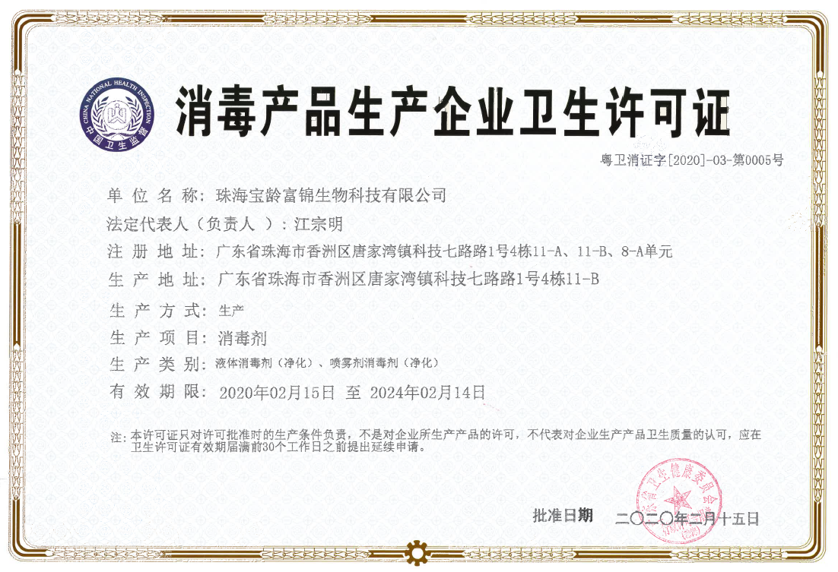


PBF China Business Unit
(B) New Product Development (New Pipeline)
a. Professional & Personal Antiseptics Product Line
Including Special Skincare Ingredient

Slide 20

Innovative Aesthetic Business Unit
Channel Development Strategy :
Establishing New Branding Marketing
Taiwan – PBF Taiwan
China – PBF China
Asia
Korea
Japan
USA
Europe
International Commercialization
& Collaboration

Slide 21







Innovative Aesthetic Business Unit
(B) New Product Development(New Pipeline)
Minimally invasive surgery
Micro Needle Product Line
Whitening Micro Needle Patch
(Micro Needle)
Nutraceutical Supplement
Nutraceutical Bar
Micro Need Production (Taiwan)
2020 Mass Production
Injection
Scale Up
Future Planning Production
Nutraceutical Bar
Facial Controuing:
(OEM)
Tissue Stimulation (PLLA)
Tissue Stimulation+Skin Hydration (PLLA + HA)
Skin Stimulation+Volume Increasing
Original
Hungarian Paprika
Sweet Chocolate
Body Contouring:
Spicy Berry
Scale Up Future Planning Production
Original Chocolate
Thread
(OEM)
Facial Contouring Nose Contouring Body Contouring

Slide 22
Innovative Diagnostics Business Unit
(A) Channel Development Strategy:
Hospital
Clinics
Professional Channel
USA / EU
Taiwan / China
Distributors/Licensing
Domestic/International OEM/ODM
OEM/ODM

Slide 23
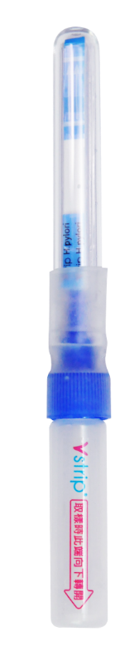
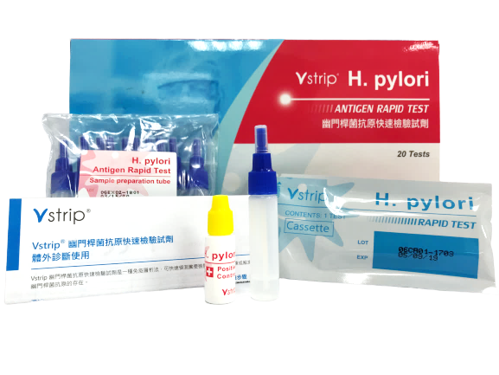
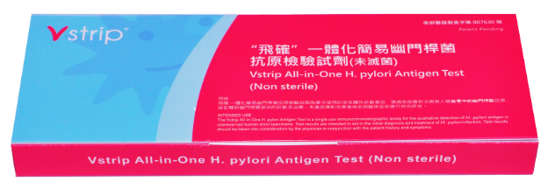
Conventional IVD vs All-in-One
Innovative Diagnostics Business Unit
(B) New Product Development Strategy (New Pipeline) :
Patent Pending
Minimum Components
1-2-3 Easy Steps
Reducing Infection
Personal IVD
Economical
Long Shelf Life
Large Scale Testing

Slide 24



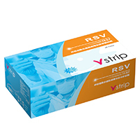
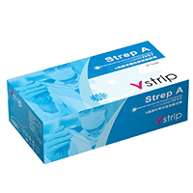
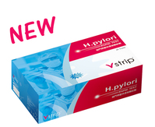



Innovative Diagnostics Business Unit
(B) New Product Development (New Pipeline) :
Respiratory IVD-Human
Flu A/B
Strep A
RSV
Gastrointestinal IVD-Human
HP – OK
Rotavirus
Adenovirus
Pet Only IVD-Dogs/Cats
Parvovirus
Coronavirus
etc.

Slide 25
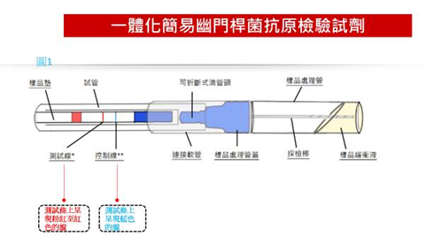
Innovative Diagnostics Business Unit
(B) New Product Development (New Pipeline)
Advantages
Commonality
Specimen Collection/Specimen Extraaction/Analysis – All in One Device Easy Collecting Specimen No More Messy Process 1-2-3 Easy Steps A test from lab to home use Avoid direct contact with infected specimen, minimizing contamination risk, able to operate from any location Future Application : Linking Smart Hospital Application with IVD Device via internet
For Respiratory Product | For Gastrointestinal Product
Avoid Specimen Contamination Minimizing Hospital Staff Cross-Contamination | No More Foul Smell and Messyness Flexible Specimen-Collecting Site
Patent Pending

Slide 26
Innovative Medication

Slide 27
Accumulated Global sales
US$ 600 Million since 2015
Pharmaceutical Grade Ferric Citrate
Innovative Medication

Slide 28
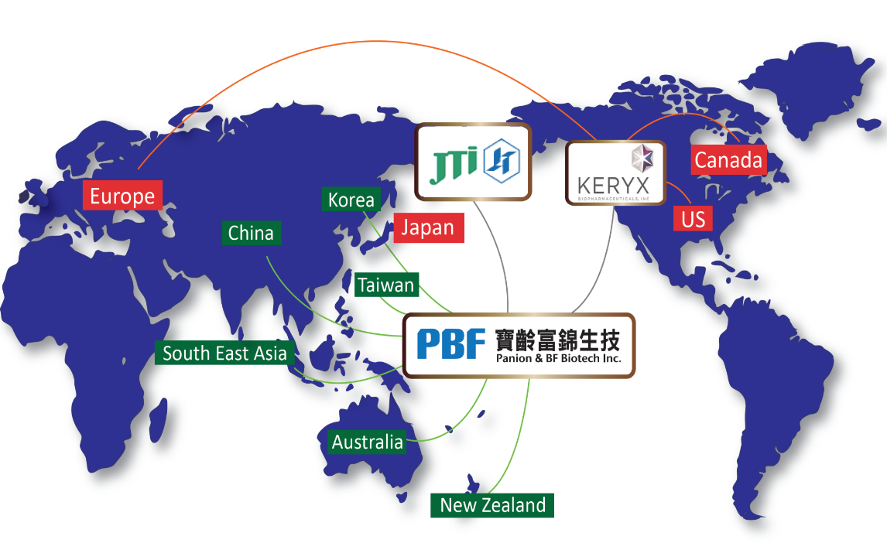


Innovative Medication
(A) Channel Development Strategy:
威高寶齡
DKSH (泰國)

Slide 29
Nephoxil-US Akebia Sales Chart
2016 ~ 2019

Slide 30
Nephoxil-Japan JT-TORII Sales Chart
2015 ~ 2019

Slide 31



Other Global Market Update
EU: PBF-Akebia Joint Scientific Committee established and actively working on EU partnership development.
China: 2019Q3 Phase III first patient enrolled.
Korea: Registration stage
South East Asia: Exclusive distribution authorization for DKSH Limited to operate Thailand market

Slide 32


Innovative Medication
(B) New Product Development (New Pipeline)
New Drug Development
Continual New Drug Development
Global Network Expansion
Professional
Sporting Brand
RACE ON
Focusing on Sporting Medical Market
Enhance/Better Sporting Performance
Innovation & Improvement

Slide 33


Innovative Medication
(B) New Product Development (New Pipeline)
Hyperphosphatemia
ESRD
Iron Deficiency
Anemia CKD
Iron Deficiency Anemia
All Conditions
Delay CKD
Progression
New Generation API

Slide 34
Indication Expansion: CKD IDA and All IDA
 | PI | PII | Pivotal | NDA | Indication
US |  |  |  |  | CKD IDA
Taiwan |  |  |  |  | CKD IDA
Japan |  |  |  |  | All IDA
USA: 2017/11 Keryx obtained sNDA on CKD IDA indication expansion. Auryxia became the first and the only oral iron for CKD IDA management.
Taiwan: 2019/6/25 PBF obtained IND for CKD-IDA PIII study initiation.
Japan: 2019/7/9 JT Torii announced positive top-line results on Riona PIII for pan IDA treatment. Planning to apply for indication expansion.

Slide 35
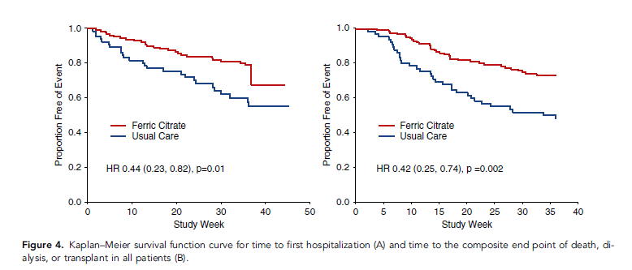

Delay CKD Progression Study
2019 published in Journal of American Society of Nephrology-acute kidney failure in pre-dialysis study :
Nine month treatment of ferric citrate with 6g/day，comparing with regular treatment，ferric citreate experimental has better data than regular treatment division。
Ferric Citrate Experimental Division has lower rate in:
  Worsen leading to death
  Worsen leading to dialysis or kidney transplant。
Significant lower hospitalization rate
Akebia will further research in related topics
Time to first Hospitalization
Time to end point of death, dialysis or transplant
Source: doi: https://doi.org/10.1681/ASN.2018101016

Slide 36
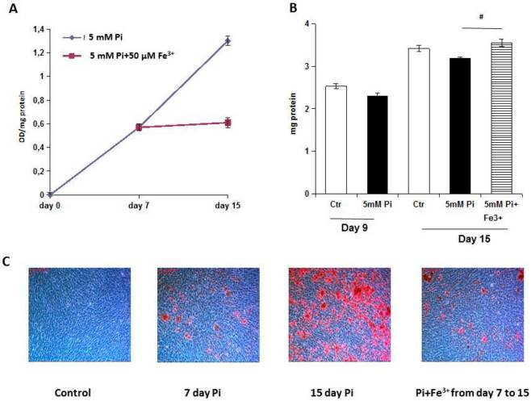
Anti Cardiovascular Sclerosis
2019 published in International Journal of Molecular Science discovered，in VSMC:
  Ferric Citrate Arrests High Pi-Induced Calcium Deposition in Established Calcified VSMCs
  Ferric Citrate Counteracts High Pi-Induced Apoptosis in Calcified VSMCs
  Ferric Citrate Induces Autophagy in Established Calcified VSMCs
Evaluate feasibility of clinical trial for CKD and non-CKD patients
Trial Protocol and Plan
Patent Awarded
住院發生時間
Time to first Hospitalization
Int J Mol Sci. 2019 Dec; 20(23): 5925.
Source: doi: https://doi.org/10.1681/ASN.2018101016

Slide 37

Be an athlete, change your game

Slide 38
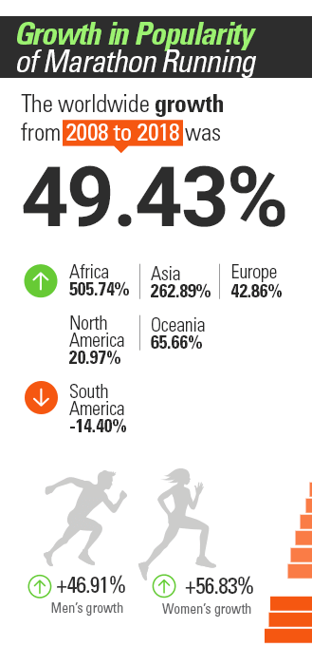
Asia
10 Year Growth Rate 262.9%
Taiwan
>700 meat/year
>1Million Runners
Strong Growth
Data from RunRepeat.com
China
>1000
meat /year
>5Million Runners
Thailand
>1000 meat /year
MARATHON
BANGKOK
One of the biggest Marathon in Asia

Slide 39
Science X Accuracy
Medical Expertise
PBF
High-end Indication Tech
GMP
Endurance Sporting Fans
Actual Demands
Trial Participation
Actual Demand
Medical Research
National Hospital Trials
Monitoring Bio-Data

Slide 40


Race
Defense
Competition
Repair Series
Preparation before races and intensified training，better training preparation、enhance sporting performance．
Daily uses，Accelerate body self-repairing and enhance self-defense mechanism，Building stronger body quality

Slide 41

Conclusion & Growth Momentum
Outlook

Slide 42
Risk vs. Challenge
Novel Coronavirus Pandemic
China Lock-Down Containment
Taiwan Pandemic Prevention Means
Stagnant Consumer Spending
Consumer Behavior Change
Consumer Buying Pattern Change

Slide 43
PBF-Growth Momentum
Innovative Medication
Innovative Aesthetic
JT-Torii Ready to File Anemia NDA to Japan Ministry of Welfare in Q3*
China Nephoxil Clinical Trial Continue
Exclusive Distributional Agreement with DKSH in Thailand
Taiwan Nephoxil Ready to Launch CKD-IDA Clinical Trial
Race On Sports Medication Product Line Launched
PBF Taiwan
Due to COVID-19 Pandemic，Antiseptic Order Explore (Hospital Market Share Over 90%)
Health Supplement Order Increase
PBF Exclusive Product Ready for Launch
Continual Development
Innovative Diagnostics
PBF China
PBF Zuhai Product Plant Acquired China Antiseptic Certificate，Trial Production & Sales Began in March
On-Line Cosmetics Flagship Store Launched
Extensive National Distribution Network Coverage
H Pylori Acquired USFDA 510K Certificate
H Pylori Acquired EU CE Mark
Flu A/B Taiwan Sales No.1
Aggressive Participate in COVID-19 IVD Development
* https://seekingalpha.com/article/4330958-akebia-therapeutics-inc-akba-ceo-john-butler-on-q4-2019-results-earnings-call-transcript

Slide 44

Covid-19-Corporate New Risk and Challenge
Specific Report

Slide 45
COVID-19
COVID-19 Characteristics
Highly Contagious
No Symptom
(Recovery)
Symptom
(Contracted)
No Symptom
(Incubation)
Antibody :
IgM, IgG
Become reinfected?
Contagious
Destructive
Contagious

Slide 46
COVID-19(Cont.)
COVID-19 Effect
Global Pandemic Containment Measure
Social Distance Restriction
Means of Life Effected
Quarantine Prior Confirmed Contraction
Treatment W/Confirmed Contraction
Confirmed Death*
歐洲 | US | KR/JP | TW
>10% | ≈5.3% | ≈2.2% | ≈1.5%
Global Economy Drop

Slide 47
COVID-19(Cont.)
COVID-19 – When Will the Pandemic be Controlled and Passed?
  Only when effective vaccine launched, the COVID-19 threat be lifted
  Soonest will be 2021 ~ 2022

Slide 48
COVID-19(Cont.)
COVID-19 Rapid Testing Kit is the best option prior to actual vaccine launched，Demands from People Life and Economic Recovery :快
Able to diagnose virus during incubation period and contraction period，Proper Quarantine and Treatment
Able to Allow Public Life Returning to Normal
Able to Bring Economy Back to Normal

Slide 49
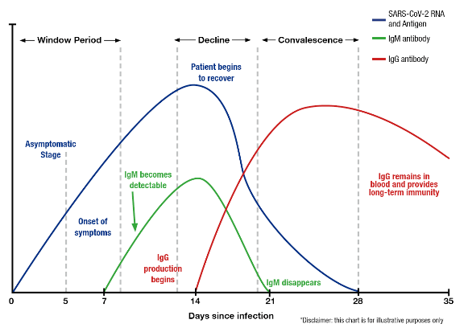
COVID-19 Rapid Testing

Slide 50
COVID-19 Rapid Testing(Cont.)
Testing Antibody-Recovery Period
  British Government : Purchased 3.5 Million Kits in April 2020 to conduct general screening
  Quarantine People with antibody able to return to normal lifeRestart economic and consuming activities
  WHO Expert : Maria Van Kerkhove Stated :
    Because insufficient COVID-19 studies, antibody testing is not helpful
    Reports showing that even with complete treatment, COVID-19 patients (with antibody) are still at risk to contract virus again
    Antibody = Immunity?

Slide 51
COVID-19 Rapid Test(Cont.)
Testing Antigen (COVID-19 Virus)
Specimen:
Professional Acquires specimen from Nostrils and Throat, test for COVID-19 Virus

Slide 52
COVID-19 Rapid Test(Cont.)
COVID-19 Testing Method
Method | RT-PCR | Antibody | Antigen Rapid Test Kit
Principle | RNA | Antibody | Antigen
Time | 4 Hours | 20~60 Minutes | 10 Minutes
Advantage | Needs to know viral gene sequence, current standard testing | Low Entry Level, Multiple Competitors | Cheap、Fast、All Labs can Operate，Early Detection
Disadvantage | Require Professional in negative pressure labs, time consuming and high cost | IgG/IgM only able test 7 days after contraction | Requires ability to pair the best antibody and improve

Slide 53
COVID-19 Rapid Test(Cont.)
Top COVID-19 Antigen Rapid Test Criteria
  Accuracy
    Avoid Fake Positive and Fake Negative – Require Focusing and Accurate Antibody Combination
  Sensitivity
    Able to detect even limited virus counts in antibody, avoiding fake negative
  Speed
    Able to obtain result in 10~15 minutes
  Simplicity
    Any location can operate
    No need trained specialist to operate
  Price
    Government can afford general screening

Slide 54
PBF - COVID-19 Antigen Test
Selecting Correct Antibody to mass produce
Antigen Rapid Test Kit
  Screening + Mass Production
    PBF
      Mature Product Development Platform，Able to Screen out the best antibody pair，Able to Maximize Rapid Test Kit Performance；
      GMP Level Manufacturing Plant，Able to Mass Produce (1 month) 。

Slide 55
Business Model
Multiple Antibody Sources
PBF
Technology Platform + GMP Manufacturing
Sales Channel A
Sales Channel B
Sales Channel C

Slide 56



