Slide 1



BETTER LIFE GROUP
Annual Investor Conference
2017

Slide 2

1.Basic Information
2.Business Strategy
Catalogue
3.Operating Performance
4.Financial Results
5.Q&A

Slide 3


1
Basic Information
Founded in 1978 and listed on TWSE in 1989. Renamed as KPT INDUSTRIES LTD in 2009. Official website: www.kpt.com.tw
Shares outstanding (mn)：81
Market cap. (US$mn)：10.4-11.2
Stock ticker symbol：1805
Chairman：Mr. Xi-Ji Zhong (鍾喜吉)
General Manager：Mr. hong-Jian Cai (蔡宏建)
Address：17F-C No.167, Dunhua N. Rd., Songshan Dist., Taipei City 105

Slide 4


2
2.Business Strategy
1
Planning various of products to satisfy a variety of consumer demand, including daping number mansion, the first home buyers and upgrade buyers.
2
Assessing the development opportunities in Greater Taipei area with a flexible sales strategy to capitalize quickly on individual cases.
3
Enhancing the brand value through deeply case studies, product value creation, differentiation and irreplaceability.

Slide 5
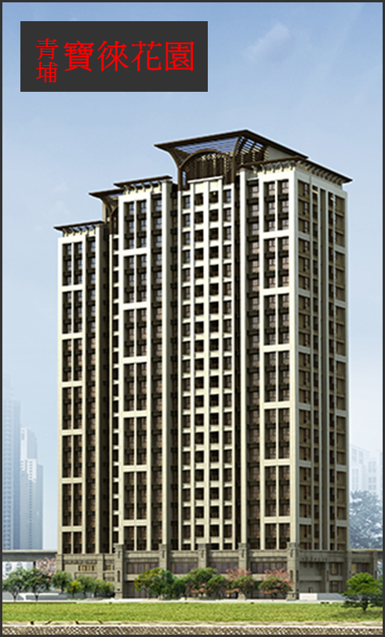
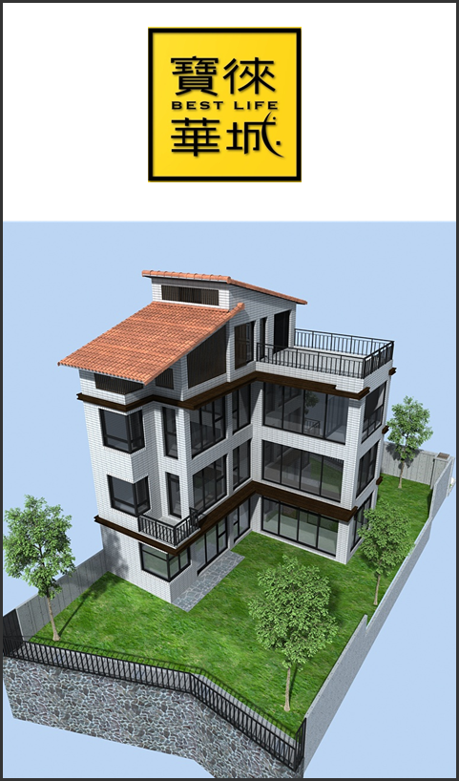
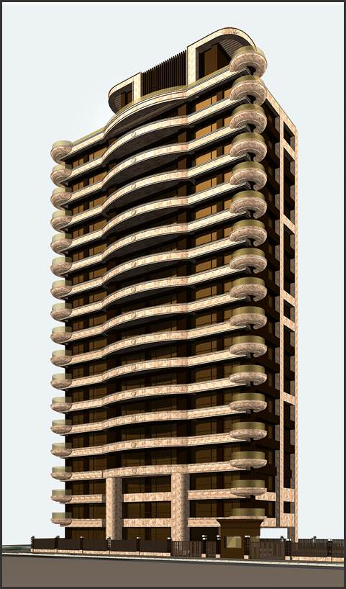
3
3.Operating Performance
Cingpu –BLG Garden will be handed over in Nov. 106, and can be regarded as revenue recognition accordingly.
Hwaseong - BLG Garden will be completed by the end of 2017, and sale in 2007 1Q as revenue recognition accordingly.
Xin Yi- BLG Garden applied the construction permit in Oct. 2017, and will be built in 2018 1Q.

Slide 6
4
4.Financial Results
Currency：NT$1,000.
Year Item | The latest 5 years financial information
 | 2012 | 2013 | 2014 | 2015 | 2016
Revenue | 190,829 | 2,472,297 | 1,031,785 | 119,632 | 31,086
Gross Profit | 45,946 | 386,306 | 147,008 | 8,391 | (16,131)
Operating Profit | (62,748) | 188,865 | 7,770 | (145,615) | (130,777)
Non-Op. Income and Exp. | 10,759 | 18,624 | 1,190 | 250,142 | 18,979
Pre-tax income | (51,989) | 207,489 | 8,960 | 104,527 | (111,798)
EPS(NT$) | (1.04) | 2.66 | 0.11 | 1.42 | (1.39)

Slide 7



5
Q&A
THANK YOU
BETTER LIFE GROUP

