Slide 1

BETTER LIFE GROUP
2020 ANNUAL INSTITUTIONAL
INVESTOR CONFERENCE
DECEMBER,22TH,2020

Slide 2

This presentation and release contain “forward- looking statements” which may include projections of future results of operations, financial condition or business prospects based on our own information and other sources.
Our actual results of operations, financial condition or business prospects may differ from those expressed or implied in these forward-looking statements for a variety of reasons, including but not limited to market demand, price fluctuations, competition, international economic conditions, supply chain issues, exchange rate fluctuations and other risks and factors beyond our control.
The forward-looking statements in this release reflect the current belief of Better Life Group of the date of this release. Better Life Group undertakes no obligation to update these forward-looking statements for events or circumstances that occur subsequent to such date.
Disclaimer Statement

Slide 3
Table of contents
1.Company Overview
2.Business Strategy
3.Operation Performance
4.Financial Overview
5.Q & A

Slide 4

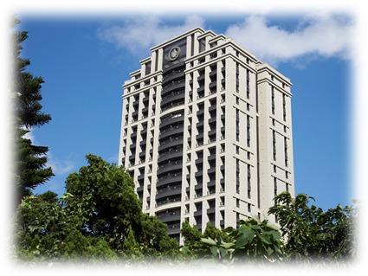
1. COMPANY OVERVIEW
Founded in 1978, the company has been listed on the Taiwan Stock Exchange since 1989, and was renamed to Better Life Group in 2009. Company website : www.blgroup.com.tw
Paid-in capital：NT$ 1,003Million
Stock Code : 1805
Chairman：Mr. CHUNG, HSI-CHI
General Manager：Mr. LIN, JUI-SHAN
Company Address : No. 218, Xinhu 1st Rd.,
Neihu Dist., Taipei City

Slide 5


2. Business strategy
1
Planning all types of products in order to satisfy all types of customer demands including the first purchase, the self-occupation products and groups of people in the high-end residence in Xin Yi district.
2
Evaluating the developing opportunities in Taipei & Taoyuan city. Devoting selected urban renewal cases, collaborate with the flexible selling strategy to acquire profit and accumulate capital through sales contribution cases.
3
Via In-depth discussion of cases through management team, to improve the differentiated product and its irreplaceability, create product value, and raise the value of company’s brand
4
Evaluate the feasibility of industrial or commercial office building projects proactively, to increase the revenues and profits of the Company.

Slide 6
3. Operation Performance-Residential Projects
Better Life Garden
Kang Chiao Asahi Villa
Yongjing Park Project
Xinyi Project-
Song Yong
Project in Meiren section

Slide 7
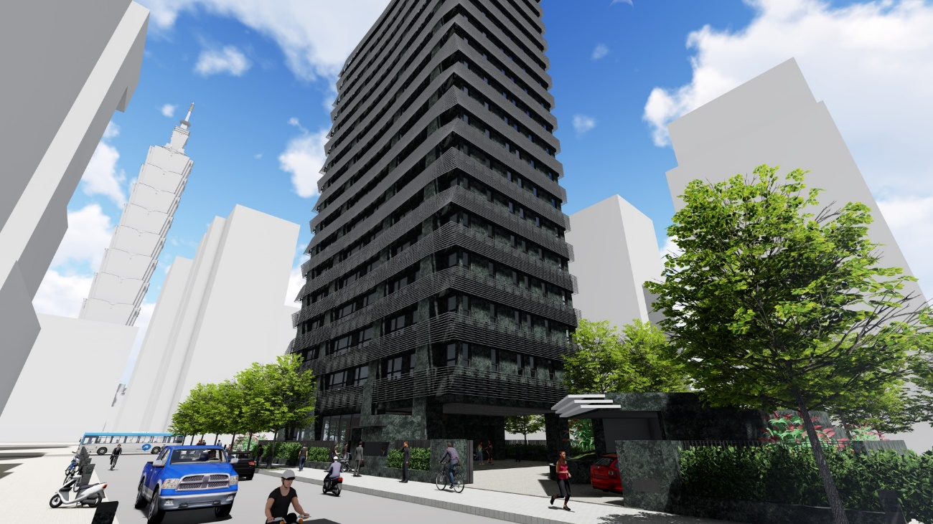
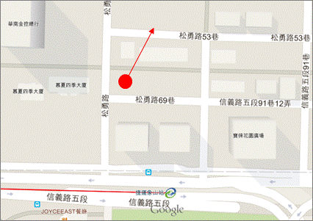
3. Residential Project coming soon-Xinyi Project-Song Yong
Project Name：Xinyi Project-Song Yong
Location ：Songyong Rd., Xinyi Dist.,Taipei City
Housing Floor：16F/B4F Residential Building
Lot Size：1,798 m²
Zoning：Residential
Total Units ：30 Residential
Total Parking Spaces：56
Total selling size ：9,263 m²
Available units for sale of BL： 926m²
(3 Residential ;7 Parking spaces)
Location

Slide 8
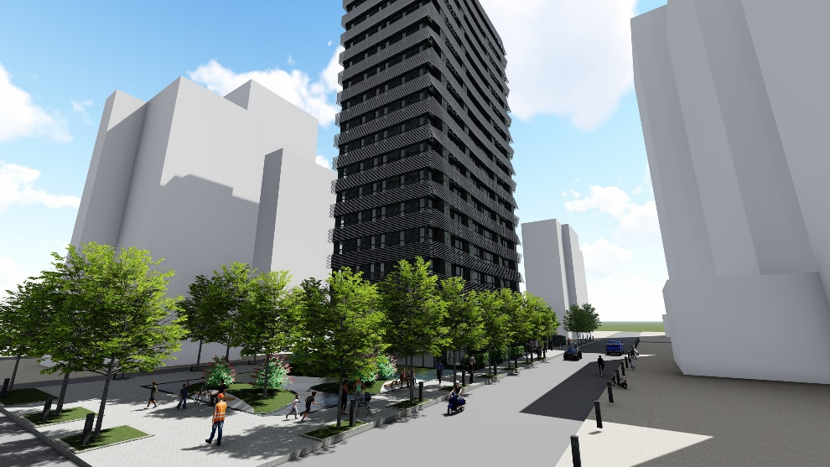

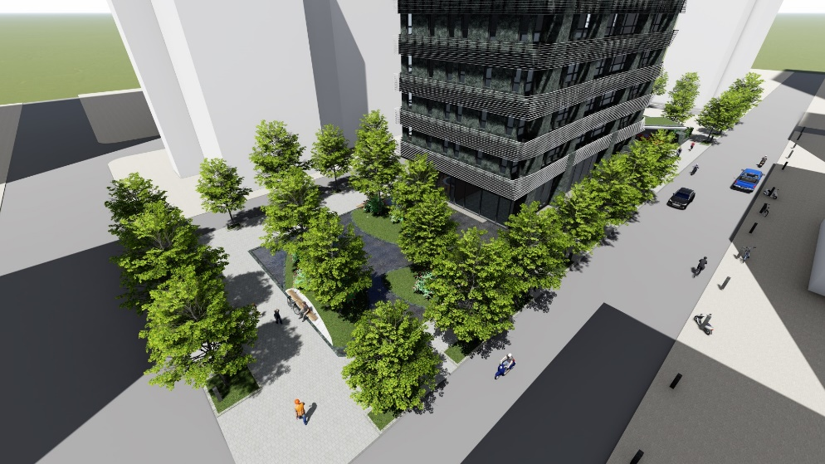
3. Residential Project coming soon-Xinyi Project-Song Yong

Slide 9
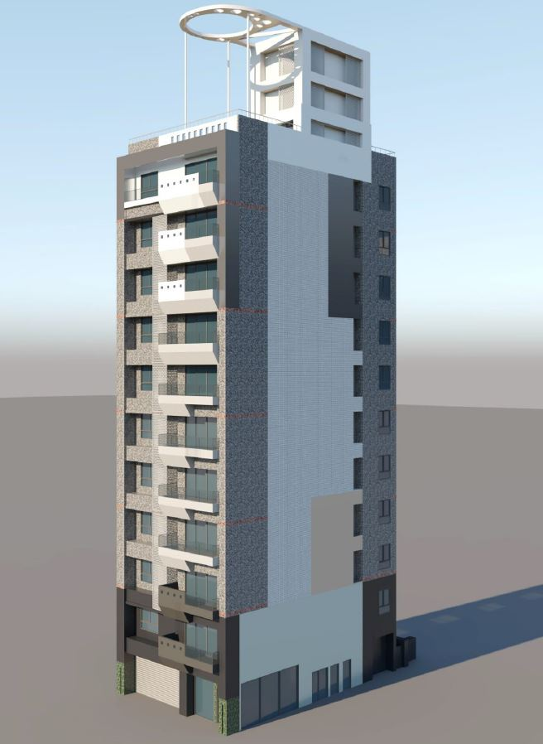
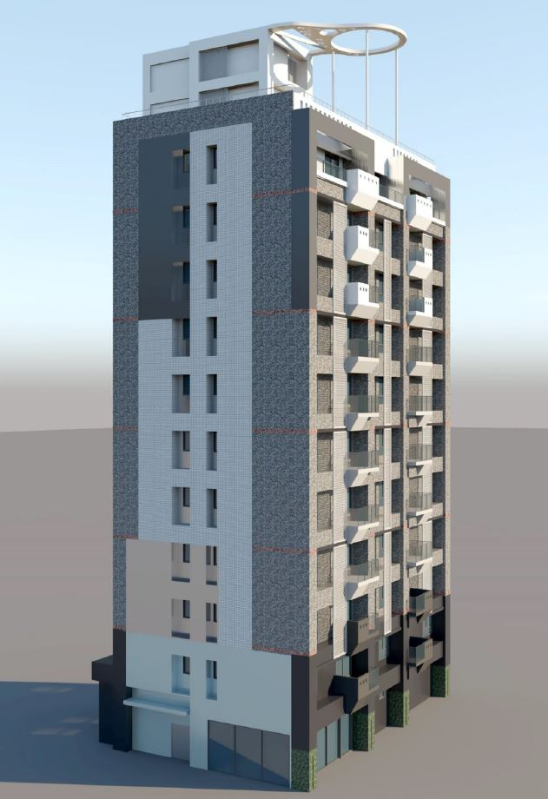
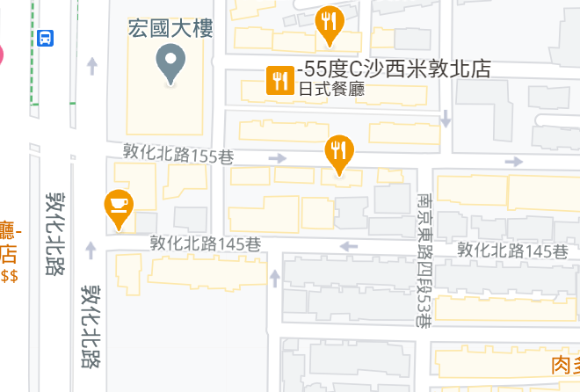
3. Residential Project coming soon-Project in Meiren section
Project Name： Project in Meiren section
Location ：Ln. 145, Dunhua N. Rd., Songshan Dist., Taipei City
Housing Floor：11F/B3F Residential Building
Lot Size：1,127m²
Zoning：Residential
Total Units ：30 Residential
Total Parking Spaces：56
Total selling size ：6,770 m²
Available units for sale of BL：631 m²
(3 Residential)
Location

Slide 10
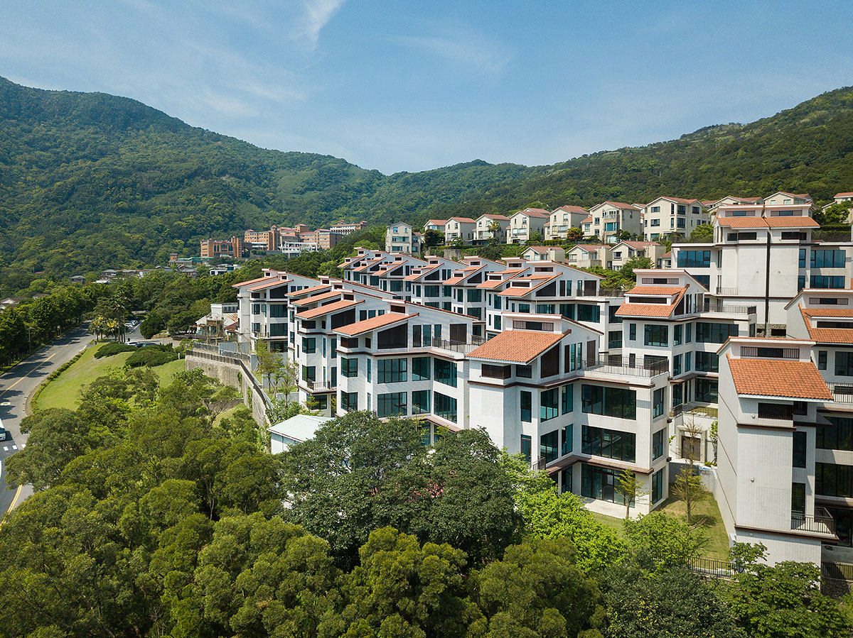
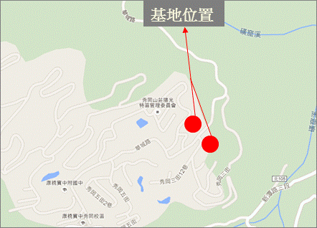
3. Residential Project－Kang Chiao Asahi Villa
Project Name：Kang Chiao Asahi Villa
Location：Huacheng Rd., Xindian Dist., New Taipei City
Housing Floor ：1~3 Floor /Single Elevator Villa
Lot Size ：50,182 m²
Zoning ：Residential
Total units ：101 Residential and 1 Community Center
Total Selling Size：34,221 m²
20 units available for sale of BL：– 5 units sold，15 units for sale now

Slide 11
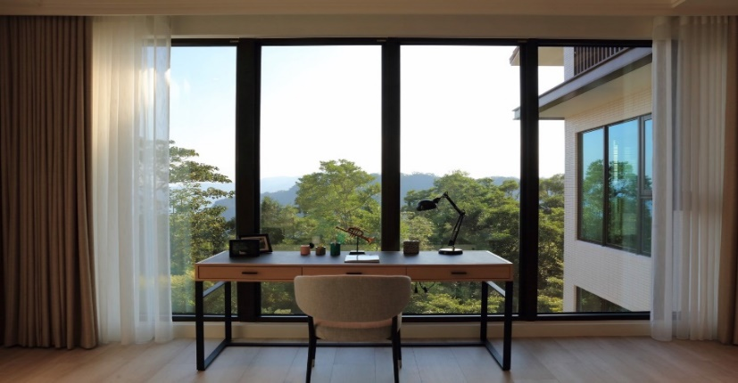
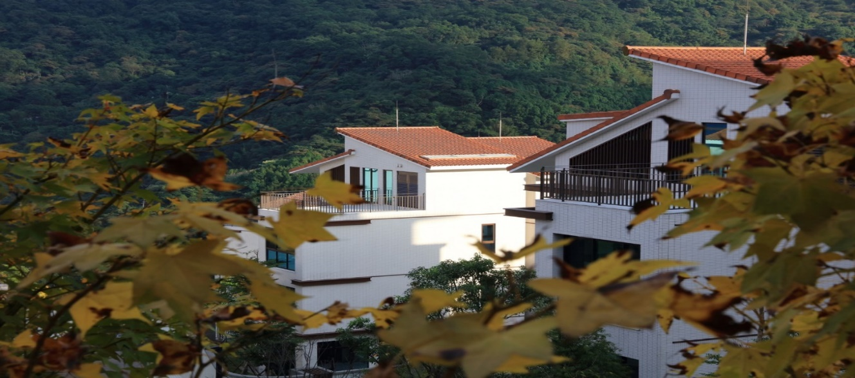
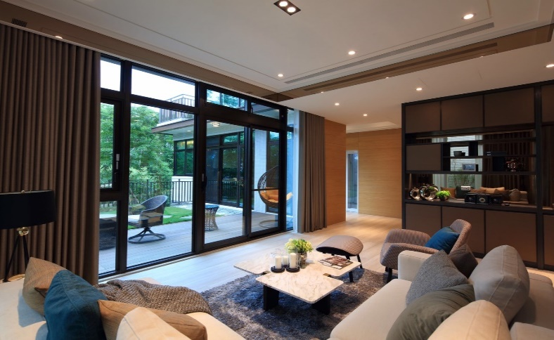
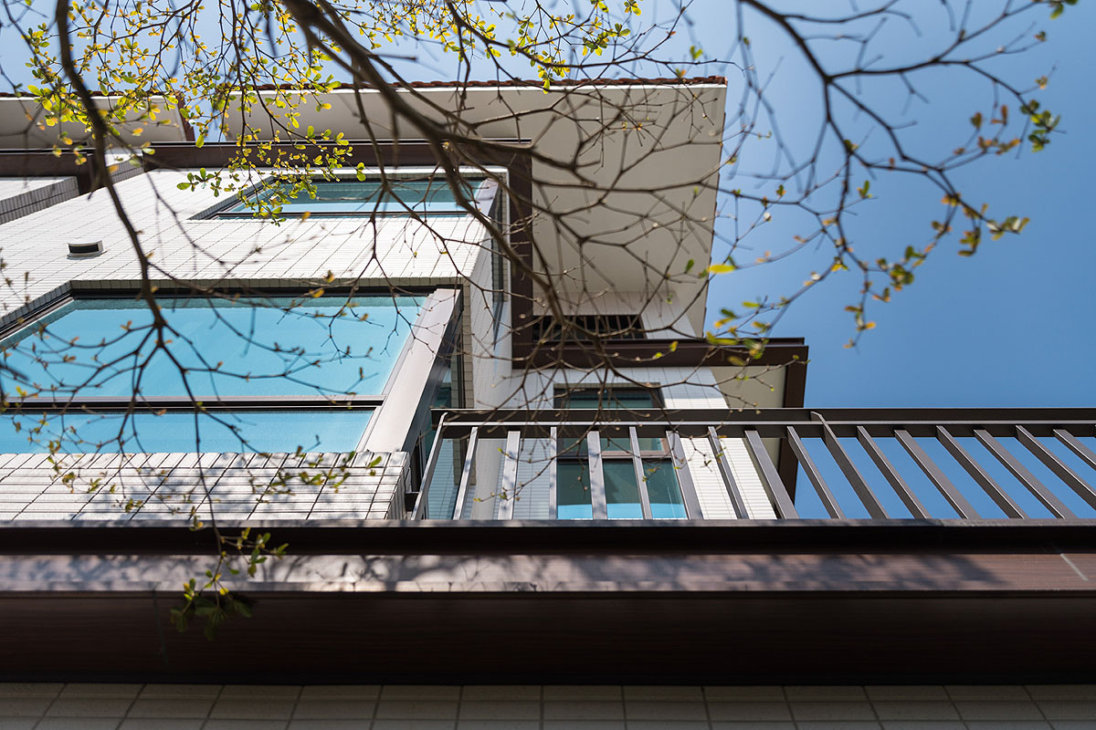
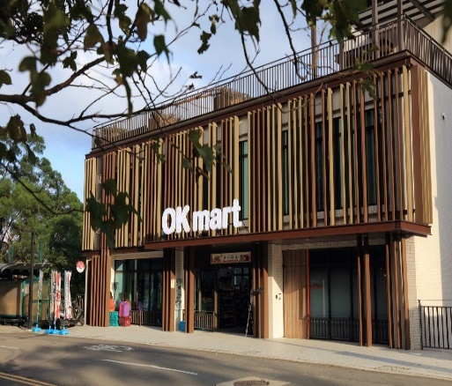
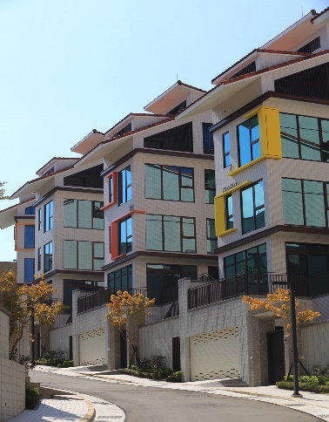
3. Residential Project－Kang Chiao Asahi Villa

Slide 12
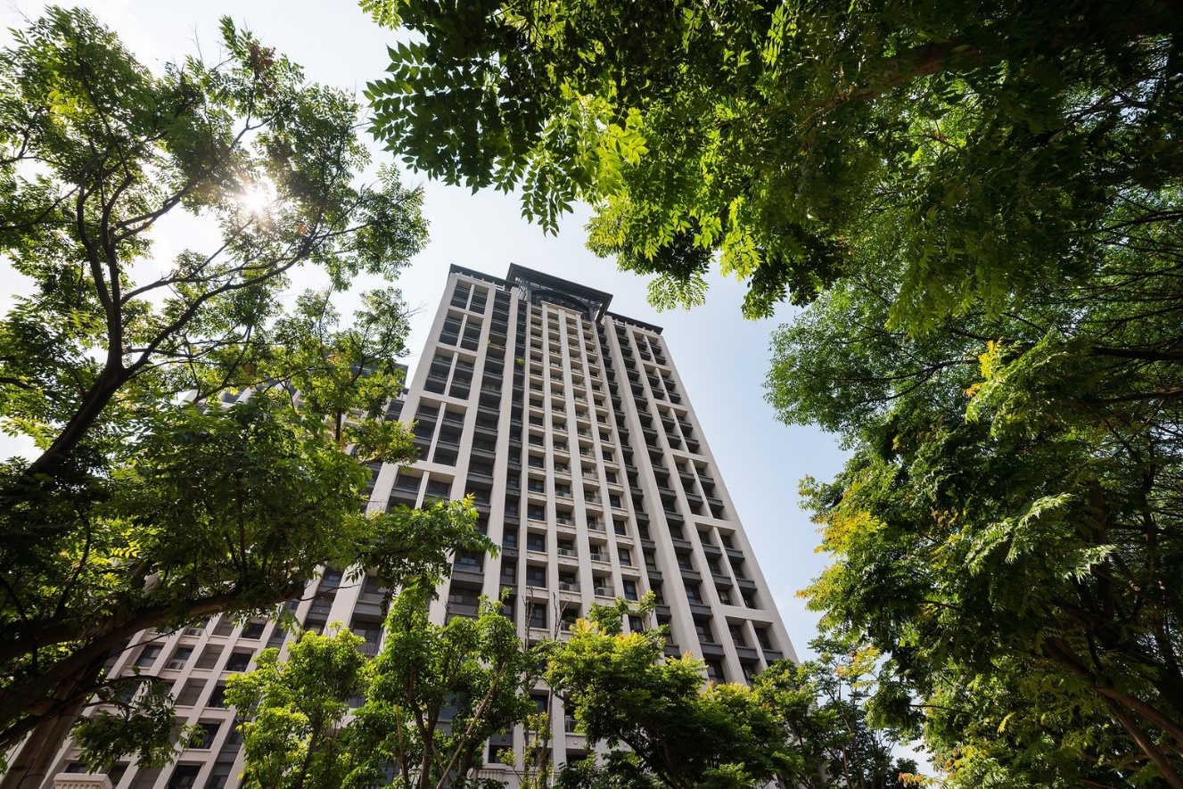
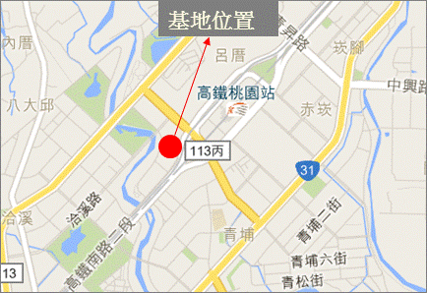
3. Residential Project－Better Life Garden
Project Name：Better life Garden
Location：Gaotie S.Rd., Dayuan Dist., Taoyuan City
Lot Size：5,484 m2
Zoning ：Residential
Total Units：313 residential，5 Commercial shopfront units
Total Parking Spaces ：426
Total selling size：31,947m2
The residential units of Better Life Group was sold out during 2019,
1commercial shopfront unit and 3 parking spaces of BL available for sale now.

Slide 13
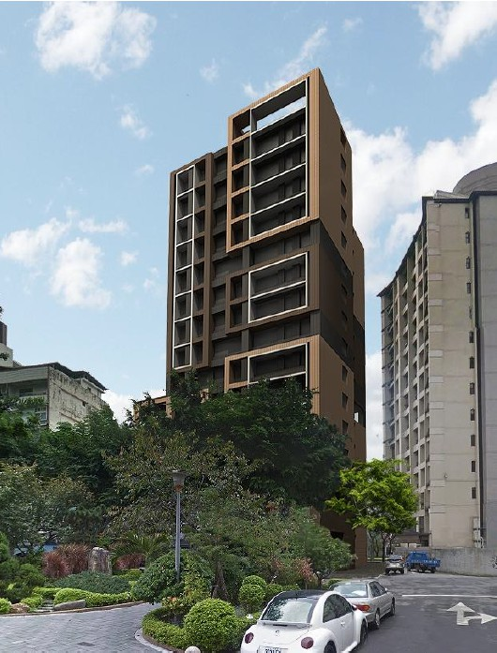
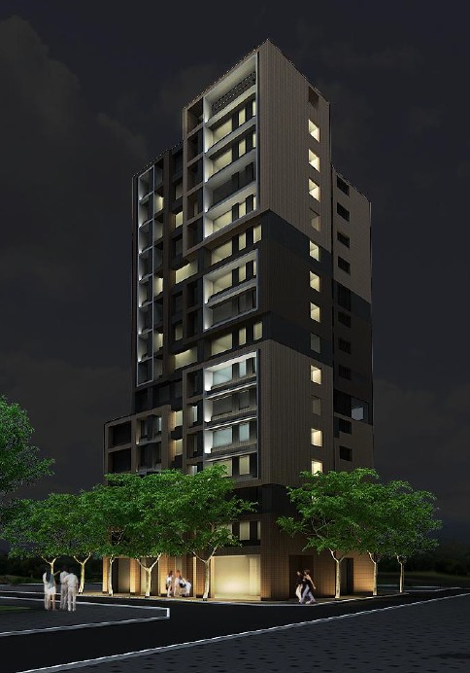
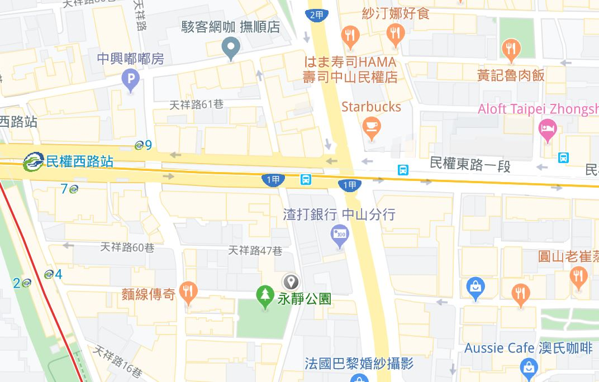
3. Project in Development－Yongjing Park Project
Project Name：Yongjing Park Project
Location：Lane 128, Zhongshan N. Rd.
Lot Size：1,084 m²
Housing Floor ：15F/B4
Estimated Total Selling Size ：8,350 m²
Total Parking spaces ：59 Parking Spaces
The Urban Renewal Plan of this project is now filing for authorization.
Location

Slide 14
4. Financial Overview
Expressed in Thousands of NT$
Years Items | 2015 | 2016 | 2017 | 2018 | 2019 | As of Q3 2020
Revenues | 119,632 | 31,086 | 258,606 | 79,876 | 127,168 | 126,755
Gross Profit | 8,391 | (16,131) | 35,350 | 12,668 | 20,486 | 17,230
Operating Profit | (145,615) | (130,777) | (65,281) | (88,133) | (60,379) | (36,876)
Non-operating Gain (Loss) | 250,142 | 18,979 | 62,886 | (5,391) | (11,297) | (7,132)
Net Income Afetr Tax | 114,093 | (111,796) | (2,395) | (93,524) | (72,992) | (44,008)
Earnings Per Share (in NT$) | 1.42 | (1.39) | (0.03) | (1.17) | (0.91) | (0.44)
Consolidated Total Assets | 1,501,935 | 1,603,840 | 1,501,325 | 1,445,028 | 1,479,983 | 1,325,148
Consolidated Total Liabilities | 604,471 | 858,305 | 758,172 | 849,680 | 813,896 | 702,931

Slide 15


5. Q&A
Thank You
Better Life Group Co., LTD.

