Slide 1


法人說明會
Investor Conference
2026.Mar.27
stock symbol:1809
stock symbol:1809

Slide 2
免責聲明
Disclaimer
本簡報是建立於本公司從各項來源所取得之資訊，有些資訊可能受未來不確定性因素影響，致使與原先本公司對於未來前景的說明迥異。未來若有變更或調整時，請以公開資訊觀測站公告資訊為依據。
This presentation is based on the information obtained from various sources which the Company believes to be reliable. But at some point in the future, there are a variety of factors which could cause actual results to differ materially from those statements. Therefore, please refer to the information on MOPS website as the main basis if any adjustment has been made.
(http://mops.twse.com.tw/mops/web/index)

Slide 3
會議議程
Agenda
公司簡介 Company Overview
營運狀況 Operating Status
未來展望 Future Strategies & Plans

Slide 4
01
公司簡介
Company Overview

Slide 5
公司簡介 Company Overview

Slide 6
中釉公司 永續經營
China Glaze Company – Sustainable Management
本公司永續發展委員會為本公司永續治理作業的最高指導組織。本委員會由董事會推舉至少三名董事組成之，其中過半數獨立董事參與，總經理擔任永續發展委員會主任委員，總幹事由公司治理主管擔任，永續發展委員會每年至少2次向董事會呈報ESG執行成果。本委員會其下設置「公司治理工作小組」、「環境永續工作小組」、「員工及社會影響工作小組」。
The Sustainability Development Committee is the Company’s highest governance body for sustainability matters. It is composed of at least three directors appointed by the Board, with a majority of independent directors. The President serves as Chairperson, and the Chief Corporate Governance Officer acts as Executive Secretary. The Committee reports ESG performance to the Board at least twice a year and oversees three working groups: Corporate Governance, Environmental Sustainability, and Employee & Social Impact.

Slide 7
中釉公司 永續經營
China Glaze Company – Sustainable Management

Slide 8
中釉公司 永續經營
China Glaze Company – Sustainable Management
中國製釉永續報告書 (2024)
Sustainability Reports
Greenhouse gas inventory Report
○ 溫室氣體盤查報告書 (2024)
8

Slide 9
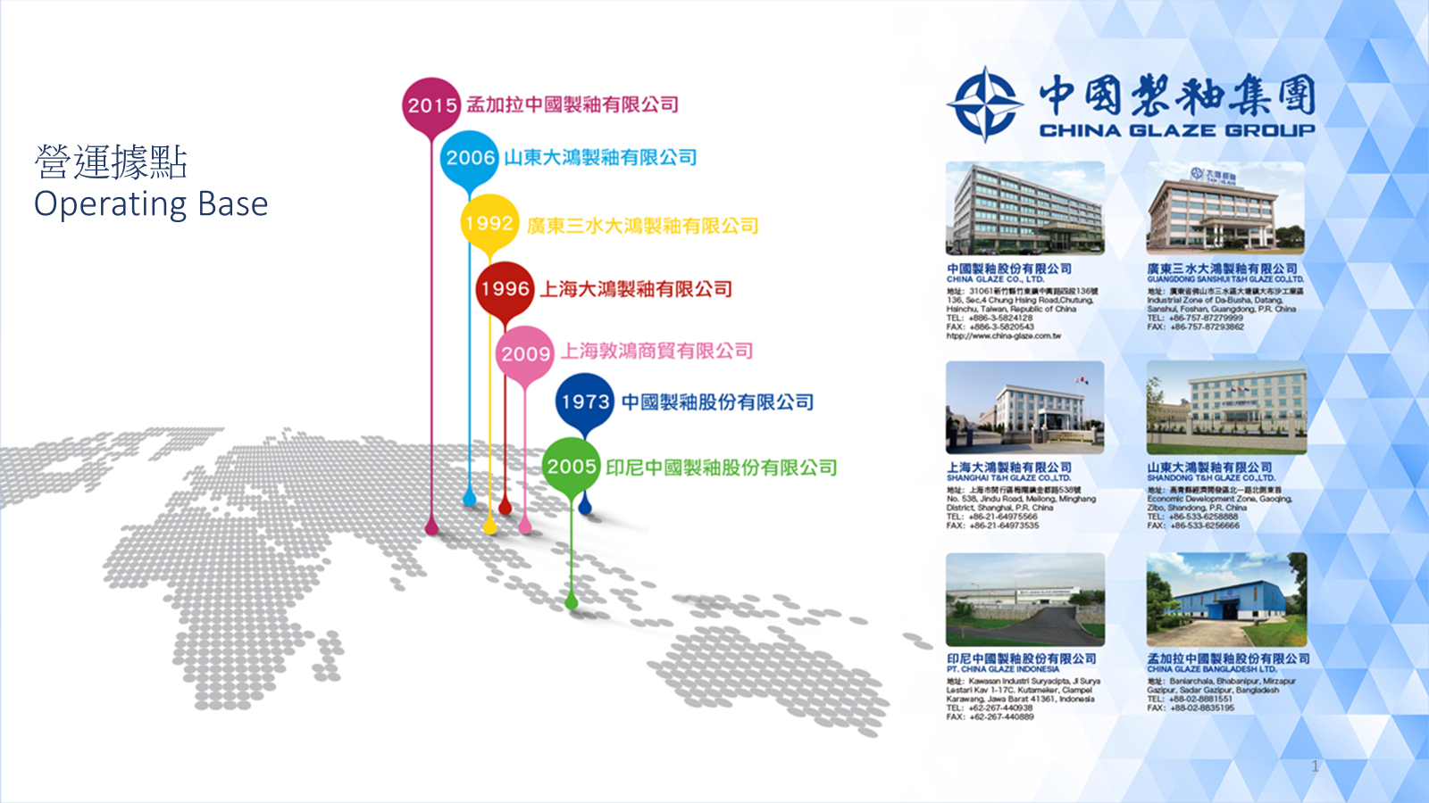

9

Slide 10

業務據點
Sales Locations
菲律賓
Philippines
中國 China
孟加拉
Bangladesh
印尼
Indonesia
馬來西亞
Malaysia
泰國
Thailand
越南
Vietnam
韓國
South Korea
日本
Japan
非洲貝南
Benin
斯里蘭卡
Sri Lanka

Slide 11
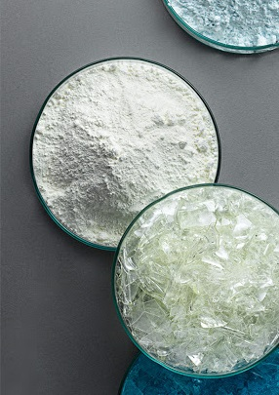
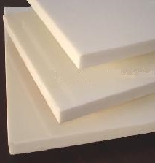

主要事業單位
Main Business Units
Ceramic
Materials
Building
Materials
Advance
Materials
陶瓷原料
建築材料
新材料

Slide 12

陶瓷事業部
Ceramics Division
專業陶瓷原料供應商
Professional ceramic raw material supplier
熔塊
Frits
乾粒
Vetrosa
Grits
防滑釉
Anti-Slip Glaze
功能釉
Functional Glaze
矽酸鋯
Zirconium Silicate
色料
Color Stains
陶瓷用無機墨水
Ceramic-Jet Inks
成釉
Composed Glaze
拋光釉
Poloshing Glaze
印刷釉
Printing
Glaze

Slide 13

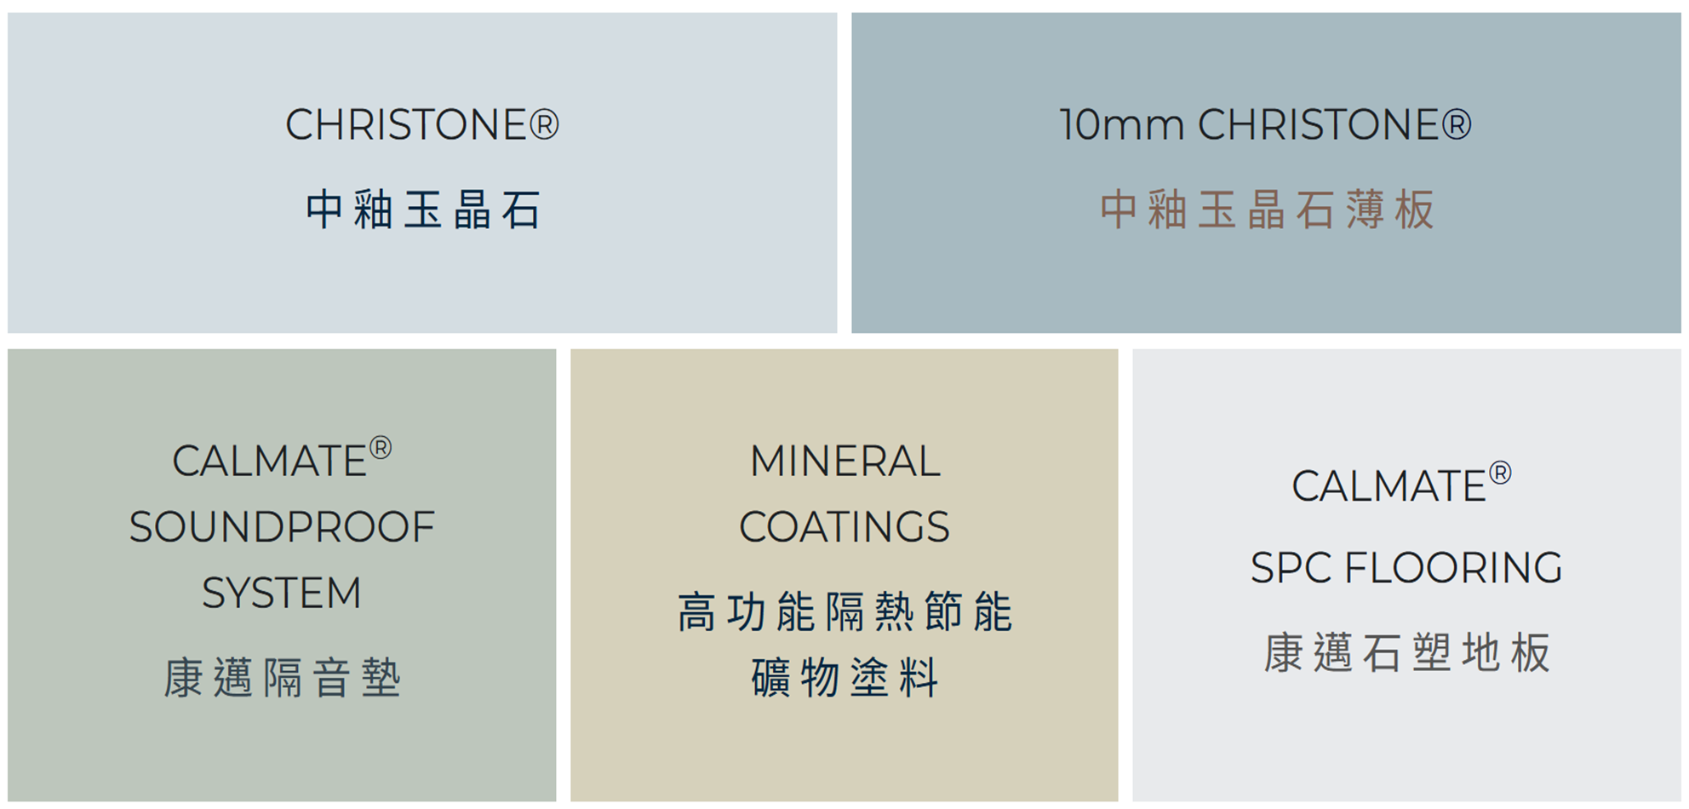
建材事業部
Building Materials Division

Slide 14

新材料事業部
Advanced Materials Division
玻璃/陶瓷螢光片
Phosphor in Glass/Ceramic
低介電類晶玻璃陶瓷基板
Low Dk/Df with High strength Ceramic-glass substrates for use in the interposer layer
固態電池用電解質隔離膜材料
Solid-state Electrolyte Material Solution for Solid-state Batteries

Slide 15
02
營運狀況
Operating Status
15

Slide 16
合併資產負債表摘要
Balance Sheet Overview (Consolidated)

Slide 17
合併綜合損益表摘要
Statements of Comprehensive Income Overview (Consolidated)

Slide 18
合併現金流量表摘要
Statement of Cash Flow Overview (Consolidated)

Slide 19
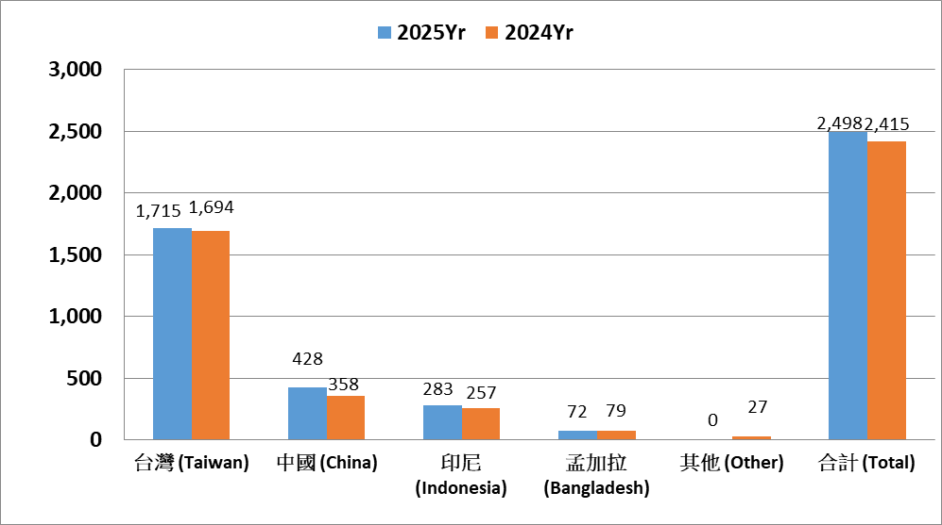
集團銷售分析(依產區營收)
Revenues by Subsidiary
19

Slide 20
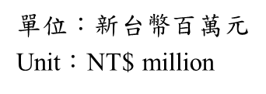
合併營收地區別同期比較
Revenues by Region (Consolidated)

Slide 21
合併營業毛利
Gross Profit (Consolidated)

Slide 22
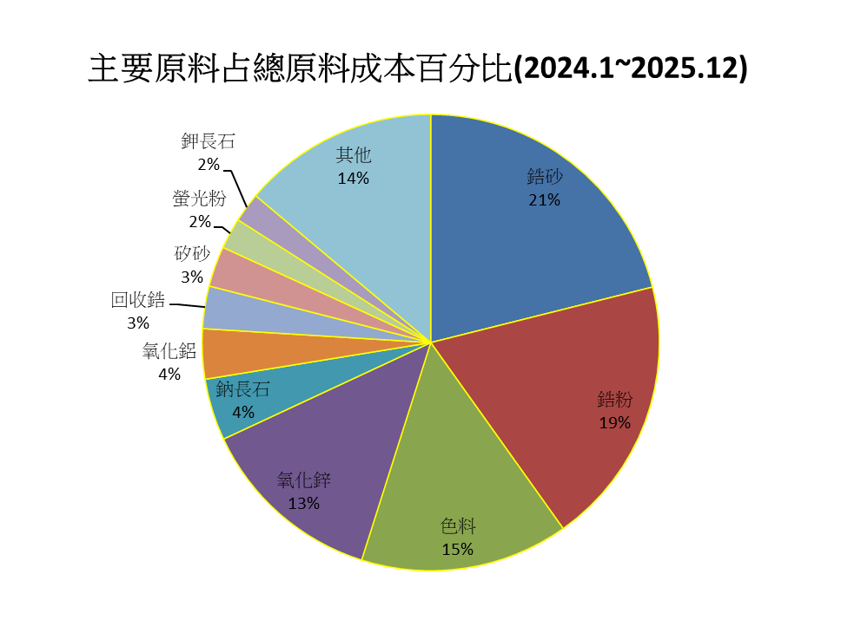
原料成本 Material Cost
單位：佔總原料成本百分比
Unit：% of total material cost

Slide 23
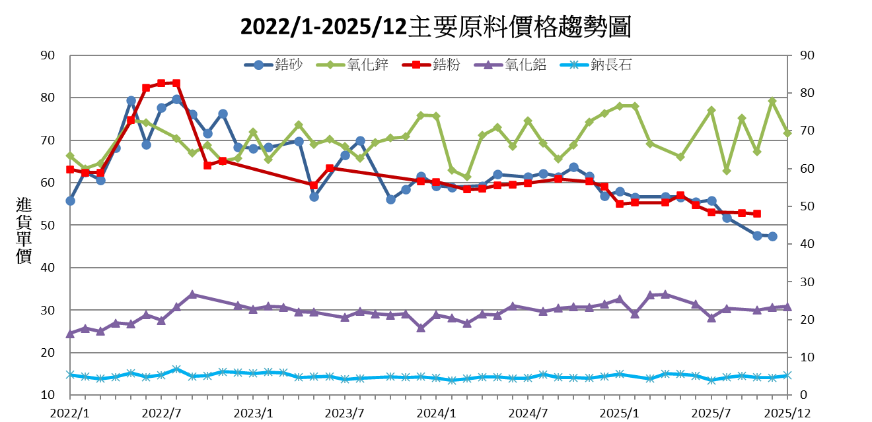
原料價格走勢-2022年~2025年第4季
Material Price Trend – 2022Yr ~ 2025Yr-Q4
單位:新台幣/公斤
Unit:NT$/Kg

Slide 24
03
未來展望
Future Strategies & Plans

Slide 25
陶瓷事業部
Ceramics Division
原訂今年推動沙烏地阿拉伯及埃及等中東市場之開發計畫，惟受美伊戰事情勢影響，相關推進時程爰暫予放緩。
The original plan to promote the development of Middle Eastern markets such as Saudi Arabia and Egypt this year has been temporarily slowed down due to the situation of the US-Iran war.
今年將成立越南分公司及生產基地，投入陶瓷成釉之生產，以整合當地原物料資源，並分散地緣政治所帶來之經營風險。
This year, a branch office and production base will be established in Vietnam to produce ceramic glazes, in order to integrate local raw material resources and mitigate the operational risks brought about by geopolitics..
本公司已將人工智慧技術導入磁磚圖紋設計作業，有效提升設計稿之品質及產出量能，未來將持續規劃並推動相關商業模式之應用與發展。
Our company has incorporated artificial intelligence technology into the design of tile patterns, which has effectively improved the quality and output of design drafts. In the future, we will continue to plan and promote the application and development of related business models.

Slide 26
建材事業部
Building Materials Division
礦物節能塗料產品在台灣陸續取得相關產品認證，產品陸續推廣至全台灣案場。
Mineral energy-saving coating products have successively obtained relevant product certifications in Taiwan, and the products have been gradually promoted to sales sites throughout Taiwan.
樓層隔音墊產品已取得綠建材標章。
The sound insulation pad product for the floor has obtained the green building material label.
結晶化玻璃產品近期已簽約的有T3航站之A14捷運站、艾斯摩爾(ASML)林口新廠、台中BMW旗艦展示中心、台北新東陽大樓、微星科技大樓，未來朝大型建案及公共工程持續推動。
Recent contracts for crystallized glass products include the A14 MRT station at Terminal 3, ASML‘s new plant, the BMW showroom in Taichung, Taipei Shin Tung Yang Building, and MSI HQ Building. Future expansion will continue towards public and large construction projects.

Slide 27
新材料事業部
Advanced Materials Division
螢光玻璃片（PiG）產品目前已導入中國電動車主流高階車款，惟因中國電動車市場於第一季銷售表現趨緩，致對本公司第一季營收造成一定影響。另方面，該產品已成功進入韓國與北美車燈供應鏈，並持續穩定放量出貨，預期今年下半年PiG產品營運成長動能可望轉趨樂觀。
The company's fluorescent glass substrate (PiG) products have been adopted in mainstream high-end electric vehicle models in China. However, the slowdown in the Chinese electric vehicle market in the first quarter had a certain impact on the company's revenue. On the other hand, the product has successfully entered the automotive lighting supply chains in South Korea and North America, and shipments continue to increase steadily. The company expects the growth momentum of PiG products to improve in the second half of the year.
開發固態電池用之固態電解質隔離膜材料，配合客戶進度送樣測試中。
Developing solid electrolyte materials for solid-state batteries, samples are testing in progress.

Slide 28
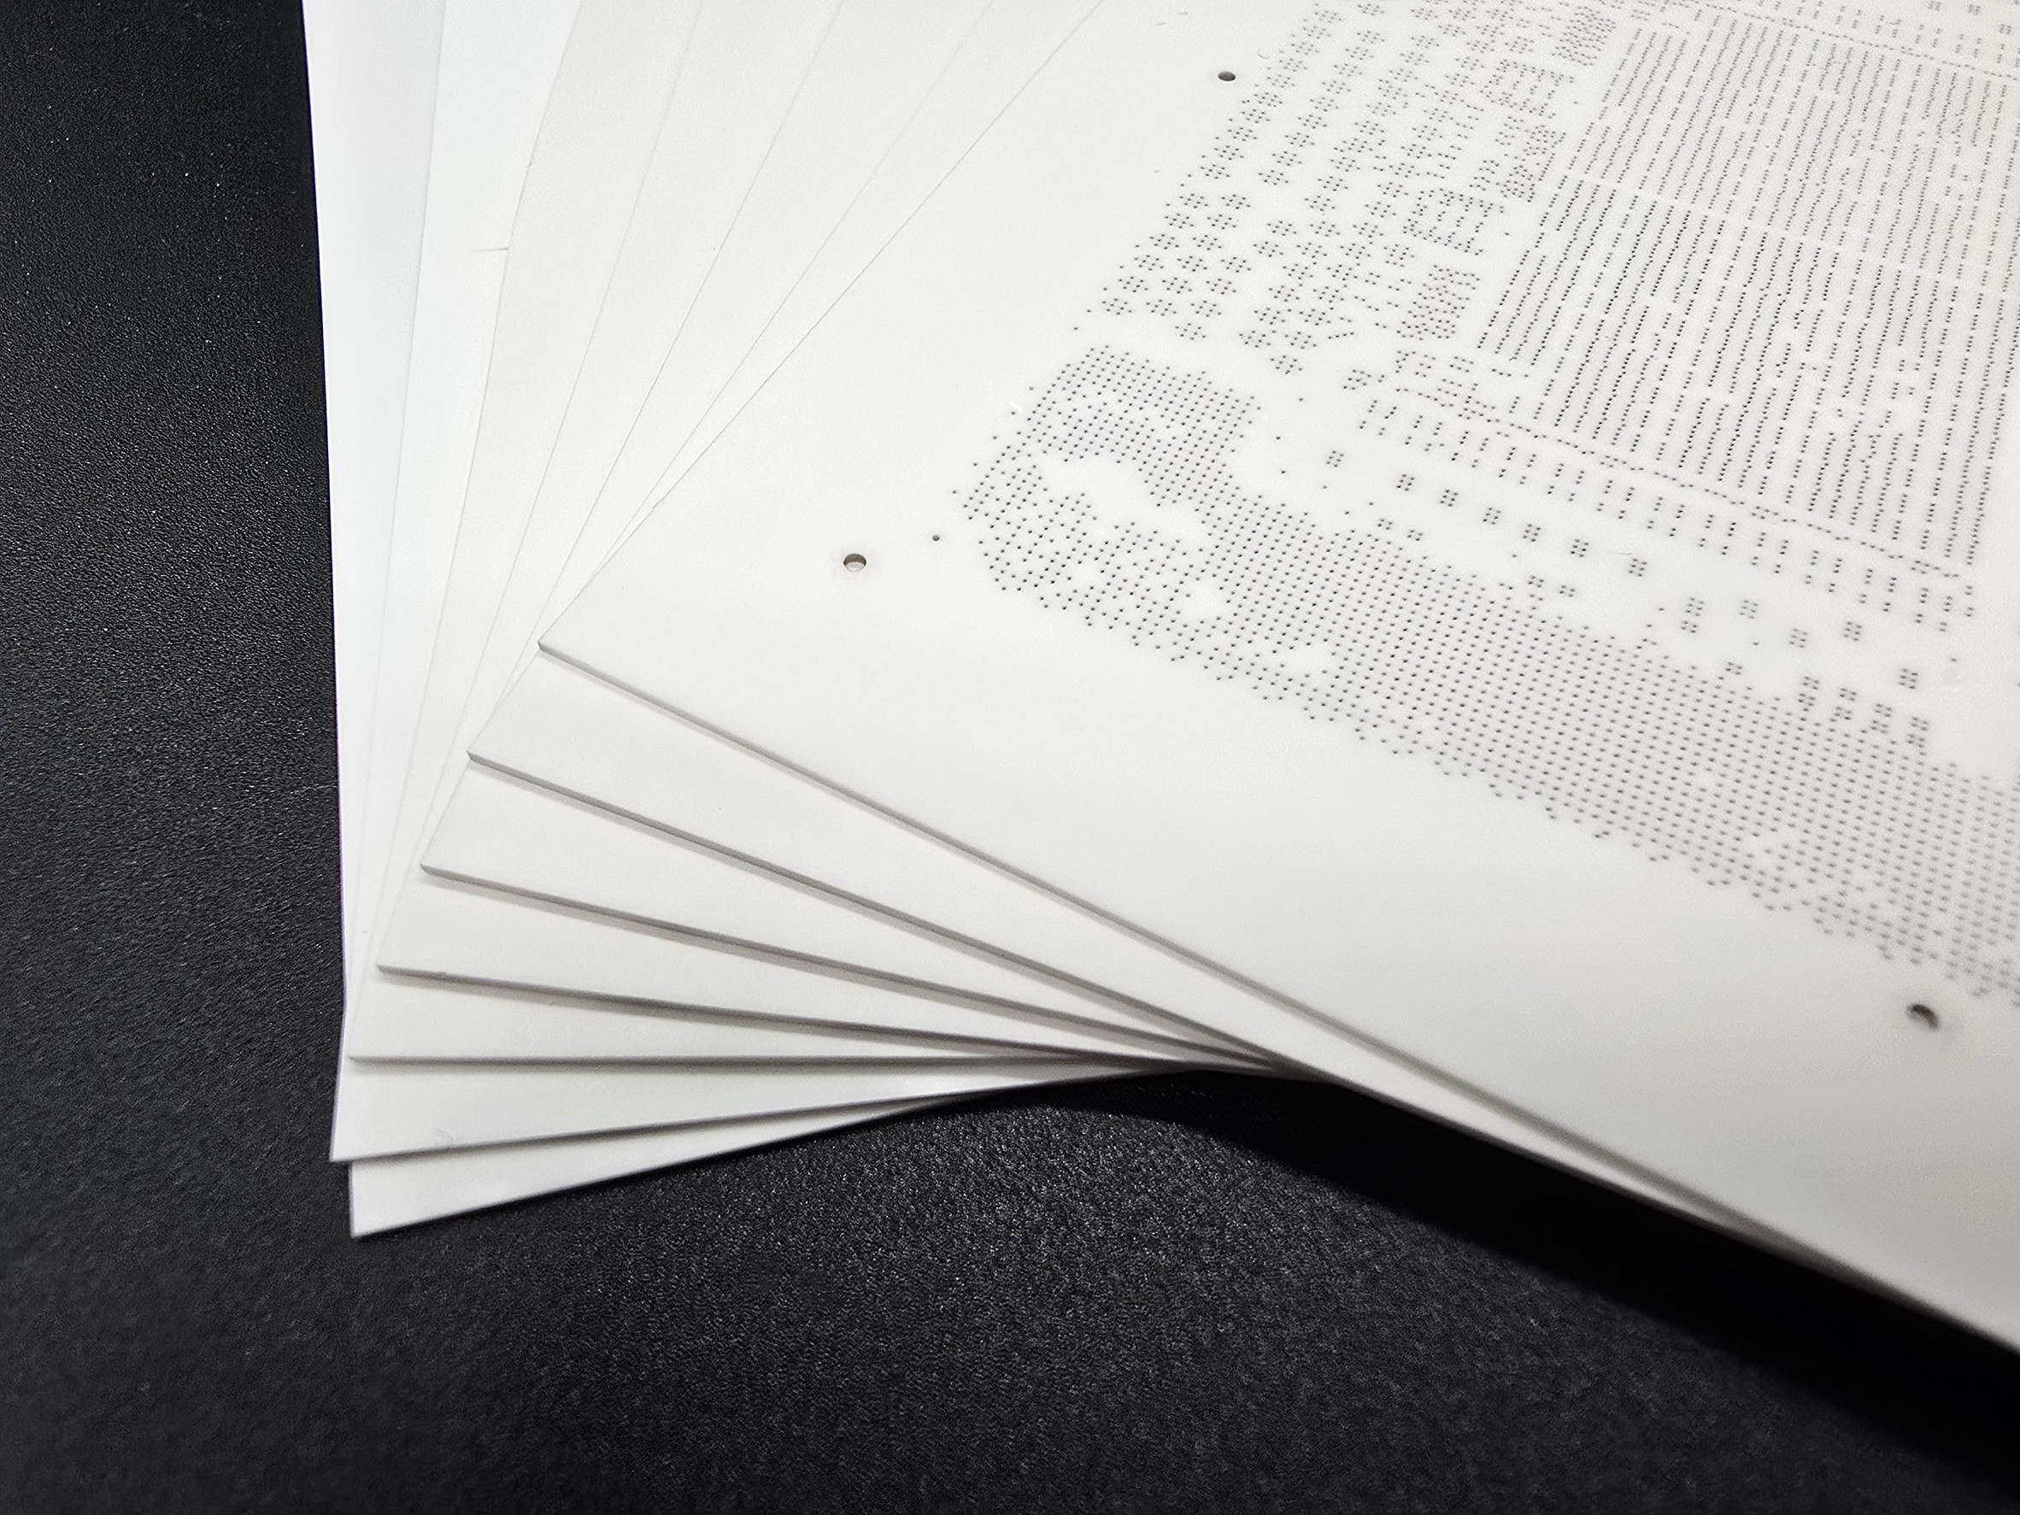
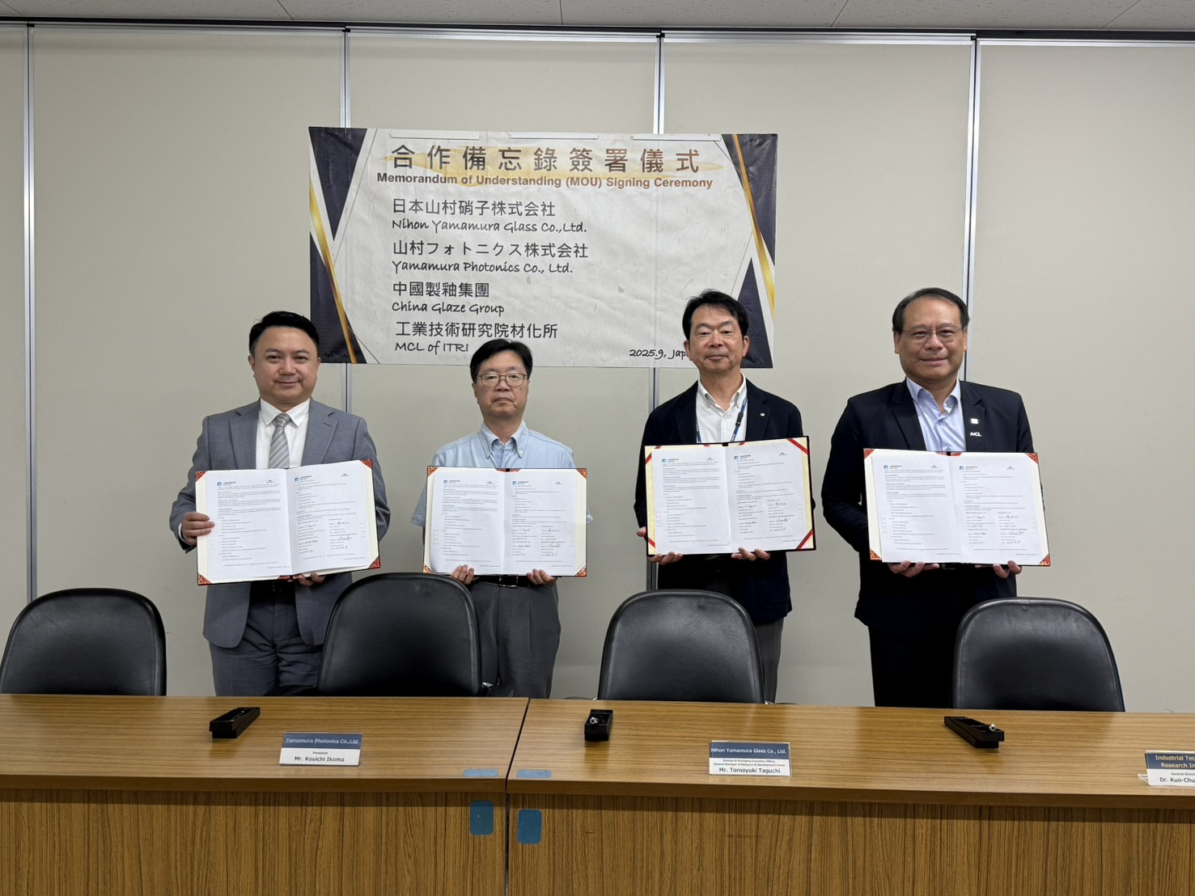
新材料事業部
Advanced Materials Division
本公司積極布局半導體先進封裝材料領域，並攜手日本山村硝子共同開發大面積、低介電（Low Dk/Df）及高強度之類晶玻璃陶瓷基板，以拓展高階電子材料應用市場。
Our company is actively expanding into the field of advanced semiconductor packaging materials and is collaborating with Yamamura Glass of Japan to develop large-area, low-dielectric (Low Dk/Df) and high-strength quasi-crystalline glass-ceramic substrates to expand the market for high-end electronic materials applications.

Slide 29
Thank you
感謝各位投資人蒞臨及對本公司之支持與愛護
Thanks for coming and kindly appreciate your support.
本公司網站：www.china-glaze.com.tw

