Slide 1
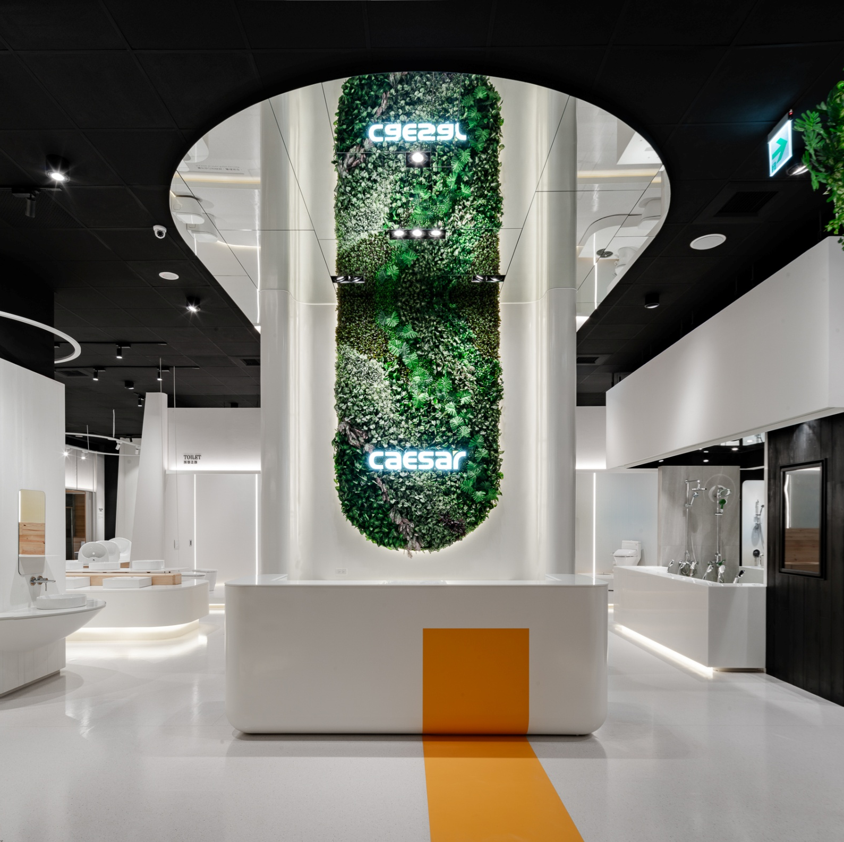

SANITAR CO., Ltd.
Stock Code: 1817
Date: 29 May. 2019, Wednesday
Time: 15:50-16:30
蕭俊祥 Tony Hsiao
President
Notes:
Hello Everybody
I’m Effy. I work for Caesar , as Marketing Executive for half of year. So actully im a new guy.
I have work at Internet Marketing company and Advertising agency for three year.
Now In Caesar ,my job is planning Advertising include TV , radio , Internet Marketing ,sale promotion and Caesar Showroom
嗨 各位同學好
我是凱撒衛浴的行銷企劃，我叫Effy，
這次很榮幸來東海大學，跟你們分享我出社會後，這三年的工作經歷。
現在我在凱撒衛浴擔任行銷企劃，規劃電視廣告，廣播，網路行銷，SP，展示中心
所以，在我這短短的10分鐘，藉由凱撒衛浴在台灣做的行銷，跟你們分享一些我工作的經歷，我遇上的事情
Advertising agency
Media / facebok .. Taiwan marekting

Slide 2

Legal Disclaimer
The information is provided for informational purposes only, and is not an offer to buy or sell or a solicitation of an offer to buy or sell any security issued by Sanitar or other parties.
Sanitar’s statements that are only historical and there are not any financial prediction.
Sanitar does not warranty their accuracy, reliability and completeness. There are a number of factors such as economic conditions, firms abilities, industry environment that could cause actual results and developments. Investors should not place undue reliance on them.

Slide 3
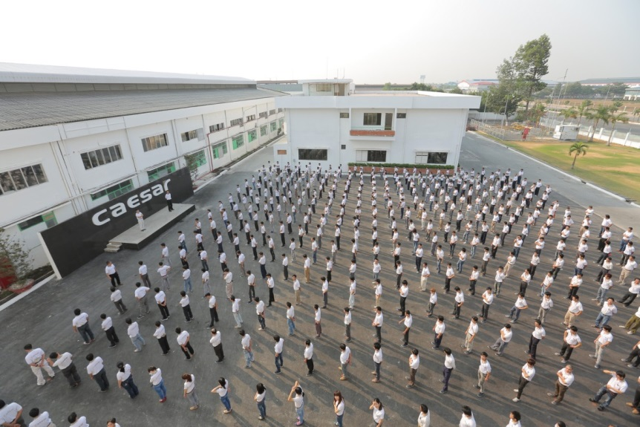
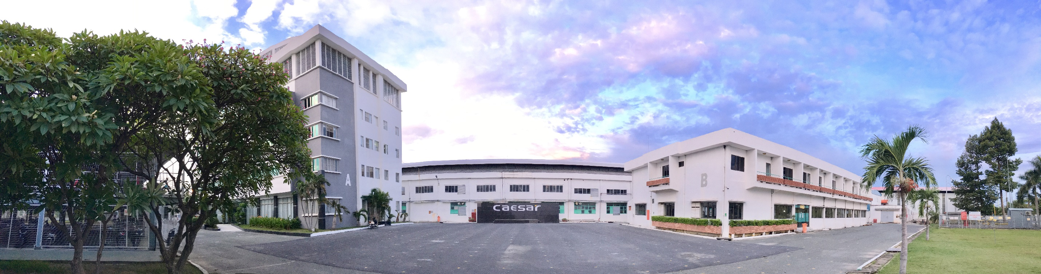
Company Information
Founded：Dec 10, 1985
Number of Employees：1,200
Main Products：Sanitary Wares
Headquarters：New Taipei City, Taiwan
Manufacturing Sites：Dong Nai Province, Vietnam

Slide 4

Our Global Presence
Others
Revenue by Region
FYE2018
1%
Vietnam
Taiwan
Revenue by Region
Revenue by Region
FYE2018
FYE2018
42%
57%
30+ years
1,200+
NTD 2.29 billion
Brand Legacy
Employees
Revenue
Notes:
Other countries, including Japan, Korea, Malaysia, China, Philippines, Australia, Myanmar, Cambodia, USA, etc

Slide 5
Financial Results
(UNITS: In Thousands of New Taiwan Dollars)
 |  | 2019 Q1 | 2018 Q1 | YoY
Financial Results | Operation Revenue | 496,161 | 532,487 | -6.82%
 | Gross Profit | 155,486 | 168,423 | -7.68%
 | Profit from Operations | 56,608 | 79,649 | -28.93%
 | Income Before Income Tax | 55,776 | 83,898 | -33.52%
Profitability Ratio | Return on Assets | 11.07% | 11.02% | 0.45%
 | Return on Equity | 14.98% | 13.87% | 8.00%
 | Operating Income to Capital Stock | 31.18% | 43.88% | -28.95%
 | Profit Before Tax to Capital Stock | 30.73% | 46.22% | -33.51%
 | Profit Margin | 8.31% | 10.59% | -21.53%
 | Earnings Per Share | 0.57 | 0.78 | -26.92%
Notes:
Other countries, including Japan, Korea, Malaysia, China, Philippines, Australia, Myanmar, Cambodia, USA, etc

Slide 6
Financial Results
(UNITS: In Thousands of New Taiwan Dollars)
 | Consolidated comprehensive income statements of past five years
 | 2018 | 2017 | 2016 | 2015 | 2014
Operating Revenue | 2,293,113 | 2,269,977 | 2,222,489 | 2,203,488 | 1,948,053
Debt to Total Assets | 25.83% | 23.51% | 21.12% | 18.90% | 18.45%
Current Ratio | 257.74% | 319.64% | 345.97% | 361.20% | 401.80%
Quick Ratio | 115.29% | 161.97% | 203.16% | 199.16% | 225.78%
Return on Equity | 15.35% | 16.27% | 16.06% | 15.98% | 13.49%
Profit Before Tax to Capital Stock | 49.21% | 47.09% | 46.67% | 44.31% | 33.11%
EPS | 3.50 | 3.58 | 3.40 | 3.18 | 2.51
Average stock price | 39.94 | 39.37 | 38.44 | 35.27 | 33.64
P/E Ratio | 11.41 | 11.00 | 11.31 | 11.09 | 13.40
*：2013.10.24 IPO
Notes:
Other countries, including Japan, Korea, Malaysia, China, Philippines, Australia, Myanmar, Cambodia, USA, etc

Slide 7
Automation

Slide 8
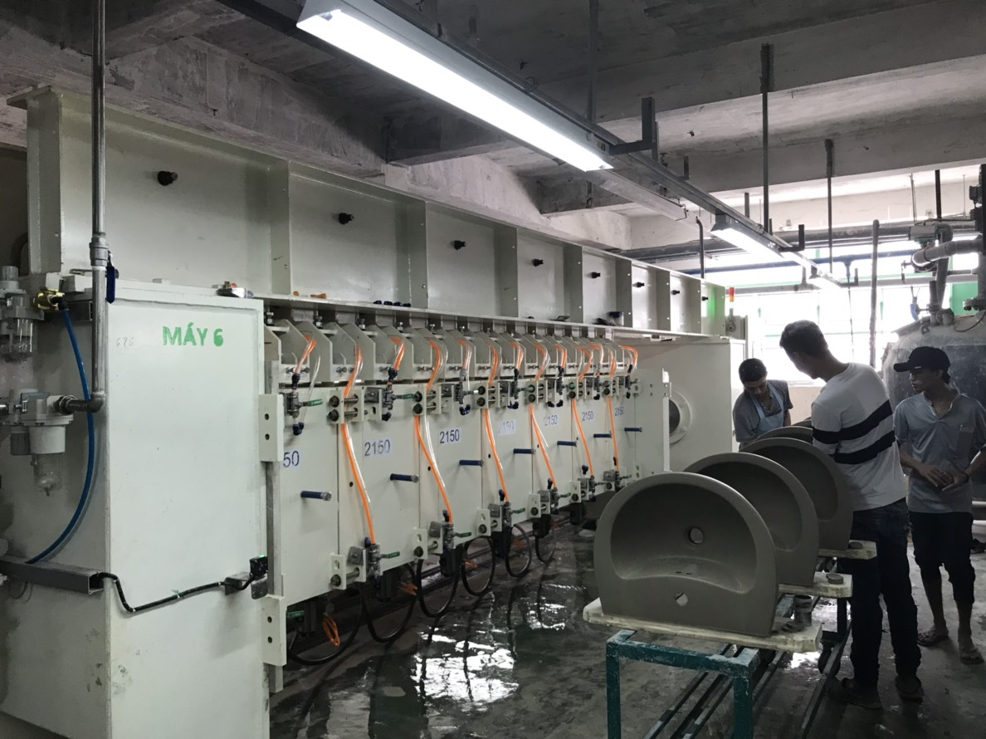
High-Pressure Grouting

Slide 9
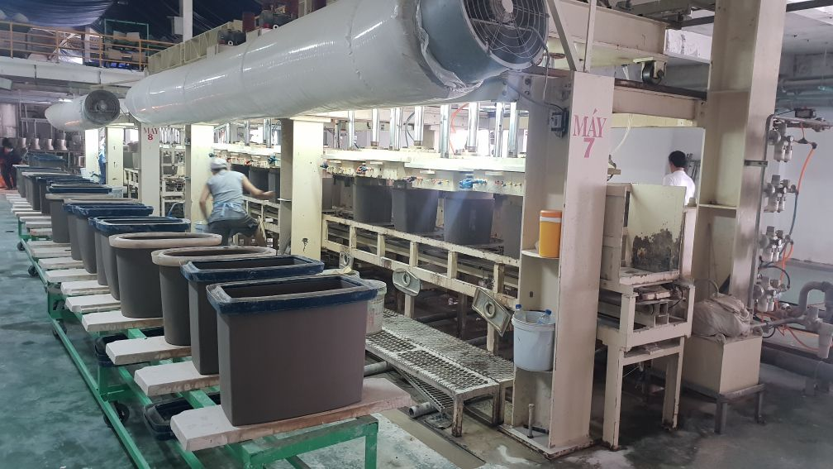
High-Pressure Grouting

Slide 10
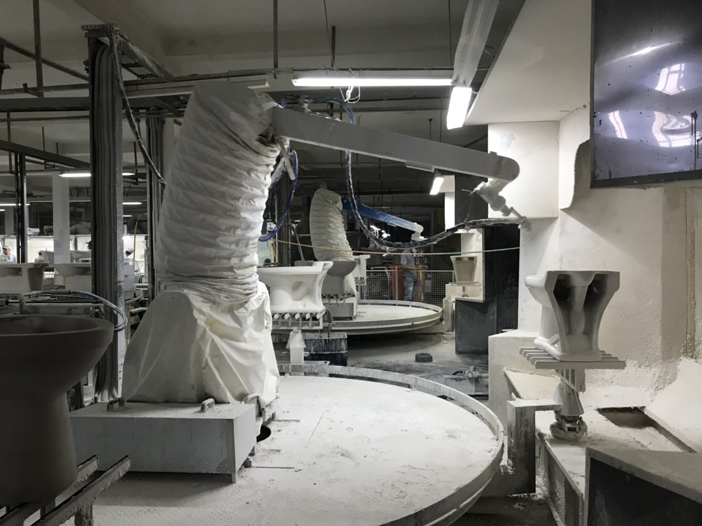
Glazing Robot

Slide 11
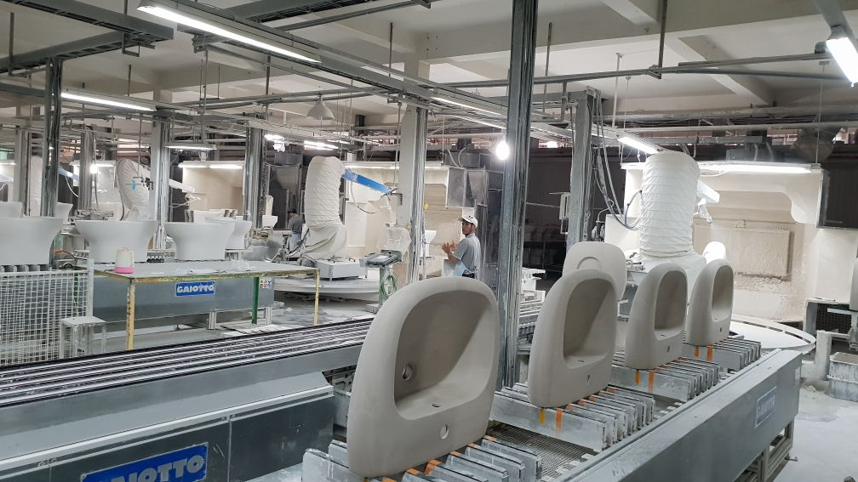
Glazing Robot

Slide 12
Capital Expenditure

Slide 13
Miaoli Dispatching Center

Slide 14

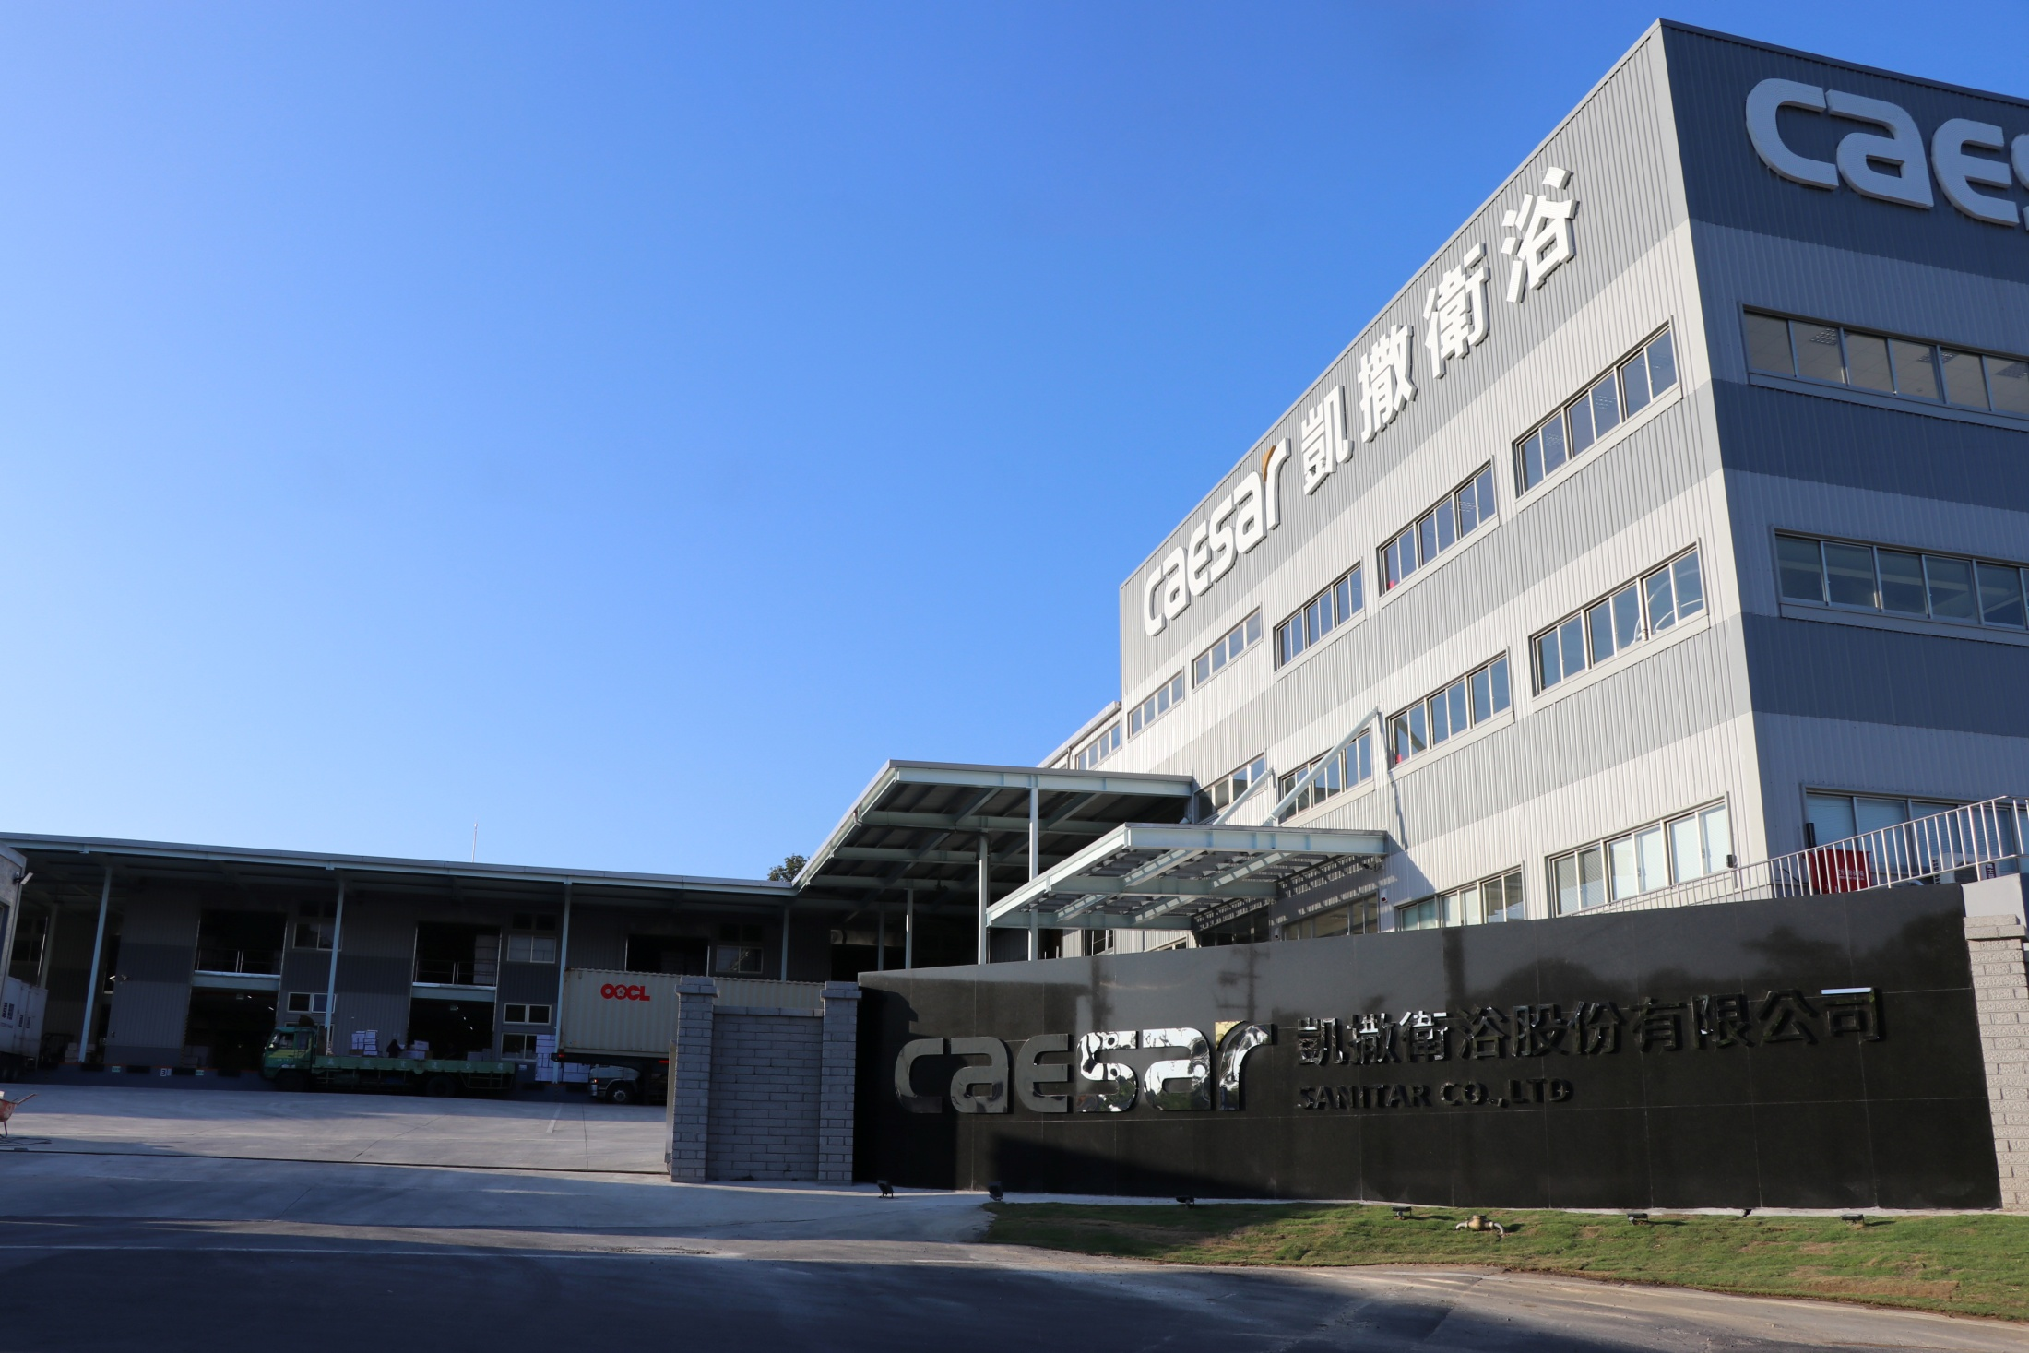
Aug, 2018 Grand Opening

Slide 15
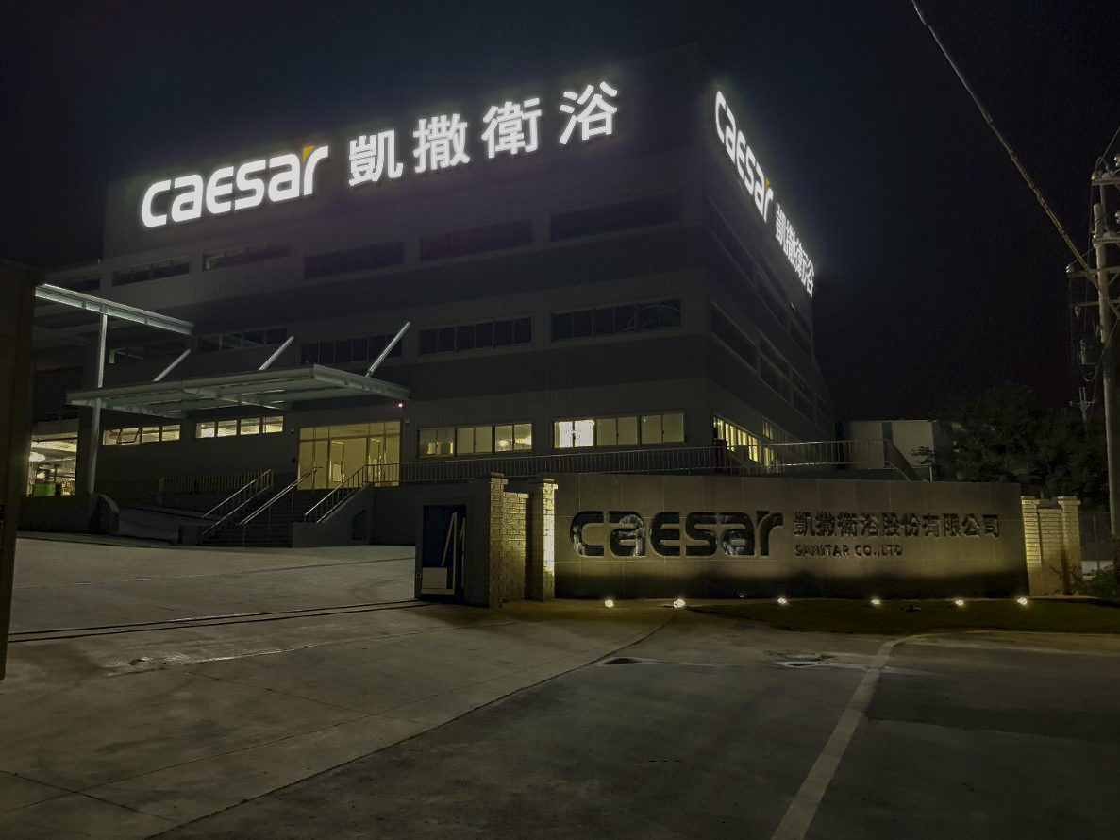
Aug, 2018 Grand Opening

Slide 16
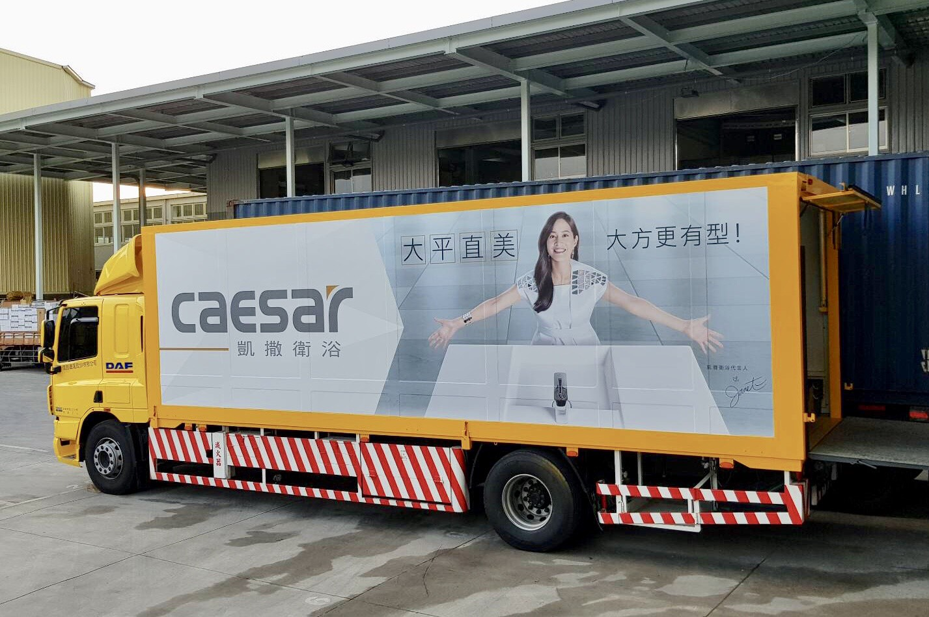
Aug, 2018 Grand Opening

Slide 17
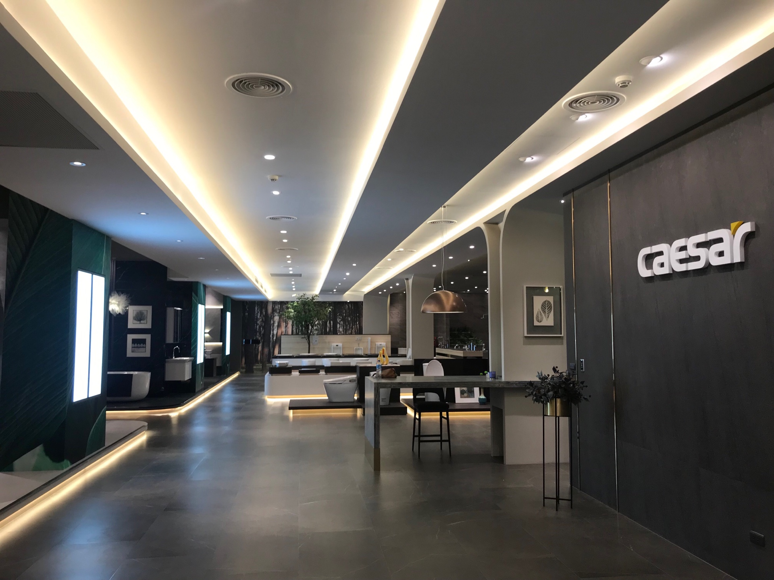
May, 2019 Showroom Grand Opening

Slide 18
The Art Gallery of Bathroom Furniture

Slide 19
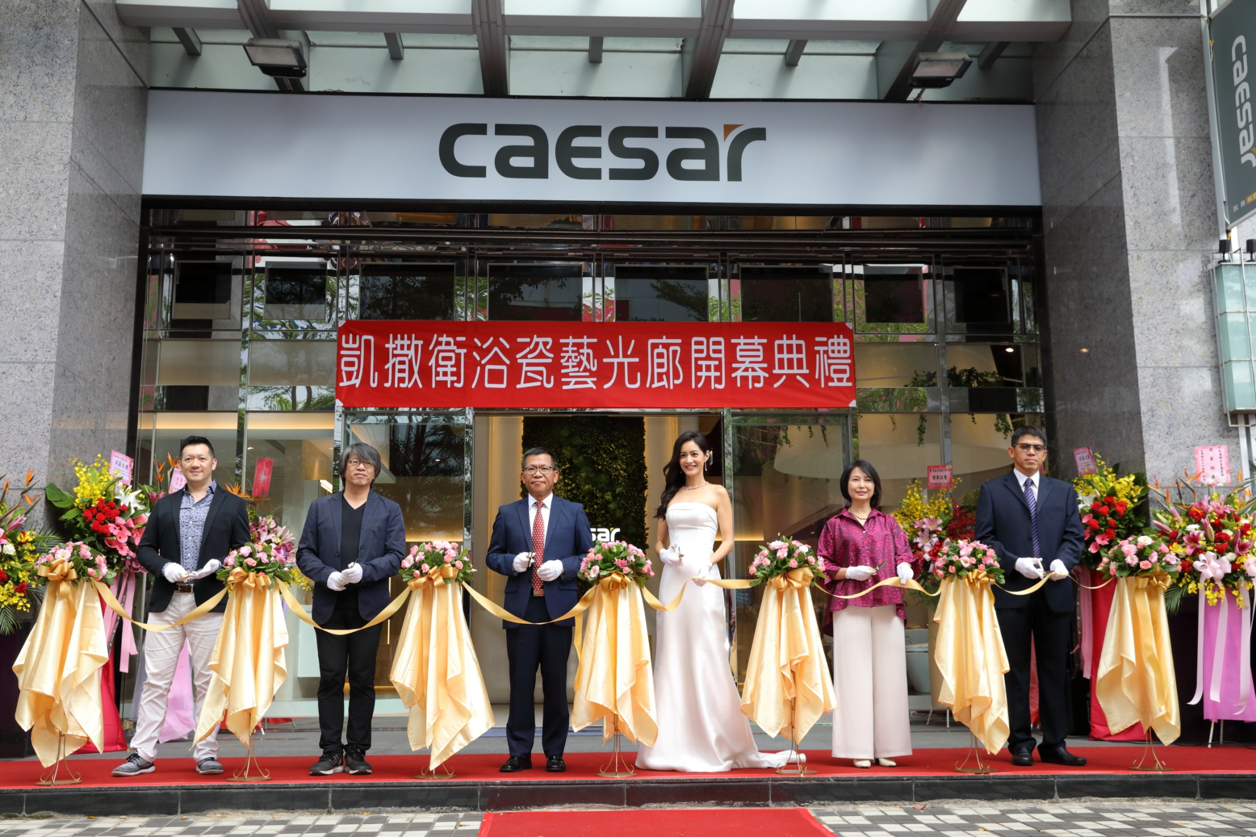
Oct. 5th, 2018 Grand Opening

Slide 20
Oct. 5th, 2018 Grand Opening

Slide 21
Oct. 5th, 2018 Grand Opening

Slide 22
Vietnam Faucet & Cabinet Plant

Slide 23
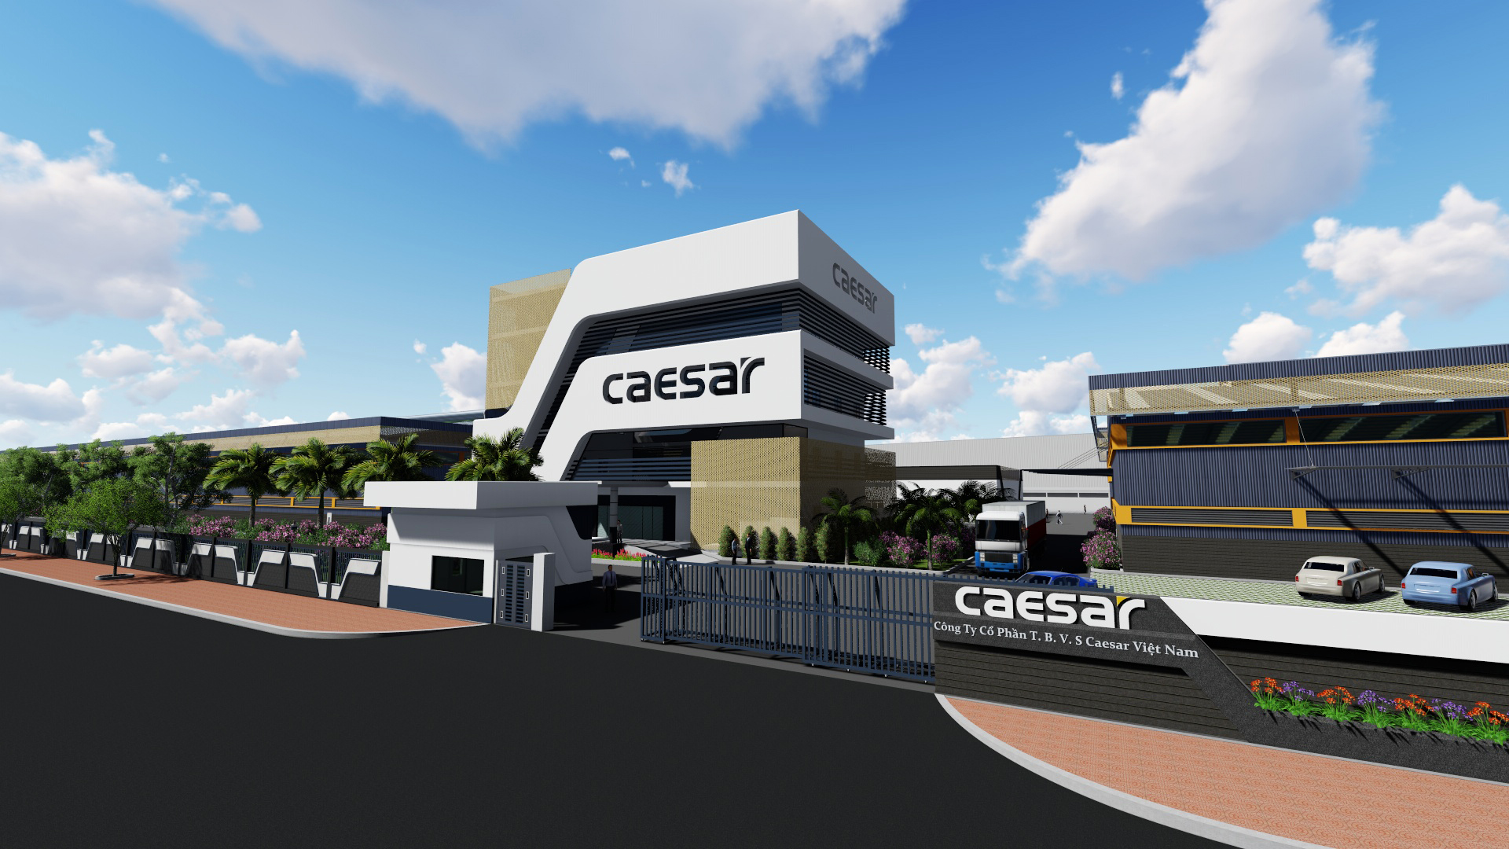
New Faucet/Cabinet Production Plant

Slide 24
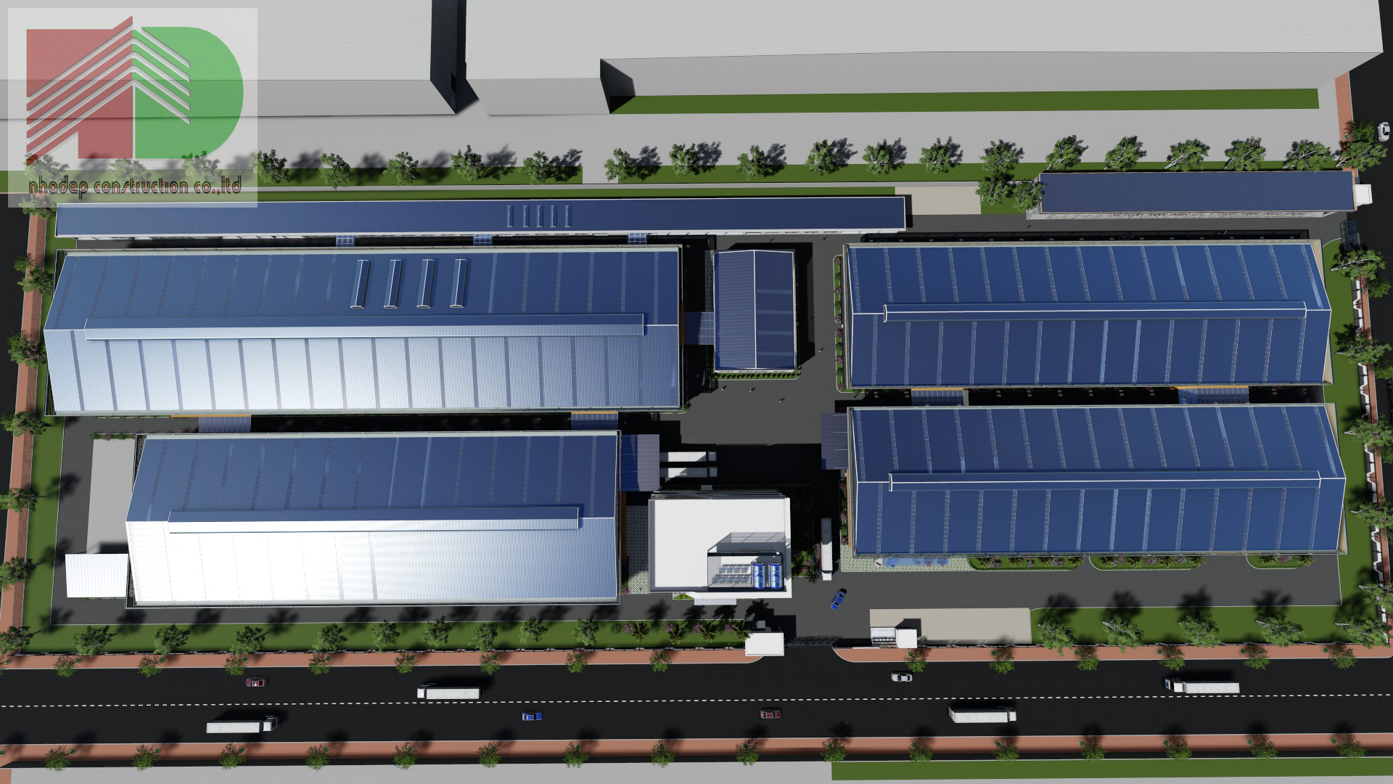
New Faucet/Cabinet Production Plant

Slide 25
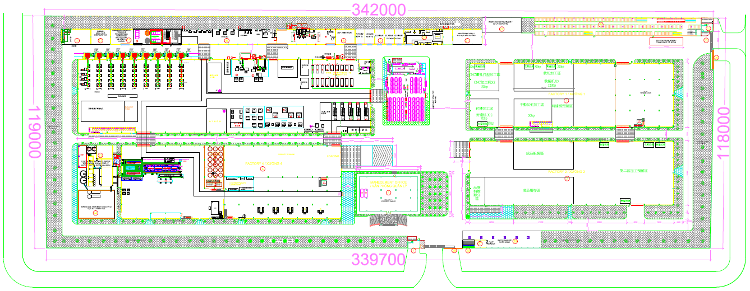
New Faucet/Cabinet Production Plant

Slide 26
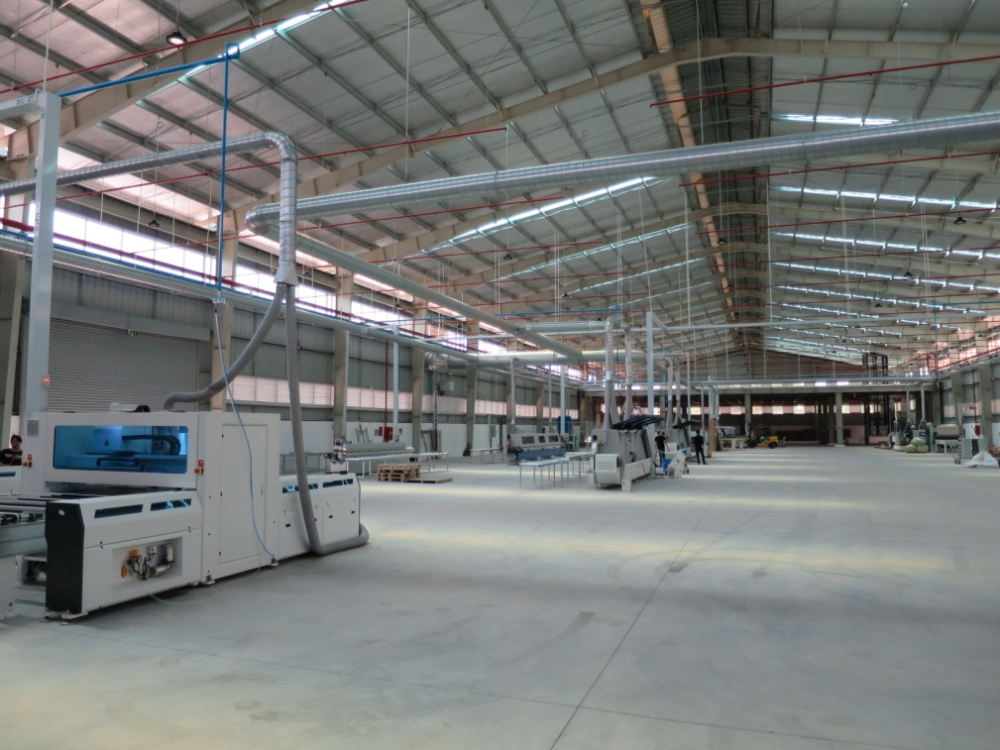
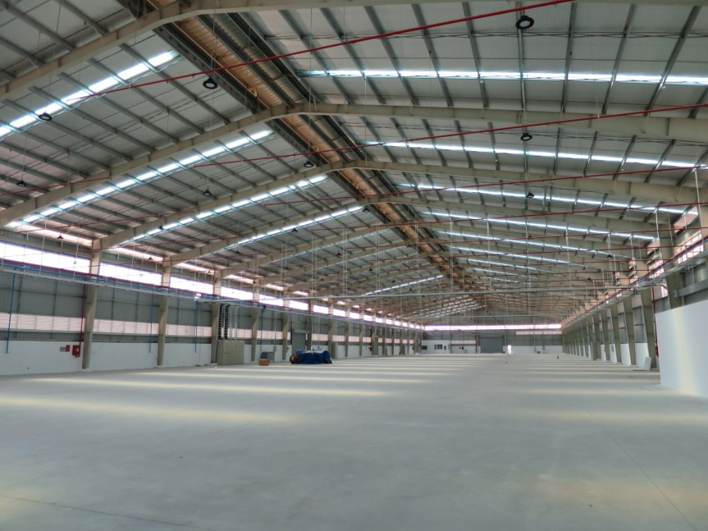
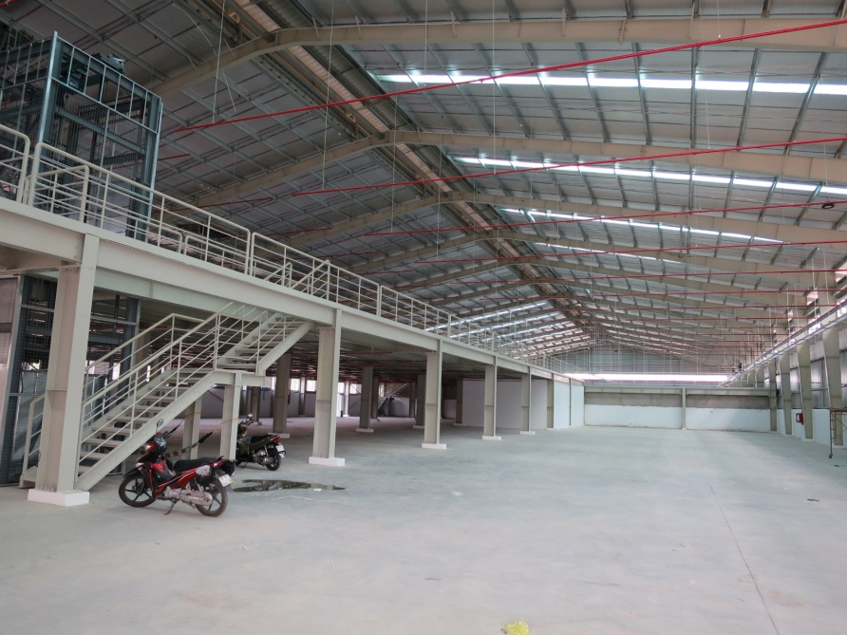
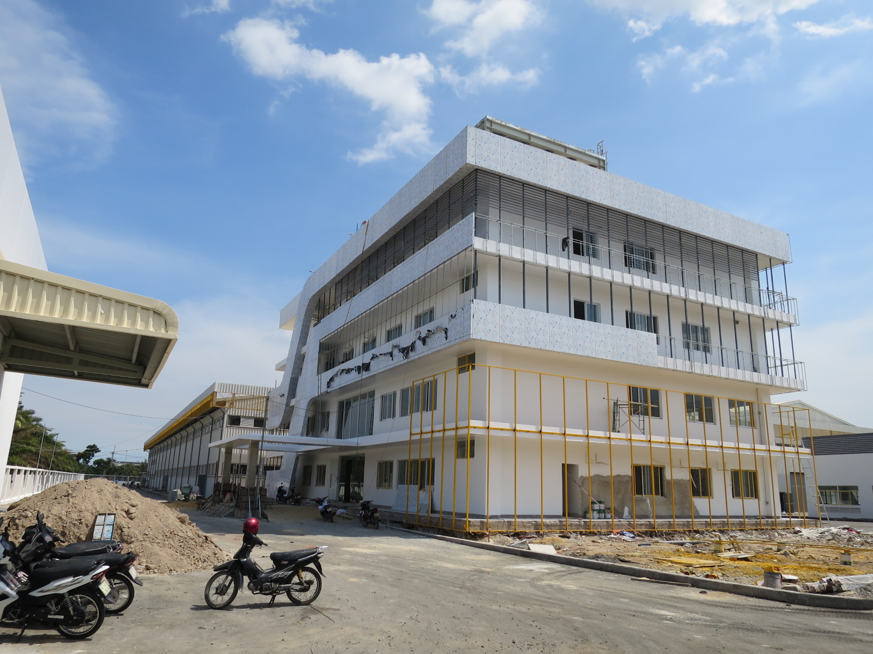
New Faucet/Cabinet Production Plant

Slide 27
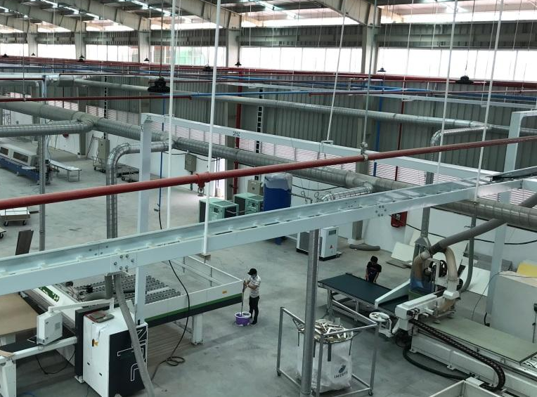
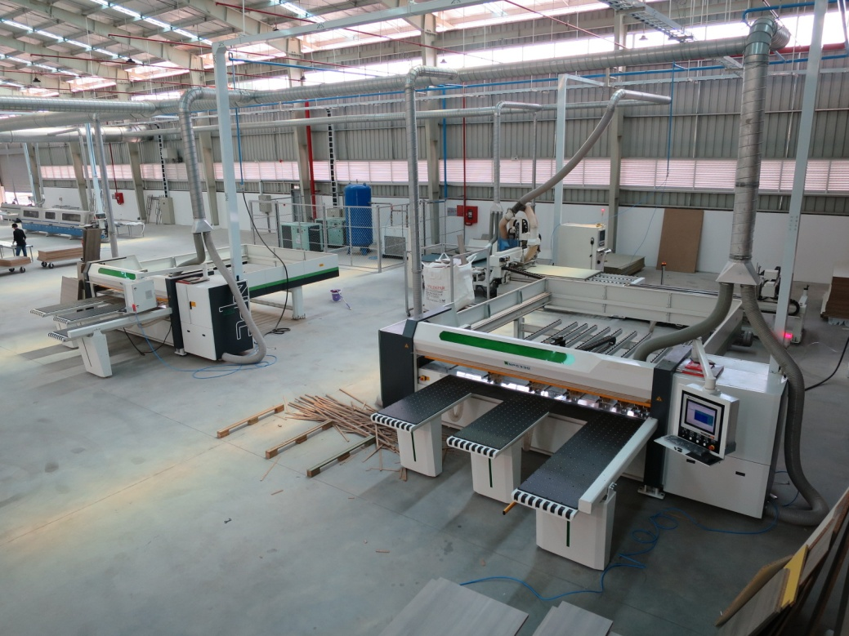
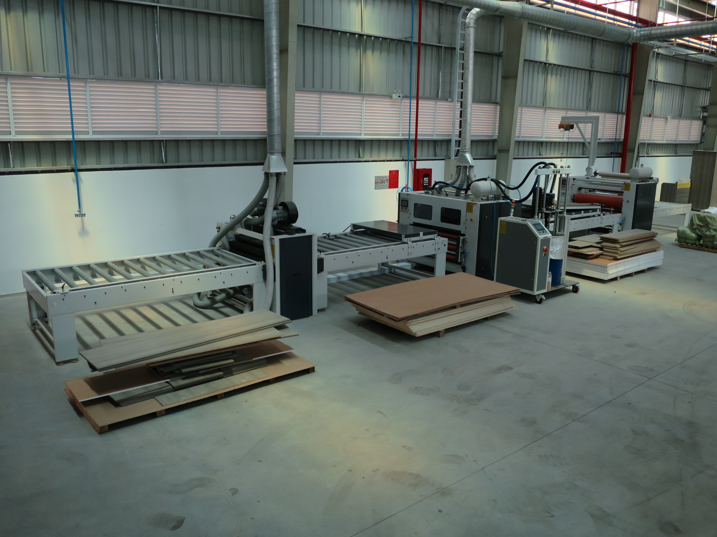
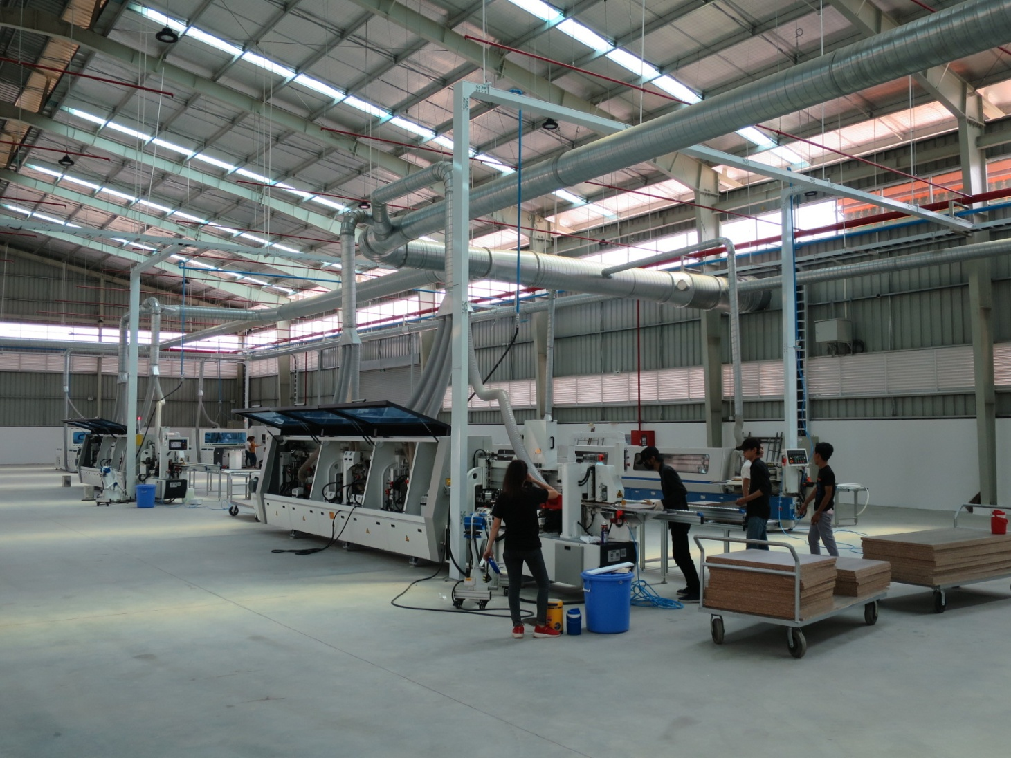
New Faucet/Cabinet Production Plant

Slide 28
New Product Launch

Slide 29
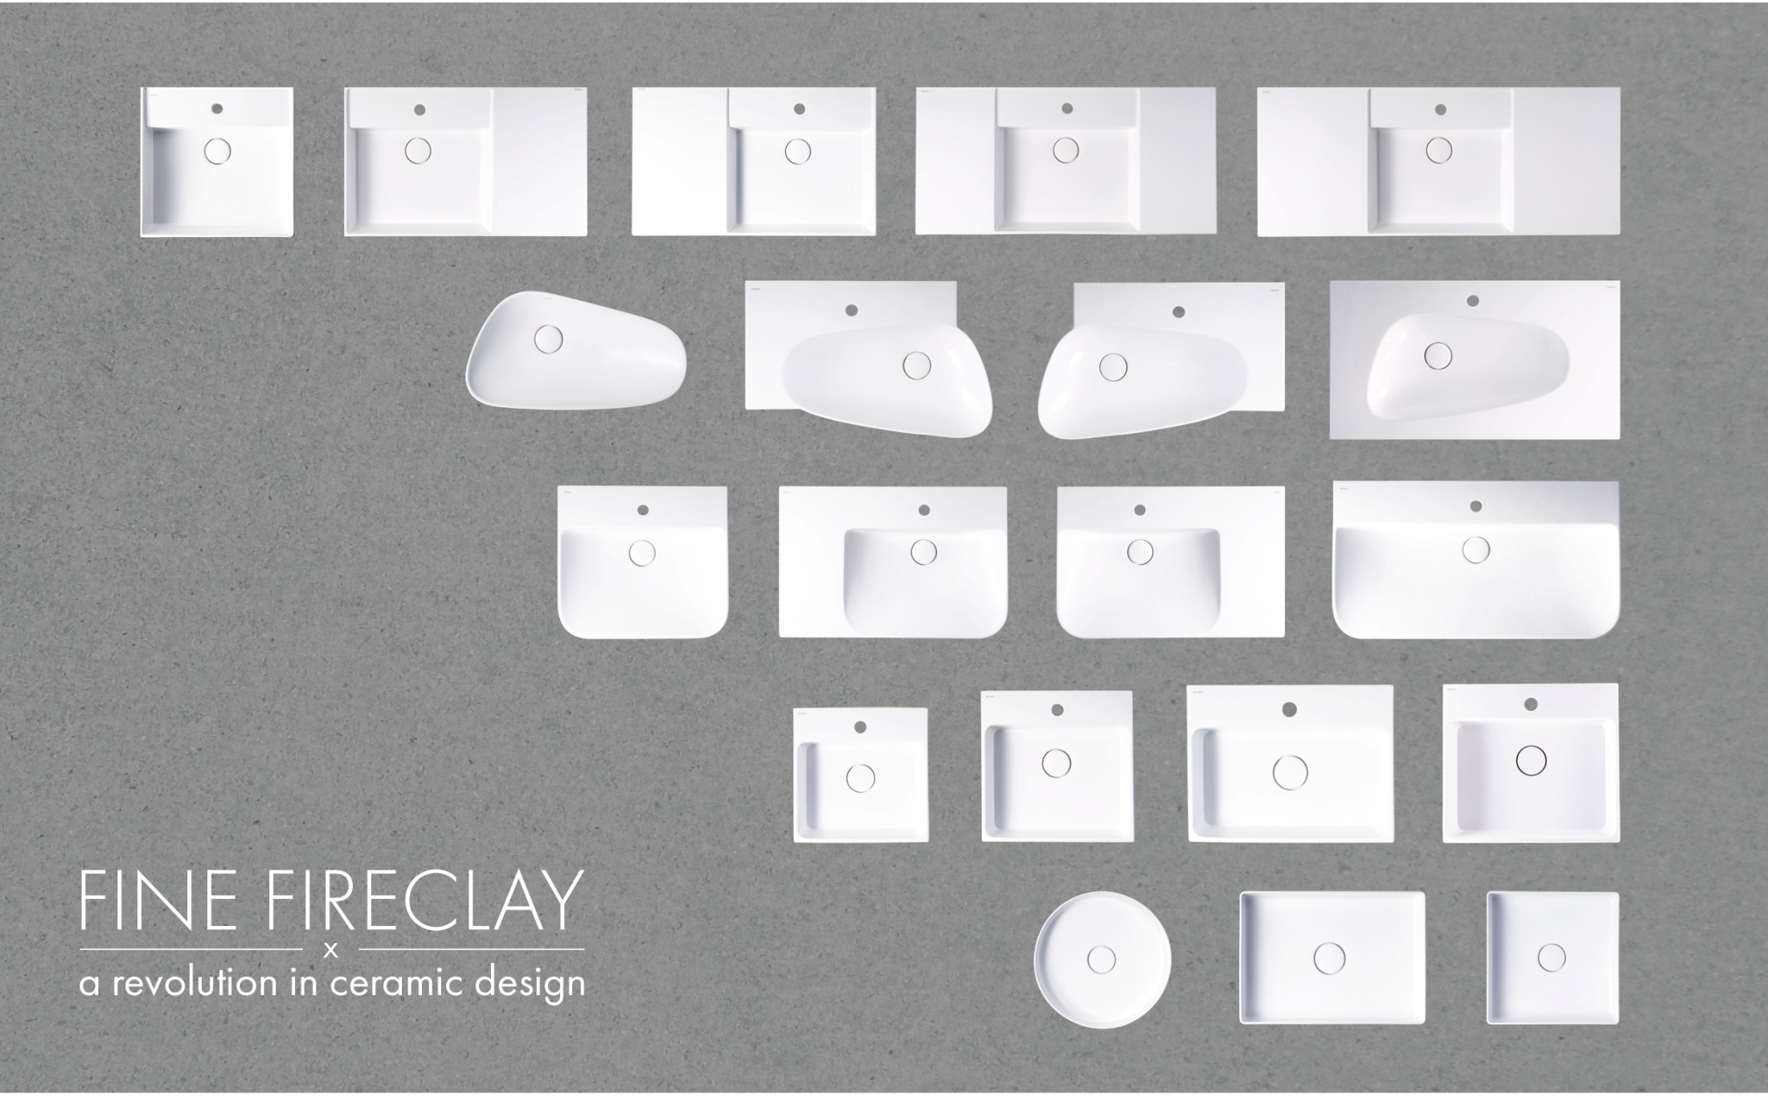
Enhancing Brand Value through Design-Lavatory
Lavatory X Cabinets

Slide 30
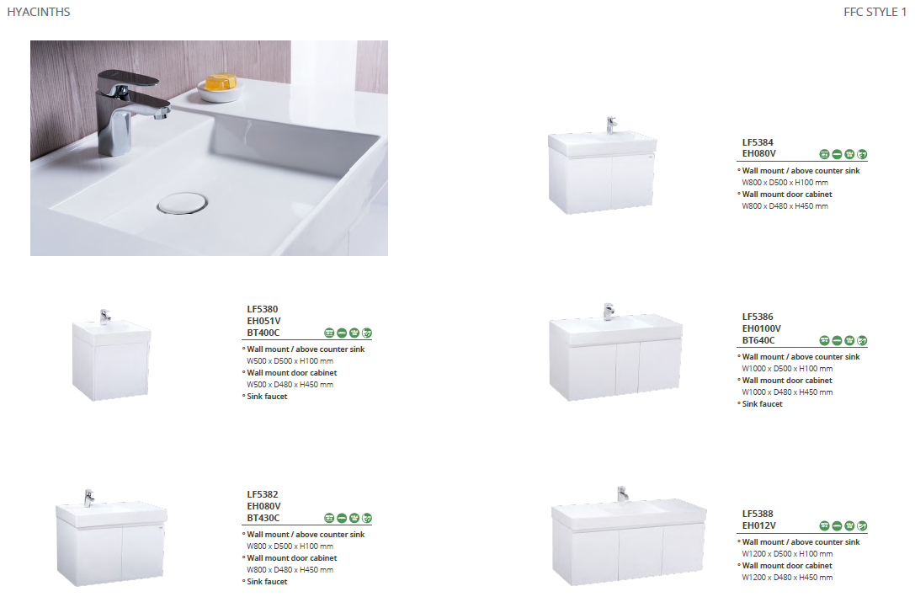

Style 1

Slide 31
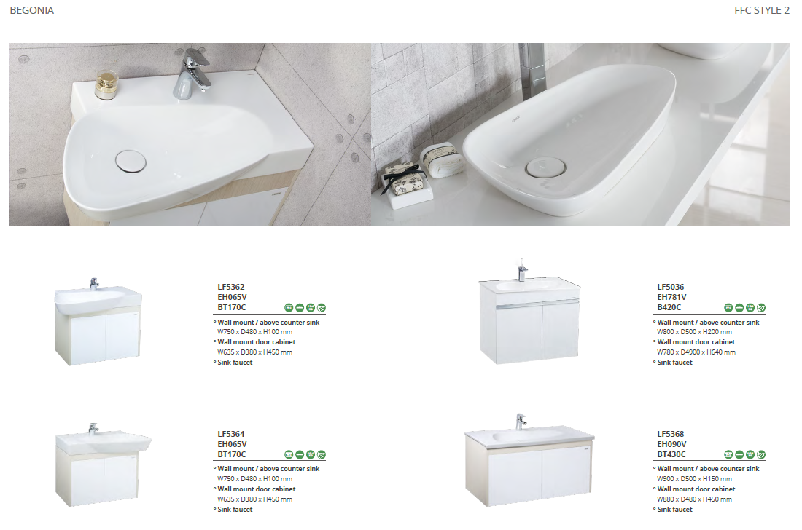

Style 2

Slide 32
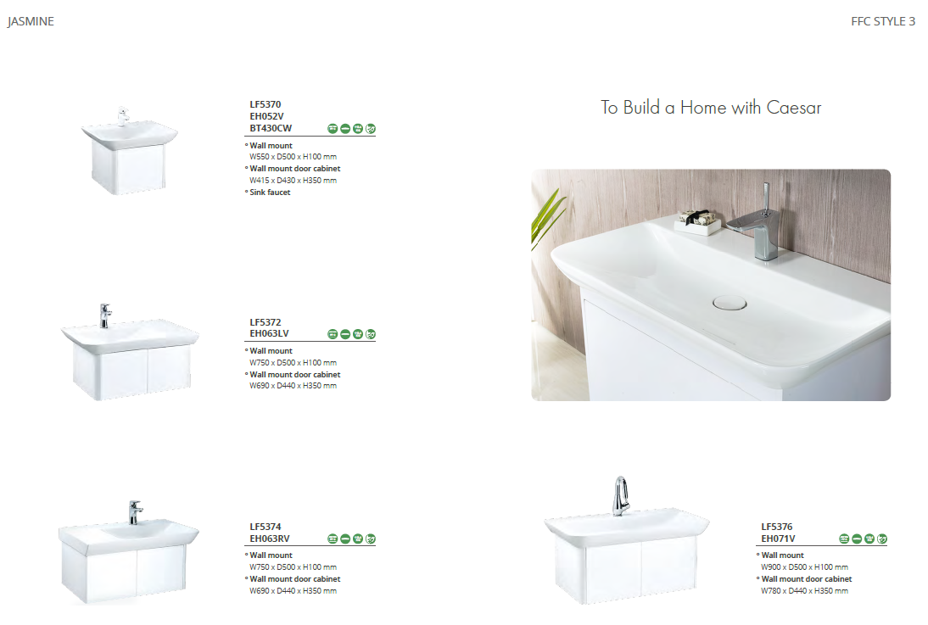

Style 3

Slide 33
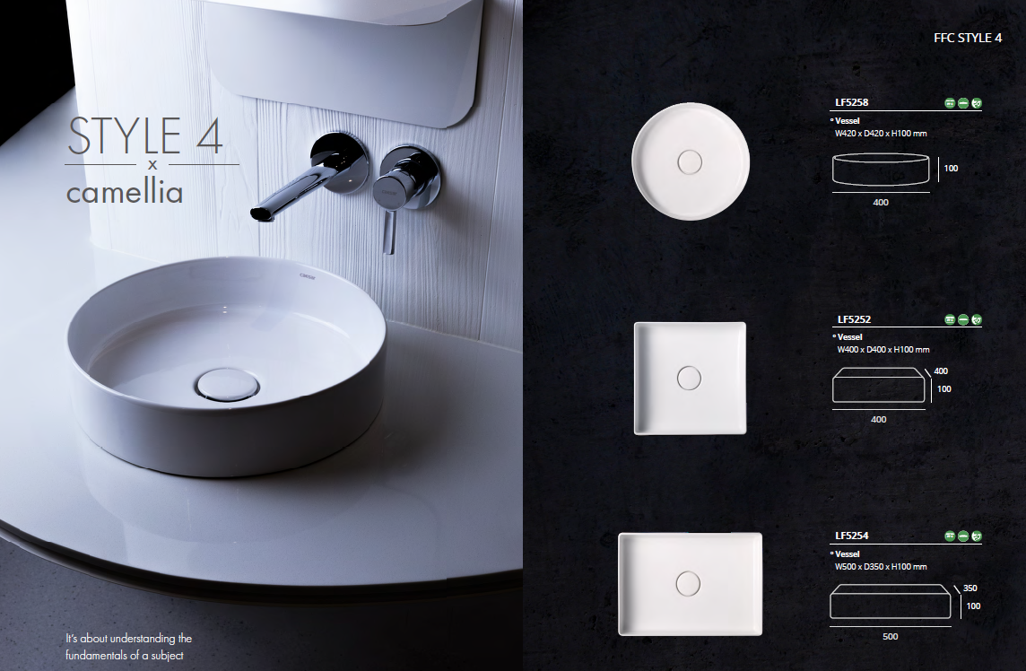

Style 4

Slide 34
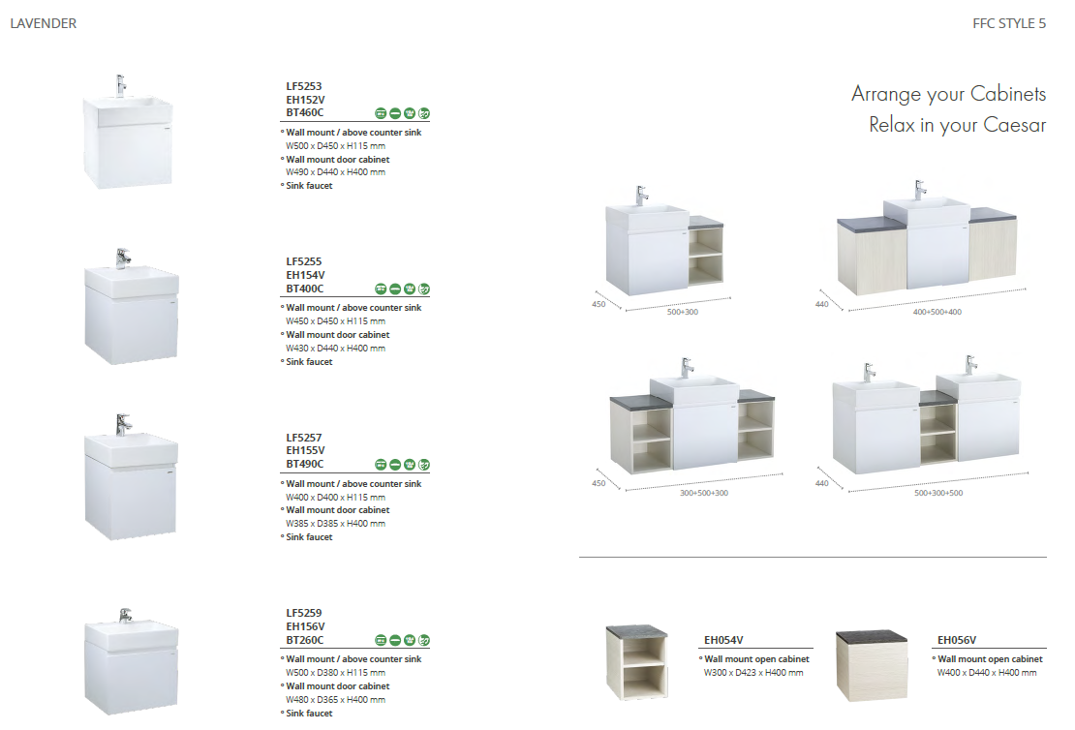

Style 5

Slide 35
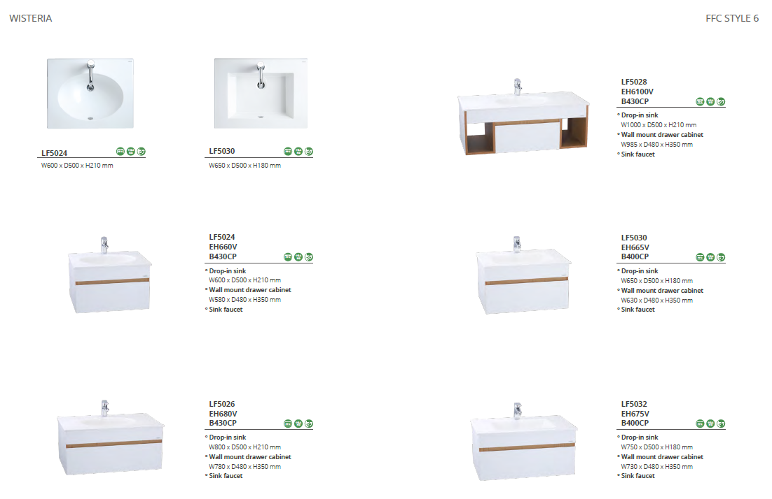

Style 6

Slide 36
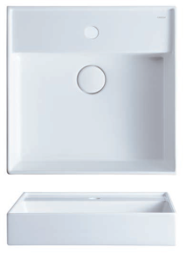
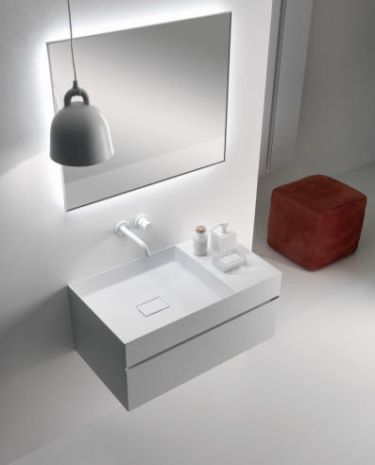
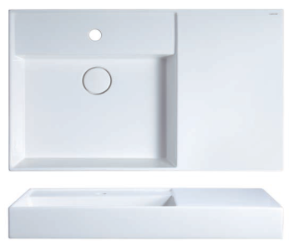
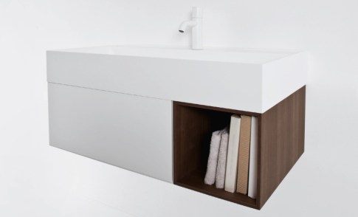
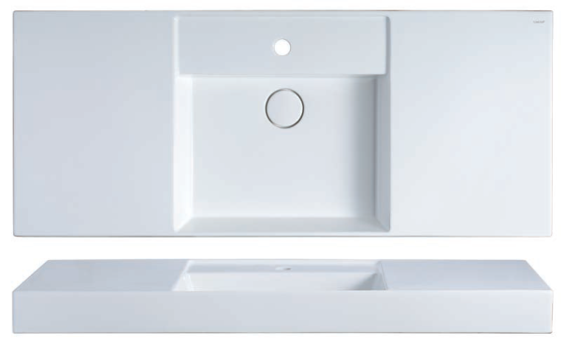
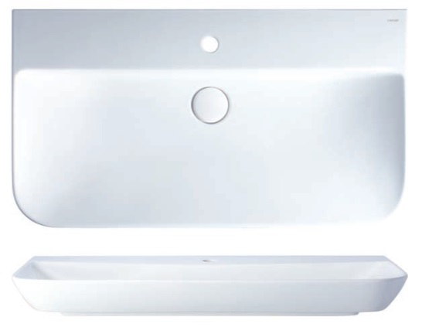

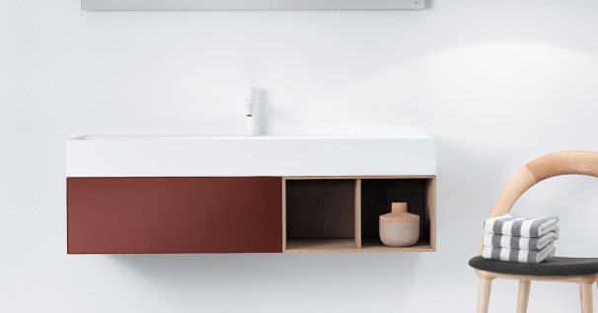
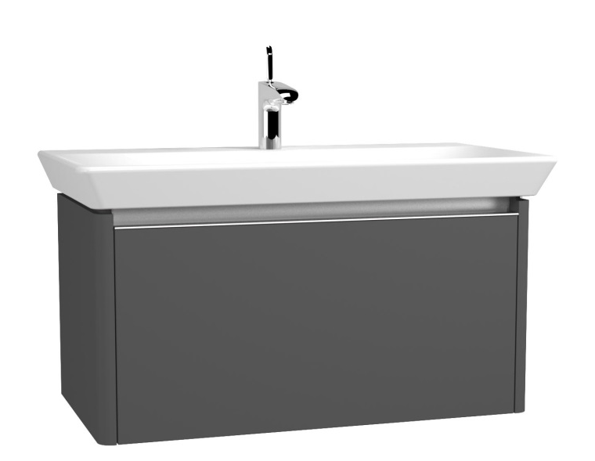
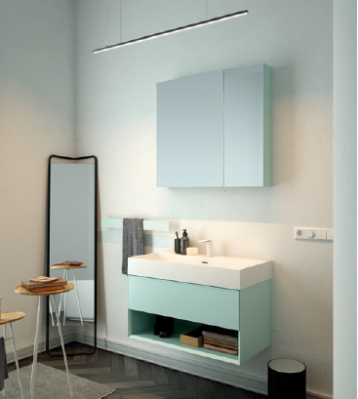
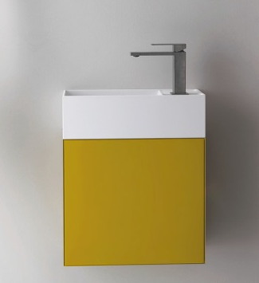
Lavatory X Cabinets

Slide 37
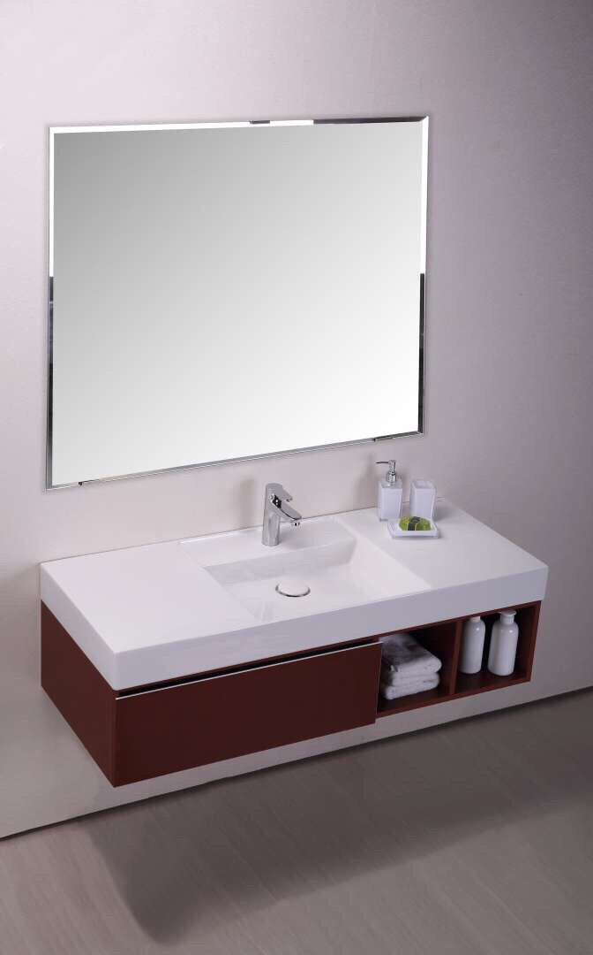
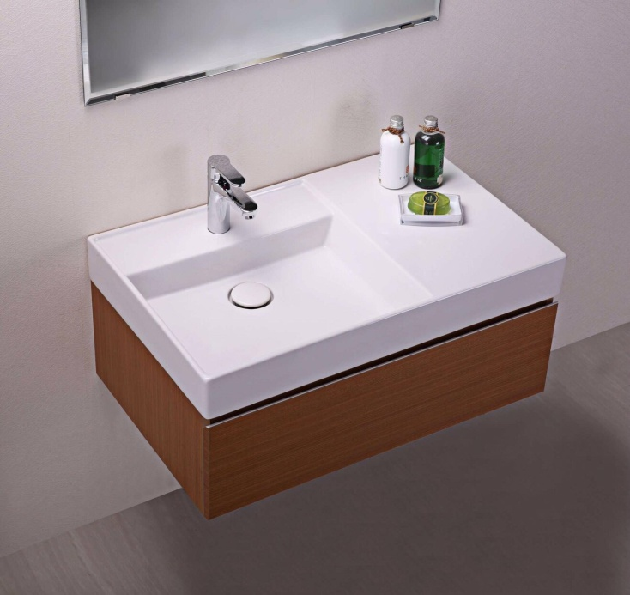
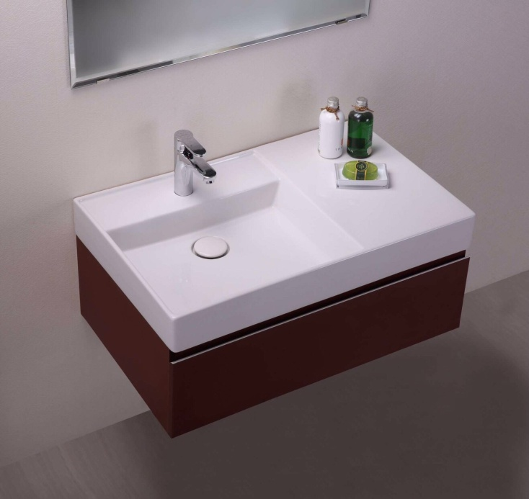
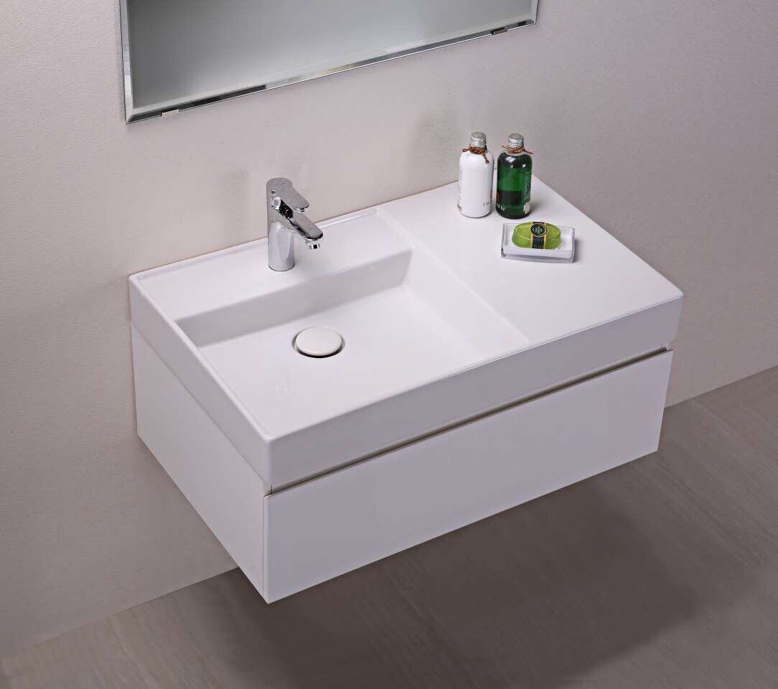
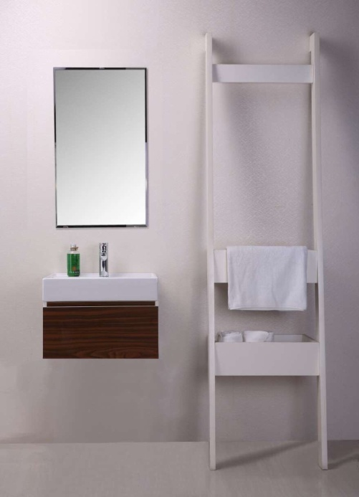
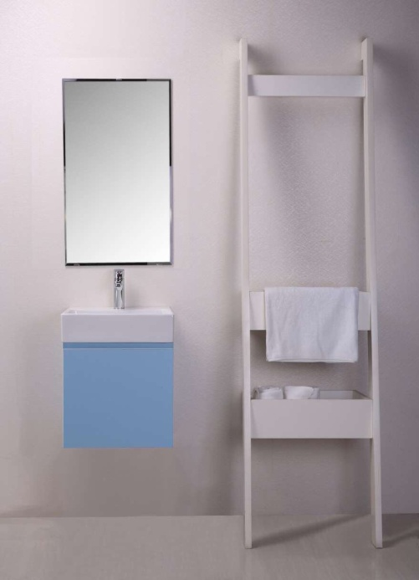
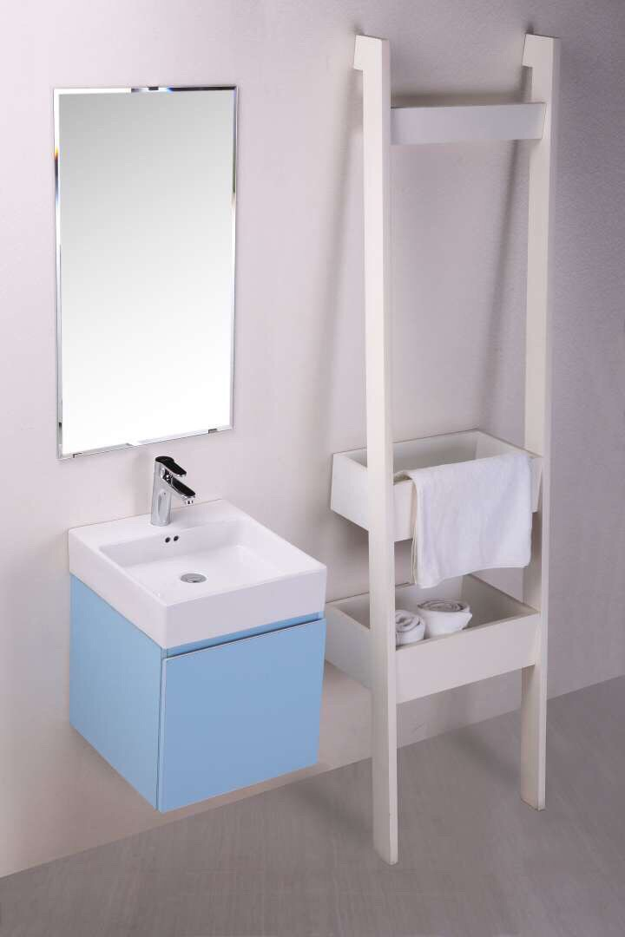
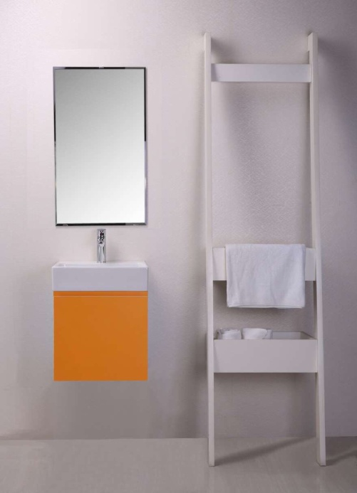
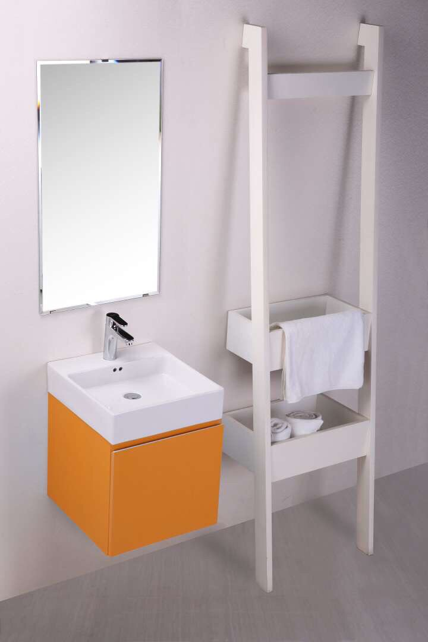
Lavatory X Cabinets

Slide 38
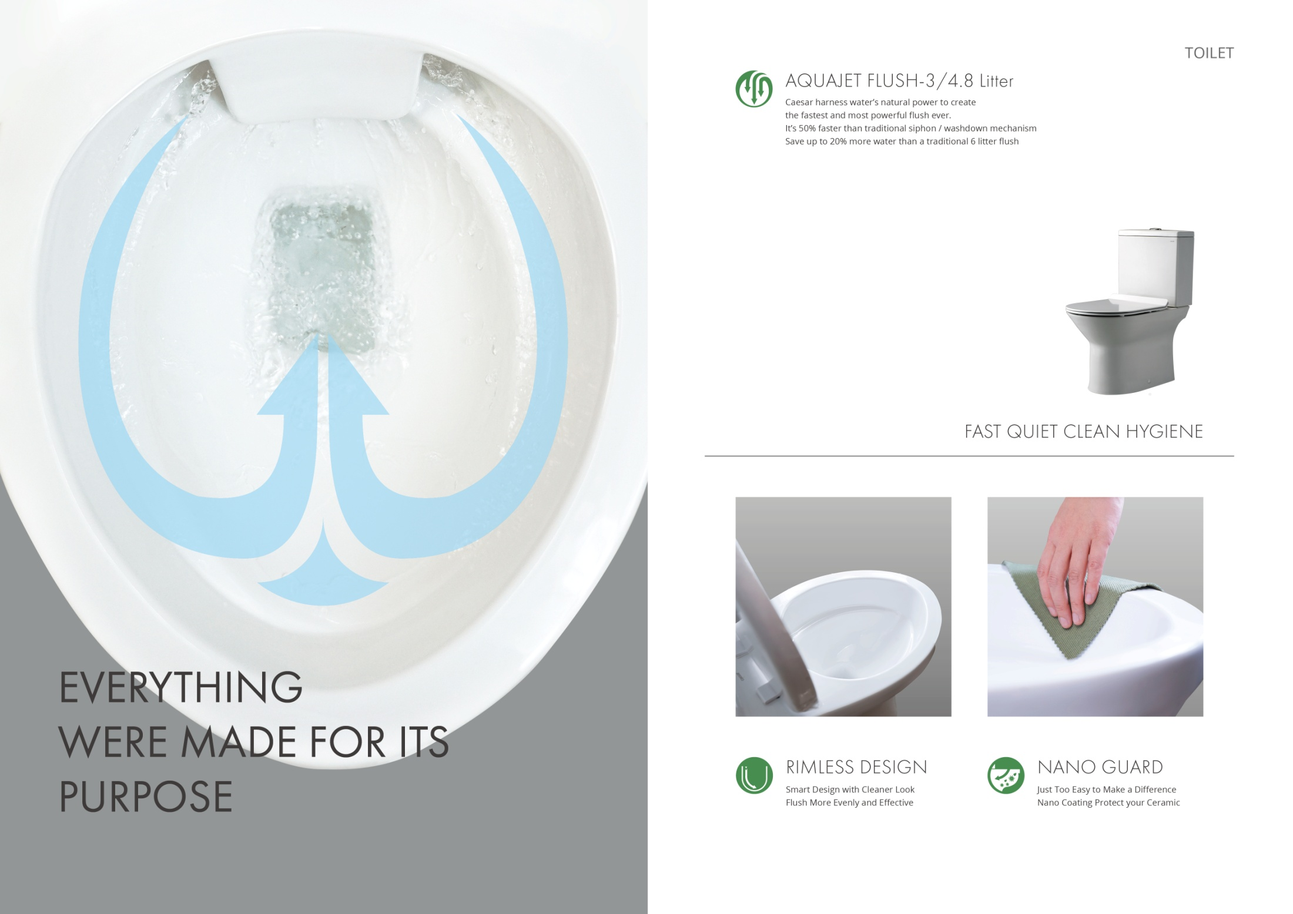
Aqua Jet Flush Technology

Slide 39


Urinal Collections~Intelligent Urinal

Slide 40

Urinal Collections

Slide 41

Urinal Collections

Slide 42
Strategic Partnerships

Slide 43

Strategic Partnerships
Notes:
Other countries, including Japan, Korea, Malaysia, China, Philippines, Australia, Myanmar, Cambodia, USA, etc

Slide 44

Strategic Partnerships
Notes:
Other countries, including Japan, Korea, Malaysia, China, Philippines, Australia, Myanmar, Cambodia, USA, etc

Slide 45

2019 KBC Joint Exhibition
Notes:
Other countries, including Japan, Korea, Malaysia, China, Philippines, Australia, Myanmar, Cambodia, USA, etc

Slide 46

2019 KBC Joint Exhibition
Notes:
Other countries, including Japan, Korea, Malaysia, China, Philippines, Australia, Myanmar, Cambodia, USA, etc

Slide 47

2019 KBC Joint Exhibition
Notes:
Other countries, including Japan, Korea, Malaysia, China, Philippines, Australia, Myanmar, Cambodia, USA, etc

Slide 48

2019 KBC Joint Exhibition
Notes:
Other countries, including Japan, Korea, Malaysia, China, Philippines, Australia, Myanmar, Cambodia, USA, etc

Slide 49

2019 KBC Joint Exhibition
Notes:
Other countries, including Japan, Korea, Malaysia, China, Philippines, Australia, Myanmar, Cambodia, USA, etc

Slide 50

2019 KBC Joint Exhibition
Notes:
Other countries, including Japan, Korea, Malaysia, China, Philippines, Australia, Myanmar, Cambodia, USA, etc

Slide 51

Q&A
Headquarters: 7F, No.111-8, XingDe Rd, SanChong Dist., New Taipei City, 241, Taiwan
http://www.caesar.com.tw
Notes:
Other countries, including Japan, Korea, Malaysia, China, Philippines, Australia, Myanmar, Cambodia, USA, etc

