Slide 1

Quintain Steel Co.,LTD
03/24/2026

Slide 2
•Company Overview
•Financial Review
•Future Developing Direction

Slide 3

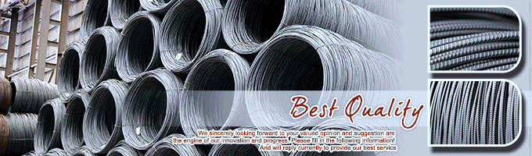

Company Overview
Established:1973
Regional Bases
Head office
Yung-Kung Plant
Ma-Tou Plant
Kuan-Tien Plant
Employee:about300

Slide 4
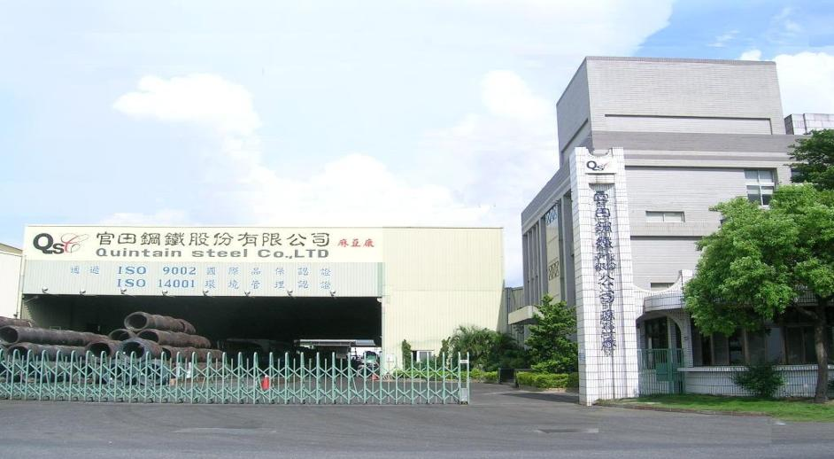
Ma-TouPlant
●Establishment:1989
●Employee:130
●Area:34,637m²
●AnnualCapacity:
120,000MT/Year
4

Slide 5
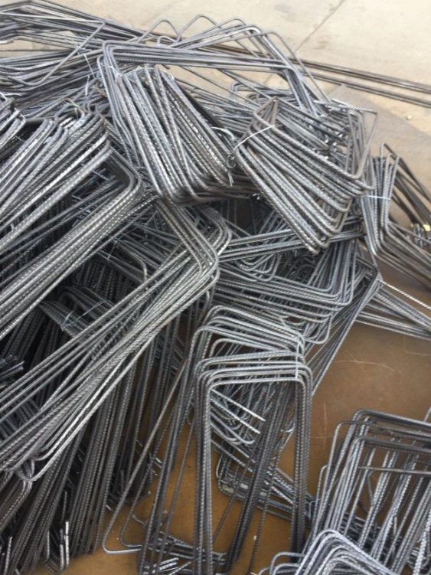
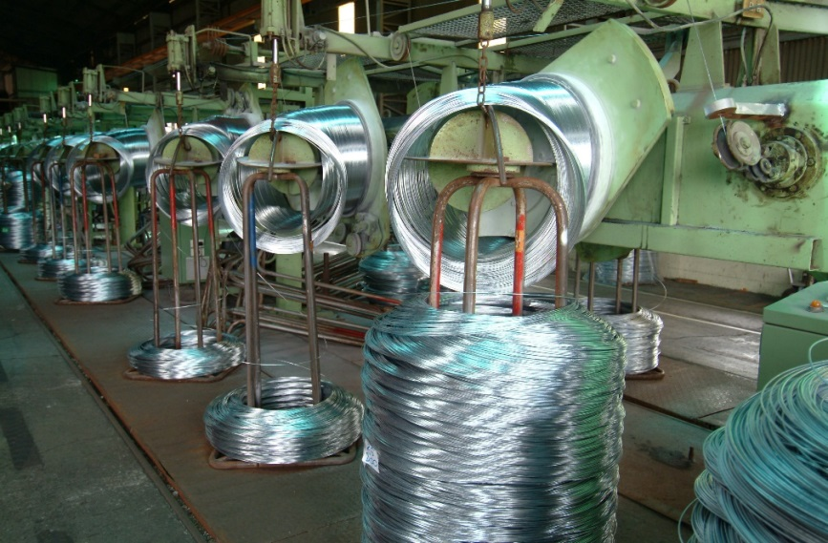
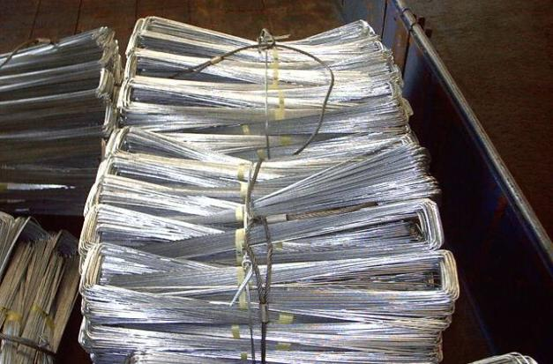
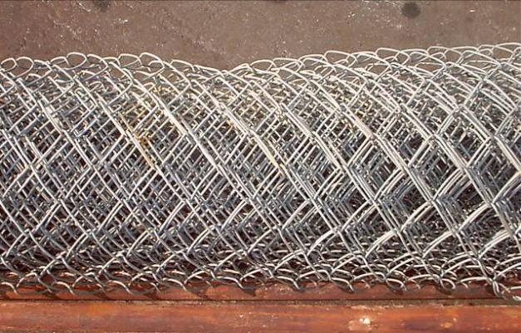
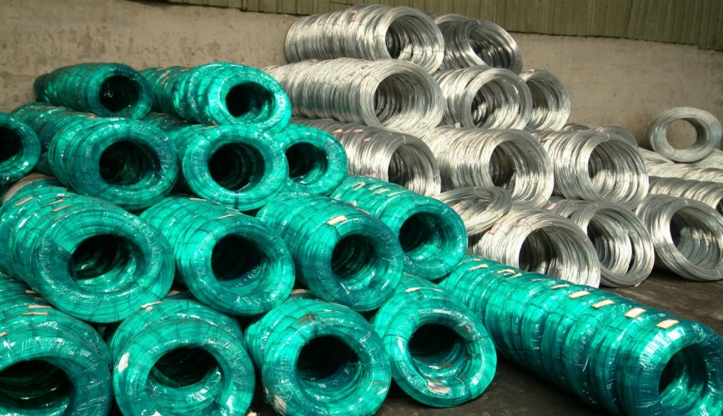
Product(Ma-TouPlant)
ApplicationProducts
HotDippedGalvanizedWire
5

Slide 6
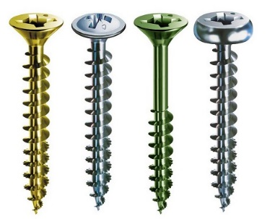
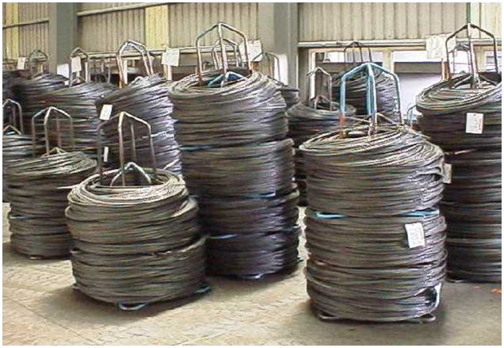
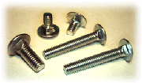
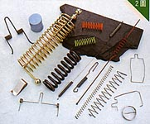
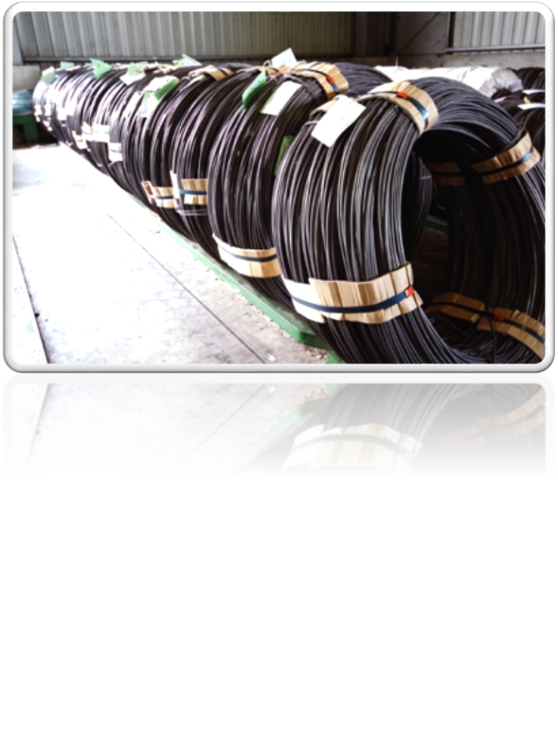
Product(Ma-TouPlant)
ApplicationProducts
SpheroidizeAnnealedWire
6

Slide 7
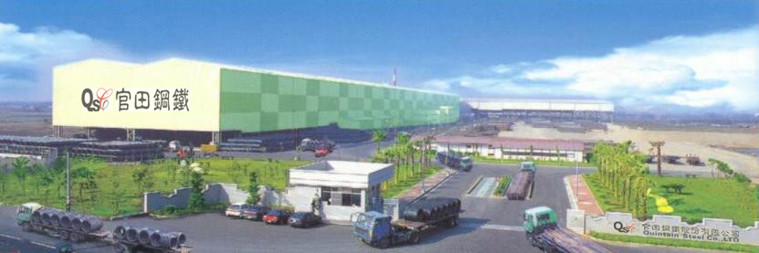
Kuan-TienPlant
●Establishment:1995
●Employee:100
●Area:237,292m²
●AnnualCapacity:
400,000MT/Year
7

Slide 8
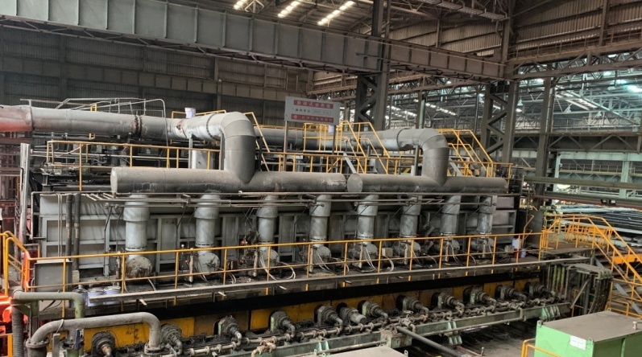
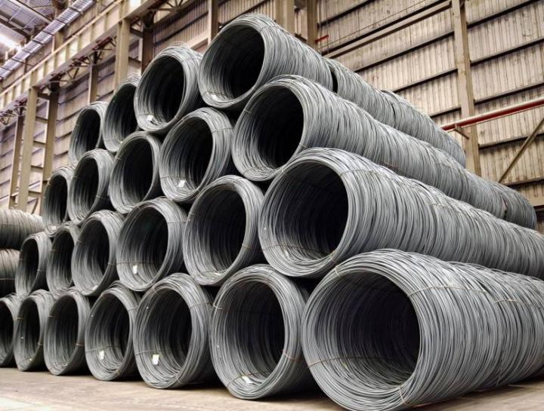
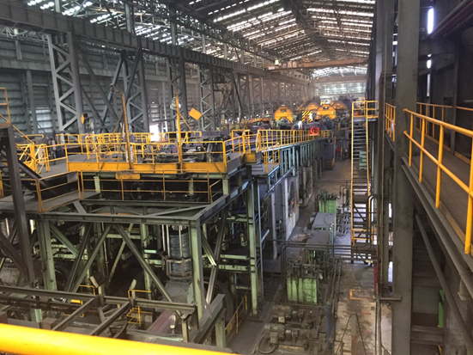
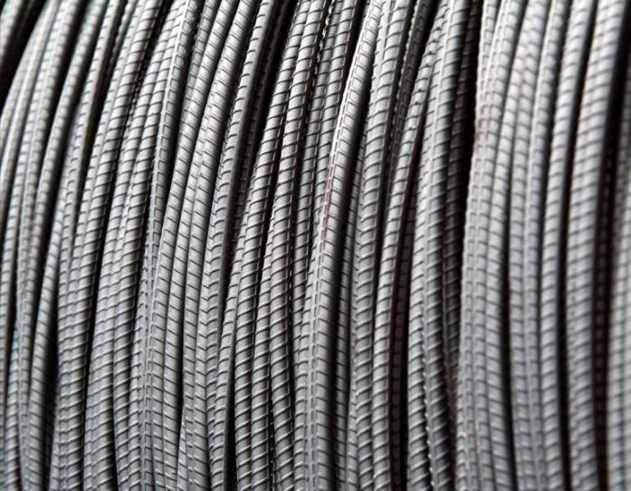
Product(Kuan-TienPlant)
HotRolledWire
HotRolledSteelWireRod
DeformedBarCoil
8

Slide 9
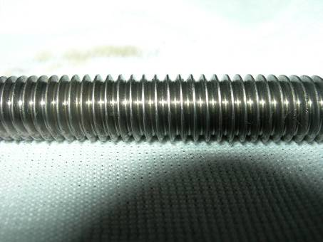
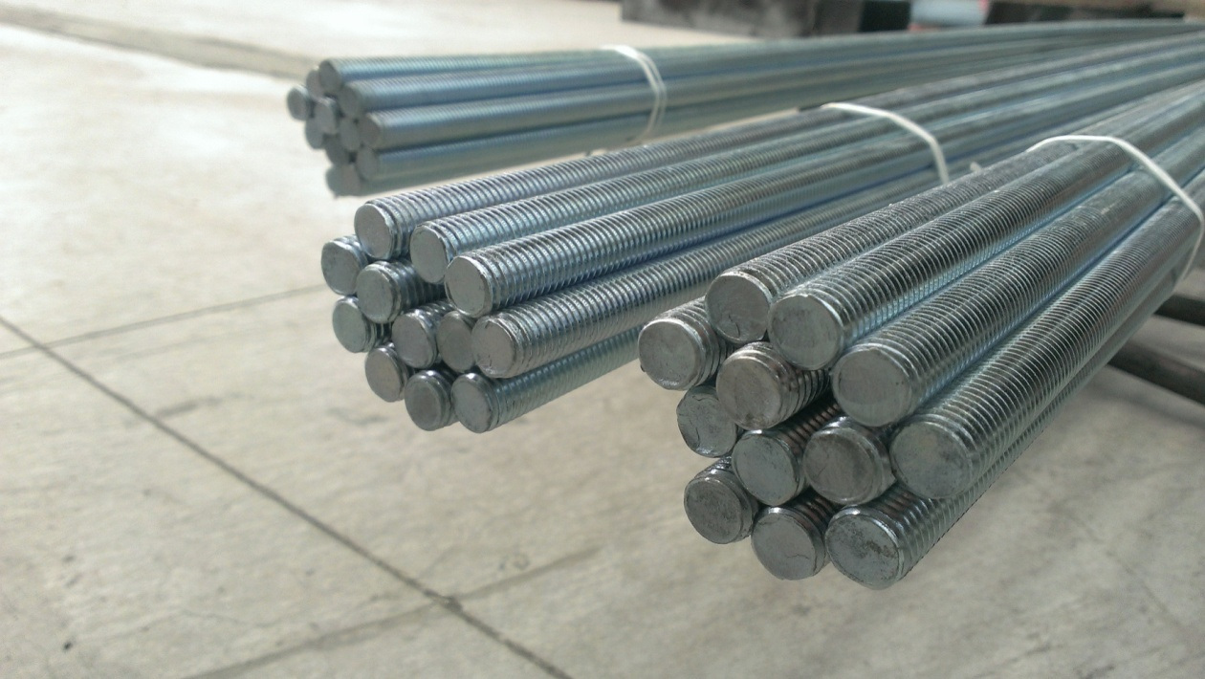
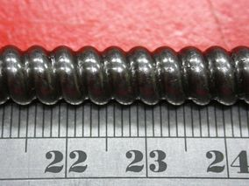
Product(Kuan-TienPlant)
v-threadRod
ProducingThreadedRod
ballthreadRod

Slide 10
PlantProductAssociationGraph
Kuan-Tien Plant: WireRod
Spheridized Wire
HardDrawingWire
MetalPlasticProcessingPlant
AllThreadRod
Ma-TouPlant
Screws
BlackWire
AnnealedWire
GalvanizedWire
HeatTreatment

Slide 11
ManagementConcept
Thanksgiving
Honesty
ProfitSharing
KnowledgeInnovation

Slide 12
Financial Review

Slide 13
Consolidated Balance Sheets(Unaudited) |  |  | Unit: NT$ thousands
 | December 31, 2025 |  | December 31, 2024
 | Amount | % | Amount | %
Current assets | 3,983,505 | 29 | 4,257,120 | 32
Non-current assets | 9,668,579 | 71 | 8,979,129 | 68
Total Assets | 13,652,084 | 100 | 13,236,249 | 100
Current liabilities | 3,733,834 | 27 | 3,577,094 | 27
Non-current liabilities | 3,486,456 | 26 | 2,658,761 | 20
Total Liabilities | 7,220,290 | 53 | 6,235,855 | 47
Total Equity | 6,431,794 | 47 | 7,000,394 | 53

Slide 14
Consolidated Statements of Comprehensive Income(Unaudited) |  |  | Unit: NT$ thousands
 | 2025 Q4 |  | 2024 Q4
 | Amount | % | Amount | %
Revenue | 2,734,198 | 100 | 3,281,159 | 100
Gross profit | 11,980 | 0 | 175,836 | 5
Operating income | -402,736 | -15 | -236,272 | -7
Profit before tax | -302,576 | -11 | 176,737 | 5
Profit | -300,314 | -11 | 164,213 | 5
Other comprehensive income | -537,077 | -20 | -225,663 | -7

Slide 16
Future Developing Direction

Slide 17
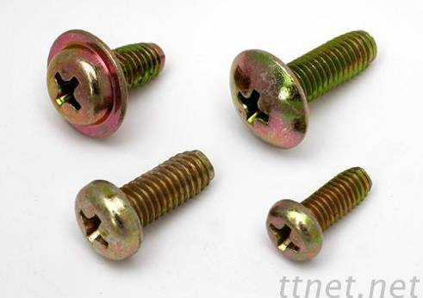
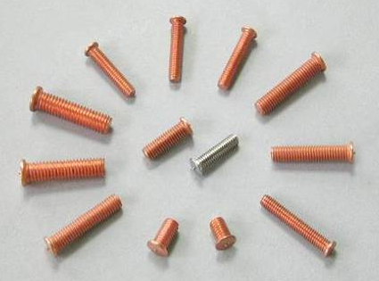
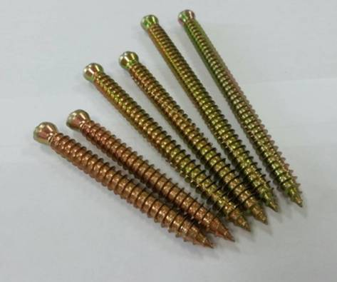
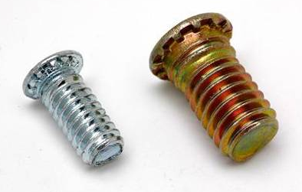
Establish our foundation-Greating a Screw Plant

Slide 18
THANKS FOR YOUR LISTENING

