Slide 1
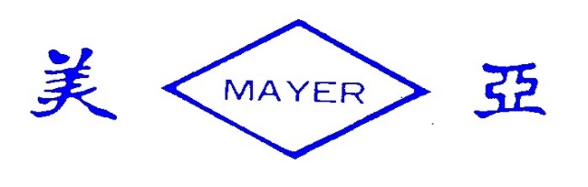
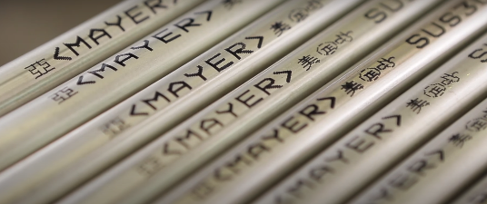
Mayer Steel Pipe Corporation
Investor Conference
2023.6 .8

Slide 2
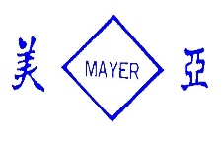
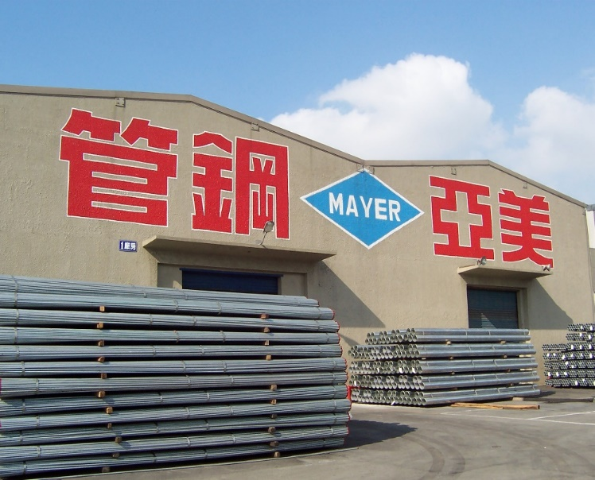
Outline：
Business Outlook
Operational Overview
ESG work report
Financial Overview
美亞鋼管廠股份有限公司
MAYER STEEL PIPE CORPORATION

Slide 3
Safe Harbor Statement
This presentation may contains forward-looking statements. All statements other than historical and current fact, without limitation, including business outlook, predictions, estimates, are forward-looking statements.
Such statements are based upon management’s current beliefs and expectations and are subject to various risks, uncertainties and other factors that could cause actual outcomes and results to differ materially.
We caution readers not to place undue reliance on forward-looking statements as these statements speak only as of the date they are made, and we disclaim any obligation to, update or alter any forward-looking statements, whether as a result of new information, future events or otherwise, except as required by applicable law or regulation.
This cautionary statement is applicable to all forward-looking statements contained in this presentation.
美亞鋼管廠股份有限公司
MAYER STEEL PIPE CORPORATION

Slide 4
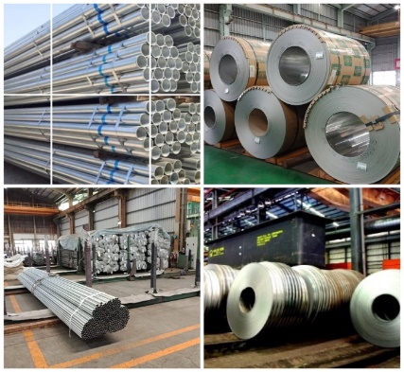
Business Outlook
The external competitive environment, regulatory environment, and general economic environment
The impact of high-inflation, high-interest and deglobalization.
The impact of China's steel industry on global steel prices
Global steel supply remains at overcapacity.
The importance of carbon neutrality is increasing.
International economic and trade integration is crowded out.
Economic uncertainty from geopolitical risks.
美亞鋼管廠股份有限公司
MAYER STEEL PIPE CORPORATION

Slide 5
Operation Overview
Production and sales volume in the last two years：
Unit : Ton / NTD Thousand
Year Department | 2023Q1 |  | 2022Q1 |  | 2022 |  | 2021
 | Output | Output value | Output | Output value | Output | Output value | Output | Output value
Steel department | 21,371 | 830,758 | 23,346 | 1,121,393 | 91,662 | 4,301,768 | 111,347 | 4,347,133
Year Department | 2023Q1 |  | 2022Q1 |  | 2022 |  | 2021
 | Sales volume | Sales value | Sales volume | Sales value | Sales volume | Sales value | Sales volume | Sales value
Steel | 30,330 | 1,619,178 | 29,680 | 1,598,834 | 121,103 | 6,555,002 | 134,742 | 6,515,200
Investment | 0 | 0 | 0 | 0 | 1,506 | 0 | 2,720 | 0
Hotel service | 32,100 | 0 | 12,477 | 0 | 67,837 | 0 | 40,698 | 0
Total | 1,651,278 | 7,308 | 1,611,311 | 7,308 | 6,624,345 | 11,128 | 6,558,618 | 11,128
美亞鋼管廠股份有限公司
MAYER STEEL PIPE CORPORATION

Slide 6
Operation Overview
Sales region of major commodities：
Unit : Ton / NTD Thousand
Region | 2023/1/1 To 2023/3/31 |  | 2022/1/1 To 2022/3/31 |  | 2022 |  | 2021
 | Net sales | Proportion (%) | Net sales | Proportion (%) | Net sales | Proportion (%) | Net sales | Proportion (%)
Taiwan | 1,546,620 | 93.66 | 1,499,164 | 93.04 | 6,132,730 | 92.58 | 6,027,298 | 91.90
Vietnam | 57,692 | 3.49 | 65,531 | 4.07 | 316,572 | 4.78 | 314,340 | 4.79
Thailand | 31,082 | 1.88 | 39,761 | 2.47 | 133,250 | 2.01 | 172,489 | 2.63
Other | 15,884 | 0.97 | 6,855 | 0.42 | 41,793 | 0.63 | 44,491 | 0.68
Total | 1,651,278 | 100 | 1,611,311 | 100 | 6,624,345 | 100 | 6,558,618 | 100
美亞鋼管廠股份有限公司
MAYER STEEL PIPE CORPORATION

Slide 7

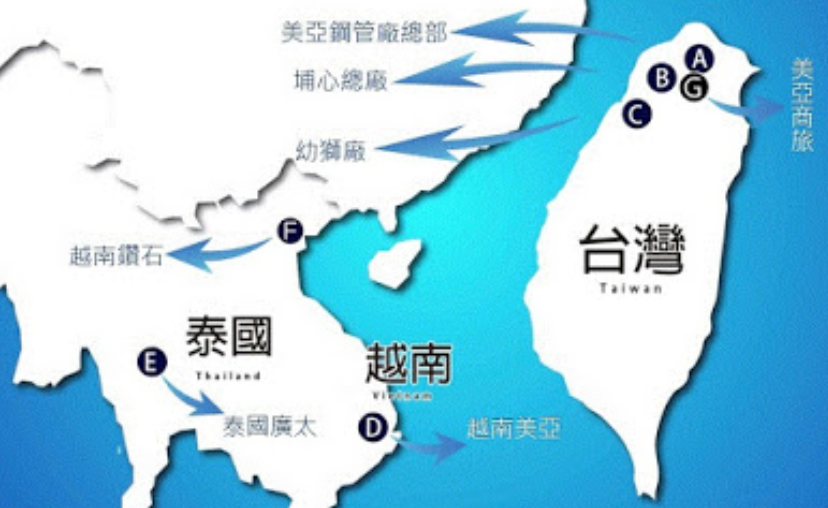

Operation Overview
Main Business Locations
公司總部
埔心總廠
幼獅廠
越南鑽石
Taiwan
G
台南 崙金
Vietnam
泰國廣太
越南美亞
美亞鋼管廠股份有限公司
MAYER STEEL PIPE CORPORATION

Slide 8
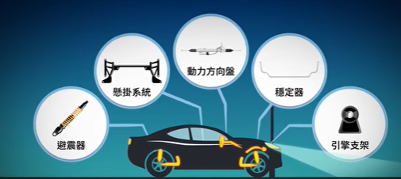
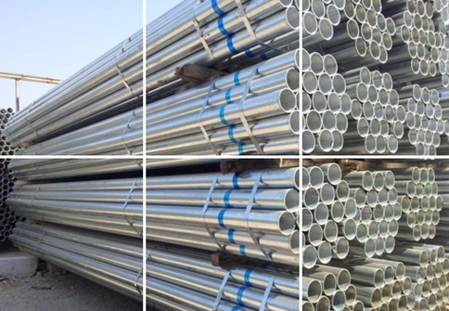
Operation Overview
Future Market Development
Price instability in steel will impact downstream processing and marketing.
Carbon Steel Products
The demand for pipe fittings for construction
projects will not decrease.
The demand for pipe fittings for machining
is slowly recovering.
美亞鋼管廠股份有限公司
MAYER STEEL PIPE CORPORATION

Slide 9
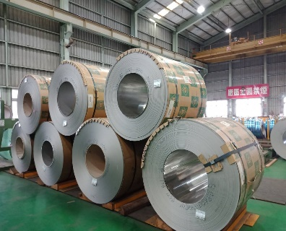
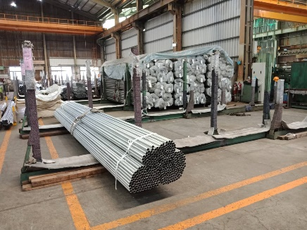
Operation Overview
Future Market Development
Stainless Steel Products
The huge fluctuation in cost of raw materials has
not stabilized.
Declining export demand impacts domestic sales and price.
Supply is greater than demand, making the
structure hard to ameliorate.
美亞鋼管廠股份有限公司
MAYER STEEL PIPE CORPORATION

Slide 10
Operation Overview
Overseas business development：
Unit : Ton / NTD Thousand
 | 2023Q1 |  | 2022Q1 |  | 2022 |  | 2021
 | Sales volume (Ton) | Sales value (Thousand) | Sales volume (Ton) | Sales value (Thousand) | Sales volume (Ton) | Sales value (Thousand) | Sales volume (Ton) | Sales value (Thousand)
Vietnam Mayer | 1,544 | 61,012 | 1,793 | 69,992 | 8,441 | 337,994 | 9,332 | 350,154
Grand Tech | 2,030 | 134,460 | 2,122 | 124,707 | 7,653 | 471,998 | 8,094 | 454,022
Diamond Steel Tube | 2,940 | 161,859 | 3,483 | 203,454 | 14,080 | 836,397 | 12,698 | 698,600
美亞鋼管廠股份有限公司
MAYER STEEL PIPE CORPORATION

Slide 11
Operation Overview
Overseas business development:
美亞鋼管廠股份有限公司
MAYER STEEL PIPE CORPORATION

Slide 12




ESG work report
Greenhouse Gas: Complete the ISO 14064-1 greenhouse gas inventory.
Energy Management: Replace major machinery with high-frequency and transistor
equipment to achieve energy-saving efficiency.
3.Renewable Energy Generation: Install a self-owned photovoltaic (PV) power plant
and plan to increase the power generation capacity.
4.Water Source Environmental Protection: Install new types of wastewater treatment
equipment to achieve the goal of water purification.
Environmental
Social
1.Occupational Safety: Prioritize occupational safety by implementing personnel training and professional certification management.
2.Talent Retention and Development: Encourage employees to continuously learn, enhance themselves, and pursue on-the-job training.
3.Human Rights Emphasis: Foster a diverse and inclusive work environment that respects human rights and provides a friendly workplace.
Governance
1.Publish the first ESG sustainability report.
2.Actively promote corporate governance in line with government policies and integrate it
with ESG initiatives.
3.Scored 4.52 in the board performance evaluation for the fiscal year 111, indicating an
excellent performance.
美亞鋼管廠股份有限公司
MAYER STEEL PIPE CORPORATION

Slide 13
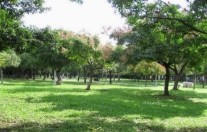
ESG work report
Promoting Green Energy ：In line with policies and social responsibilities, we have built PV power generators on the roofs of our plants.
Year | 2019 | 2020 | 2021 | 2022 | 2023 | Total
Estimated Capacity Installed (kW) | 962 | - | - | - | 341 | 1,303
Actual Capacity Installed(kW) | 962 | - | - | - | - | 962
Electricity Output (kwh) | 801,540 | 1,070,596 | 1,023,956 | 999,588 | 382,458 (as of May) | 4,278,138
As of May. 2023, the accumulated electricity output of solar power in
CSC group reached 4,278,138 kwh. Revenues from electricity sales
reached 22,476 thousand. Carbon reduction reached 2,178 tons,
equivalent to the CO2 absorption of 5.60 Taipei Daan Park.
* 5.60 座
* (Estimated based on the 2021 Taipower electricity carbon emission factor, 0.509 kg CO2e/kwh)
美亞鋼管廠股份有限公司
MAYER STEEL PIPE CORPORATION

Slide 14
Historical EPS and Dividends Paid
Financial Overview
Profitable year | 2019 | 2020 | 2021 | 2022 | 2023
EPS | 1.34 | 1.96 | 1.76 | 3.52 | 1.2
Cash Dividend in NTD per share | 1.40 | 1.85 | 1.70 | 3 | 1
Cash dividend allotment rate(%) | 104 | 94 | 97 | 85 | 83
美亞鋼管廠股份有限公司
MAYER STEEL PIPE CORPORATION

Slide 15
Consolidated Balance Sheet(Year)
Financial Overview
 | Current Assets | Total Assets | Current Liabilities | Total Liabilities | Equity attributable to Owners of the Company | Total Equity
2020.12.31 | 37 | 68 | 26 | 36 | 31 | 31
2021.12.31 | 49 | 81 | 35 | 45 | 36 | 36
2022.12.31 | 41 | 74 | 33 | 42 | 32 | 32
美亞鋼管廠股份有限公司
MAYER STEEL PIPE CORPORATION

Slide 16
Consolidated Balance Sheet(Quarterly)
Financial Overview
 | Current Assets | Total Assets | Current Liabilities | Total Liabilities | Equity attributable to Owners of the Company | Total Equity
2021.3.31 | 40 | 71 | 26 | 36 | 35 | 35
2022.3.31 | 49 | 81 | 33 | 43 | 38 | 38
2023.3.31 | 42 | 75 | 35 | 44 | 32 | 32
美亞鋼管廠股份有限公司
MAYER STEEL PIPE CORPORATION

Slide 17
Key Financial Indicators(Year)
Financial Overview
 | gross margin(%) | OPERATING PROFIT MARGIN(%) | Net benefit rate after tax（％） | Return on Total Assets (%) | Rate of Return on Stock Equity (%) | Net value per share
2020 | 9.67 | 5.27 | 7.73 | 6.59 | 12.50 | 14.10
2021 | 13.06 | 7.97 | 11.87 | 10.97 | 23.00 | 16.27
2022 | 6.40 | 3.48 | 4.03 | 4.02 | 7.81 | 14.39
美亞鋼管廠股份有限公司
MAYER STEEL PIPE CORPORATION

Slide 18
Key Financial Indicators (Quarterly)
Financial Overview
 | gross margin(%) | OPERATING PROFIT MARGIN(%) | Net benefit rate after tax（％） | Return on Total Assets (%) | Rate of Return on Stock Equity (%) | Net value per share
2021.1-3 | 14.56 | 8.58 | 24.02 | 4.73 | 9.84 | 15.76
2022.1-3 | 6.33 | 5.98 | 11.18 | 2.22 | 4.83 | 17.22
2023.1-3 | 13.16 | 8.96 | 10.16 | 2.25 | 5.27 | 14.17
美亞鋼管廠股份有限公司
MAYER STEEL PIPE CORPORATION

Slide 19
Consolidated Income Statement(Year)
Financial Overview
 | Operating Revenue | Gross Profit (Loss) from Operations | Net Operating Income (Loss) | Non-Operating Income and Expenses | Profit (Loss) from Continuing Operations | Earnings Per Share (in NTD per share )
2020 | 50.74 | 4.90 | 2.67 | 1.78 | 3.92 | 1.76
2021 | 65.59 | 8.57 | 5.23 | 3.84 | 7.79 | 3.52
2022 | 66.24 | 4.24 | 2.31 | 1.08 | 2.67 | 1.20
Unit:NTD$ Hundred Million
美亞鋼管廠股份有限公司
MAYER STEEL PIPE CORPORATION

Slide 20
Consolidated Income Statement(Quarterly)
Financial Overview
Unit:NTD$ Hundred Million
 | Operating Revenue | Gross Profit (Loss) from Operations | Net Operating Income (Loss) | Non-Operating Income and Expenses | Profit (Loss) from Continuing Operations | Earnings Per Share (in NTD per share )
2021.1-3 | 13.64 | 1.99 | 1.17 | 2.46 | 3.28 | 1.47
2022.1-3 | 16.11 | 1.02 | 0.96 | 0.81 | 1.80 | 0.81
2023.1-3 | 16.51 | 2.17 | 1.48 | 0.44 | 1.68 | 0.75
美亞鋼管廠股份有限公司
MAYER STEEL PIPE CORPORATION

Slide 21

Q & A
THANKS
美亞鋼管廠股份有限公司
MAYER STEEL PIPE CORPORATION

