Slide 1
Taiwan Mask Corporation
2018 Financial Status

Slide 2
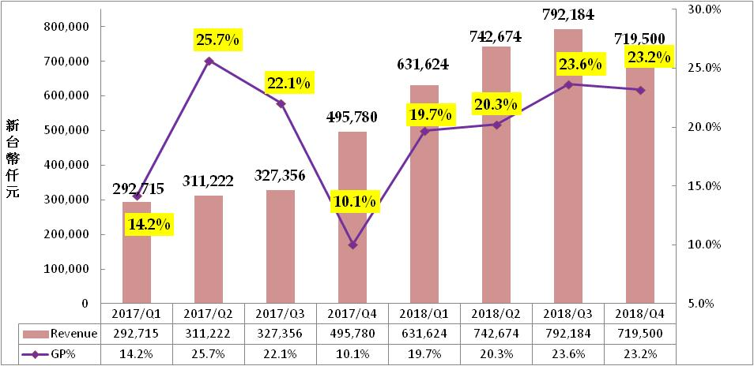
Revenue and Margin
In NTD $K
NTD K

Slide 3
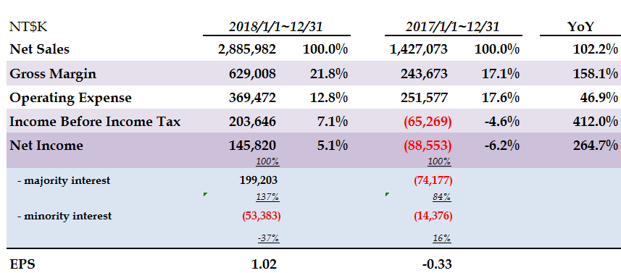
YoY Income Statement

Slide 4
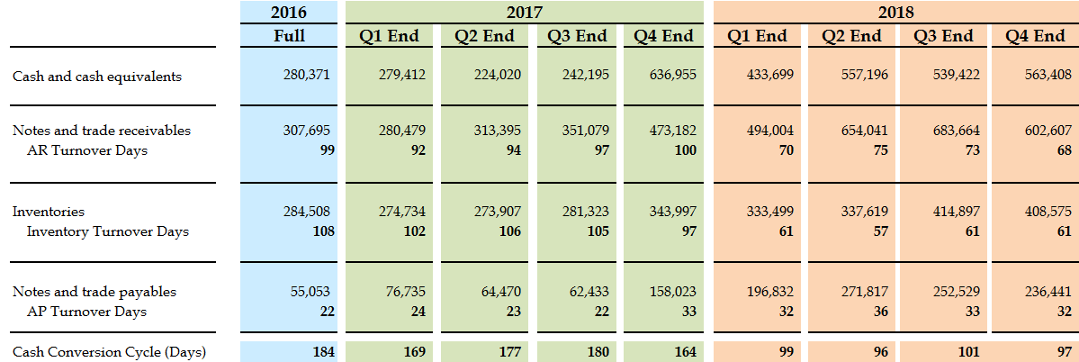
Turnover Status

Slide 5
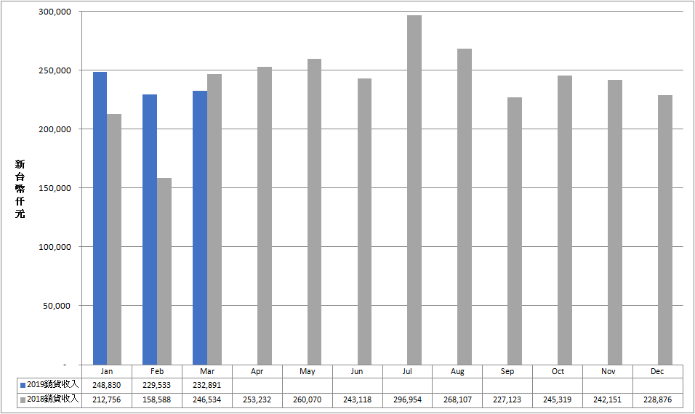
2019 Revenue Trend
In NTD $K
2018 Sales
2017 Sales
Sales
Sales

Slide 6
Introduction of Companies in TMC Group

Slide 7
TMC Introduction
Mask Size：
  Mainly in 6”, could be applied in 6”/8”/12” wafer
  (9”/14”)Large size mask, applied in LCD monitor or wafer scale package
Mask Process：
  0.35um(mainly for 6” wafer)
  0.18um (mainly for 8” wafer)
  0.11um~90nm (mainly for 12” wafer)
Product Application: mature processes for IoT, Motor, LED lighting are the main focus of current market, but eventually the application is decided by IC design house.

Slide 8
Miracle Technology
Focus：helping IC design house to search capacity in Foundry FAB
Know-how：helping customers to integrate FAB, testing house to improve the yield, reduce design risk , increase CP value
Locations：Taiwan, China, HongKong, Shenzen
Allied FAB：FABs in Taiwan and Korea
Customers：small and medium sized IC design houses in Taiwan and China
Revenue：around 1~1.2 billion NTD
Future Planning：provide turnkey solution to IC design houses

Slide 9
Weida Hi-Tech
Focus: Touch panel driver IC (for NB, tablet, AIO, electronic white board and large size LCD Panel)
End Customers: HP, Dell, Samsung and Panel makers
Locations: HsinChu, ShangHai
Future Planning:
  Expanding product lines in touch panel driver IC, get into the market in panel makers for mass production
  Planning to consolidate Miracle and package, testing technology to provide SIP(System in Package) turnkey solutions to our customers

Slide 10
Market Research in Mask Industry

Slide 11
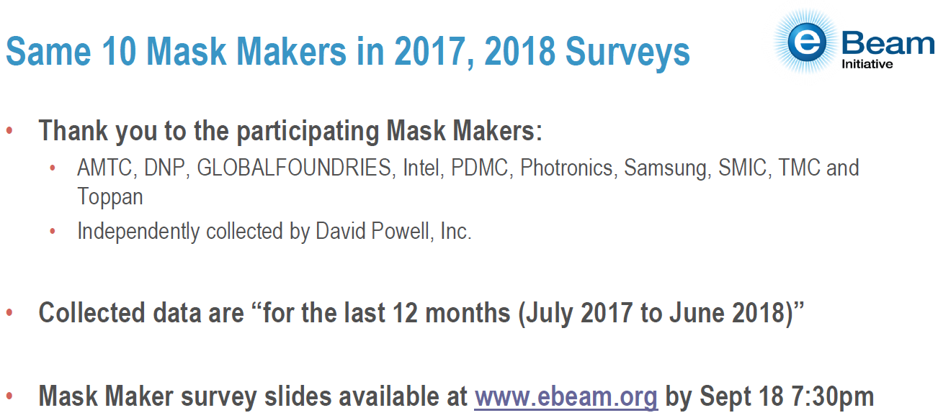
Market Research in Mask Industry

Slide 12
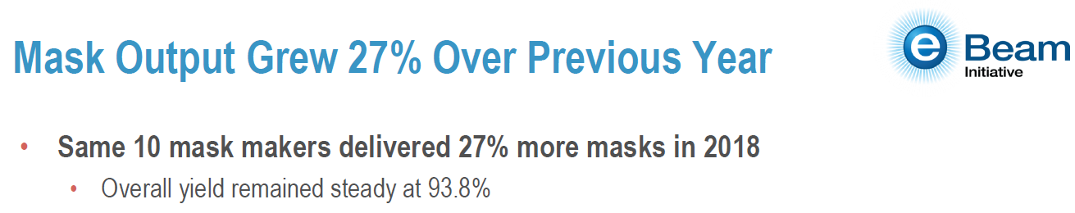
2017/7~2018/6光罩成長27%

Slide 13
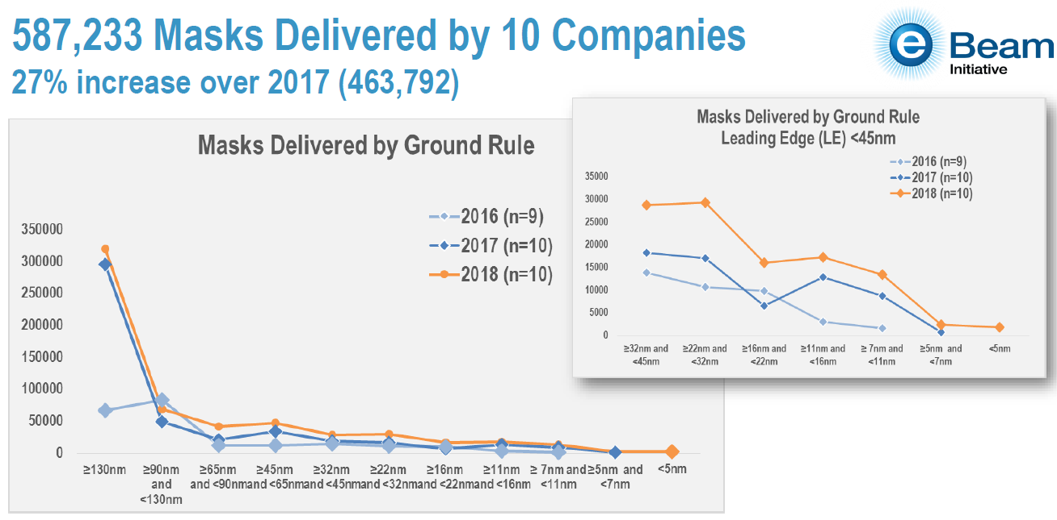
Masks Delivered by Ground Rule

Slide 14
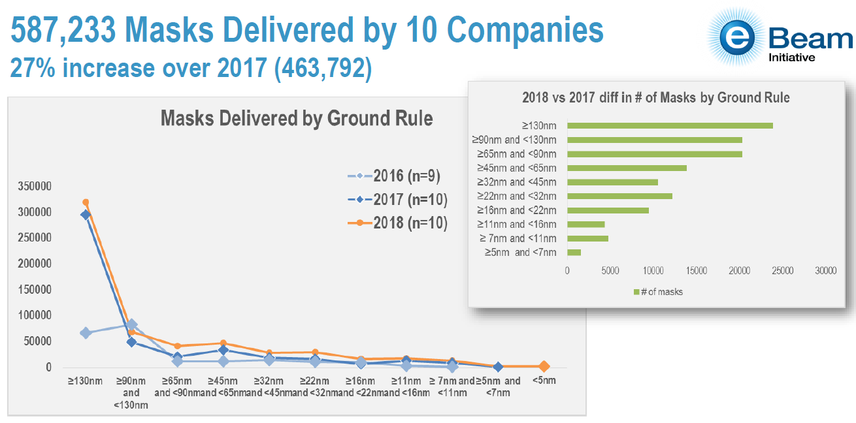
2018 vs. 2017 diff in # of Masks

Slide 15
Strategic Planning in 2019
Invest in new equipments:
  Product Technology: 65nm~40nm
  Equipments: Writers, inspectors, mask repair equipments, cleaners…
  Investment amount: around NT $ 1.5 billion
  Move-in schedule: 2019 Q3~2020 Q1
  Mass production: in 2020
Develop new customers:
  Tied-up with foundry FAB
  Develop new customers in China
  Provide advanced technology mask service
Group synergy:
  TMC moves to advanced technology
  Miracle plays the role of connecting the whole semiconductor industry
  Weida plans to consolidate Miracle and package, testing technology to provide SIP(System in Package) turnkey solutions to our customers

