Slide 1
Taiwan Mask Corporation
2019 H1 Financial Status

Slide 2
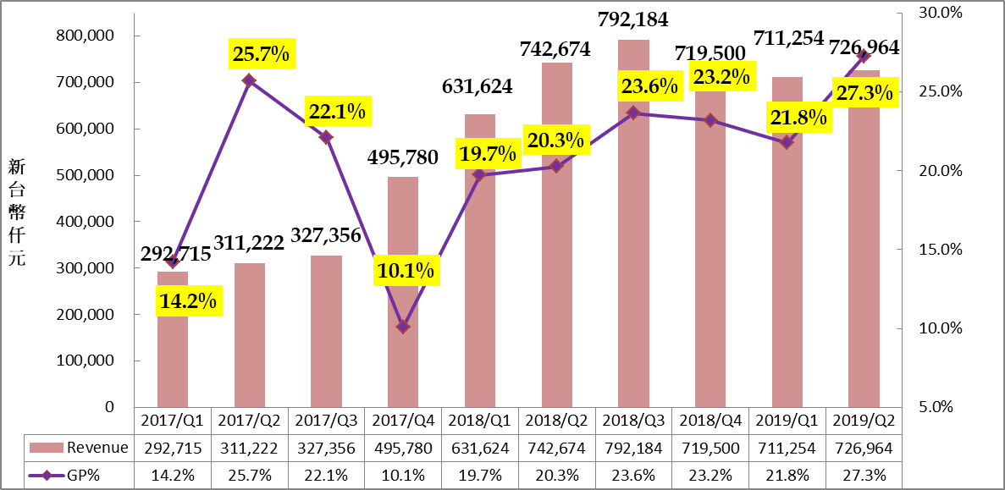
Revenue and Margin
In NTD $K
NTD K

Slide 3
YoY Income Statement

Slide 4
Turnover Status

Slide 5
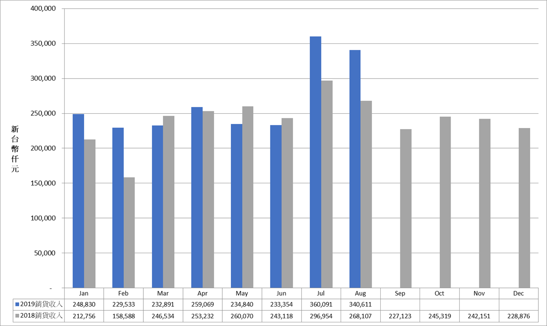
2019 Revenue Trend
In NTD $K
2019 Sales
2018 Sales

Slide 6
Introduction of Companies in TMC Group

Slide 7
TMC Group
Taiwan Mask
(Main Business：Mask)
Miracle Tech
(Main Business:
Wafer Agent)
Weida Hitech
(Main Business: Touch Panel driver IC design)
Aptos
(Main Business: Flash Assembly)

Slide 8
TMC Group
Taiwan Mask
(Main Business：Mask)
Mask Size：
  Mainly in 6”, could be applied in 6”/8”/12” wafer
  (9”/14”)Large size mask, applied in LCD monitor or wafer scale package
Mask Process：
  0.35um(mainly for 6” wafer)
  0.18um (mainly for 8” wafer)
  0.11um~90nm (mainly for 12” wafer)
Product Application: mature processes for IoT, Motor, LED lighting are the main focus of current market
Miracle Tech
(Main Business:
Wafer Agent)
Weida Hitech
(Main Business: Touch Panel driver IC design)
Aptos
(Main Business: Flash Assembly)

Slide 9
TMC Group
Taiwan Mask
(Main Business：Mask)
Focus：helping IC design house to search capacity in Foundry FAB
Know-how：helping customers to integrate FAB, testing house to improve the yield, reduce design risk , increase CP value
Locations：Taiwan, China, HongKong, Shenzen
Allied FAB：FABs in Taiwan and Korea
Customers：small and medium sized IC design houses in Taiwan and China
Miracle Tech
(Main Business:
Wafer Agent)
Weida Hitech
(Main Business: Touch Panel driver IC design)
Aptos
(Main Business: Flash Assembly)

Slide 10
TMC Group
Taiwan Mask
(Main Business：Mask)
Focus: Touch panel driver IC (for NB, tablet, AIO, electronic white board and large size LCD Panel)
End Customers: HP, Dell, Samsung and Panel makers
Locations: HsinChu, ShangHai
Miracle Tech
(Main Business:
Wafer Agent)
Weida Hitech
(Main Business: Touch Panel driver IC design)
Aptos
(Main Business: Flash Assembly)

Slide 11
TMC Group
Taiwan Mask
(Main Business：Mask)
Focus：Flash Assembly
Customers: Phison, Essencore(Hynix)
Location: Chu-Nan, Hu-Ko
Miracle Tech
(Main Business:
Wafer Agent)
Weida Hitech
(Main Business: Touch Panel driver IC design)
Aptos
(Main Business: Flash Assembly)

Slide 12
Market Research in Mask Industry

Slide 13
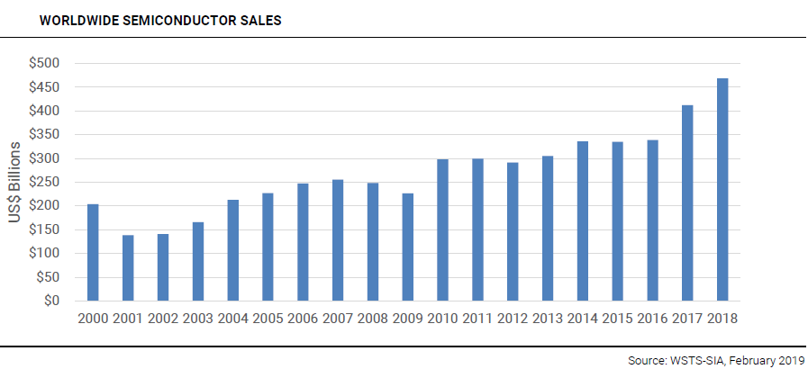
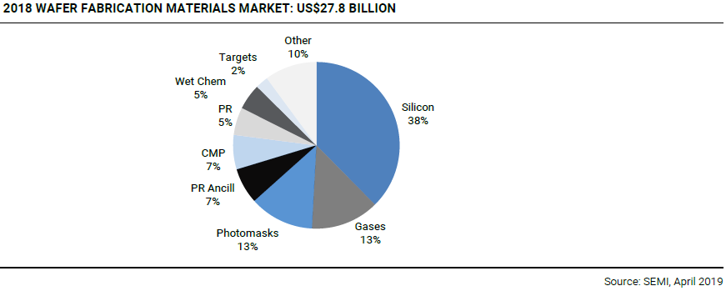
2018 Global Mask Revenue
Global semiconductor revenue in 2018 is USD 468.8 billion (NTD 14 trillion)
Growth rate is 14% compared to Year 2017
Mask is 13% of total semiconductor materials cost
2018 mask revenue is USD 4 billion(NTD 121 billion)

Slide 14
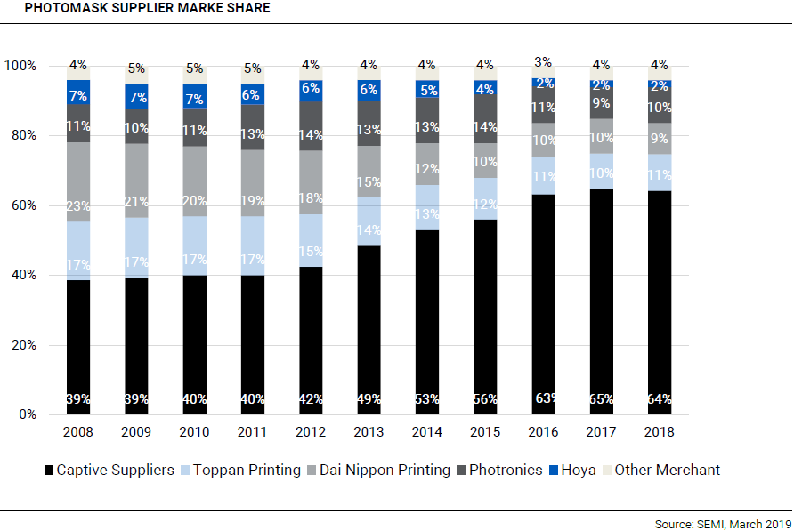
2018 Merchant Mask House Revenue
2018 merchant mask house revenue is 36% of total mask house, and growth rate is 1% compared to 2017
2018 merchant mask house revenue is USD 1.45 billion(NTD 43.6 billion)

Slide 15
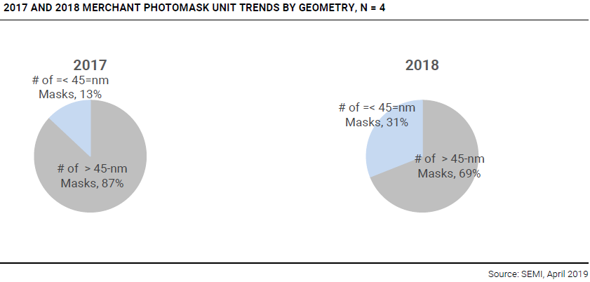
Merchant Mask House % by Geometry
2017 mature process (>45nm) is 87%
2018 mature process is lower to 69%
Advanced process (<45nm) % increased aggressively

Slide 16
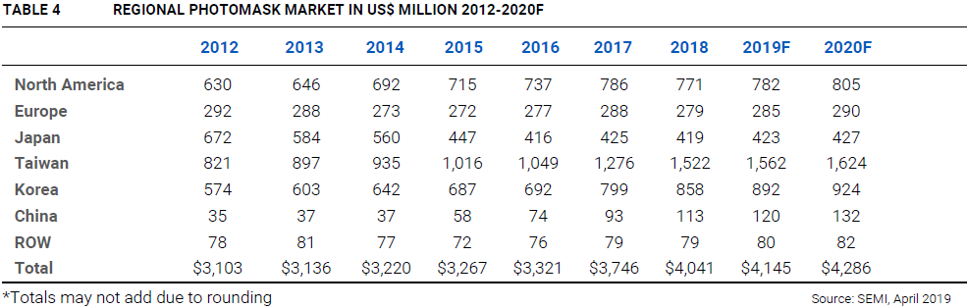
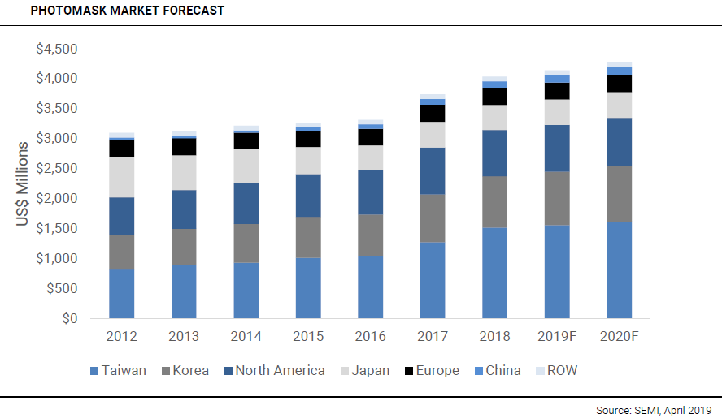
Regional Mask Market
2018 global mask revenue is USD 4 billion, 2019 expected to grow 2.6%, 2020 expected to grow 3.4%
Taiwan mask houses are in leading position of mask market

Slide 17
Strategic Planning in 2019
Invest in new equipments:
  Product Technology: 65nm~40nm
  Equipments: Writers, inspectors, mask repair equipments, cleaners…
  Investment amount: around NT $ 2 billion
  Move-in schedule: 2019 Q3~2020 Q1
  Mass production: in 2020
Develop new customers:
  Tied-up with foundry FAB
  Develop new customers in China
  Provide advanced technology mask service
Group synergy:
  TMC moves to advanced technology
  Miracle plays the role of connecting the whole semiconductor industry
  Weida plans to consolidate Miracle wafer agent and Aptos assembly technology to provide SIP(System in Package) turnkey solutions to our customers
  Aptos is expected to expand its product line outside flash assembly, like finger-print identification assembly, automobile sensor assembly and power management assembly

