Slide 1



MOSEL VITELIC INC.
MOSEL VITELIC INC.
Investor Relation Presentation
Dec. 03, 2025
1 / 17

Slide 2

風險聲明
This presentation material contains certain forward-looking statements that are based on current expectations and are subject to known and unknown risks and uncertainties that could cause actual results to differ materially from those expressed or implied by such statements.
Risk Disclosures
Statement

Slide 3

會議議程
Financial Information
------------Chairman Rebecca Tang
Product Development Plan
------------President Lawrence Lu
Q&A
Meeting Agenda
3

Slide 4
2025 Q3 Result Highlights
Unit：NTD Million
Item / Year | 2025Q3 | 2025Q2 | 2025Q1 | 2024Q3
Net Revenue | 513 | 526 | 551 | 525
Net Income (Loss) | (5) | (58) | 28 | 31
EPS (NT$) | (0.03) | (0.37) | 0.18 | 0.20
Cash, Cash Equivalent | 871 | 944 | 918 | 1,036
Equity | 2,390 | 2,391 | 2,444 | 2,421
Total Wafers Shipped (K pcs) | 142 | 140 | 135 | 135

Slide 5
Statements of Comprehensive Income
Unit：NTD Million
 | 2025Q3 |  | 2025Q2 |  | 2025Q1 |  | 2024Q3 |  | QOQ | YOY
Item / Year | Amount | % | Amount | % | Amount | % | Amount | % | % | %
Net Revenue | 513 | 100.0 | 526 | 100.0 | 551 | 100.0 | 525 | 100.0 | (2.5) | (2.3)
Cost of Revenue | (460) | (89.7) | (432) | (82.1) | (437) | (79.5) | (399) | (76.0) | 6.5 | 15.3
Gross Profit | 53 | 10.3 | 94 | 17.9 | 114 | 20.5 | 126 | 24.0 | (43.6) | (57.9)
Operating Expenses | (99) | (19.3) | (95) | (18.1) | (96) | (17.5) | (91) | (17.3) | 4.2 | 8.8
Operating Income (Loss) | (46) | (9.0) | (1) | (0.2) | 18 | 3.1 | 35 | 6.7 | 4500.0 | (231.4)
Net Other Non-operation Income | 41 | 8.1 | (57) | (10.8) | 10 | 1.8 | (4) | (0.8) | (171.9) | (1125.0)
Income before Income Tax | (5) | (1.0) | (58) | (11.0) | 28 | 4.9 | 31 | 5.9 | (91.4) | (116.1)
Net Income (Loss) | (5) | (1.0) | (58) | (11.0) | 28 | 4.9 | 31 | 5.9 | (91.4) | (116.1)
EPS (NT$) | (0.03) |  | (0.37) |  | 0.18 |  | 0.20

Slide 6
Consolidated Balance Sheet
Unit：NTD Million
 | 2025Q3 |  | 2025Q2 |  | 2025Q1 |  | 2024
Item / Year | Amount | % | Amount | % | Amount | % | Amount | %
Total Assets | 3,222 | 100.0 | 3,346 | 100.0 | 3,381 | 100.0 | 3,365 | 100.0
Cash | 871 | 27.0 | 944 | 28.2 | 918 | 27.2 | 891 | 26.5
Accounts Receivable | 348 | 10.8 | 305 | 9.1 | 341 | 10.1 | 348 | 10.3
Inventories | 261 | 8.1 | 276 | 8.2 | 267 | 7.9 | 285 | 8.5
Total Current Assets | 1,614 | 50.1 | 1,781 | 53.2 | 1,979 | 58.5 | 2,063 | 61.3
Property, Plant and Equipment | 838 | 26.0 | 803 | 24.0 | 768 | 22.7 | 770 | 22.9
Right-of-use Assets | 267 | 8.3 | 270 | 8.1 | 272 | 8.0 | 287 | 8.5
Notes and Accounts Payable | 176 | 5.5 | 188 | 5.6 | 188 | 5.6 | 176 | 5.2
Accrued Liabilities and Others | 373 | 11.6 | 471 | 14.1 | 451 | 13.3 | 415 | 12.3
Total Current Liabilities | 549 | 17.0 | 659 | 19.7 | 639 | 18.9 | 591 | 17.6
Total Equity | 2,390 | 74.2 | 2,391 | 71.5 | 2,444 | 72.3 | 2,462 | 73.2
Book Value (NT$) | 15.04 |  | 15.04 |  | 15.40 |  | 15.51

Slide 7
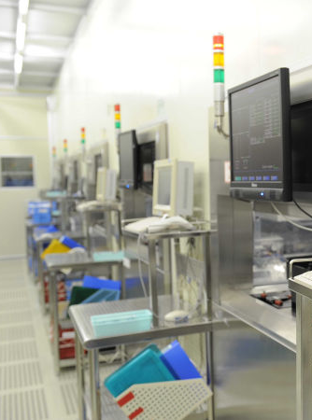
會議議程
Financial Information
------------Chairman Rebecca Tang
Product Development Plan
------------President Lawrence Lu
Q&A
Meeting Agenda

Slide 8
2025 Monthly Sales

Slide 9
2025 Quarterly Sales
Unit: NTD Thousands

Slide 10
Revenue Breakdown by Product
2024 VS. 2025Q1-Q3

Slide 11
Wafer Foundry Output Trend
(avg. per month)
*During the pandemic, excess inventory affected orders and production in 2023.

Slide 12
Automobile Products Shipment Q’ty
12.3%
*Year-over-year percentage increase in automobile products shipments.

Slide 13
MOSEL Power Device Tech. Roadmap
MOSFET |  | 60V~200V TRENCH PMOS
 |  |  | 150V~300V FR TRENCH NMOS
 | 100V~300V TRENCH NMOS
 |  |  |  |  | 60V~200V UD SGT PMOS
 |  |  |  | 60V~200V LR SGT PMOS
 |  |  | 150V~300V FR SGT NMOS
 |  | 120V~300V UD SGT NMOS
 | 120V~300V LR SGT NMOS
FS-IGBT |  |  |  | 600V~1600V G7 RC-SERIES
 |  |  | 650V~1200V G7 S-SERIES
 |  | 650V~1200V G7 H-SERIES
 |  | 650V~1700V G7 T-SERIES
 | 650V~1700V G4 T-SERIES
2024
2025
2026
2027
2028
2029

Slide 14
MOSEL Power Device Tech. Roadmap
FRED |  |  |  | 600V~1200V Low Qrr Ultra FRED
 |  |  | 600V~1200V Low Vf Ultra FRED
 | 1200V H-SERIES
 | 650V~1200V T-SERIES
PTC FRD |  |  | 650V~1200V G7 H-SERIES
 |  | 650V~1500V G7 T-SERIES | 150V~300V FR SGT NMOS
TVS ESD |  |  |  | SurgeSwitch
 |  |  | CAN BUS Transceivers
FS-IGBT |  | Automotive CAN BUS TVS
 |  | High Surge TVS
 |  | Ultra Low Cap TVS
 | General Purpose
2024
2025
2026
2027
2028
2029

Slide 15
MOSEL Power Device Tech. Roadmap
SiC MOS |  |  | SiC SMART SWITCH
 |  | 650V~2200V Trench SiC MOS | 600V~1200V Low VF Ultra FRED
 | 650V~3300V Planar SiC MOS
GaN HEMT |  |  | 650V~1200V G7 H-SERIES FRD | GaN SMART SWITCH
 |  | 650V E-Mode GaN HEMT | 650E-Mode GaN HEMT
2024
2025
2026
2027
2028
2029

Slide 16
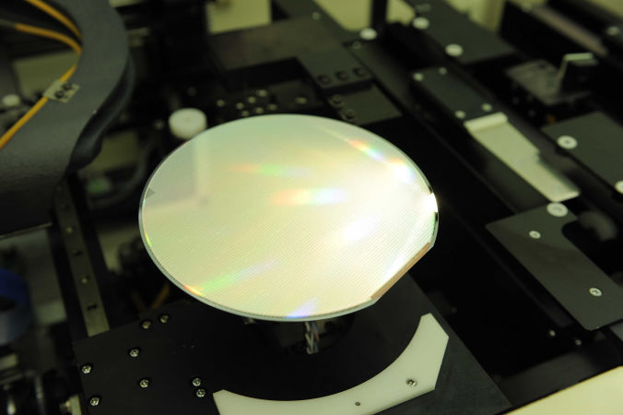
Summary of Current Business Operations
CONTINUOUS GROWTH in
AUTOMOTIVE, INDUSTRIAL and
INTELLIGENT POWER Markets
Foundry products for automotive applications continued to grow from 47% in 2025.
The sales of medium and low current 1200V FS IGBT products are stable; the new generation FS-IGBT has entered the sampling stage and will boost revenue in 2026.
The capacity utilization rate reached 90% in 2025 and will keep into 2026.
SiC MOSFETs are about to be sampled and are expected to mass production in 2026.
FRED/SGT MOSFETs/TVS have all entered the sampling stage and are expected to mass production in 2026.

Slide 17
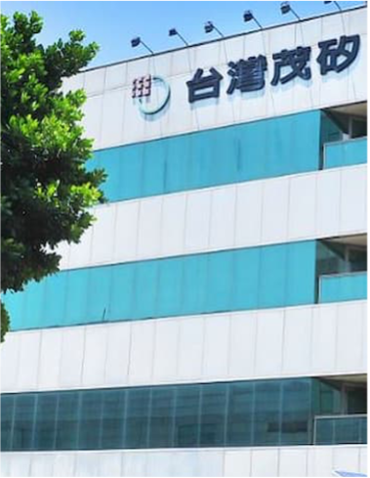


MOSEL VITELIC INC.
Thank you.
Q&A
MOSEL VITELIC Inc.
Investor’s Conference
2025.12.3

