Slide 1
Q1 2020 Results
SYNNEX TECH. INTL. CORP.
May, 2020
Notes:
OK

Slide 2
Disclaimer
IMPORTANT NOTICE
Synnex’s statements of its current expectations provided herein are forward-looking. These statements are subject to risks and uncertainties that might cause significant deviations from actual results, including but not limited to changes in business policy, possible fluctuations in economic situations, technology development, competition environment, and other circumstances beyond control. Synnex undertakes no obligation to update the forward-looking statements to reflect events or circumstances after the issuance of the statements.
Nothing contained herein constitutes an investment advice, offer or solicitation for the purchase or sale of any financial instrument. While reasonable care has been taken to ensure that the information contained herein is not untrue or misleading at the time of publication, Synnex makes no representation that it is accurate or complete. Neither Synnex nor any of its officers or employees shall be liable for any direct, indirect or consequential loss, damage, cost or expense incurred or arising from any use of the information contained herein.

Slide 3
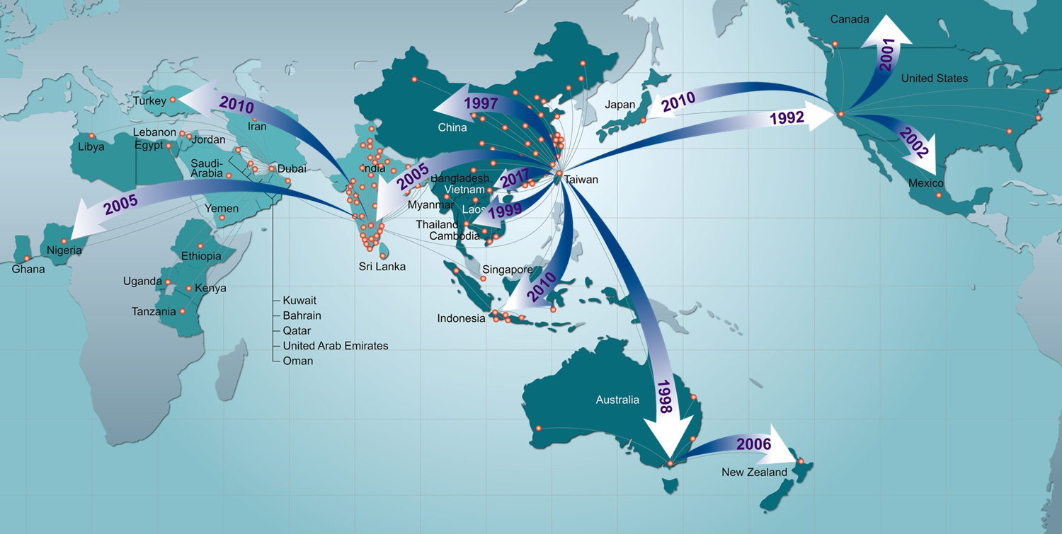
Synnex Group
Worldwide Footprint
US$10B (Y20 Q1)
Operating History
& Current Position....
Taiwan 1975 No.1
USA 1992 No.3
HK / China 1997 No.3
Australia / New Zealand 1998 No.2
Thailand 1999 No.1
India 2005 No.2
Middle East / Africa 2005 No.1
Turkey 2010 No.1
Japan 2010 No.3
Indonesia 2011 No.1
Vietnam 2017 No.1
Across 39 countries, 60% world population
Notes:
營收速報-Global Revenue

Slide 4
Y20Q1 Financial Summary
Notes:
工作底稿
ok

Slide 5
Quarterly & Yearly Earning Trend
2020 LTM*: Last Twelve Months up to Y2003
Notes:
工作底稿
ok

Slide 6
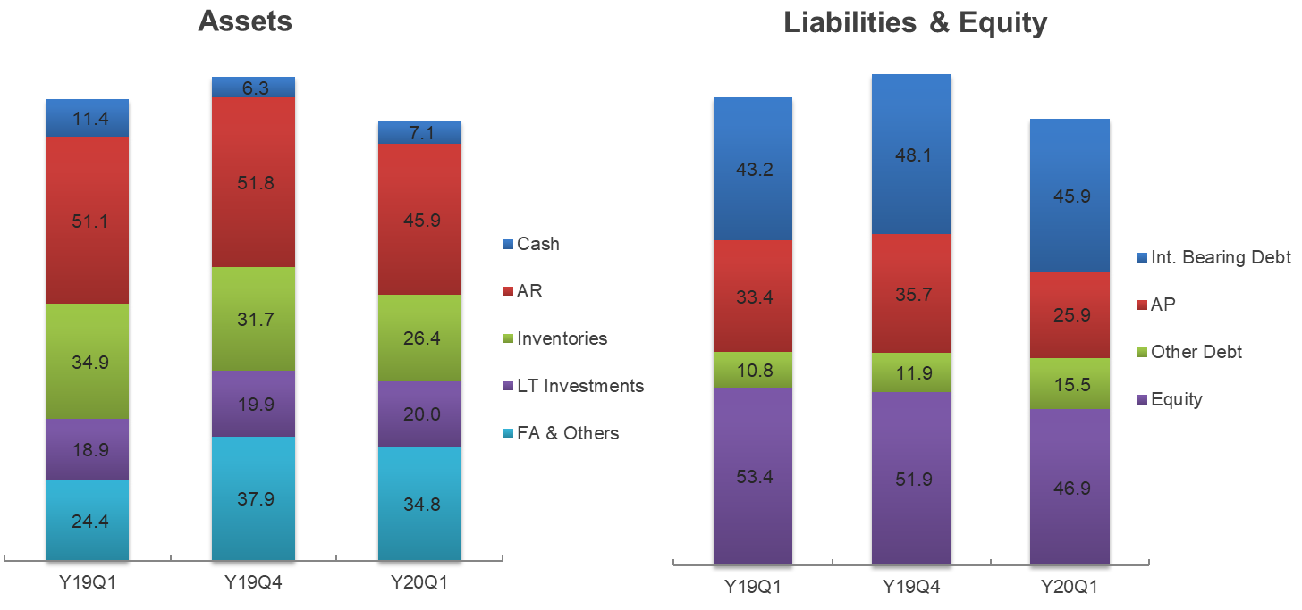
Balance Sheet Key Index
NT$ B
147.7
147.7
140.8
140.8
134.2
134.2
Notes:
工作底稿
ok

