Slide 1

Q4 2020 Results
SYNNEX TECH. INTL. CORP.
March, 2021
Notes:
OK

Slide 2
Disclaimer
IMPORTANT NOTICE
Synnex’s statements of its current expectations provided herein are forward-looking. These statements are subject to risks and uncertainties that might cause significant deviations from actual results, including but not limited to changes in business policy, possible fluctuations in economic situations, technology development, competition environment, and other circumstances beyond control. Synnex undertakes no obligation to update the forward-looking statements to reflect events or circumstances after the issuance of the statements.
Nothing contained herein constitutes an investment advice, offer or solicitation for the purchase or sale of any financial instrument. While reasonable care has been taken to ensure that the information contained herein is not untrue or misleading at the time of publication, Synnex makes no representation that it is accurate or complete. Neither Synnex nor any of its officers or employees shall be liable for any direct, indirect or consequential loss, damage, cost or expense incurred or arising from any use of the information contained herein.

Slide 3
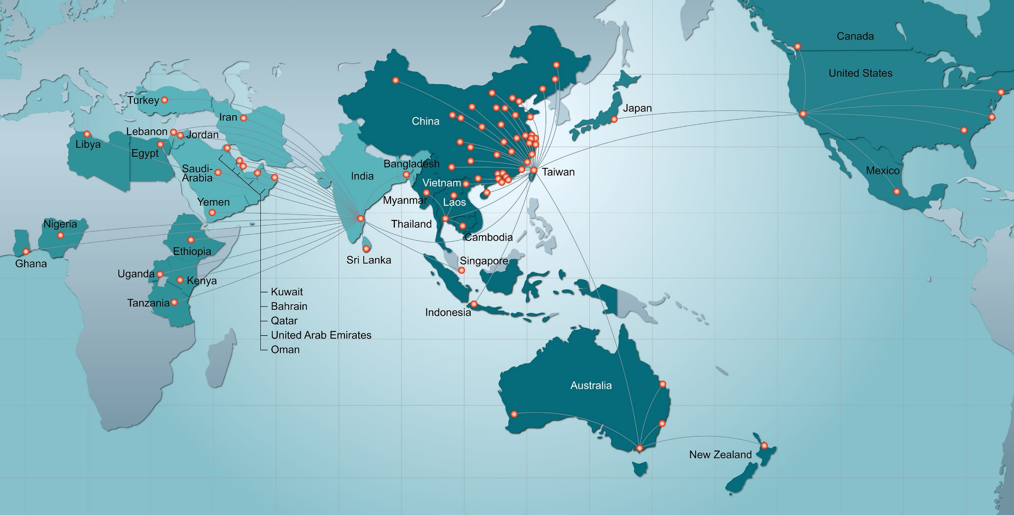



A Global Hi-Tech Service Provider
US$44B (Y20 FY)
USA 1980 No.3
Japan 1962 No.3
Taiwan 1975 No.1
HK / China 1982 No.3
Australia 1991 No.1
(New Zealand)
Indonesia 1975 No.1
Thailand 1988 No.1
Vietnam 1988 No.1
India 1993 No.2
Middle East / Africa 1997 No.1
Turkey 1991 No.1
Across 39 countries, 200 offices, 60% world population
SYNNEX APAC : Taiwan(HQ), Hong Kong, China, Australia, New Zealand, Indonesia, Thailand, Vietnam, Indochina
Redington : India, Sri Lanka, Bangladesh, Middle East, Africa, Turkey, CIS
SYNNEX US : USA, Canada, Mexico, Japan
Notes:
營收速報-Global Revenue

Slide 4
Y20Q4 Financial Summary
Notes:
工作底稿
ok

Slide 5
Y20Q1~Q4 Financial Summary
Notes:
工作底稿
ok

Slide 6
Quarterly & Yearly Earning Trend
2020 LTM*: Last Twelve Months up to Y2009
Notes:
工作底稿
ok

Slide 7
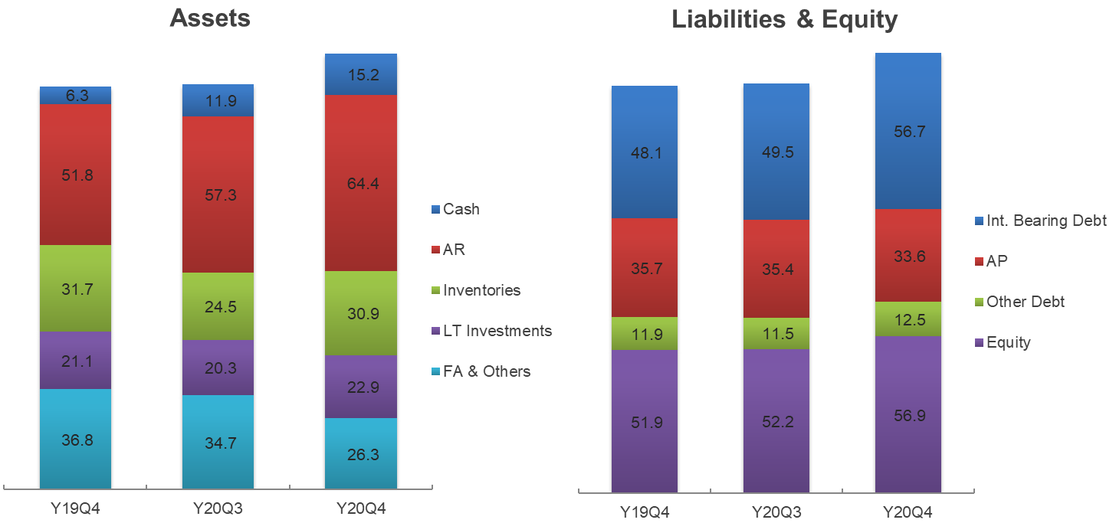
Balance Sheet Key Index
NT$ B
159.7
159.7
147.7
148.5
147.7
148.5
Notes:
工作底稿
ok

Slide 8

Group website http://www.synnex-grp.com/en
CSR http://www.synnex-grp.com/en/csr-report

