Slide 1
2022年第二季營運成果
聯強國際股份有限公司
May, 2022
Notes:
改日期

Slide 2
免責聲明
本簡報係由聯強國際股份有限公司(以下簡稱本公司)提供，本簡報可能包含前瞻性陳述，當中涉及風險與不明朗因素包括陳述本身的不確定性、風險、假設或其他因素如：經營上的改變、競爭環境、經濟情勢、法規變化、科技發展與超出本公司管控等因素，皆可能導致本公司實際營運結果與上開前瞻性陳述有很大的差異。本公司不承擔因情勢變更而即時更新或修正相關內容之義務。
本簡報的內容、陳述或主張非為買賣或提供買賣任何有價證券或金融商品的邀約，邀約之引誘或建議。本公司已盡合理之注意，使本簡報於公開時無任何不真實或誤導。本公司及其各關係企業代表人或董事，均不對此使用或因他人引用本份簡報資料、或其它因簡報資料導致的任何損害負擔任何責任。

Slide 3














供應鏈服務商與平台
Sales/PM Service
Mgmt. Service Platform
Solution Sell
Channel & Market Development
Logistics Service
Finance Service
Brand / Supplier / Manufacture
SI / ISV / MSP / eRetailer / LFR / Shop
Warranty Service
Home/On-site Service
Warehouse Mgmt. Service
Delivery Service
XaaS / Subscription
Credit / Payment
Leasing / Installment
Project Financing
Professional Service
Consulting Service
Technical & Installation Service
Management Service
Notes:
有調整才更新

Slide 4
Y22Q2 營運績效

Slide 5
Y22Q2 營運績效速覽
Revenue
7%
Y22Q2 NT$103.4B
Gross Margin
1%
NT$4.1B / 4.00%
Operating Income
-3%
NT$2.0B / 1.92%
JV Income
-2%
NT$739M
Profit before Tax
-21%
NT$3.0B / 2.93%
EPS
-29%
PAT NT$2.4B / NT$1.43
+32%
(Ex. TD SNX
Investment Income)
+4%
(Ex. TD SNX Investment Income
& nonrecurring profit)
ROE
15%
15yr avg. 15%
WC Days
85 days
Y21Q2 60 days / +25 days
Free Cash Flow
-NT$12.5B
: 歷史新高
: 同期歷史新高

Slide 6
Y22H1 營運績效速覽
Revenue
11%
Y22H1 NT$204.2B
Gross Margin
3%
NT$8.4B / 4.12%
Operating Income
2%
NT$4.3B / 2.10%
JV Income
-1%
NT$1,410M
Profit before Tax
-9%
NT$6.3B / 3.07%
EPS
-16%
PAT NT$4.9B / NT$2.95
+35%
(Ex. TD SNX
Investment Income)
+8%
(Ex. TD SNX Investment Income
& nonrecurring profit)
ROE
16%
15yr avg. 15%
WC Days
83 days
Y21H1 63 days / +20 days
Free Cash Flow
-NT$11.2B
歷史新高
: 同期歷史新高

Slide 7
營運績效-季趨勢
單位: 新台幣十億元
歷史新高
: 同期歷史新高

Slide 8
營運績效-月趨勢
單位:新台幣十億元
Y22Q2 : NT$103.4bn / YoY +7%
歷史新高
: 同期歷史新高

Slide 9
產品別營運績效
單位:新台幣十億元
Notes:
From：法人季報 → Biz-YXX

Slide 10
產品別營運績效-季趨勢
x%
Y22Q2 營收占比
單位:新台幣十億元
29%
34%
3%
34%
Notes:
底稿待訂

Slide 11
區域別營運績效
x%
Y22Q2 營收占比
26%
15%
14%
6%
5%
34%
Notes:
底稿待訂

Slide 12
營運績效– 合資企業
: Historical High
: Record High in Same Period
Notes:
底稿待訂

Slide 13
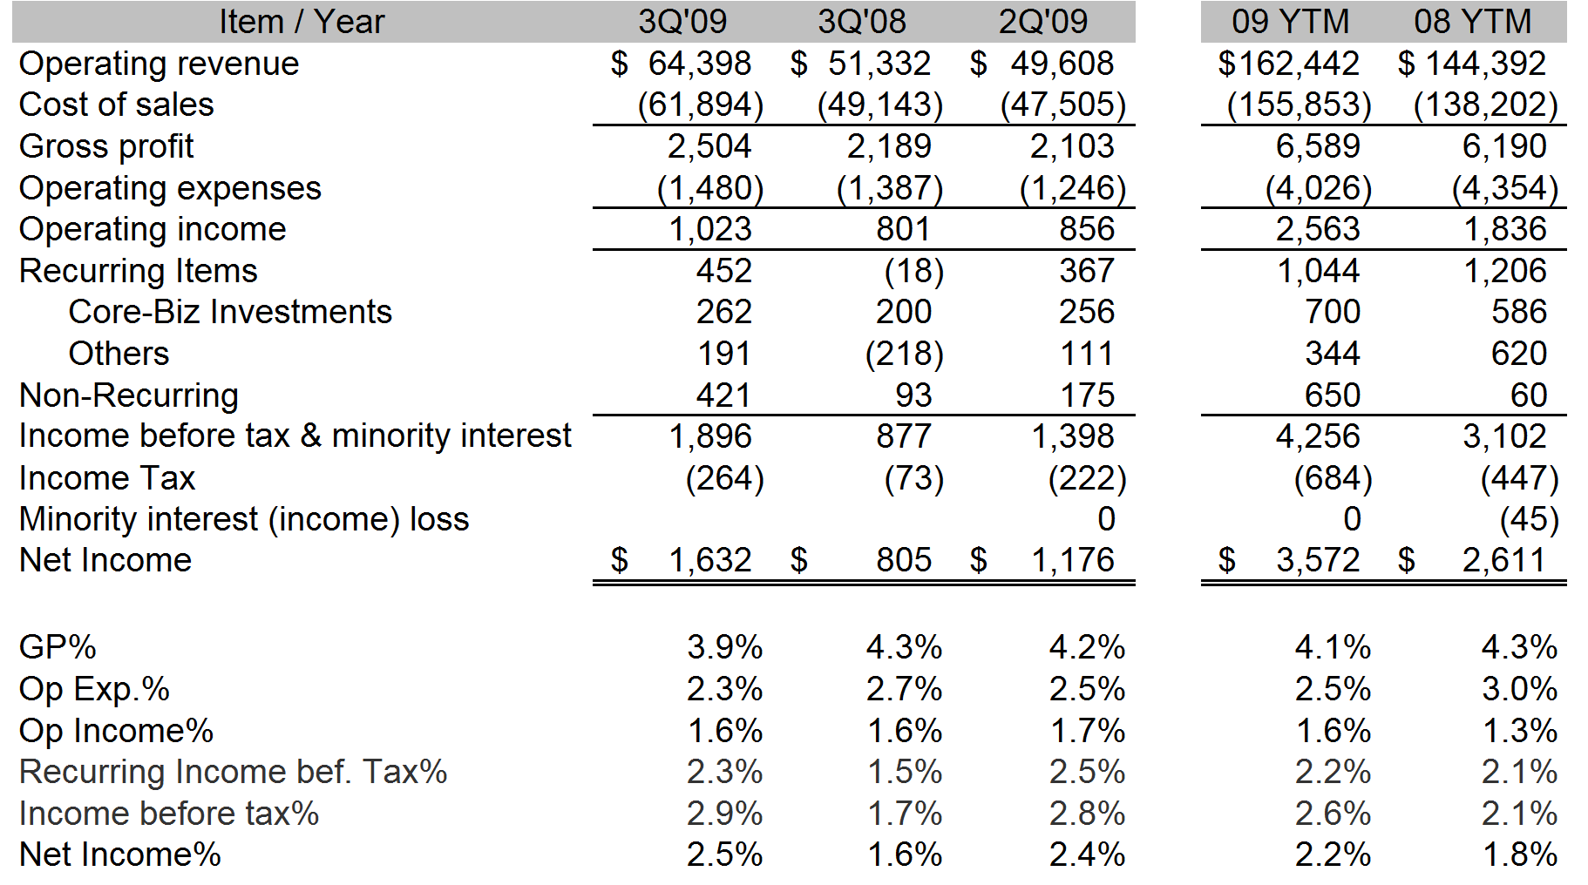
合併損益表 – Y22Q2&H1
單位:新台幣百萬元
* JV Business in Concentrix, Redington India, Synnex Thailand and Synnex FPT which were accounted under equity method.
Notes:
From：法人季報 → IC

Slide 14
營運資金指標

Slide 15
財務結構指標
單位:新台幣十億元
Notes:
From：法人季報 → BS Key Index
手動更新圖最上面的總數

Slide 16
合併資產負債表
單位:新台幣百萬元
Notes:
From：法人季報 → Q BS(kim)

Slide 17
歷史績效
EPS:
3yr average $6.44
5yr average $5.39
- 10yr average $4.21
- 15yr average $4.02
2020 LTM*: Last Twelve Months up to Y2009
Notes:
有調整才更新

Slide 18
獲利能力
單位:新台幣十億元 / %
OPI/GP Ratio
- 3yr average 47%
- 10yr average 40%
Y22H1 : 51%
Gross Margin
- 3yr average 4.38%
- 10yr average 3.81%
Y22H1 : 4.12%
Operating Expense
- 3yr average 2.32%
- 10yr average 2.27%
Y22H1 : 2.02%
Operating Income
- 3yr average 2.07%
- 10yr average 1.54%
Y22H1 : 2.10%
Notes:
有調整才更新

Slide 19
股東價值
單位:新台幣十億元/ 元
Net Income & ROE
Net Income:
- 5yr CAGR 30%
- 15yr CAGR 11%
ROE : 15yr average 15%
Y22H1 16%
Book Value
- 15yr CAGR 6%
- Y21: NT$63.6B
& NT$38.1 /share
- Y22H1: NT$60.3B
& NT$36.2 /share
Dividend & Payout ratio
- Y21 NT$5.0, Payout 48%
- 15yr average: NT$ 2.53
- 15yr average Payout 65%
Notes:
有調整才更新

Slide 20

Group website http://www.synnex-grp.com/en
CSR http://www.synnex-grp.com/en/csr-report

Slide 21
附件

Slide 22
公司總覽

Slide 23
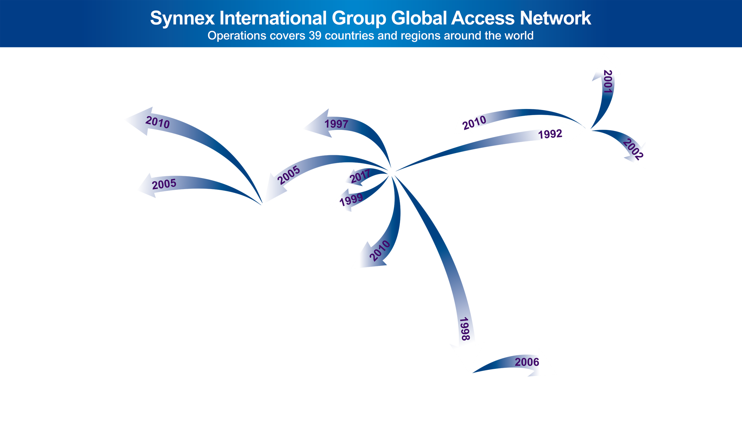
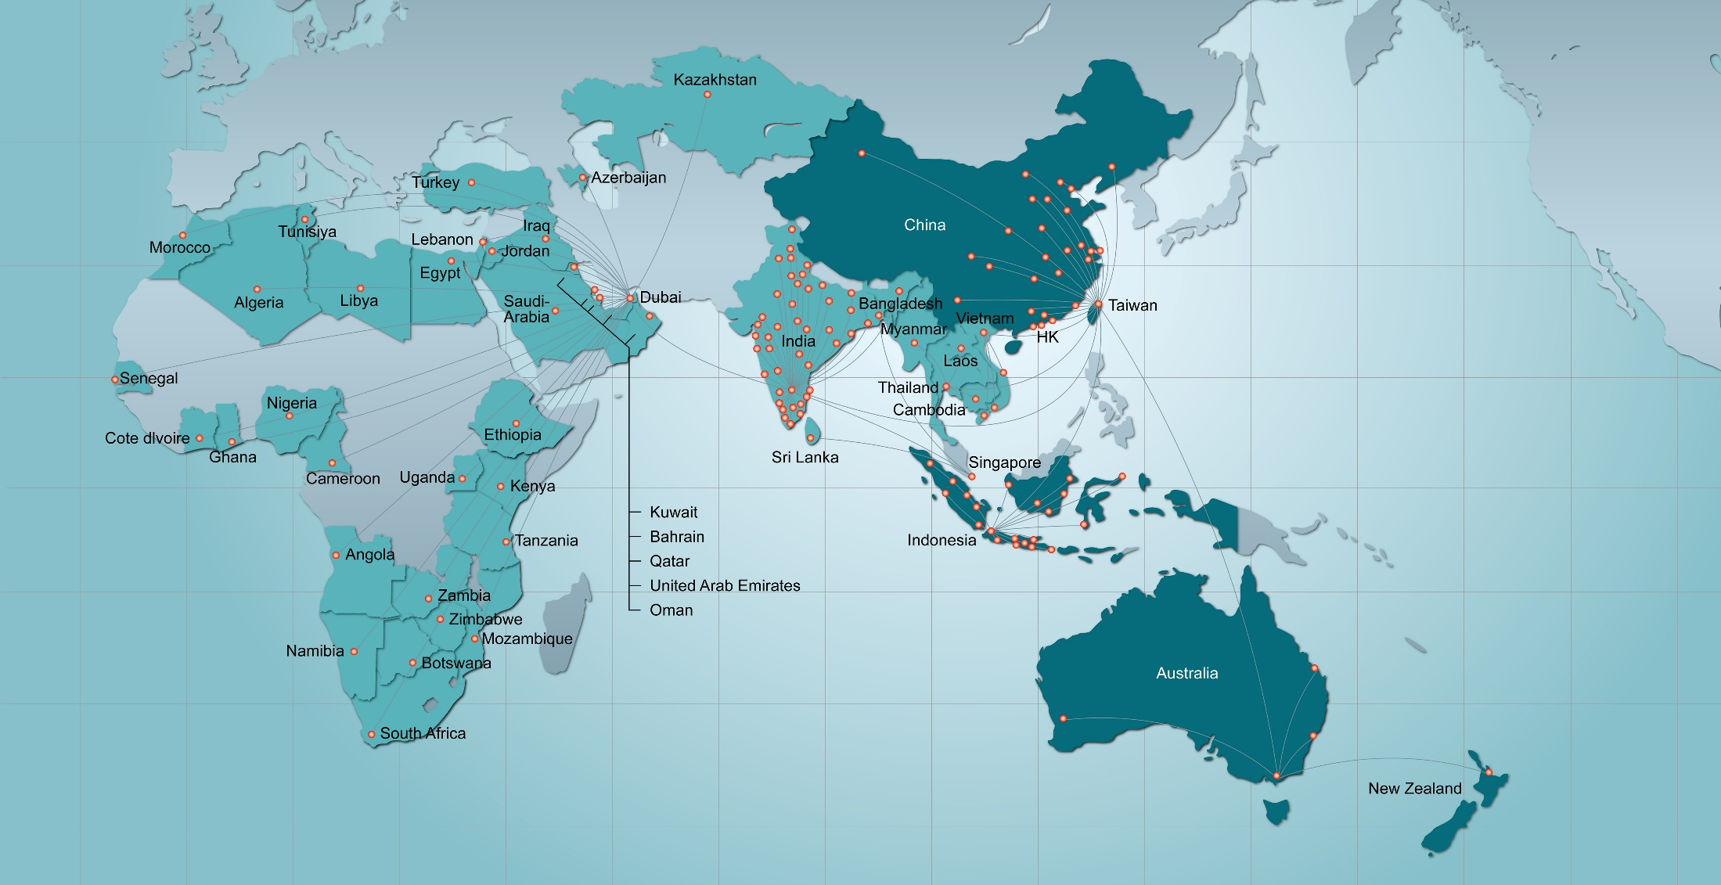
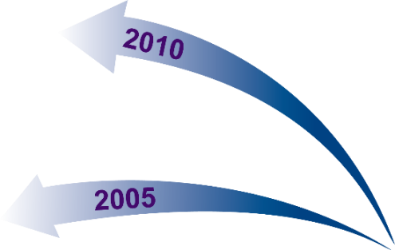
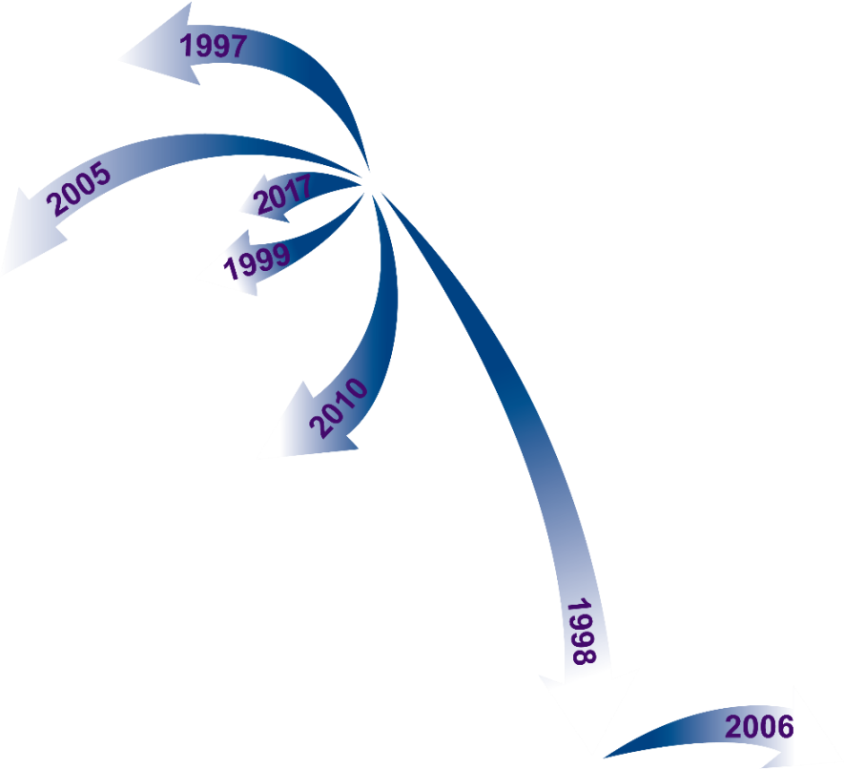


2021
A USD $25B Hi-Tech Supply Chain Management Service Provider
Taiwan 1975 No.1
China 1982 No.3
Hong Kong 1982 No.1
Australia 1991 No.1
(New Zealand)
Indonesia 1975 No.1
Thailand 1988 No.1
Vietnam 1988 No.1
India / SA 1993 No.2
Middle East / Africa 1997 No.1
Turkey 1991 No.2
Across 51 markets, 400+ sales/logistics/service points
SYNNEX APAC : Taiwan (HQ), Hong Kong, China, Australia, New Zealand, Indonesia, Thailand, Vietnam, Indochina
Redington : India, Srilanka, Bangladesh, Middle East, Africa, Turkey, CIS

Slide 24
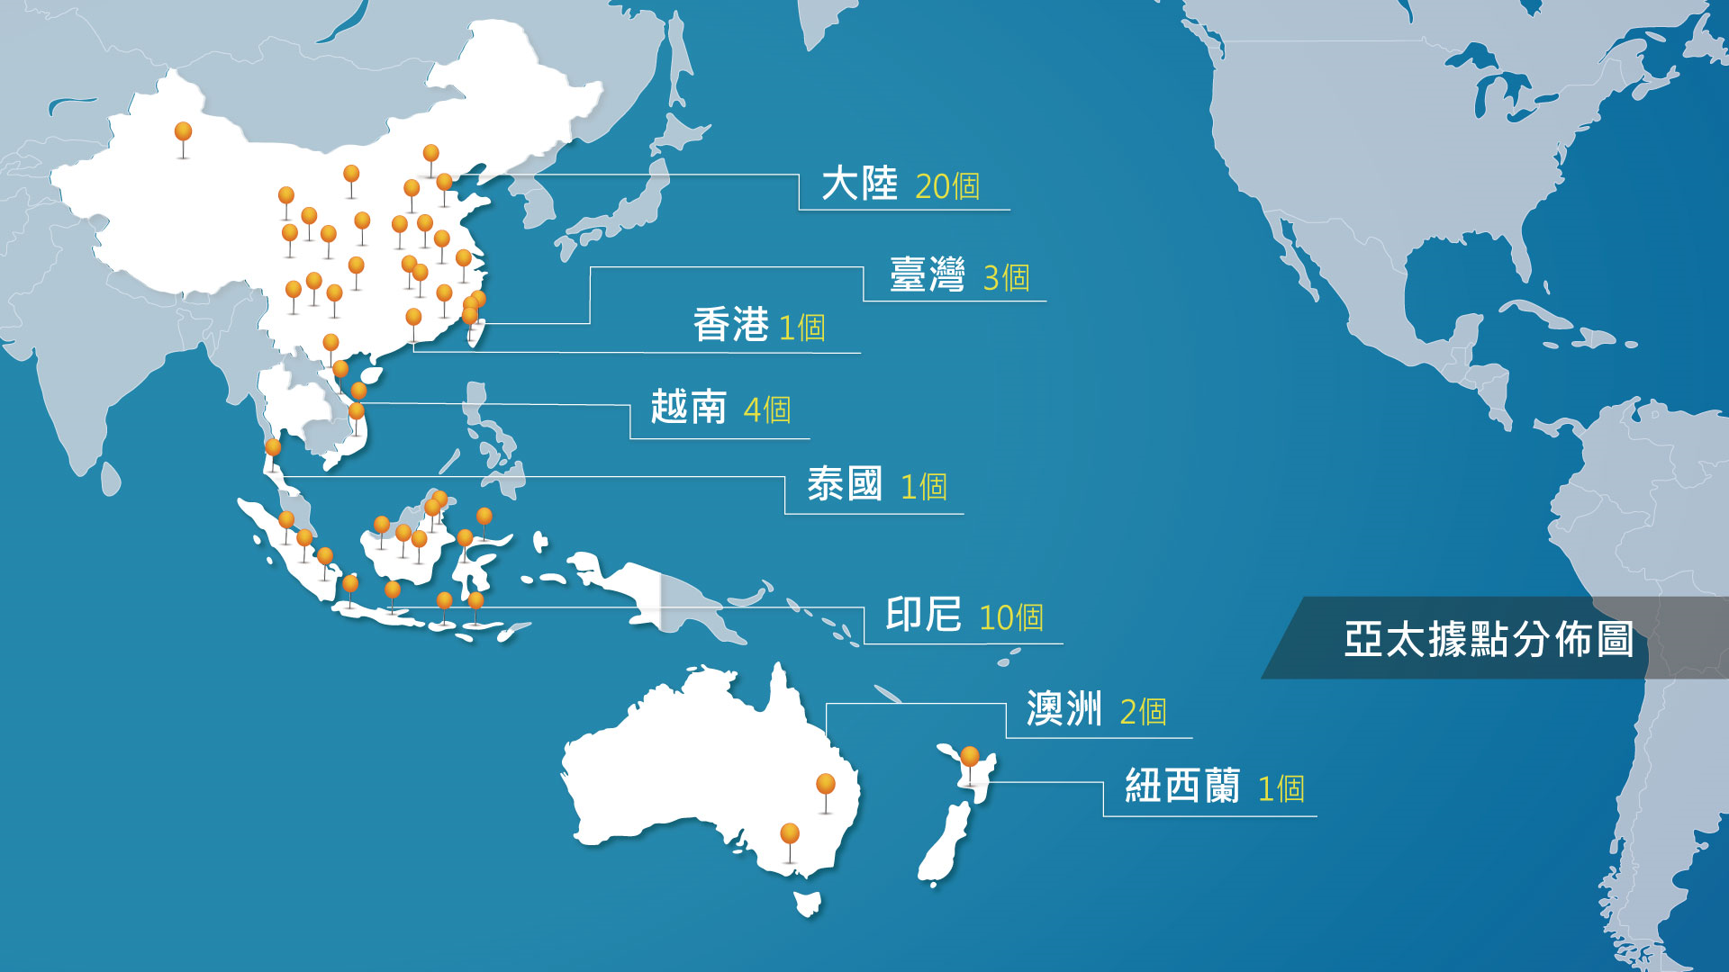
聯強亞太地區雲倉佈局
China 41
Taiwan 4
Hong Kong 3
Vietnam 4
Thailand 1
Indonesia 11
68 Warehouses
Australia 3
New Zealand 1

Slide 25


































































產品組合– 終端裝置&消電
Client Devices
PC Components
eSport / Gaming
Mobile Phones
Peripheral / Accessory
Smart Devices / Home Appliance

Slide 26








































































產品組合– 企業解決方案
Server & Storage
Networking
Data Center Infra.
Cloud Services
Data Protection
Security
Productivity
Security Infra.
L.F.D. & Printing
Analytics / BI

Slide 27











































產品組合– 元組件
CPU / Chipset
Storage
Panel / Touch
AIoT
Networking
LED
Memory
Power
Software
STB

Slide 28
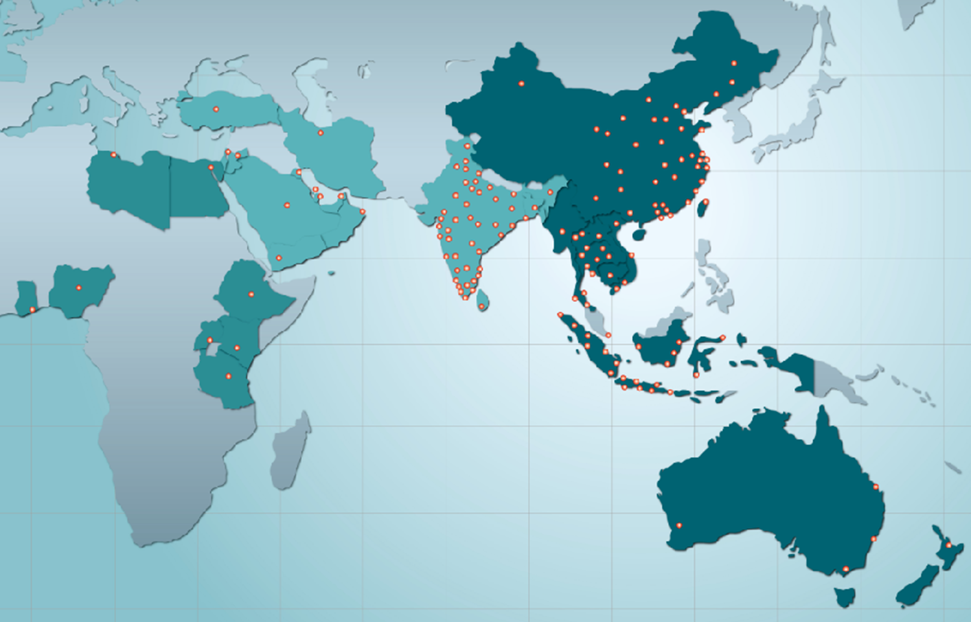
Widespread & Downstream Channel Reach
1,200 cities & 85,000 channels
700 cities
14,000 channels
80 cities
10,000 channels
100 cities
30,000 channels
35 cities
9,000 channels
80 cities
6,000 channels
63 cities
4,800 channels
150 cities
5,200 channels
Data Center Infra.
Cloud Service
Solution VAR
Software House
Security
Surveillance
eSport Channel
Apple Channel
Specialty Store
Brand Store
Telco Shop
CE Retailer
IPC/AIoT
Automotive
Surveillance
VR/AR/MR
Healthcare
Networking
60 cities
6,000 channels
Notes:
有調整才更新

Slide 29
Group website http://www.synnex-grp.com/en
CSR http://www.synnex-grp.com/en/csr-report

