Slide 1
Gold Circuit Electronics
2021 Investor Conference
Date: Sep. 14 , 2021

Slide 2
Disclaimer
The presentation contains projections & estimates of financial
information as well as market and product developments for
future periods.
These projections & estimates are based on information currently
available which we believe to be reliable, but they involve risks &
uncertainties.
Our actual results of operations & financial condition may differ
significantly from those contained in projections & estimates.
The projections & estimates should not be interpreted as legally binding
commitments, but rather as flexible information subject to change
occasionally.

Slide 3
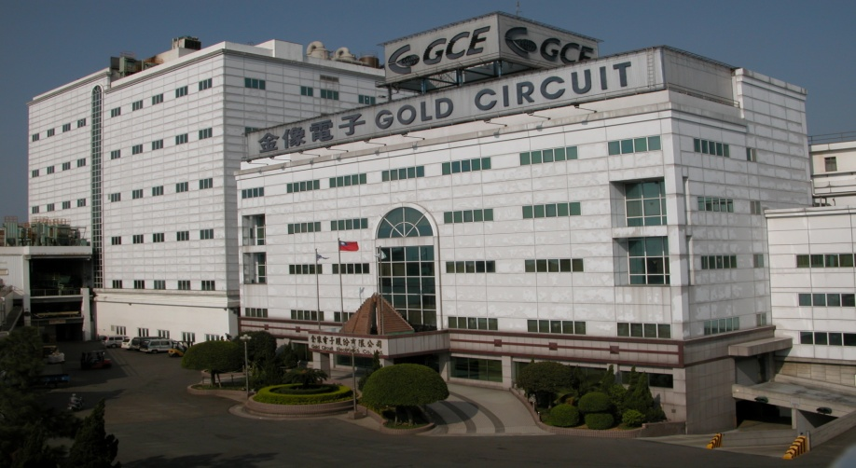
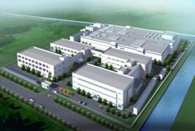
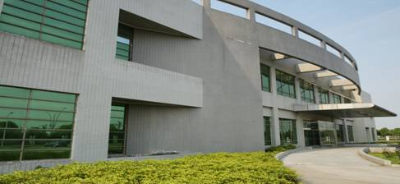
General Information
Company Name:
Founded in
Stock Listed
Capital
Product Tech.
Manufacturing Sites
Gold Circuit Electronics
1981
Mar. 9th, 1998
NTD 5465 Million
High Layer Count, HDI, Heavy Cu & Backplane
Taiwan 、Suzhou 、Chang Shu

Slide 4
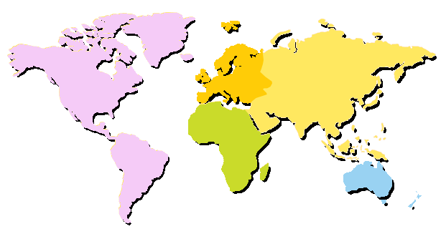
Global Support & Service
Europe
Europe
Asia
America
Korea
East USA
ChangShu I
Japan
West USA
South USA
ChangShu II
ShenZhen
Suzhou
Taiwan
Africa
Malaysia
Oceania
Service Office
Plant

Slide 5
Sales Revenue History

Slide 6
Y2021 H1
Consolidated Financial Statement
Unit: NT$ hundred million
 | 2021 H1 | 2020 H1 | Compared with the same period last year
Operating Revenue | 121.67 | 113.56 | 7%
Operating costs | 92.56 | 87.35
Gross Profit | 29.11 | 26.21 | 11%
Gross Profit Margin | 24% | 23% | 1%
Operating Expenses | 10.76 | 10.83
Net other income (expenses) | 0.09 | (0.73)
Operating Income | 18.44 | 14.65 | 26%
Non-Operating Income and Expenses | (0.60) | (0.63)
Pre-Tax Income | 17.84 | 14.03 | 27%
Net Income | 13.21 | 11.34
EPS | 2.44 | 2.10 | 0.34

Slide 7
Y2021/Y2020(Quarterly)
Consolidated Financial Statement
Unit: NT$ hundred millions
 | Q1 | Q2 | Q3 | Q4 | TOTAL
Y2020
Operating Revenue | 50.46 | 63.1 | 64.3 | 56.12 | 234
Income before Tax | 5.22 | 8.81 | 7.21 | 5.74 | 26.98
Y2021
Operating Revenue | 57.8 | 63.77 |  |  | 121.6
Income before Tax | 7.78 | 10.05 |  |  | 17.84
Revenue growth rate | 15% | 1%

Slide 8
Capability
Layer
Full range Technology & Capability
52L
IC Testing
Adv.Server
&
Networking
Server
Telecom
30L
Power
Telecom
Automotive
10L
Telecom
Server
NB
Automotive
Smart Home
Tablet/NB
Smart Phone
Automotive
MLB
HDI
Heavy Cu
Technology

Slide 9
Product Application (GCE)

Slide 10
Q & A

Slide 11
Thank you for your attention !

