Slide 1
Gold Circuit Electronics
2023 Investor Conference
Date: Mar. 13 , 2023

Slide 2
Disclaimer
The presentation contains projections & estimates of financial
information as well as market and product developments for
future periods.
These projections & estimates are based on information currently
available which we believe to be reliable, but they involve risks &
uncertainties.
Our actual results of operations & financial condition may differ
significantly from those contained in projections & estimates.
The projections & estimates should not be interpreted as legally binding
commitments, but rather as flexible information subject to change
occasionally.

Slide 3
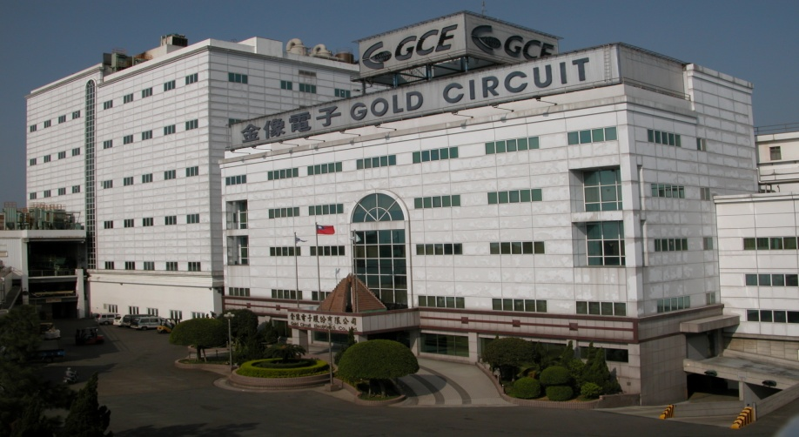
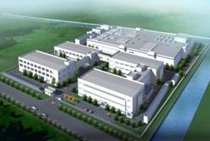
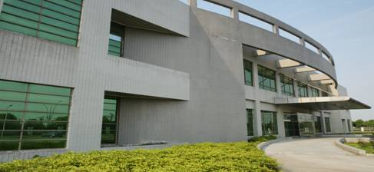
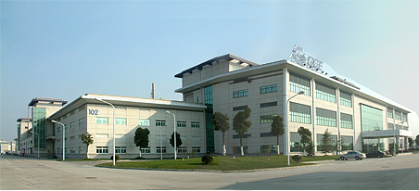
General Information
Company Name:
Founded in
Stock Listed
Capital
Product Tech.
Manufacturing Sites
Gold Circuit Electronics
1981
Mar. 9th, 1998
NTD 4,918 Million
High Layer Count, HDI, Heavy Cu & Backplane
Taiwan 、Suzhou 、Chang Shu

Slide 4
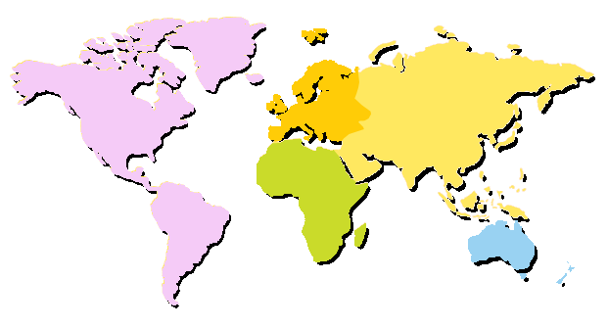
Global Support & Service
Europe
Europe
Asia
America
Korea
East USA
ChangShu I
Japan
West USA
South USA
ChangShu II
ShenZhen
Suzhou
Taiwan
Africa
Malaysia
Oceania
Service Office
Plant

Slide 5
Sales Revenue History

Slide 6
Y2022
Consolidated Financial Statement
Unit: NT$ hundred million
 | 2022 | 2021 | Compared with the same period last year
Operating Revenue | 327.85 | 266.07 | 23%
Operating costs | 240.57 | 202.36
Gross Profit | 87.28 | 63.71 | 37%
Gross Profit Margin | 26.6% | 23.9% | 2.7%
Operating Expenses | 27.05 | 22.46
Net other income (expenses) | 0.14 | (0.03)
Operating Income | 60.37 | 41.23 | 46%
Non-Operating Income and Expenses | 3.52 | (0.74)
Pre-Tax Income | 63.88 | 40.49 | 58%
Net Income | 45.68 | 29.27
EPS | 8.86 | 5.41 | 3.45

Slide 7
Y2022/Y2021(Quarterly)
Consolidated Financial Statement
Unit: NT$ hundred millions
 | Q1 | Q2 | Q3 | Q4
Y2021
Operating Revenue | 57.9 | 63.8 | 70.5 | 73.9
Gross Profit Margin | 22.8% | 24.9% | 23.7% | 24.3%
Income before Tax | 7.8 | 10.1 | 10.8 | 11.8
Y2022
Operating Revenue | 72.4 | 84.6 | 86.1 | 84.8
Gross Profit Margin | 23.0% | 29.4% | 27.6% | 26.0%
Income before Tax | 11.1 | 20.2 | 18.9 | 13.7
Revenue growth rate | 25% | 33% | 22% | 15%

Slide 8
Capability
Full Range of Technology Availability
Layer
Count
56L
IC Testing
Adv. Server
&
Networking
30L
Server
Telecom
Telecom
Server
NB
LEO
Automotive
Power
Telecom
Automotive
Smart Home
Tablet/ NB
Smart Phone
Automotive
10L
MLB
HDI
Heavy Cu
Technology

Slide 9
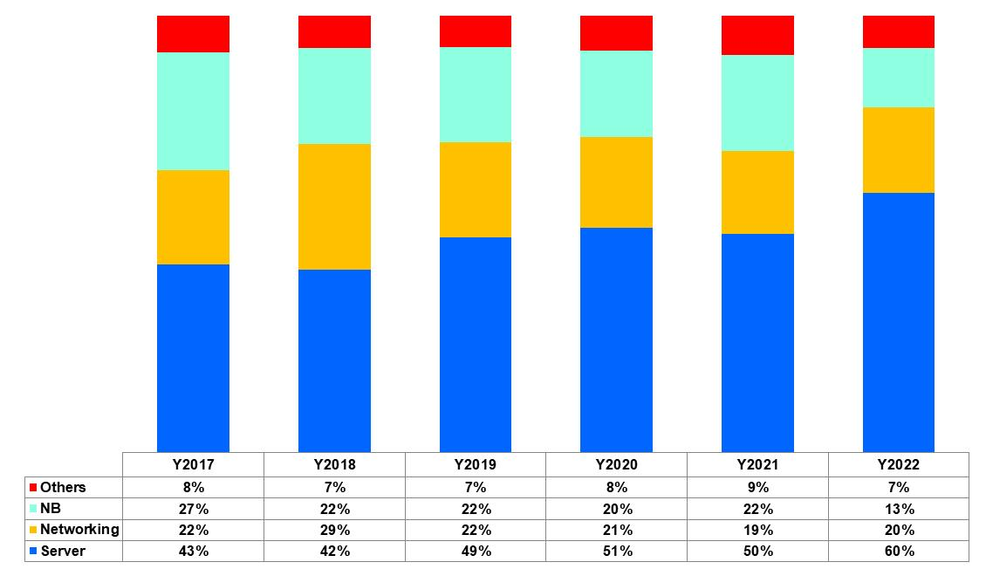
Product Application (GCE)

Slide 10
Q & A

Slide 11
Thank you for your attention !

