Slide 1


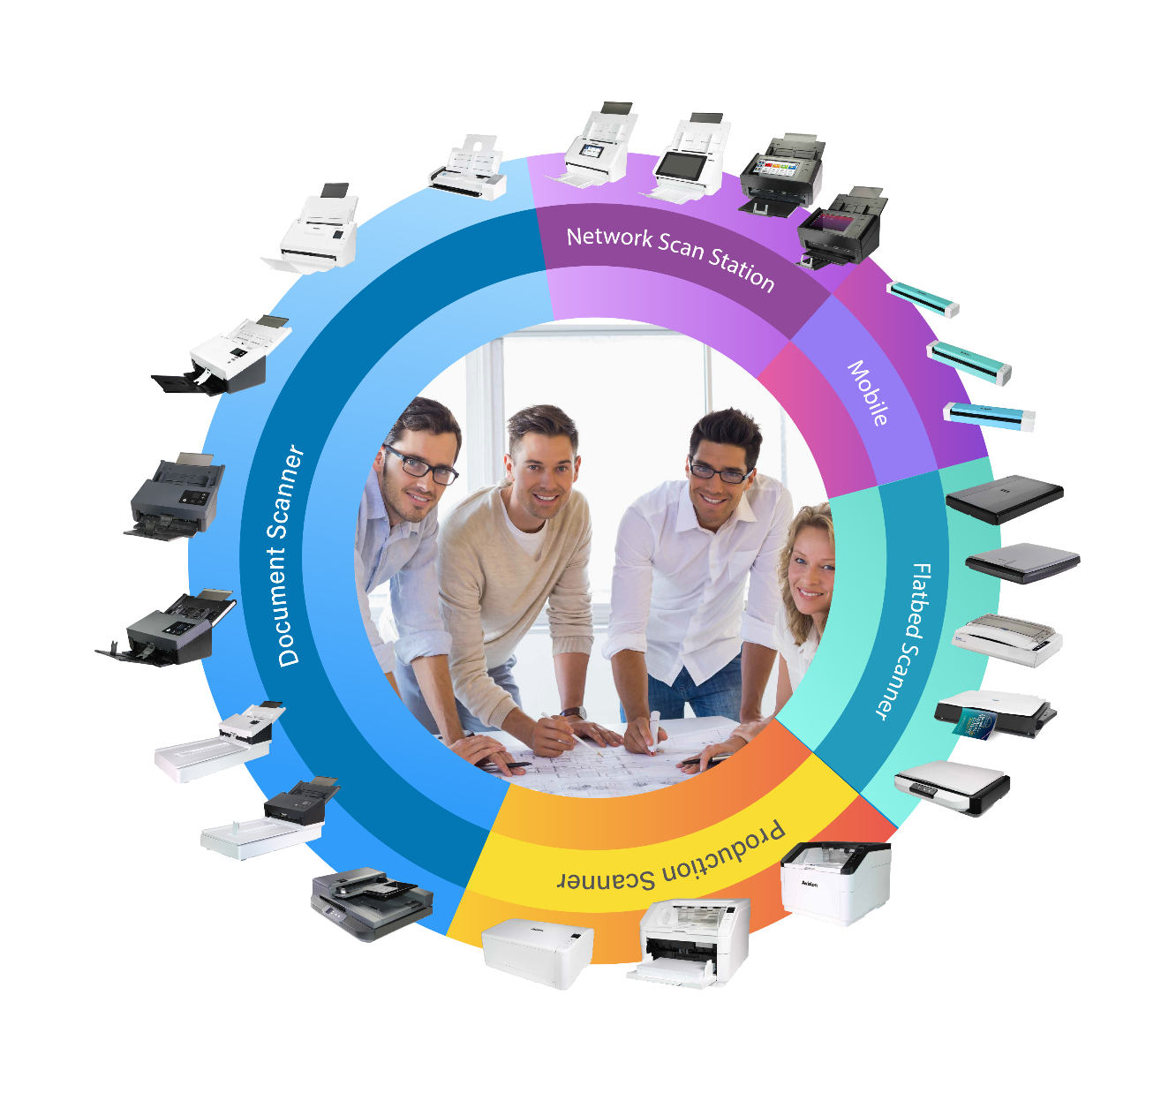
A vision of your office
2024
COMPANY & PRODUCT INTRODUCTION

Slide 2

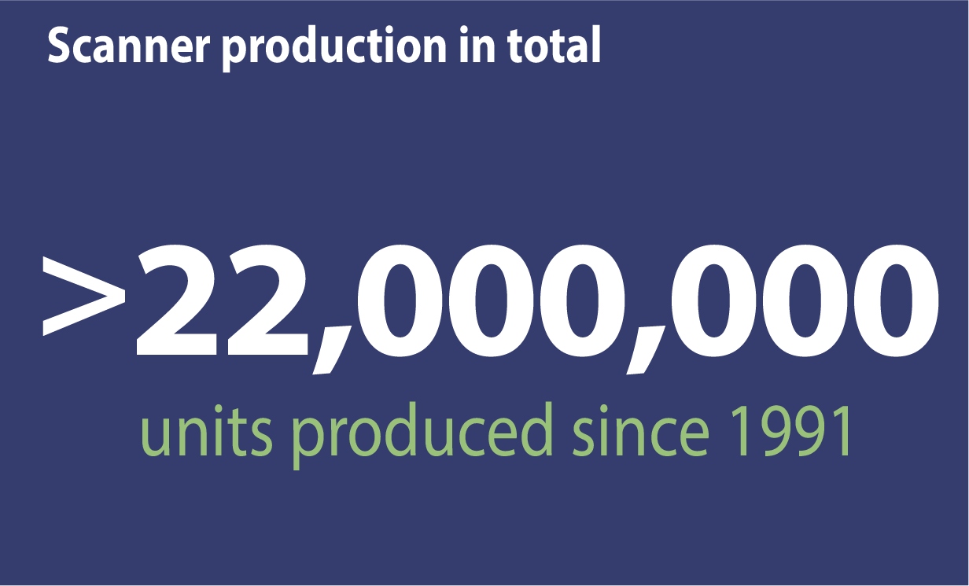
Avision's Achievement
Time-tested Good Quality
Avision has produced more than 22 million scanners since its establishment in 1991.

Slide 3
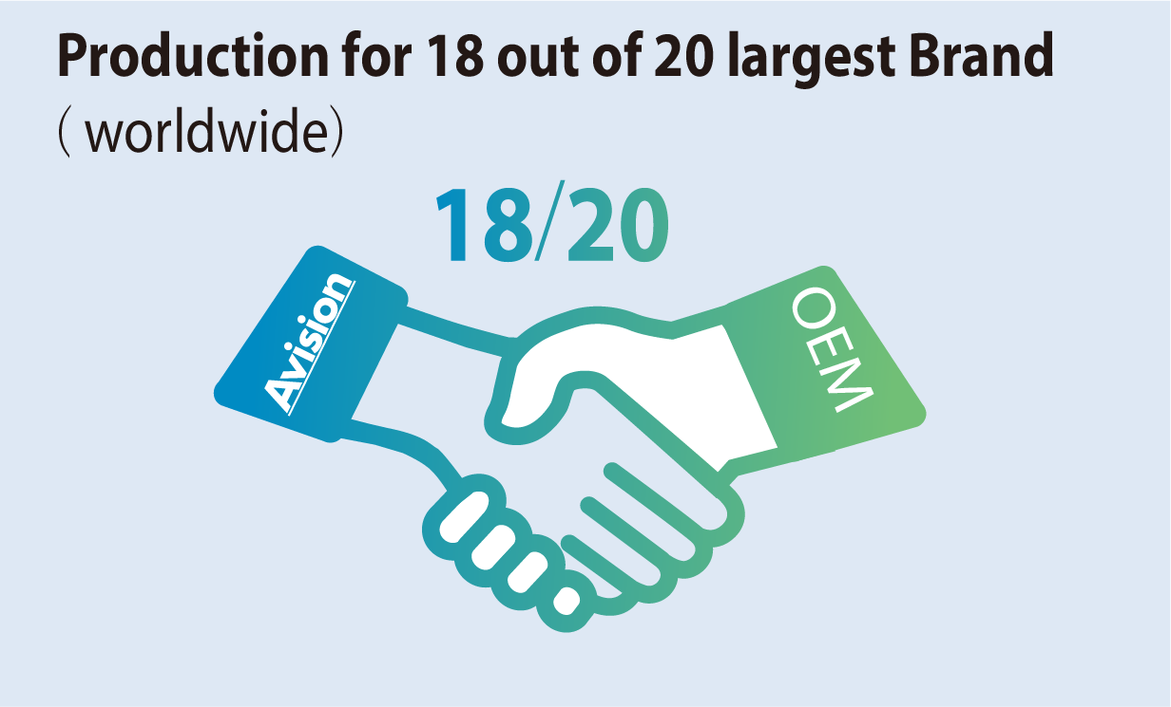

Avision's Achievement
A Reliable Business Partner
Avision is a reliable business partner of 18 among the top 20 Scanner/ multi- function printer manufacturers in the world.
Resource: Infosource / IDC

Slide 4



Avision's Achievement
Driven by Innovation, Proved by Products
With more than 230 R&D engineers, Avision invests more than 23% of the company's revenue each year in its product development, and has successfully developed more than 520 product models by far.

Slide 5
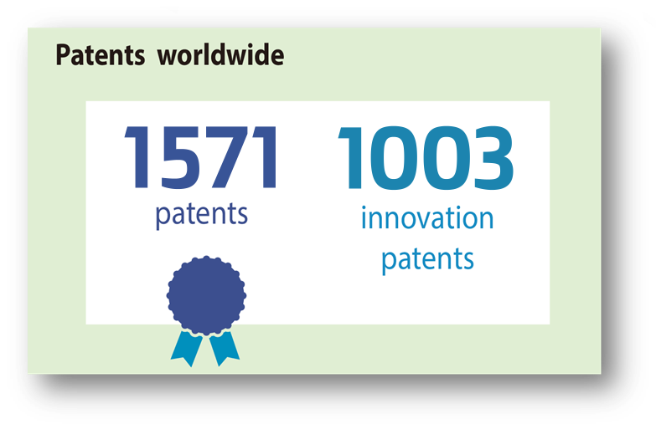
Avision's Achievement
Internationally Recognized
Expertise
Avision has obtained 1,571 patents and 1,003 innovation patents, and has 76 patents on pending list.

Slide 6
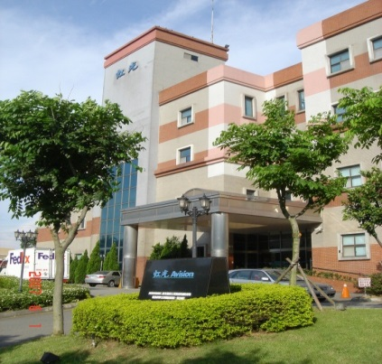
Company Introduction
Established 1991
Location Science Park, Hsinchu, Taiwan
Capital NT$2,100,000,000 (~US$67.5M)
No. of Employees: Taiwan/ 390 China / 318
Stock Listed December, 1998
ISO-9001 Certified since Sep 1993
ISO-14001 Certified since Jan 2000
ISO-13485 Certified since Nov 2012
Avision Inc. Headquarter (AVI)
Avision Brazil Ltd. (ABL)
Avision-Labs Inc. (AVL)
Avision Europe GmbH(AEG)
Avision (Suzhou) (AVS F1)
Avision (Suzhou) (AVS F2)

Slide 7
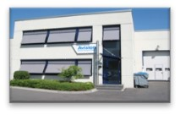
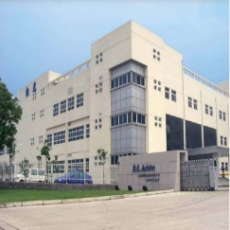

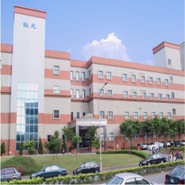
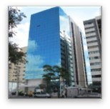
Branch Office of Worldwide
AEG Branch Office
AEG Branch Office
AVS Suzhou Factory F2
AVL Branch Office
AVI Headquarter
ABL Branch Office

Slide 8
R&D Team
R&D Group 1
Firmware
O. Mechanical
Software
Hardware
Network System
Develop.
System Develop
ASIC Develop.
Test Team
R&D Group 2
EP Develop.
Mechanical 1
Mechanical 2
Firmware
Software
Hardware

Slide 9
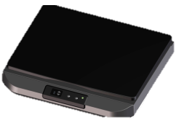











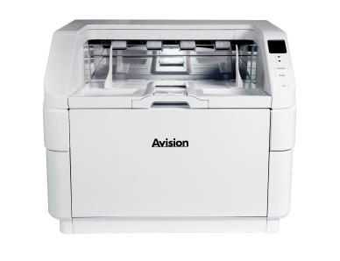


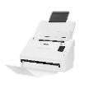
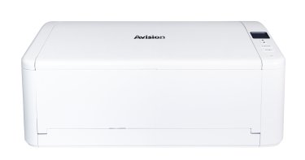





Avision Scanner Roadmap
H
FB5100
FB6300
FB6380E
AD370
AD380
AD5800
AD3100
AD8150
4 Sec
4 Sec
4 Sec
70ppm
80ppm
80ppm
100ppm
150ppm
M
FB2380E
AD136
AD345G
AD360G
AD8120U
1.5 Sec
36ppm
45ppm
60ppm
120ppm
FB25
AV332
AD340G
AD6090
L
1.5 Sec
32ppm
40ppm
90ppm
FB15
AD225
ScanQ-DW
ScanQ-DW
ScanQ-DW
2.5 Sec
25ppm
4 Sec
4 Sec
4 Sec
ENTRY
Mobile Scanner
Flatbed Scanner
Document Scanner
Production Scanner
Notes:
CIS拿掉 CCD留著 / 改成金字塔圖

Slide 10
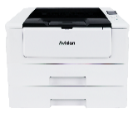
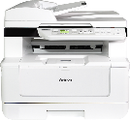
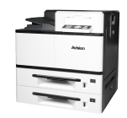


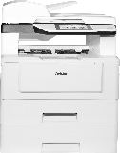

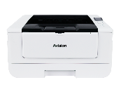
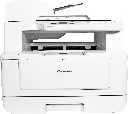
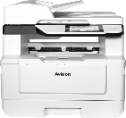
Avision SFP / MFP Products in 2024
AP30 Print : 30ppm /31ppm
AP33 Print : 33ppm/35ppm
Print : 43ppm/45ppm
Print : 40ppm/42ppm
Scan : 36ppm/72ipm
AP400 : 40 ppm (A4 LEF)
AP500 : 50 ppm (A4 LEF)
Print : 25-50 ppm (A4 LEF)
Scan : 60ppm/120ipm
Print : 50 ppm
Scan : 100 ppm/200 ipm
AP30/AP33
AP43 Plus
AM40
AP400/AP500
AM76XX
AM77XX
AP40
AM30/AM33
AM40A
AM43A Plus
AM56XX
Print : 40ppm / 42ppm
AM30 Print : 30ppm / 31ppm
Scan : 10 ppm
AM33 Print : 33ppm / 35ppm
Scan : 20 ppm
Print : 40ppm/42ppm
Scan : 36ppm/72ipm
Print : 43ppm/45ppm
Scan : 36ppm/72ipm
Print : 25-50 ppm (A4 LEF)
*Printing Speed : (A4) / (Letter)

Slide 11
Printer Core Technology -1
Independently MFP core controller
Controller VM3(NP115) Feature
  Highly integrated : Designed for BW& color printer and high-speed scanners.
  High performance computing, low power consumption, TEC energy compliance, Energy Star compliance.
  Encryption / Decryption function: Equipped with encoding engine, ultra-high-speed, encryption & decryption function.
  Equipped scanning control, printing control, image processing.
VM4 (under developing)
  The first MFP core controller use RISC-V
  Richer functions and lower cost than VM3

Slide 12
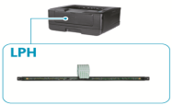
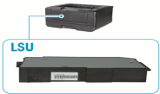
Printer Core Technology -2
LED Printer Head (“LPH”)
  Key component of Color Printers
  Small size, Space efficiency
  High-quality print imaging
  Efficiency and low power consumption than LSU
  No motor and polygon mirror, No noise
  Rarely Provider (eg: FujiXerox, OKI), only for its internal use.
Core Advantages
  Patent ownership and manufacturing technology
  All-Round IPs: LED Chip Design -> LPH Module Design -> GaAs Wafer Outsource -> Finish production

Slide 13
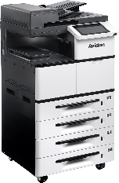
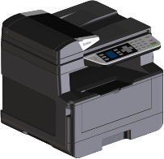
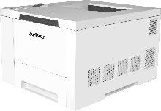
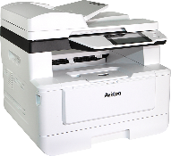
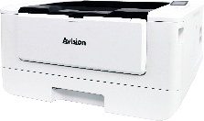
Avision Laser Printer and Copier Roadmap
Market Price
AM7760i
AM7650i
Intelligence
A3 60ppm
Intelligence
A3 50ppm
Color MFP
AM7640i
A4 30/35ppm
Intelligence
A3 40ppm
Color printer
A4 30/35ppm
Scorpion
AM40/45
Falcon
High speed
A4 50ppm
AP40
A4 40/45ppm
Low cost
A4 22/28ppm
A4 40ppm
2024
2025
Time

Slide 14
THANKS
Thank You
COMPANY & PRODUCT INTRODUCTION

