Slide 1
Elite Material Co., Ltd.
Global leader of eco-friendly laminates
Presentation
August, 2021

Slide 2
Disclaimer
This presentation may contain “forward-looking statements” which may include projections on future results of operations, financial condition, and business prospects based on our own information and other sources.
The actual results of operations, financial condition, and business prospects may differ from those explicitly or implicitly indicated in those forward-looking statements for a variety of reasons, including but not limited to market demand, price fluctuations, competition, supply chain issues, global economic conditions, exchange rate fluctuation and other risks and factors beyond EMC’s controls.
The forward-looking statements in this presentation, if any, only reflect the current view of EMC as of the date of its release. EMC undertakes no obligation to update those forward-looking statements for events or circumstances that occur subsequently.

Slide 3
Content
Industry outlook
Financial performance
Appendix

Slide 4
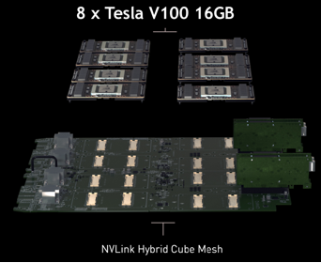
PCB design of networking infrastructure is migrating
Trend 1: Halogen-free. HF laminates are preferred or required.
New platforms of PCIe 4 include, but are not limited to, Intel’s Whitely, request only halogen-free laminates.
Trend 2: HDI. AI semiconductors, GPUs and CPUs, and heterogeneous integration of semiconductors increase pin counts substantially.
Fine line/pitch HDI architecture design by PCB constructors becomes common.
Trend 3: The manufacturing technique of HDI becomes the must handicraft art of high-end networking board.
Decades of experiences and knowledge EMC accumulated in HF and HDI now a competitive advantage unrivalled by peers.
AFTER
Multi-GPUs make a super high speed computing AI Server
BEFRORE
Source: nVidia

Slide 5
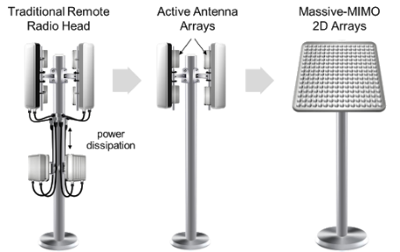
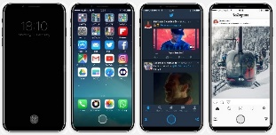


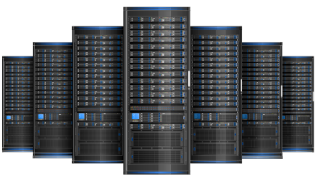
Trend of 5G infrastructure development: HDI, High Speed, High Frequency
HDI
High Speed
High Frequency
AAU
MIMO
AiP
RRU
BBU
Phone-5G
mmWave
Phone-4G
ADAS
77GHz
Phone-3G
AI Server
Switch-800G
26.56 GHz
NB- USB4.0
Server- PCIe5
16GHz
Switch-400G
14GHz
Infotainment
NB- USB3.0
E-Mobility
Switch-100G
12.89GHz
ECU
Server- PCIe4
8GHz
Server- PCIe3
4GHz
Switch-40G
5GHz

Slide 6
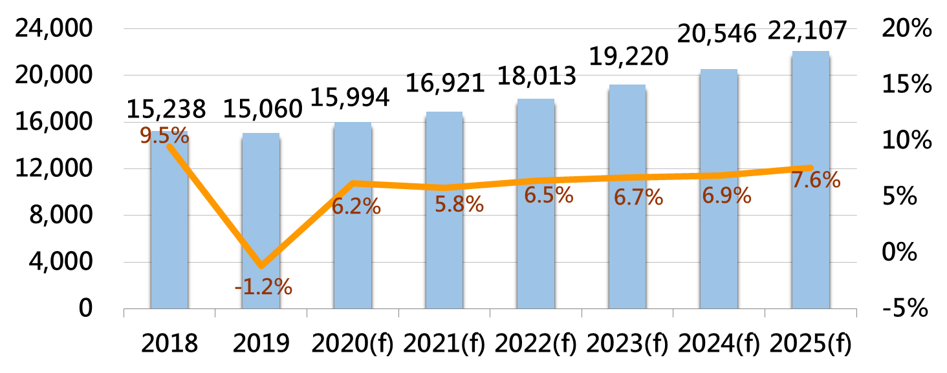
Global server shipment is increasing for next 5 years
Unit：k set
CAGR 6.7%
Source：DIGITIMES Research，2020/9
Notes:
2020年雖首季受疫情影響出貨，但隨供應鏈恢復正常作業，加上2019年雲端業者去化庫存致基期低，2020年出貨量將年增約6.2%。
2021年預期整體伺服器市場成長較為趨緩，年增約5.8%。
肺炎疫情雖加速企業與個人使用雲端服務而有助雲端資料中心營運成長，但在全球疫情未能有效控制導致經濟不振下，亦將影響部分企業客戶對伺服器的採購，減緩伺服器出貨成長速度。
2020年後預期中美關係趨緊張，使中國大陸伺服器業者在關鍵組件(如CPU、記憶體等)取得可能受阻；若轉單予戴爾、慧與或聯想等其他業者，亦需磨合時間，而恐延遲伺服器出貨進度。
預期2022年後疫情影響將減弱，加上晶片商英特爾、超微、NVIDIA新一代CPU及GPU方案開始有效帶動資料中心伺服器換機需求，將恢復年增6.5%以上的態勢。

Slide 7
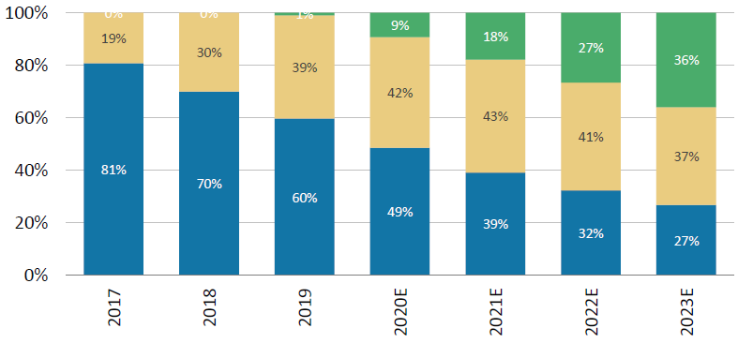
The 100/400G switch is becoming the main stream
2017~2023 switch split
800G
Source: IDC, Morgan Stanley Research
7

Slide 8


The CAGR of 5G Smartphone is 37.9%
Unit: Million
Source: DIGITIMES Research, 2020/9

Slide 9
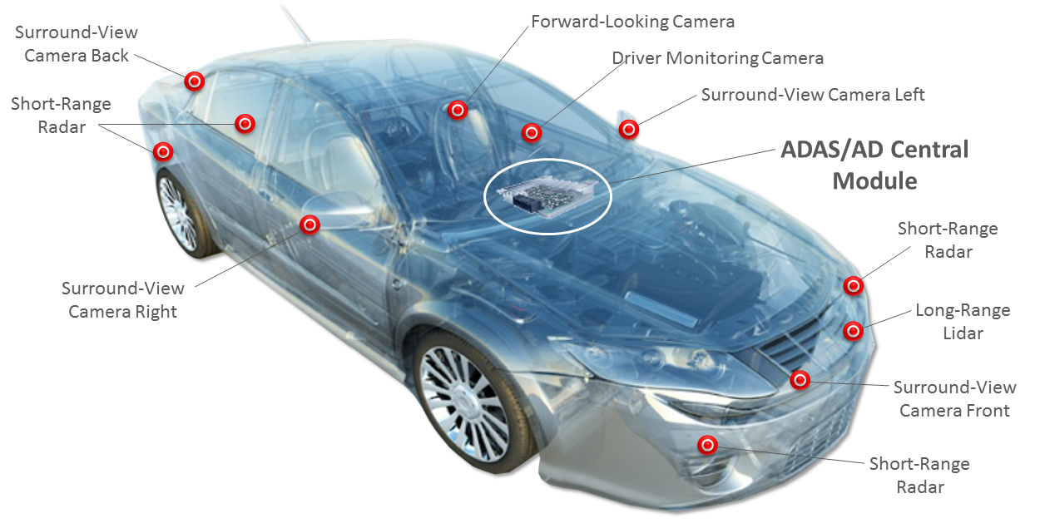
HDI is a must trend of wide varieties of automotive electronics applications
HDI (High-Density Interconnection) PCB adoption in automotive electronics is set to rise in the next 10 years in step with higher penetration of ADAS (advanced driver assistance systems), infotainment systems and telematic systems.
Notes:
https://www.eetasia.com/18062706-xilinx-and-daimler-team-up/

Slide 10
Sales Revenue
NTD：Billion
2003：2.3Bn→2020：27.2Bn
(2003 ~ 2020) 17 years GAGR=15.5%

Slide 11
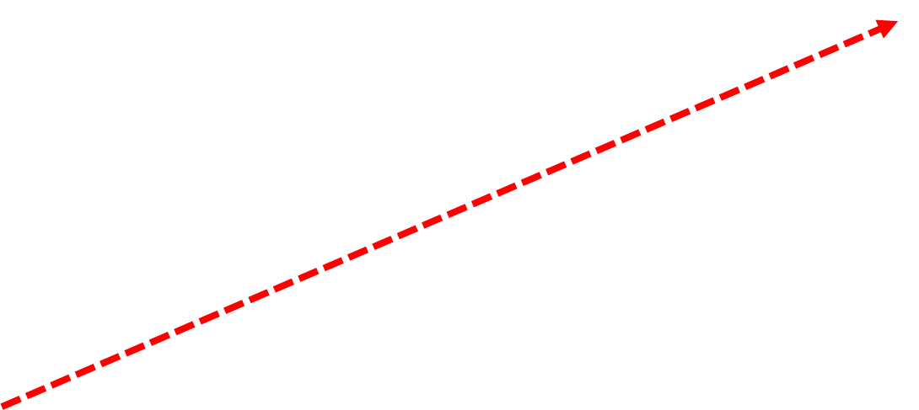
Operation Performance

Slide 12
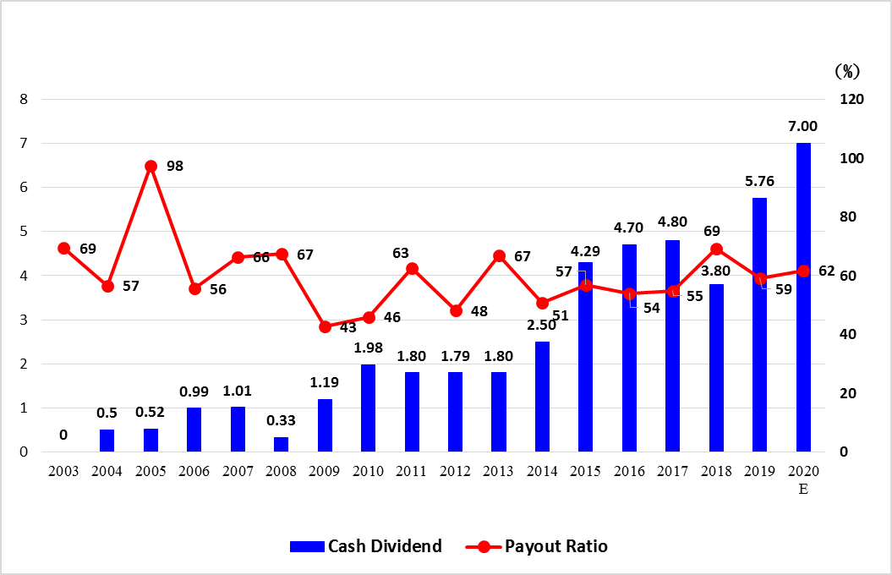

History of Cash dividend and Payout ratio

Slide 13
Q21 P&L summary

Slide 14
1Q21 Abstracted Balance Sheet

Slide 15
appendix

Slide 16
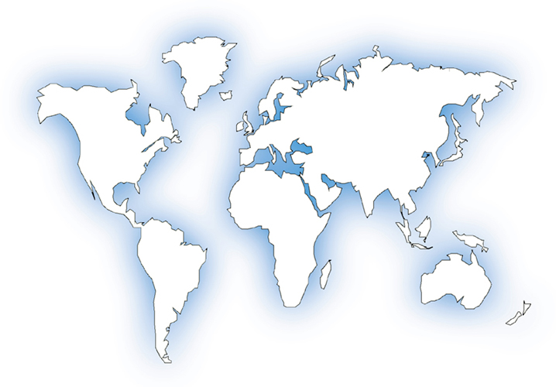

Company profile- Global Footprint
UK
Kunshan, China
Japan
MN
MN
Germany
MN
OH
Huangshi, China
Korea
SJ & SA, CA
EMC Group Outline
TAIEX listing code: 2383
Established: 1992
Manpower: 3,200+
Capacity: 3.55 KK sheets/ month (CCL)
10.7 KK m/ month (PP)
800 K SF/ month (Mass Lam)
40K panels/ month (MCCCL)
Paid-in capital: USD 96 million
Revenue in 2020: USD 920 million
Qualification: ISO-9001, ISO-14001, IATF-16949,
ISO-45001, QC080000, AS9100C
and Sony Green Partner
UL file number: E150504
Zhongshan, China
RC, CA
France
CA
Taiwan, HQ
Production facility
Distributor
Representative office

Slide 17
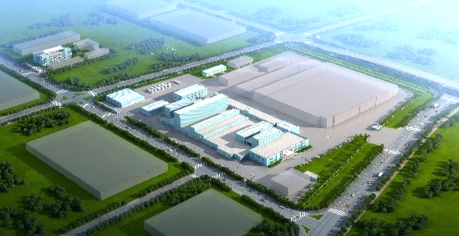
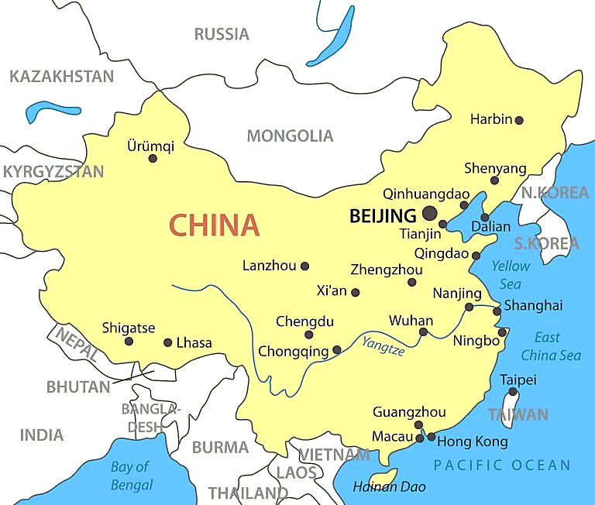
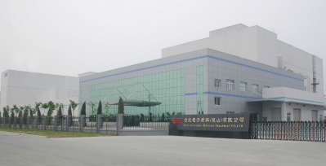
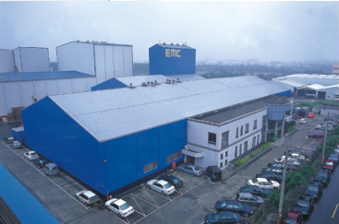
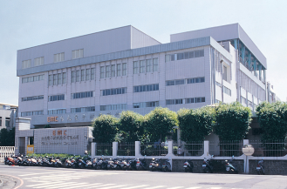
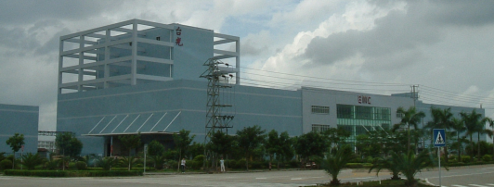
Manufacturing Locations and Monthly Capacity
EMC (KS)
Kunshan
CCL: 1.35kk sheets
PP: 3.3kk meters
Manpower: 1,000+
+300K SHT/M in Q3,2022
EMC (HS)
Huangshi
CCL: 600k sheets
PP: 2.4kk meters
Manpower: 500+
+300K SHT/ Month
by June, 2022
EMC (TW)
Taoyuan
CCL: 500k sheets
PP: 1.8kk meters
Manpower: 600+
EMC (TW)
Hsinchu
CCL: 150k sheets
PP: 1.1kk meters
Mass Lam: 800k ft2
Metal Core: 40k pnls
Manpower: 300+
EMC (ZS)
Zhongshan
CCL: 950k sheets
PP: 2.1kk meters
Manpower: 800+

