Slide 1
股票代號：2404
漢唐集成股份有限公司
法人說明會
United Integrated Services Co.
Investor Conference
2019/05/17

Slide 2
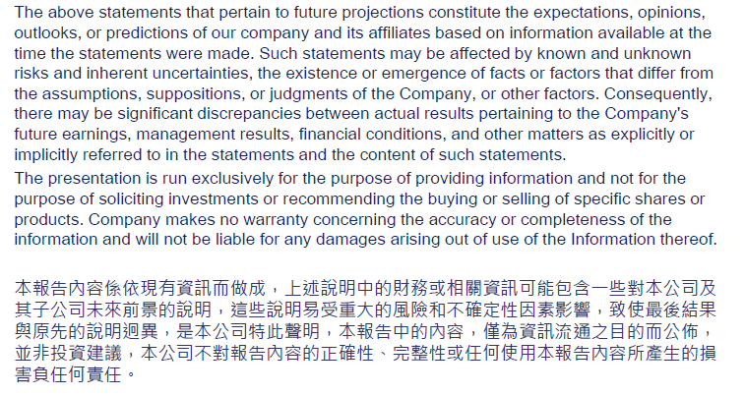
Disclaimer

Slide 3
Agenda
漢唐集成公司簡介 (About UIS)
營運概況說明 (Operation)
財務狀況說明 (Financials)
業務展望 (Future Prospects)
Q & A

Slide 4
關於漢唐集成
漢唐集成股份有限公司
財務業務說明會
漢唐集成成立於1982年，為一以「全面性整合服務」方式，專業提供高科技產業建廠之系統集成服務公司；主要業務範圍包括技術顧問服務、高科技整廠集成專案及電腦、控制、無塵室、機電、電信系統之專案業務。
漢唐集成的工程系統完備，服務更講求以提供「整體解決方案」之方式，一次滿足客戶需求。針對高科技事業建廠所需之建築工程系統、無塵室系統、機械系統、電氣系統、配管系統、製程支援系統、儀錶及控制系統、通訊系統、生命安全系統、門禁及安全管理系統、空間規劃管理、大宗及特殊氣體系統、超純水（UPW）及再生系統、超純水回收系統、廢水處理與製程化學品輸送，及二次配管路工程等系統，均囊括在漢唐集成的服務範圍內。
漢唐集成並就以上各項系統提供從規劃、設計、施工、試車、移交、保固到維修，及營建之監督及管理的服務，同時將以上各項系統工程加以整合，達成介面統一，使客戶完全無需擔憂各個不同系統之間的整合問題；目前全國亦唯有漢唐集成真正有此能力，可將各種高技術系統工程加以集成。

Slide 5
About UIS
United Integrated Services Co., Ltd is a multidisciplinary engineering and construction company that is capable of overall systems coordination. We provide fully integrated design/build services to our clients in the high technology industry for their manufacturing facility needs.
Our scope of services include engineering consulting, high-tech factory planning and delivery in which clean-room systems, HVAC, electrical systems, instrumentation and control, process utilities, telecommunication systems and tool hook-up are all vital parts in need of total coordination. Our value added integrated turn-key services not only provide continuity from planning, design, procurement, construction, tool hook-up and start-up/commissioning but also go beyond after service by assisting our clients in facility operation and maintenance.
In short, we strive to be a one-stop shop to satisfy our clients’ every facility needs.
About UIS

Slide 6
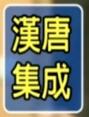





UIS歷史沿革
About UIS
漢唐科技工程有限公司成立
Company Established
成立江西漢唐系統集成限公司
Established UIS, Jiang Xi
申請掛牌上市(股票代號 2404)
IPO
1990
2002
2011
1982
2000
2003
合併訊聯系統股份有限公司並更名為漢唐訊聯股份有限公司
Acquired United Information Systems
申請更名為漢唐集成股份有限公司
Changed name to United Integrated Services Co.
成立新加坡漢唐私人有限公司
Established UIS, Singapore

Slide 7
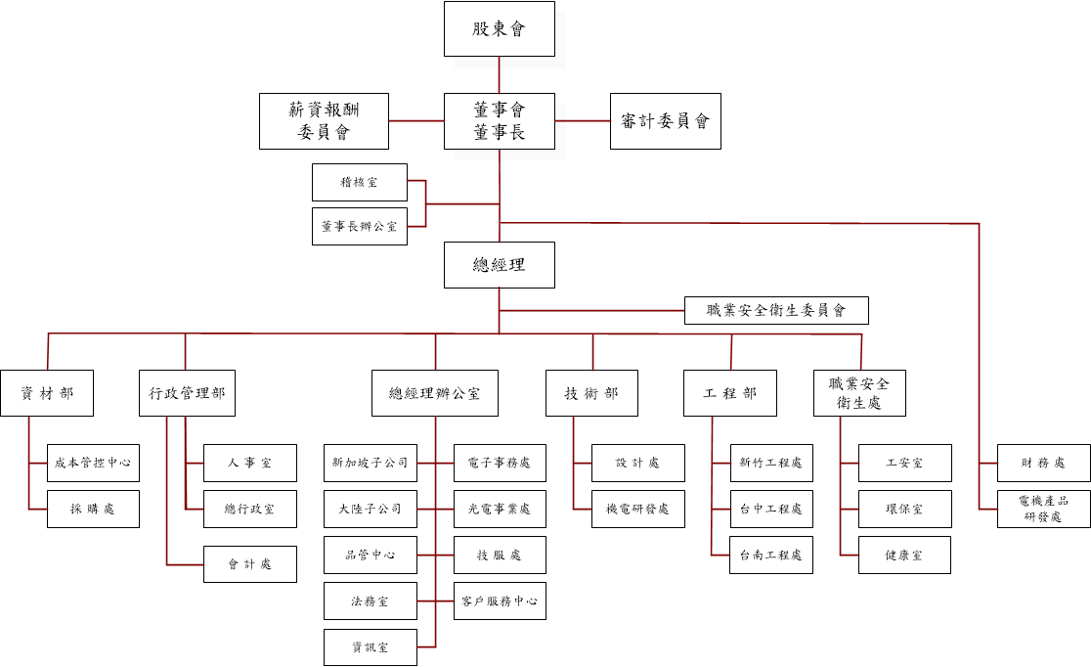
UIS公司組織表
Organization

Slide 8
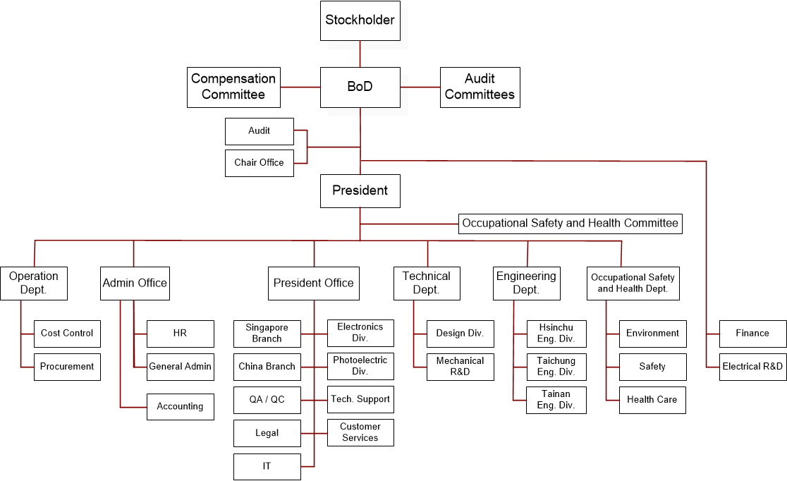
UIS公司組織表
Organization

Slide 9
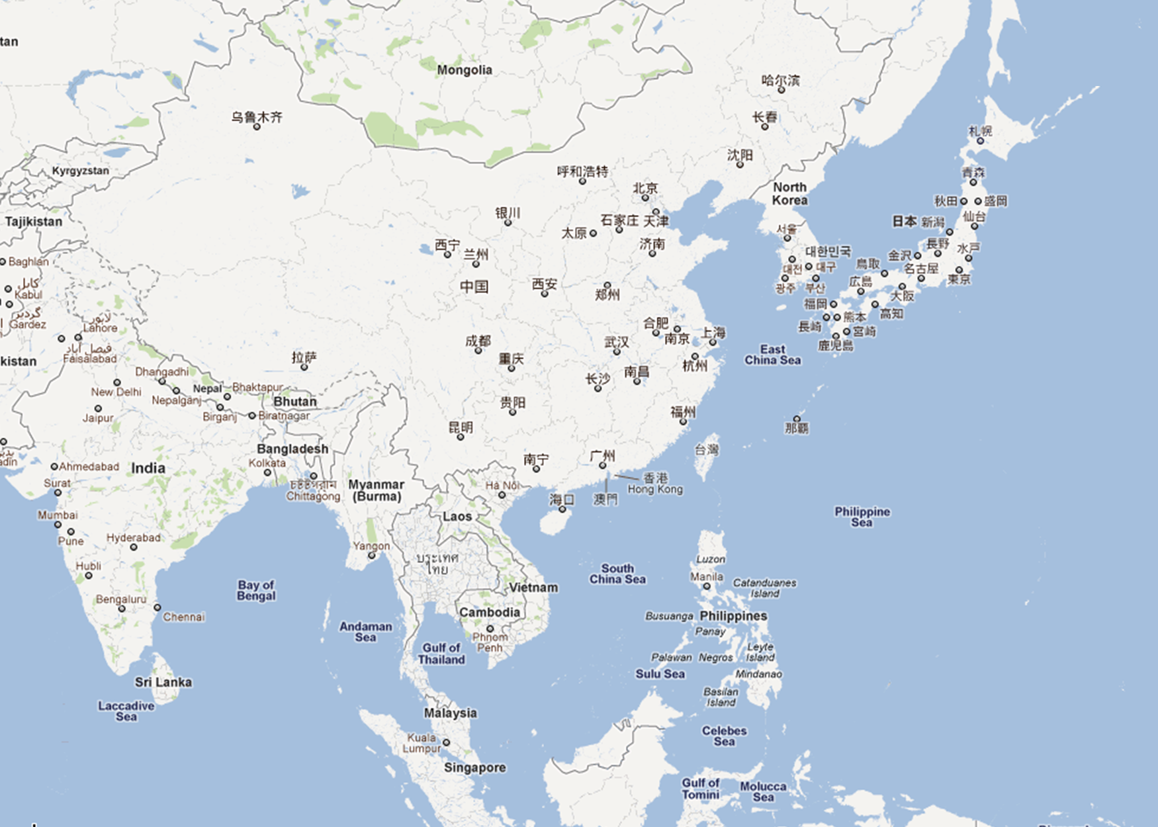
UIS客戶群(UIS Clients)
● TSMC Nanjing Project-Cleanroom
Hsinchu
● Tsmc FAB 12 P5, P6,P7
Longtan
● QPM FAB C (TSMC BP03)
● CEC- Panda G6/G8.5 FAB
● CHOT G8.6 CELL
Taichung
● Tsmc FAB 15 P1- P7
● Micron FAB A2
● Auo L8B FAB
● tsmc Solar
● Auo Crystal
● CEC-Panda G8.6 洁净室系 统及辅助系统三标段
● CSOT T3
●長鑫 洁净室工程
Tainan
● Tsmc FAB 14 P4- P7
● Tsmc FAB 18 P1-P2
Kaohsiung
● ASE K22
●晶合集成 洁净室工程
★
深圳
● 华佳彩洁净室A包工程
● CSOT G8.5 FAB T1/ T2P1 /T2P2
★ Main office
Xindian
● Branch office and
Service Locations
Hsinchu
Taichung
Tainan
Shanghai
Nanjing
Hefei
Shenzhen
Singapore
● AUO L4B P1, P2, P3
● SSMC
Notes:
This is the regional support of UIS. We offer our services in three countries, Taiwan, Singapore, and China. The main office is here in Xindian. We have three branch offices in Taiwan located in Hsinchu, Taichung, and Tainan.
In China, there are three Service locations, Shanghai, Nanjing, and Shenzhen.

Slide 10
主要服務
Key Services
工程承包範圍
Scope of Engineering
  無塵室工程
  Cleanroom
  機電工程
  Mech. / Elec. Engineering
  水氣化等特殊系統工程
  Gas / Chem. / Special Systems
  監控系統工程
  I&C
服務範圍
Scope of Services
  工程顧問服務
  Consulting
  工程設計
  Design
  工程施工
  Construction
  工程監造
  construction supervision
  售後服務
  After Sale Services

Slide 11
整合服務
System Integration
Architectural Systems
Civil
Landscaping
Finishes
Exterior Wall System
Special Equipment; such as kitchen equipment, loading/unloading, etc.
Interior of general areas
Aesthetic Lighting
Structural Systems
Piling
Foundations
Structural Floors and Walls
Seismic Considerations
Wastewater collection and treatment
Bulk gas, specialty gas and clean dry air
Chemical delivery, waste chemical collection, and chemical reclaim
Arch./Stru.
Cleanroom
PCS
MEP
Hook Up
Consultant
Mechanical System
Electrical System
Plumbing System
Construction
Cleanroom System
  Partitions, Floors, and Ceiling
  Temperature and Humidity Control
  Process Support
  Process Exhaust
  Contamination Control
  Lighting
General Contractor
System Integration

Slide 12

半導體主要客戶
Semiconductor
Taiwan Semiconductor Manufacturing Company, Ltd.
  tsmc FAB III
  tsmc FAB IV
  tsmc FAB VI
  tsmc FAB XII P1, P2, P3, P4, P5, P6, P7
  tsmc FAB XIV P1, P2, P3, P4, P5, P6, P7
  tsmc FAB XV P1, P2, P3, P4, P5, P6,P7
  tsmc FAB XVIII P1, P2
  tsmc NANJING F16P1
Micron Memory Taiwan Co., Ltd.
  Micron FAB A1 A2
Winbond Electronics Corp.
  Winbond FAB I
  Winbond FAB II
  Winbond FAB III
  Winbond FAB IV
  Winbond FAB CTSP, FAB 6C
Powerchip Semiconductor Corp.
  PSC FAB 8A
  PSC FAB P3
  PSC FAB P4, P5
Macronix International Co., Ltd.
  MXIC FAB I
  MXIC FAB II
  MXIC FAB III

Slide 13
半導體主要客戶
Semiconductor
台灣積體電路製造股份有限公司
  台積電三廠
  台積電四廠
  台積電六廠
  台積電十二廠 P1, P2, P3, P4, P5, P6, P7
  台積電十四廠 P1, P2, P3, P4, P5, P6, P7
  台積電十五廠 P1, P2, P3, P4, P5, P6,P7
  台積電十八廠 P1,P2
  台積電南京廠 F16P1
台灣美光記憶體股份有限公司
  美光 FAB A1 A2
華邦電子股份有限公司
  華邦 FAB I
  華邦 FAB II
  華邦 FAB III
  華邦 FAB IV
  華邦 FAB CTSP, FAB 6C
力晶半導體股份有限公司.
  力晶 FAB 8A
  力晶 FAB P3
  力晶 FAB P4, P5
旺宏電子股份有限公司
  旺宏 FAB I
  旺宏 FAB II
  旺宏 FAB III

Slide 14
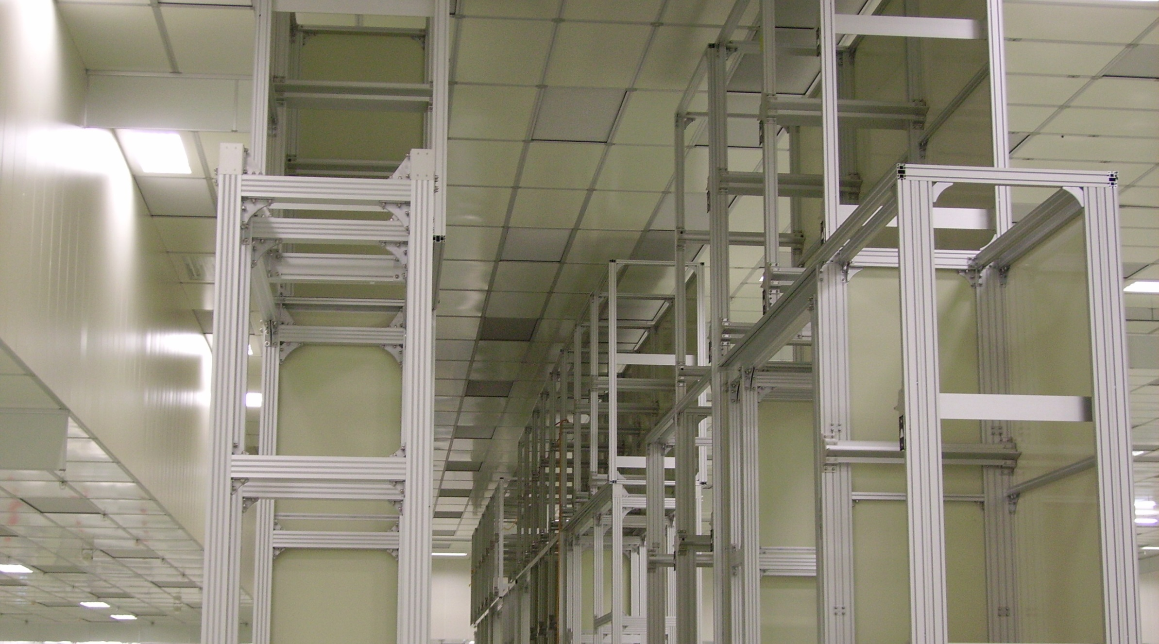
主要客戶
FPD
AU Optronics Corp.
  auo FAB L3C
  auo FAB L3D (QDI Line I)
  auo FAB L4A
  auo FAB L5A
  auo FAB L5B
  auo FAB L5C
  auo FAB L5D (QDI Line II)
  auo FAB L6A
  auo FAB L6B (QDI Line III)
  auo FAB L7A, L7B
  auo FAB L8A, L8B
Chi Mei Optoelectronics Corp.
  CMO FAB III
  CMO FAB IV
  CMO FAB V
  CMO FAB VI
  CMO FAB VII
  CMO FAB VIII
HannStar Display Corp.
  HannSrar FAB I
  HannSrar FAB II
  HannSrar FAB III
  HannSrar FAB IV
Nanjing CEC Panda LCD Technology Co., Ltd.
CEC Panda G6 FAB
CEC Panda G8.5 FAB
CSOT Corporation
  CSOT G8.5 FAB(T1)
  CSOT G8.5 FAB II(T2)
  CSOT LTPS(T3)
Qualcomm Panel Manufacturing Ltd.
  QMP FAB C
  Century Display (Shenzhen) Co., Ltd
  CDY Array/CF K1FAB

Slide 15
主要客戶
FPD
友達光電股份有限公司
  友達 FAB L3C
  友達 FAB L3D (QDI Line I)
  友達 FAB L4A
  友達 FAB L5A
  友達 FAB L5B
  友達 FAB L5C
  友達 FAB L5D (QDI Line II)
  友達 FAB L6A
  友達 FAB L6B (QDI Line III)
  友達 FAB L7A, L7B
  友達o FAB L8A, L8B
奇美電子股份有限公司
  奇美 FAB 三廠
  奇美 FAB 四廠
  奇美 FAB 五廠
  奇美 FAB 六廠
  奇美 FAB 七廠
  奇美 FAB 八廠
瀚宇彩晶股份有限公司
  瀚宇彩晶 FAB I
  瀚宇彩晶 FAB II
  瀚宇彩晶 FAB III
  瀚宇彩晶 FAB IV
南京中電熊貓液晶顯示科技有限公司
南京中電熊貓6代廠
南京中電熊貓8.5代廠
華星科技有限公司
  華星科技8.5代廠(T1廠)
  華星科技8.5代廠(T2廠)
  華星科技 LTPS(T3廠)
高通液晶顯示器股份有 限公司
  高通 FAB C
  深超光電(深圳)有限公司
  CDY Array/CF K1FAB

Slide 16
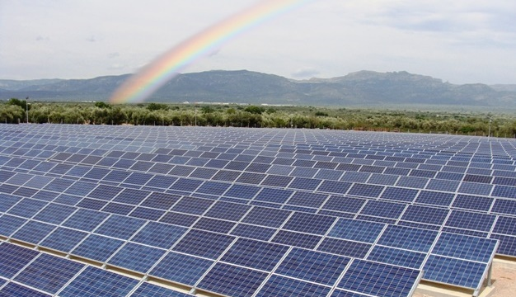
主要客戶
Solar & Others
Taiwan Semiconductor Manufacturing Company, Ltd
  tsmc Solar FAB
Taiwan Polysilicon Corp.
Advanced Semiconductor Engineering Inc
ChipMOS TECHNOLOGIES INC
Xintec Inc
Thailin Semiconductor Corp.
ProMOS Technologies Inc
AGC Display Glass Taiwan Co.,Ltd.
Hermes-Epitek Corp
Chipmore Technology Corporation Limited
TCL Communication Technology Holdings Limited
BASED SOLAR （JIANGSU）ENERGY HIGH TECHNOLOGY CO., LTD
Kunshan Guoxian Optoelectronics Co., Ltd.
AUO Crystal Corp.,
  auo Crystal Wuqi
  auo Crystal Houli
Darwin Precisions Corporation
Tianma Microelectronics Co., Ltd
Tripod Technology Corporation
BenQ Hospital
Global Advanced Packaging Technology Limited
Radiant Opto-Electronics Corporation
Shanghai Huahong (Group) Co., Ltd.

Slide 17
主要客戶
Solar & Others
台灣積體電路製造股份有限公司
  tsmc Solar FAB
福聚太陽能股份有限公司
日月光半導體製造股份有限公司
南茂科技股份有限公司
精材科技股份有限公司
泰林科技股份有限公司
茂德科技股份有限公司
旭硝子顯示玻璃股份有限公司
漢民科技股份有限公司
頎中科技（蘇州）有限公司
TCL光電科技(惠州）有限公司
江蘇百世德太陽能高科技有限公司
昆山龍騰光電有限公司
友達晶材股份有限公司
  auo Crystal 中港廠
  auo Crystal 后里廠
Darwin Precisions Corporation
Tianma Microelectronics Co., Ltd
Tripod Technology Corporation
BenQ Hospital
威宇科技封裝測試有限公司
瑞儀光電(南京)有限公司
華虹NEC(上海)有限公司

Slide 18
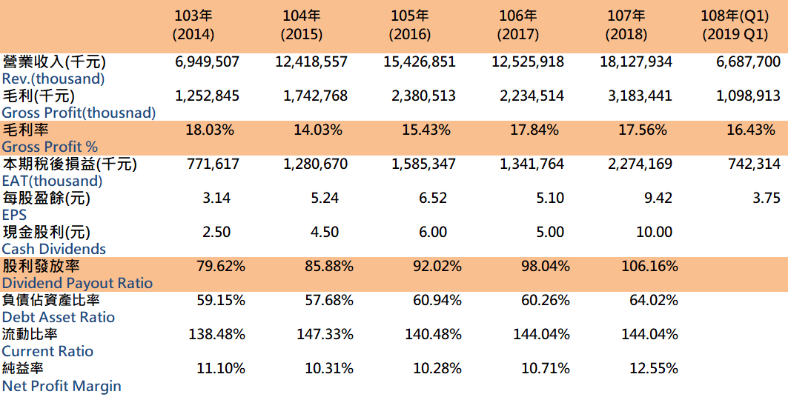
營運概況
Operation
近五年盈餘分配狀況 Income Statement

Slide 19


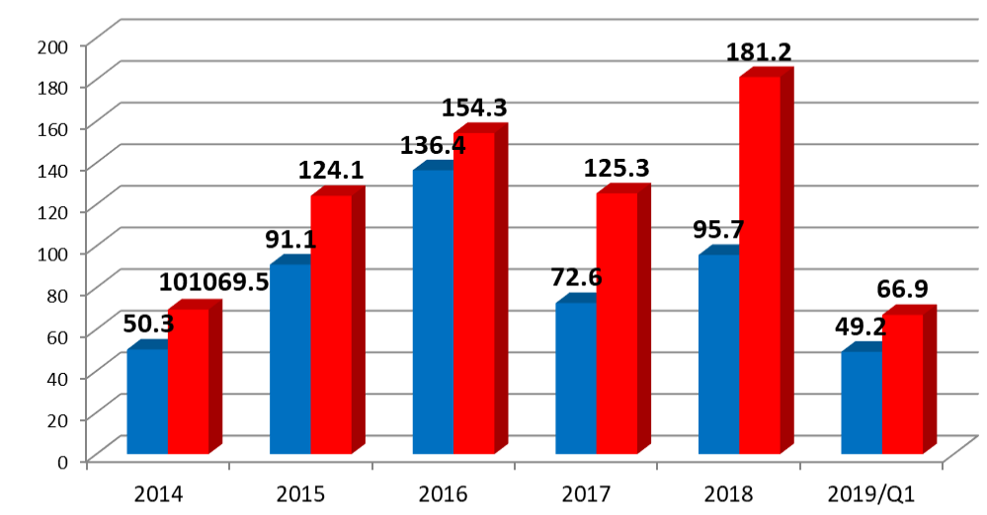
營運概況
Operation
近五年營收 (Revenue)
Unit:NTD 100 million
Individual
Consolidated

Slide 20
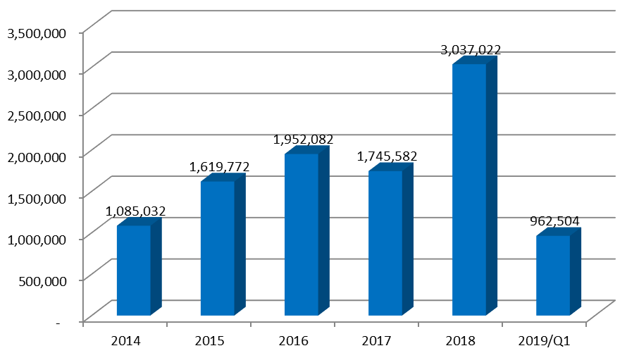
營運概況
Operation
近五年稅前淨利 (EBIT)
單位:仟元
Unit: NTD thousand

Slide 21
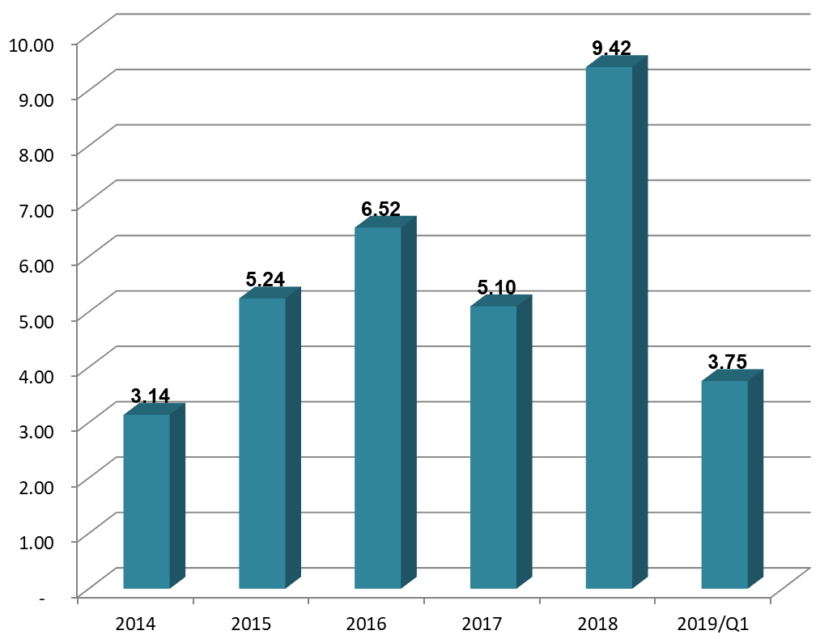
營運概況
Operation
每股盈餘 (EPS)
Unit: NTD

Slide 22
營運概況
Operation
累計接單狀況統計
Business in total
108年接單合約金額
NTD46,133,287仟元
108年1月至4月累計營收 NTD8,560,169仟元
截至108年4月已簽約未認列之金額
NTD62,655,008仟元
2019Contract Value
(thousand)
Accumulated Rev.
(from Jan. to Apr.)
(thousand)
Accumulated
Account Receivable
(to Apr.)
(thousand)

Slide 23
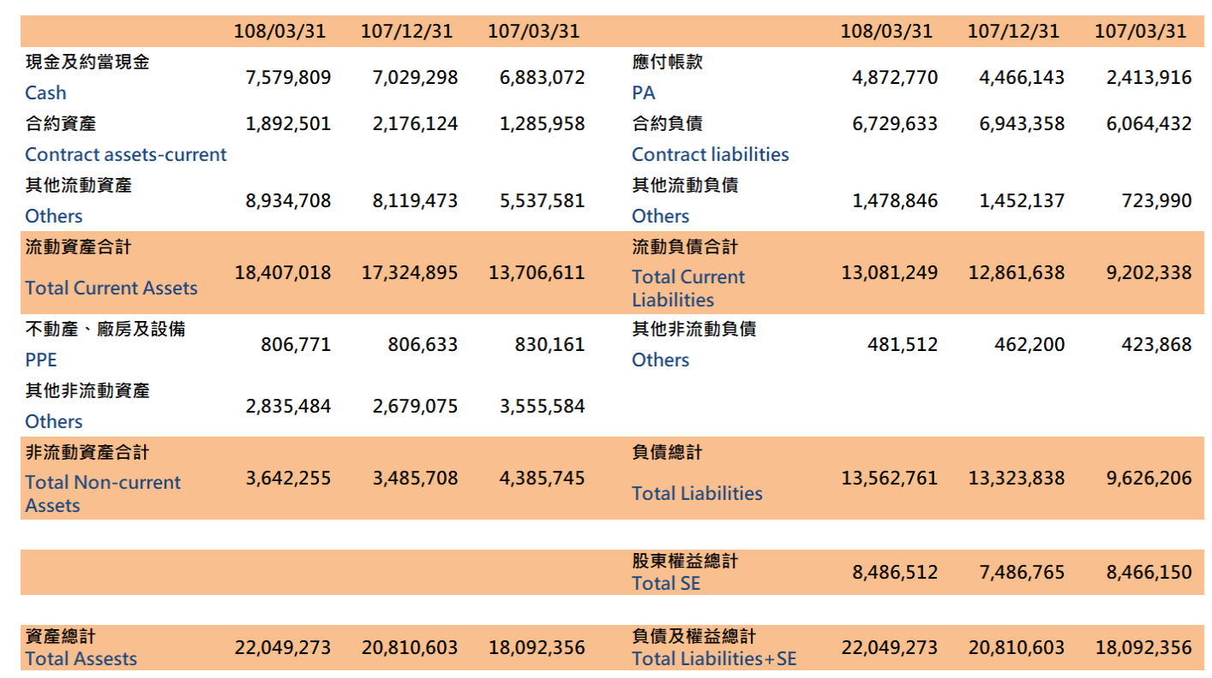
財務狀況說明
Financials
108年第一季合併資產負債表 2019 Q1 Consolidated Balance Sheet
單位:仟元 Unit: thousand
若本簡報引述的財務資料 , 與已對外公告的財務報告有不符的情形 , 以已對外公告的財務報告的內容為主 .
If there is any conflict between, or any difference in the financial information quoted in this presentation and the announced financial report, the announced financial report shall prevail

Slide 24
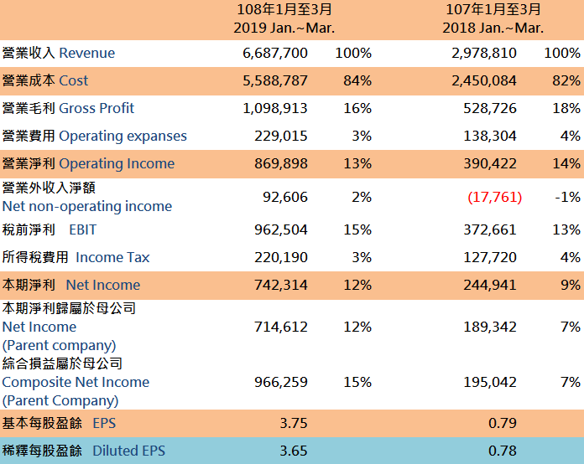
財務狀況說明
Financials
108年第一季合併損益表 2019 Q1 Consolidated Income Statement
單位:仟元 Unit: thousand
若本簡報引述的財務資料 , 與已對外公告的財務報告有不符的情形 , 以已對外公告的財務報告的內容為主 .
If there is any conflict between, or any difference in the financial information quoted in this presentation and the announced financial report, the announced financial report shall prevail

Slide 25
業務展望
Future Prospects
一○七年度由於大陸及新加坡市場有大幅成長，整體海外營收佔公司總營收達47%，是歷年來最高，加上台灣營收也有相當的成長，所以一○七年度公司營收創歷史新高。
一○八年度海外市場會較為降溫，但台灣市場將會持續成長，預估一○八年度整體營收應屬持平狀況或有再突破的機會，但明後年應該有機會更好。

Slide 26
業務展望
Future Prospects
Due to the substantial growth of the Chinese market and Singapore market in 2018, the overall overseas revenue accounted for 47% of the company’s total revenue, which was the highest in the recent years. In addition, Taiwan’s revenue had also grown considerably, so the company’s revenue in 2018 was a record high.
The overseas market will cool down in 2019, but the Taiwanese market will continue to grow. The overall revenue in 2019 is expected to remain the same and may have a chance to break through, but the next year should be have more opportunities can be better.

Slide 27
股票代號：2404
Thank You

Slide 28
股票代號：2404
Q & A

