Slide 1
Lien Chang Electronic Enterprise Co., Ltd.
2025 Investor Conference
2025.11.21

Slide 2
Safe Harbor Statement
This Presentation contains certain forward-looking statements that are based on current expectations and are subject to known and unknown risks and uncertainties that could cause actual results to differ materially from those expressed or implied by such statements.
Except as required by law, we undertake no obligation to update any forward – looking statements, whether as a result of new information, future events or otherwise.

Slide 3
History of Lien Chang

Slide 4
Main products
Power supplies for niche markets or special purposes.
Display manufacturing.
Drive Controller
DC boosters for hydrogen refueling stations.

Slide 5
Developing the wind turbine industry towards net-zero transformation
Facing global energy price volatility and the pressure of a net-zero transition, Lien Cheng Electronics, in collaboration with ITRI and a fan manufacturer, announced a new "Wide-Area High-Efficiency Electronically Commutated (EC) Fan" in November 2025. The successful development of the 3kW and 4.5kW mid-to-high power drive controllers is a significant milestone for the company.. The technology utilizes ITRI's self-developed "Zero Rare Earth IE5 Permanent Magnet Motor" and Lien Cheng Electronics designed "High-Efficiency Electrolytic Capacitor-Free Drive Control Platform," breaking the reliance on imported rare earth magnetic materials and enabling Taiwan's independent manufacturing of key components. This can improve the energy efficiency of airflow circulation equipment in air conditioning, data centers, and semiconductor plants by over 60%.

Slide 6
Drive controller:
The company continues its product transformation and focuses on core drive control technologies. Under the trend of environmental protection and energy conservation, it develops various energy-saving products and collaborates with system manufacturers to develop a series of drive controllers, hoping to contribute to the government's policies promoting energy conservation and emission reduction. The products are mainly used in the following different fields.
1. FCU (Fan Coil Unit) controller for hotel/hospital air conditioning systems.
2. Among dust-free factories in semiconductor, electronic information,
pharmaceutical, medical, food, laboratory and other industries
FFU (Fan Filter Unit ) controller. .
3. Controllers for outdoor units for air conditioning and blower fans in industrial
plants and logistics warehouses.
4. Drive controller for industrial fan motor.
5. Temperature cycle test equipment/ice water machine controller used in the
semiconductor industry.
6. Industrial dryer/freezer/refrigerator controller.
7、Water pump pressurization motor drive control
8、Vehicle/mobile refrigerator compressor drive control

Slide 7
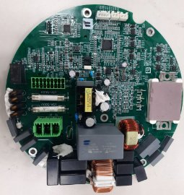
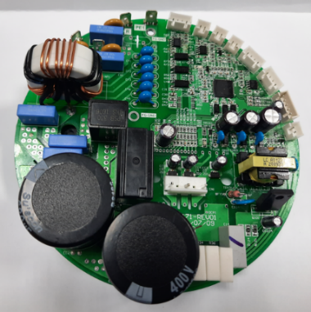
Application of External Rotor Motor in ECM Fans
LCE has developed the external rotor motor EC Fan (can be used with centrifugal fans and axial fans) and the group-controlled EC air wall controller, as well as the development and sales of EC Fan complete machines.
Application fields: parking lot ventilation, constant temperature and humidity air-conditioning boxes, cold chain warehousing, storage ventilation, information and communication computer room Data Center, smart air-conditioning boxes
External rotor centrifugal Electronically Commutated (EC)Fan electronically commutated motor, EC Fan can be a stand-alone unit or can be formed into a wind wall that can be controlled in a group manner. The fan operation can be controlled based on sensors such as temperature/humidity/enthalpy value.
The drive control adopts an electrolytic capacitor-free design.
The design leads the industry in high-voltage/high-power driver control design. It uses a firmware to switch the input waveform to the required current waveform, improving the traditional use of large capacitor filtering and occupying a large space. It can flatten/shrink the body and achieve integrated motor/drive control. machine
Non-EC Capacitor Design
W/EC Capacitor Design
無電解電容設計
電解電容設計

Slide 8
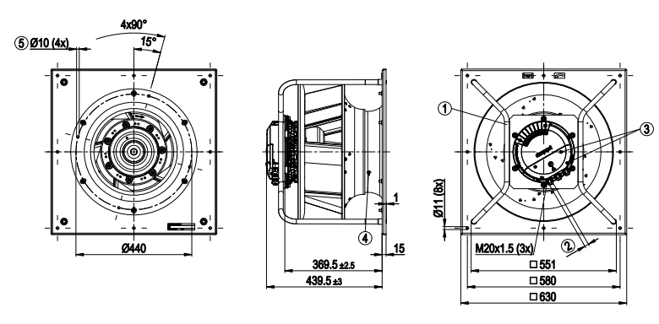
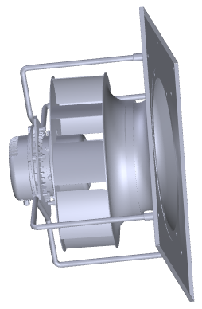
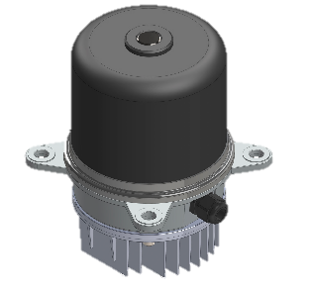
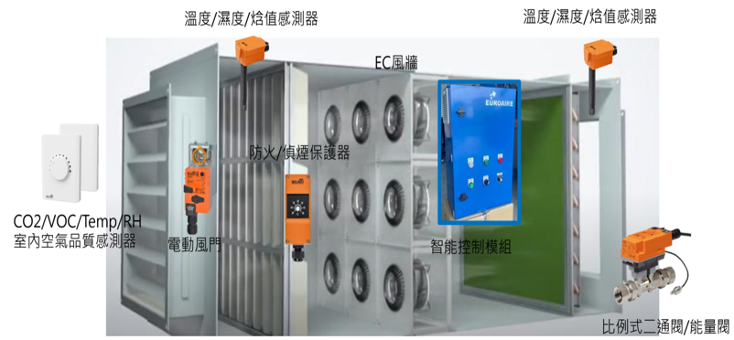
EC Motor Application- MAU/AHU

Slide 9
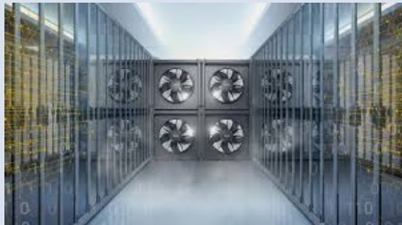
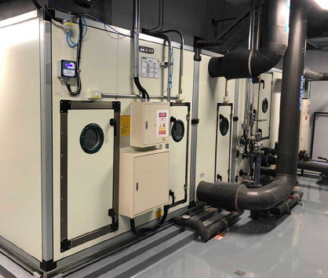
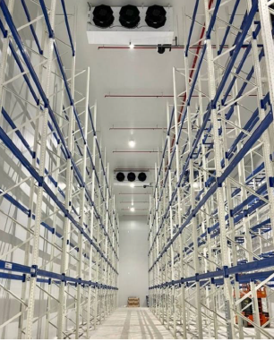
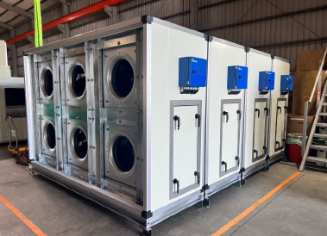
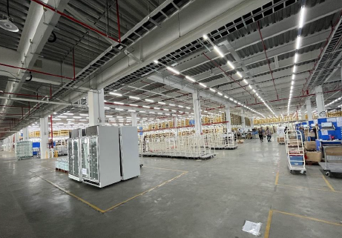
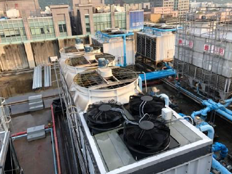
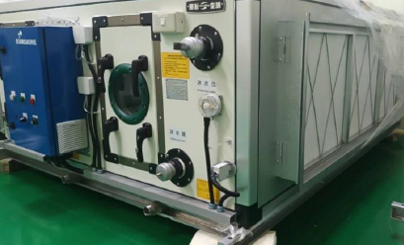
EC Fan field application
資通訊機房Data Center
MAU
恆溫恆濕空調箱
冷鍊倉儲
Refrigeration
Ventilation
停車場通風
Ventilation
倉儲通風
Cooling Tower
冷卻水塔
RCU
智能空調箱

Slide 10
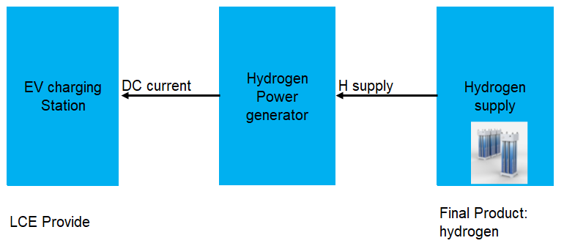
DC Booster
Hydrogen-EV charging station
Lien Chang provides DC Booster to Taiwanese hydrogen chargemanufacturers. This product has been actively targeting niche markets in the hydrogen energy sector, including hydrogen power generation systems and related hydrogen energy solutions for vehicles. Its target market is not limited to Taiwan; it has already successfully entered the EU hydrogen energy industry supply chain and the Indian market.

Slide 11
2025 3rd Quarter Financials Results

Slide 12
Consolidated Statements of Comprehensive Income
In Thousands of New Taiwan Dollars
Item | For the nine-months periods ended Sep 30, |  |  |  | Growth%
 | 2025 |  | 2024
 | Amount | % | Amount | %
Operating revenues | 306,825 | 100.0 | 299,420 | 100.0 | 2.5
Operating costs | 313,895 | 102.3 | 308,491 | 103.0 | 1.8
Gross profit ( loss ) | (7,070) | (2.3) | (9,071) | (3.0) | 22.1
Operating expense | 76,645 | 25.0 | 78,367 | 26.2 | (2.2)
Operating loss | (83,715) | (27.3) | (87,438) | (29.2) | 4.3
Non-Operating income and expense | 27,602 | 9.0 | 34,203 | 11.4 | (19.3)
Loss before income tax | (56,113) | (18.3) | (53,235) | (17.8) | (5.4)
Net loss | (56,134) | (18.3) | (53,297) | (17.8) | (5.3)
Loss per share(NT$) | (0.51) |  | (0.48)

Slide 13
Consolidated Balance Sheets
In Thousands of New Taiwan Dollars
Item | 2025.09.30 |  | 2024.12.31 |  | 2024.09.30
 | Amount | % | Amount | % | Amount | %
Cash | 307,830 | 21.5 | 736,149 | 46.4 | 559,010 | 35.5
Financial Assets | 559,205 | 39.0 | 211,174 | 13.3 | 384,662 | 24.4
Accounts Receivable | 63,425 | 4.4 | 95,882 | 6.0 | 101,440 | 6.4
Inventory | 69,350 | 4.8 | 97,356 | 6.1 | 78,560 | 5.0
Long-term Investments | 138,050 | 9.6 | 147,654 | 9.3 | 141,972 | 9.0
Property, Plant and Equipment | 114,172 | 8.0 | 107,941 | 6.8 | 112,498 | 7.2
Investment property, net | 144,545 | 10.1 | 146,132 | 9.2 | 146,662 | 9.3
Others | 35,069 | 2.6 | 44,069 | 2.9 | 48,123 | 3.2
Total Assets | 1,431,646 | 100.0 | 1,586,357 | 100.0 | 1,572,927 | 100.0
Current Liabilities | 132,385 | 9.2 | 188,869 | 11.9 | 164,790 | 10.5
Non-current Liabilities | 38,807 | 2.8 | 34,473 | 2.2 | 35,825 | 2.3
Total Liabilities | 171,192 | 12.0 | 223,342 | 14.1 | 200,615 | 12.8
Total Equity | 1,260,454 | 88.0 | 1,363,015 | 85.9 | 1,372,312 | 87.2
Total Liabilities & Equity | 1,431,646 | 100.0 | 1,586,357 | 100.0 | 1,572,927 | 100.0

Slide 14
Consolidated Statements of Cash Flows
In Thousands of New Taiwan Dollars
Item | For the nine-months periods ended Sep 30,
 | 2025 | 2024
Net cash flows used in operating activities | (20,036) | 30,383
Net cash flows from ( used in ) operating activities | (363,163) | (162,301)
Net cash flows used in financing activities | (17,868) | (14,946)
Effect of exchange rate changes | (27,252) | 18,160
Net ( decrease ) increase in cash and cash equivalents | (428,319) | (128,704)
Cash and cash equivalents at beginning of year | 736,149 | 687,714
Cash and cash equivalents at end of year | 307,830 | 559,010

Slide 15
Q&A

Slide 16
Thank you!

