Slide 1


Enlight Corporation
2025 Investors Conference

Slide 2

Enlight Corporation
【
Disclaimer
This report and related content are derived from available internal and external information. Changes or adjustments may occur due to factors such as market demand, price fluctuations, international economic trends, supply chain issues, international exchange rate fluctuations, and other factors beyond the company’s control. The company is not responsible for providing updates or notifications. Please refer to the information published by the Market Observation Post System of theTaiwan Stock Exchange for the most accurate data. Thank you.
翔耀實業股份有限公司

Slide 3

Agenda
Introduction to the Company
Operational Performance
Operational status and management strategies of various business operations.
Introduction to the current status, historical background, and company environment.
Introduction to the Company
Operational Performance
Future Outlook
Q&A
Future Outlook
Operational progress and plans for the next year.
Q&A
Q&A Session
3
翔耀實業股份有限公司

Slide 4


Enlight Corporation
Introduction to the Company

Slide 5

Enlight Corporation
Relocated to Qingpu, Taoyuan in September 2023, established the Taipei headquarters, expanded e-commerce services, and created a complete e-commerce ecosystem.
In November 2023, obtained the Ministry of Defense Air Force clothing supply station commission contract.
Company History
Listed on the over-the-counter market in December 1996, and transitioned to a stock exchange listing in September 2000.
Completed a public offering of 20 million shares through a cash capital increase in April 2016, with a capital of NT$952 million.
Founded the “Easy Life” brand in March 2019 to enter the smart home appliance market.
In July 2024, started an AI computing center with SMCI
In April 2025, awarded ISO 27001 Information Security Certification.
71
85
103
105
107
108
112
113
114
Established the Jubilux brand in 2023 to enter the skincare and healthcare supplement market.
* In December 2023, subsidiary Ginwin acquired 51% shares of Abon Touchsystems inc., a professional touch panel module and e-paper design and manufacturing company.
Founded in January 1982
Acquired 51% ownership of subsidiary GINWIN in 2014,
a professional glass grinding and processing factory.
Established an e-commerce shopping platform in 2018 to strengthen online marketing operations.
翔耀實業股份有限公司

Slide 6



Enlight Corporation was founded in 1982, with a continued commitment to innovation, integrity, and excellence as the company’s mission, and upholding the goal of 'Customer First' in its ongoing efforts.
In 2019, the company launched the 'Easy Life ' brand, focusing on small home appliances, striving to enhance the beauty of family life, and becoming a leading brand in the all-around small home appliance market.
To provide consumers with more comprehensive services, in 2023, Enlight Corporation expanded into the skincare and healthcare supplement market and launched its own brand 'Jubilux.'
In November 2023, the company obtained the Ministry of Defense Air Force clothing supply station commission contract.
In June 2024, through a strategic partnership with ‘Fami Cloud' ,Enlight Corporation provided fresh food, household goods, and other products, creating an all-around operational service and pioneering a new e-commerce business model.
In addition, Enlight Corporation also acquired stakes in GINWIN Technology and Abon Touchsystems Co.,Ltd. in 2014 and 2023, respectively, to enter the optoelectronics industry.
In July 2024, in partnership with Super Micro Computer (SMCI), Enlight Corporation established the AI Computing Center. It is Asia's first H200 AI computing center to use a water-cooling system, entering the AI and electronics field.
In April 2025, Enlight Corporation was awarded ISO 27001 Information Security Certification.
翔耀實業股份有限公司

Slide 7
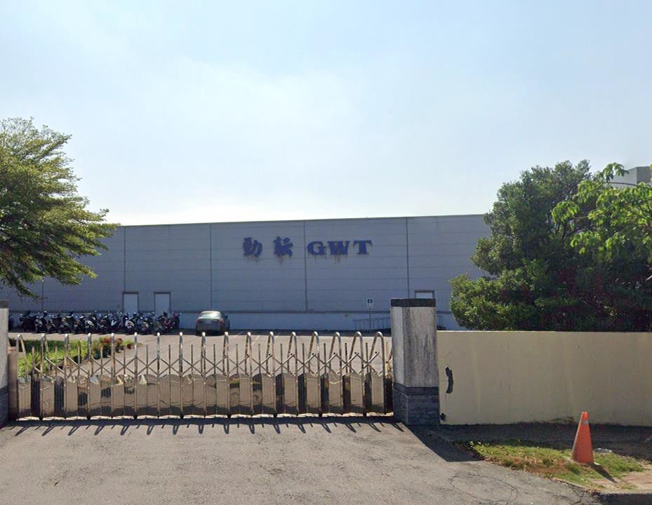

Enlight Corporation
(Affiliated Companies)
Subsidiary - GinWin Technology Co., Ltd.
Founded in July 2008
Capital: NT$337 million
Main business activities: A professional manufacturer specializing in the recycling and regeneration of TFT-LCD color filters for glass and glass products.
The core technology is the regeneration of color filter substrates.
Main customers are well-known domestic TFT-LCD panel manufacturers.
Number of employees: Approximately 60.
翔耀實業股份有限公司

Slide 8
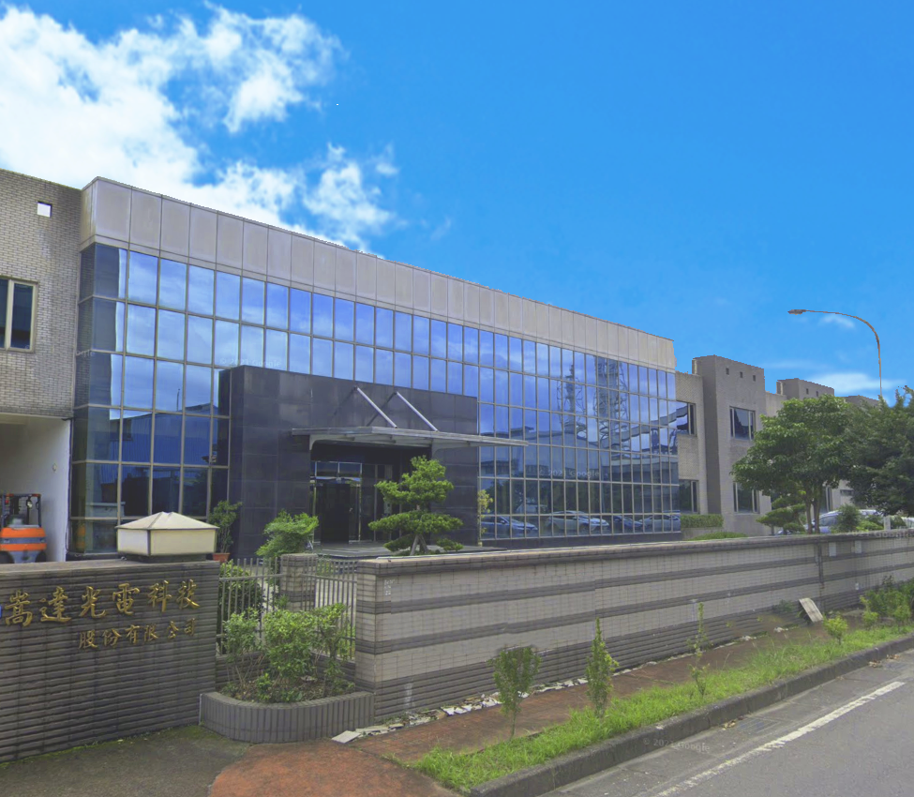

Enlight Corporation
(Affiliated Companies)
Subsidiary – AbonTouchsystems Co., Ltd.
Capital: NT$292 million
Company and Factory: Longde Industrial Park, Yilan, Taiwan
Company Address: No. 9, Dexing 4th Road, Dongshan Township, Yilan County 26950
Land Area: 12,800㎡
Products:
★ Projected Capacitive Touch Panel
★ 5-Wire Resistive Zero-Frame Touch Panel
★ 5-Wire Resistive Touch Panel
★ 5-Wire Resistive Touch Controller
Certificates: ISO9001 / ISO14001 / ISO13485 Compliant with ROHS / CE / FC / UL
*Sales: 65", 75" Pcap Touch Displays
Design Capacity: 30K/month (17” Mother Glass)
翔耀實業股份有限公司

Slide 9

Enlight Corporation
Operational Performance

Slide 10
Consolidated Statement of Comprehensive Income
Unit: NT$ Thousand
Year |  | 2024 |  |  |  | 2025 |  |  | Compared to last year (%)
Item/Period | First Quarter | Second Quarter | Third Quarter | Total (A) | First Quarter | Second Quarter | Third Quarter | Total (B) | [(B)-(A)]/(A)
Operating Income | 61,213 | 88,507 | 103,151 | 252,871 | 94,583 | 124,266 | 101,384 | 320,233 | 26.63
Gross Profit (Gross Loss) | (4,362) | 8,199 | 11 ,095 | 14,932 | 30,766 | 32,461 | 26,675 | 89,902 | 502.07
Operating Expenses | 39,524 | 31,391 | 32,046 | 102,961 | 49,822 | 46,092 | 55,716 | 151,630 | 47.26
Operating Profit (Loss) | (43,886) | (23,192) | (20,951) | (88,029) | (19,056) | (13,631) | (29,041) | (61,728) | 29.87
Other Income and Expenses | 163 | 15,220 | (3,564) | 11,819 | (3,254) | (11,037) | (69,678) | (83,969) | (810.45)
Profit (Loss) Before Tax | (43,723) | (7,972) | (24,515) | (76,210) | (22,310) | (24,668) | (98,719) | (145,697) | (91.17)
Net Profit (Loss) | (43,723) | (7,965) | (24,515) | (76,203) | (22,310) | (24,652) | (98,719) | (145,681) | (91.17)
Other Comprehensive Income | (14,599) | (4,637) | (9,921) | (29,157) | (2,208) | (13,308) | 11,301 | (4,215) | 85.54
Total Comprehensive Income | (58,322) | (12,602) | (34,436) | (105,360) | (24,518) | (37,960) | (87,418) | (149,896) | (42.27)
Net Profit (Loss) Attributable to Owners of the Parent | (31,734) | (3,806) | (22,181) | (57,721) | (14,256) | (20,670) | (96,069) | (130,995) | (126.94)
Net Profit (Loss) Attributable to Non-controlling Interests | (11,989) | (4,159) | (2,334) | (18,482) | (8,054) | (3,982) | (2,650) | (14,686) | 20.53
Earnings (Loss) Per Share | (0.57) | (0.07) | (0.37) | (1.01) | (0.23) | (0.33) | (1.54) | (2.11) | (108.91}
翔耀實業股份有限公司

Slide 11
Consolidated Balance Sheet
Item/Period |  |  | September 30, 2024 | December 31, 2024 |  |  |  | September 30, 2025
Current Assets |  |  | 387,074 | 574,106 |  |  |  | 634,215
Non-Current Assets |  |  | 1,104,861 | 1,070,467 |  |  |  | 1,144,408
Current Liabilities |  |  | 425,351 | 528,495 |  |  |  | 704,057
Non-Current Liabilities |  |  | 368,345 | 383,123 |  |  |  | 491,507
Total Equity |  |  | 698,238 | 732,955 |  |  |  | 583,059
Non-controlling Interests |  |  | 206,459 | 267,471 |  |  |  | 248,900
Equity Attributable to Owners of the Parent |  |  | 491,779 | 465,484 |  |  |  | 334,159
Book Value per Share |  |  | 10.70 | 11.24 |  |  |  | 8.94
Key Financial Performance Indicators
Average Collection Day |  |  | 84 |  | 66 |  | 59
Average Days of Sales |  |  | 77 |  | 56.32 |  | 69
Current Ratio % |  |  | 91 |  | 108.63 |  | 90.08
Debt Ratio % |  |  | 113.67 |  | 124.37 |  | 205.05
Unit: NT$ Thousand
翔耀實業股份有限公司

Slide 12

Enlight Corporation
Revenue Performance
Q3 2025 Consolidated Revenue Growth of 26%
1. The main revenue still comes from the subsidiary Abon Touchsystems Co.,Ltd. Although its revenue from January to September this year was slightly affected by tariff issues, it still showed slight growth. The company is now focusing on expanding the higher-value TDM (Touch Panel Display Model) market. It is estimated that this will account for about 8% to 10% of revenue this year. After mass production and with stable orders for Abon existing niche products, the company hopes to effectively contribute to the revenue growth for the year.

Slide 13
Enlight Corporation
Revenue Performance
Q3 2025 Consolidated Revenue Growth of 26%
2. The subsidiary GINWIN Technology's TFT glass recycling has significantly stabilized, and the second phase of solar power generation sales revenue has also contributed. From January to September, its revenue reached NT$48,264 thousand (excluding warehouse income), up nearly 37% compared to NT$35,341 thousand in the same period last year, making it a key factor in the group's revenue growth.
3. The parent company, Enlight Corporation Industrial, has been steadily operating the project after becoming the main contractor for the national (air force) military project.

Slide 14

Enlight Corporation
Consolidated Operational Performance Explanation
Profit Performance:
In the third quarter, although the parent company and GINWIN Technology showed decent improvement in revenue with increased gross profit, the following factors impacted profitability:
(1). The main revenue source, subsidiary Abon Touchsystems Co.,Ltd. was affected by tariff and foreign exchange issues. Although its revenue grew slightly compared to the same period last year, profits fell short of expectations, with a loss increase of 227% compared to last year.
翔耀實業股份有限公司

Slide 15
Enlight Corporation
Consolidated Operational Performance Explanation
(2). The subsidiary GINWIN Technology saw revenue and gross profit growth, and its losses narrowed. However, its growth could not immediately surpass operating expenses, resulting in continued losses.
(3). The parent company, focused on effectively maintaining and managing the military clothing supply business. This involved a learning process between suppliers and joint bidders, resulting in higher operating and litigation costs. Additionally, the company took over and added 10 physical military clothing supply stores, which increased costs related to site construction, information network restructuring, and staffing.
翔耀實業股份有限公司

Slide 16
Enlight Corporation
Consolidated Operational Performance Explanation
(4). The costs associated with the setup of new businesses, such as the AI computing center, have led to higher operating expenses and non-operating expenditures.
翔耀實業股份有限公司

Slide 17
Enlight Corporation.
Consolidated Operational Performance Explanation
(5). The main reason for the Q3 loss:
It is primarily due to a one-time recognition by the parent company, Enlight Corporation, for the termination of a data center contract signed with CHIEF TELECOM INC. in July 2024. The lease termination penalty of NT$54,432 thousand was recognized and accounted for under other income and expenses.
However, after this termination, Enlight Corporation, in order to activate its assets and effectively respond to future changes in the AI computing industry, signed a 5-year financial lease agreement with CHIEF TELECOM INC. to lease facility assets and related operational agreements, which will support the development of Enlight Corporation’s AI business operations.
翔耀實業股份有限公司

Slide 18
Enlight Corporation.
Consolidated Operational Performance Explanation
Based on the factors described in (1), (2), (3), (4), and (5), the group's cumulative Q3 profits were less than ideal. It is expected that the company will have a better chance of turning losses into profits by the second quarter of next year.
翔耀實業股份有限公司

Slide 19

Enlight Corporation
Future Outlook

Slide 20







Affiliated Companies
Enlight
Panel Recycling Business Group
Touch Panel Business Group
E-commerce Division
Project Division
AI
Division
GinWin Technology
AbonTouchsystems
National (Air Force) Military Clothing Supply Station
Home Appliances
Skincare Products / Health Supplements
AI Computing Center
翔耀實業股份有限公司

Slide 21

Subsidiary - GinWin Technology Co., Ltd.
The subsidiary GinWin Technology has been affected by the rapid decline of the domestic panel industry in recent years, which led to disappointing operational performance over the past two years. However, this year, benefiting from the implementation of U.S. tariffs and the escalation of the U.S.-China trade war, panel recycling orders have shown a rebound in growth. Additionally, the second phase of solar power generation sales revenue from the solar energy division has contributed to the improvement. As a result, the third-quarter operational performance has significantly improved, with a 37% increase in revenue and a 29% reduction in losses compared to the same period last year (excluding the warehouse business).
For future development, GinWin Technology is actively focusing on the following new areas and pursuing diversification:
(1) Specialized products for the semiconductor industry
(2) Strengthening the warehouse logistics operations division to ensure stable operations.
It is expected that the construction will be completed gradually by 2026, contributing to the group’s revenue and profitability.

Slide 22

Subsidiary – AbonTouchsystems Co., Ltd.
Subsidiary AbonTouchsystems, despite its revenue being affected by tariff issues this year, is still actively expanding into the high-value-added TDM (Touch Panel Display Model) market. It is estimated that this will account for about 8% to 10% of its revenue this year. After mass production, it is expected that the revenue share will gradually increase next year, further driving the utilization rate of the touch panel production lines.
Additionally, benefiting from the middle and large-size markets in gaming and industrial control, new projects and orders are being developed and shipped. The company hopes that the smooth expansion of new customers and products will help it gradually stabilize in the industrial control market and achieve sustained profitability.
Abon is also actively planning to enter the electronic paper contract manufacturing industry chain. Currently, the company has started small-scale contract manufacturing with domestic manufacturers. Furthermore, new non-touch panel products have entered the trial production stage, injecting new momentum into future business growth.
翔耀實業股份有限公司

Slide 23

Enlight Corporation
E-commerce Division
1. Home Appliances:
Enlight Corporation launched home appliances under the “Easy Life" brand with the following advantages:
(1) In an era where the internet is highly developed, consumers have an increasingly diverse range of choices, and consumption patterns are gradually changing. At the same time, the IoT industry is constantly updating. By capturing the consumer market and implementing targeted marketing along with the integration of IoT and e-commerce into the O2O market, “Easy Life" is able to gradually solidify its position in the home appliance market.
2. Beauty, Skincare, and Healthcare Supplements:
Launched the in-house brand JubiluxTR (skincare and healthcare supplements).
(a) Large e-commerce platforms: MOMO, ETtoday, Shopee are investing marketing budgets.
(b) Membership management: Recruiting members and offering more free trial activities and discount purchases.
3. E-commerce Division × Project Division Collaborative Development:
The E-commerce Department will leverage its existing platform operational experience, product development capabilities, and channel integration advantages to assist the Project Division in enhancing the depth and breadth of products at the military clothing supply stations.
翔耀實業股份有限公司

Slide 24

Enlight Corporation
Project Division
Military Clothing Supply Station:
Based on the e-commerce development platform, Enlight Corporation can utilize the Military Clothing Supply Station to integrate the complete supply chain ecosystem. The future development trends are as follows:
Air Force Families Joining: Air Force personnel can introduce up to 7 family members, with an estimated total number of over 200,000 people, maximizing APP sales.
2. Closed Sales Network: The targets are clearly defined for the military personnel and their families, and the platform can also be offered to more corporate welfare committees for selection.
翔耀實業股份有限公司

Slide 25

Enlight Corporation
.
Project Division
3. Full Takeover and Addition of 10 Physical Military Clothing Supply Locations:
Locations:
(1) Taipei City: 2 Yonggu Building stores, Xin Xin store (inside Xin Xin Department Store)
(2) Hsinchu City: 1 store (inside welfare station)
(3) Taichung City: 1 store (inside welfare station)
(4) Chiayi County: 1 store (street-side store)
(5) Tainan City: 1 store (inside Carrefour)
(6) Kaohsiung City: 1 store (inside welfare station)
(7) Pingtung County: 1 store (street-side store)
(8) Hualien County: 1 store (inside welfare station)
(9) Taitung County: 1 store (inside welfare station)
Existing Functions and Future Outlook:
Currently, the focus is on serving the existing Air Force personnel. In the future, the goal is to increase the diversity of products and expand services to Air Force personnel and their families.
翔耀實業股份有限公司

Slide 26

Enlight Corporation
AI Division
In July 2024, Enlight Corporation partnered with Super Micro Computer, Inc. (SMCI) to establish Asia's leading AI computing center—Enlight AICC (AI Computing Center) in Neihu, Taipei. The center will feature Asia's first H200 AI computing center equipped with a water-cooling system.
In Q3 2025, based on asset activation and favorable AI operational considerations, and in response to future changes in the AI computing industry,Enlight signed a 5-year financial lease agreement with Chief Telecom Inc for the leasing of facility assets and related operational agreements, facilitating the development of Enlight AI business operations and creating a win-win situation with Chief Telecom Inc .
翔耀實業股份有限公司
翔耀實業股份有限公司

Slide 27

Enlight Corporation
AI Division
The key differences and advantages compared to the previous plan are as follows:
1. Original Chief lease agreement:
(1) The data center’s monthly rent is fixed per unit as agreed.
(2) Electricity costs: Based on the estimated total contract capacity of the machines and the actual electricity usage.
(3) The lessee needs to invest a large amount of capital to build data center operations and facilities.
2. New 5-year financial lease agreement for facility assets and related operational agreements:
(1) Rent is based on the use of cabinets, with charges according to actual electricity usage. In the early stages, when the number of customers and machines is small, this plan offers a significant cost advantage in rental fees compared to the previous agreement.
(2) Due to the ancillary equipment for the data center, Enlight has adopted a financial lease model for the operation of the facilities. The previous investment funds can be recovered sequentially by the lessee—Chief , through rent payments, helping to activate fixed assets and reduce financial pressure, which facilitates further business operations.
翔耀實業股份有限公司

Slide 28

Enlight Corporation
AI Division
Strategy Change and Precise Project Layout
Faced with the rapid evolution of the AI industry, Enlight will launch the “Operation Model Upgrade”plan in Q3 2025. To maximize shareholder equity and strengthen capital efficiency, we are strategically adjusting the infrastructure holding costs, shifting resources from a heavy asset operational model to a more flexible “customer-demand project-based” model. Enlight is currently focusing on the computing power needs of the financial technology (FinTech) sector. We have entered into discussions with several financial institutions and expect to generate profit momentum in the coming year. Additionally, we are planning to negotiate with research institutions for computing power collaborations, with the goal of becoming part of the national team.
翔耀實業股份有限公司

Slide 29

Strategic Partner - FamiCloud
Through its strategic partner, FamiCloud , Enlight provides a one-stop shopping platform offering thousands of frozen and ambient food ingredients, as well as well-known licensed food brands. It aims to satisfy consumers' tastes while integrating warehousing and logistics. This partnership enables Enlight's E-commerce and Project Division to present a more diversified range of products, thereby expanding the variety of consumer choices for military personnel, their families, and other customers.
翔耀實業股份有限公司
翔耀實業股份有限公司

Slide 30

Enlight Corporation
Q&A
翔耀實業股份有限公司

Slide 31
Enlight Corporation
Thank You!

