Slide 1
LEADTEK 2018 Investor Conference
2018/12/21

Slide 2

Company Profile
Incorporation: 1986/10/24
IPO: 1999/6/3
Stock code: 2465
Chairman & CEO: K.S. Lu
Headquarters: Taipei, Taiwan
Subsidiaries: China and Japan
Number of employees: 350
2
Notes:
2

Slide 3
Company Org. Chart
Leadtek Subsidiaries
CEO
Leadtek Japan
GM Office
Leadtek China
Computer Product
BU
Smart
Medical
BU
Big Data
BU
Product Design Center
Engineering Division
Operation Management Division
TQM
Division
Admin.
Division
Finance Division

Slide 4
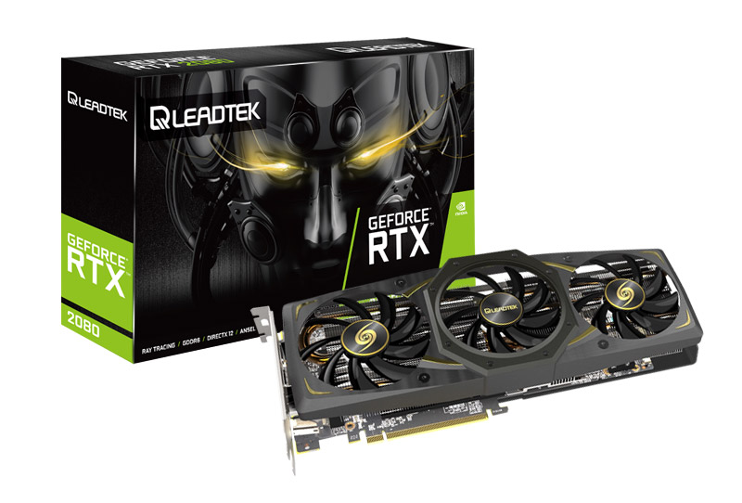
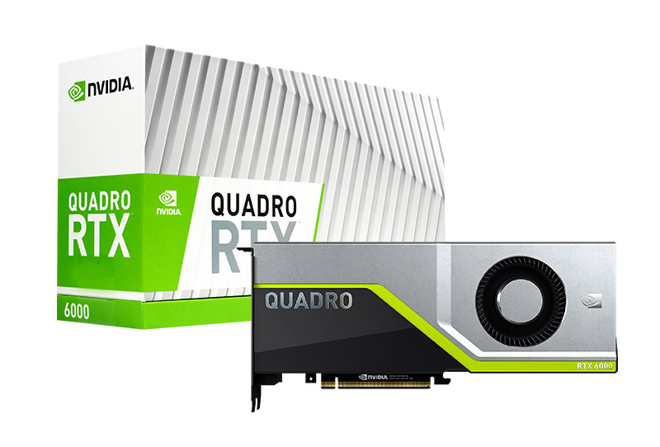
A Leading Brand of Graphics Cards for 30 years
A full range of consumer/professional graphics cards, powered by the latest Turing architecture and the all-new RTX platform, support real-time ray tracing and artificial intelligence technology, providing high quality and diverse products to completely meet the needs of the market.

Slide 5

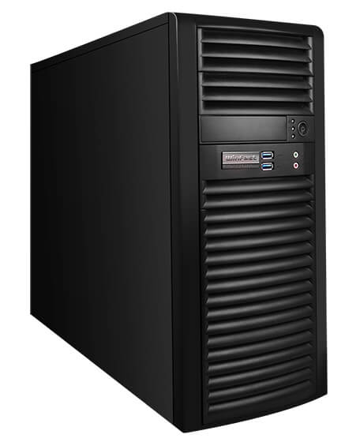
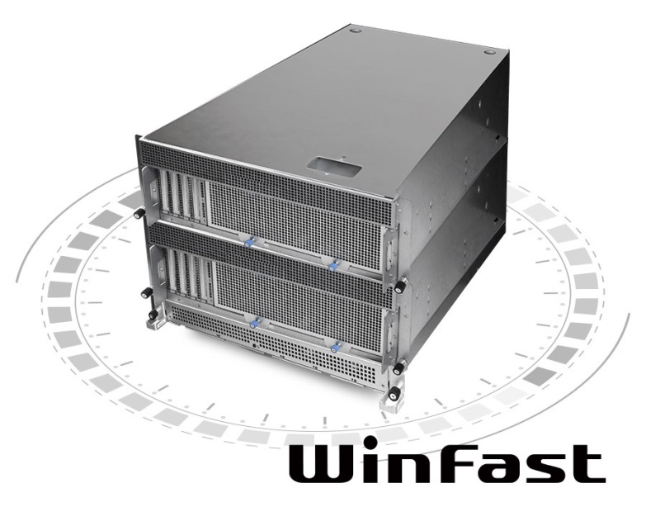
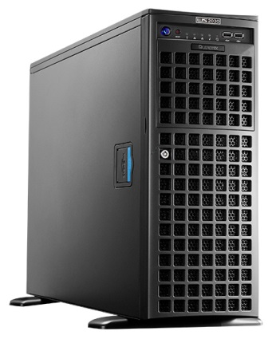
AI Cloud Computing Total Solution
AI/Deep Learning and CUDA Training Courses
AI Development Project Collaboration
System Planning
GPU Technical Service
Maintenance Service
Software Integration

Slide 6
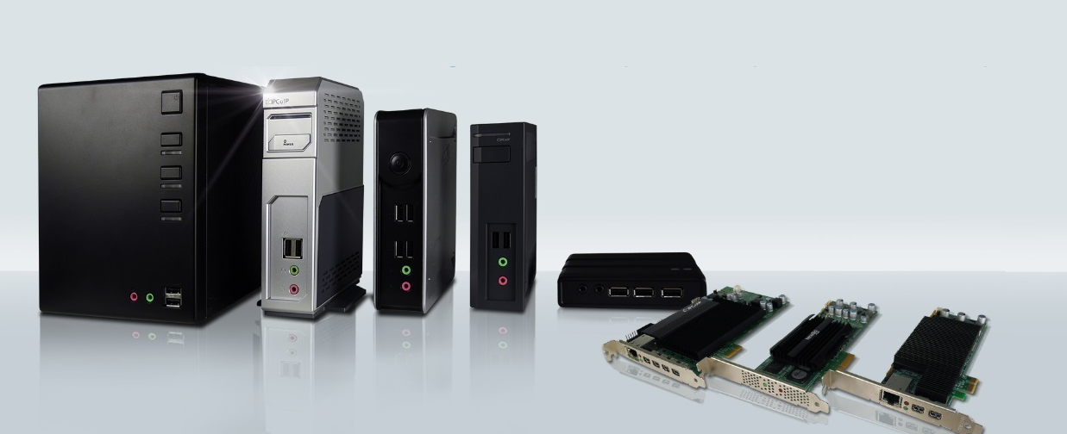
Leadtek Zero Client & Thin Client
INTEGRATION ‧ SECURITY ‧ CREATIVITY ‧ GREEN ‧ SCALABILITY
Leadtek delivers truly astounding graphics, outstanding power efficiency, and highly reliable endpoints for VDI applications. Optimized for the latest VDI solutions including VMware, Citrix and Microsoft, Leadtek Zero Client & Thin Client endpoints are designed to meet all types of user's demands and preferences.

Slide 7

Big Data Solution
Data Warehousing Solutions
  Data Cleaning
Data Analysis
  Visualization
  Statistical model building
  AI
Predictive Analytics Software
  Support for R
  Drag and Drop
Customized Dashboard
  Responsive Web Design
  Data synchronization

Slide 8

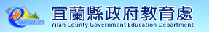


Institutional Research (IR)
Successful Cases: 50+ colleges/universities and 2 cities of government's departments of education

Slide 9
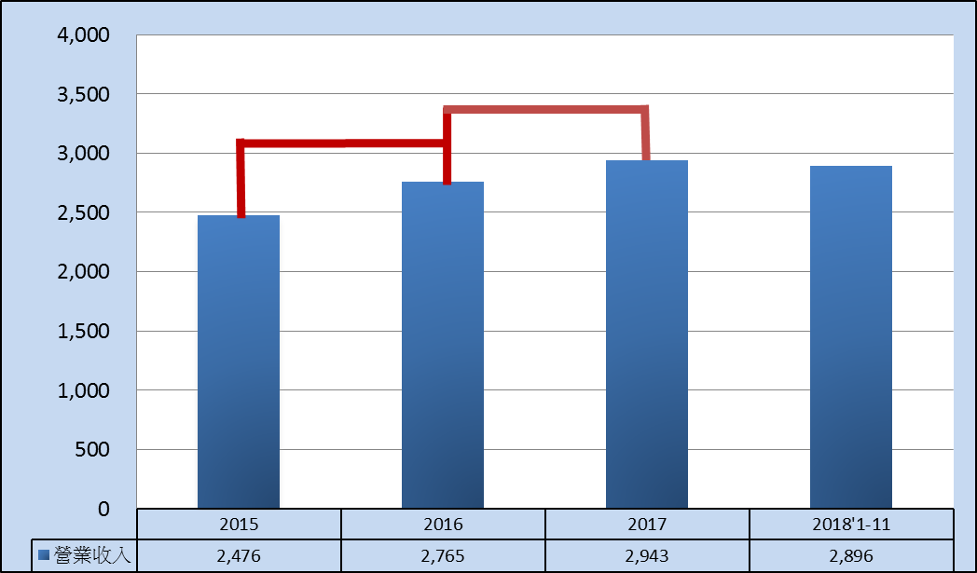

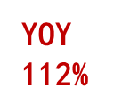
REVENUES
NTD in Million
Revenues
Net Income attributed to Parent Co. | 52 | (208) | (58) | (52) 2018Q1~Q3

Slide 10



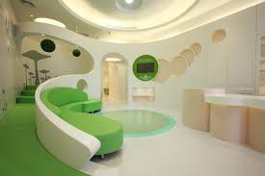
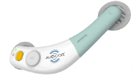
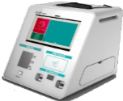
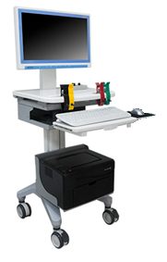



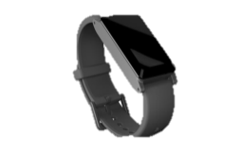


AI Smart Medical Solution
Quick screening
Risk evaluation
(ECG/heart sounds/blood pressure/blood sugar/
cholesterol/smoking…)
Community/
workplace
Clinic /
Physical check-up
Referrals
(10-second quick screening)
DxPatch ECG &
heart sounds recorder
Health Kiosk
AI Smart Medical Center
HRV
Household
amor H2
Health band
Hospital
DxPatch ECG &
heart sounds recorder
Health examination at hospital
(PCG 18018b)
H100
household transmission box
Rehabilitation at home
(Assessing post-surgery heart & lung functions)
amor H1
Hospital discharge risk assessment
(To avoid hospital readmission soon)
Care at home
(Daily measurement, such as blood pressure)

Slide 11


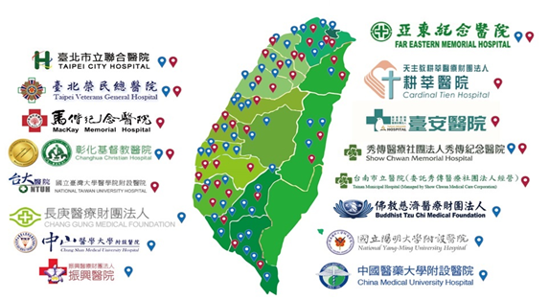
















Leadtek Smart Medical Solution in Taiwan
Autonomic Nervous System Analysis (HRV Analyzer)
Heart Failure Diagnosis (DxPatch)

Slide 12
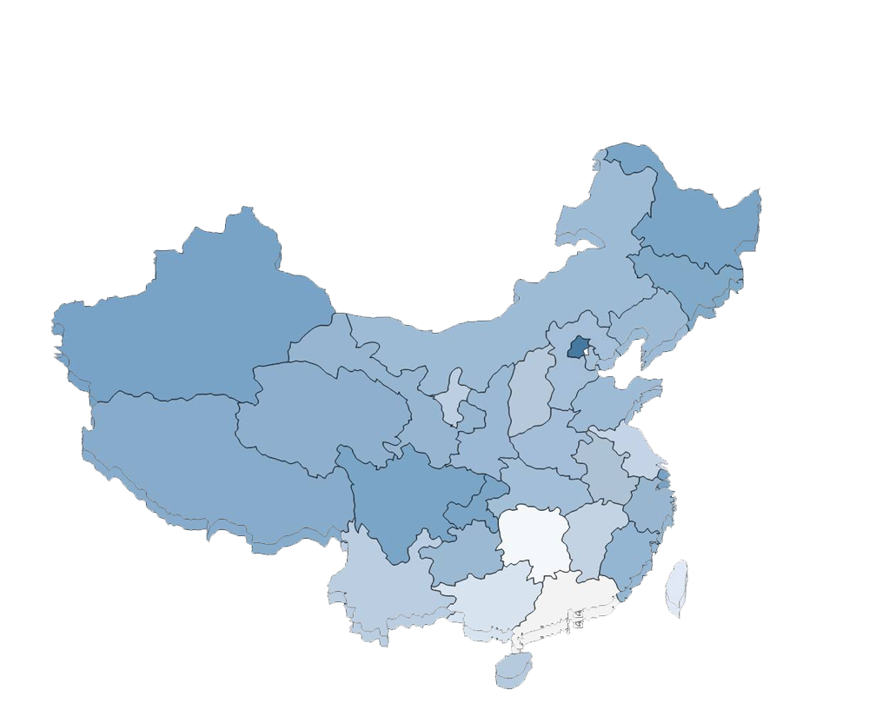















Leadtek Smart Medical Solution in China
Made in Shenyang, Shanghai as the base
Autonomic Nervous System Analysis (HRV Analyzer)

Slide 13


